Slide 1
Streaming Machine Learning Ensemble Classification
Alessio Bernardo
Post-doc @ Politecnico di Milano
CTO & Co-founder @ Motus ml

Slide 2
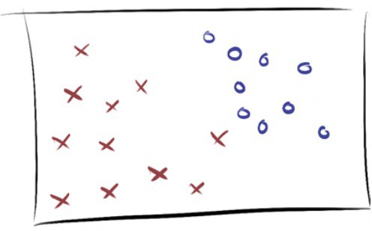
SML Ensemble Classification models

Slide 3
Ensemble Classifiers
“An ensemble can be described as a composition of multiple weak learners to form one with (expected) higher predictive performance (strong learner), such that a weak learner is loosely defined as a learner that performs slightly better than random guessing”
Freund and Schapire, 1997

Slide 4





Ensemble Classifiers
Data point from the stream
[…]
HAT₁
HAT₂
HAT_{n}
Voting
Prediction

Slide 5
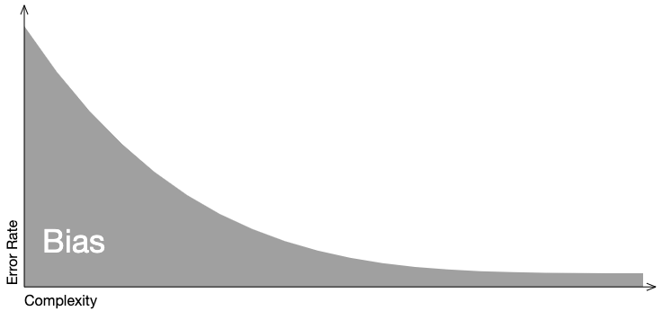
Bias-Variance trade-off
Bias
When a model is less complex, it ignores relevant information, and error due to bias is high. As the model becomes more complex, error due to bias decreases.
http://www.r2d3.us/visual-intro-to-machine-learning-part-2/

Slide 6
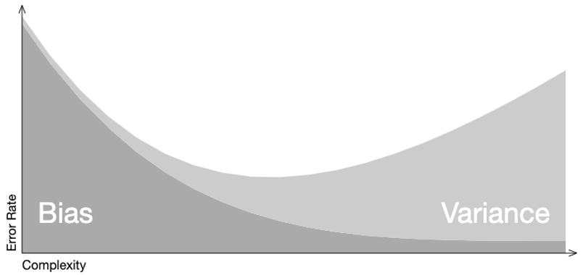
Bias-Variance trade-off
Variance
On the other hand, when a model is less complex, error due to variance is low. Error due to variance increases as complexity increases, i.e. overfitting.
http://www.r2d3.us/visual-intro-to-machine-learning-part-2/

Slide 7
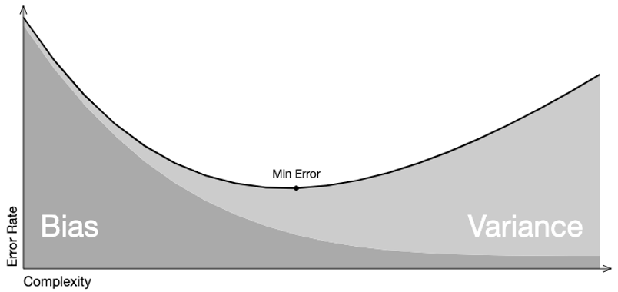
Bias-Variance trade-off
Trade-off
Overall model error is a function error due to bias and variance. The ideal model minimized error from each.
http://www.r2d3.us/visual-intro-to-machine-learning-part-2/

Slide 8
Ensemble Classifiers in ML
Bagging
Fits M independent models and “average” their predictions in order to obtain a model with a lower variance…
But we have only one dataset, how can we build independent models?
Bootstrapping
Create M bootstrap samples (one for each model) from the original dataset of size N, created by drawing random samples with replacement. Each bootstrap contains each original sample K times, where Pr(K=k) follows a binomial distribution.
0.632 of the data points in the original sample show up in the bootstrap sample (the other 0.368 won't be present in it)
L. Breiman. Bagging predictors. Machine Learning, 1996

Slide 9
Ensemble Classifiers in ML
Bagging → Random Forests
The random forest approach is a bagging method where M trees, fitted on bootstrap samples, are combined to produce an output with lower variance.
To make the M trees a bit less correlated with each others: random forest also samples over features and keep only a random subset of them to build the tree.
L. Breiman. Random Forests. Machine Learning, 2001

Slide 10
Ensemble Classifiers in ML
Boosting
Sequential method that combines weak models no longer fitted independently from each others.
It fits models iteratively such that the training of model at a given step depends on the models fitted at the previous steps: it gives more importance to observations in the dataset that were badly handled by the previous models in the sequence.
It produces an ensemble model that is in general less biased than the weak learners that compose it.
Y. Freund & R. Schapire. Experiments with a new boosting algorithm. ICML, 1996

Slide 11
Ensemble Classifiers in ML
Boosting → Adaptive Boosting (AdaBoost)
It puts more weight on difficult to classify instances and less on those already handled well:
First, it updates the observations weights in the dataset and train a new weak learner with a special focus given to the observations misclassified by the current ensemble model.
Second, it adds the weak learner to the weighted sum according to an update coefficient that expresses the performances of this weak model: the better a weak learner performs, the more it contributes to the strong learner.
Y. Freund & R. Schapire. Experiments with a new boosting algorithm. ICML, 1996

Slide 12
Ensemble Classifiers in ML
Boosting → Gradient Boosting
Instead of fitting a weak learner on the data at each iteration, it actually fits a new weak learner to the residual errors made by the previous one:
For every instance in the training set, it calculates the residuals for that instance, or, in other words, the observed value minus the predicted value.
Once it has done this, it adds a weak learner that tries to predict the residuals that was previously calculated.
J. H. Friedman. Stochastic gradient boosting. Computational statistics & data analysis, 2022

Slide 13
Ensemble Classifiers in ML
Stacking
It considers heterogeneous weak learners (different learning algorithms are combined).
It learns to combine the base models using a meta-model.
It produces an ensemble model that is in general less biased than the weak learners that compose it.
K. M. Ting & I. H. Witten. Stacking bagged and dagged models. 1997

Slide 14

Ensemble Classifiers in SML
Diversity: induce diversity among learners
Combination: combine the predictions
Adaptation: adapt to evolving data
Pro
High Predictive performance
Flexibility
Cons
Computational resources
Gomes, H. M., Barddal, J. P., Enembreck, F., & Bifet, A. A survey on ensemble learning for data stream classification. ACM, 2017

Slide 15
Induce Diversity
Horizontal Partitioning
Bagging: build a set of M base models, with a bootstrap sample from the original dataset of size N, created by drawing random samples with replacement. Each bootstrap contains each original sample K times, where Pr(K=k) follows a binomial distribution.
Gomes, H. M., Barddal, J. P., Enembreck, F., & Bifet, A. A survey on ensemble learning for data stream classification. ACM, 2017

Slide 16
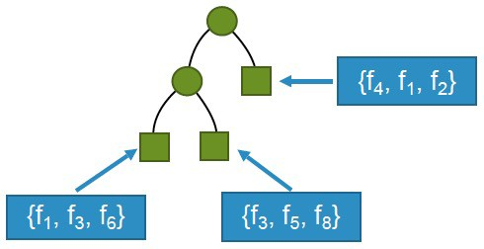
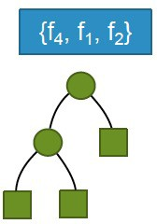
Induce Diversity
Vertical Partitioning
Random Subspaces: train learners on different subsets of features
Local Randomization
Global Randomization
Gomes, H. M., Barddal, J. P., Enembreck, F., & Bifet, A. A survey on ensemble learning for data stream classification. ACM, 2017

Slide 17
Induce Diversity
Others
Base Learner Manipulation: varying parameters of the same base learner
Heterogeneous Base Learners (Stacking): use heterogeneous base learners and obtain ensemble members with different biases
Gomes, H. M., Barddal, J. P., Enembreck, F., & Bifet, A. A survey on ensemble learning for data stream classification. ACM, 2017

Slide 18

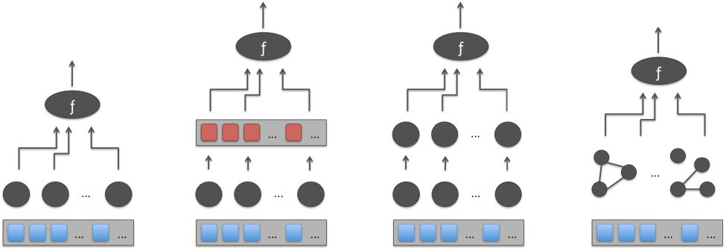
Combination
Architecture
Base learners
Instances
Flat
Meta-Learner
Hierarchical
Network
Gomes, H. M., Barddal, J. P., Enembreck, F., & Bifet, A. A survey on ensemble learning for data stream classification. ACM, 2017

Slide 19
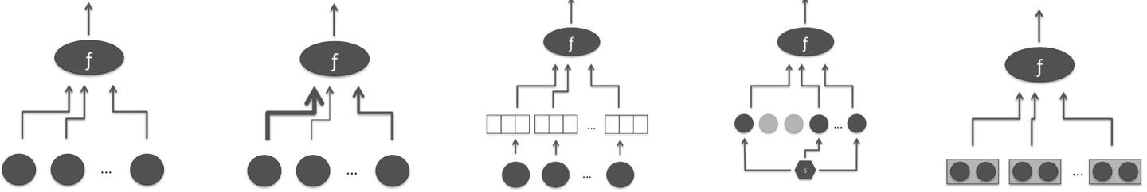
Combination
Voting
Base learners
Instances
Majority
Weighted Majority
Rank
Abstaining
Relational
Gomes, H. M., Barddal, J. P., Enembreck, F., & Bifet, A. A survey on ensemble learning for data stream classification. ACM, 2017

Slide 20
Adaptation
Cardinality
Fixed: fixed numbers of base learners
Dynamic: add classifiers on the fly
Gomes, H. M., Barddal, J. P., Enembreck, F., & Bifet, A. A survey on ensemble learning for data stream classification. ACM, 2017

Slide 21
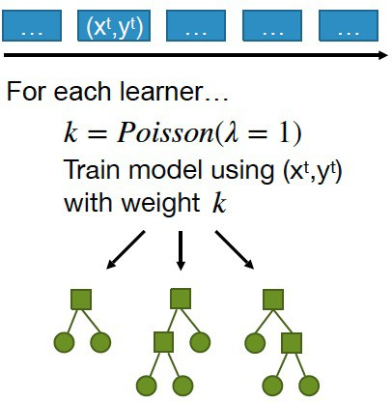
Online Bagging
Since data streams are supposed to be unbounded (large N), the binomial distribution tends to a Poisson(1) distribution.
Train learners on different subsets of instances
Oza and Russel Online bagging and boosting. Artificial Intelligence and Statistics, 2001

Slide 22
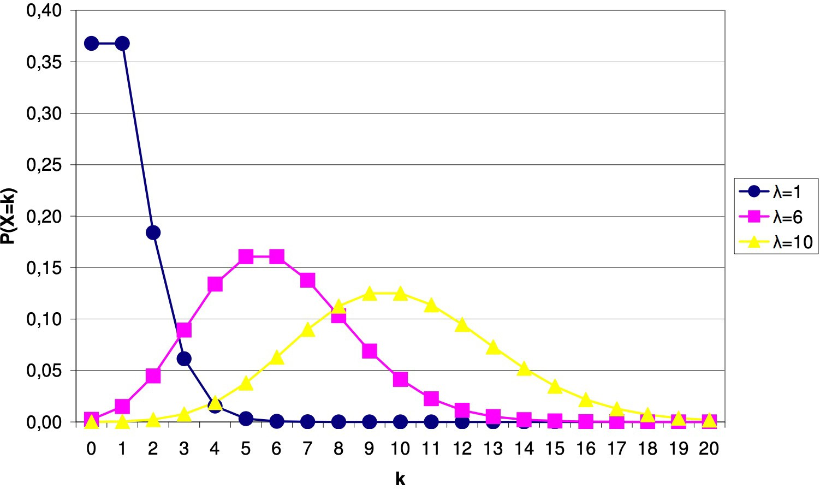
Leveraging Bagging
Add an ADWIN drift detector per base learner
Use more weight during training - Poisson(6)
Bifet, G. Holmes, and B. Pfahringer Leveraging bagging for evolving data streams. PKDD, 2010

Slide 23
Adaptive Random Forest (ARF)
Base Learners: Hoeffding Trees
Diversity: Leveraging Bagging + Local Random Subspaces
Combination:
Flat architecture
Voting:
Majority voting
Naïve Bayes
Naïve Bayes Adaptive
Adaptation: Adaptive window + warning period (train background learners)
H. M. Gomes et al. Adaptive random forests for evolving data stream classification. Machine Learning, 2017

Slide 24
Streaming Random Patches (SRP)
Base Learners: User choice
Diversity: Leveraging Bagging + Global Random Subspaces
Combination:
Flat architecture
Voting:
Base learner’s voting strategy
Adaptation: Adaptive window + warning period
Gomes, Read and Bifet. Streaming Random Patches for Evolving Data Stream Classification. ICDM, 2019

Slide 25

Exercise 4: Stream Ensemble Classification

Slide 26
Credits
Albert Bifet DATA STREAM MINING 2020-2021 course at Telecom Paris
Alessio Bernardo & Emanuele Della Valle

Slide 27
Streaming Machine Learning Ensemble Classification
Alessio Bernardo
Post-doc @ Politecnico di Milano
CTO & Co-founder @ Motus ml

