Slide 1
Streaming Machine Learning Regression
Alessio Bernardo
Post-doc @ Politecnico di Milano
CTO & Co-founder @ Motus ml

Slide 2
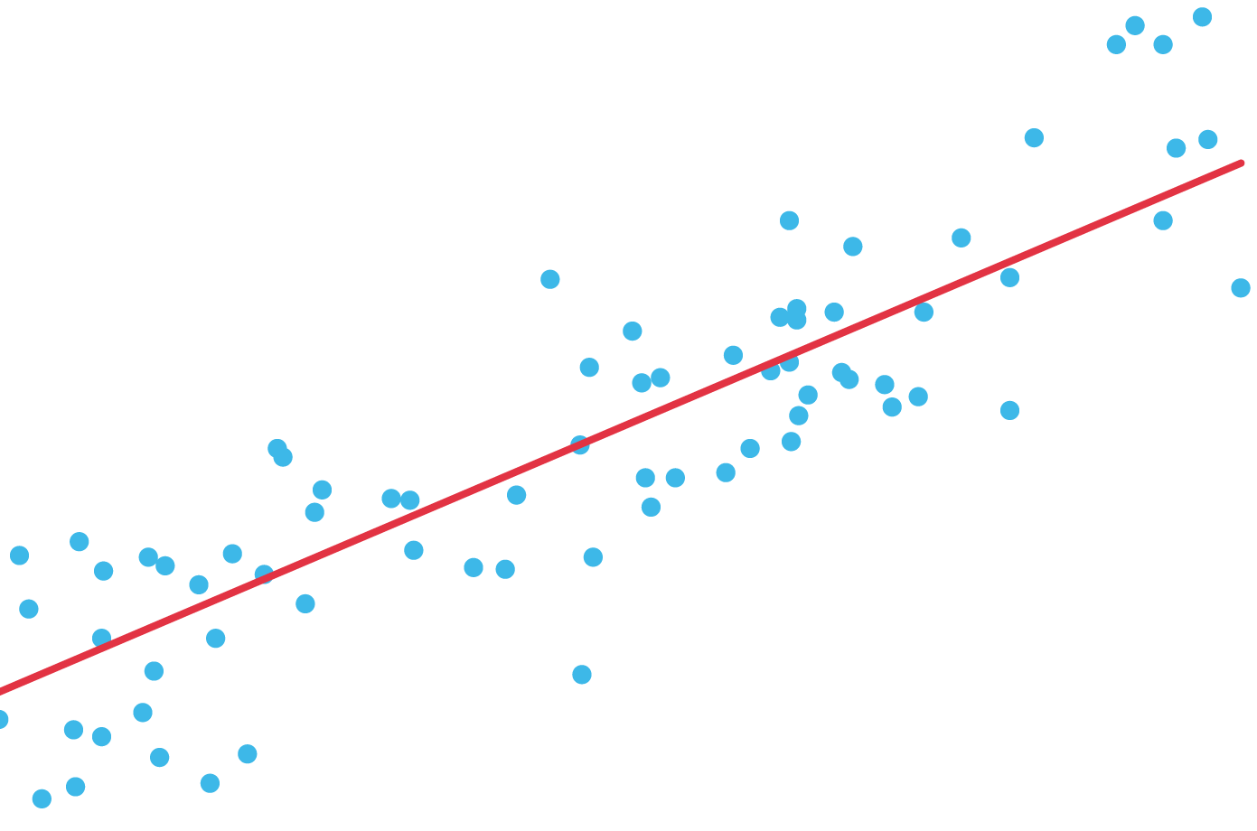
SML Regression models

Slide 3



From Classification to Regression
Instead of using a majority voting approach, use the mean or median or a regression model built over the points saved into leaves to aggregate results e compute the predicted target feature
Classification
Regression
Data point
Data point
Model₁
[…]
[Model_{n}]
Model₁
[…]
[Model_{n}]
Majority Voting
Mean, Median, Regression Model
Class prediction
Numerical prediction

Slide 4
From TSA to SML Regression
TSA models learn from time series in the past how to forecast future behaviours, without knowing the respective future time series value.
SML Regression models learn how to predict data coming from a continuous flow. To predict a new label, they must see the respective features.
TSA Forecasting
SML Regression prediction
Past
Future
Seen data

Slide 5



Online K-Nearest Neighbours Regressor
Use a fixed size sliding window to save the instances
Find the k nearest neighbours to the new sample in input
The predicted target feature is the mean / weighted mean / median of the k nearest neighbours’ target features
Latest instance added
K-Nearest Neighbours to use to compute the mean / median
Bifet, A., Pfahringer, B., Read, J., & Holmes, G. Efficient data stream classification via probabilistic adaptive windows. ACM symposium on applied computing, 2013

Slide 6
Adaptive Model Rules (AMRules)
The antecedent of a rule is a set of literals (conditions based on multiple attribute values)
The consequent of a rule is a function that minimizes the mean square error of the target attribute computed from the set of samples covered by rule
Each rule uses a Page-Hinkley test to detect changes and react to changes by pruning the rule set
Each rule is also equipped with outliers' detection mechanisms to avoid model adaption using anomalous examples
Multiple rules form a set of rules, similarly to a tree. Hoeffding Bound is used to grow the set
The prediction strategy used by decision rules can be the mean, a regression model, or adaptive, i.e., chooses between ‘Mean’ and ‘Regression model’ dynamically
Duarte, J., Gama, J. & Bifet, A. Adaptive Model Rules From High-Speed Data Streams. ACM TKDD, 2016

Slide 7
HT Regressor
Learner:
Incremental decision tree
Hoeffding bound to split over nodes
Voting:
Mean
Regression model
Adaptive, i.e., chooses between ‘Mean’ and ‘Regression model’ dynamically
Pedro Domingos and Geoff Hulten. Mining high-speed data streams. 2000

Slide 8
HAT Regressor
Learner:
Incremental decision tree
Hoeffding bound to split over nodes
Voting:
Mean
Regression model
Adaptive, i.e., chooses between ‘Mean’ and ‘Regression model’ dynamically
Adaptation: Adaptive window + warning period (train background learners)
A. Bifet, R. Gavald`a. Adaptive Parameter-free Learning from Evolving Data Streams. IDA, 2009

Slide 9
ARF Regressor
Base Learners: Hoeffding Tree Regressors
Diversity: Leveraging Bagging + Local Random Subspaces
Combination:
Flat architecture
Voting:
Mean, Regression model or Adaptive, i.e., chooses between ‘Mean’ and ‘Regression model’ dynamically
Adaptation: Adaptive window + warning period (train background learners)
Gomes, H. M., et al. Adaptive random forests for data stream regression. ESANN, 2018

Slide 10
SRP Regressor
Base Learners: User choice
Diversity: Leveraging Bagging + Global Random Subspaces
Combination:
Flat architecture
Voting:
Base learner’s voting strategy
Adaptation: Adaptive window + warning period (train background learners)
Gomes, Read and Bifet. Streaming Random Patches for Evolving Data Stream Classification. ICDM, 2019

Slide 11

Exercise 5: Stream Regression [optional]

Slide 12
Credits
Albert Bifet DATA STREAM MINING 2020-2021 course at Telecom Paris
Alessio Bernardo & Emanuele Della Valle

Slide 13
Streaming Machine Learning Regression
Alessio Bernardo
Post-doc @ Politecnico di Milano
CTO & Co-founder @ Motus ml

