Slide 1
Vertically Scalable solutions illustrated via EPL and Esper
Emanuele Della Valle
Politecnico di Milano

Slide 2
Positioning this lecture

Slide 3
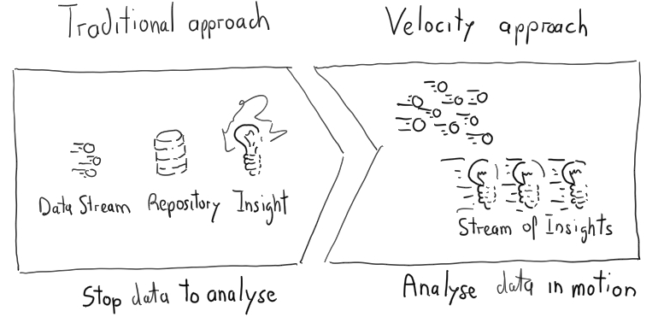
1st premises: continuity matters

Slide 4
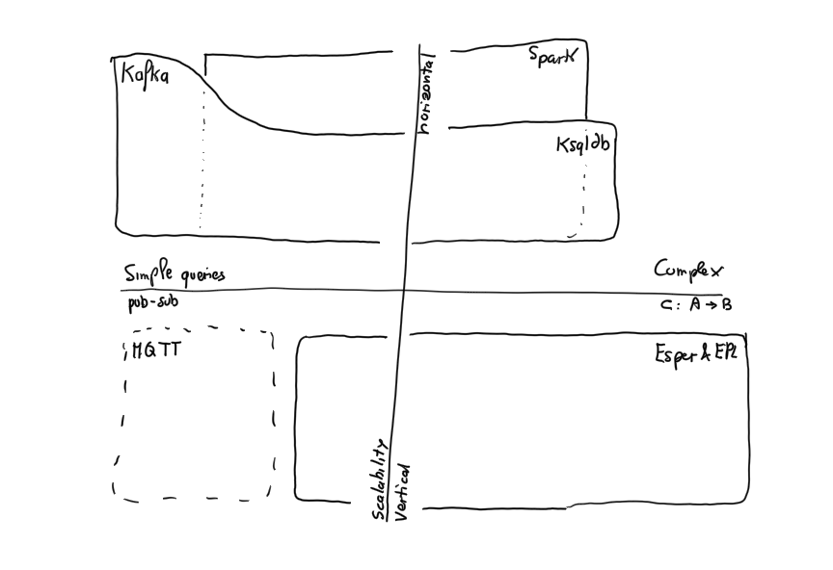

Slide 5
The Event Processing Language & its reference implementation Esper

Slide 6
Esper in a nutshell
Implemented as a Java library
Can be embedded in any JVM application
Designed for performance
High throughput
Low latency
Tree-based recognition algorithm
Inverted indexes to dispatch incoming events to EPL statements
Builds indexes to quickly retrieve events with given properties among those stored

Slide 7
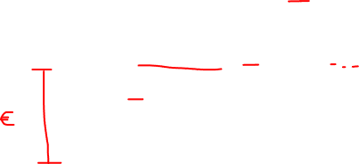
Esper in a nutshell (cont.)
Interaction with static / historical data
Configurable push or pull communication
Several adapters for input/output
CSV, JMS in/out, API, DB, Socket, HTTP
Esper HA
High Availability
Ensures that the state is recoverable in the case of failure

Slide 8
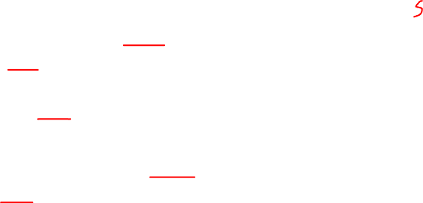
EPL in a nutshell
EPL: rich language to express rules (a.k.a., statementa)
Grounded on the DSMS approach
Windowing
Relational select, join, aggregate, …
Relation-to-stream operators to produce output
Queries can be combined to form a graph
Includes complex event recognition abstractions
Pattern detection

Slide 9
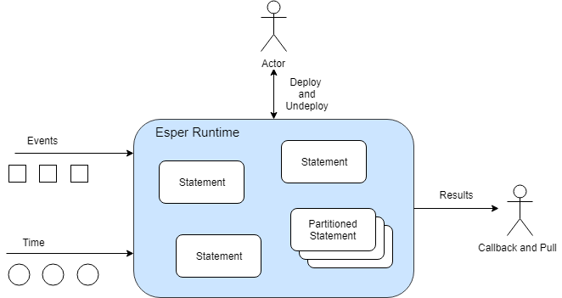

Esper & EPL

Slide 10
The Basics of the Event Processing Language

Slide 11
Running example
Count the number of fires detected using a set of smoke and temperature sensors in the last 10 minutes
Events
Smoke event: String sensor, boolean state
Temperature event: String sensor, double temperature
Fire event: String sensor, boolean smoke, double temperature
Condition:
Fire: at the same sensor smoke followed by temperature>50 within 2 minutes

Slide 12
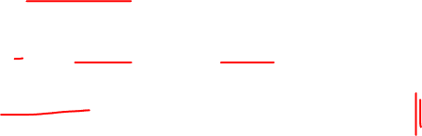
Declare event types
Two ways
EPL create schema clause
Runtime configuration API addEventType
Syntax
create schema
schema_name [as]
(property_name property_type
[,property_name property_type [,...])
[inherits inherited_event_type
[, inherited_event_type] [,...]]

Slide 13
Running example
create schema SmokeSensorEvent(
sensor string,
smoke boolean
);
create schema TemperatureSensorEvent(
sensor string,
temperature double
);
create schema FireComplexEvent(
sensor string,
smoke boolean,
temperature double
);

Slide 14
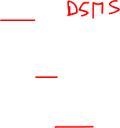
Event Processing Language (EPL)
EPL is similar to SQL
Select, where, …
Event streams and views instead of tables
Views define the data available for the query
Views can represent windows over streams
Views can also sort events, derive statistics from event attributes, group events, …

Slide 15
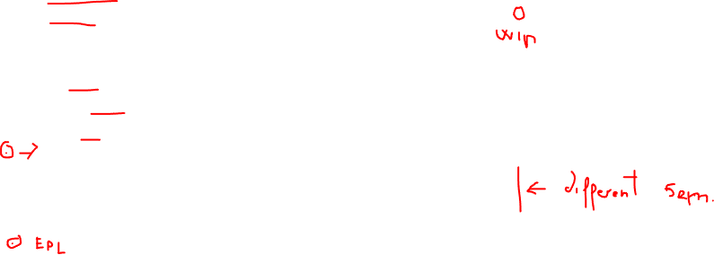
EPL syntax
[insert into insert_into_def] select select_list from stream_def [as name]
[, stream_def [as name]] [,...]
[where search_conditions] [group by grouping_expression_list] [having grouping_search_conditions] [output output_specification] [order by order_by_expression_list] [limit num_rows]

Slide 16
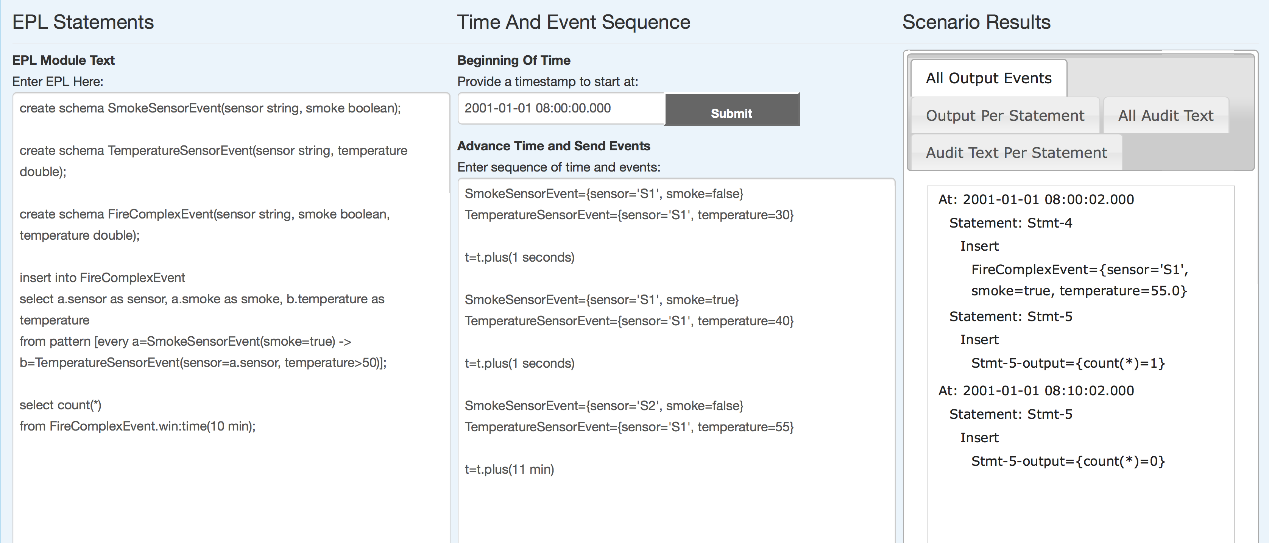
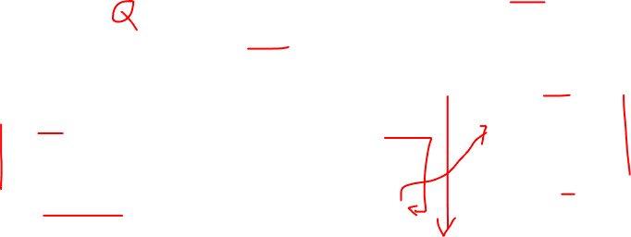
Running example
http://esper-epl-tryout.appspot.com/epltryout/mainform.html

Slide 17
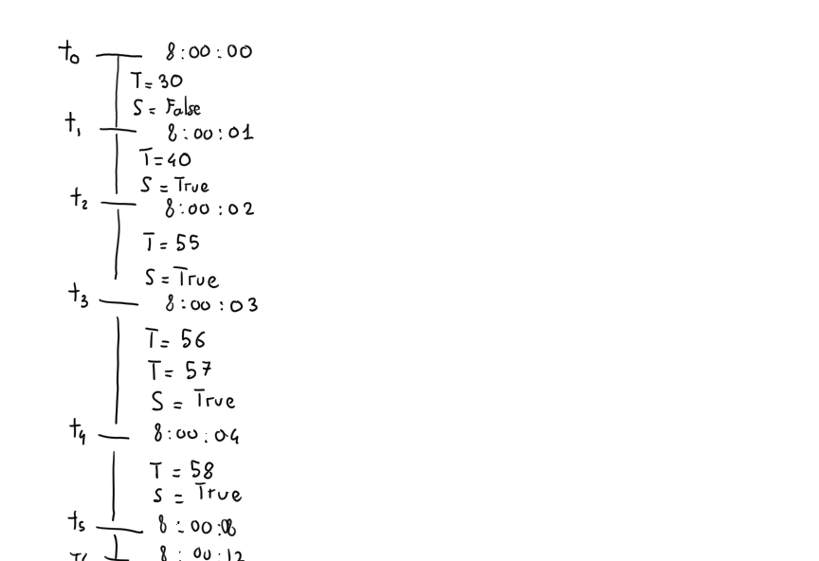
Time line

Slide 18
Filtering
Q0 - the SQL-style
select *
from TemperatureSensorEvent
where temperature > 50;
Q0bis - the Event-Based System Style
select *
from TemperatureSensorEvent(temperature > 50) ;

Slide 19
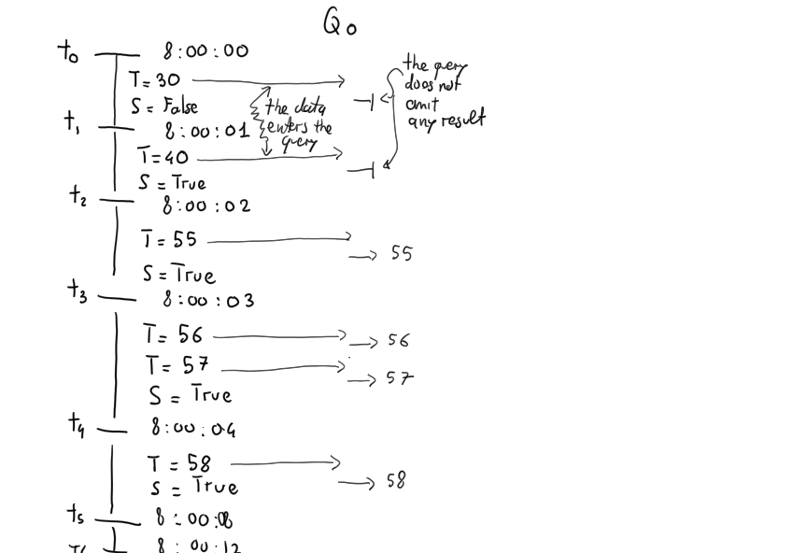
Filtering the SQL style
Q0 - the SQL-style
select *
from TemperatureSensorEvent
where temperature > 50;
Execution mode
Data points enter the query that filters them

Slide 20
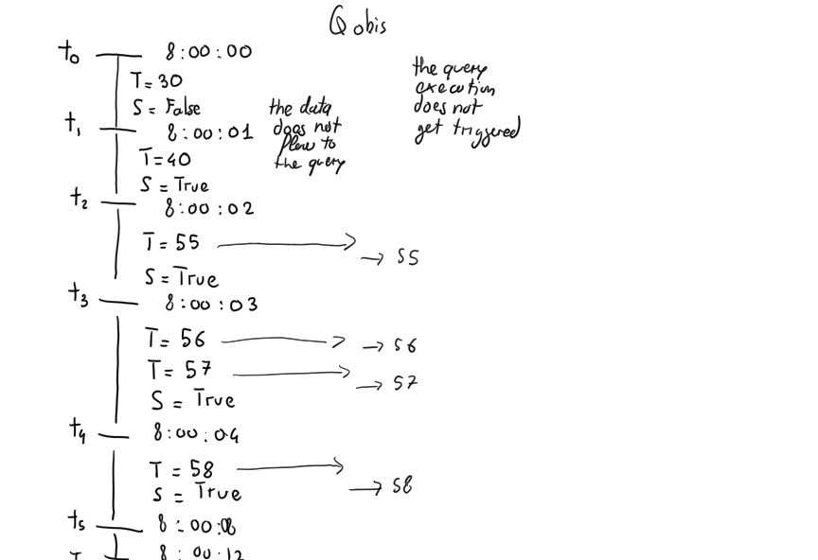
Filtering the Event-Based System Style
Q0bis - the Event-Based System Style
select *
from TemperatureSensorEvent(temperature > 50) ;
Execution mode
Data points are filtered before flowing into the query and the query execution does not get triggered

Slide 21
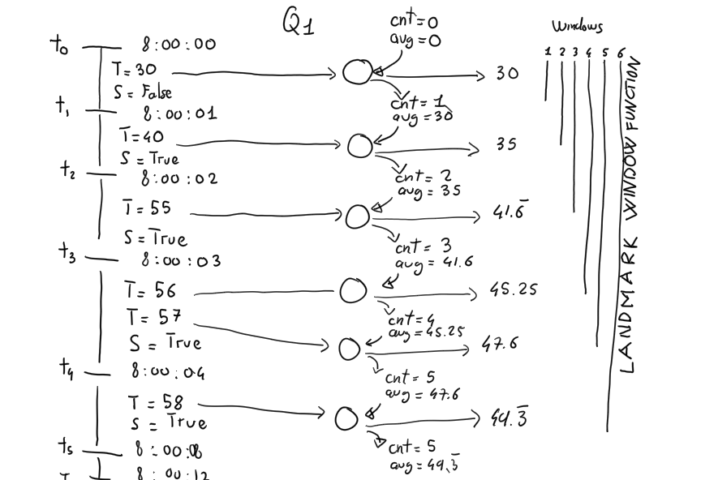
Basic Aggregation
select sensor, avg(temperature)
from TemperatureSensorEvent
group by sensor;
Execution mode
From a logical perspective, data points cumulate in the landmark window, and the query emits a new avg for every data point
From a physical perspective, the query is evaluated incrementally and maintains a state that captures the number of events (cnt) seen so far and the previous avg. The new average only depends on the state and the new data point entering the query. Old data can be forgotten.

Slide 22
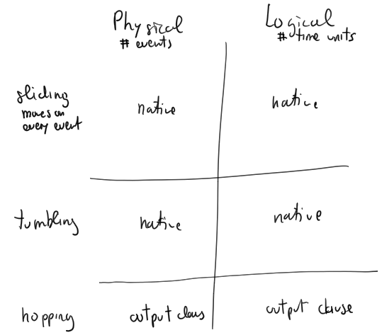
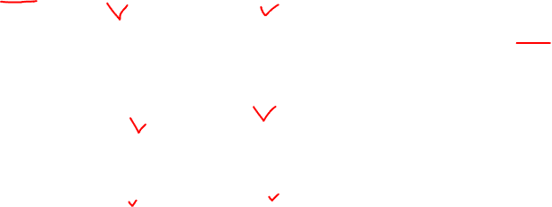
Data Windowing
+ session window

Slide 23
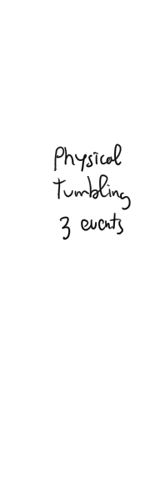
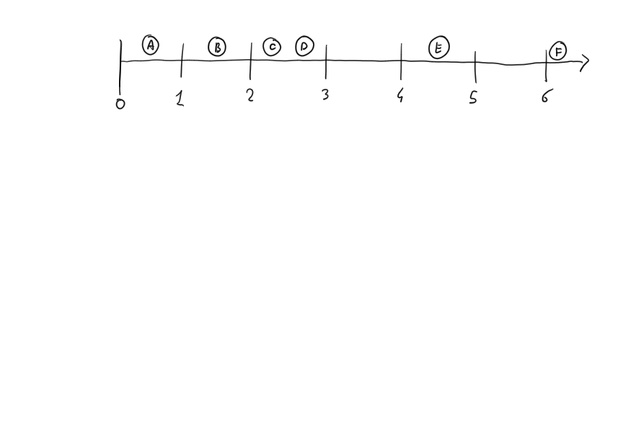
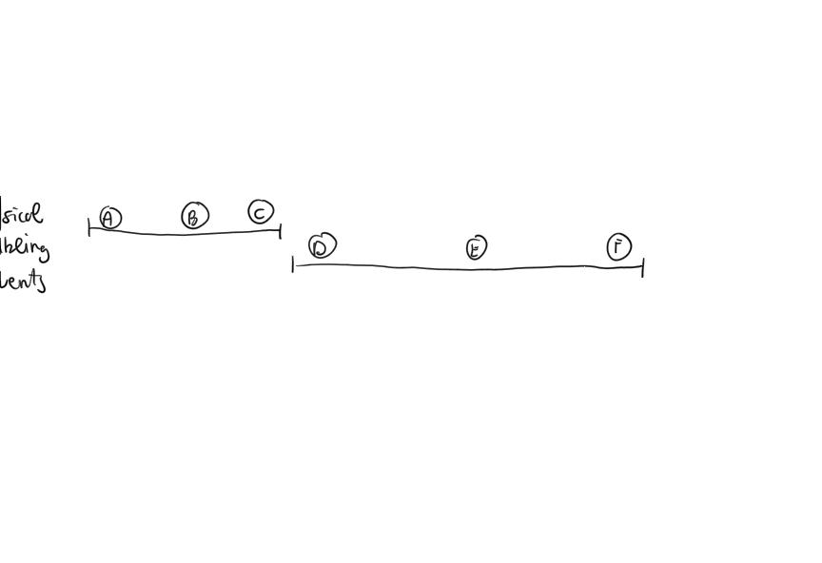
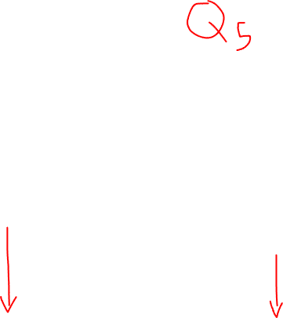
Physical tumbling windows

Slide 24
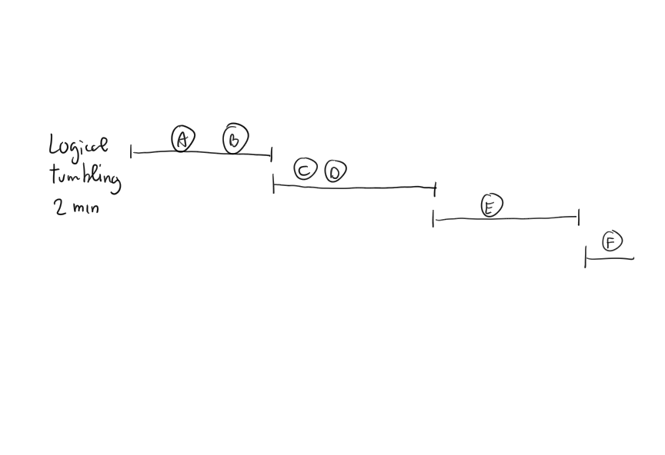
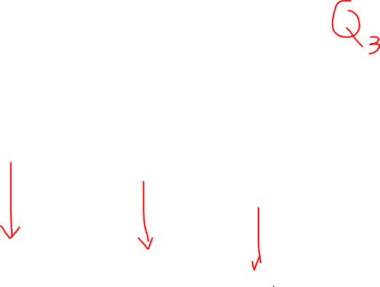
Logical tumbling windows

Slide 25
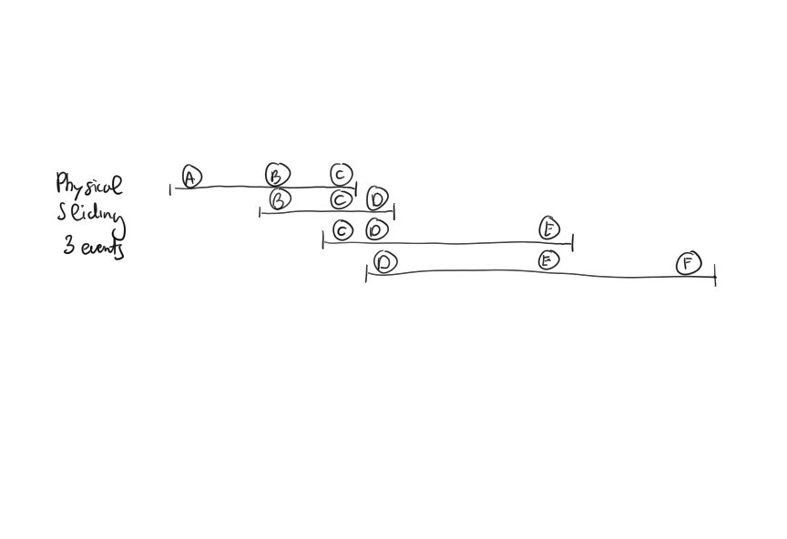

Physical sliding windows

Slide 26
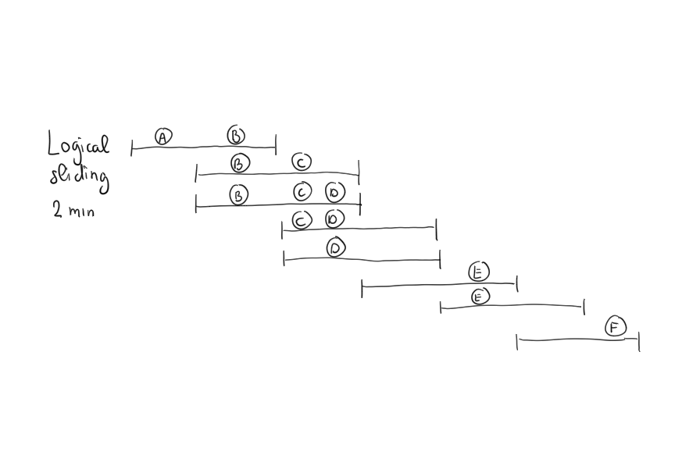


Logical sliding windows

Slide 27
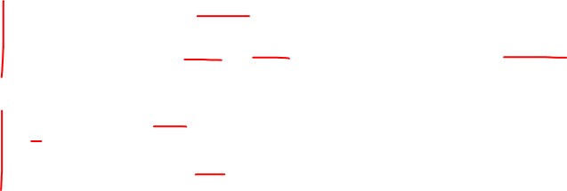
EPL window syntax
Type | Syntax | Description
Logical Sliding | win:time(time_period) | Sliding window that covers the specified time interval into the past
Logical Tumbling | win:time_batch(time_period [, reference point] [, flow control]) | Tumbling window that batches events and releases them every specified time interval, with flow control options
Physical Sliding | win:length(size) | Sliding window that covers the specified number of elements into the past
Physical Tumbling | win:length_batch(size) | Tumbling window that batches events and releases them when a given minimum number of events has been collected

Slide 28
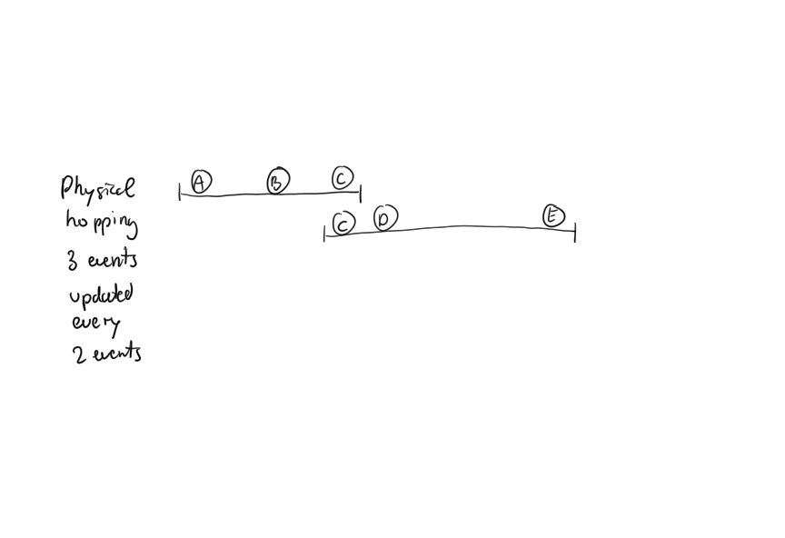
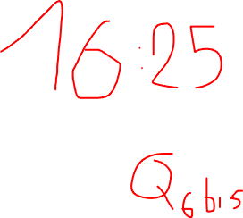
Physical hopping windows

Slide 29
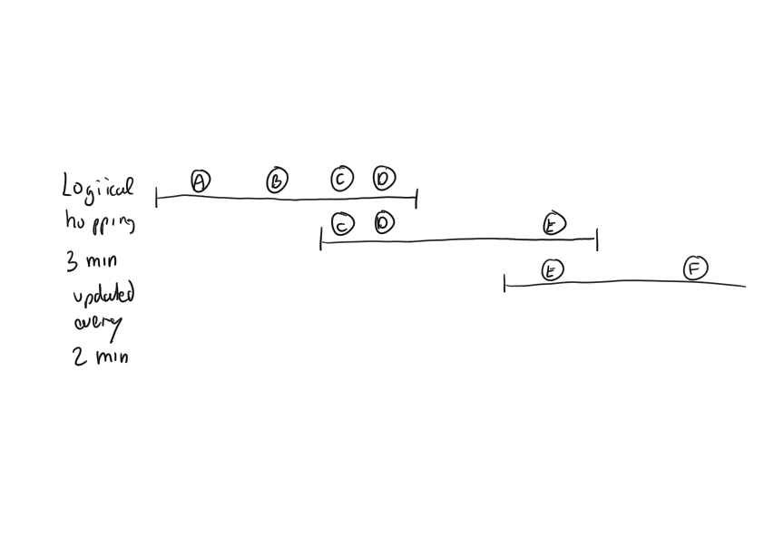
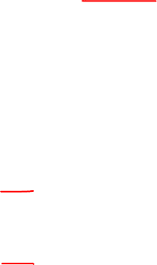

Logical hopping windows

Slide 30
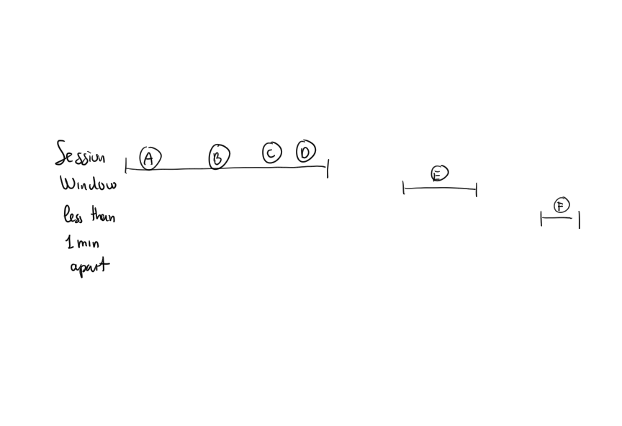
Session windows (not supported in EPL)

Slide 31
EPL Output control syntax
The output clause is optional in Esper
It is used to
Control the output rate
Suppress output events
output [all | first | last | snapshot]
every output_rate [seconds | events]

Slide 32
Output control and Hopping Windows
Control advancement of sliding windows
select avg(temperature) from TemperatureSensorEvent.win:length(4)
output snapshot every 2 events
select avg(temperature) from TemperatureSensorEvent.win:time(4 sec)
output snapshot every 2 sec

Slide 33
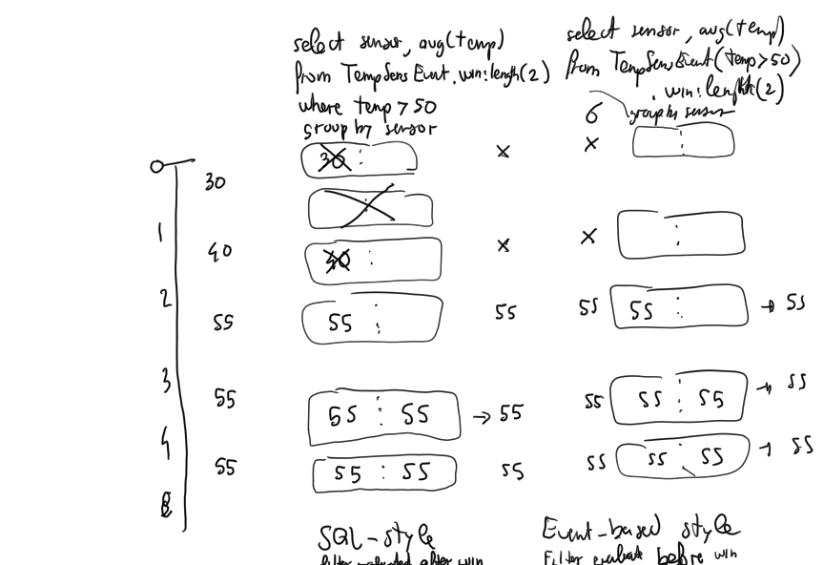
A digression on data windowing and SQL-style vs. Event-base style filtering
56
56
56
56
56
57
56
57
57
56
57
57

Slide 34
The Pattern Matching clause of the Event Processing Language

Slide 35
Pattern matching
An event pattern emits when one or more event occurrences match the pattern definition, which can include
Constraints on the content of events
Constraints on the time of occurrence of events
Conditions for pattern creation / termination

Slide 36
Pattern matching
Content-based event selection
TempStream(sensor="S0", val>50)
Time-based event observers specify time intervals or time schedules
timer:interval(10 seconds)
timer:at(5, *, *, *, *)
Fires after 10 seconds
Every 5 minutes
Syntax: minutes, hours, days of month, months, days of week

Slide 37
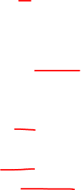
Pattern matching operators
Logical operators
and, or, not
Temporal operators that operate on event order
-> (followed-by)
Creation/termination control
every, every-distinct, [num] and until
Guards filter out events and cause termination
timer:within, timer:withinmax and while-expression

Slide 38
Pattern matching
select a.sensor from pattern
[every (
a = SmokeEvent(smoke=true)
->
TempEvent(val>50, sensor=a.sensor)
where timer:within(2 min)
)]

Slide 39
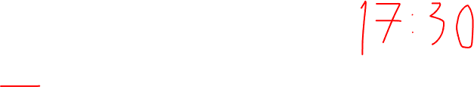
Pattern matching
every expr
When expr evaluates to true or false …
… the pattern matching for expr should re-start
Without the every operator the pattern matching process does not re-start

Slide 40
Pattern matching
This pattern fires when encountering an A event and then stops
A
This pattern keeps firing when encountering A events, and does not stop
every A

Slide 41
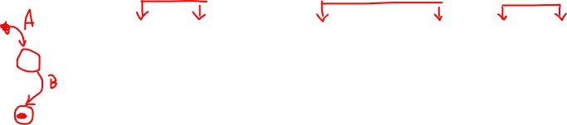
Pattern matching
A1 B1 B2 A2 A3 B3 A4 B4
every (A -> B)
Detect an event A followed by an event B:
at the time when B occurs, the pattern matches and restarts looking for the next A event
B1 | {A1, B1}
B3 | {A2, B3}
B4 | {A4, B4}

Slide 42
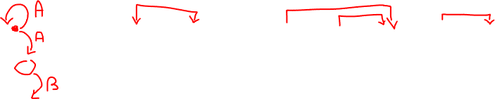
Pattern matching
A1 B1 B2 A2 A3 B3 A4 B4
every A -> B
The pattern fires for every A followed by a B event
B1 | {A1, B1}
B3 | {A2, B3}, {A3, B3}
B4 | {A4, B4}

Slide 43
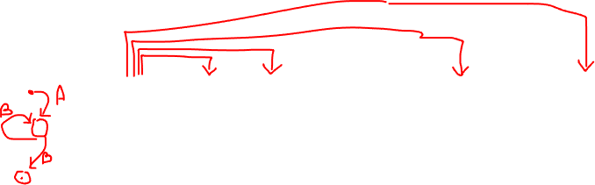
Pattern matching
A1 B1 B2 A2 A3 B3 A4 B4
A -> every B
The pattern fires for an A event followed by every B event
B1 | {A1, B1}
B2 | {A1, B2}
B3 | {A1, B3}
B4 | {A1, B4}

Slide 44
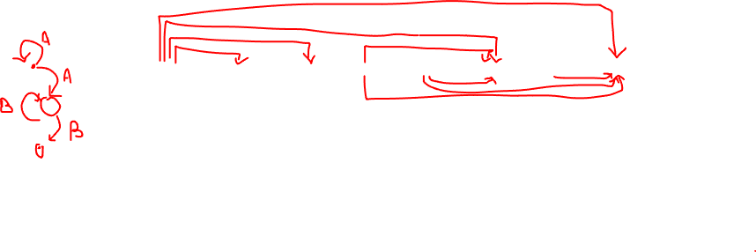
Pattern matching
A1 B1 B2 A2 A3 B3 A4 B4
every A -> every B
The pattern fires for every A event followed by every B event
B1 | {A1, B1}
B2 | {A1, B2}
B3 | {A1, B3}, {A2, B3}, {A3, B3}
B4 | {A1, B4}, {A2, B4}, {A3, B4}, {A4, B4}

Slide 45

Pattern matching
With the every operator
Multiple (partial) instances of the same pattern can be active at the same time
Each instance can consume some resources when events enter the engine
End pending instances whenever possible
With the timer:within construct
With the and not construct
Note: the data windows on a pattern do not always limit pattern sub-expression lifetime

Slide 46
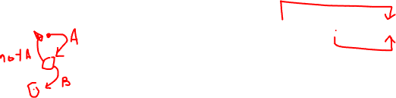
Pattern matching
A1 A2 B1
Pattern | Results
every A -> B | {A1, B1}, {A2, B1}
every A -> (B and not A) | {A2, B1}
The and not operator causes the sub-expression looking for {A1, B?} to end when A2 arrives

Slide 47
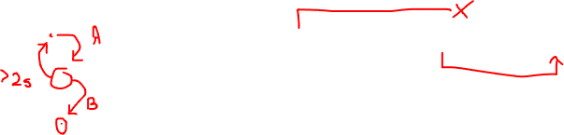
Pattern matching
A1@1 A2@3 B1@4
Pattern | Results
every A -> B | {A1, B1}, {A2, B1}
every A -> (B where timer:within(2 sec)) | {A2, B1}
The timer:within operator causes the sub-expression looking for {A1, B?} to end after 2 seconds

Slide 48
Combine queries
The insert into clause forwards events to other streams for further downstream processing
insert into FireComplexEvent
select a.sensor as sensor,
a.smoke as smoke,
b.temperature as temperature
from pattern
[every a=SmokeSensorEvent(smoke=true)
->
b=TemperatureSensorEvent(
sensor=a.sensor, temperature>50)];
select count(*)
from FireComplexEvent.win:time(10 min);

Slide 49
Reference
Esper documentation online
https://esper.espertech.com/release-8.8.0/reference-esper/html_single/
Esper EPL online
http://esper-epl-tryout.appspot.com/epltryout/mainform.html

Slide 50
License and Acknowledgment
This work is licensed under the Creative Commons Attribution-ShareAlike International Public License
The original slides where prepared by Alessandro Margara for the PhD course on “Stream and Complex Event Processing in the Big Data Era” offered in 2019
http://streamreasoning.org/events/scep2019

Slide 51
Vertically Scalable solutions illustrated via EPL and Esper
Emanuele Della Valle
Politecnico di Milano

