Slide 1
Monte Carlo for a knock-in bivariate barrier option
Sara Maresca
Elena Kutsak
Emanuele Gobbato
Arjola Cibaj
Stefano Franciotti
Rodolfo Cociani

Slide 2


Our goal
We did a Montecarlo simulation to price a certificate consisting in a knock-in bivariate barrier call option. This means the payoff depends on two securities:
S2 determines the value of the plain vanilla call since it is the underlying of such option.
S1 leads the activation of the option: when it touches the barrier the option will become a plain vanilla one. Viceversa, if at maturity the barrier has never been touched, its value is going to be zero.
In order to have a full picture of the value of the option and avoiding to consider the price path as static and stand-alone, we tried different settings by changing the volatilities and the correlation between the securities.
$$c\left(T\right)=\max{\{{ S}_{2}\left(T\right)−K;0\}}$$
$$M_{1}\left(T\right)=\max{\{{ S}_{1}\left(t\right):t∈\{t_{1},…,t_{m}\}\}≥b}$$
$$X\left(T\right)=c(T)∙𝕀_{M_{1}(T)≥b}$$

Slide 3
Procedure
1
2
3
4
Simulated a price path for both securities with standard values
Defined the function «montecarlo_knock_in» whose inputs are the relevant parameters and that returns the option price and the relative confidence interval.
Setted three arrays each one containing different values of frequency, volatilities and correlation. With for cycles nested one into the other, used the montecarlo_knock_in function to find the certificate price in different scenarios.
Stored the various prices in a data frame and compared them.

Slide 4
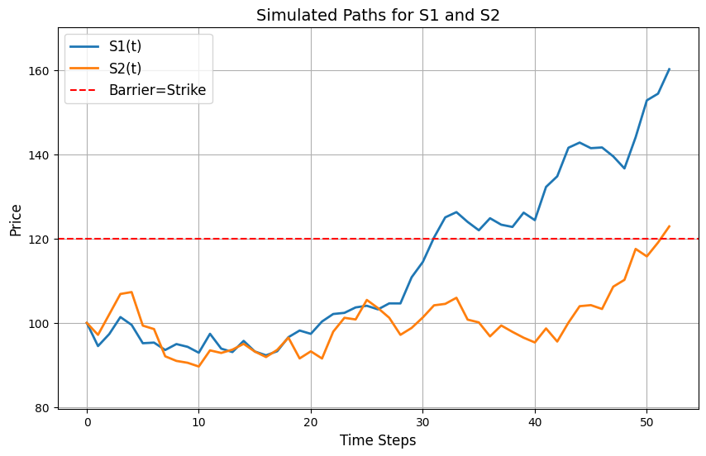
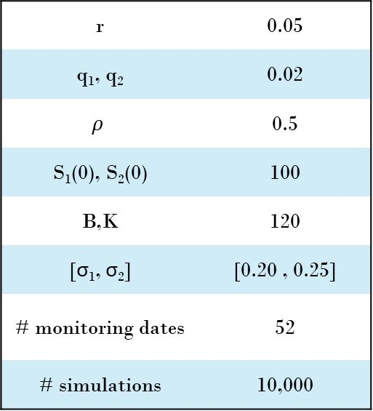


Simulated a price path for both securities with standard values
1
$$S_{i}\left(t+∆t\right)=S_{i}\left(t\right)∗e^{\left(r−q−\frac{1}{2}σ^{2}\right)∗∆t+σ_{i}∆W}$$
With ${ σ}_{1}=\left[v_{1},0\right]$
$$σ_{2}=\left[{ρv}_{2},\sqrt{1−ρ^{2}}v_{2}\right]$$
r | 0.05
q₁, q₂ | 0.02
$$ρ$$ | 0.5
S₁(0), S₂(0) | 100
B,K | 120
[σ₁, σ₂] | [0.20 , 0.25]
# monitoring dates | 52
# simulations | 10,000

Slide 5
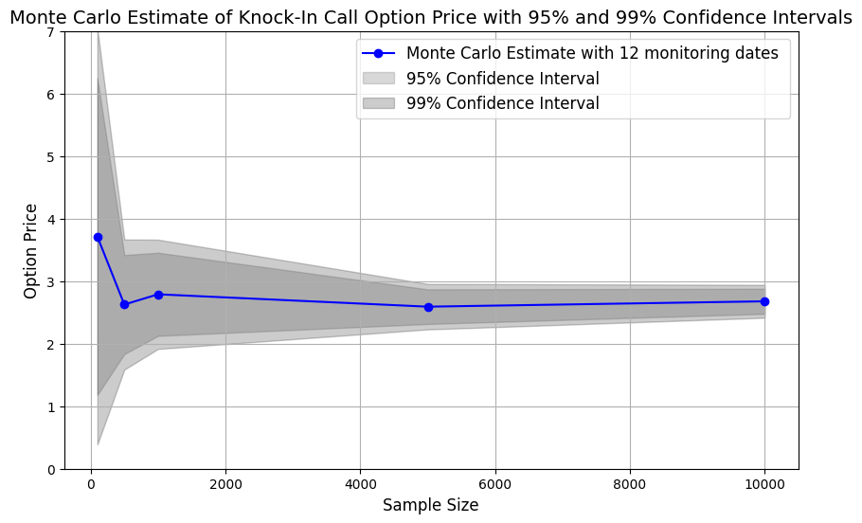
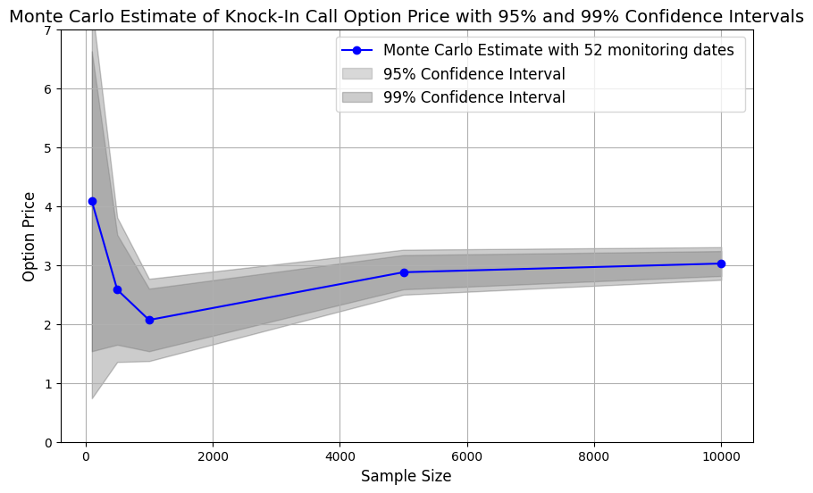
Defined the function «montecarlo_knock_in» whose inputs are the relevant parameters and that returns the option price and the relative confidence interval.
2
The two graphs illustrate the role of monitoring frequency in the pricing of barrier options, specifically for a knock-in call option in our case: the price of the option is higher when using a higher monitoring frequency (when using 52 monitoring dates in this case), since it increases the likelihood that the underlying asset’s price will hit the barrier. In the case of lower monitoring frequency (12 monitoring dates), the barrier is checked less frequently, reducing the probability of it being breached and, consequenty, lowering the estimated option price.

Slide 6
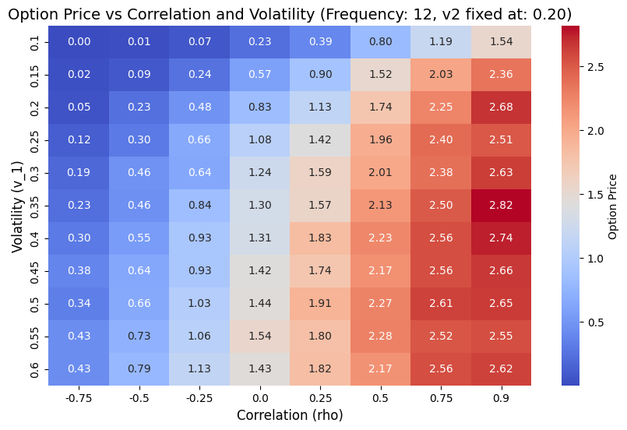

Setted three arrays each one containing different values of frequency, volatilities and correlation.
With for cycles nested one into the other, we used the montecarlo_knock_in function to find the certificate price in different scenarios.
3
The heat map shows how the option price moves when changing the correlation between the securities and the volatility of the first stock, while maintaing fixed σ_{2.}
In this specific case (up and in option) we are long correlation: the value of the knock-in option increases as $ρ$ rises, as this increases both the likelihood of touching the barrier (for S₁) and the premium linked to S₂.

Slide 7
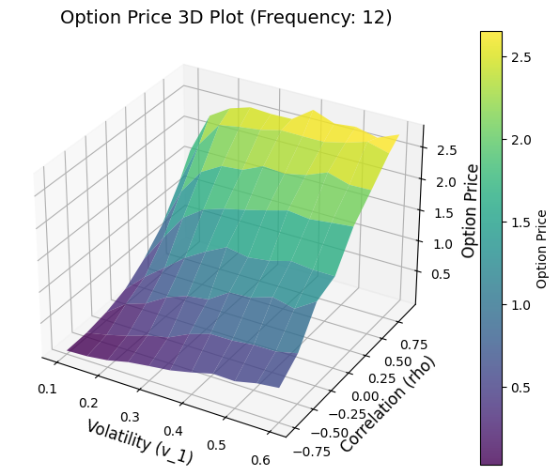
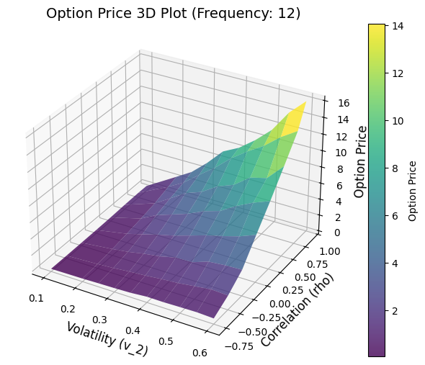

Stored the various prices in a data frame and compared them.
4
We plotted in a 3D Surface Plot the prices of the option while maintaining fixed one of the volatility parameters at 0.2 ($σ_{2}$ in the left graph, $σ_{1 }$in the right one). It’s evident how the volatility of S2 is more impactful on the price of the option, especially at high correlations. At negative correlations instead, we are slightly long on both volatilities.

