Slide 1
Music as a Complex System
A Quantitative Graph-Based Analysis of Electronic Tracks
Integrating insights from Álvaro Corral, Lucio Arese, and my Audio Intelligence Pipeline

Slide 2
Origins of the Project
This project arises from three converging sources:
1. Álvaro Corral:
Music behaves like a complex system, but lacks a quantitative framework.
2. Lucio Arese:
Music can be visualized as a trajectory moving through timbral space.
3. My previous work:
A full Audio Intelligence Pipeline capable of converting raw audio into detailed numerical features.
Together, these reveal a path toward modelling music as a true complex system.

Slide 3
Why Music as a Complex System?
Corral highlights that music exhibits:
• scaling laws
• emergent structure
• balance between repetition and novelty
• multi-scale organization
Yet there is no universal quantitative method to measure music structurally.
Electronic music, with its stable timbral roles and rich transitions, is ideal for such analysis.

Slide 4
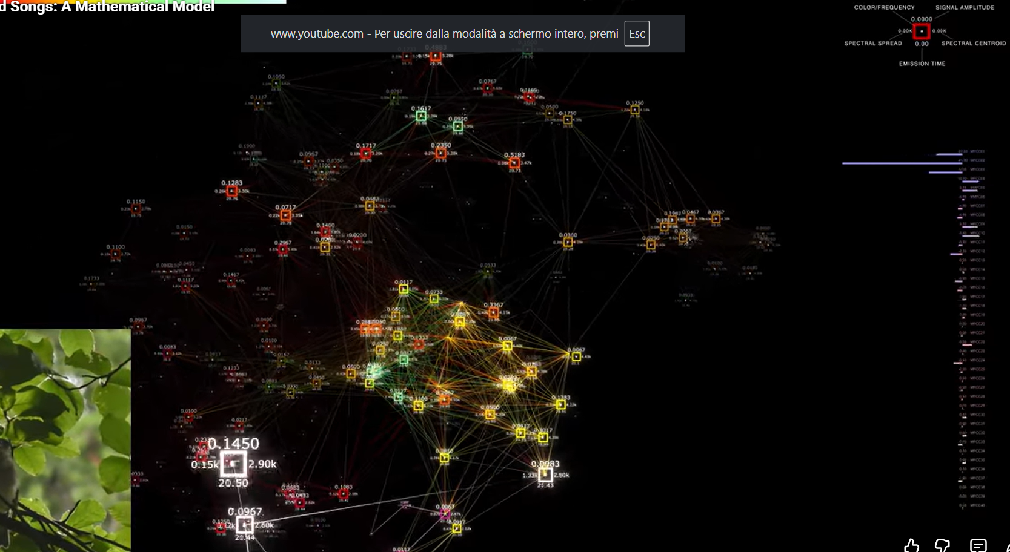
Visual Inspiration from Lucio Arese
Lucio Arese demonstrates that music forms a trajectory within a low-dimensional timbre manifold.

Slide 5
My project extends his visual intuition with:
• formal clustering into states
• a graph-based dynamical model
• complexity metrics
• evolutionary comparisons

Slide 6
Technical Foundation: My Audio Pipeline
My pipeline provides:
• automatic downloading and WAV conversion
• Spotify metadata and lyrics extraction
• frame-level feature extraction (~46ms):
RMS, ZCR, centroid, bandwidth, rolloff, flatness, flux,
spectral contrast, HLCR, MFCCs
This enables high-resolution modelling of musical dynamics.

Slide 7
Dataset Construction
Tracks are sampled across:
• genres (techno, house, ambient, hardtechno…)
• periods (2000–2010-2015–2020-2025)
• representative artists
Total dataset size: ~80–150 tracks
Each track transformed into thousands of feature vectors.

Slide 8
From Audio to Feature Space
Each frame becomes a feature vector:
f_t = [RMS, ZCR, centroid, bandwidth, rolloff, flatness, flux, contrast, HLCR, MFCC1...MFCC13]
This describes moment-to-moment timbral evolution.

Slide 9
Dimensionality Reduction
PCA is used in two ways:
• PCA 3D for visualizing timbral trajectories
• PCA kD for clustering timbral patterns
This preserves structure while reducing redundancy.

Slide 10
Defining Timbral States (Choosing K)
Electronic tracks are constructed from ~12 macro timbral roles:
kick, snare, hats, bass, leads, pads, FX, textures, vocals...
Each role typically has 2–3 variant timbres.
This suggests: 12 × 2–3 ≈ 24–36 classes.
Thus K ≈ 30 is musically grounded, not arbitrary. We use this theorical backround alltogether with statistical empirical results such as elbow method or other relevant statistic to find the right trade off
Each frame is assigned a state:
(z1, z2, ..., zT)

Slide 11
Building the State Graph
A directed weighted graph is constructed:
• nodes = timbral states
• edges = transitions between states
• weights = transition counts
The transition matrix P_ij captures the internal dynamics of the track.

Slide 12
Complexity Metrics from the Graph
1. State Entropy:
diversity of timbral usage.
2. Transition Entropy:
unpredictability of transitions.
3. Modularity:
structural segmentation emerging from state clusters.
4. Backbone (Disparity Filter):
statistically significant transitions forming the core skeleton.
These metrics form a reproducible complexity fingerprint.

Slide 13
What We Learn from the Graph
• Internal Dynamics: how the track flows through timbral space.
• Complexity: degree of order vs chaos in transitions.
• Structure: emergent sections of the track.
• Essential Backbone: core transitions driving musical evolution.
• Evolution: differences across genres, artists, decades.
• Signature: each track reveals a unique complexity identity.

Slide 14
Comparative Analysis
Metrics allow comparisons between:
• genres
• periods
• artists

Slide 15
Conclusion
This project unifies:
• Corral’s theoretical insights,
• Arese’s visual intuition,
• my audio analysis pipeline,
into a single quantitative framework.
By modelling each track as a dynamical graph of timbral states,
we reveal measurable complexity, structure, and evolution in electronic music.
This approach finally gives music analysis the rigor of complex-systems science.

