Slide 1
Project 4a — Reinforcement Learning for Optimal Steering
Task:
Learn a Reinforcement Learning (RL) policy to steer latent representations in diffusion or flow-matching models, moving generation toward or away from target concepts (e.g., violence, bias, nudity) without retraining the model.
Motivation:
Current steering methods are static, layer-specific, and break with multi-concept edits.
Diffusion models encode rich latent spaces but lack precise control.
RL enables adaptive, context-aware steering that balances safety and visual fidelity.
Related Work:
Latent/activation steering & patching (linear, non-optimal).
CLIP-based concept directions.
RL for control and decision-making (Proximal Policy Optimization-PPO, Soft Actor-Critic-SAC) used in complex environments.

Slide 2
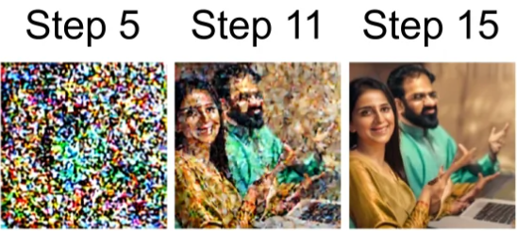
Models, Tools & Novelty
Approach:
Extract multi-layer activations from diffusion/flow models.
Train an RL steering policy π(a|s) that acts during sampling:
  State: latent, timestep, layer, prompt embedding
  Action: scale steering vectors, adjust cross-attention, apply residual noise
  Reward: safe-CLIP ↑, unsafe ↓, safety classifier, fidelity, OT/KL penalty
Tools:
PyTorch, Diffusers
CLIP + safety classifier
PPO/SAC (continuous control)
Optimal Transport metrics
Novelty:
First RL-based adaptive, multi-layer steering without retraining.
Learns when/where/how to intervene.
Identifies most influential layers for safety control.

Slide 3
Benchmark & Evaluation
Setup
Standard safety benchmarks (I2P, Safe-Variants).
Paired prompts: unsafe→safe, concept-present→suppressed.
Compare RL steering vs training-free baselines (SAFREE, CAStee).
Metrics
Safety classifier score
CLIP safe/unsafe similarity
LPIPS fidelityOT/KL latent stability
Adversarial/robustness tests
Expected Results
Layer-specific, timestep-specific control
Stronger, more reliable concept suppression
Better robustness with minimal quality loss
Clear identification of key steering layers

