Slide 1
Alignment Problem

Slide 2
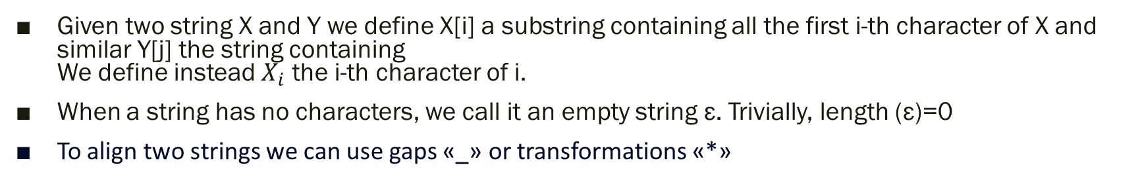
Basic Idea for developing Algorithm
Notation used in the Algorithm
Given two string X and Y we define X[i] a substring containing all the first i-th character of X and similar Y[j] the string containing We define instead $X_{i}$ the i-th character of i.
When a string has no characters, we call it an empty string ε. Trivially, length (ε)=0
To align two strings we can use gaps «_» or transformations «*»
Utilize the identical strategy employed in the LCS algorithm, employing dynamic programming with mnemonization of intermediate results.
During each iteration, we will compute the cost, taking into consideration whether we must insert gaps or apply transformations.

Slide 3
Notes
The two aligned output strings of the algorithm should have matching lengths. This requirement can be satisfied, even if the two input strings X and Y have differing lengths, by introducing gaps that can be treated as the insertion of a neutral character. Example: We can align every string Z with an empty string just by adding length(Z) gaps.
When we allow a mismatch between two characters, it is necessary to insert two asterisk (*) characters: one at the mismatched position in the first string and the other at the corresponding mismatched position in the second string. Therefore, we only need to take into consideration the cost of mismatch between two letters. (In our case, prior to parametrization, this cost would amount to 5 + 5, totaling 10)
The cost function is a commutative function therefore Cost (X, Y) = Cost (Y, X)

Slide 4
Cost Versus Length
We can approach the problem from two perspectives: 1) One is to minimize the cost by allowing the addition of any number of characters (gaps), Example Input : X = AGGGCT, Y = AGGCA, Output: X = AGGGC_T, Y = AG_GCA_, final_cost= 6 2) The other is to minimize the cost while ensuring that the resulting string remains as short as the longer of the two input strings. Input : X = AGGGCT, Y = AGGCA, Output: X = AGGGC*, Y = A_GGC* ,final_cost= 6
We will initially focus on studying the algorithm to address the first problem. Following that, we will introduce certain modifications to its functionality to also solve with the second criteria. Let’s start by solving it recursively

Slide 5
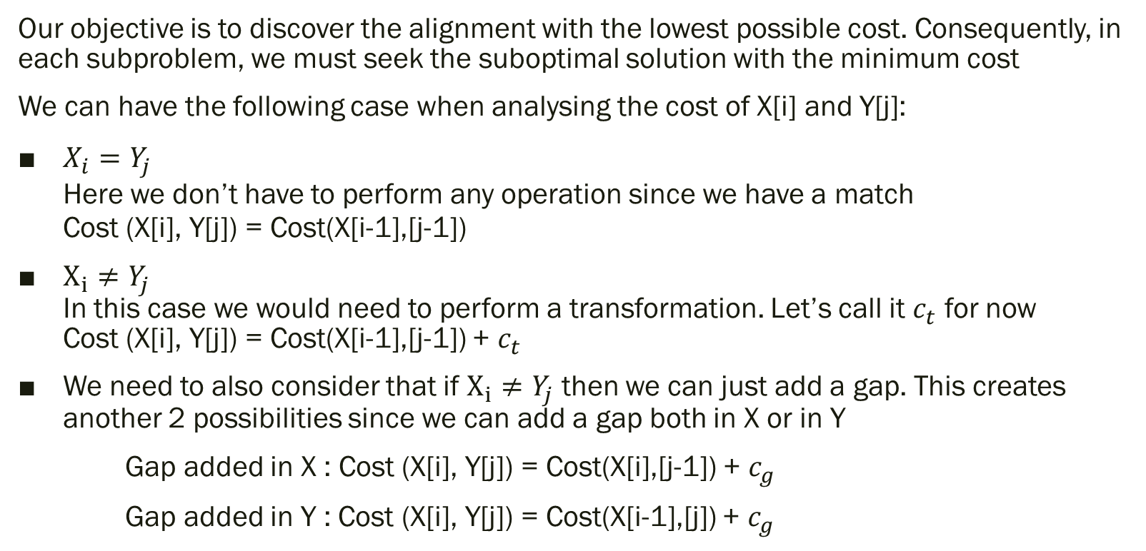
Recursive Case
Our objective is to discover the alignment with the lowest possible cost. Consequently, in each subproblem, we must seek the suboptimal solution with the minimum cost
We can have the following case when analysing the cost of X[i] and Y[j]:
$X_{i}=Y_{j}$ Here we don’t have to perform any operation since we have a match Cost (X[i], Y[j]) = Cost(X[i-1],[j-1])
$X_{i}≠Y_{j}$ In this case we would need to perform a transformation. Let’s call it $c_{t}$ for now Cost (X[i], Y[j]) = Cost(X[i-1],[j-1]) + $c_{t}$
We need to also consider that if $X_{i}≠Y_{j}$ then we can just add a gap. This creates another 2 possibilities since we can add a gap both in X or in Y
Gap added in X : Cost (X[i], Y[j]) = Cost(X[i],[j-1]) + $c_{g}$
Gap added in Y : Cost (X[i], Y[j]) = Cost(X[i-1],[j]) + $c_{g}$

Slide 6

Base Case
The base case just consist in the cost of alignment between an empty string with another. Since, there is no other way of aligning them without using gap, this only depends based on the cost of the gap. We are going to call it $c_{g}$
Cost (X,ε) = length(X) * $c_{g}$

Slide 7
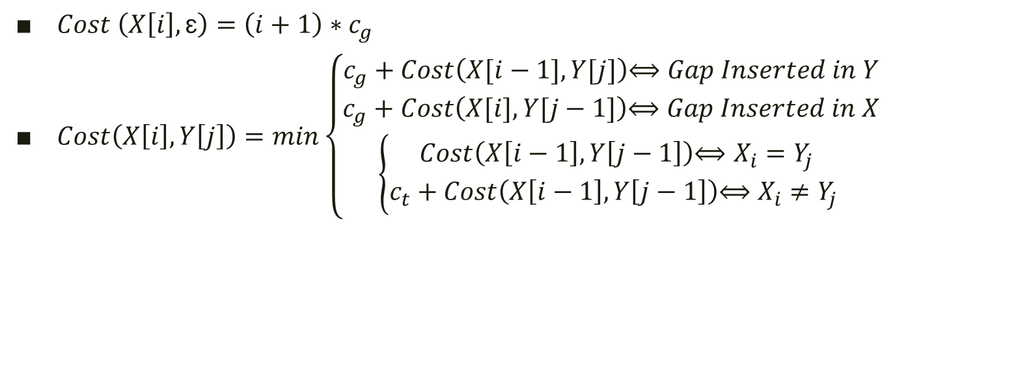
Summary
$Cost \left(X\left[i\right],\text{ε}\right)=\left(i+1\right)∗c_{g }$
$Cost\left(X\left[i\right],Y\left[j\right]\right)=min\left\{\begin{aligned}c_{g}+Cost\left(X[i−1],Y[j]\right)\text{⟺ }Gap Inserted in Y \\ c_{g}+Cost\left(X[i],Y[j−1]\right)\text{⟺ }Gap Inserted in X \\ \left\{\begin{aligned}Cost\left(X\left[i−1\right],Y\left[j−1\right]\right)\text{⟺ }X_{i}=Y_{j} \\ c_{t}+Cost\left(X\left[i−1\right],Y\left[j−1\right]\right)\text{⟺ }X_{i}≠Y_{j} \end{aligned}\right.\end{aligned}\right.$

Slide 8
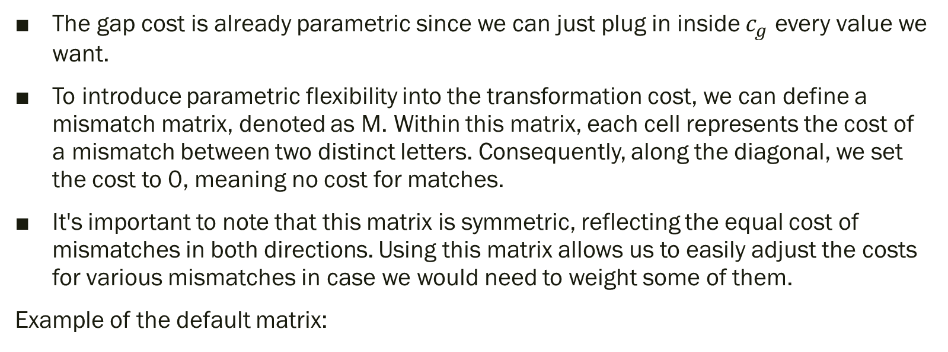
Parametrization
The gap cost is already parametric since we can just plug in inside $c_{g}$ every value we want.
To introduce parametric flexibility into the transformation cost, we can define a mismatch matrix, denoted as M. Within this matrix, each cell represents the cost of a mismatch between two distinct letters. Consequently, along the diagonal, we set the cost to 0, meaning no cost for matches.
It's important to note that this matrix is symmetric, reflecting the equal cost of mismatches in both directions. Using this matrix allows us to easily adjust the costs for various mismatches in case we would need to weight some of them.
Example of the default matrix:
 | A | T | G | C
A | 0 | 10 | 10 | 10
T | 10 | 0 | 10 | 10
G | 10 | 10 | 0 | 10
C | 10 | 10 | 10 | 0

Slide 9


Improvement of equation
From the previous slide we obtain that: cost of a mismatch/match between $X_{i}$ and $Y_{j}=M\left[X_{i}\right]\left[Y_{j}\right]$
Therefore, the new equations of the algorithm will be:
$Cost \left(X\left[i\right],\text{ε}\right)=\left(i+1\right)∗c_{g }$
$Cost\left(X\left[i\right],Y\left[j\right]\right)=min\left\{\begin{aligned}c_{g}+Cost\left(X[i−1],Y[j]\right)\text{⟺ }Gap Inserted in X \\ c_{g}+Cost\left(X[i],Y[j−1]\right)\text{⟺ }Gap Inserted in Y \\ M\left[X_{i}\right]\left[Y_{j}\right]+Cost\left(X\left[i−1\right],Y\left[j−1\right]\right)\end{aligned}\right.$

Slide 10
Implementation
We can build a table in which we store every intermediate cost between the strings. In particular, to compute the value of a cell in the table we just need the values that are on the top diagonal cell (i-1, j-1); left cell (i-1,j); top cell (i, j-1)
Every time we change value, we store a pointer (represented as arrow) to point to the cell that gave us that value
Once we compute all the cells in the table, we will obtain the cost of our alignment by looking at the most bottom-left cell which will be exactly Cost(X, Y). To understand what were the operation that brought to that cost we can backtrack using the previous saved pointer.

Slide 11

Example
Let’s take the strings X=AGGCA and Y=AGGGCT. Let’s build the table. For the initialization we need to put the cost of the GAP where we have only the ε.
Then we compute the cost of the first cell based on the three cells around it. We leave a pointer on the cell from which we took the min
After this we can compute all the row and the successive row.
ε
A
G
G
G
C
T
ε
0
2
4
6
8
10
12
A
2
0
2
4
6
8
10
G
4
2
0
2
4
6
8
G
6
4
2
0
2
4
6
C
8
6
4
2
4
2
4
A
10
8
6
4
6
4
6

Slide 12
Example - BackTracking
Once we obtain the cost we backtrack until we reach the first cell. Any path we take it’s fine since it will have cost 12. Going diagonal it’s equivalent to a match/mismatch. Going left/up means that we have a gap
ε
A
G
G
G
C
T
ε
0
2
4
6
8
10
12
A
2
0
2
4
6
8
10
G
4
2
0
2
4
6
8
G
6
4
2
0
2
4
6
C
8
6
4
2
4
2
4
A
10
8
6
4
6
4
6
AGGGCT_ A_GGC_A

Slide 13
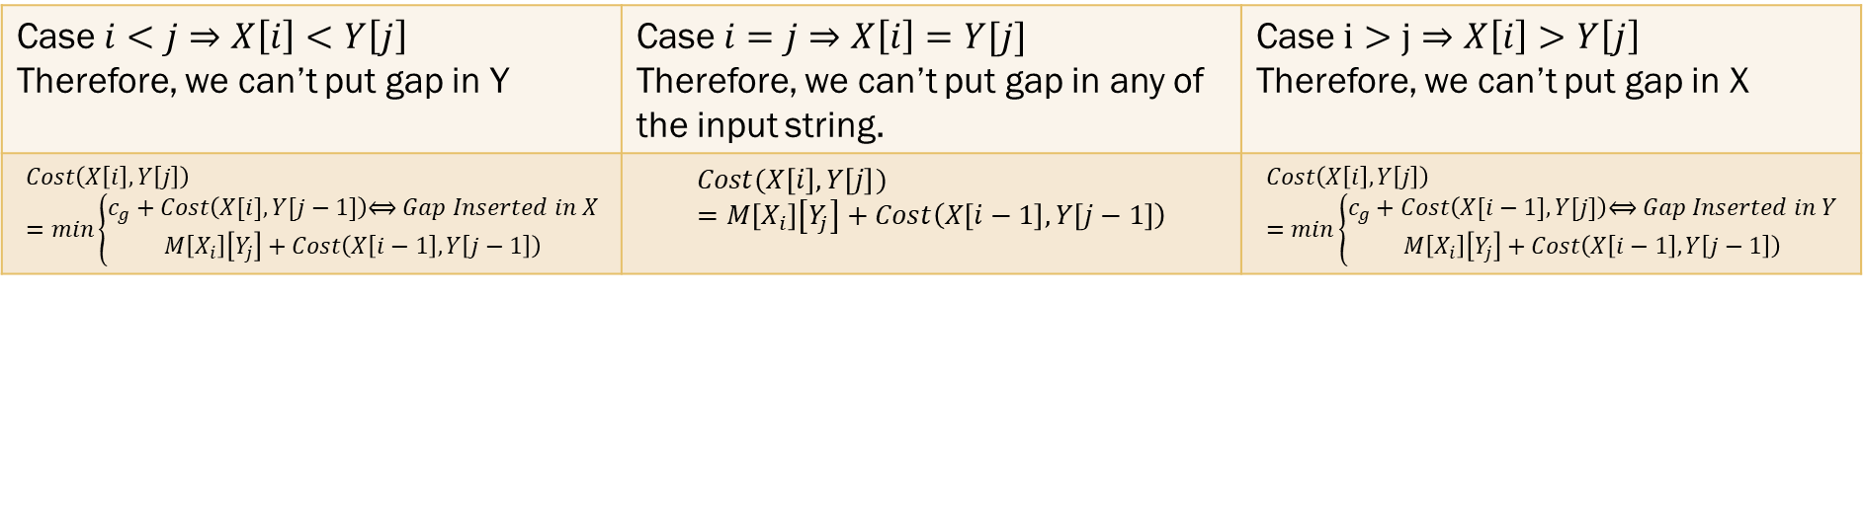
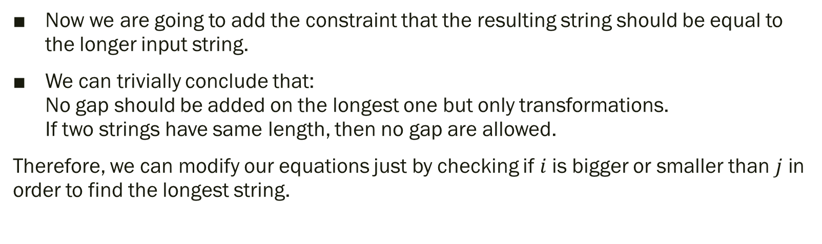
Minimum Length Criteria
Now we are going to add the constraint that the resulting string should be equal to the longer input string.
We can trivially conclude that: No gap should be added on the longest one but only transformations. If two strings have same length, then no gap are allowed.
Therefore, we can modify our equations just by checking if $i$is bigger or smaller than $j$ in order to find the longest string.
Case $i<j⇒X\left[i\right]<Y\left[j\right]$ Therefore, we can’t put gap in Y | Case $i=j⇒X\left[i\right]=Y[j]$ Therefore, we can’t put gap in any of the input string. | Case $i>j⇒X\left[i\right]>Y\left[j\right]$ Therefore, we can’t put gap in X
$$Cost\left(X\left[i\right],Y\left[j\right]\right)=min\left\{\begin{aligned}c_{g}+Cost\left(X[i],Y[j−1]\right)\text{⟺ }Gap Inserted in X \\ M\left[X_{i}\right]\left[Y_{j}\right]+Cost\left(X\left[i−1\right],Y\left[j−1\right]\right)\end{aligned}\right.$$ | $$Cost(X\left[i\right],Y\left[j\right])=M\left[X_{i}\right]\left[Y_{j}\right]+Cost\left(X\left[i−1\right],Y\left[j−1\right]\right)$$ | $$Cost\left(X\left[i\right],Y\left[j\right]\right)=min\left\{\begin{aligned}c_{g}+Cost\left(X[i−1],Y[j]\right)\text{⟺ }Gap Inserted in Y \\ M\left[X_{i}\right]\left[Y_{j}\right]+Cost\left(X\left[i−1\right],Y\left[j−1\right]\right)\end{aligned}\right.$$

Slide 14
Example
Let’s build the table with the same strings as before but with the new rules X=AGGCA and Y=AGGGCT. For the initialization as before we need to put the cost of the GAP where we have only the ε.
Then since for the diagonal we only need the previous part we can immediately calculate all of it.
Without lack of generalization we are going to assume that the horizontal string is always bigger than the vertical one in the table (If not we can just swap them). With this hyphotesis we can avoid calculating all the lower part of the matrix since we are not going to need it for our calculation.
ε
A
G
G
G
C
T
ε
0
2
4
6
8
10
12
A
0
2
4
6
8
10
G
0
2
4
6
8
G
0
2
4
6
C
10
2
4
A
20
12

Slide 15
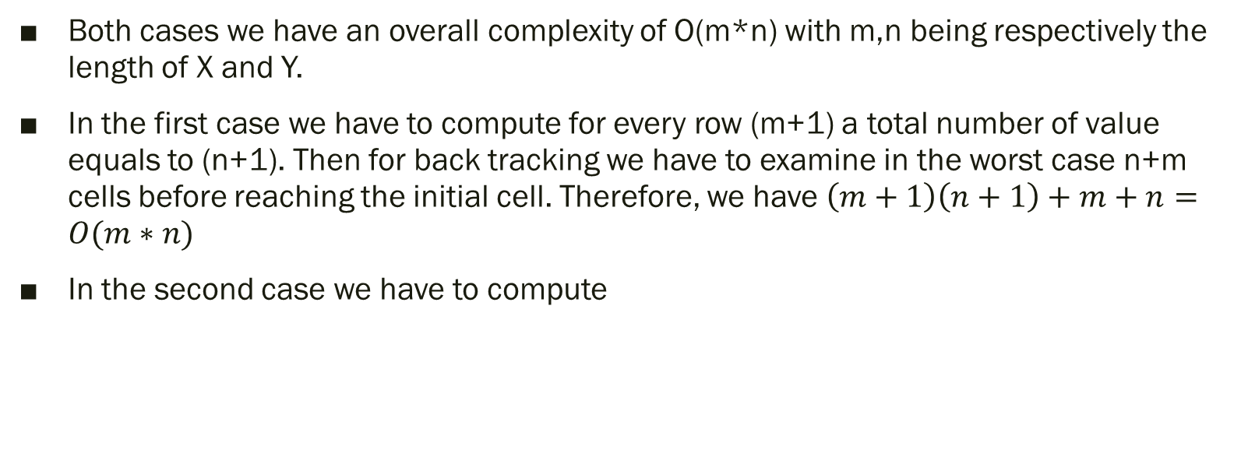
Complexity
Both cases we have an overall complexity of O(m*n) with m,n being respectively the length of X and Y.
In the first case we have to compute for every row (m+1) a total number of value equals to (n+1). Then for back tracking we have to examine in the worst case n+m cells before reaching the initial cell. Therefore, we have $\left(m+1\right)\left(n+1\right)+m+n=O(m∗n)$
In the second case we have to compute

Slide 16
Generator
Given two numbers n, m we have to produce two strings respectively of length n and m that when aligned produce the maximum cost.
To determine the maximum cost of aligning two strings, let’s consider the worst-case scenario: when the two strings share no common letters. In such a scenario, you can generate the two strings by placing, for instance, all "A" and "C" characters randomly in the first string and all "G" and "T" characters in the second string.
Example n=2, m=3 => X= AC ; Y=GTG MinCost = 10 where we have X alignment: ___AC and Y alignment: GTG__ MinCost with Min Length = 22 where we have X alignment: _**and Y alignment: G**

