Slide 1


Named Entity Extractors for new domains by Transfer Learning with automatically annotated data
Emanuel Matos
Mário Rodrigues
António Teixeira
IEETA, DETI, Universidade de Aveiro, Portugal

Slide 2
Outline
Named Entity Recognition - NER
Motivation
Main Objectives
Our proposal
assess the potential of automatically annotated entities is summarized
Dataset
Results
Future Work

Slide 3
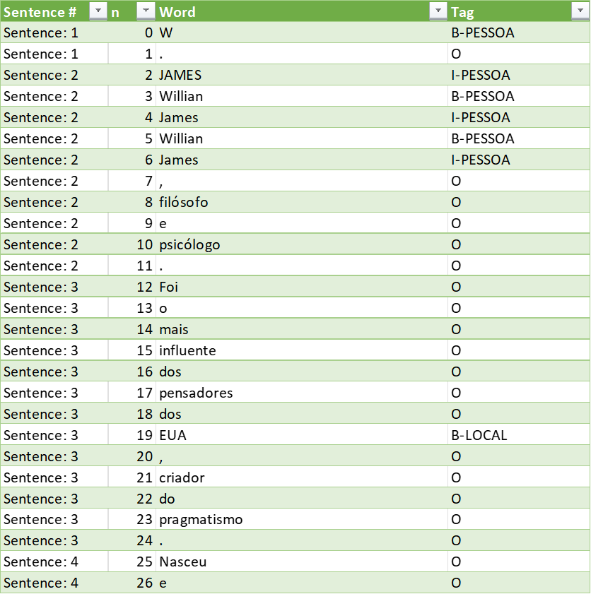
NER
Named entities are single-word or multi-word expressions that refer to specific individuals, such as people and organizations, or denote other concrete information such as postal and e-mail addresses or dates.
They are expressed using specific patterns (ex: addresses, dates, e-mails) or composed by a sequence of nouns referring a single entity
Examples: “António Guterres” or “The Secretary-General of the United Nations” which, in 2021, refer to the same person.
Automatic recognition of these named entities is the objective of Named Entity Recognition (NER)
a key step used in several natural language processing (NLP) tasks
Example of MiniHarem dataset:

Slide 4
Motivation / Problem(s)
Approaches to NER include training statistical sequential models based on handcrafted features, and more recently, deep learning models.
NER tasks imply token-level labels, annotating many documents can be time-consuming, and thus costly and prone to human error.
Most systems provide methods to train and adapt them to concrete applications
Our approach is also based on BERT.

Slide 5
Problem(s)
Not easy to have data to train ML approaches for new domains
Obtain or create annotated data that associates words or sequences of words to a type of entity is essential
And in general a major problem
Expressing data in the format accepted by existing systems
also doing so in a way non-developers feel comfortable with

Slide 6
Main Objectives
Assess the potential of automatically annotated data for the development of Named Entity Detection for new domains
Assess the possibility of using automatically annotated data with BERT based NERs
Notes:
Distinct BERT-based NERs were trained with automatically annotated data (BIO annotations) to detect words belonging to entities.

Slide 7
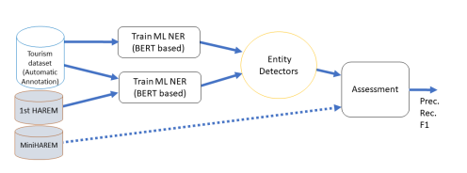
Method
Overview of the process adopted to

Slide 8
Datasets
Tourism*
New, based in Wikivoyage, automatic annotation [SLATE 2021]
1906 Sentences
+
1st HAREM dataset
666 Sentences
MiniHAREM
2450 Sentences
Training: the combination Tourism+HAREM used for training.
SLATE 2021 : Towards Automatic Creation of Annotations to Foster Development of Named Entity Recognizer

Slide 9
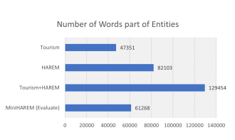
Datasets (cont.)
Notes:
Number of words annotated as part of an Entity for the 3 datasets used and the combination Tourism+HAREM used for training.

Slide 10
BERT-based Classifiers for Entity Detection
After tests with several implementations, we have adopted a simple and documented implementation by Tobias Sterbak
using the Transformers package by Huggingface , Keras and TensorFlow
It uses a BERT case sensitive tokenizer
based on Wordpiece tokenizer
that splits tokens into subwords

Slide 11
Training process
Split train, test
10% test
Tunning (Default parameters)
AdamW
optimizer_grouped_parameters,
lr=3e-5
eps=1e-8
Stop criteria
epochs = 10
Validation Loss (increase)

Slide 12
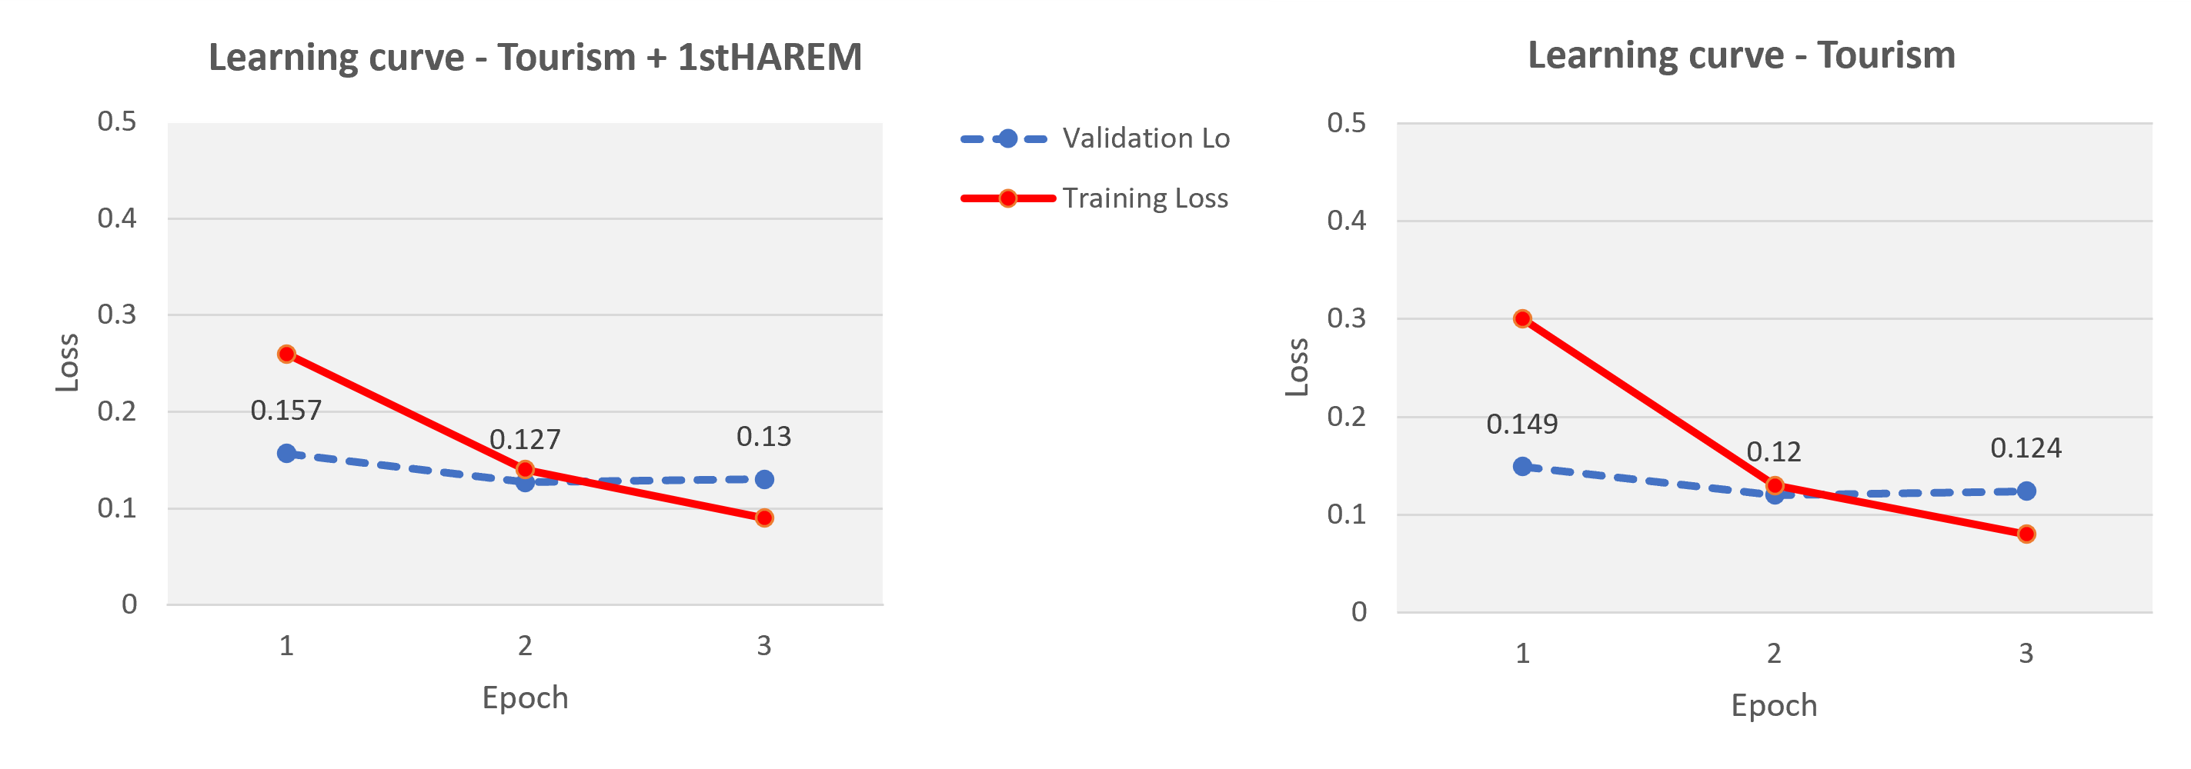
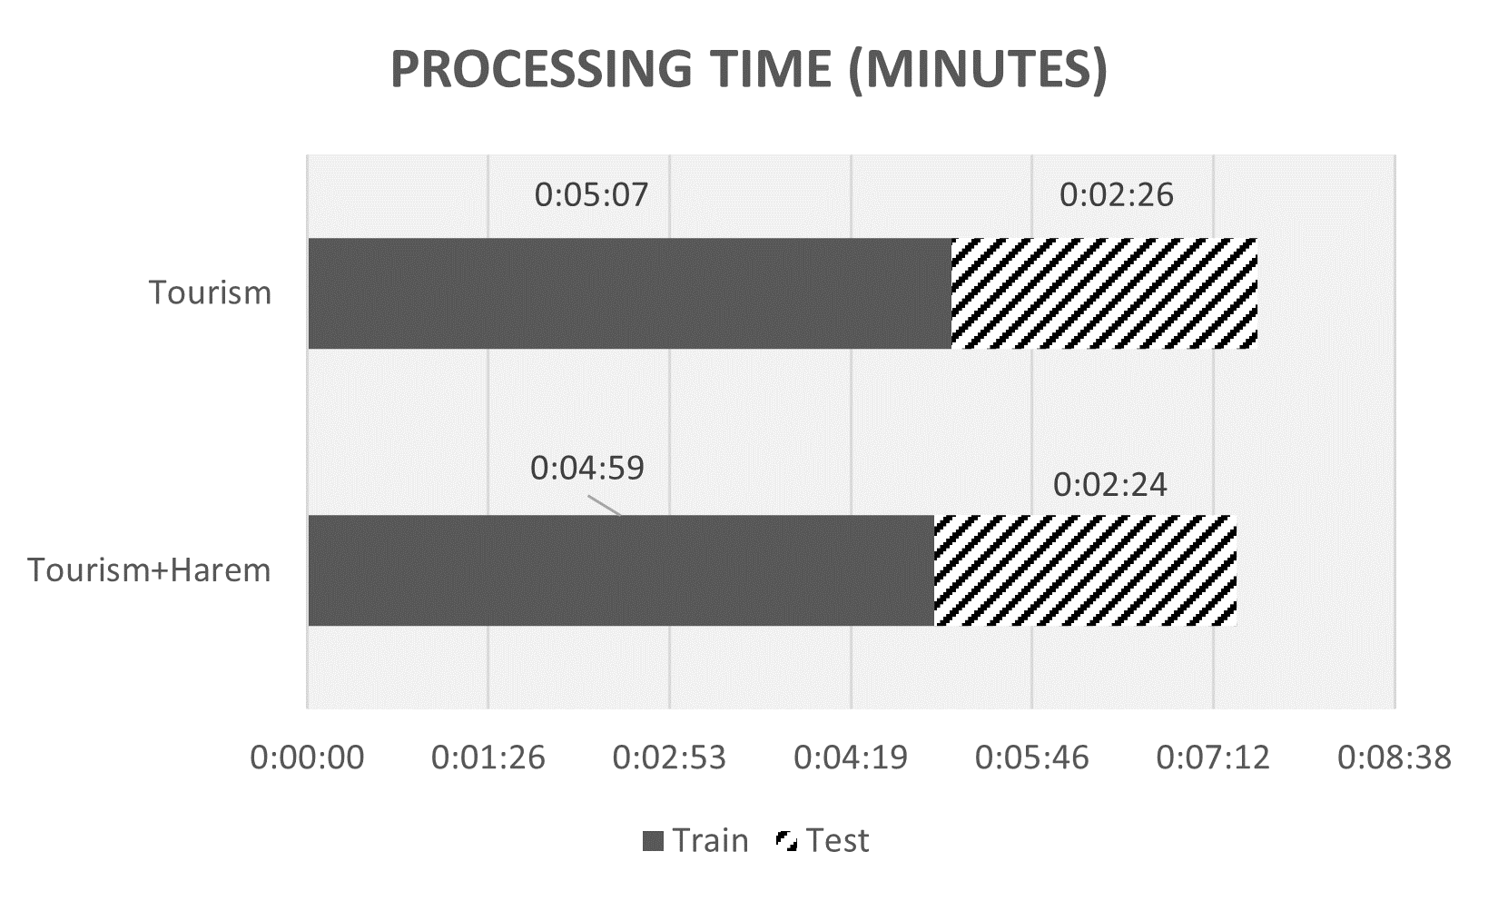
Training - Tourism Only vs Tourism+HAREM
Loss variation
Training time

Slide 13
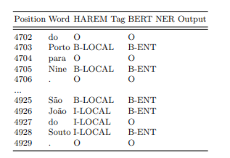
Results – BERT annotation examples
fragments of the results obtained with the BERT-based NER using MiniHAREM, showing the HAREM tag and the output of the variant trained only with automatic annotations.

Slide 14

Results - Evaluation scores
Results of the evaluation of both variants with MiniHAREM,
showing word and entity metrics
Acc.* refers to Accuracy calculated excluding all words with tag “O”.
Not so bad results with Tourism data only for training (automatically annotated)
92.6 % Acc word-based / 88.6 Entity
Acc equal for Entity-based with and without adding HAREM
Better when adding HAREM
But we tested with MiniHAREM ! Not necessarily fair.

Slide 15
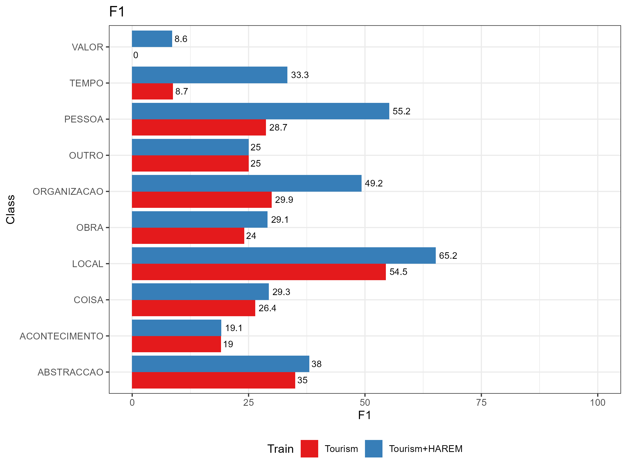
Results - By class
The test dataset contains several entity classes not annotated in our tourism data, it is worth looking in detail at the performance by class.
Best results for LOCAL
System Recognizes ABSTRACTION, not in our annotated data for Tourism
Also TIME, WORK, EVENT
Some improvement by adding HAREM

Slide 16
Conclusion
The potential of automatic annotation to provide the necessary datasets for training of entity detectors by finetuning of BERT models was assessed.
A first proof-of-concept of the proposed method was evaluated with an existing manually annotated dataset, MiniHAREM.
As the dataset used for testing - selected by being the only publicly available dataset for NER evaluation in Portuguese - is out-of-domain and integrates several entities without examples in the domain dataset, the results need to be considered with caution.
The results are promising regarding the potential to create Named Entity detectors for a new domain without manually annotated data
as demonstrated by the results obtained for classes more represented in the domain dataset.

Slide 17
Future Work
(ongoing) Test with more adequate dataset(s)
Extension of the Tourism dataset(s)
by processing additional texts by the automatic annotation process (ensemble of NER)
Addition of new entities to the automatic annotation process (e.g. TIME)
Exploration of recent evolutions in BERT-based NER and similar models
e.g., GPT-3 or FLAN
Add the post-processing step to classify the entity detected
using, for example, queries to DBPEdia and Wikipedia
Apply to new domains

Slide 18
Acknowledgement
IEETA Research Unit, funded by National Funds through the FCT - Foundation for Science and Technology - Foundation for Science and Technology, in the context of the project UIDB/00127/2020.

Slide 19
Thanks for your attention. Any questions?

