Slide 1





Extraction and Access to Information in Natural Language for Non-Developers - Democratizing Information
Emanuel Matos
António Teixeira, Mário Rodrigues, Liliana Ferreira
Year of 1st registration: 2019 (Number of full-time equivalent years: 2)
PhD program: MAP-i

Slide 2

Research Challenge
Citizens, institutions, companies need
To keep updated and attentive to changes
To have simple and structured access to information
To have access to an increasing diversity of sources
Particularly relevant is information in Natural Language (texts, speech, videos, …)
A big challenge is to fulfil these needs with cost-effective solutions…
… and for required domains
Democratization of usage of such solution by non specialists
Notes:
To deal with new aspects from technology for people who are not experts in the area of Open Information Extraction, Non-developers.

Slide 3
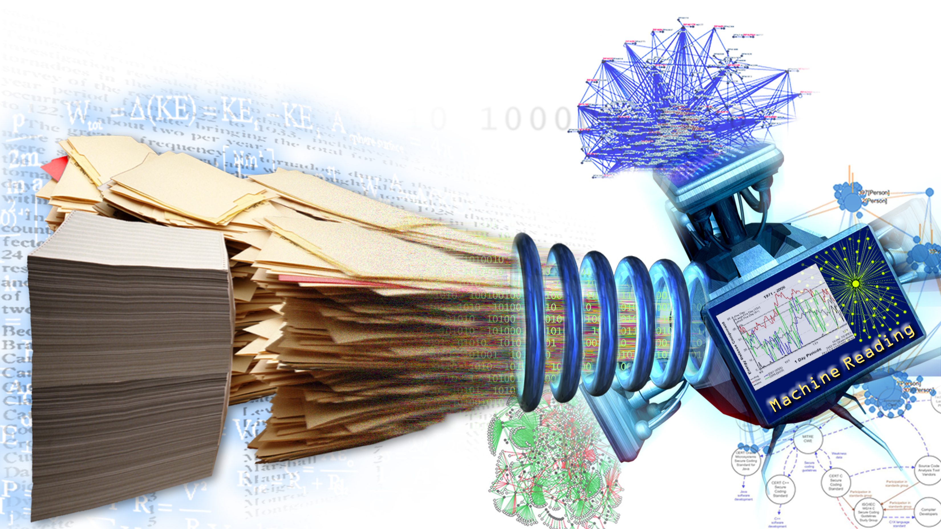
Research method and techniques
Engineering Research
Development of information extraction for non specialists
Application to Tourism domain
Main techniques
Recognition of Entities
(Open) Information Extraction
Automatic creation of datasets
Deep Learning (e.g. BERT)
Semantic knowledge bases
Tools for non specialists
to simplify the creation of information extraction
Notes:
Build up an App based in Open IE for Tourism.
Scientists use their varied approaches—controlled experiments or longitudinal observational studies—to generate knowledge.
The final result might be a research paper or a book, and the knowledge therein can be used to help us understand and make predictions about the natural world.
Engineers use scientific knowledge to create a technology.
What does this mean in a real-world context? Use this example: a virologist is a scientist who researches how viruses are spread and how they affect the human body. A biomedical engineer can use the virologist's research to create an anti-viral drug that blocks a certain virus from spreading to new cells in the body.
In this way, both engineers and scientists are extremely important, and both fields benefit from the ingenuity and hard work of its counterpart. In some cases, scientists rely on the innovations that engineers design to further their research (e.g. microscopes or monitors), for example. To help students envision the wide range of STEM careers and opportunities available to them, it’s important to reinforce distinctions between the fields and deepen their understanding and appreciation.The four aforementioned questions can help as you address the E in STEM

Slide 4
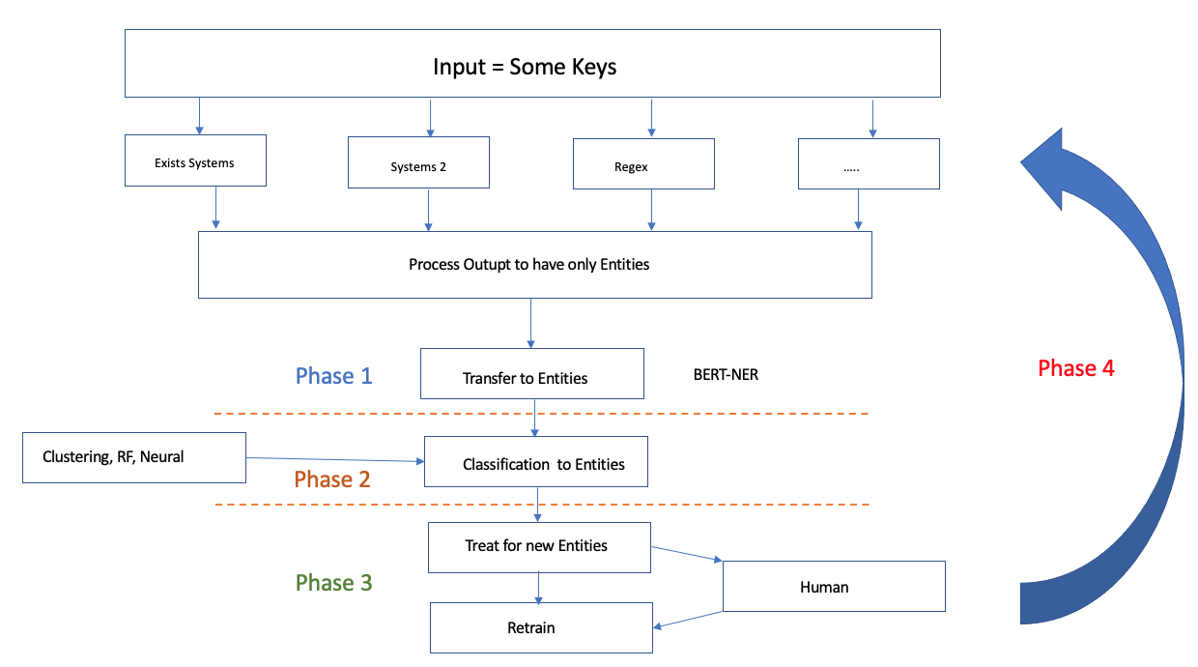

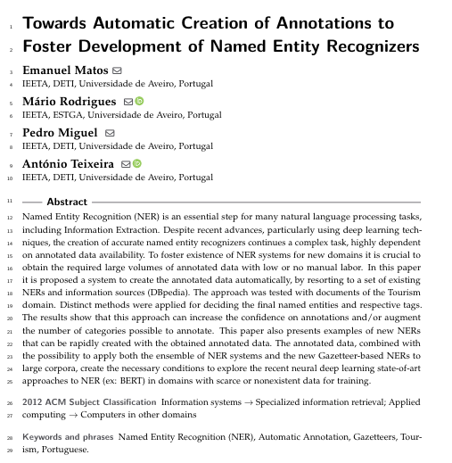
Did / To do
CAIT / Baseline – App for Tourism

Slide 5
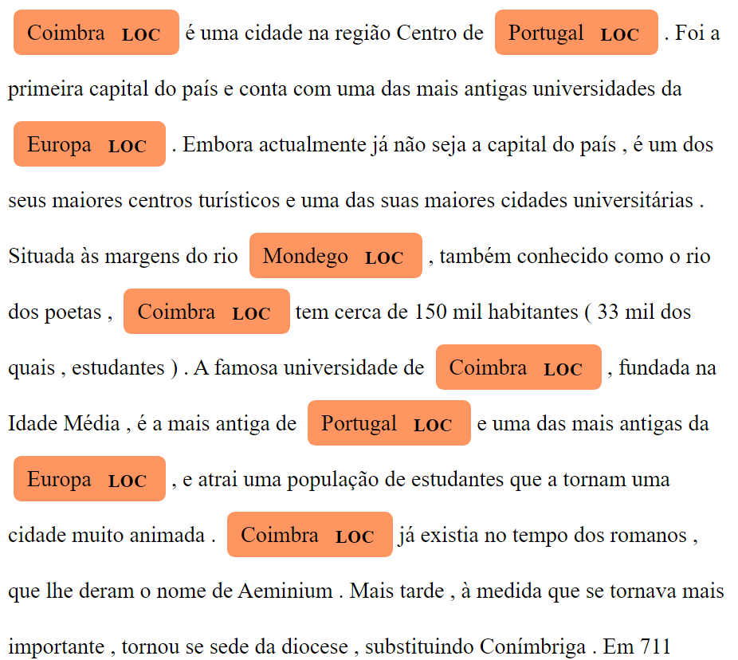
Next steps
Named Entity Recognition (AKA)
Improve the NERs integrating ex.: BERT-NER.
Increase dataset.
Improve the process of NERs output combination
Test the system in new domains.
Integrate the newly obtained NERs in an Information Extraction pipeline
Tools for non specialists

