Slide 1

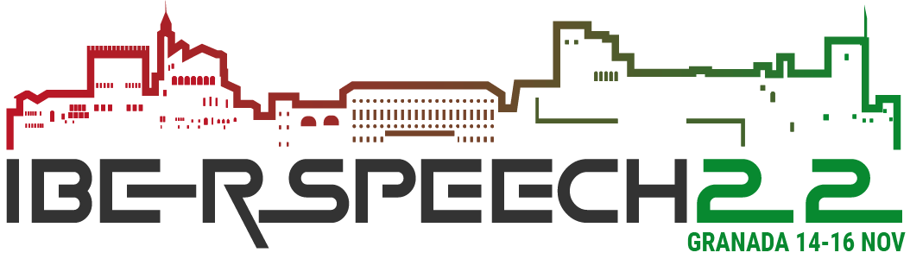
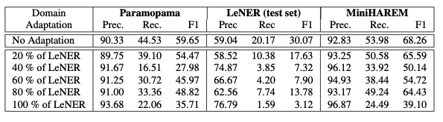
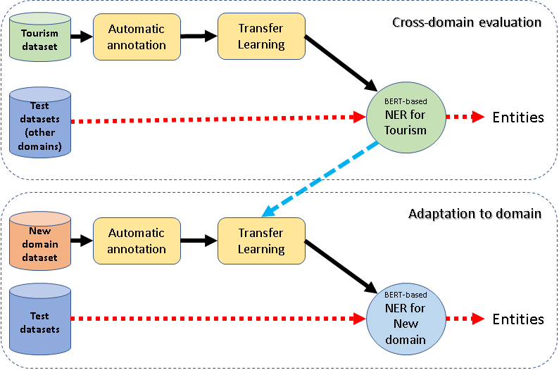
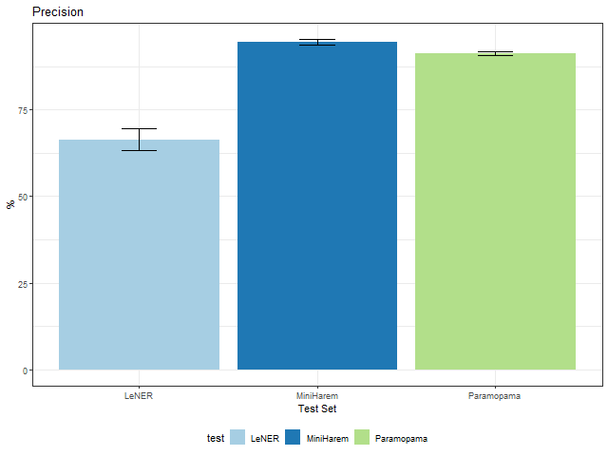
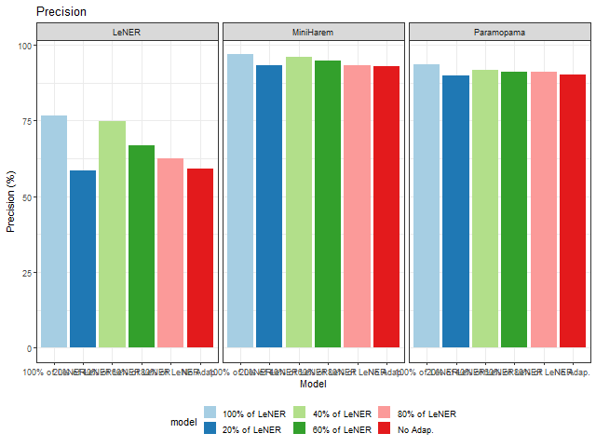
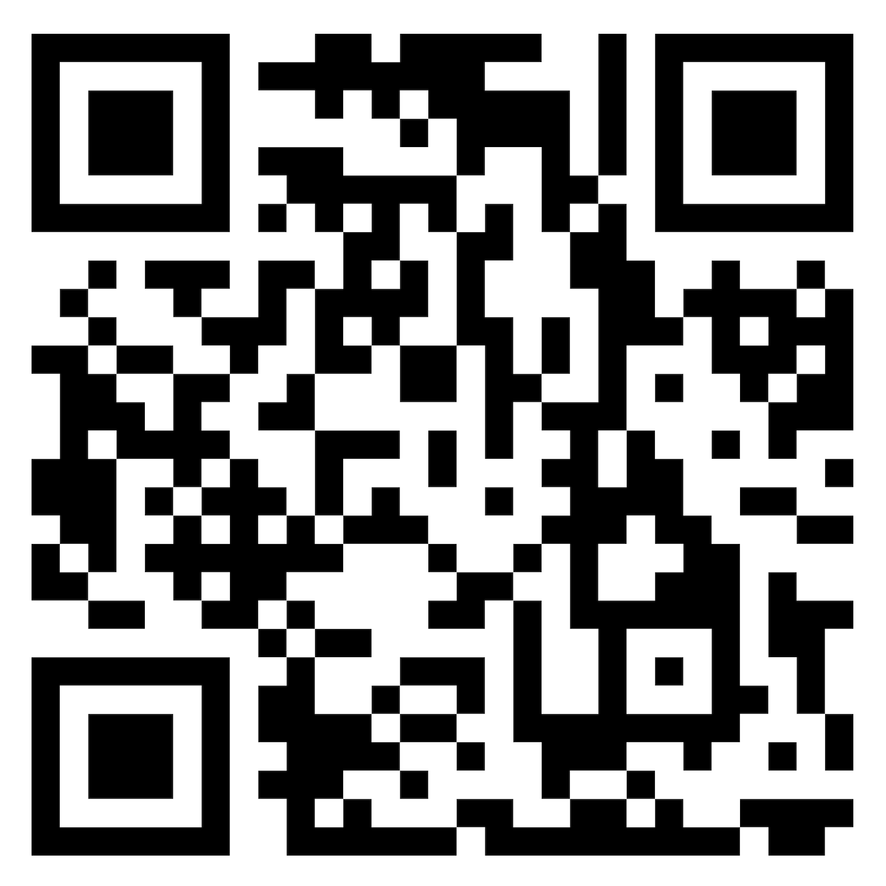
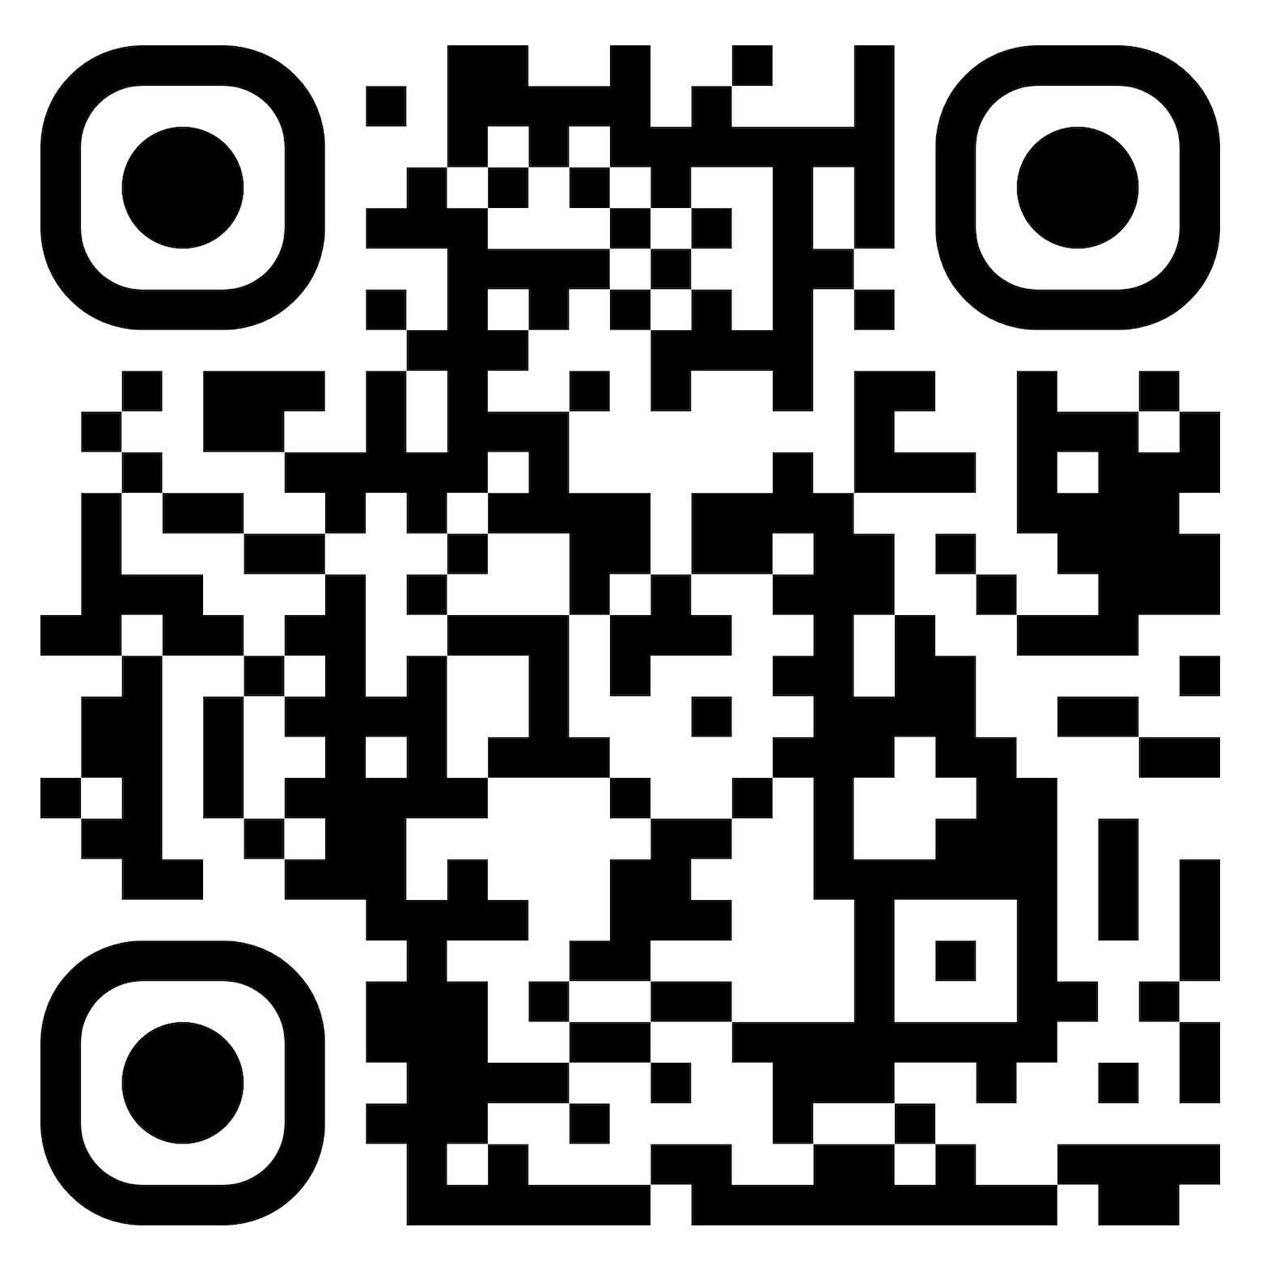



Assessing Transfer Learning and automatically annotated data in the development of Named Entity Recognizers for new domains.
Emanuel Matos^{1,3}, Mário Rodrigues^{2,3}, António Teixeira^{1,3}
¹IEETA, DETI, University of Aveiro, Aveiro, Portugal
²IEETA, ESTGA, University of Aveiro, Aveiro, Portugal
³LASI - Intelligent Systems Associate Laboratory, Portugal
{easm,mjfr,ajst}@ua.pt
Introduction
Related Work
The identification of entities is a key step in many natural language processing (NLP) tasks and consequently named entity recognition (NER) is a task important in several contexts, text genres, and languages.
State-of-the-art solutions are based on deep learning models, requiring annotated data for training.
Problems:
The creation of those datasets is time-consuming, costly, and prone to human error.
The lack of labeled data prevents NER being effectively used in some domains and tasks
Objective: Avoid the traditional manual labeling procedure to develop NER for new domains
NER, as many tasks in NLP, has been approached in two very different ways: systems based in rules and lists (the so-called Gazetteers) and data-driven systems base in machine learning. Machine Learning approaches to NER can be more flexible but they depend on the existence of adequate datasets for the target domain.
Several machine learning methods have been applied to NER:
For example, Support Vector Machines (SVM), Conditional Random Field (CRF) or Neural networks (NN).
State-of-the-art NER systems for Portuguese are BERT-based.
Recently, the authors developed NER systems for PT based on BERT using automatically annotated data.
Adopting Transfer Learning, finetuning pretrained BERT models with an automatically annotated dataset for the Tourism domain, based in Wikivoyage texts. Best F1 obtained was 64.9 %
Proposal
Results
Process consisting of two parts:
Cross-domain application of a BERT-based NER model previously trained with automatically annotated data (top part of the Figure);
Fine-tuning of this base model to a new domain resorting to automatically annotated data for that domain.
For this initial exploration of cross-domain BERT-base NERs, the previously explored domain of Tourism was selected and complemented with the Legal domain.
The next Table presents the results for the selected metrics as function of the NER model and test-set. For easier understanding,
part of the information in the Table is presented graphically in Figures.
Table and plots show that:
The results obtained for LeNER legal dataset are worst than the ones obtained for the two other test sets
being particularly worst in terms of Recall
The results for Paramopama are similar to the MiniHAREM results, confirming in this new dataset the results reported in figures
Despite showing some reduced contribute to improve Precision, the additional training (fine-tuning) of the model with LeNER train dataset resulted in degradation of Recall, for all 3 test sets.
The best Recall is obtained without additional training for the 3 datasets, being the best overall score obtained with MiniHAREM.
Datasets
Wikivoyage Tourism dataset
Resulting from automatic annotation of texts from Wikivoyage.
LeNER Legal texts dataset
60 texts from LeNER dataset of legal documents in Brazilian Portuguese.
Paramopama datasets
Extension of the PtBR version of WikiNER corpus,
Has a total of 240,755 words tagged as part of an entity, considering 4 types (PERSON, LOCATION, ORGANIZATION and TIME).
HAREM datasets
Two HAREM datasets were used, the First HAREM and the MiniHAREM, both having manually annotated entities.
Conclusions
Addressing the problem of development of NERs for new domains without annotated datasets, the potential of cross-domain application of BERT-based NER models with and without tuning with in-domain additional training was investigated.
As expected, models had a much higher difficulty in recognizing entities of classes not present in the training dataset(s).
Nevertheless, the Recall of approx. 10% for both LEGISLATION and JURISPRUDENCE in LeNER without any in-domain training is an interesting result, with potential to be explored in bootstrap methods.
Additional training with a small amount of in-domain data (automatically annotated) was not very useful.
Despite some improvement in Precision (e.g., for PERSON in LeNER), it contributed to degradation of Recall.
References (previous work)
E. Matos, M. Rodrigues, P. Miguel, and A. Teixeira, “Towards Automatic Creation of Annotations to Foster Development of Named Entity Recognizers,” in SLATE 2021.
Available: https://drops.dagstuhl.de/opus/volltexte/2021/14428
E. Matos, M. Rodrigues, and A. Teixeira. "Named Entity Extractors for New Domains by Transfer Learning with Automatically Annotated Data." International Conference on Computational Processing of the Portuguese Language (PROPOR). Springer, Cham, 2022.
ACKNOWLEDGEMENTS
This research was supported by IEETA Research Unit, funded by National Funds through the FCT - Foundation for Science and Technology, in the context of the project UIDB/00127/2020.

