Slide 1





3th year
Extraction and Access to Information in Natural Language for Non-Developers - Democratizing Information
Emanuel Matos
António Teixeira, Mário Rodrigues, Liliana Ferreira
Year of 1st registration: 2019 (Number of full-time equivalent years: 3)
PhD program: MAP-i

Slide 2
Research Challenge
Citizens, institutions, companies need
To keep updated and attentive to changes
To have simple and structured access to information
To have access to an increasing diversity of sources
Particularly relevant is information in Natural Language (texts, speech, videos, …)
A big challenge is to fulfil these needs with cost-effective solutions…
… and for required domains
Democratization of usage of such solution by non specialists

Slide 3
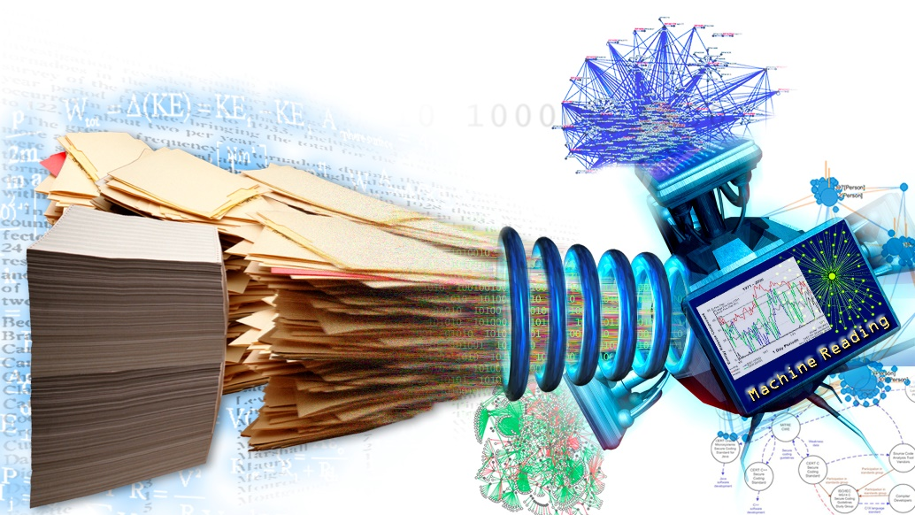
Research method and techniques
Engineering Research
Development of information extraction for non specialists
Application to Tourism domain
Main techniques
Recognition of Entities
(Open) Information Extraction
Automatic creation of datasets
Deep Learning (e.g. BERT/GPT_J)
Semantic knowledge bases
Tools for non specialists
to simplify the creation of information extraction

Slide 4
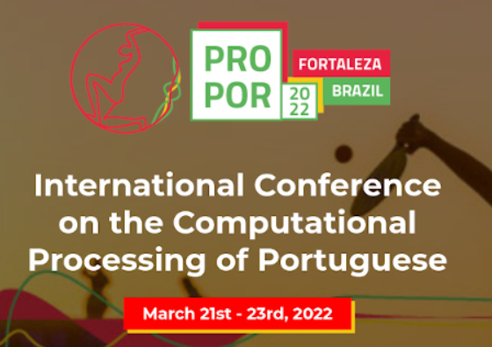
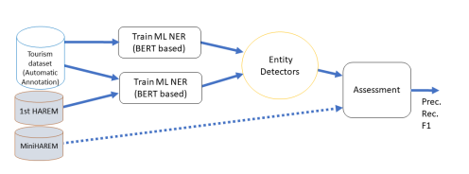
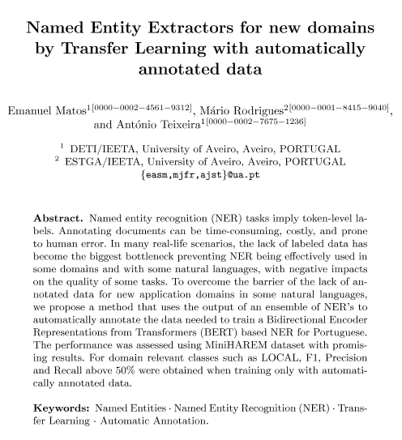
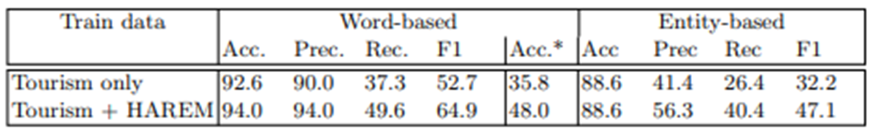
Did / Doing
Extension of the Tourism dataset, by processing additional texts by the automatic annotation process (ensemble of NER) (Paramopama/ Wikiner/ LeNer).
Improve the NERs integrating ex.: BERT-NER.
Improve the process of NERs output combination.
Test the system in new domains.
Apply and evaluate the process proposed to new domains.

Slide 5
Next steps
Manual revision of part of the results obtained for a subset of Tourism texts to allow computing performance metrics for domain data.
2
Add the NEC post-processing step to classify the entity detected, using, for example, queries to DBPEdia and Wikipedia.
3
Exploration of recent evolutions in BERT-based NER and similar models (e.g., GPT-3 or FLAN)
1
Addition of NER for classes such as TIME to the automatic annotation process.
https://sustainabledevelopment.un.org/?menu=1300

