Slide 1


Extraction and Access to Information in Natural Language for Non-Developers - Democratizing Information
Emanuel Matos
Progress 2021/2022 – partial Time

Slide 2
Overview
Introduction
Developments
Dataset
Results
Future Work
Worplan Update

Slide 3
INTRODUCTION
Automatic extraction of information from natural language sources has many applications, including Business Intelligence , Forensics, Medicine and question answering systems . Seeking to work new concepts and diversity, both in terms of the environment, various datasets, such as the technical issue and experiments, the year of 2021 was very interesting. Even with the limitation of working part-time and being in Brazil, we were able to immerse ourselves in a world of new algorithms and evaluate diversity possibilities, as well as have technical production that allowed us to publish and present at an international conference. Not only that, the results obtained during this process of experiments led us to develop a pipeline that will be the basis for continuing the development of the work.

Slide 4
Developments
Test the methods proposed and explored in 2020/2021 in new domains.
Seek and find new Data-set and environment.
Improve the process of NERs output combination.
Publication of results.
Testing and training several different algorithms sounds like GPT3, GPT2, GPT-J and GPT-Neo.

Slide 5
State-of-the-art update
Throughout the year, an active search for state-of-art developments was performed. A selection of promising approaches was further tested and evaluated. The most relevant are briefly mentioned next.
BERT
They are based in BERT implementation by Tobias Sterbak using the Transformers package by Huggingface, Keras and TensorFlow.
GPT Family
Was evaluated the possibility of using GPT3, GPT2, GPT-J and GPT-Neo. As the volume of parameters and GPU’s required for each of the algorithms to work, in addition to the machine that currently processes/processed BERT, we seek alternatives without cost, because one of the basic issues of this work is to be democratic, and with cost this means restriction. We still use Google’s Collaboration in its lighter paid version to try to process and work with some new algorithm. The GPT-Neo was the one that came closest to the possibility of working, because in its lightest version of processing i.e. with 125mega was the one that under test it was possible to use with a ready example.

Slide 6
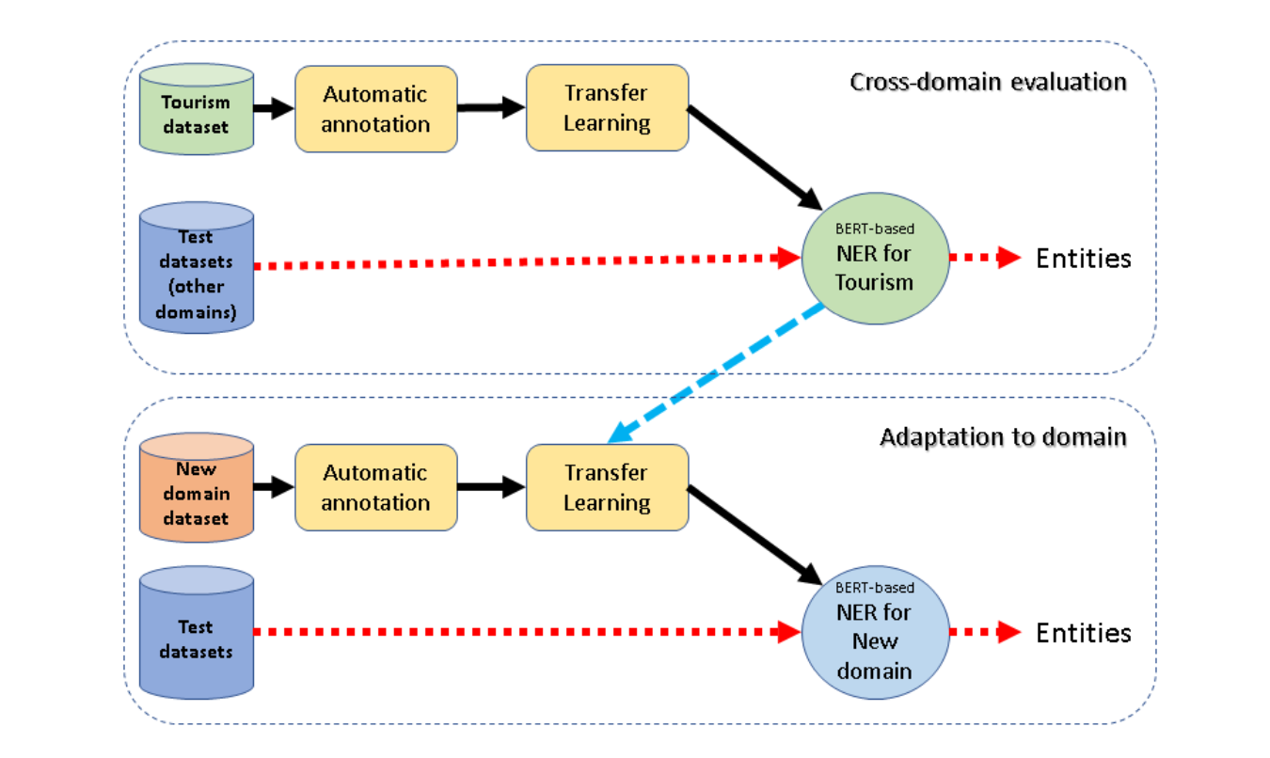
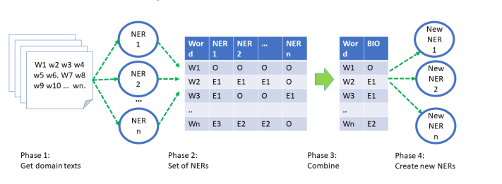
Ensamble NERs
Named Entity Recognition (NER) is an essential step for many natural language processing tasks, including Information Extraction. Despite recent advances, particularly using deep learning techniques, the creation of accurate named entity recognizers continues a complex task, highly dependent on annotated data availability. To foster existence of NER systems for new domains it is crucial to obtain the required large volumes of annotated data with low or no manual labor.
The below present our update and new strategy to apply for development the pipeline.
Notes:
Build up an App based in Open IE for Tourism.

Slide 7
Dataset(s)
Tourism Domain
For our initial proof-of-concept the area of Tourism was selected. A set of sources were selected manually, and the text scrapped using the Scrapy library for retrieving documents and BeautifulSoup library for getting document data. The option for Tourism domain resulted from our previous work in this domain . Selected by the high potential of automatic information extraction to provide relevant information to several domain stakeholders (e.g., hotel managers). The main source selected was Wikivoyage, with hundreds of texts regarding countries, regions, cities, tourist attractions, etc. Based on the tool’s ease of use concept, the manual extraction option, without advanced features, was implemented to adjust expectations regarding the development of the work and evaluate the capture properties of possible entities without advanced techniques.
LeNER Legal texts dataset
2021 was an experiment year, we use a LeNER Dataset[18]. LeNER-Br is a Portuguese language dataset for named entity recognition applied to legal documents. LeNER-Br consists entirely of manually annotated legislation and legal cases texts and contains tags for persons, locations, time entities, organizations, legislation and legal cases. To compose the dataset, 60 legal documents from several Brazilian Courts were collected. Courts of superior and state levels were considered, such as Supremo Tribunal Federal, Superior Tribunal de Justiça de Minas Gerais and Tribunal de Contas da União. In addition, four legislation documents were collected, such as ”Lei Maria da Penha”, giving a total of 70 documents.
Paramopama
Extends the PtBR version of WikiNER corpus, revising incorrect assigned tags in order to improve corpus quality, also extend the corpus size and provide proper evaluation[19]. This dataset has a total of 240,755 words tagged as part of an entity, considering 4 types (PERSON, LOCATION, ORGANIZATION and TIME).
Notes:
Build up an App based in Open IE for Tourism.

Slide 8
BERT-based NER trained with automatically annotated data
Aiming to mitigate the problems highlighted above, the following main objectives were adopted for the work presented:
1. Develop processes to simplify the creation of NER systems for new domains, starting by the creation of the needed annotated data;
2. Make NER deployment as easy as possible in order to used by non specialists, contributing to breaking existing usage barriers thus fostering wider adoption of such systems.
Notes:
Build up an App based in Open IE for Tourism.

Slide 9

Results
The results obtained in 2021/2022:
Published / Presentations
“Named Entity Extractors for New Domains by Transfer Learning with Automatically Annotated Data” – Propor 2022, how was mentioned in 2021
Published as full paper in a book of Springer LNCS series and presented by the author.
“Assessing Transfer Learning and automatically annotated data in the development of Named Entity Recognizers for new domains “ – IberSpeech 2022 – accept (30/09/2022)
Software
Despite the option made for not developing at this stage the “Tools for non- programmers” 1, several scripts were developed and existing ones improved to contemplate the specifics of new domains.
Notes:
Build up an App based in Open IE for Tourism.

Slide 10
Future work
Based on what happened in 2021/2022, working part-time, we believe it is possible to deliver everything we planned for this year, as the experience together with the support of supervisors created a balance that makes sense to maintain for the next period.
Improve the NERs integrating the Ensemble: This task has been maintained since the previous year, as this point should be prioritized this year. Particularly improving the performance of DBpedia-based NER, both in augmenting its speed (ex: with a local Virtuoso server) and improving the decision of Tags to keep from the DBpedia query results. Also the exploration of translation to increase the number of entities annotated has been started.
Addition of NERs to the Ensemble: This task was kept but with a different focus, we have the idea of treating post-general training as UNICLASS. Add other NERs to the ensemble: For example, specialized NERs for specific classes (ex: time) or using other sources of information (ex: YAGO and Wikipedia) and ontologies.
Use tagged data to train NERs: Continue and extend the work on training ML systems, starting with a NER based on BERT ENTITY/NO-ENTITY tagging.
Improve the process of NERs output combination. Implement more robust word/phrase alignment for NER assessment.
Integrate the newly obtained NERs in an Information Extraction base line. At this point, we will develop a block that allows us, after complete post-processing, to use the results to extract some information from the text evaluated by the NERs.
Notes:
Build up an App based in Open IE for Tourism.

Slide 11
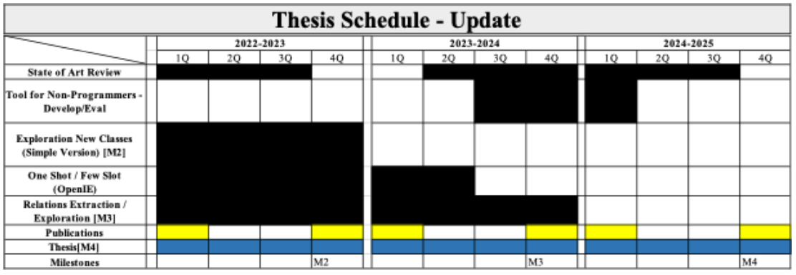
Workplan Update
Each Milestone refers to a delivery and then will be necessary an update too , next the product or report as follows:
M1 - delivery of the “NER without data registration”, planned to the end of the 1st complete year of Thesis work. Was achieved a bit later, in the final months of 2021.
M2 - New conceptions of NER classifications planned for 4th quarter of 2022/2023.
M3 - Exploration of other relationships and Information within the domain in the 4th Quarter of 23/24.
M4 - must be the delivery of the document with the details of how the App was developed, the technology shipped and the results obtained the delivery planned for September 2025 .

