Slide 1
Emanuil Tolev, Cottage Labs
Opening up science, knowledge and getting paid to develop FLOSS

Slide 2
Exciting stuff!
Open Knowledge
Science
FOOD!
Medicine
Government
----------------------
Civilisation
Partnership of developers
Interested in education
Everything open
Build FLOSS together
----------------------
Need to eat though. How?

Slide 3
Current Science workflow
YOU Pay tax
University library pays 6-7 digit figures to get previous science
Scientist uses past science, gets money to do more
Scientists writes up results in paper, sends to other scientists to review
Publisher does NOT pay reviewers
Publisher doesn't give YOU access to science, demands more $ from libraries

Slide 4

Current Science workflow – visualised
Grants, wages
You
Scientists
Your
government
University
Science
Tax
€, £, $ …
Lots of your tax money :)
Publishers
Science … you can't have it!

Slide 5
Results from current Science
You paid for it, twice.
You can't get it.
Individual article prices can be astronomical (you need to read many to get useful ideas) – avg. €15-30
Publishers have an established monopoly
People stuck in closed mindset or don't care
Fear, Uncertainty, Doubt
Some “adopt” open ways but actually twist them
Sound familiar?

Slide 6
Open Knowledge & Open Data
This is not good. Developing countries, individuals, business – can't afford the Paywall, no science for you!
Open Knowledge Foundation
(main principles of what's “open”)
Free and open access to the material
Freedom to redistribute the material
Freedom to reuse the material
No restriction of the above based on who someone is (e.g. their nationality) or their field of endeavour (e.g. commercial or non-commercial)

Slide 7
Open Knowledge, not just Science
Open Government & Economics
PublicWhip, WhereDoesMyMoneyGo, OpenSpending
Official UK Open Government Data: Data.gov.uk
& the data sharing piece of FLOSS, CKAN
You can have anything:
Open Nutrition data,
Open Medicine
Open Lobbying data (hot topic in EU atm)

Slide 8
Why care about Open Knowledge?
We build FLOSS, right?
Why?
Open Knowledge can be the heart of a lot more FLOSS. Visualising data & communicating can really help improve life, push for progress, and FLOSS is the way to go.

Slide 9
Open data breeds more FLOSS!
Open Knowledge
Free, Libre and Open-Source Software

Slide 10
So how does this help us devs?
Enlarging the Open movement good - more opportunity:
apply programming skills
and Open development practices
get paid (when enough people want Open)
So, what can you do in this area?

Slide 11
Things devs do Open for a living
Visualising data (interactive maps, Javascript visualisations)
Creating new Open tools (OKFN employs 10+ devs)
Creating new Open services to expose Open data (web services, API-s) (devs were needed to code each of these!)
Quite a lot of integration work – ReSTful services nowadays but also often interact with older systems or slightly unconventional databases like Research Data Repositories
Reports – report on potential FLOSS uses to organisations which hire you (examples of reports we've done)
Consulting work - purely because of Open-source software dev. Experience and because of work in the relevant field.

Slide 12
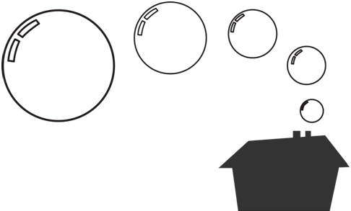
Actually, you can do this
Cottage Labs LLP (Limited Liability Partnership)
Close-knit group of freelancers
Look for work together, bid together.
Share profits.
We can take on more projects even if an individual runs out of time – other people could start developing the opportunity.
Based on Community of Practice and Learning Community concepts (we do, learn, think together)

Slide 13
But who would want to hire us?
Partners have (shared!) decades of experience in the Higher Education software development sector
UK Gov't hires us quite often to help out with Research infrastructure for that experience & because we're not shy about open-sourcing all our work
We don't sell products, we trade our skills & release the results of the work openly.
Universities hire us, companies have started hiring us (we do high-speed quality catalogue-style systems, visualisations, web services & other things quite well)
Been at it for 2+ years!

Slide 14
Tech we use
Elasticsearch, an advanced search server
  eats JSON, spews out JSON
  very, very fast search and faceting (faceting example)
Python (+ the Flask web framework, often)
D3 Javascript data visualisation library
Facetview (pure Javascript front-end to Elasticsearch and Apache Solr – basically build a fully-fledged, paginated catalogue in minutes just by writing 1x HTML page)
DSpace – repository software. Think of as a special database geared for storing and describing individual files (resources).

Slide 15
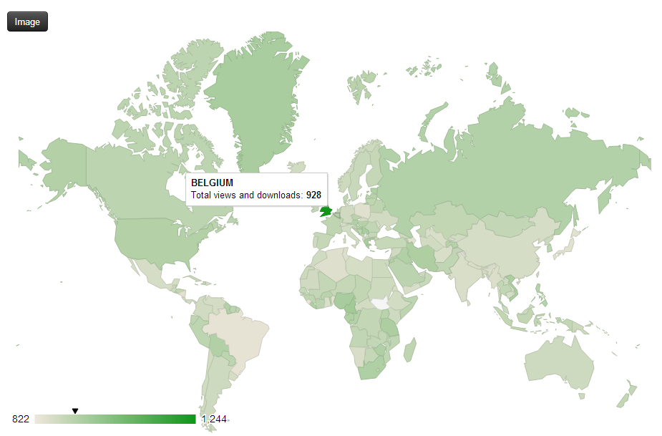
Visualisation example (1)

Slide 16
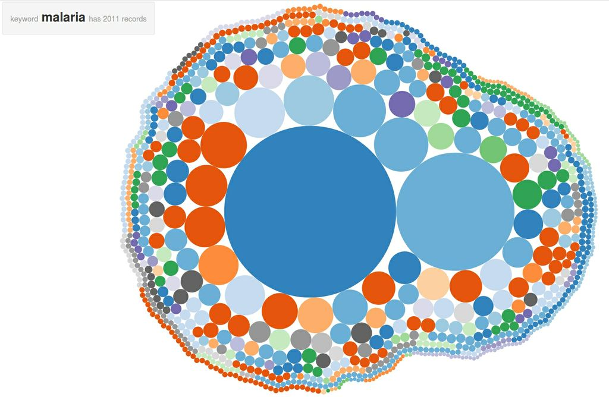
Visualisation example (2)

Slide 17
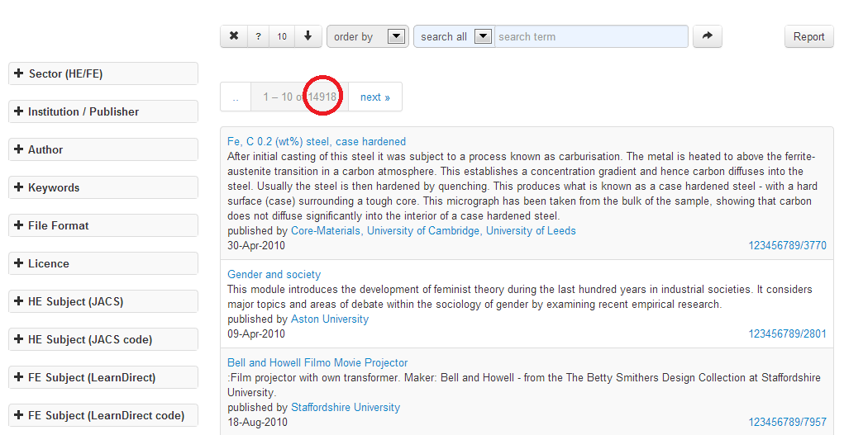
Faceted search example (part 1)

Slide 18
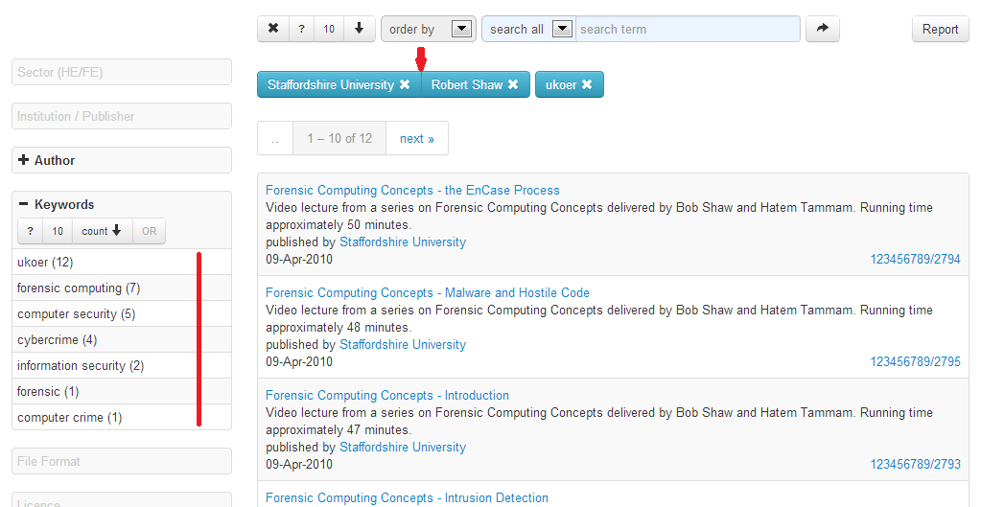
Faceted search example (part 2)

Slide 19
We're all good
Think about what you can do.
We're developers. We have lots of experience developing software and also domain knowledge.
You can do this in your professional area, in your country, with your friends.

Slide 20
Collaborating
If you're interested by what you just heard about our partnership
Want to start a similar thing
Want to work with us on something
Talk to me after this presentation! Or come here.

Slide 21
A bit of inspiration
Mobile + web applications which people made to help their city/country/the EU and demonstrate the potential of Open Data:
http://publicdata.eu/app
http://opendatachallenge.org/#winners
Real-time underground train traffic map
Bike share map
Carbon Dioxide emissions map
Connections between commercial companies
Business influencing politics – state deals
(Useful) list of all public financial transactions EVERYWHERE
Air cleanliness & particles map

Slide 22
Disruption
Free Software – disruptive.
However, Disruptive -> Innovative!
But also:
Useful
Nice
Respects users
Respects their Freedom

Slide 23
Disruption (2)
Science is very important. Public data is very important.
Both have some problems, but Free Software and Openness can help!
Disrupting these “knowledge” sectors with Open approaches will help spread the Openness philosophy.

Slide 24
Questions?
Thanks for listening!
Good luck!

Slide 25
FAQ 1
How do you licence your stuff?
(exactly..?)
Any Open Licence the client agrees to.
We personally like Copyheart :). Love isn't subject to law and we love our work. We've done MIT too.
GPL: we could use it, but we don't push it, don't mind commercial companies using our software. Just means it's actually useful... Also, our sector is quite small software-wise.

