Slide 1
Virtual Pantry
Emmanuel Velazquez & Oscar Benitez

Slide 2
System Description
We created an interactive web-based application that manages a virtual pantry designed around three main roles:
Customers
Browse food items using filters and search bars
Create a new account
Place orders online
Employees
Fulfill customer orders
Update stock quantities after order completion
Manage inventory
Admin
Oversee employees
Manage stock and orders
Maintain the overall system

Slide 3
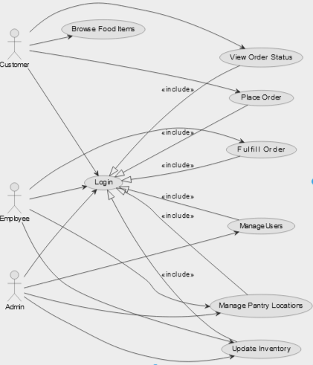
Use Case Diagram

Slide 4
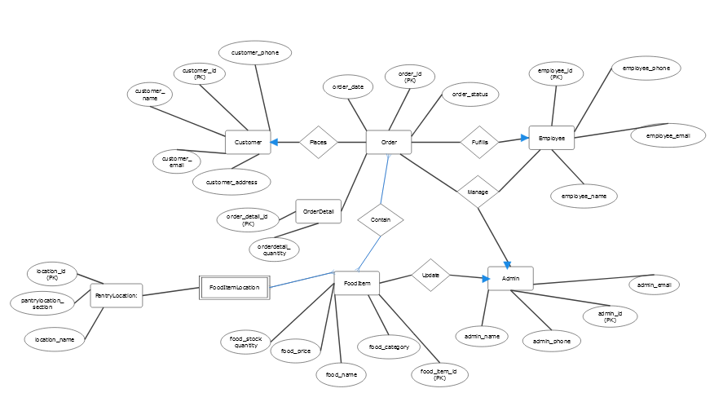
E/R Diagram

Slide 5
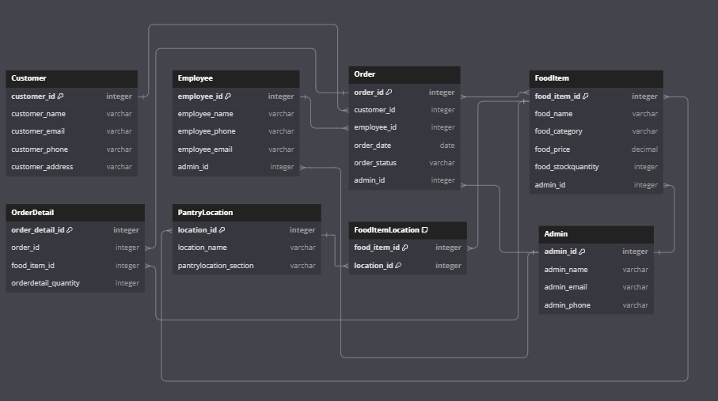
Relational Schema

Slide 6
Implementation Details
Implementation
Sample Data Generation
Generated sample data online to populate the database.
Backend and Database Design
Used SQLite for database management.
Database stored in db.sqlite3.
Frontend Development
Built using Flask and SQLAlchemy.
Integrated JavaScript, CSS, and HTML for the user interface..
Application Components
app.py
Manages user interaction and routes for the application
Templates folder
Contains HTML files for UI design and text formatting.
Static folder
Stores images, CSS, and other assets for the frontend.
Database Management
db.sqlite3 stores all pantry data and is used to populate the database dynamically.

Slide 7
Demo
GitHub Repo

