Slide 1
S
Swoop
Data-Driven Insights & Optimization
for a Multi-Restaurant Food Delivery Platform
PostgreSQL · Power BI | Amdari Data Analytics Project
Esmeralda Pinamang Osei

Slide 2
S
COMPANY OVERVIEW
About Swoop
Swoop is a multi-restaurant food delivery platform founded in 2020 to solve a problem no major delivery app had: letting customers order from several restaurants in a single transaction.
Built around a fleet of electric scooters and a “bulk meal stocking” pre-order feature, Swoop expanded into San Francisco, Los Angeles and New York, partnering with over 1,000 restaurants.
Despite rapid growth, leadership lacked real-time visibility into revenue, high-value customers and delivery costs — the gap this project closes.
2020
3
Founded
Cities (SF · LA · NY)
1,000+
$2.53M
Restaurant partners
Revenue, 2025

Slide 3
S
PROJECT SCOPE
Objectives Covered
1
Revenue Tracking
2
Customer Segmentation
Track revenue by order, meal category and time and measure profit.
Find the top 10%, build RFM segments and measure retention.
3
Operational Costs
4
Real-Time Reporting
Analyse delivery cost per order and bulk-vs-standard unit economics.
Consolidate every KPI into one interactive Power BI dashboard.
Tools: PostgreSQL for analysis · Power BI for the dashboard

Slide 4
S
METHODOLOGY
Behind the Dashboard: SQL Analysis
Every metric on the dashboard was produced with SQL in PostgreSQL , one query per business question.
-- Revenue & profit by meal category
SELECT m.category,
SUM(oi.subtotal) AS revenue,
SUM(oi.quantity * m.cost_to_make) AS cost,
SUM(oi.subtotal -
oi.quantity*m.cost_to_make) AS profit
FROM orders o
JOIN order_items oi ON o.order_id = oi.order_id
JOIN meals m ON oi.meal_id = m.meal_id
WHERE o.order_status = 'delivered'
GROUP BY m.category
ORDER BY revenue DESC;
ANALYSES RUN
Total revenue & gross profit
Revenue by meal category & time of day
Active users : 3-month trend
Top 10% high-value customers
Retention rate (quarter-over-quarter)
RFM customer segmentation
PostgreSQL → SQL views → Power BI

Slide 5
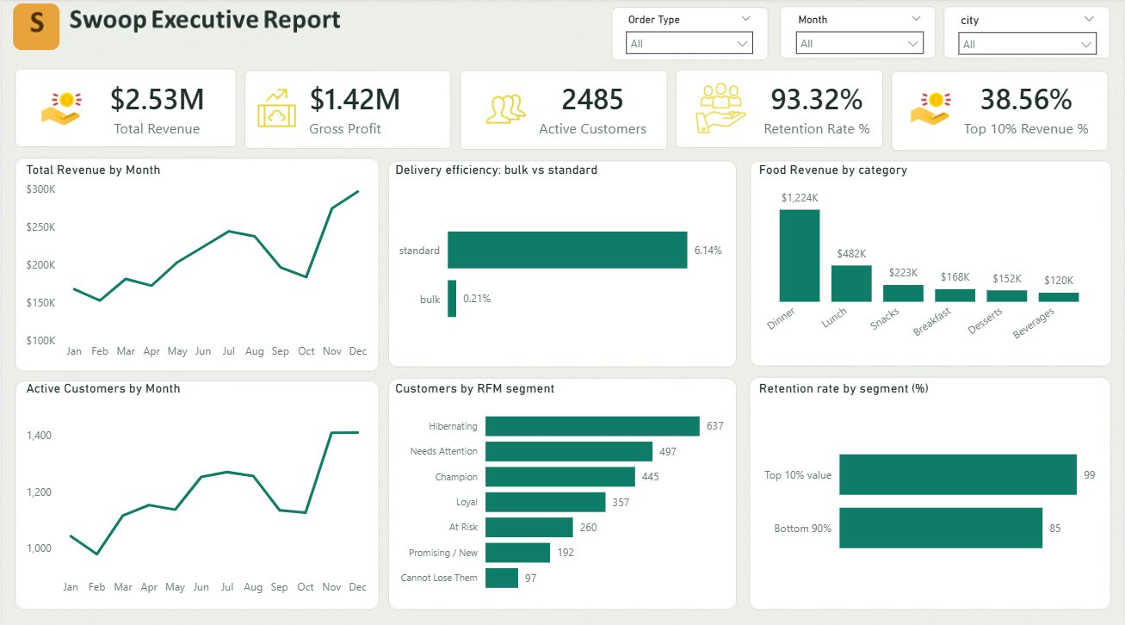
The Executive Dashboard
One interactive page : revenue, customers and operations across three cities

Slide 6
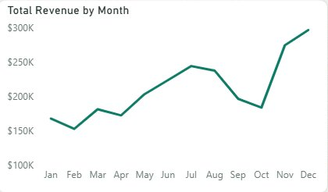
$2.53M
S
CHART 1 OF 6
Total Revenue by Month
Revenue growth accelerated significantly in Q4
INSIGHT
❖ Revenue increased consistently throughout the year.
❖ November and December generated the highest revenue, making Q4 the strongest-performing period.
❖ The Q4 surge indicates strong seasonal demand and higher customer purchasing activity.
RECOMMENDATION
❖ Increase inventory and operational capacity ahead of the Q4 peak period.
❖ Launch targeted marketing campaigns before year-end to maximize revenue opportunities.
❖ Analyze drivers behind November’s revenue surge and replicate successful strategies across other months.

Slide 7
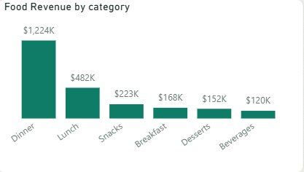
$1.22M
S
CHART 2 OF 6
Food Revenue by Category
Dinner drives nearly 50% of category revenue
INSIGHT
❖ Dinner generated the highest revenue at $1.22M, significantly outperforming all other categories.
❖ Lunch ranked second at $482K, while all remaining categories contributed significantly lower revenue.
❖ Revenue concentration in Dinner suggests stronger customer demand during evening meal periods.
RECOMMENDATION
❖ Expand high-performing Dinner menu options to maximize revenue opportunities.
❖ Expand partnerships with restaurants serving high-demand Dinner products to sustain revenue growth.
❖ Introduce bundled offers and promotions to improve sales in lower-performing categories.

Slide 8
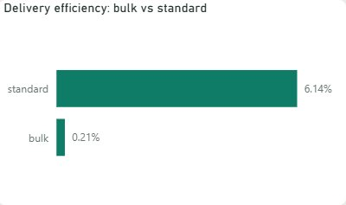
0.2% vs 6.1%
S
CHART 3 OF 6
Delivery Efficiency: Bulk vs Standard
Bulk orders are significantly more cost-efficient
INSIGHT
❖ Bulk orders incur only 0.2% delivery cost relative to revenue, compared to 6.1% for standard orders.
❖ Standard orders have significantly higher delivery costs, reducing operational efficiency.
❖ Bulk orders generate stronger economies of scale, making them the more cost-efficient order type.
RECOMMENDATION
❖ Prioritize bulk orders as they generate higher revenue at significantly lower delivery cost.
❖ Introduce bulk-order incentives to encourage customers toward larger purchases.
❖ Optimize standard order delivery operations to reduce cost and improve efficiency.

Slide 9
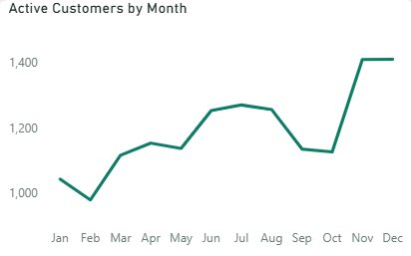
+23%
S
CHART 4 OF 6
Active Customers by Month
Customer activity surged significantly in Q4
INSIGHT
❖ Active customer count increased steadily throughout the year, showing overall platform growth.
❖ Customer activity surged by approximately 23% in November and remained strong through December.
❖ The Q4 increase suggests successful customer acquisition efforts and stronger user engagement during year-end.
RECOMMENDATION
❖ Identify the factors that drove the November customer growth and replicate successful strategies.
❖ Strengthen customer retention initiatives to convert new active users into repeat customers.
❖ Increase marketing and engagement campaigns during high-growth periods to sustain user activity.

Slide 10
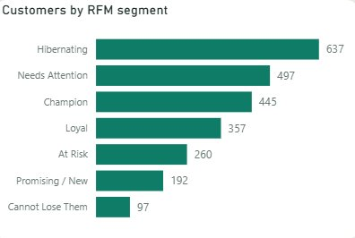
445
S
CHART 5 OF 6
Customers by RFM Segment
Champion customers represent the highest-value customer segment
INSIGHT
❖ Champion customers (445) are the highest-value customers and drive strong revenue contribution.
❖ Hibernating customers (637) form the largest segment, showing a large inactive customer base.
❖ High At Risk and Needs Attention segments indicate potential future customer churn.
RECOMMENDATION
❖ Retain Champion and Loyal customers through loyalty programs and personalized rewards.
❖ Re-engage Hibernating and At Risk customers using targeted campaigns before permanent churn.

Slide 11
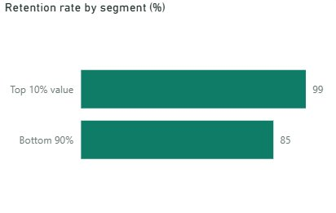
99% vs 85%
S
CHART 6 OF 6
Retention Rate by Segment
Top 10% customers show significantly stronger retention
INSIGHT
❖ Top 10% customers recorded a 99% retention rate, significantly higher than the 85% retention rate of the bottom 90%.
❖ High-value customers show stronger loyalty and are more likely to make repeat purchases over time.
RECOMMENDATION
❖ Prioritize loyalty programs and personalized rewards for top-value customers to maintain retention.
❖ Improve engagement strategies for lower-value customers to increase repeat purchase behavior.

Slide 12
S
Strategic Summary
Swoop’s revenue is led by bulk orders and Dinner, and is concentrated in a small group of high-value Champions who also retain almost perfectly. The strategy writes itself: grow and protect that high-value, bulk-ordering base.
1
Grow bulk ordering
It drives the majority of revenue while costing almost nothing to deliver — 0.2% of order value versus 6% for standard.
2
Protect the Champions
445 customers, 46% of revenue, 99% retention — reward and retain them first.
3
Lean into Dinner & Q4
Focus menu, partners and promotions where the money already is.

