Slide 1
A gated, automated design pipeline
An automated, gated simulation pipeline that sizes a small electric aircraft: what it does, what it caught, and how much engineering time it saves.
Version 2
Status at build time: SU2 pool 32 of 32 designs complete; confirmation of the answer on 30 designs: pass; confirmation of the answer on 32 designs: FAIL.
V1 | 1
Notes:
I built a pipeline that takes design questions to a CFD solver and back without a person in the loop for the routine steps, and that refuses to pass on a result it cannot check. I will show it on one aircraft, end to end.

Slide 2
The engineering problem
High-fidelity simulation is slow, its setup is manual, and its failures are often silent; a design study needs many runs and every one of them has to be trusted.
Slow
Manual
Silent
A design study needs many high-fidelity runs, and each one takes minutes of a cloud machine.
Each case needs a mesh, a configuration and a check written for it.
A solver that stops cleanly can still hand back the wrong numbers.
One SU2 angle costs a median 11.8 min on the coarse mesh; a design needs five angles.
In the pipeline a low-fidelity design costs 0.25 s of one core, and an SU2 case is staged by a typed tool call (11 tools).
The first SU2 case exited with code 0 and its lift and drag were -10.5 % and +24.7 % off (V3).
The loop is propose, simulate, check, decide: the pipeline runs it unattended and checks every result before anyone sees it.
V2 | 2
Notes:
Engineering design is a loop of propose, simulate, check, decide. The simulate step dominates the clock, and the check step is where people quietly lose days. The pipeline attacks both: it runs the loop unattended, and it checks every result before anyone sees it.

Slide 3
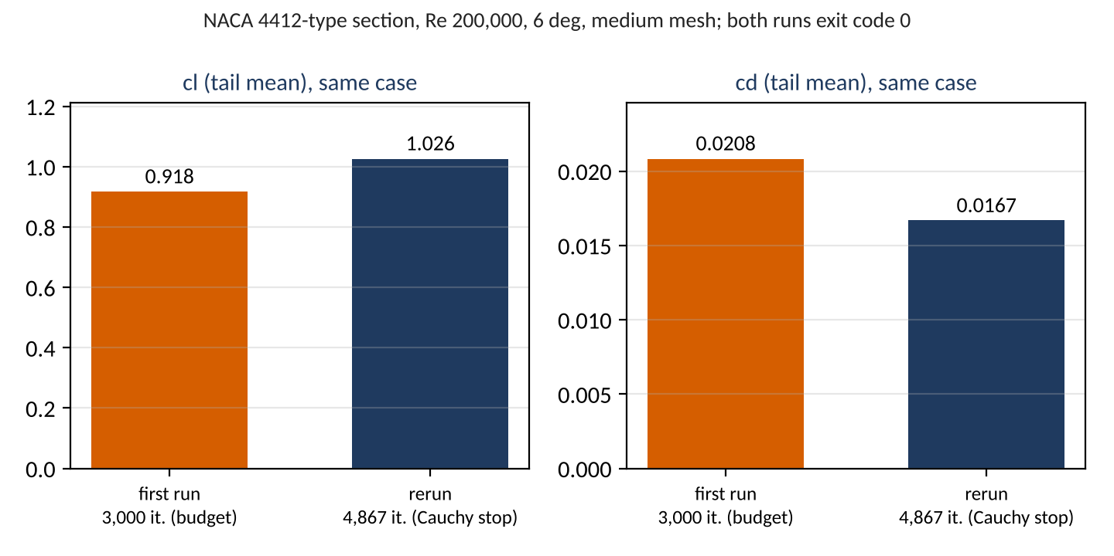
A clean exit is not a correct result
The first SU2 airfoil case exited with code 0 after its whole 3,000-iteration budget, with lift -10.5 % and drag +24.7 % against its own properly stopped rerun; only checks after the solver could see it.
SU2 exits with code 0
after 3,000 iterations, files written
postprocess looks for rms[rho]
and records a postprocess error
drift rule on the history:
cl 5.6 %, cd 17.4 % over the last fifth
ruling: budget 6,000 with a Cauchy stop;
the rerun stops at 4,867
V3 | 3
Notes:
This is the design principle of the whole pipeline. The solver said success. The numbers were wrong by double digits. So the pipeline treats the solver's exit code as a hint and decides convergence itself, from the history.

Slide 4
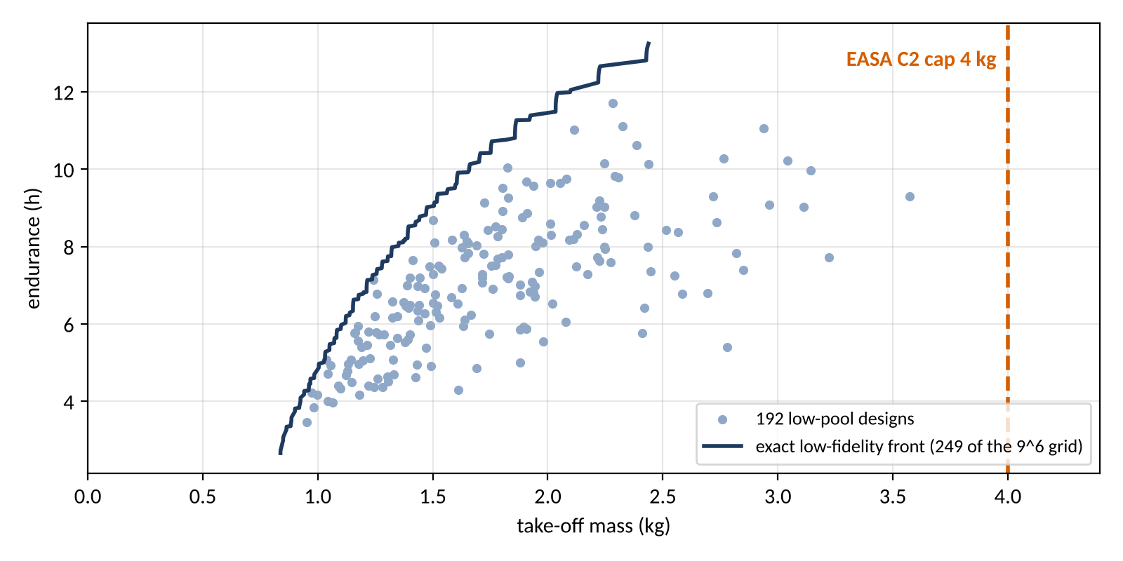
The test problem
Endurance against take-off mass at a fixed 0.5 kg payload, under the 4 kg cap of the EASA open-category class C2, over six design inputs.
Input | Range
span m | 1.2 to 3
aspect ratio | 6 to 16
taper ratio | 0.3 to 1
battery fraction | 0.2 to 0.45
camber pct | 0 to 6
thickness pct | 8 to 15
Payload fixed at 0.5 kg; cap 4 kg at P(mass <= cap) >= 0.9, fixed before any run.
Heaviest low-pool design: 3.57 kg, so only SU2 tests the cap.
V4 | 4
Notes:
The aircraft is deliberately small so that every step can be run end to end. Six inputs span the box; everything else is fixed in a graded ledger, 46 quantities, 21 of them assumptions with a band.

Slide 5
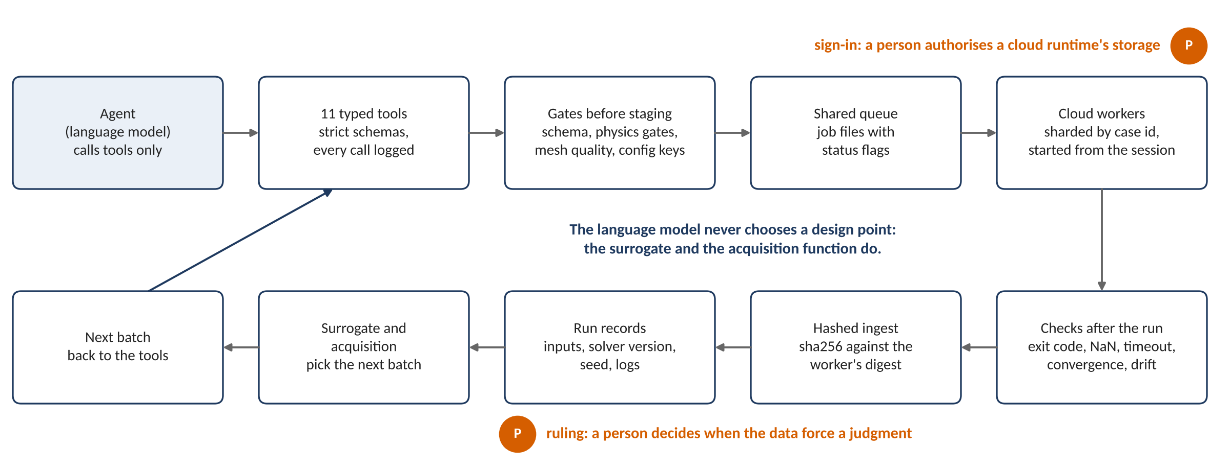
The pipeline at a glance
Requests enter through typed tools and gates, run on cloud workers through a shared queue, and come back through checks into versioned records that the surrogate learns from; the language model never chooses a design point.
V5 | 5
Notes:
Read it left to right. Every arrow has a check on it. The two places a person is needed are marked: a ruling when the data force a judgment, and a sign-in when a cloud runtime has to be authorised. Everything else runs unattended.

Slide 6
The agent's interface: typed tools, not free text
The agent reaches the solver only through 11 typed tools with strict schemas; the tools never run the solver, and every call is logged.
The 11 tools
What the typed interface adds | What does not depend on it
One entry point for the agent, with typed arguments | The physics gates, run again by the worker before SU2 starts
A strict schema per family: unknown fields and wrong types refused | The mesh fingerprint and the configuration hash the worker re-checks
An audit line per call: tool, argument hash, ok, case | The sha256 digest checked at ingest
Nothing is staged when a check fails | The sampling points: design tables and acquisition code, never the language model
validate_config
create_case
submit
status
list_results
queue_batch
export_batch
record_transfer
ingest_result
ingest_error
postprocess
V6 | 6
Notes:
A typed interface is what lets an agent drive engineering software safely: a malformed request is rejected with a message, not executed. The tools stage, submit, ingest and report; the solver runs elsewhere.

Slide 7
Gates before any solver
A design passes 5 gates before any solver runs, and an airfoil case passes a mesh-quality gate; a gated design costs nothing.
Gate | Checks | Note
1. Reynolds range | cruise Reynolds number in [80000, 500000] | where the section data are validated
2. Stall margin | V_cruise >= 1.3 V_stall; cruise CL <= 0.7 CL_max | two checks on one margin
3. Mass closure | structure and propulsion at least 0.15 of take-off mass | closure is a fixed point, at most 100 iterations
4. Manufacturing floor and wing loading | manufacturing floor: tip chord >= 0.08 m, root thickness >= 0.008 m; wing loading in [20, 150] N/m^2 | one gate, two checks
5. Lattice quality | lattice tip panel aspect ratio <= 20 | keeps the lattice panels well shaped
Mesh quality (airfoil cases) | no inverted cells; minimum angle >= 40 deg; first cell within 10% of the request; growth <= 1.25; cell aspect ratio <= 5000 | before a case is staged; the worker re-checks the mesh fingerprint
Low-fidelity grid: 72,009 of 531,441 designs stopped by the gates, each with the offending value in its message.
V7 | 7
Notes:
Gates are cheap pure functions. They turn an expensive failure into an instant refusal with the offending value in the message.

Slide 8
Two fidelity levels
A low-fidelity design costs 0.25 s of one core; one SU2 angle costs a median 11.8 min on the coarse mesh and 22.9 min on the medium mesh, and a design needs five angles.
Level | Section data | Measured cost | Used for
Low (container) | closed-form thin-airfoil lift and flat-plate drag | 0.25 s per design per core: the 531,441-point grid in 4.7 h on 8 workers; the 192-point pool in 669 s | exact front, low pool, replays, the low level of the two-level model
High (cloud, 2 or 4 ranks) | SU2 polar of the design's own section at its cruise Reynolds number | per angle: median 11.8 min coarse (173 cases), 22.9 min medium (30 cases); five angles per design | the SU2 pool: 172 cases
Medians over every SU2 run record at build time, by mesh level. Both levels share geometry, lattice, closure and mission.
V8 | 8
Notes:
The two levels share everything except the section data, so the expensive level corrects the cheap one rather than replacing it. That is what makes the two-level model on V16 possible.

Slide 9
Validation before any machine learning
The solver's own checks pass (12 rows pass, 0 fail); against the wind tunnel SU2's lift slope misses by 5.49 % against a 5 % tolerance, a fail that is kept and travels with every result.
Group | Verdict | Rows | Which
Solver's own checks | pass | 12 | vortex lattice against closed forms (V6a, 4); Warren-12 benchmark wing (V6b, 1); lattice refinement (V6c, 3); mass closure and energy balance (V6d, 4)
 | fail | 0 | none
 | PENDING | 1 | Warren-12 fine Cm_alpha (reference point not yet sourced)
SU2 against the wind tunnel | pass | 2 | cd ratio Re 203800: +7.99 % against 20 %; cd ratio Re 305200: +5.74 % against 20 %
 | FAIL | 2 | cl_alpha Re 203800: +5.49 % against 5 %; cl_alpha Re 305200: +6.44 % against 5 %
Not run | not run | 2 | medium vs fine mesh at Re 203800; Ultra Stick 25e CL_alpha and CD0
Decision 8 (Éder, 2026-11-08 22:35 UTC): "accept the medium mesh as the high level with the bias recorded". The fail stays a fail; every SU2 result carries it as a flag.
V9 | 9
Notes:
Tolerances were fixed before the runs. The miss was not tuned away: every SU2 result carries it as a flag in its own record.

Slide 10
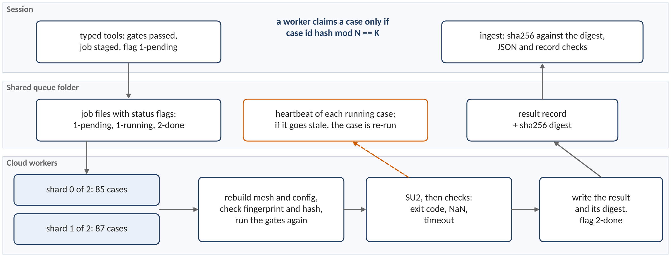
Queue, workers and shards
Workers split the queue by a hash of the case id, so they never race for a case; a worker that dies leaves a heartbeat that goes stale, and its case is re-run.
Every case id lands in exactly one shard: the 172 pool cases split 85 and 87 over two shards. Adding a worker changes N, nothing else.
V10 | 10
Notes:
The queue is a shared folder of job files with status flags. Sharding by hash means adding a worker is a configuration change, not a coordination problem.

Slide 11
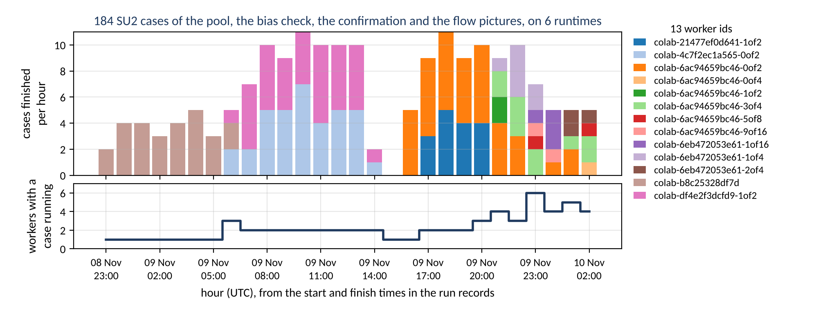
Version 2: the session runs the compute
The session starts, deploys, watches, rebalances and restarts the cloud runtimes itself; a person is needed only to authorise a runtime's storage and to rule on the data.
A worker id is a runtime and its shard (for example 1of2); a new shard suffix on the same runtime marks a re-split of the queue.
V11 | 11
Notes:
Before, a person restarted workers by hand: when both runtimes ended at 14:10 UTC nothing ran until 15:50. Now the session starts and restarts runtimes through a command-line interface, sees a dead worker from its heartbeat, and re-splits the shards when one runtime drains, so neither idles while the other has a queue. The runtime log in the task record lists every action.

Slide 12
What the checks caught
Each of these was found by a check or a recorded run before it reached a result.
Caught | By | Resolution
Postprocess looked for the compressible residual rms[rho] | the first airfoil case failing at postprocess | the classifier reads rms[P]
First case unconverged: cl drift 5.6 %, cd drift 17.4 % | the drift rule on the recorded history | budget 6,000 with a Cauchy stop (a ruling)
Fine mesh not reproduced at the 1 nm fingerprint | the worker's mesh fingerprint check | refused attempt kept beside the rerun
Fine E387 mesh has 8 inverted cells | the mesh inversion gate | that row of the validation stays not run
Point-vortex induced drag under-counts | the elliptic-wing validation rows | Trefftz-plane drag from a Glauert series
Volume file unreadable: the zone declares 22,102 nodes, the file holds more rows | a structure check on reading the file | re-run on local disk; one case still unreadable, nothing drawn from it
The pool was planned on one 4-rank worker | the solver block of every record: 72 pool cases on 2 ranks, 100 pool cases on 4 ranks | costs and rank counts quoted from the records
V12 | 12
Notes:
None of these would have shown up as a solver error. They were caught because every result is checked and every claim is computed from the records.

Slide 13
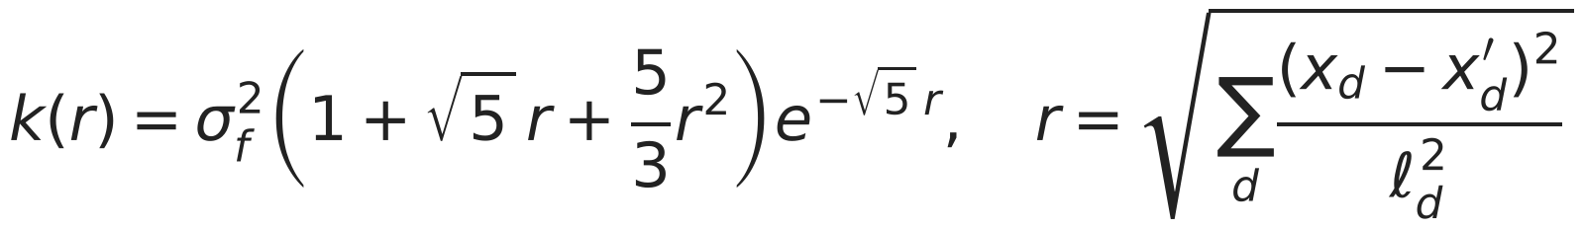



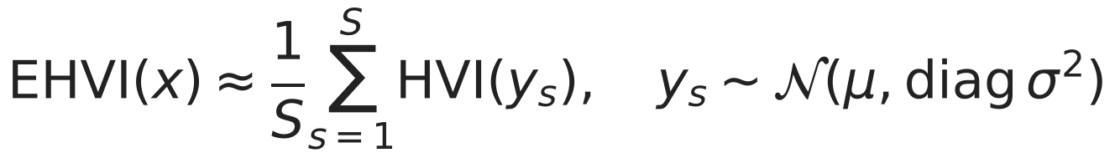
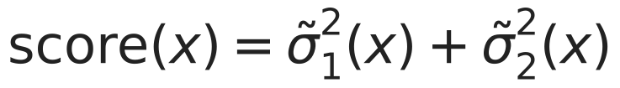
Surrogate and acquisition
One Gaussian process on endurance and one on log take-off mass give a mean and an interval everywhere; an acquisition function picks the next design, and the language model chooses nothing.
Strategy | Picks the next design by
random | a uniform draw
lhs | a Latin hypercube order fixed by the seed
al_maxvar | the largest summed scaled variance
al_ehvi | the largest expected hypervolume improvement
al_ehvi_feas | EHVI times P(feasible), online only (V15)
One GP on endurance, one on log take-off mass, six inputs scaled to [0, 1].
The language model calls tools; it never picks a point.
V13 | 13
Notes:
The surrogate is what turns a few hundred expensive runs into a map of the whole design space.

Slide 14
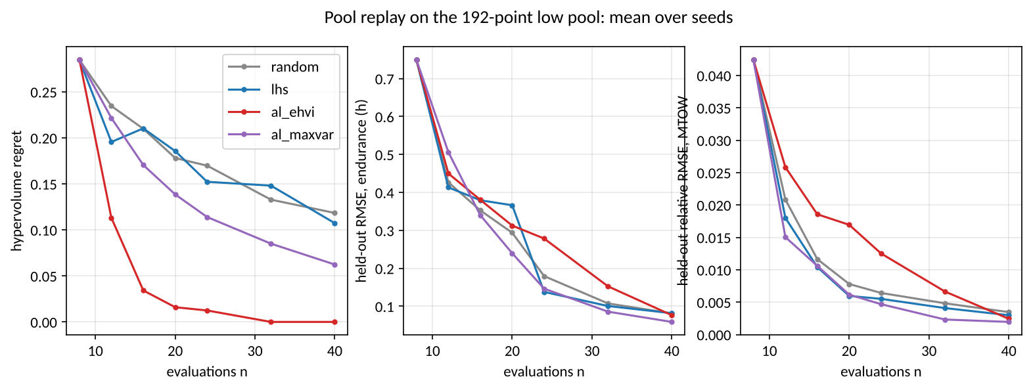
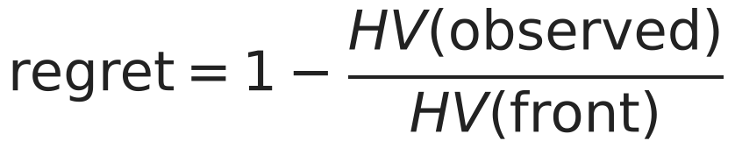
Active learning on a fixed pool
On a 192-point pool, expected hypervolume improvement reaches regret 0.000 at 32 evaluations, while random sampling is still at 0.118 after 40.
Mean hypervolume regret, 10 seeds
n | random | lhs | al_ehvi | al_maxvar
8 | 0.285 | 0.285 | 0.285 | 0.285
16 | 0.210 | 0.210 | 0.034 | 0.170
24 | 0.170 | 0.152 | 0.012 | 0.114
32 | 0.133 | 0.148 | 0.000 | 0.085
40 | 0.118 | 0.107 | 0.000 | 0.062
Same 8 initial points for every strategy of a seed.
The pool is smooth and gate-free: the easy case.
V14 | 14
Notes:
Regret is how much of the true front is still missing. Active learning has the whole front at 32 evaluations; random sampling is still missing part of it after 40.

Slide 15
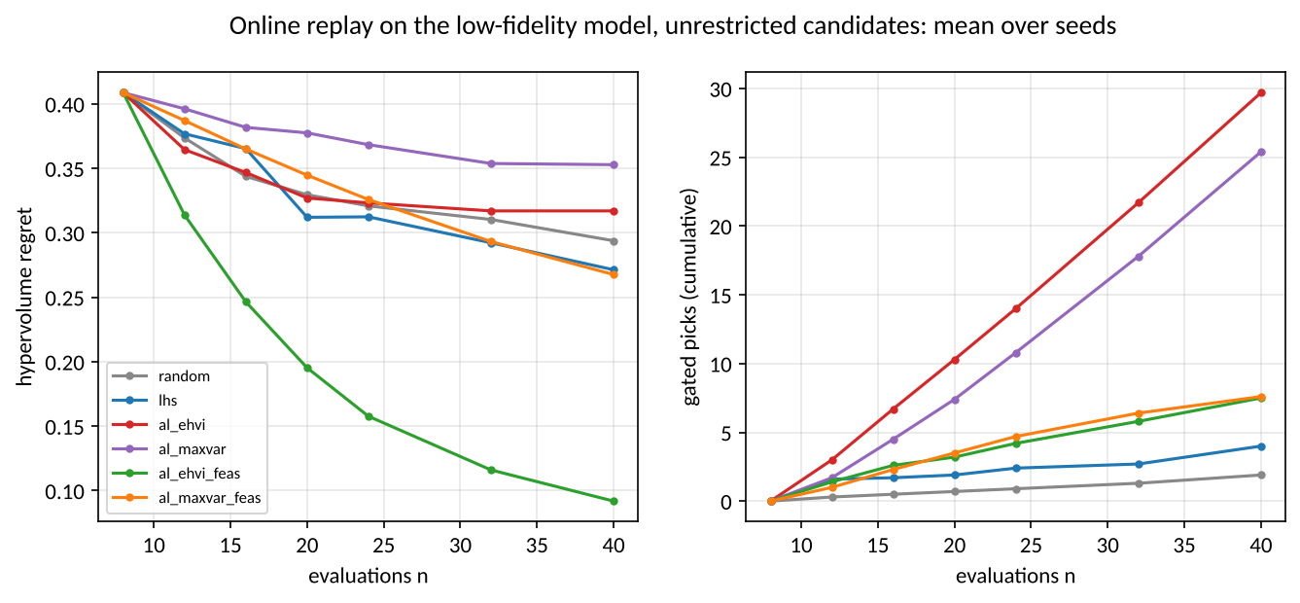
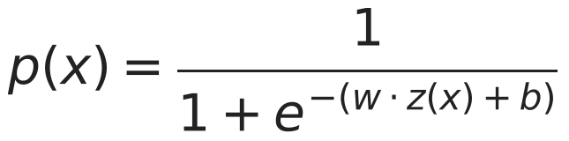
Active learning on the open box, honestly
On the open box plain expected improvement loses to random (0.317 against 0.294) because it keeps picking designs the gates reject; weighted by the probability of passing the gates it reaches 0.092.
Strategy | Regret at 40 | Gated picks
random | 0.294 | 1.9
lhs | 0.271 | 4.0
al_ehvi | 0.317 | 29.7
al_ehvi_feas | 0.092 | 7.5
al_maxvar | 0.353 | 25.4
al_maxvar_feas | 0.268 | 7.6
The front lies against the gated edge, and the GPs do not know the gates.
Both runs are published; neither replaces the other.
V15 | 15
Notes:
This is the result I lead with, because it includes a loss. The fix is a small feasibility model. Without it, the clever method is worse than chance.

Slide 16
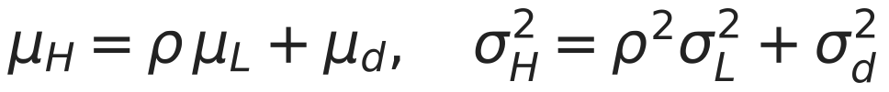

Two levels: fewer expensive runs
With 8 SU2 designs the two-level endurance error is 0.824 h against 1.525 h for SU2 alone; SU2 alone reaches it at 24 designs; 90 % interval coverage is in the table.
SU2 designs n | endurance RMSE (h): SU2 only | two-level | 90 % coverage: SU2 only | two-level | mass rel. error: SU2 only | two-level
8 | 1.525 | 0.824 | 0.43 | 0.61 | 0.0869 | 0.0022
12 | 1.112 | 0.808 | 0.62 | 0.61 | 0.0198 | 0.0024
16 | 0.865 | 0.747 | 0.71 | 0.68 | 0.0133 | 0.0021
24 | 0.704 | 0.726 | 0.78 | 0.69 | 0.0071 | 0.0022
Means over ten seeds; coverage is the share of held-out designs inside the 90 % interval, and it is below 0.9 for both models.
V16 | 16
Notes:
The cheap model runs everywhere; SU2 only has to learn the scale and a correction. The saving is large at small SU2 budgets and reverses by 24 designs, where SU2 alone is slightly better; neither model's interval is calibrated, so I quote the mean.

Slide 17
How much engineering time this saves
531,441 low-fidelity designs ran in 4.7 h; 172 SU2 cases ran in 37.0 worker-hours over 24.9 h of elapsed time; the two-level model reaches with 8 SU2 designs the error SU2 alone needs 24 for.
What ran | How many | How long | What a person had to do
Low-fidelity grid | 531,441 designs | 4.7 h on 8 workers | nothing: one command
SU2 pool and its bias check | 172 cases | 37.0 worker-hours over 24.9 h elapsed | sign in to 6 cloud runtimes
Two-level model | 8 SU2 designs | reaches the endurance error SU2 alone needs 24 designs for | nothing: computed from the records
Rulings | 10 recorded | each when the data forced a judgment | read the evidence and decide
Runtimes counted from the worker ids in the SU2 records; rulings counted from the decision headings of the task ledger.
V17 | 17
Notes:
The point is not that the computer is fast. The point is that the loop runs overnight, checks itself, and hands a person only the decisions that need judgment.

Slide 18
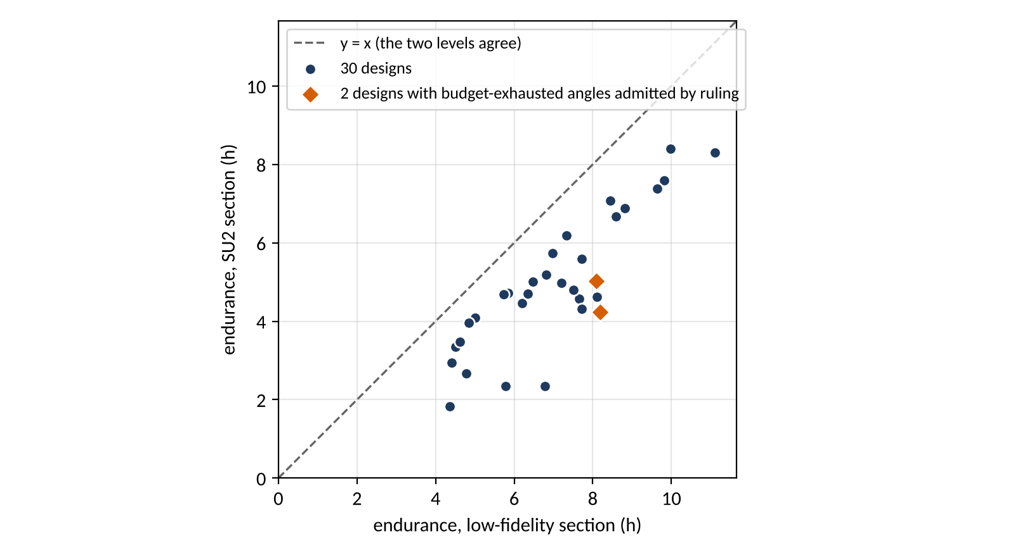
The expensive level against the cheap one
Of the 32 SU2 designs, 32 are complete; on every one the SU2 endurance is 15.8 to 65.5 % low against the low model's.
32 complete designs, every one below the line: SU2 endurance is 15.8 to 65.5 % low against the low model.
Largest gaps: design 30 (-65.5 %), design 19 (-59.5 %), design 17 (-58.0 %).
A gap of one sign is what a scale and a correction surface can learn.
V18 | 18
Notes:
The direction is the same on every design, which is exactly what a two-level model can learn.

Slide 19
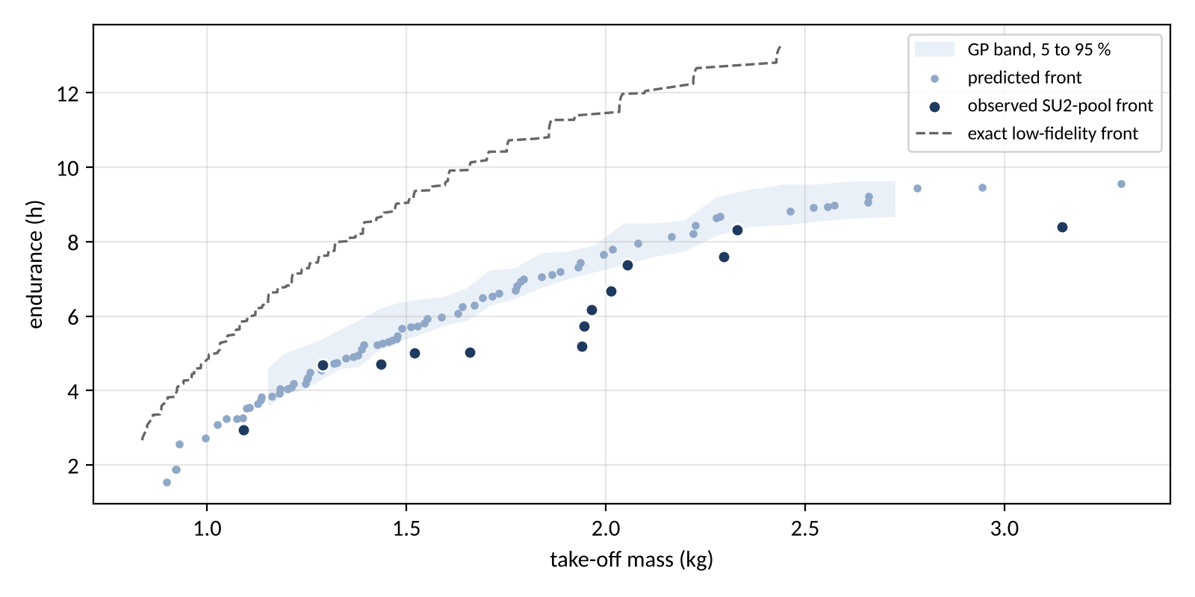
The front
On the SU2 pool the observed front has 13 designs, from 2.95 h at 1.09 kg to 8.40 h at 3.14 kg; the band is the GPs' posterior, and every point carries the decision-8 bias.
V19 | 19
Notes:
The low-fidelity front is exact because the cheap model ran on the whole grid; the SU2 front comes from the surrogate with its band.

Slide 20
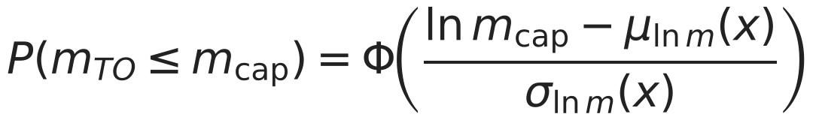
The inverse query under the 4 kg cap
On the low model the answer is a box corner and the cap never binds; on the SU2 pool the answer is 10.14 h at 3.92 kg with P = 0.991.
 | Value
Low pool GPs: design | span 3 m, aspect ratio 16, taper ratio 0.3, battery fraction 0.45, camber 6 %, thickness 8 %
Low pool GPs: endurance | 13.307 h, 90 % interval [13.228, 13.386]
Low pool GPs: take-off mass | median 2.435 kg, 90 % interval [2.428, 2.441]; P(mass <= 4 kg) = 1.000
Low model, evaluated directly | 13.245 h and 2.438 kg: inside both intervals
SU2 pool GPs: design | span 3 m, aspect ratio 7, taper ratio 0.3, battery fraction 0.45, camber 3.9 %, thickness 10.8 %
SU2 pool GPs: endurance | 10.139 h, 90 % interval [9.116, 11.163]
SU2 pool GPs: take-off mass | median 3.918 kg, 90 % interval [3.862, 3.975]; P(mass <= 4 kg) = 0.991
V20 | 20
Notes:
The expensive level moves the answer off the corner and brings the cap into play, which the cheap model never showed. That is the value of the second level in one slide.

Slide 21
Confirmation: does the prediction hold?
At the answer on 30 designs SU2 gives 9.95 h, inside [8.60, 10.07], and 2.963 kg, inside [2.919, 2.988]: pass; at the answer on 32 designs SU2 gives 8.95 h, below [9.12, 11.16], and 3.936 kg, inside [3.862, 3.975]: FAIL.
Run | Objective | Predicted | 90 % interval | SU2 | Position | Pass
answer on 30 designs | endurance | 9.334 h | [8.596, 10.073] | 9.951 h | inside | pass
 | mtow | 2.953 kg | [2.919, 2.988] | 2.963 kg | inside
answer on 32 designs | endurance | 10.139 h | [9.116, 11.163] | 8.955 h | below | FAIL
 | mtow | 3.918 kg | [3.862, 3.975] | 3.936 kg | inside
Pass condition fixed before the run: endurance and mass both inside their 90 % intervals, and the mass under the cap.
Each run is one SU2 polar (five angles) at the answer of the inverse query, sent through the same queue and checks as the pool.
V21 | 21
Notes:
The pass condition was fixed before the run: both endurance and mass inside their ninety-percent intervals. A miss would be reported with its direction.

Slide 22
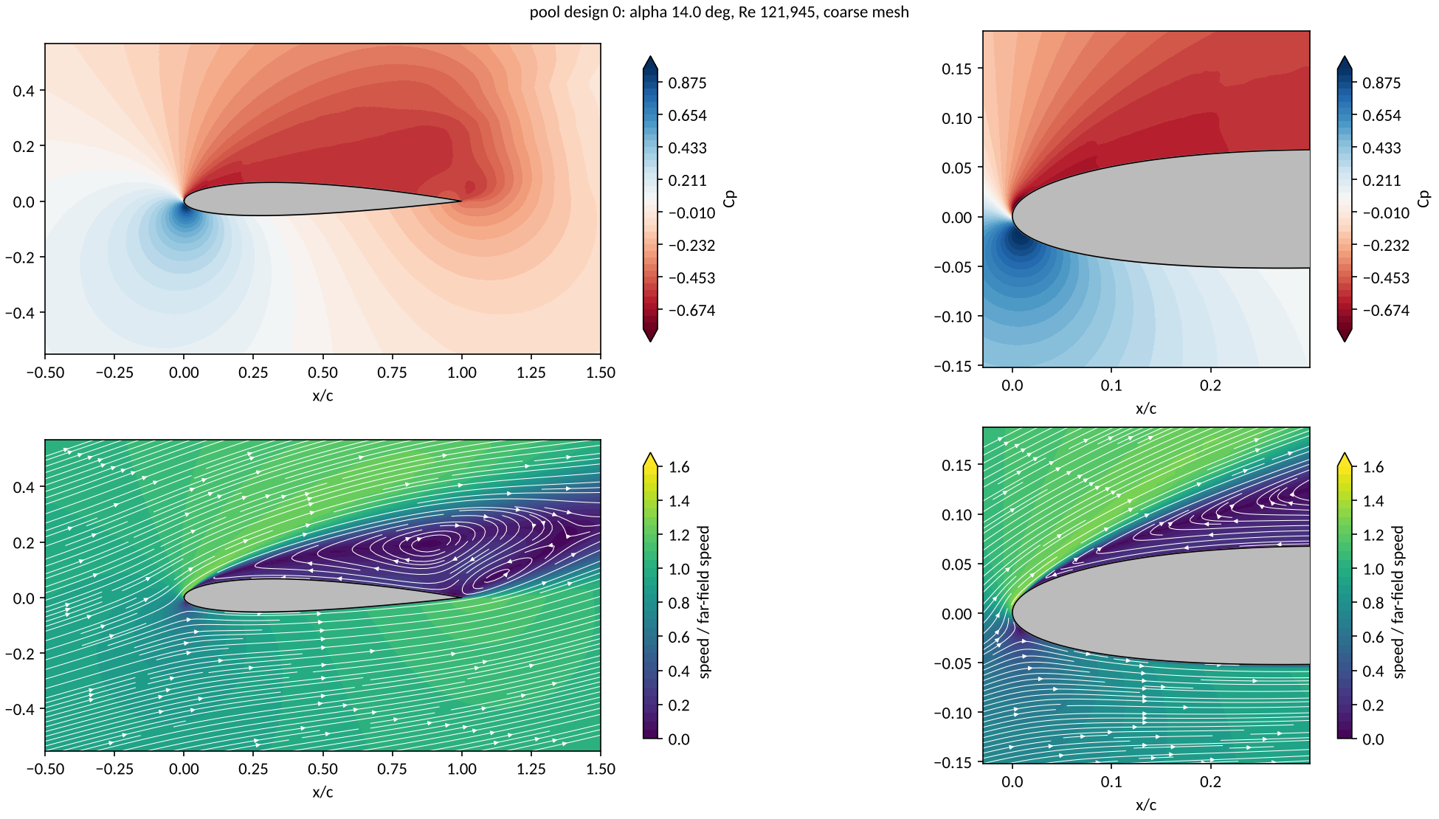
What the flow looks like at stall
At 14 degrees the upper surface of pool design 0 is separated over most of the chord; this is the stall the cheap section model cannot show.
V22 | 22
Notes:
The picture is a sanity check on what the numbers say: lift falls and drag rises past 10 degrees.

Slide 23
Limits that travel with every number
One cruise point at sea level, a fixed propeller efficiency, a closed-form structure, and an SU2 lift-slope bias of 5.49 %: these bound what the front and the answer mean.
Biases that travel with every figure
Out of scope
No trim drag
Fully turbulent skin friction on the non-wing parts above Re 5e5
The fixed propulsive efficiency
The closed-form structure
The section polar at one Reynolds number per design (the cruise one) while the wing's chord varies along the span
Drift band of the kept pool cases: cl 0.4 to 12.6 %, cd 0.0 to 7.5 %
Section lift effectiveness 0.75, band [0.6, 0.9]: the tunnel value lies outside it (open ruling)
Stability and control beyond the static margin, structural analysis beyond the spar rule, propeller design (a fixed efficiency), take-off and landing distances, wind and altitude envelopes, cost, and certification beyond the class C2 mass cap.
Carried by every SU2 section polar
v6e:cl_alpha:Re203800=+5.5%:fail
v6e:cd_ratio:Re203800=+8.0%:pass
v6e:cl_alpha:Re305200=+6.4%:fail
v6e:cd_ratio:Re305200=+5.7%:pass
v6e_ruling=decision8_accepted_with_bias
V23 | 23
Notes:
Every number in this talk is conditional on these. They are written into the records, not just said here.

Slide 24
Conclusions
The pipeline runs the design loop unattended, refuses what it cannot check, and asks a person only for rulings; on this problem it cut the expensive runs at small budgets and answered the capped design question; one confirmation run passed and the final one found the endurance below its predicted interval, which is the honest limit of the surrogate.
Question | Answer from the records | Status
1. The front | Exact low-fidelity front of 249 designs over 531,441 points | low level done; SU2 level done
2. Active learning | Pool: EHVI regret 0.000 at 32 against random 0.118 at 40. Open box: plain EHVI loses (0.317 against 0.294), weighted by P(feasible) it wins (0.092) | answered on the low level
3. Two-level model | Endurance error with 8 SU2 designs: 0.824 h against 1.525 h for SU2 alone, which needs 24 designs to match it; both intervals under-cover | recorded
4. Inverse query | Low level: a box corner at 13.31 h, the cap does not bind. SU2 pool: 10.14 h at 3.92 kg, P = 0.991 | answer on 30 designs: pass; answer on 32 designs: FAIL
What version 2 changed: the cloud runtimes are managed from the session; the records show 13 worker ids on 6 runtimes.
V24 | 24
Notes:
If I had to keep one idea: put the checks after the solver, not just before it, and make every claim computable from the records.

Slide 25
Questions
Discussion; the backup slides hold the detail behind every number.
Likely question | Backup
How was the SU2 solver validated, row by row? | B3 Validation table, solver checks; B10 SU2 against the tunnel, and the decision to accept the bias; B20 Tunnel points at both Reynolds numbers
How do you know a run converged? | B6 Two stopping rules: Cauchy stop and drift; B7 A solver history; B21 Budget-exhausted runs and the ruling on them
What does the mesh do to the answer? | B5 The airfoil mesh; B8 What the mesh does to the pressure distribution; B18 Coarse against medium on the pool
How good is the low-fidelity model? | B9 The low-fidelity section against the tunnel; B13 Section polars; B16 The exact low-fidelity front
Which assumptions move the answer most? | B17 Bias sweep at the answer; B26 Ledger provenance
What went wrong first, and who decided what? | B19 What the record keeps that was wrong first; B25 The decision log; B29 Open rulings
What did it cost? | B27 Cost ledger
Where do the equations come from? | B28 Equations; B4 Mass closure and the endurance balance; B2 The vortex lattice and its checks
V25 | 25
Notes:
Open the backup that answers the question rather than describing it.

Slide 26
Backup
Opened only on a question

Slide 27
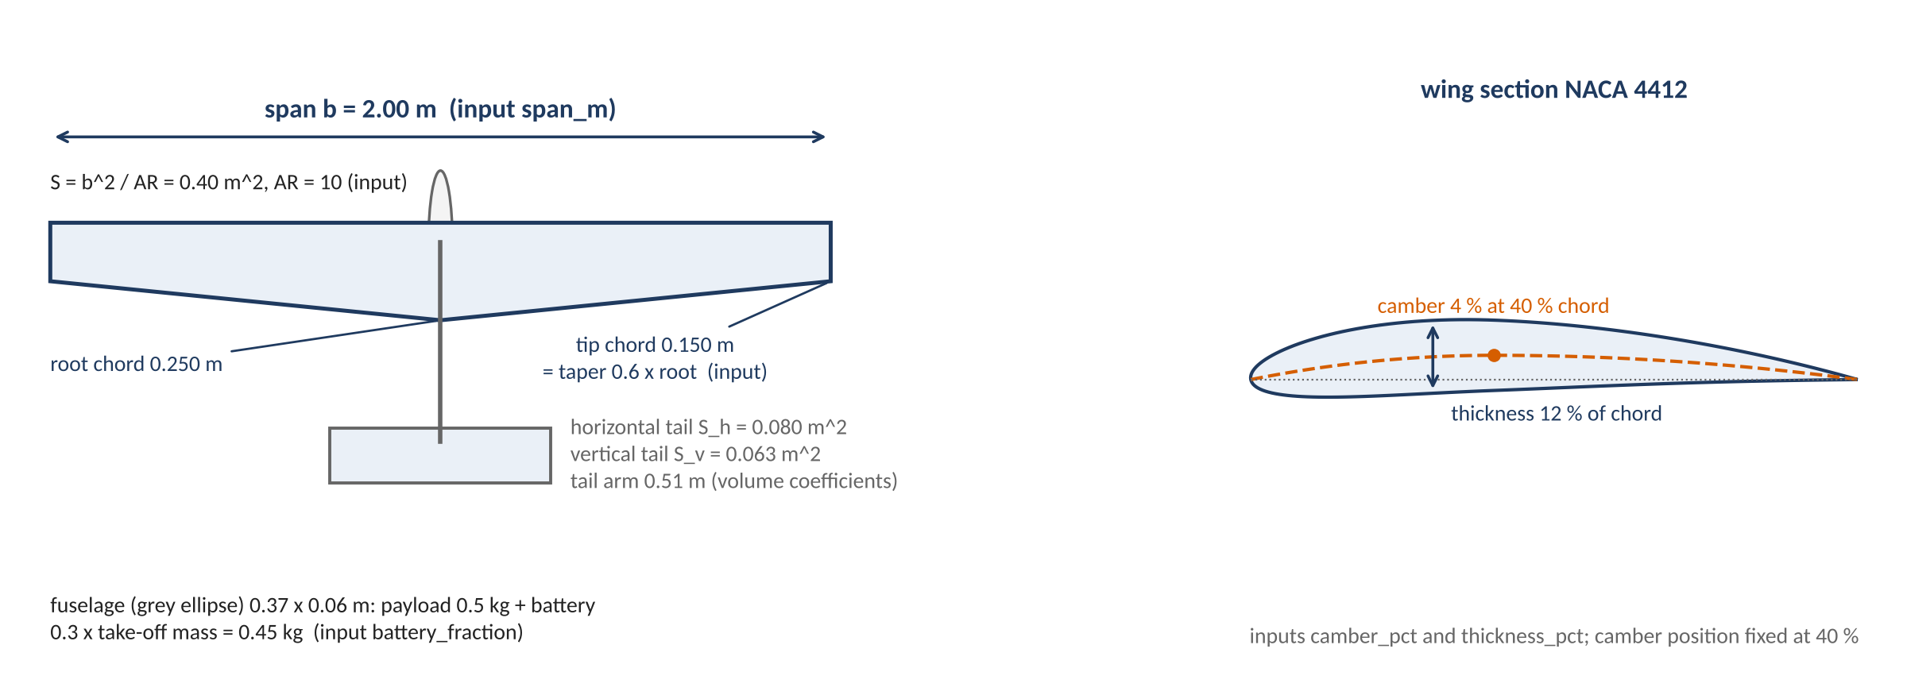
The nominal design in one top view
B1 | 27

Slide 28
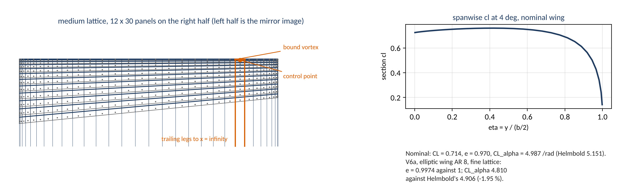
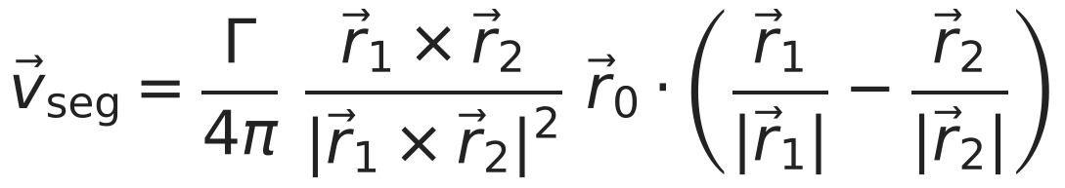
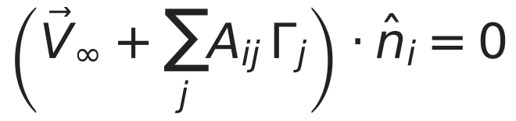
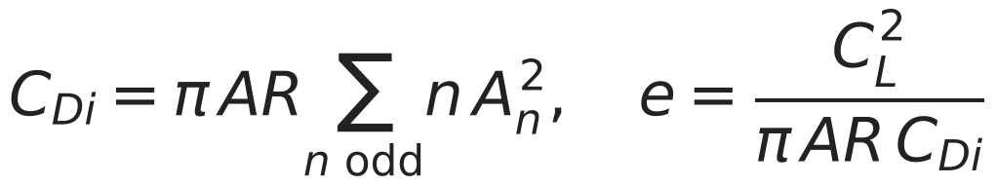
The vortex lattice and its checks
B2 | 28

Slide 29
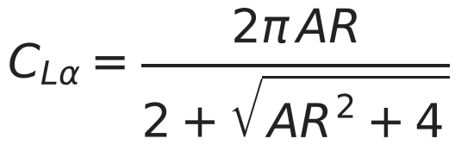
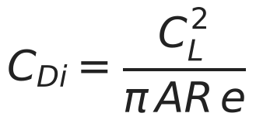
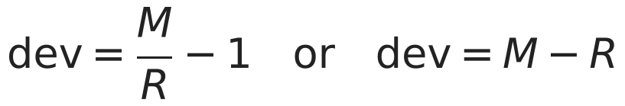
Validation table, solver checks
Row | Measured | Reference | Deviation | Tol. | Verdict
V6a elliptic AR 8 fine: e at 4 deg vs 1 | 0.9974 | 1 | -0.26 % | 1 % | pass
V6a elliptic AR 8 fine: CL_alpha vs Helmbold | 4.81 | 4.906 | -1.95 % | 3 % | pass
V6a elliptic AR 8 fine: CDi vs CL^2/(pi AR_planform e) | 0.00448 | 0.00448 | 0.0e+00 | 1e-09 | pass
V6a elliptic AR 100 fine: CL_alpha vs 2 pi AR/(AR+2) | 6.154 | 6.16 | -0.09 % | 1 % | pass
V6a (report) rectangular AR 100 fine: CL_alpha vs 2 pi AR/(AR+2) | 6.072 | 6.16 | -1.44 % | report | report
V6a (report) elliptic AR 8 coarse: CL_alpha vs Helmbold | 4.829 | 4.906 | -1.56 % | report | report
V6a (report) elliptic AR 8 coarse: e vs 1 | 0.9994 | 1 | -0.06 % | report | report
V6a (report) elliptic AR 8 medium: CL_alpha vs Helmbold | 4.817 | 4.906 | -1.82 % | report | report
V6a (report) elliptic AR 8 medium: e vs 1 | 0.9981 | 1 | -0.19 % | report | report
V6b Warren-12 fine: CL_alpha vs benchmark | 2.771 | 2.743 | +1.01 % | 2 % | pass
V6b Warren-12 fine: Cm_alpha (about root LE, reference chord 1.0) vs benchmark | -3.137 | -3.1 | +1.19 % | 2 % | PENDING
V6c nominal: CL_alpha, medium vs fine | 4.991 | 4.983 | +0.17 % | 1 % | pass
V6c nominal: e at 4 deg, medium vs fine | 0.9775 | 0.9801 | -0.26 % | 1 % | pass
V6c nominal: endurance_h, medium vs fine | 6.748 | 6.757 | -0.13 % | 2 % | pass
V6c (report) nominal: CL_alpha, coarse vs medium | 5.008 | 4.991 | +0.34 % | report | report
V6c (report) nominal: e at 4 deg, coarse vs medium | 0.9728 | 0.9775 | -0.49 % | report | report
V6c (report) nominal: endurance_h, coarse vs medium | 6.734 | 6.748 | -0.22 % | report | report
V6d closure_residual below 1e-9 | 5.606e-10 | 0 | 5.6e-10 | 1e-09 | pass
V6d energy balance: spent vs usable battery energy | 2.35e+05 | 2.35e+05 | 2.2e-16 | 1e-09 | pass
V6d endurance_h vs closed form | 6.748 | 6.748 | 0.0e+00 | 1e-06 | pass
V6d sum of masses vs mtow | 1.511 | 1.511 | 0.0e+00 | 1e-09 | pass
M measured, R reference
B3 | 29

Slide 30
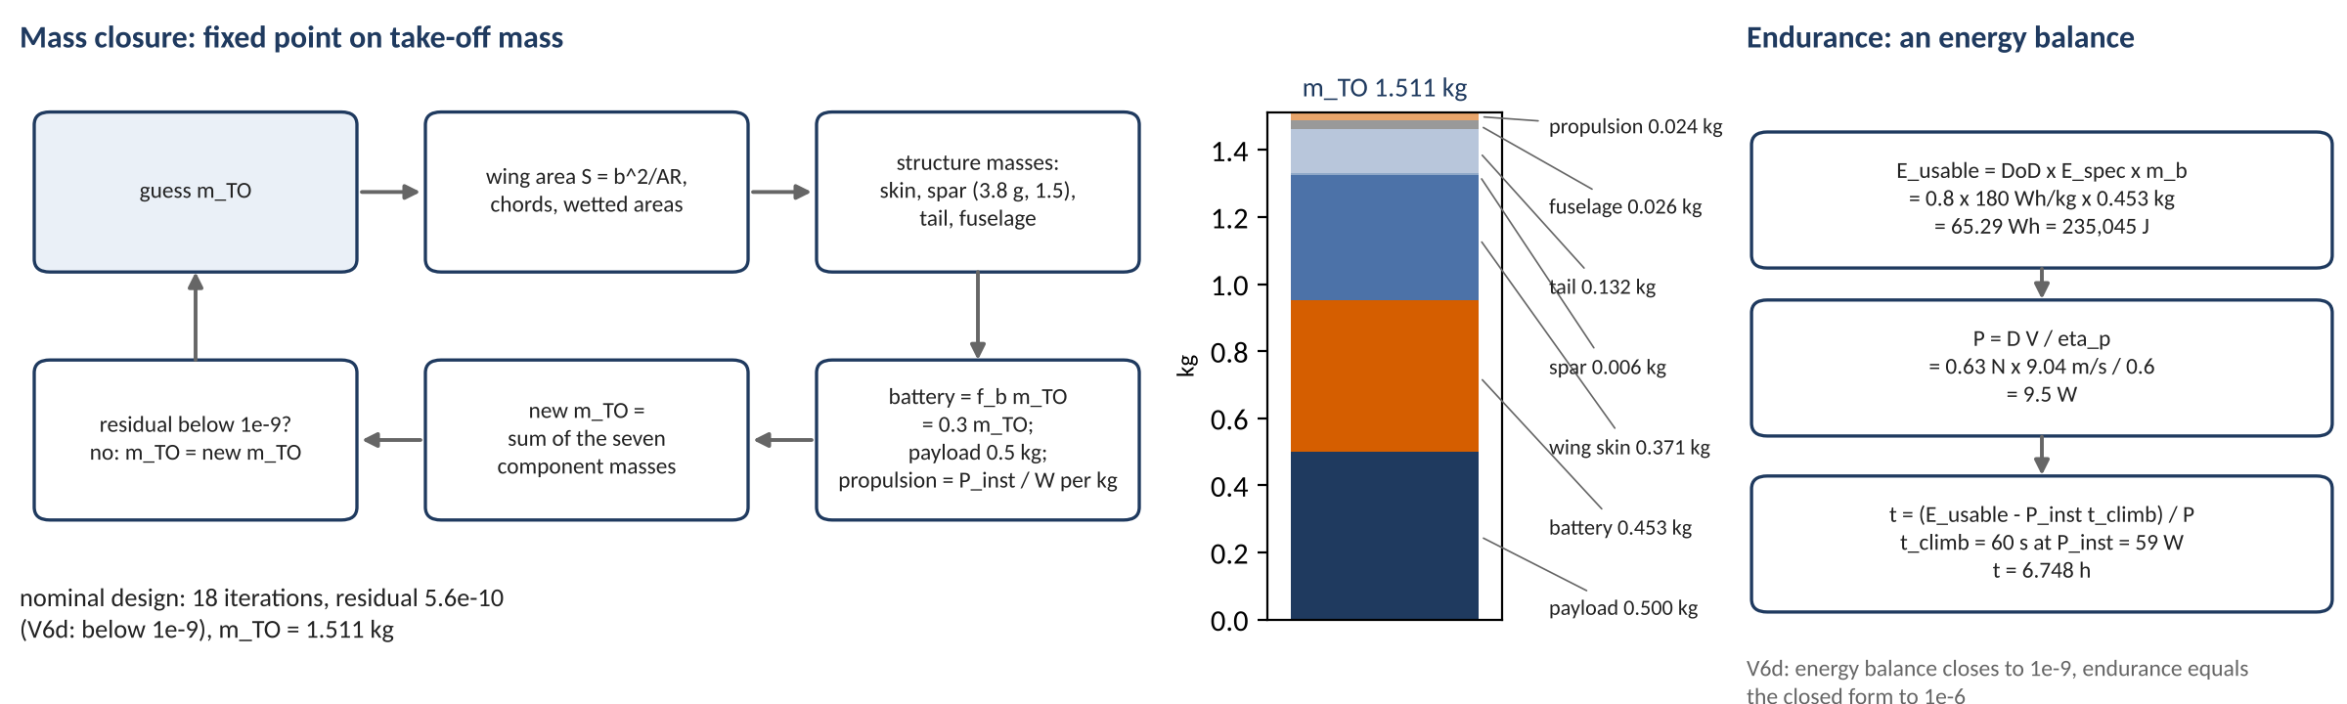
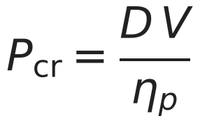
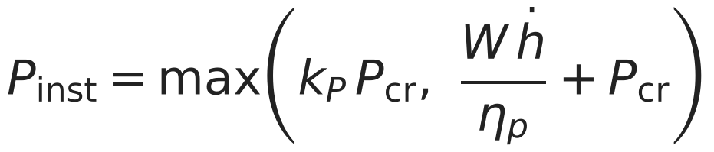
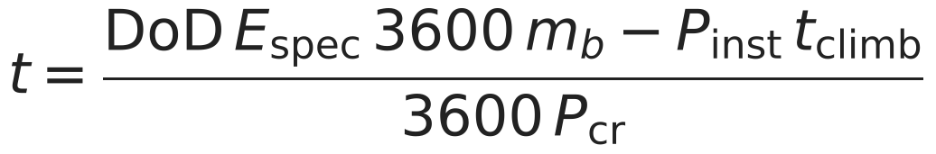
Mass closure and the endurance balance
B4 | 30

Slide 31
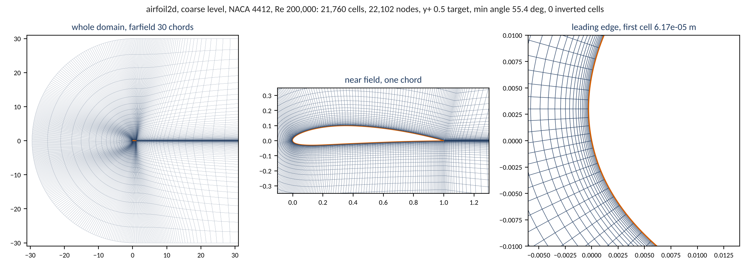
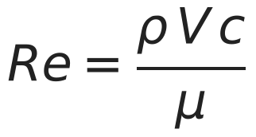
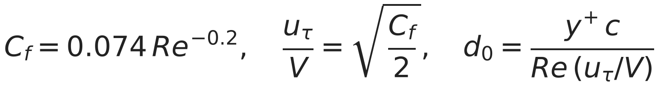
The airfoil mesh
B5 | 31

Slide 32
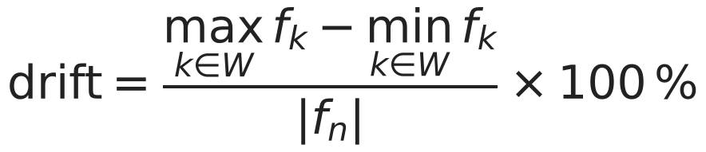
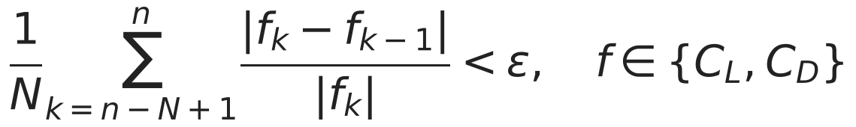
Two stopping rules: Cauchy stop and drift
Run | Budget | Iterations | cl drift (%) | cd drift (%) | Status
first smoke case | 3000 | not recorded (postprocess error) | 5.62 | 17.38 | error
rerun with Cauchy stop | 6000 | 4867 | 2.15 | 5.34 | not_converged
Drift rule, applied after ingest
SU2 Cauchy rule, as the case template states it
Cauchy settings of the airfoil case template
The drift rule and SU2's Cauchy rule measure different things; the record carries both.
A run that ends on its budget is flagged, not silently kept.
CONV_FIELD= ( LIFT, DRAG )
CONV_CAUCHY_ELEMS= 200
CONV_CAUCHY_EPS= 1E-5
CONV_STARTITER= 500
B6 | 32

Slide 33
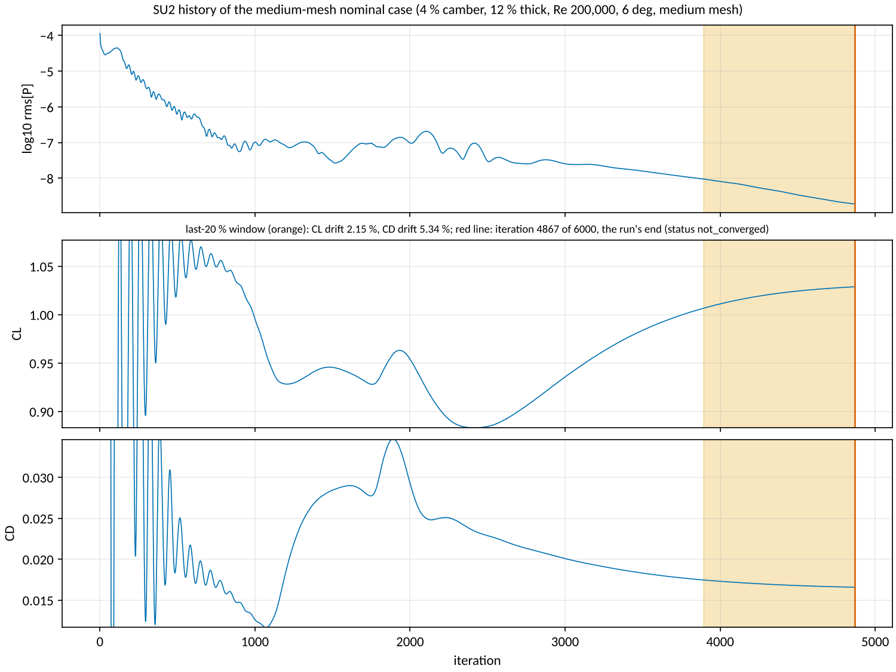
A solver history
B7 | 33

Slide 34
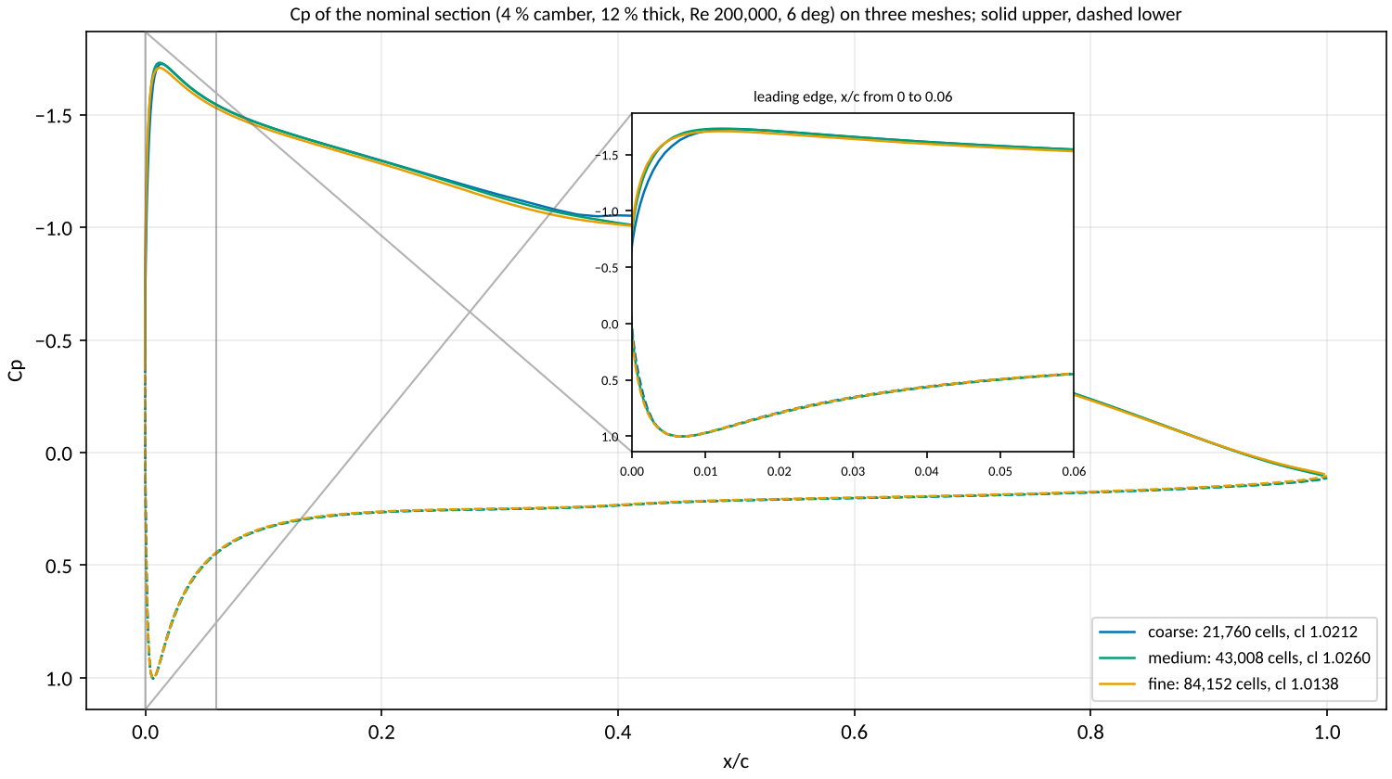
What the mesh does to the pressure distribution
B8 | 34

Slide 35

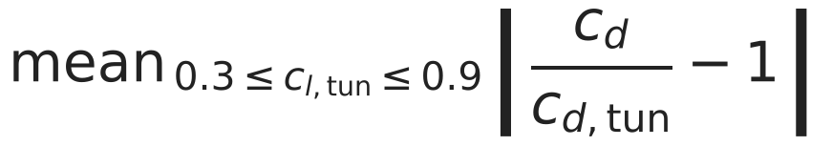
The low-fidelity section against the tunnel
Quantity | Re 101,800 | Re 203,800 | Re 305,200
lift slope | -22.6 % | -19.1 % | -20.2 %
zero-lift angle | -0.90 deg | -0.76 deg | -0.83 deg
profile drag, mean ratio | +52.0 % | +47.5 % | +43.4 %
cl_max | +12.2 % | +12.7 % | +13.5 %
Report-only rows by the spec: the closed-form section at the E387's measured camber and thickness against tunnel runs 211, 213 and 215.
The ledger's assumed lift effectiveness does not contain the value the tunnel implies: a ledger ruling, not a number to move here.
B9 | 35

Slide 36
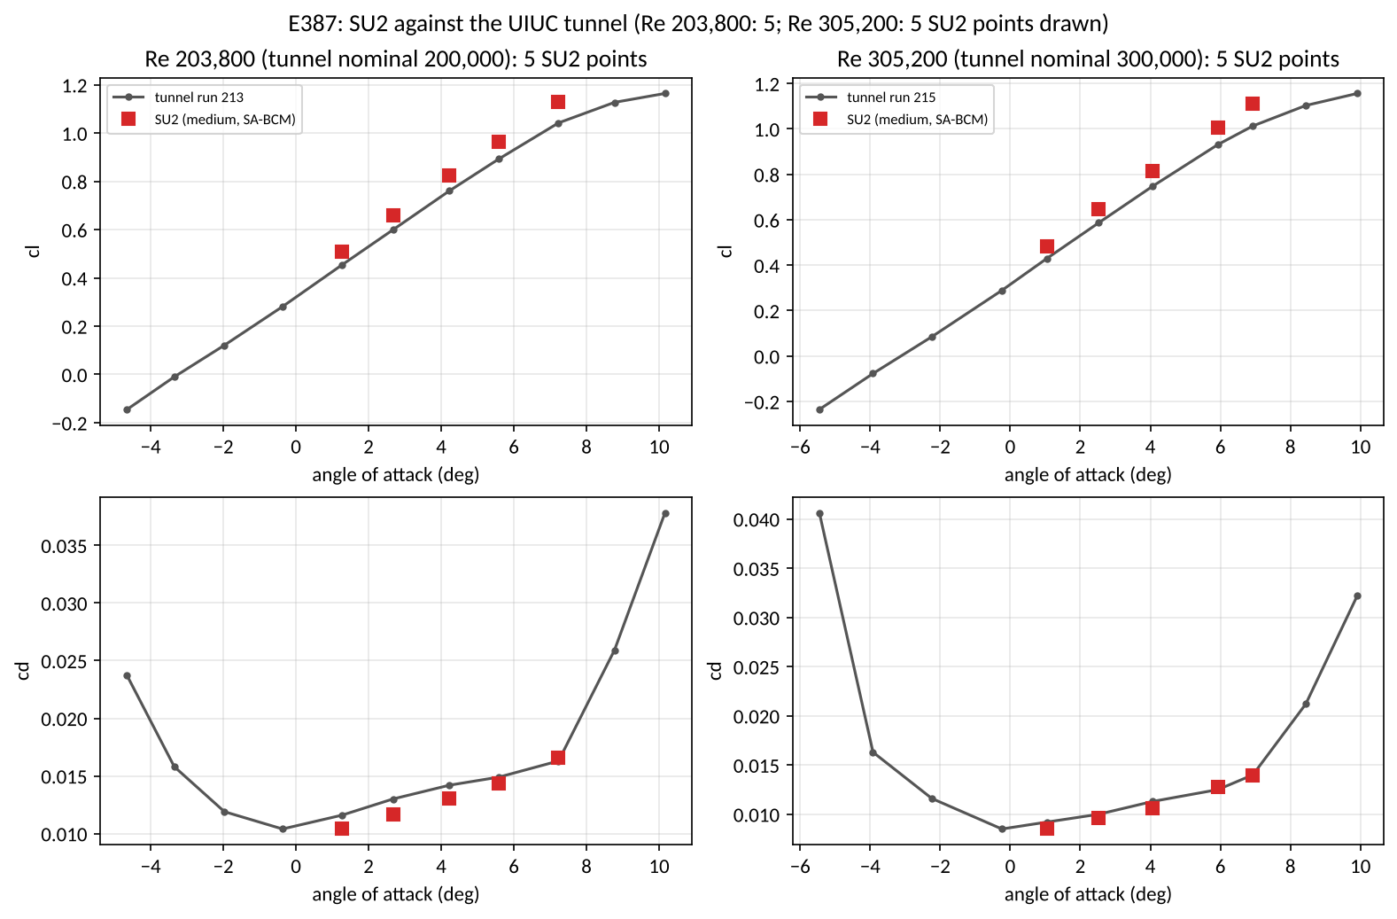
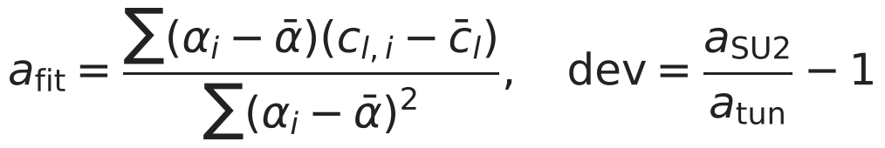
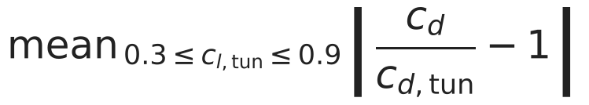
SU2 against the tunnel, and the decision to accept the bias
Row | Deviation | Tol. | Verdict
cl_alpha Re 203800 | +5.49 % | 5 % | FAIL
cd ratio Re 203800 | +7.99 % | 20 % | pass
cl_max Re 203800 | -3.00 % | report | report
cl_alpha Re 305200 | +6.44 % | 5 % | FAIL
cd ratio Re 305200 | +5.74 % | 20 % | pass
cl_max Re 305200 | -3.92 % | report | report
Against the tunnel at the five angles of Re 203,800: cl is 8.0 to 11.6 % high; cd is 10.3 % low to 1.6 % high.
Decision 8 (Éder, 2026-11-08 22:35 UTC): "accept the medium mesh as the high level with the bias recorded".
Not run: medium vs fine mesh at Re 203800 (no medium and fine pair of records at Re 203800); Ultra Stick 25e CL_alpha and CD0 (Ultra Stick data not retrieved).
B10 | 36

Slide 37
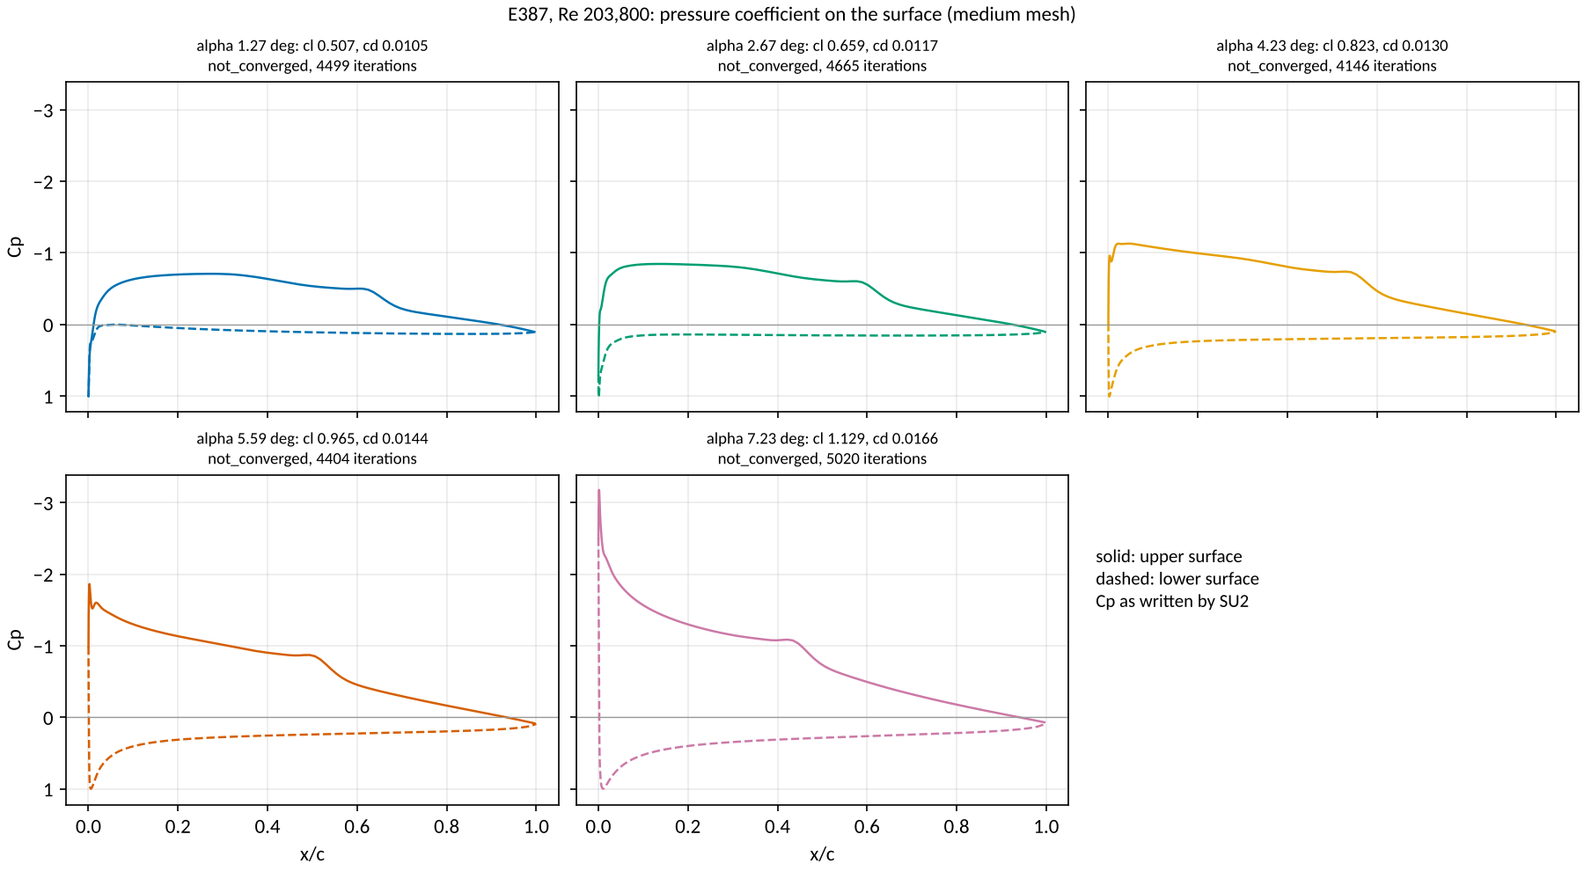
Tunnel pressure distributions
B11 | 37

Slide 38
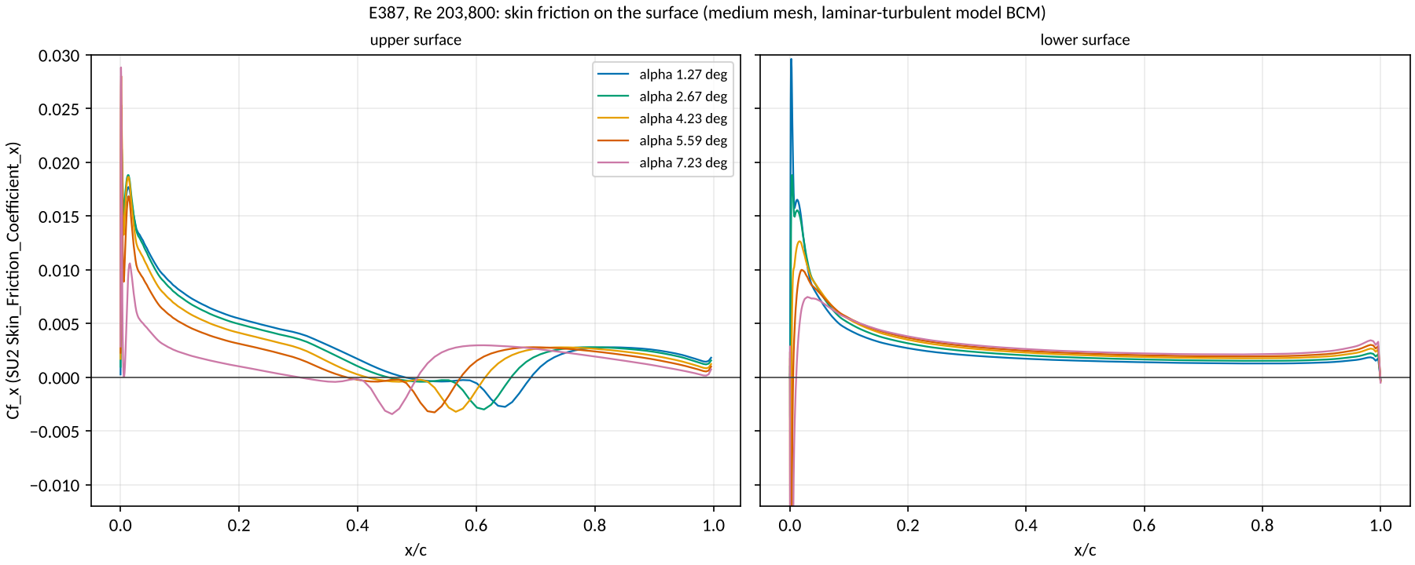
Where the wall shear reverses
B12 | 38

Slide 39
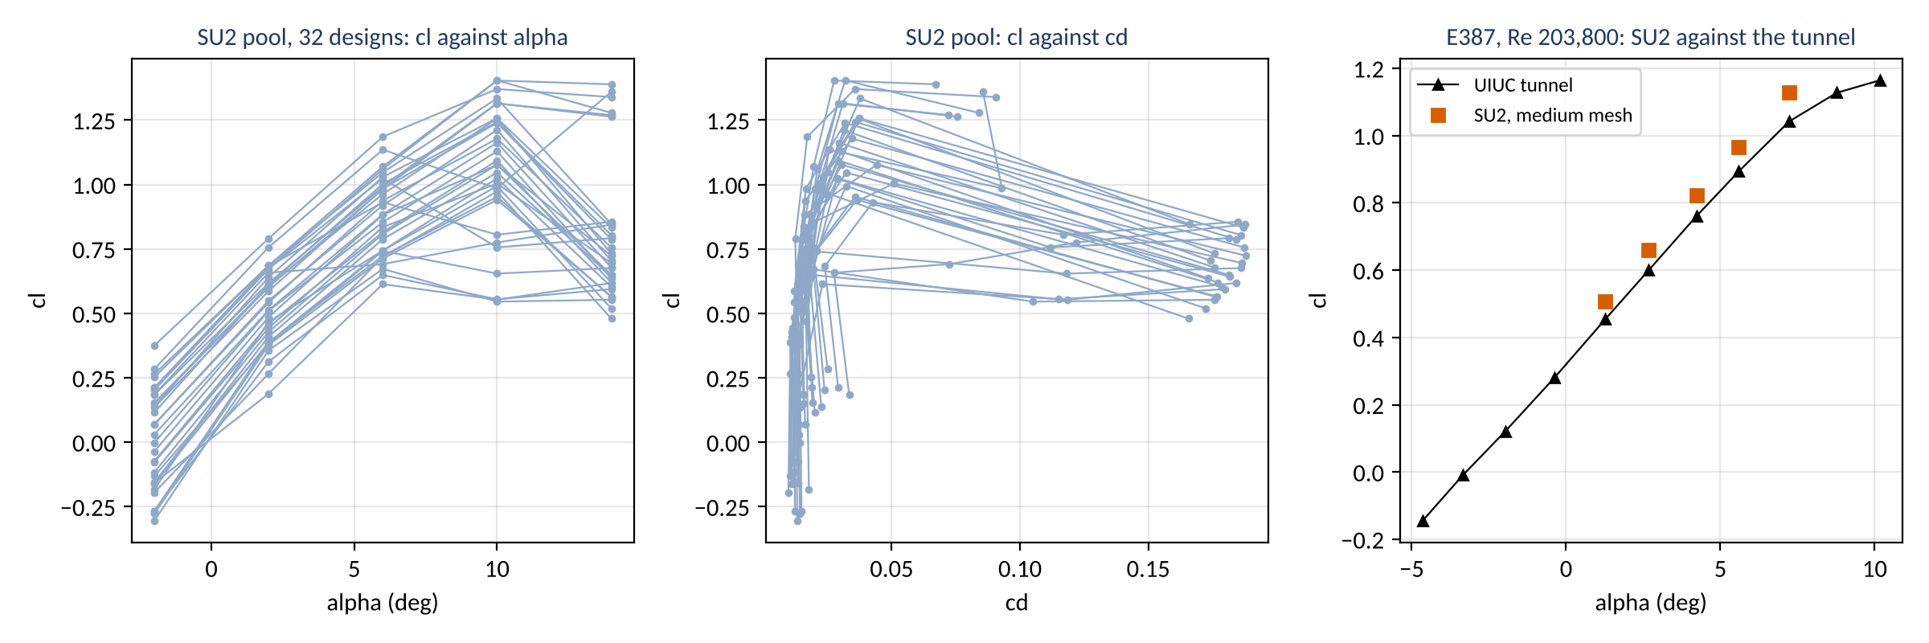
Section polars
B13 | 39

Slide 40
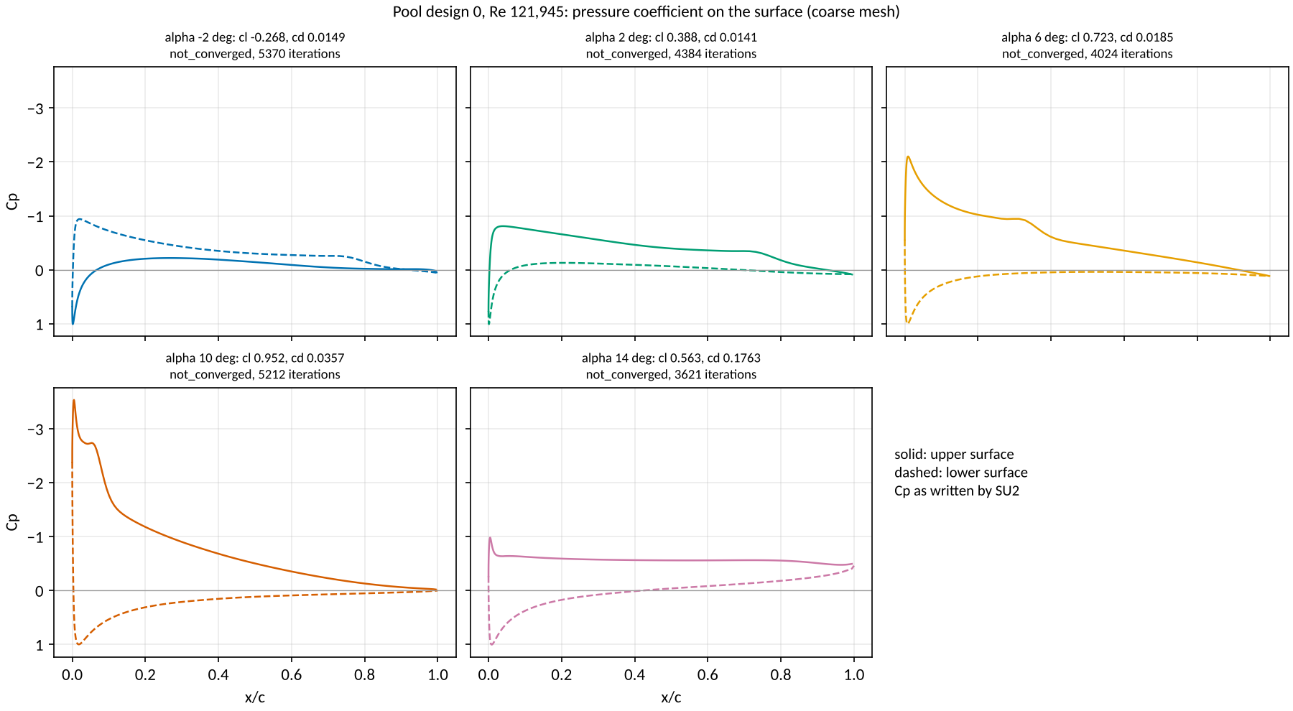
The stall at 14 degrees, pressure
B14 | 40

Slide 41
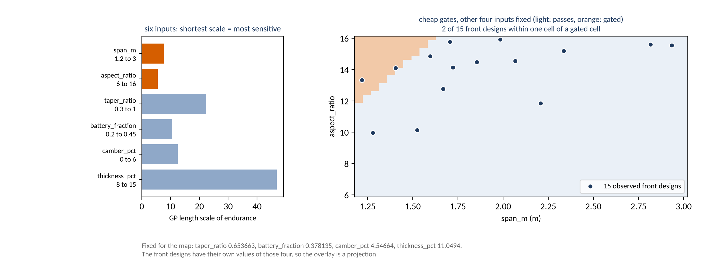
What the surrogate learned about the box
B15 | 41

Slide 42
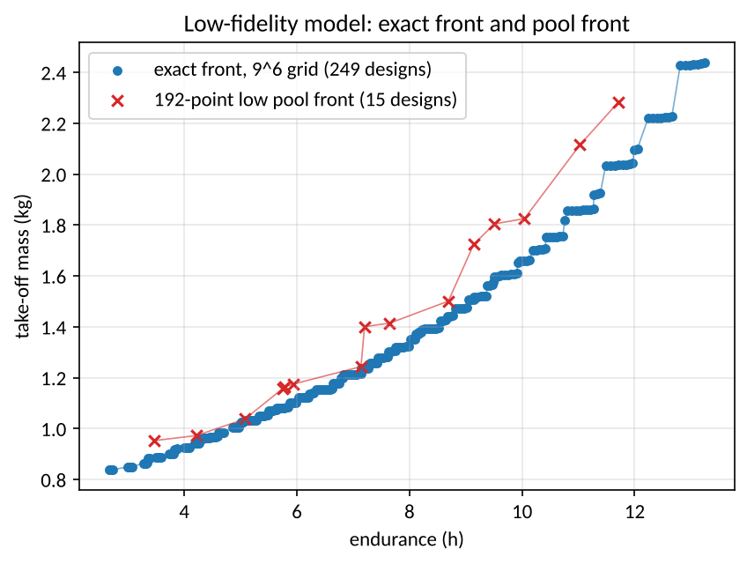
The exact low-fidelity front
Grid: 531,441 points, 459,432 clean, 72,009 gated, 0 failed.
Exact front: 249 designs.
Wall time: 16747 s on 8 workers.
Low pool: 192 designs, 0 gated, front of 15, 669 s.
Both runs are at the medium lattice level.
B16 | 42

Slide 43
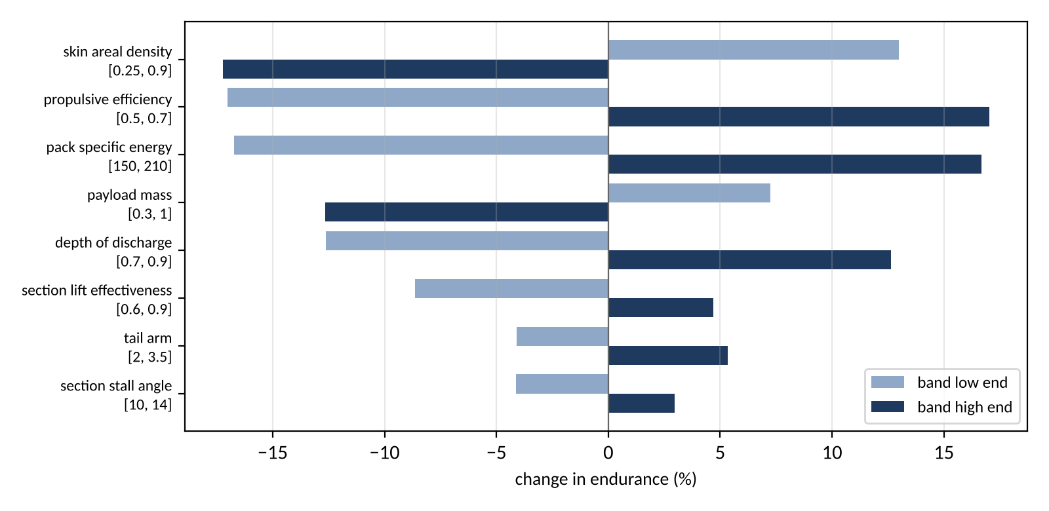
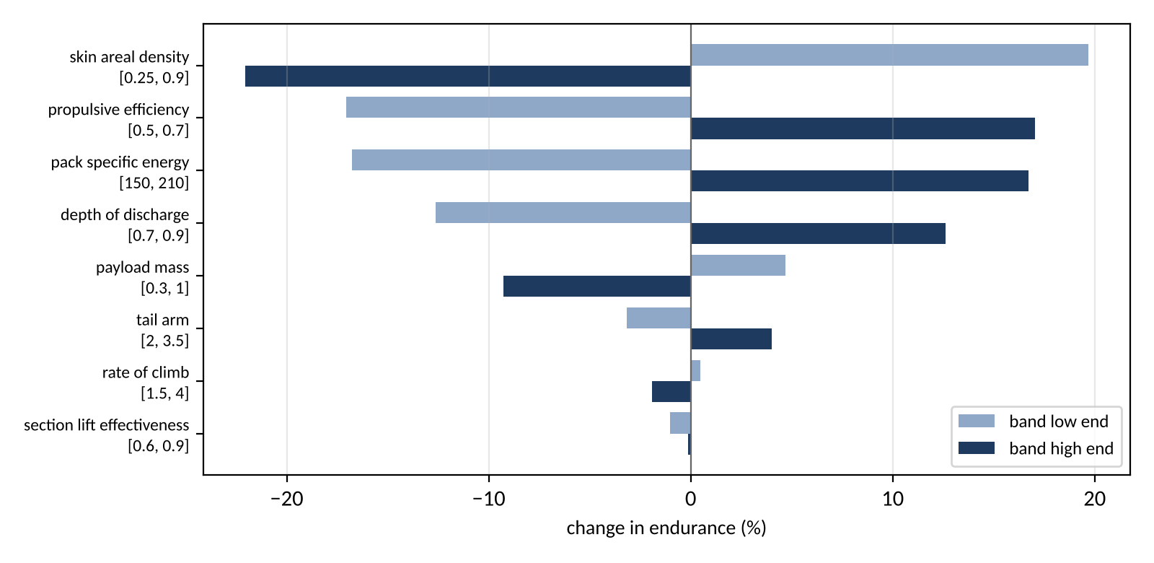
Bias sweep at the answer
At the low-fidelity answer
At the SU2-pool answer
Largest: skin areal density (17.2 %), propulsive efficiency (17.0 %), pack specific energy (16.7 %)
One quantity at a time, to each end of its ledger band.
Largest: skin areal density (22.0 %), propulsive efficiency (17.1 %), pack specific energy (16.8 %)
One quantity at a time, to each end of its ledger band.
B17 | 43

Slide 44
Coarse against medium on the pool
Pool designs on both meshes
Design | Re | alpha | cl coarse | cl medium | ratio | cd coarse | cd medium | ratio
0 | 121,945 | 6 | 0.7227 | 0.7236 | 1.0013 | 0.01855 | 0.01794 | 0.9674
1 | 170,204 | 2 | 0.5858 | 0.5923 | 1.0112 | 0.01207 | 0.01203 | 0.9966
1 | 170,204 | 6 | 0.9833 | 0.9886 | 1.0053 | 0.01658 | 0.01642 | 0.9902
1 | 170,204 | 10 | 1.2393 | 1.2439 | 1.0037 | 0.03183 | 0.03232 | 1.0157
2 | 149,605 | 2 | 0.5091 | 0.5140 | 1.0096 | 0.01356 | 0.01376 | 1.0149
2 | 149,605 | 6 | 0.8538 | 0.8564 | 1.0031 | 0.01872 | 0.01810 | 0.9668
2 | 149,605 | 10 | 1.1287 | 1.1603 | 1.0280 | 0.03035 | 0.02870 | 0.9454
3 | 156,312 | 2 | 0.4584 | 0.4654 | 1.0152 | 0.01252 | 0.01260 | 1.0067
3 | 156,312 | 6 | 0.8145 | 0.8175 | 1.0036 | 0.01729 | 0.01672 | 0.9667
3 | 156,312 | 10 | 1.0930 | 1.0873 | 0.9948 | 0.02933 | 0.02959 | 1.0087
Nominal section | Cells | Iterations | Wall (s) | cl | cd | cl, cd against fine
coarse | 21,760 | 3,595 (Cauchy) | 498 | 1.02115 | 0.017348 | +0.7 %, +1.1 %
medium | 43,008 | 4,867 (Cauchy) | 1,385 | 1.02599 | 0.016710 | +1.2 %, -2.6 %
fine | 84,152 | 6,000 (budget) | 3,162 | 1.01381 | 0.017157 | reference
B18 | 44

Slide 45
What the record keeps that was wrong first
First recorded | The record now says | Found by
SU2 "drags 3 to 10 % low" (task ledger) | per point cd is 10.3 % low to 1.6 % high; the block is corrected in place | the deck builder reading the E387 records
Lattice check: a rectangular AR 100 wing against 2 pi AR / (AR + 2) | that is the elliptic slope; the rectangular wing sits -1.44 % below it, so the row tests an elliptic wing | the solver's own refinement, before any verdict
Induced drag from the midpoint point-vortex sum | Trefftz-plane drag of the Glauert series | the elliptic-wing rows on the first lattice run
Online replay: plain EHVI at regret 0.317 against random's 0.294 | kept as published, with the feasibility-weighted run (0.092) beside it | the plan's rule to publish a loss
Fine mesh refused at the 1 nm fingerprint | fingerprint at 1 micrometre, the refused attempt kept | the worker's mesh check
Airfoil budget 3,000 iterations | 6,000 with a Cauchy stop (decision 6) | the first smoke case
Volume file corrupted by the shared drive mount | the writer itself corrupts one case even on local disk; the diagnosis is corrected, not overwritten | re-running on local disk
B19 | 45

Slide 46
Tunnel points at both Reynolds numbers
Re 203,800 (medium mesh, SA-BCM; tunnel: UIUC low-speed airfoil data)
alpha | SU2 cl | tunnel cl | ratio | SU2 cd | tunnel cd | ratio
1.27 | 0.5067 | 0.4540 | +11.6 % | 0.01046 | 0.01160 | -9.8 %
2.67 | 0.6588 | 0.5990 | +10.0 % | 0.01166 | 0.01300 | -10.3 %
4.23 | 0.8226 | 0.7610 | +8.1 % | 0.01302 | 0.01420 | -8.3 %
5.59 | 0.9646 | 0.8930 | +8.0 % | 0.01438 | 0.01490 | -3.5 %
7.23 | 1.1290 | 1.0420 | +8.4 % | 0.01655 | 0.01630 | +1.6 %
Re 305,200 (medium mesh, SA-BCM; tunnel: UIUC low-speed airfoil data)
alpha | SU2 cl | tunnel cl | ratio | SU2 cd | tunnel cd | ratio
1.04 | 0.4835 | 0.4290 | +12.7 % | 0.00851 | 0.00920 | -7.5 %
2.53 | 0.6478 | 0.5870 | +10.4 % | 0.00962 | 0.01000 | -3.8 %
4.07 | 0.8145 | 0.7480 | +8.9 % | 0.01063 | 0.01130 | -5.9 %
5.93 | 1.0056 | 0.9310 | +8.0 % | 0.01278 | 0.01250 | +2.3 %
6.93 | 1.1107 | 1.0130 | +9.6 % | 0.01391 | 0.01400 | -0.6 %
B20 | 46

Slide 47
Budget-exhausted runs and the ruling on them
Tag | Design, alpha | Mesh | cl | cd | cl drift (%) | cd drift (%) | Kept
confirm | 14 deg | coarse | +0.8495 | 0.19215 | 12.0 | 7.2 | yes, by ruling
confirm | 14 deg | coarse | +1.3492 | 0.06477 | 3.8 | 9.4 | no
mesh | 6 deg | fine | +1.0138 | 0.01716 | 4.4 | 10.3 | not a pool case
nominal | 0 deg | medium | +0.4320 | 0.01063 | 3.0 | 0.6 | not a pool case
nominal | 10 deg | medium | +1.3338 | 0.02643 | 4.2 | 11.1 | not a pool case
pool af | 2, -2 deg | coarse | -0.0020 | 0.01411 | 98.2 | 0.7 | no
pool af | 29, -2 deg | coarse | +0.1525 | 0.01908 | 7.2 | 3.9 | no
pool af | 16, -2 deg | coarse | -0.1617 | 0.01115 | 3.1 | 1.2 | no
pool af | 14, -2 deg | coarse | -0.0360 | 0.01239 | 61.6 | 10.2 | no
pool af | 15, -2 deg | coarse | +0.2522 | 0.01858 | 2.8 | 2.4 | no
pool af | 9, 14 deg | coarse | +1.3888 | 0.06705 | 1.8 | 4.2 | no
pool af | 13, 14 deg | coarse | +1.2694 | 0.07220 | 4.8 | 10.2 | no
pool af | 22, 10 deg | coarse | +1.1621 | 0.02951 | 6.9 | 12.1 | no
pool af | 22, -2 deg | coarse | +0.0299 | 0.01390 | 39.2 | 2.9 | no
pool af | 5, 10 deg | coarse | +1.2572 | 0.03736 | 22.1 | 58.6 | no
pool af | 28, 14 deg | coarse | +0.5940 | 0.17985 | 3.1 | 2.0 | yes, by ruling
pool af | 31, -2 deg | coarse | -0.1172 | 0.01207 | 25.1 | 9.7 | no
pool af | 28, 10 deg | coarse | +0.5545 | 0.11488 | 2.8 | 1.9 | yes, by ruling
pool af | 8, 14 deg | coarse | +0.6758 | 0.18617 | 4.7 | 3.4 | yes, by ruling
pool af | 28, -2 deg | coarse | -0.2691 | 0.01230 | 6.9 | 6.8 | yes, by ruling
Tag | Design, alpha | Mesh | cl | cd | cl drift (%) | cd drift (%) | Kept
pool af | 8, -2 deg | coarse | -0.1317 | 0.01034 | 41.6 | 9.6 | yes, by ruling
pool af | 3, -2 deg | coarse | -0.0740 | 0.01353 | 4.2 | 0.7 | no
pool af | 11, 10 deg | coarse | +1.0037 | 0.05086 | 4.4 | 4.6 | no
pool af | 27, 10 deg | coarse | +1.3703 | 0.03568 | 7.6 | 13.7 | no
pool af | 8, 10 deg | coarse | +0.6541 | 0.11821 | 54.1 | 44.8 | yes, by ruling
pool af | 25, 10 deg | coarse | +1.2423 | 0.03592 | 17.5 | 34.5 | no
pool af | 17, 10 deg | coarse | +0.5531 | 0.11844 | 7.7 | 5.2 | no
pool af | 6, 2 deg | coarse | +0.2656 | 0.01036 | 14.1 | 8.0 | no
pool af | 19, 6 deg | coarse | +0.9312 | 0.04262 | 9.6 | 27.7 | no
pool af | 21, 10 deg | coarse | +1.4040 | 0.03187 | 1.7 | 14.6 | no
pool af | 20, -2 deg | coarse | -0.1557 | 0.01199 | 17.5 | 10.8 | no
pool af | 4, 14 deg | coarse | +1.3594 | 0.08557 | 4.0 | 7.6 | no
pool af | 24, -2 deg | coarse | +0.0684 | 0.01391 | 8.8 | 2.1 | no
pool af | 18, 14 deg | coarse | +1.2631 | 0.07550 | 5.4 | 12.1 | no
pool af | 1, 14 deg | coarse | +0.7871 | 0.18430 | 1.5 | 0.4 | no
pool af | 23, 10 deg | coarse | +0.9937 | 0.03231 | 1.8 | 4.3 | no
pool af | 6, -2 deg | coarse | -0.1957 | 0.00977 | 11.3 | 5.9 | no
pool af | 17, 14 deg | coarse | +0.6174 | 0.18412 | 29.6 | 20.4 | no
pool af | 11, -2 deg | coarse | -0.0781 | 0.01155 | 57.2 | 11.2 | no
pool af bias | 0, 2 deg | medium | +0.3972 | 0.01417 | 2.7 | 0.3 | no
pool af bias | 0, 10 deg | medium | +0.8590 | 0.04055 | 18.9 | 39.7 | no
A drift of tens of percent at cl near zero is the division by |f_n| in the drift rule. Kept by ruling: pool designs 8 and 28 and 1 confirmation case(s).
B21 | 47

Slide 48
The low-fidelity Pareto record
Item | Record
training rows | 192 of 192
candidates | 4,096 kept of 4,544 drawn (420 failed the closed-form gates, 4 the full gates)
observed front | 15 designs, 3.47 h at 0.953 kg to 11.71 h at 2.283 kg
predicted front | 57 points
band | 25 mass levels, 50 joint samples per level
Input | Length scale
aspect_ratio | 5.49
span_m | 7.57
battery_fraction | 10.50
camber_pct | 12.47
taper_ratio | 22.31
thickness_pct | 46.90
B22 | 48

Slide 49
The inverse query record
Item | Record
grid | 21^6 = 85,766,121 points
pass the closed-form gates | 76,587,147
training rows | 192
query | P(mass <= 4 kg) >= 0.9
answer: design | span_m 3, aspect_ratio 16, taper_ratio 0.3, battery_fraction 0.45, camber_pct 6, thickness_pct 8
answer: endurance | 13.307 h, 90 % interval [13.228, 13.386]
answer: take-off mass | median 2.435 kg, 90 % interval [2.428, 2.441]; P(mass <= 4 kg) = 1.000
closure gates at the answer | passed
lightest observed design | 0.953 kg
interval | 90 percent, predictive (includes noise)
B23 | 49

Slide 50
Online replays, full tables
Mean hypervolume regret against the exact front
n | random | lhs | al_ehvi | al_ehvi_feas | al_maxvar | al_maxvar_feas
8 | 0.409 | 0.409 | 0.409 | 0.409 | 0.409 | 0.409
12 | 0.374 | 0.377 | 0.365 | 0.314 | 0.396 | 0.387
16 | 0.344 | 0.365 | 0.347 | 0.246 | 0.382 | 0.365
20 | 0.330 | 0.312 | 0.327 | 0.195 | 0.378 | 0.345
24 | 0.321 | 0.312 | 0.323 | 0.158 | 0.368 | 0.326
32 | 0.310 | 0.292 | 0.317 | 0.116 | 0.354 | 0.293
40 | 0.294 | 0.271 | 0.317 | 0.092 | 0.353 | 0.268
Mean gated picks (cumulative)
n | random | lhs | al_ehvi | al_ehvi_feas | al_maxvar | al_maxvar_feas
8 | 0.0 | 0.0 | 0.0 | 0.0 | 0.0 | 0.0
12 | 0.3 | 1.6 | 3.0 | 1.4 | 1.7 | 1.0
16 | 0.5 | 1.7 | 6.7 | 2.6 | 4.5 | 2.3
20 | 0.7 | 1.9 | 10.3 | 3.2 | 7.4 | 3.5
24 | 0.9 | 2.4 | 14.0 | 4.2 | 10.8 | 4.7
32 | 1.3 | 2.7 | 21.7 | 5.8 | 17.8 | 6.4
40 | 1.9 | 4.0 | 29.7 | 7.5 | 25.4 | 7.6
B24 | 50

Slide 51
The decision log
Decision | Who and when | As recorded | What it changed
6 | Éder, 2026-11-08 06:50 UTC | Éder chose the recommendation: rerun the same case once with max_iter 6000 and a Cauchy stopping criterion on the lift and drag coefficients, CONV_CAUCHY_ELEMS= 200, CONV_CAUCHY_EPS= 1E-5, CONV_STARTITER= 500), read the drift and the iteration at which it stopped, and only then fix the iteration budget and cut the pool to 64 designs at 3 angles. | budget 6,000 with a Cauchy stop on lift and drag
7 | Éder, 2026-11-08 20:45 UTC | "Colab is running now" | the SU2 pool staged: 32 designs at five angles on the coarse mesh, plus the medium bias check
8 | Éder, 2026-11-08 22:35 UTC | "accept the medium mesh as the high level with the bias recorded" | the V6e fail kept, its flags written into every SU2 polar; no SST-LM attempt
9 | Éder, 2026-11-10 01:35 UTC | "accept the budget-exhausted runs for designs 8 and 28" | designs 8 and 28 complete; the rule for every other run unchanged
10 | Éder, 2026-11-10 02:20 UTC | "accept the 14 degree run too" | the 14 degree confirmation case admitted; the confirmation result unchanged
B25 | 51

Slide 52
Ledger provenance
Set | Quantities | Published | Derived | Assumed | With a band
air | 3 | 3 | 0 | 0 | 0
battery | 3 | 0 | 0 | 3 | 3
propulsion | 2 | 0 | 0 | 2 | 2
structure | 5 | 3 | 0 | 2 | 2
rules | 33 | 11 | 8 | 14 | 14
total | 46 | 17 | 8 | 21 | 21
The ledger loader refuses a quantity without a source, and an assumed one without a band that contains its value.
Validation data (E387, Warren-12) are kept apart and not counted.
B26 | 52

Slide 53
Cost ledger
Mesh level | Cases | Wall (s): median | min to max | Iterations: median | Worker-hours
coarse | 173 | 705 | 305 to 2,053 | 4,388 | 35.7
medium | 30 | 1,372 | 786 to 1,882 | 5,037 | 11.5
fine | 1 | 3,162 | 3,162 to 3,162 | 6,000 | 0.9
Tag | Worker-hours
confirm | 3.4
e387 | 3.3
mesh | 1.0
nominal | 2.4
pool af | 31.9
pool af bias | 5.1
smoke | 0.2
smoke2 | 0.4
viz | 0.4
Low-fidelity grid: 4.65 h on 8 workers.
Low pool: 669 s on 2 workers.
Online replays: 2496 s and 851 s.
SU2 wall times are from each run record; ranks per case: 72 cases on 2 ranks, 132 cases on 4 ranks.
B27 | 53

Slide 54
Equations
Slide | Relation
B2 | Biot-Savart velocity of a vortex segment
B2 | no-flow condition at the control points
B2 | Trefftz-plane induced drag, span efficiency
B3 | Helmbold lift slope (V6a reference)
B3 | induced drag identity
B3 | deviation of a validation row
B4 | the seven component masses
B4 | cruise power
B4 | installed power
B4 | endurance from the energy balance
B5 | chord Reynolds number
B5 | first-cell height for a target y+
B6 | drift over the last fifth
B6 | the drift window
B6 | SU2's Cauchy stop
B9 | closed-form section cl_max
B9 | closed-form profile drag
Slide | Relation
B9, B10 | mean drag deviation over cl 0.3 to 0.9
B10 | least-squares lift slope
V13 | Matern 5/2 kernel with ARD
V13 | GP posterior mean
V13 | GP posterior variance
V13 | the two objectives, minimized
V13 | hypervolume improvement
V13 | expected hypervolume improvement
V13 | max-variance score
V14 | hypervolume regret
V15 | feasibility-weighted EHVI
V15 | logistic feasibility model
V16 | two-level model
V16 | two-level posterior
V16 | generalized least squares for rho and c
V20 | the inverse query
V20 | probability under the cap
B28 | 54

Slide 55
Open rulings
Ruling | Evidence | Status
1. Admit budget-exhausted SU2 runs into the pool? | pool cases that used their whole budget; designs 8 and 28 were incomplete | decided 2026-11-10 (decision 9) for those designs only
2. The section lift-effectiveness band | ledger 0.75, band [0.6, 0.9]; closed-form lift slope 19 to 23 % low against the tunnel | open: re-centring moves the low-fidelity grid and the replays (a full re-run)
3. The Warren-12 moment reference point | Cm_alpha +1.2 % about the root leading edge, verdict pending | open: sourcing the point closes the row; no tolerance moves
B29 | 55

