Slide 1
Sizing a small electric aircraft with the inlet pipeline
A small electric aircraft sized by the same gated, queued, active-learning pipeline as the supersonic inlet, with the validation verdicts and the pending SU2 results stated as they stand.
Status at build time: validation V6a to V6f recorded, low-fidelity studies complete, SU2 pool 15 of 32 designs complete.
Every number is read from a record in this repository at build time.
D1 | 1
Notes:
The inlet study built a pipeline; this study asks whether it carries over to a different physics problem. The answer so far is partly in, and every slide says which part.

Slide 2
1a. Why a gated, automated process
2.5 minutes

Slide 3
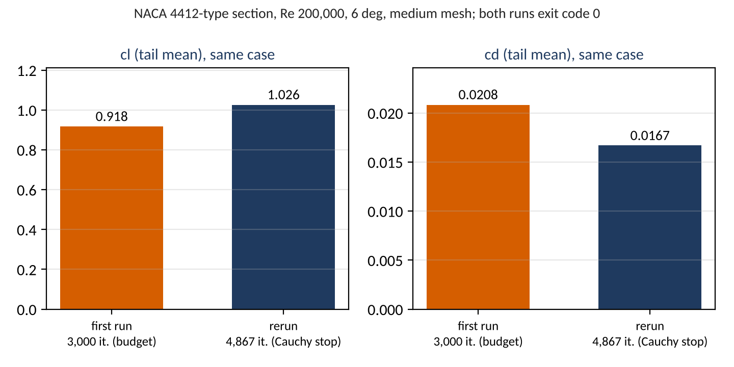
A clean exit is not a correct result
The first SU2 airfoil case exited with code 0 after its whole 3,000-iteration budget, with cl -10.5 % and cd +24.7 % against its own Cauchy-stopped rerun; only checks after the solver could see it.
SU2 exits with code 0
after 3,000 iterations, files written
postprocess looks for rms[rho]
error.json: postprocess_error
drift rule on the history:
cl 5.6 %, cd 17.4 % over the last fifth
Figure: docs/talk/figures/drone/clean_exit.png. Record: runs/smoke/airfoil2d-96a9dd0f51, runs/smoke2/airfoil2d-51d551f2cc.
decision 6: budget 6,000 with a Cauchy stop;
the rerun stops at 4,867
sources: runs/smoke/airfoil2d-96a9dd0f51/result.json, runs/smoke/airfoil2d-96a9dd0f51/error.json, runs/smoke2/airfoil2d-51d551f2cc/result.json, docs/specs/task10_tasks.md
D2 | 3
Notes:
SU2 ran its budget, wrote its files and exited cleanly, and the numbers were far from the solution the same case reaches when it is allowed to stop itself. The postprocess step failed first, looking for the compressible residual rms[rho], and the incompressible solver writes rms[P]; that failure is what made anybody look. The budget became 6,000 with a Cauchy stop, and the rerun stopped itself at 4,867 iterations.

Slide 4
What caught each problem, and when
Six problems were stopped by the earliest check that could see them; two of them were found by reading the records rather than by a gate.
Problem | Caught by | Without the check | Record
Postprocess read the compressible residual rms[rho] | the postprocess step (postprocess_error) | a run with no convergence status | smoke error.json
The 3,000-iteration budget ended with cl -10.5 % | drift rule; the Cauchy-stopped rerun | a polar built on unconverged runs | smoke, smoke2 result.json
Fine mesh not reproduced at the 1 nm fingerprint | the worker's mesh check (mesh_mismatch; boxes differ by 0 m) | a solve on a mesh nobody checked | first_attempt error.json
A 29 deg kink at the E387 nose from two half-splines | a geometry test and the inverted-cell gate | a mesh with inverted cells | task 10 report, section 3
The ledger said SU2 "drags 3 to 10 % low" | the deck builder reading runs/e387 | a wrong statement: per point cd is 10.3 % low to 1.6 % high | runs/e387 result.json
SU2's lift slope +5.5 % off the tunnel | V6e, tolerance 5 % fixed before any run | an unflagged bias in every SU2 polar | v6.json; decision 8
sources: runs/smoke/airfoil2d-96a9dd0f51/error.json, runs/mesh/airfoil2d-e161fb7e6b.first_attempt/error.json, docs/validation/2026-11-08_task10_report.md, runs/e387/airfoil2d-498b156761/result.json, runs/drone/validation/2026-11-08/v6.json, docs/specs/task10_tasks.md
D3 | 4
Notes:
The fingerprint refusal is the worker declining to run a mesh it could not reproduce bit for bit, even though the bounding boxes agreed to 0 m. The drag claim was a sentence in the task ledger that the deck builder contradicted when it read the E387 records directly. The lift-slope miss was caught by a tolerance fixed before any case ran, and decision 8 kept it a fail.

Slide 5
Why MCP tools, and what they do not add
The agent reaches the queue only through 11 typed MCP tools with a strict schema and the physics gates; the worker repeats the gates, and every call is logged.
The 11 tools (mcp_server/server.py)
What the MCP layer adds | What does not depend on it
One entry point for the agent, with typed arguments | The physics gates, run again by the worker before SU2 starts
A strict schema per family: unknown fields refused (extra="forbid", strict=True) | The mesh fingerprint and the config hash the worker re-checks
An audit line per call in mcp_log.jsonl (tool, argument hash, ok, case id) | The sha256 digest checked at ingest
Nothing is staged when a check fails | The sampling points: Sobol tables and acquisition code, never the language model
validate_config
create_case
submit
status
list_results
queue_batch
export_batch
record_transfer
ingest_result
ingest_error
postprocess
sources: mcp_server/server.py, mcp_server/schemas.py, mcp_server/queue.py, worker/run_worker.py
D4 | 5
Notes:
A script with the same validation would give the same gates and checksums, so MCP is a convenience layer with one entry point, typed arguments and an audit log. The language model never chose a sampling point in this study: the pools are Sobol tables and the acquisitions are code. No transcript of an agent call was recorded for this study, so the claim rests on the code and not on a session.

Slide 6
1. Problem and why it matters
4 minutes

Slide 7
The questions of the study
Four questions: the front, active learning against sampling, the two-level model, and the inverse query under a mass cap; the status of each answer is read from the records at build time.
Question | Status at build time | Slides
1. The front of endurance against take-off mass, with the GP's band and the named biases | Exact low-fidelity front: 249 designs. SU2-pool front: PENDING: runs/drone_pareto_hf/2026-11-09/pareto.csv | D34, D36
2. Active learning against LHS and random: pool replay, and online against the exact front | Answered on the low-fidelity model: plain EHVI loses online, weighted EHVI wins. SU2-pool replay: PENDING (pool batch) | D31, D32
3. Does the two-level model reach a given error with fewer SU2 polars? | recorded (15 of 32 SU2 designs complete) | D33
4. Longest endurance under the 4.0 kg cap with P(mass <= cap) >= 0.9, and one SU2 confirmation | Low model: a box corner, the cap never binds. SU2: PENDING: runs/drone_confirm/2026-11-09/confirm.json | D37, D38
sources: docs/specs/task10_drone_sizing.md, docs/specs/task10_tasks.md
D5 | 7
Notes:
Questions 1 and 2 have answers on the low-fidelity model, and the SU2 pool is what tests them at the high level. A null result on any of them is reported as such. The same loop applies to any validated simulator with a few inputs and two competing outputs.

Slide 8
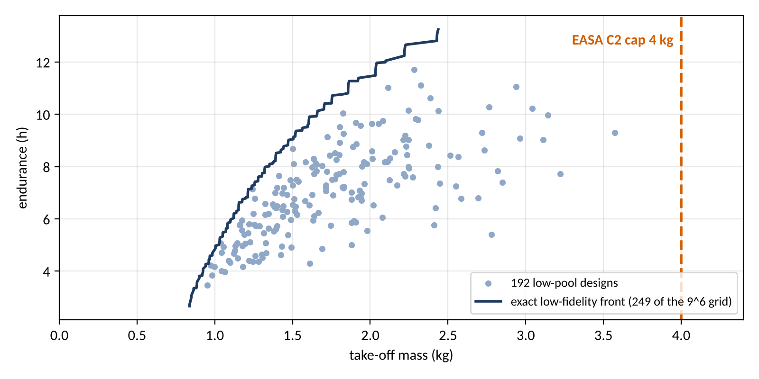
Endurance against take-off mass, under the C2 cap
The trade is endurance against take-off mass at a fixed 0.5 kg payload, and the EASA open-category class C2 caps take-off mass at 4 kg; on the low model none of the 192 pool designs comes near the cap (the heaviest is 3.57 kg).
Payload fixed at 0.5 kg (data/drone/rules.yaml).
Cap 4 kg at P(mass <= cap) >= 0.9, fixed in the spec before any run.
Heaviest low-pool design: 3.57 kg.
So the cap is tested only by the SU2 level (D37).
Figure: docs/talk/figures/drone/c2_cap.png. Record: runs/drone_pool_lf/2026-11-08/grid.csv, runs/drone_inverse_lf/2026-11-09/inverse.json.
sources: runs/drone_pool_lf/2026-11-08/grid.csv, runs/drone_grid/2026-11-08/front.csv, runs/drone_inverse_lf/2026-11-09/inverse.json, data/drone/rules.yaml
D6 | 8
Notes:
A longer wing and a bigger battery buy endurance and cost mass, so the answer is a front and not a point. The cap is a regulatory line fixed in the spec before any run. That it never binds on the low model is itself a finding: question 4 is only tested at the high level.

Slide 9
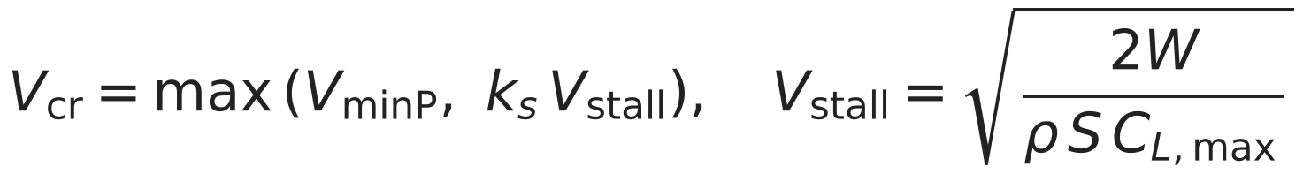
Six inputs, and what is fixed
Six inputs span the box; 46 fixed quantities come from the ledger, 21 of them assumed with a band, and the cruise speed is set by a rule rather than chosen.
Input | Range | Nominal | Sets
span_m | 1.2 to 3 | 2 | wing span b
aspect_ratio | 6 to 16 | 10 | b^2 / S, so the wing area
taper_ratio | 0.3 to 1 | 0.6 | tip over root chord, no sweep
battery_fraction | 0.2 to 0.45 | 0.3 | battery mass over take-off mass
camber_pct | 0 to 6 | 4 | NACA camber, at 40 % chord
thickness_pct | 8 to 15 | 12 | NACA thickness
Ledger set | n | pub. | der. | ass.
air | 3 | 3 | 0 | 0
battery | 3 | 0 | 0 | 3
propulsion | 2 | 0 | 0 | 2
structure | 5 | 3 | 0 | 2
rules | 33 | 11 | 8 | 14
k_s is the ledger's stall margin; V_minP is the speed of least power on the design's own polar.
Sea-level ISA air; the bands of the fixed quantities are swept once on D39, not learned.
sources: mcp_server/schemas.py, runs/drone/validation/2026-11-08/v6.json, data/drone/air.yaml, data/drone/battery.yaml, data/drone/propulsion.yaml, data/drone/structure.yaml, data/drone/rules.yaml, drone/mission.py
D7 | 9
Notes:
Cruise speed is not an input because an optimizer would always drive it to the same place. The fixed quantities' bands are not surrogate inputs; their effect is measured once by the one-at-a-time sweep on the results section. Sea-level ISA air is the only flight condition.

Slide 10
Two fidelity levels, and what each costs
A low-fidelity design costs 0.25 s of one core; one SU2 angle costs a median 10.6 min on the coarse mesh and 22.9 min on the medium mesh, and a design needs five angles.
Level | Section data | Measured cost | Used for
Low (container) | closed forms, drone/section.py | 0.25 s per design per core: the 531,441-point grid in 4.7 h on 8 workers; the 192-point pool in 669 s on 2 | exact front, low pool, online replay, the low level of the two-level model
High (Colab, 4 ranks) | SU2 polar of the design's own section at its cruise Re | per angle: median 10.6 min coarse (84 cases), 22.9 min medium (30 cases); five angles per design | the SU2 pool: 172 cases in the case table
Medians over every SU2 result.json in runs/ at build time, by mesh level (E387, nominal, mesh, smoke and pool cases).
sources: runs/drone_grid/2026-11-08/record.json, runs/drone_pool_lf/2026-11-08/record.json, runs/pool_af/airfoil2d-2862718ac9/result.json, runs/e387/airfoil2d-498b156761/result.json, designs/pool_af_cases.csv
D8 | 10
Notes:
The costs are medians over every SU2 record in the repository at build time, by mesh level. The ratio between the levels is what makes the exact low-fidelity front possible and the high-fidelity pool small. The two levels differ only in where the section data come from.

Slide 11
2. Physics and validation
10 minutes

Slide 12
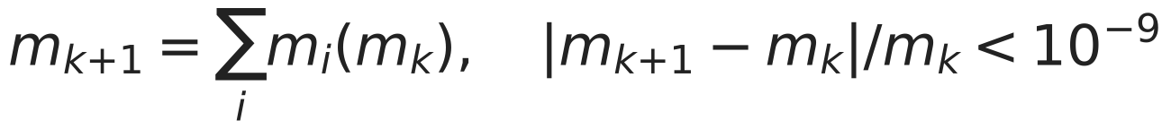
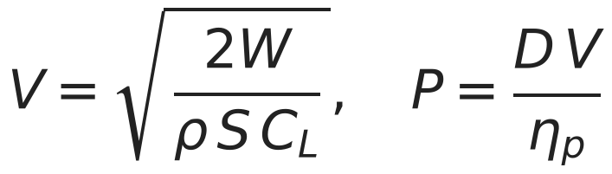
The model in one picture
Six inputs go through a vortex lattice, a drag build-up, a mass closure and a mission to endurance and take-off mass, at two fidelity levels that differ only in the section data.
Two fidelity levels: the section data is the only block that differs
Low: closed forms (drone/section.py)
thin-airfoil lift, flat-plate drag
High: SU2 airfoil2d polar
SA-BCM, at the design's own Re
(PENDING: pool batch)
Six inputs
span_m 1.2 to 3
aspect_ratio 6 to 16
taper_ratio 0.3 to 1
battery_fraction 0.2 to 0.45
camber_pct 0 to 6
thickness_pct 8 to 15
Geometry
drone/geometry.py
wing, tail, fuselage
Vortex lattice
drone/vlm.py
CL_alpha, e, strip cl
Drag build-up
drone/drag.py
Mass closure
fixed point on m_TO
Mission
energy balance
P = D V / eta
Outputs
endurance, m_TO,
gates
Gates before any solver: Reynolds range, stall margin, mass closure, manufacturing floor, lattice quality (spec section 4).
sources: docs/specs/task10_drone_sizing.md, drone/evaluate.py, mcp_server/schemas.py, docs/talk/build_deck_drone.py
D9 | 12
Notes:
The lattice, the drag build-up and the closure are the same at both levels. The low level takes the section from closed forms; the high level takes it from an SU2 airfoil polar at the design's own Reynolds number.

Slide 13
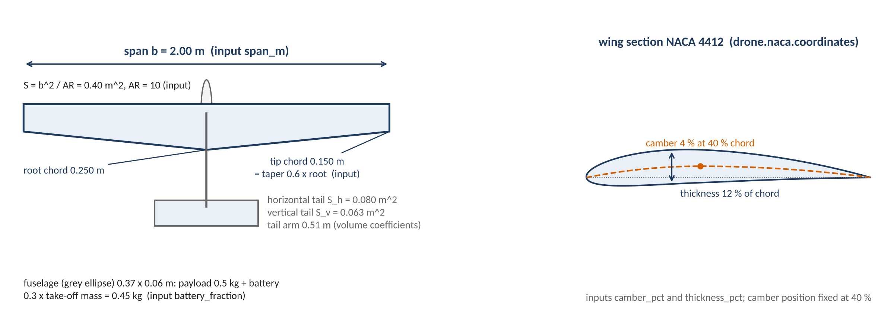
The nominal design in one top view
The nominal design has a 2 m span, aspect ratio 10 and taper 0.6: 0.40 m^2 of wing and a closed take-off mass of 1.51 kg; tail and fuselage follow from the wing by rule.
Figure: docs/talk/figures/drone/planform.png. Record: drone/geometry.py, drone/naca.py.
sources: drone/geometry.py, drone/naca.py, drone/evaluate.py, runs/drone/validation/2026-11-08/v6.json, docs/talk/build_deck_drone.py
D10 | 13
Notes:
Span and aspect ratio fix the wing area, taper fixes the chords, and the tail is sized by volume coefficients with a fixed arm. The fuselage is a body of revolution holding the payload and the battery; its position along the wing is schematic.

Slide 14
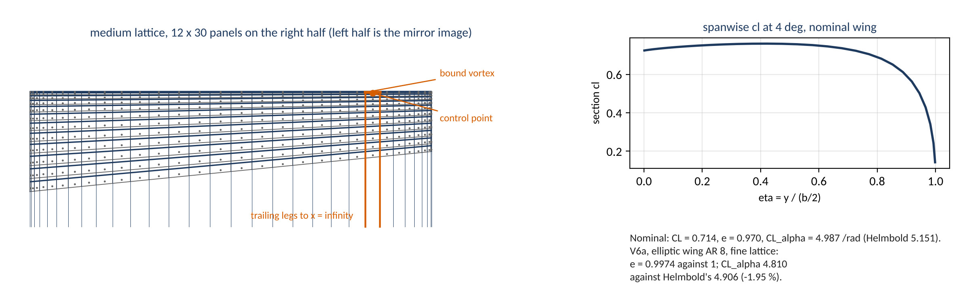
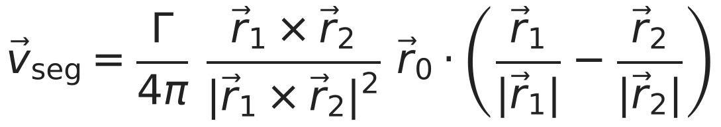
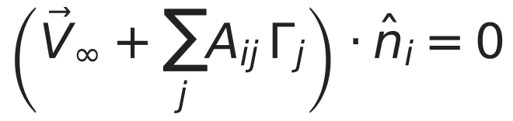
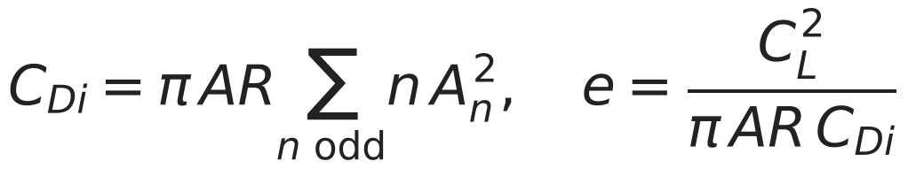
What V6a checks: the vortex lattice
The lattice puts one horseshoe vortex on each panel; V6a checks its span efficiency (-0.26 % against 1) and lift slope (-1.95 % against Helmbold) on an elliptic wing of aspect ratio 8.
Figure: docs/talk/figures/drone/vlm_lattice.png. Record: runs/drone/validation/2026-11-08/v6.json, drone/vlm.py (segment velocity, no-flow condition, Trefftz-plane drag).
sources: drone/vlm.py, drone/geometry.py, runs/drone/validation/2026-11-08/v6.json, docs/talk/build_deck_drone.py
D11 | 14
Notes:
Bound vortices sit on the quarter chord and control points on the three-quarter chord of each panel. The nominal wing's own span efficiency and lift slope are in the figure beside the V6a values.

Slide 15
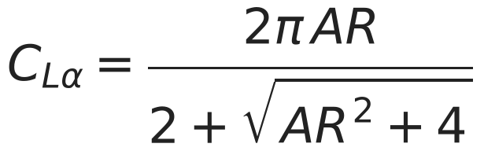
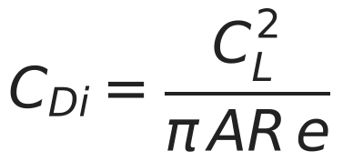
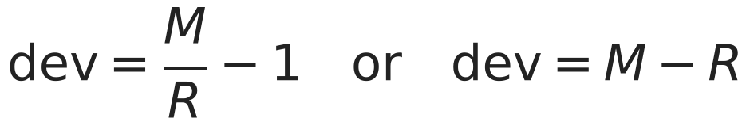
Validation V6a to V6d
The solver's own checks pass: 12 toleranced rows pass, 1 is pending a source, 0 fails.
Row | Deviation | Tolerance | Verdict
V6a elliptic AR 8 fine: e at 4 deg vs 1 | -0.26 % | 1 % | pass
V6a elliptic AR 8 fine: CL_alpha vs Helmbold | -1.95 % | 3 % | pass
V6a elliptic AR 8 fine: CDi vs CL^2/(pi AR_planform e) | 0.00e+00 | 1e-09 | pass
V6a elliptic AR 100 fine: CL_alpha vs 2 pi AR/(AR+2) | -0.09 % | 1 % | pass
V6b Warren-12 fine: CL_alpha vs benchmark | +1.01 % | 2 % | pass
V6b Warren-12 fine: Cm_alpha (about root LE, reference chord 1.0) vs benchmark | +1.19 % | 2 % | PENDING: reference point not yet sourced
V6c nominal: CL_alpha, medium vs fine | +0.17 % | 1 % | pass
V6c nominal: e at 4 deg, medium vs fine | -0.26 % | 1 % | pass
V6c nominal: endurance_h, medium vs fine | -0.13 % | 2 % | pass
V6d closure_residual below 1e-9 | 5.61e-10 | 1e-09 | pass
V6d energy balance: spent vs usable battery energy | 2.22e-16 | 1e-09 | pass
V6d endurance_h vs closed form | 0.00e+00 | 1e-06 | pass
V6d sum of masses vs mtow | 0.00e+00 | 1e-09 | pass
M measured, R reference; the table says which form each row uses
sources: runs/drone/validation/2026-11-08/v6.json
D12 | 15
Notes:
These rows check the vortex lattice against Helmbold's slope and lifting-line theory, the Warren-12 benchmark, the lattice convergence and the mass and energy closure. The one pending row waits on the source of the benchmark's moment reference point; it is not tuned to agree.

Slide 16
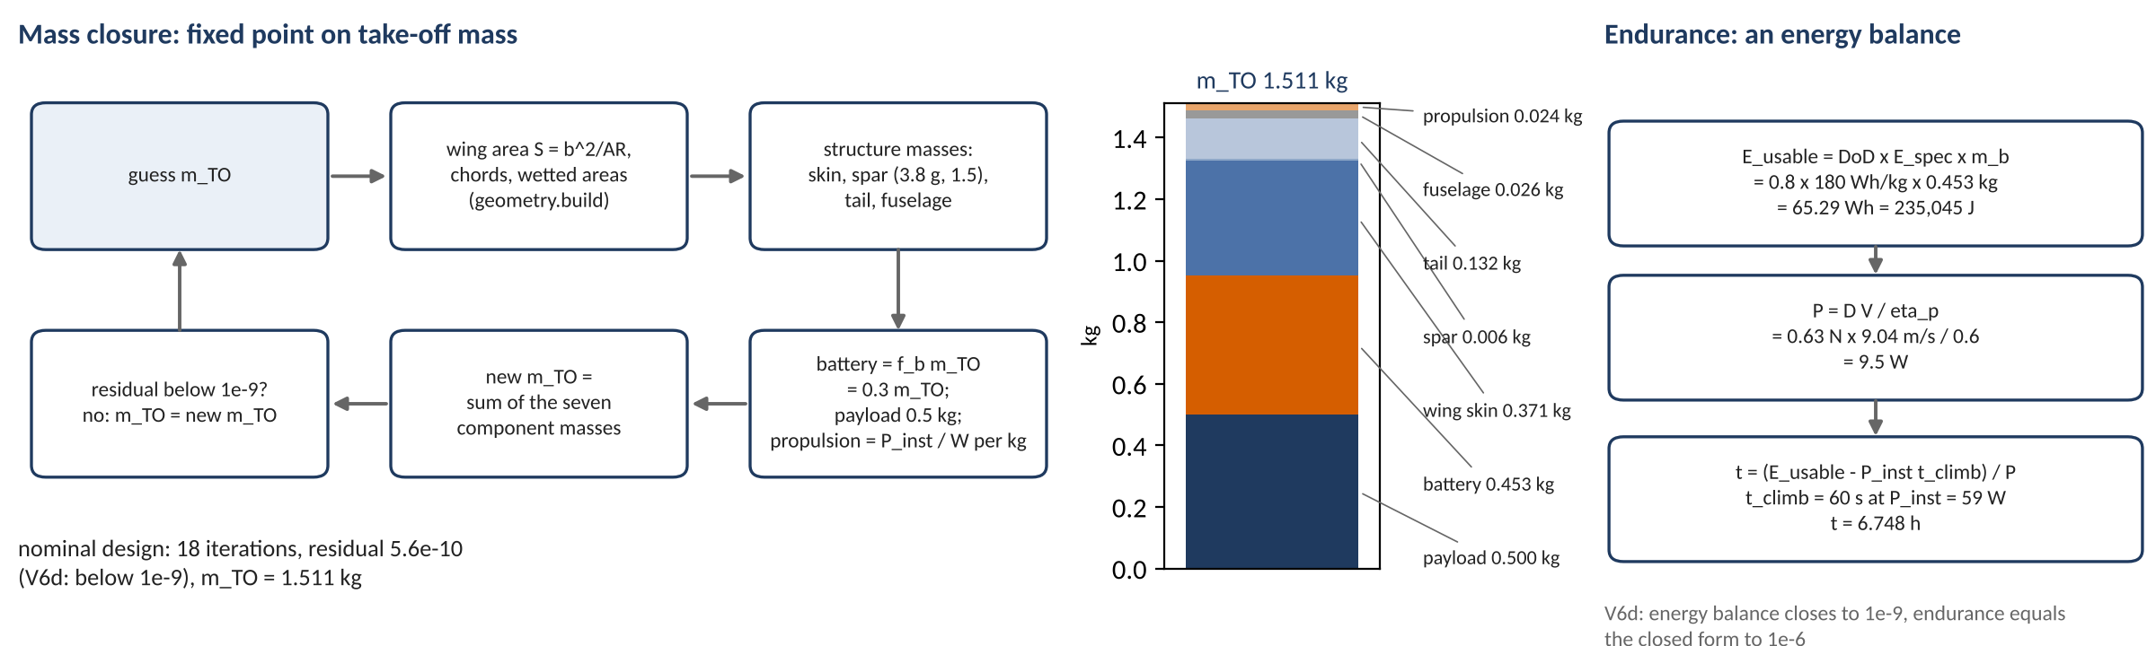
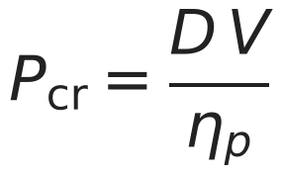
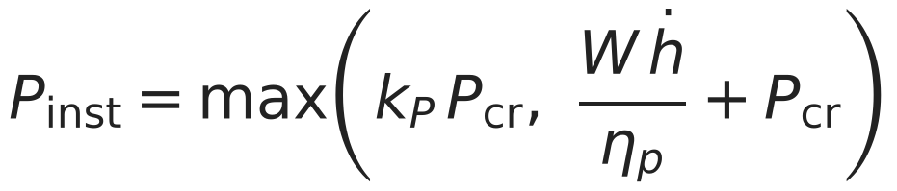
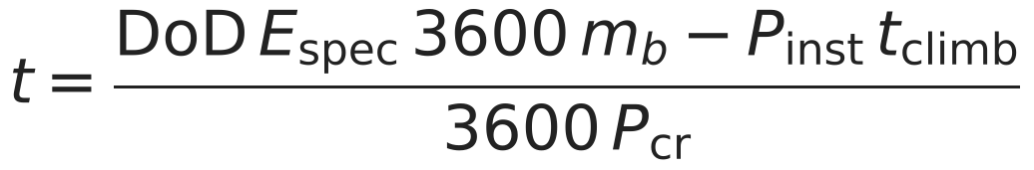
Mass closure and the endurance balance
Take-off mass is a fixed point and endurance is an energy balance: at the nominal design the closure takes 18 iterations and the balance gives 6.75 h.
Figure: docs/talk/figures/drone/closure_energy.png. Record: runs/drone/validation/2026-11-08/v6.json, drone/evaluate.py, drone/mission.py.
sources: drone/evaluate.py, drone/mission.py, runs/drone/validation/2026-11-08/v6.json, docs/talk/build_deck_drone.py
D13 | 16
Notes:
Battery mass is the battery fraction times take-off mass, so the loop has to be iterated. V6d checks that the loop and the energy balance close to 1e-9.

Slide 17
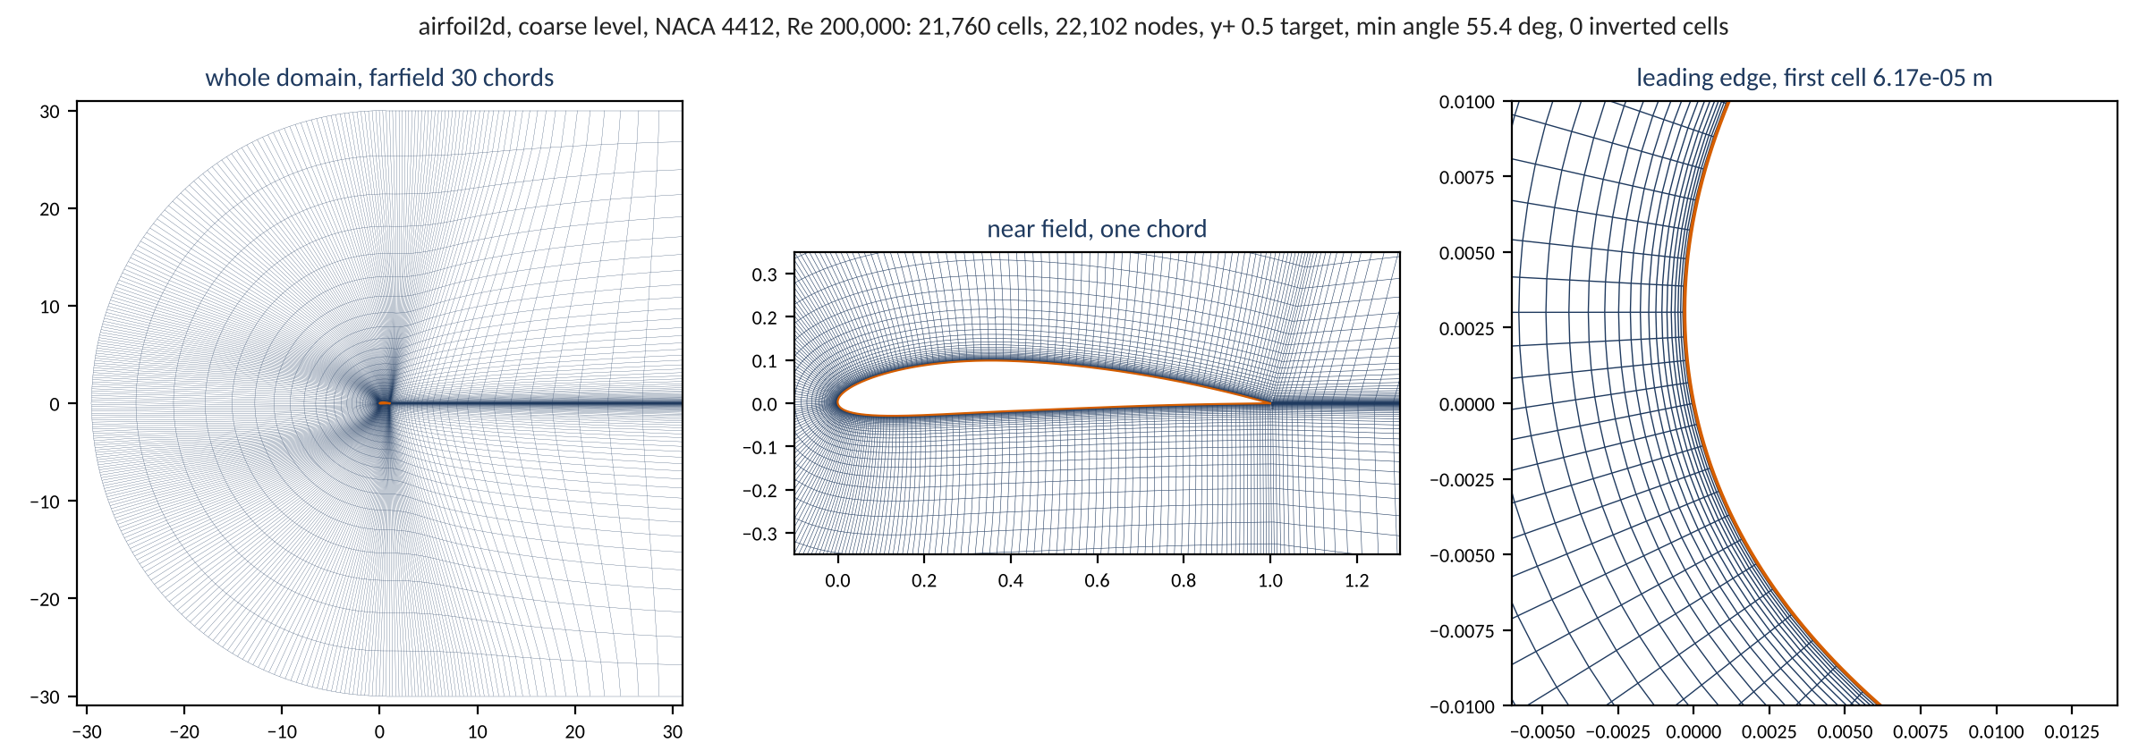
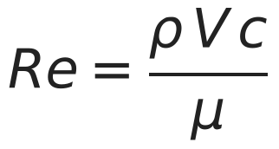
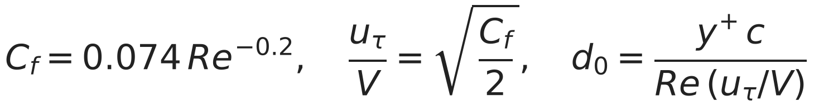
The airfoil RANS family: the mesh
The SU2 section runs incompressible RANS with Spalart-Allmaras and its BCM transition option on a structured C-mesh of 21,760 cells with a first cell of 6.17e-05 m, drawn here from the mesh builder at the coarse level.
Figure: docs/talk/figures/drone/airfoil2d_mesh.png. Record: runs/mesh/airfoil2d-59cd4287e9/geometry.json. Equations: drone/evaluate.py, geometry/airfoil2d.py.
sources: geometry/airfoil2d.py, runs/mesh/airfoil2d-59cd4287e9/geometry.json, runs/mesh/airfoil2d-59cd4287e9/mesh_quality.json, runs/mesh/airfoil2d-59cd4287e9/params.json, cases/templates/inc_rans_airfoil.cfg
D14 | 17
Notes:
The mesh is rebuilt from the recorded parameters and checked against the recorded cell count before it is drawn. The first cell is set for y+ of 0.5 at the design's Reynolds number.

Slide 18
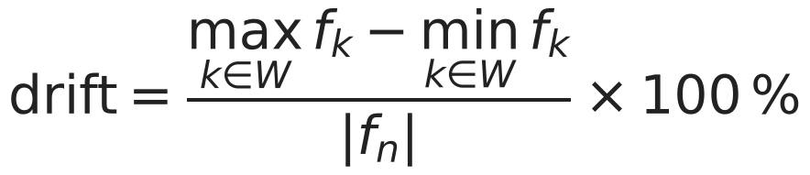
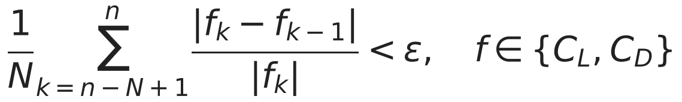
Two stopping rules: SU2's Cauchy stop and the drift rule
The airfoil2d family stops on a Cauchy criterion because the first smoke case ran its whole 3,000-iteration budget unconverged; the rerun stopped itself at 4,867, and the drift rule still reports both runs as moving.
Run | Budget | Iterations | cl drift (%) | cd drift (%) | Status
first smoke case | 3000 | not recorded (postprocess error) | 5.62 | 17.38 | error
rerun with Cauchy stop | 6000 | 4867 | 2.15 | 5.34 | not_converged
Drift rule (postprocess/history.py)
SU2 Cauchy rule, as the case template states it
Cauchy settings (cases/templates/inc_rans_airfoil.cfg)
What stays the same: the Drive queue, the worker, the digest check and the gates.
What is new: the airfoil2d family, its mesh-quality checks and this stopping rule.
The drift rule and SU2's Cauchy rule measure different things; the record carries both.
CONV_FIELD= ( LIFT, DRAG )
CONV_CAUCHY_ELEMS= 200
CONV_CAUCHY_EPS= 1E-5
CONV_STARTITER= 500
sources: runs/smoke/airfoil2d-96a9dd0f51/result.json, runs/smoke2/airfoil2d-51d551f2cc/result.json, cases/templates/inc_rans_airfoil.cfg, docs/specs/task10_tasks.md
D15 | 18
Notes:
The two rules measure different things: SU2's averages the per-iteration change over the last 200 iterations, the drift rule takes the range over the last fifth of the run. Both are kept on every record and no rule was loosened. Everything else in the queue, the worker and the gates is the inlet machinery unchanged.

Slide 19
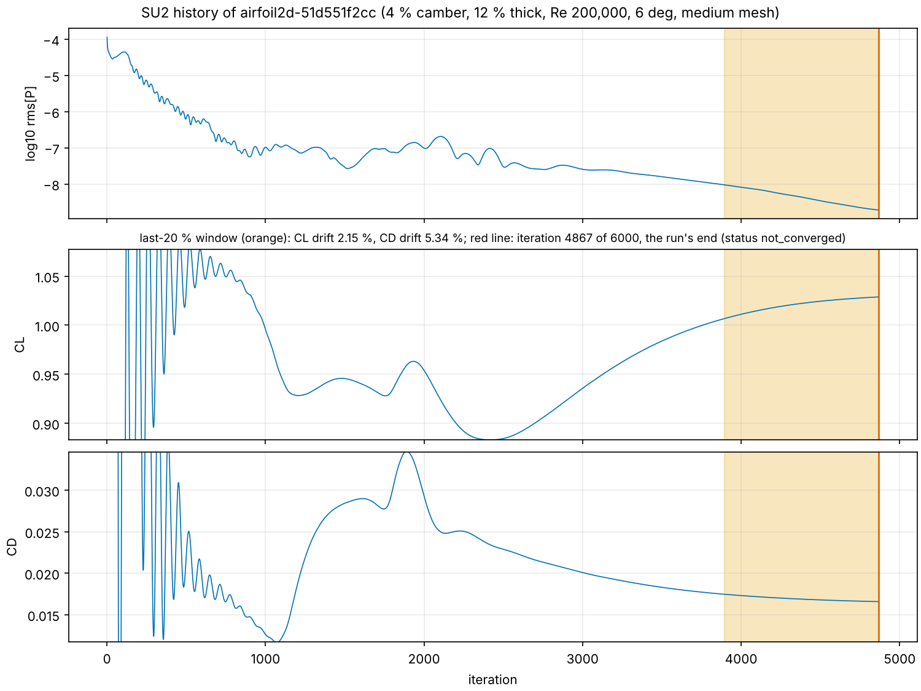
What the solver history looks like
The medium-mesh nominal case ran 4867 of 6000 iterations and dropped rms[P] by 4.8 orders, yet over the last 20 % of its history CL still drifts 2.15 % and CD 5.34 %.
Figure: docs/validation/figures/task10/flow/convergence_smoke2.png. Record: runs/smoke2/airfoil2d-51d551f2cc/history.csv.gz.
sources: docs/validation/figures/task10/flow/convergence_smoke2.png, docs/validation/figures/task10/flow/captions.md, runs/smoke2/airfoil2d-51d551f2cc/history.csv.gz, runs/smoke2/airfoil2d-51d551f2cc/result.json
D16 | 19
Notes:
The residual alone looks converged while the force coefficients are still moving, which is why the drift rule exists. This is the only history file downloaded so far; the others are not drawn.

Slide 20
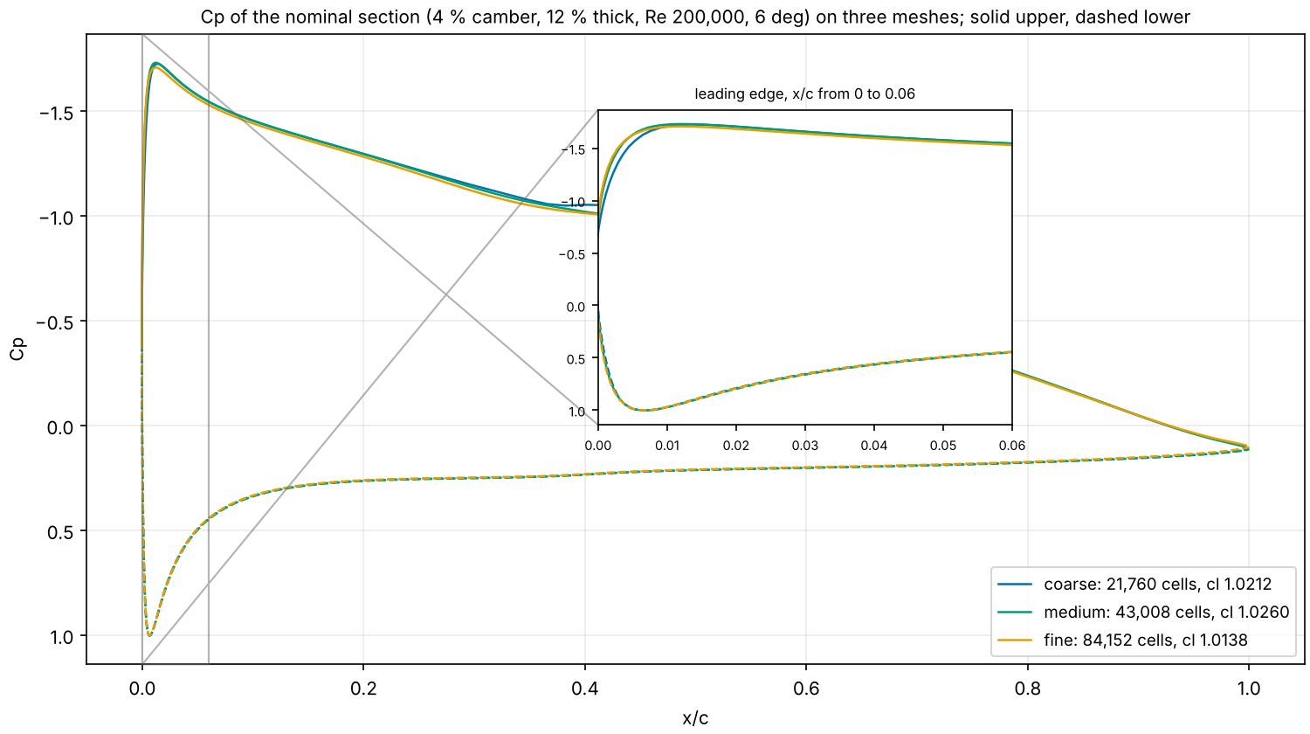
What the mesh does to the pressure distribution
On the nominal section the peak suction is Cp -1.726 on the coarse mesh (21,760 cells), -1.731 on the medium (43,008) and -1.708 on the fine (84,152); cl is 1.0212, 1.0260 and 1.0138.
Figure: docs/validation/figures/task10/flow/cp_mesh_pair.png. Record: runs/mesh, runs/smoke2 surface_flow.dat.gz.
sources: docs/validation/figures/task10/flow/cp_mesh_pair.png, docs/validation/figures/task10/flow/captions.md, runs/mesh/airfoil2d-59cd4287e9/surface_flow.dat.gz, runs/smoke2/airfoil2d-51d551f2cc/surface_flow.dat.gz, runs/mesh/airfoil2d-e161fb7e6b/surface_flow.dat.gz
D17 | 20
Notes:
This is the picture behind the mesh table in backup DB4: the curves agree away from the leading edge and differ in the peak. Every run of the three was flagged not converged, so the differences mix mesh and convergence effects.

Slide 21

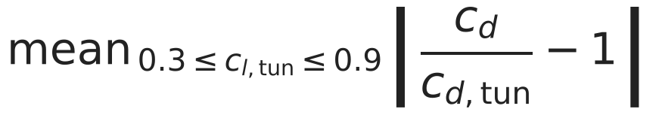
V6f: the low-fidelity section against the E387 tunnel
The closed-form section is 19 to 23 % low in lift slope, misses profile drag by 43 to 52 % and overpredicts cl_max by 12 to 13 %; nothing was tuned.
Quantity | Re 101,800 | Re 203,800 | Re 305,200
lift slope | -22.6 % | -19.1 % | -20.2 %
zero-lift angle | -0.90 deg | -0.76 deg | -0.83 deg
profile drag, mean ratio | +52.0 % | +47.5 % | +43.4 %
cl_max | +12.2 % | +12.7 % | +13.5 %
Report-only rows by the spec: closed forms of drone/section.py at the E387's measured camber and thickness against Volume 1 runs 211, 213 and 215.
The ledger's assumed lift effectiveness does not contain the value the tunnel implies: a ledger ruling, not a number to move here.
sources: runs/drone/validation/2026-11-08/v6.json, data/validation/e387_uiuc.yaml
D18 | 21
Notes:
These are the sizes of the errors the two-level model has to learn. The lift effectiveness the ledger assumes does not contain the value the tunnel implies; that is a ledger ruling and not a number to move here.

Slide 22
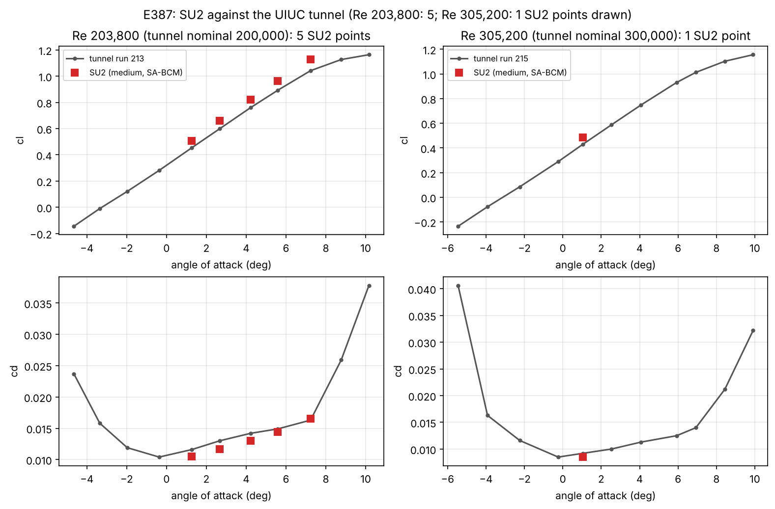
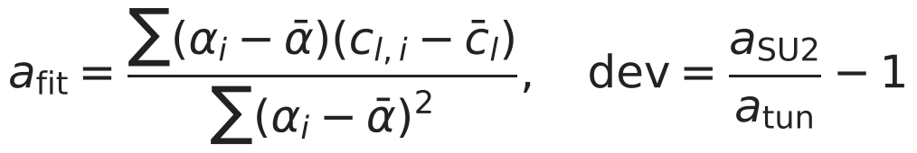
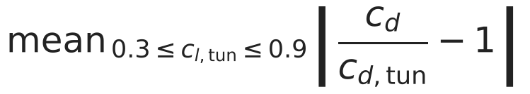
V6e: SU2 against the tunnel, and decision 8
SU2's lift slope misses the tunnel by 5.49 % against a 5 % tolerance: a fail, kept as a fail, and accepted as the high level with the bias recorded.
Row | Deviation | Tol. | Verdict
cl_alpha Re 203800 | +5.49 % | 5 % | FAIL
cd ratio Re 203800 | +7.99 % | 20 % | pass
cl_max Re 203800 | -3.00 % | report | report
cl_alpha Re 305200 | +6.44 % | 5 % | FAIL
cd ratio Re 305200 | +5.74 % | 20 % | pass
cl_max Re 305200 | -3.92 % | report | report
Against the tunnel at the five angles of Re 203,800: cl is 8.0 to 11.6 % high; cd is 10.3 % low to 1.6 % high.
Decision 8: accepted as the high level with the miss recorded beside every number.
The medium-against-fine row is not run (DB2); the figure draws what exists.
Figure: docs/validation/figures/task10/d_e387_comparison.png. Record: runs/e387/*/result.json.
sources: docs/validation/figures/task10/d_e387_comparison.png, runs/drone/validation/2026-11-08/v6.json, runs/e387/airfoil2d-498b156761/result.json, docs/specs/task10_tasks.md
D19 | 22
Notes:
The tolerance was fixed before any case ran, and the miss is reported as a fail. Decision 8 accepts the medium-mesh polar as the high level and attaches the miss to every record it produces. The figure draws whatever E387 points exist at build time.

Slide 23
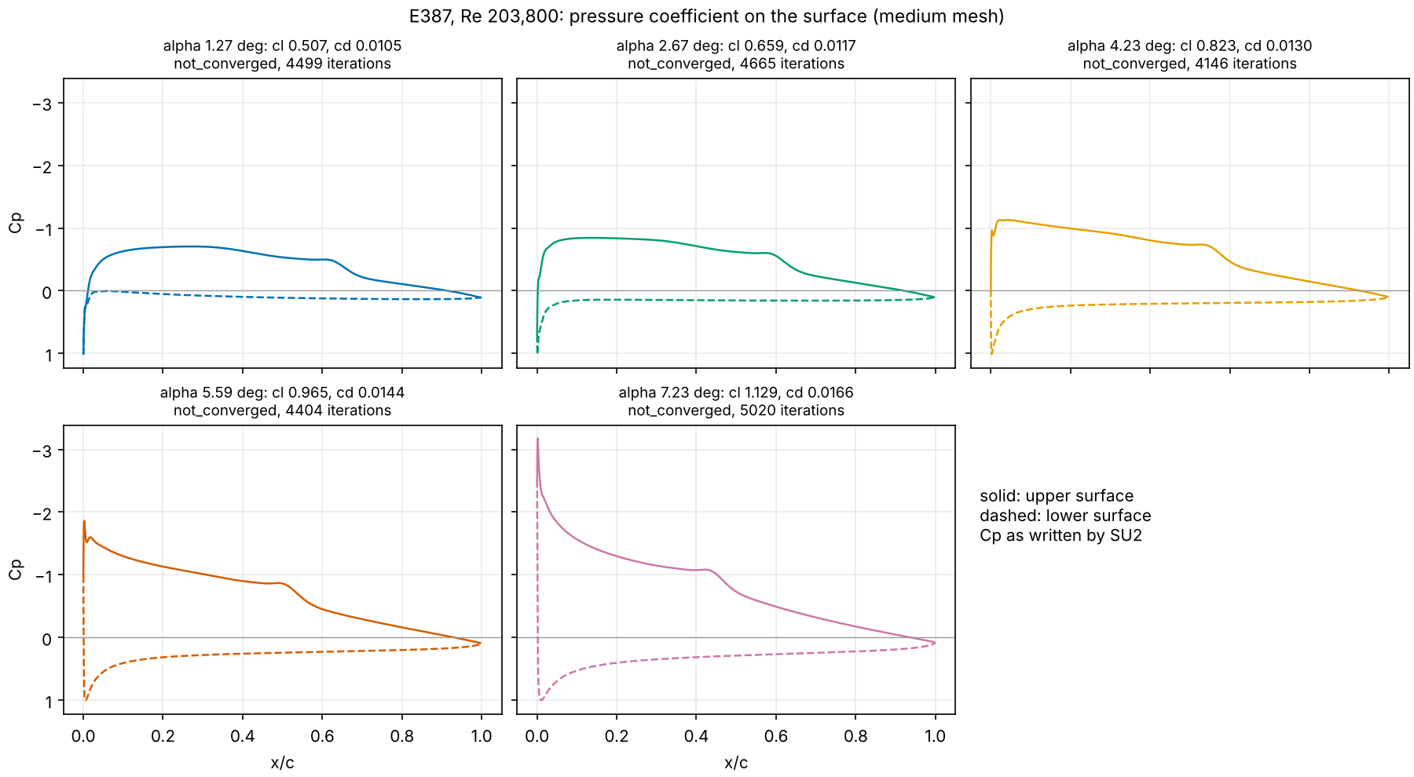
The E387 pressure distributions
On E387 at Re 203,800 the suction peak on the upper surface deepens from Cp -0.71 at 1.27 deg to -3.18 at 7.23 deg, and a kink in the upper-surface Cp moves forward as the angle rises.
Figure: docs/validation/figures/task10/flow/cp_e387.png. Record: runs/e387/*/surface_flow.dat.gz.
sources: docs/validation/figures/task10/flow/cp_e387.png, docs/validation/figures/task10/flow/captions.md, runs/e387/airfoil2d-498b156761/surface_flow.dat.gz, postprocess/plot_airfoil.py
D20 | 23
Notes:
Every curve is the Pressure_Coefficient column SU2 wrote at the surface nodes, read from the committed files. All five cases are flagged not converged by the drift rule, which each panel title states.

Slide 24
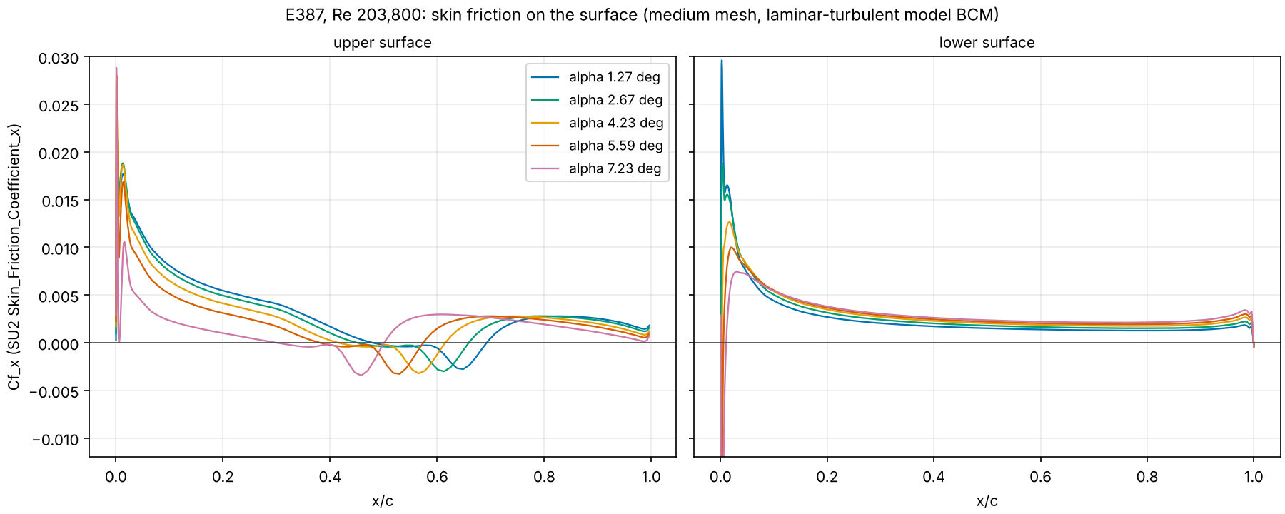
Where the wall shear reverses
On the E387 upper surface the skin friction changes sign, which marks reversed flow at the wall: from x/c 0.48 to 0.68 at 1.27 deg and from 0.30 to 0.49 at 7.23 deg.
Figure: docs/validation/figures/task10/flow/cf_e387.png. Record: runs/e387/*/surface_flow.dat.gz.
sources: docs/validation/figures/task10/flow/cf_e387.png, docs/validation/figures/task10/flow/captions.md, runs/e387/airfoil2d-498b156761/surface_flow.dat.gz, postprocess/plot_airfoil.py
D21 | 24
Notes:
Cf_x is the x component of SU2's Skin_Friction_Coefficient, so a negative value means the wall shear points upstream. The negative stretch sits where the Cp panels show their kink, and it moves forward with angle.

Slide 25
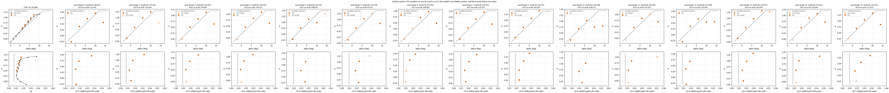
Section polars: SU2, the closed form and the tunnel
On E387 SU2's cl is 8.0 to 11.6 % high and cd is 10.3 % low to 1.6 % high against the tunnel; on the 15 complete pool designs the 15 cases at 14 degrees (cl 0.48 to 1.39, cd 0.067 to 0.188) are the stall the closed form cannot show.
Figure: docs/validation/figures/task10/flow/section_polars.png. Records: runs/e387/*/result.json, runs/pool_af/*/result.json, runs/pool_af/2026-11-09/results.csv, data/validation/e387_uiuc.yaml. Open circles are cases the pool did not keep.
sources: docs/validation/figures/task10/flow/section_polars.png, docs/validation/figures/task10/flow/captions.md, runs/pool_af/2026-11-09/results.csv, data/validation/e387_uiuc.yaml, drone/section.py
D22 | 25
Notes:
The closed form is a straight line to a cap and a constant drag, so it has no stall and no drag rise. Open circles are cases the pool did not keep for the polar. The figure is redrawn from the pool records at every build.

Slide 26
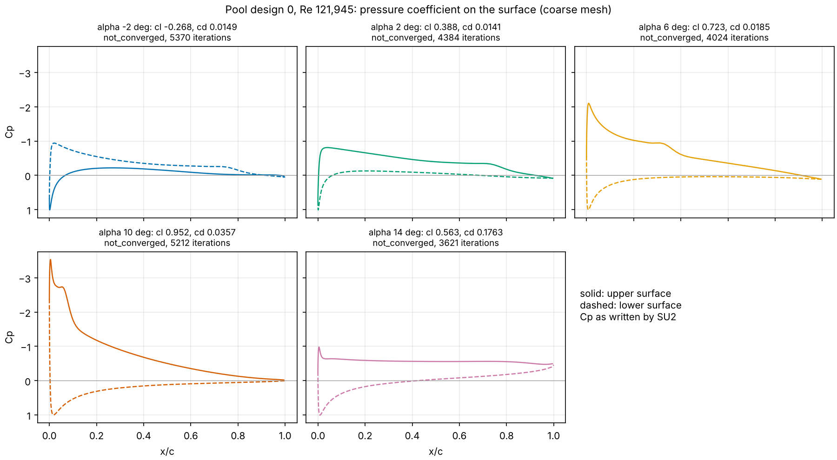
The stall at 14 degrees
On pool design 0 the section stalls between 10 and 14 degrees: cl falls from 0.952 to 0.563, cd rises from 0.0357 to 0.1763, and the suction peak collapses from Cp -3.53 to -0.98.
Figure: docs/validation/figures/task10/flow/cp_design0.png. Record: runs/pool_af/*/surface_flow.dat.gz.
sources: docs/validation/figures/task10/flow/cp_design0.png, docs/validation/figures/task10/flow/captions.md, runs/pool_af/airfoil2d-2862718ac9/surface_flow.dat.gz, postprocess/plot_airfoil.py
D23 | 26
Notes:
The flat upper-surface Cp at 14 degrees is the signature of separated flow over most of the chord. Cases a pool design leaves out of its polar are drawn as open circles on the polar slide.

Slide 27
Pressure contours and streamlines
PENDING: two volume-output cases, airfoil2d-731806baea and airfoil2d-0ae85f2779, will give Cp contours and streamlines at 6 and 14 degrees once they run after the pool.
PENDING: no number is shown here until the record exists.
Cp contours and streamlines, design 0 coarse mesh:
airfoil2d-731806baea: 6 deg
airfoil2d-0ae85f2779: 14 deg
PENDING: the viz batch (flow.dat is written only when save_volume is true)
The command that draws them exists: python -m postprocess.plot_flowfield airfoil CASE_DIR --out PNG, tested on a synthetic volume file.
Panels: Cp contours and speed with streamlines, whole section and the leading edge.
sources: PENDING: runs/viz/airfoil2d-731806baea/flow.dat.gz, runs/viz/airfoil2d-0ae85f2779/flow.dat.gz (viz batch, volume output of design 0, coarse mesh)
D24 | 27
Notes:
The cases are queued with volume output on and run after the pool. The drawing command is written and tested on a synthetic file, so the pictures follow the moment the files land.

Slide 28
3. Automation layer: MCP tools, gates, queue
4 minutes

Slide 29
The tools and the gates
The MCP server exposes 11 tools and never runs SU2; a drone design passes 5 gates of the spec before any solver, and an airfoil case passes the mesh-quality gate.
Tool | What it does (first docstring line)
validate_config | Check case parameters through schema, physics gates, mesh and config; writes nothing,
create_case | Validate the parameters and stage a job directory with status created; refuses bad input
submit | Mark a created job as pending so it can be uploaded to the worker's Drive queue.
status | List staged jobs (or one) with their status from the flag files.
list_results | Table of staged jobs with metrics from result.json where available (null otherwise),
queue_batch | Create and submit one inlet2r job per row (theta1_deg, theta2_deg) of a committed design
export_batch | Bundles staged jobs into one batch file for upload; never runs SU2.
record_transfer | Log a Drive upload or download of a job or result file done through the connector
ingest_result | Validate a result.json downloaded from Drive against the staged job (case_id, mesh and config
ingest_error | Store an error.json downloaded from Drive for a staged job and flag the job failed.
postprocess | Return the metrics block of a staged job from its result.json, or recompute it from a staged
Drone gates (drone/evaluate.py)
gate 1 (reynolds range)
gate 2 (stall margin)
gate 3 (mass closure)
gate 4 (manufacturing floor)
gate 4 (wing loading)
gate 5 (lattice quality)
airfoil2d: the mesh-quality gate (worker/make_case.py, quality_failures): inverted cells, minimum angle, first cell, growth, aspect ratio.
Messages carry the offending value, in the inlet's form.
sources: mcp_server/server.py, drone/evaluate.py, physics/gates.py, worker/make_case.py
D25 | 29
Notes:
Each gate fails with the offending value in its message, in the inlet's form. The same gate function runs when a case is created and again on the worker before SU2 starts.

Slide 30
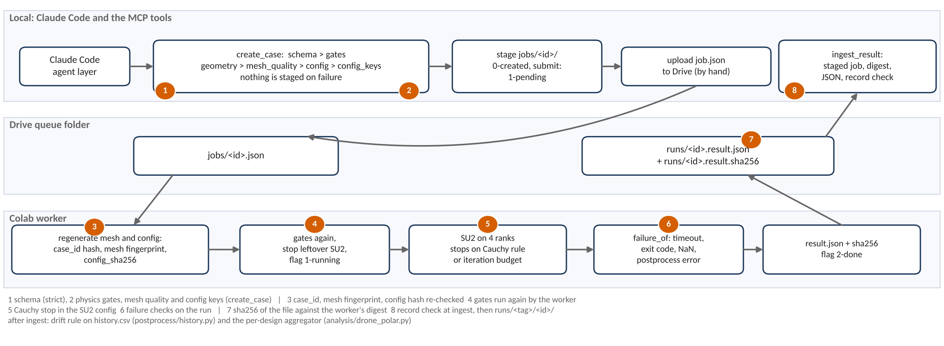
Where each gate sits: the Drive queue and the Colab worker
Every request passes the same ordered checks before SU2 starts, and every result passes more before it becomes a record; the numbered marks show where.
Figure: docs/talk/figures/drone/queue_gates.png. Record: mcp_server/queue.py, worker/run_worker.py.
sources: mcp_server/queue.py, mcp_server/schemas.py, worker/run_worker.py, analysis/drone_polar.py, postprocess/history.py, docs/talk/build_deck_drone.py
D26 | 30
Notes:
Colab cannot take inbound connections, so jobs go through a Drive folder and come back as files with a digest. The worker rebuilds the mesh and config from the uploaded parameters and refuses a mismatch. Stage and step names in the drawing are checked against the code at build time.

Slide 31
Two workers on one queue, and ingestion with sha256
With --shard K/N each worker takes the cases whose id hash is K modulo N, so two Colab sessions split the 172 pool cases 85 and 87 with no claim race; every result is ingested against its sha256, and the pool table's own hash checks: yes.
The shard rule (worker/run_worker.py, in_shard)
worker: result.json + its sha256 to Drive
int(case_id hex digest, 16) mod N == K
Shard | Cases of the table it owns
--shard 0/2 | 85
--shard 1/2 | 87
total | 172
ingest_result: digest, JSON and record checks; runs/<tag>/<id>/
pool_af_results: per-design polar from at least 3 kept angles
Every case id lands in exactly one shard, so no two workers claim one job.
Worker ids in the pool records so far: 3.
Without the flag a worker takes every job; two unsharded workers on one queue are not allowed.
results.csv: 32 designs, 15 complete, 17 incomplete, 0 failed
record.json holds the sha256 of its inputs and outputs; the table's hash matches its record: yes.
sources: worker/run_worker.py, designs/pool_af_cases.csv, mcp_server/queue.py, analysis/pool_af_results.py, runs/pool_af/2026-11-09/record.json, runs/pool_af/2026-11-09/results.csv
D27 | 31
Notes:
Before the shard flag two workers on one queue would both have started the same job, so only one ran. The worker ids in the pool records so far: 3. The aggregator keeps Cauchy-stopped cases with their drift as flags and forms a design only when at least three angles are kept.

Slide 32
What the gated process caught
Each of these was found by a check or a recorded run before it could reach a result.
Caught | By | Resolution
Postprocess looked for the compressible column rms[rho] | The first airfoil2d case failing at postprocess | The classifier reads rms[P] (decision 6)
First case unconverged: cl drift 5.6 %, cd drift 17.4 % | The drift rule on the recorded history | Budget 6000 with a Cauchy stop (decision 6)
Fine-mesh case refused on the 1 nm fingerprint | The worker's mesh fingerprint check | Kept beside the rerun as .first_attempt
Fine E387 mesh has 8 inverted cells | The mesh inversion gate | Strict xfail; the V6e fine row stays not run
Point-vortex induced drag under-counts by about 1/N | The V6a elliptic-wing rows on the first lattice run | Trefftz-plane Glauert series (drone/vlm.py)
V6a reference for the AR 100 rectangular wing was wrong, not the solver | The same V6a rows | Reference corrected before any formal verdict (addendum 2)
sources: docs/specs/task10_tasks.md, runs/smoke/airfoil2d-96a9dd0f51/error.json, drone/vlm.py
D28 | 32
Notes:
The list holds only items recorded in the task file. Fix and cause are in the record each row names.

Slide 33
4. Surrogate and active learning
8 minutes

Slide 34
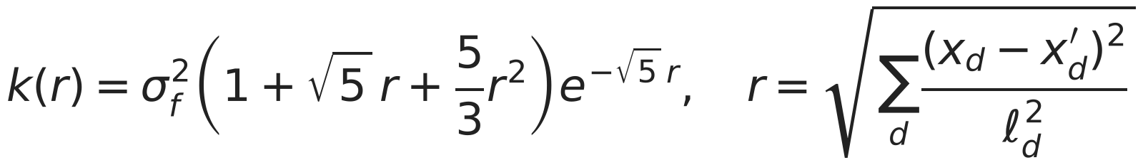



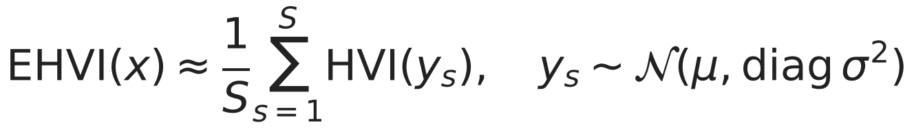
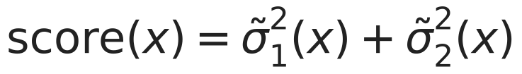
One Gaussian process per objective, and who chooses
An exact GP on endurance and one on log take-off mass give a mean and an interval at every candidate; EHVI or max-variance picks the next design, random and LHS are the baselines, and the language model chooses nothing.
Strategy | Picks the next design by
random | a uniform draw (pool: from the remaining pool)
lhs | a Latin hypercube order fixed by the seed
al_maxvar | the largest summed scaled variance
al_ehvi | the largest expected hypervolume improvement
al_ehvi_feas | EHVI times P(feasible), online only (D32)
One GP on endurance, one on log take-off mass, six inputs scaled to [0, 1].
The language model calls tools; it never picks a point.
sources: surrogate/gp.py, surrogate/acquisition.py, surrogate/replay.py, analysis/replay_drone_online.py, surrogate/feasibility.py
D29 | 34
Notes:
This is the inlet's GP and acquisition code with the drone bounds, a Matern 5/2 kernel with one length per input fitted by marginal likelihood. Every strategy is deterministic given a seed, so each run reproduces from its record. Max-variance is in the comparison so that the audience can see what the hypervolume term adds.

Slide 35
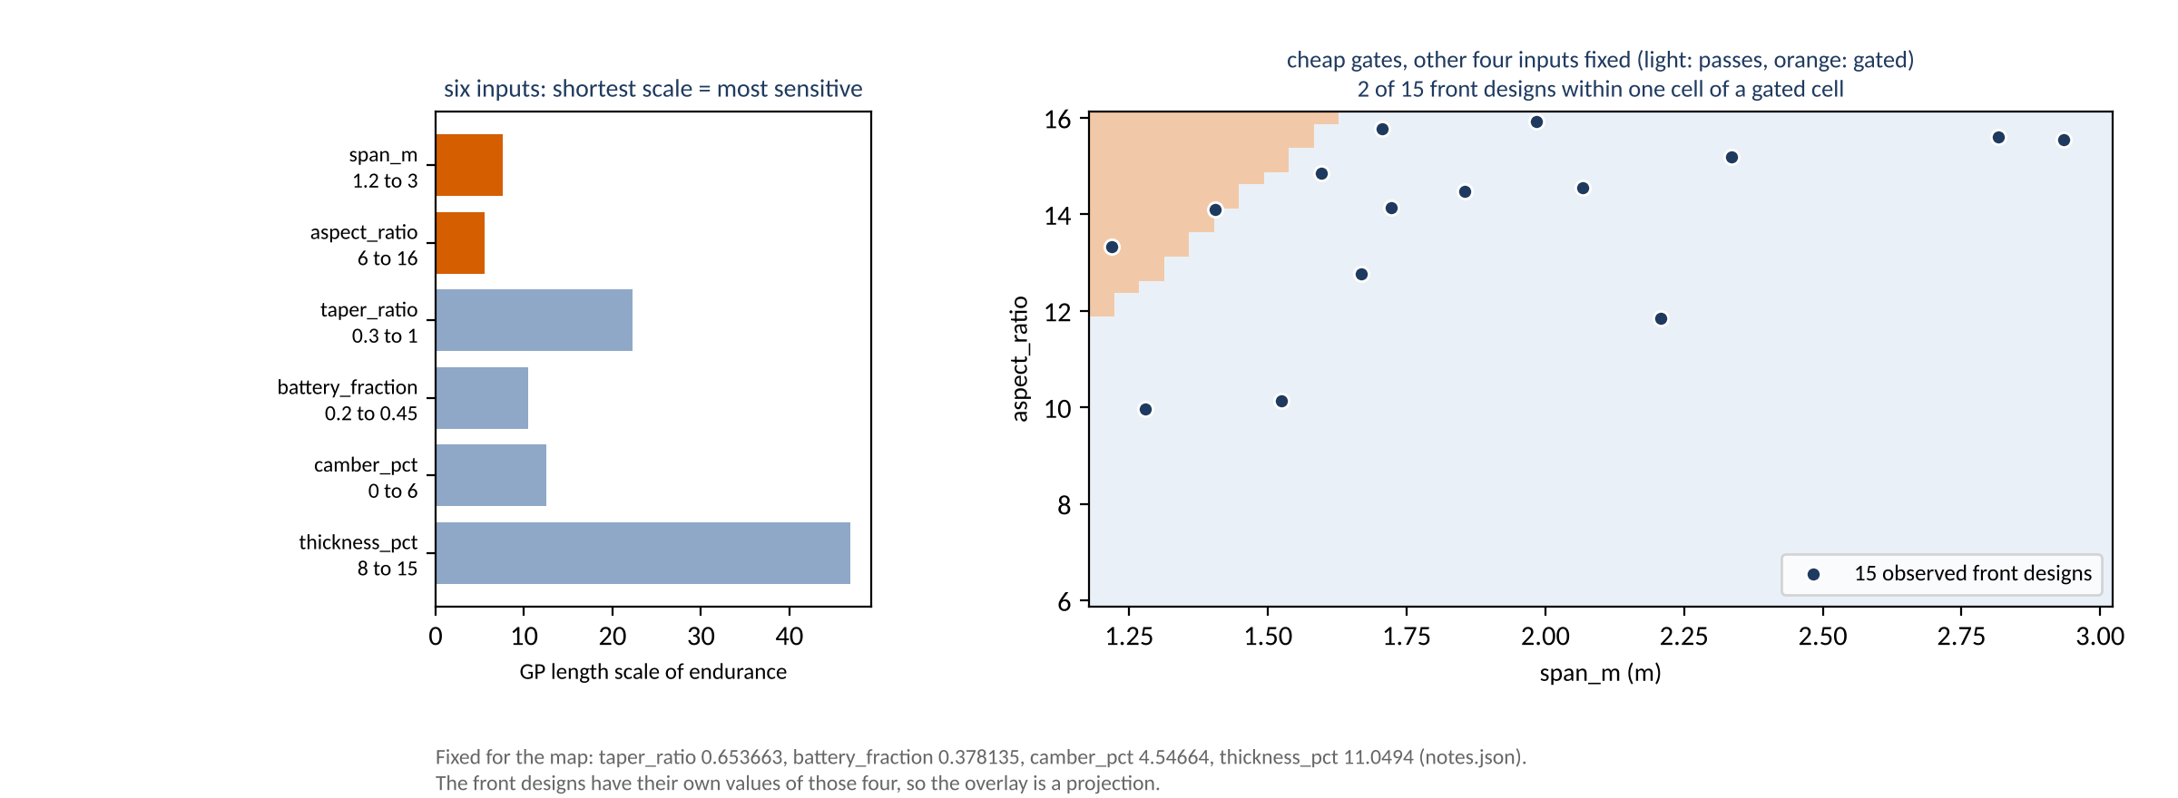
What the GP learned about the box
Endurance changes fastest with aspect ratio and span, which is why the design map uses them; in this projection 2 of the 15 observed front designs lie within one cell of a gated cell.
Figure: docs/talk/figures/drone/design_space.png. Record: runs/drone_pareto_lf/2026-11-09/design_map.csv.
sources: runs/drone_pareto_lf/2026-11-09/design_map.csv, runs/drone_pareto_lf/2026-11-09/notes.json, runs/drone_pool_lf/2026-11-08/front.csv, docs/talk/build_deck_drone.py
D30 | 35
Notes:
The map holds the other four inputs at one base point while the front designs have their own values, so the overlay is a projection. The count says how close the front comes to the cheap gates in this view, and no more.

Slide 36
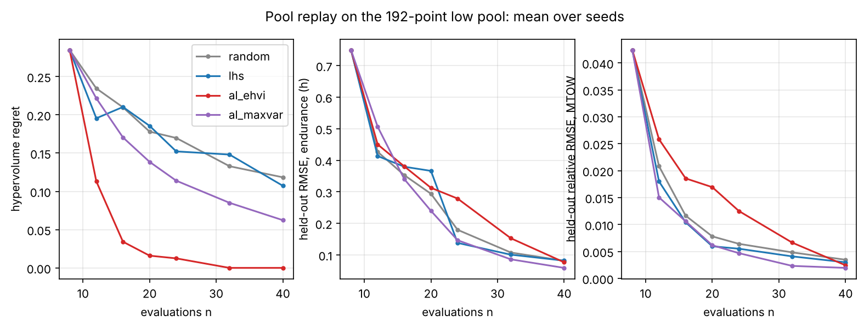
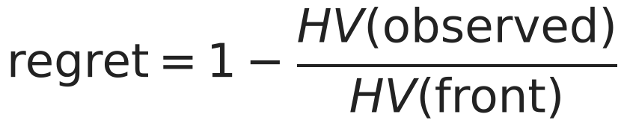
The pool replay
On the 192-point low pool, EHVI reaches regret 0.000 at 32 evaluations while random is at 0.118 after 40.
Mean hypervolume regret, 10 seeds
n | random | lhs | al_ehvi | al_maxvar
8 | 0.285 | 0.285 | 0.285 | 0.285
16 | 0.210 | 0.210 | 0.034 | 0.170
24 | 0.170 | 0.152 | 0.012 | 0.114
32 | 0.133 | 0.148 | 0.000 | 0.085
40 | 0.118 | 0.107 | 0.000 | 0.062
Figure: docs/validation/figures/task10/b_pool_replay.png. Record: runs/replay_drone_pool/2026-11-08/replay.csv.
Same 8 initial points for every strategy of a seed.
The pool is smooth and gate-free: the easy case.
sources: docs/validation/figures/task10/b_pool_replay.png, runs/replay_drone_pool/2026-11-08/replay.csv
D31 | 36
Notes:
Every strategy draws from the same pool, so the ground truth is shared and no extra run is needed. This is the easy case: a smooth, gate-free pool. The online replay is the test that matters.

Slide 37
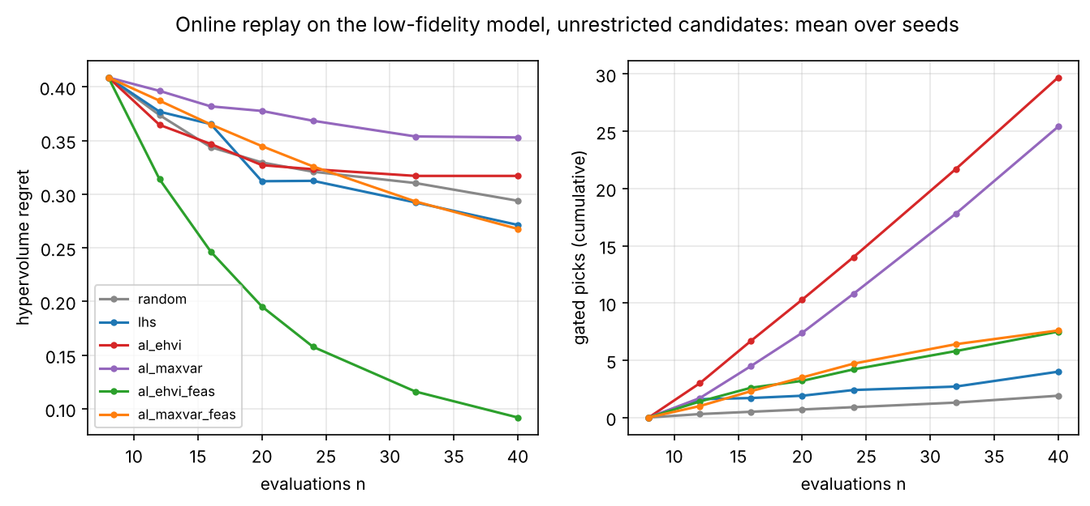
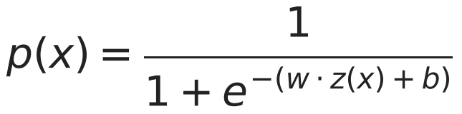
Online replay: plain EHVI loses, weighted EHVI wins
On the unrestricted box plain EHVI ends at regret 0.317 against random's 0.294 and wastes 29.7 of 32 picks on gated designs; weighted by P(feasible) it ends at 0.092.
Strategy | Regret at 40 | Gated picks
random | 0.294 | 1.9
lhs | 0.271 | 4.0
al_ehvi | 0.317 | 29.7
al_ehvi_feas | 0.092 | 7.5
al_maxvar | 0.353 | 25.4
al_maxvar_feas | 0.268 | 7.6
The front lies against the gated edge, and the GPs do not know the gates.
Both runs are published; neither replaces the other.
Figure: docs/validation/figures/task10/c_online_regret.png. Record: runs/replay_drone_online/2026-11-08/online.csv, runs/replay_drone_online/2026-11-08_feas/online.csv.
sources: docs/validation/figures/task10/c_online_regret.png, runs/replay_drone_online/2026-11-08/online.csv, runs/replay_drone_online/2026-11-08_feas/online.csv, runs/replay_drone_online/2026-11-08/record.json
D32 | 37
Notes:
The front lies against the gated edge of the box, and the two GPs know nothing about the gates. Active learning beats space-filling sampling only when the acquisition knows where the design is buildable. Both runs are published, and the full tables are in backup DB9.

Slide 38
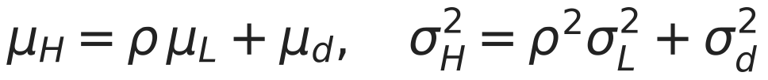

The two-level model
Does the two-level model reach a given held-out error with fewer SU2 designs than SU2 alone? With 8 SU2 designs the two-level endurance error is 0.869 h against 1.277 h for SU2 alone; SU2 alone does not reach it within 8 designs (mean over seeds, runs/drone_mf/2026-11-09/mf.csv).
SU2 designs n | endurance RMSE (h): SU2 only | two-level | mass rel. error: SU2 only | two-level
8 | 1.277 | 0.869 | 0.0856 | 0.0013
Record: runs/drone_mf/2026-11-09/mf.csv (mean over seeds). Equations: surrogate/mf_gp.py.
sources: runs/drone/validation/2026-11-08/v6.json, docs/talk/build_deck_drone.py, surrogate/mf_gp.py, runs/drone_mf/2026-11-09/mf.csv
D33 | 38
Notes:
The known bias of the high level is recorded beside every SU2 number, so the correction term absorbs a known offset. The inlet's Task 9 found that a cheap level helps most at small budgets, and this is the same measurement on a new problem. Whether that pays here is the measurement this slide is waiting for, if it says PENDING.

Slide 39
5. Results and the inverse query
6 minutes

Slide 40
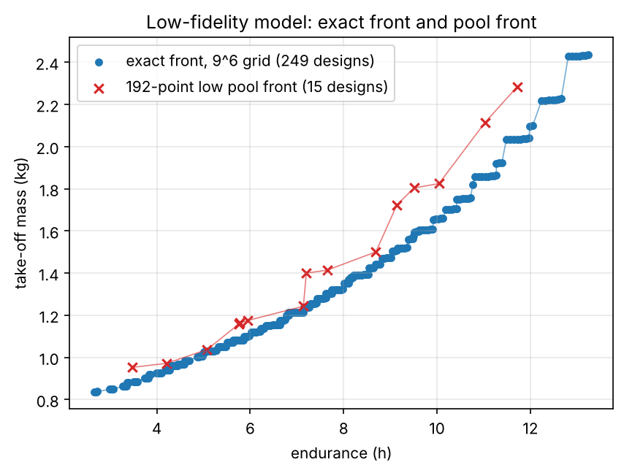
The low-fidelity grid and its exact front
Because the low level is cheap, the exact front over the whole box exists: 249 designs out of 531,441 grid points, 72,009 of which were gated.
Grid: 531,441 points, 459,432 clean, 72,009 gated, 0 failed.
Exact front: 249 designs.
Wall time: 16747 s on 8 workers.
Low pool: 192 designs, 0 gated, front of 15, 669 s.
Both runs are at the medium lattice level.
Figure: docs/validation/figures/task10/a_front_lowfi.png. Record: runs/drone_grid/2026-11-08/front.csv.
sources: docs/validation/figures/task10/a_front_lowfi.png, runs/drone_grid/2026-11-08/record.json, runs/drone_grid/2026-11-08/front.csv, runs/drone_pool_lf/2026-11-08/front.csv
D34 | 40
Notes:
The exact front is the reference against which both replays measure regret. The pool's front has 15 designs. It is a low-fidelity front and carries every low-fidelity bias on the limitations slide.

Slide 41
The SU2 pool as it stands
Of the 32 SU2 pool designs, 15 are complete and 17 incomplete (95 of 172 cases landed); on the complete ones the high-level endurance is 15.8 to 44.1 % low against the low level's.
Design | Angles kept | Endurance SU2 (h) | low (h) | ratio | Mass SU2 (kg) | low (kg) | ratio
0 | -2.0, 2.0, 6.0, 10.0, 14.0 | 4.98 | 7.20 | 0.692 | 1.718 | 1.715 | 1.001
1 | -2.0, 2.0, 6.0, 10.0 | 6.18 | 7.34 | 0.842 | 1.964 | 1.962 | 1.001
2 | 2.0, 6.0, 10.0, 14.0 | 6.67 | 8.59 | 0.777 | 2.013 | 2.011 | 1.001
3 | 2.0, 6.0, 10.0, 14.0 | 7.60 | 9.82 | 0.773 | 2.295 | 2.292 | 1.001
4 | -2.0, 2.0, 6.0, 10.0 | 2.95 | 4.41 | 0.669 | 1.091 | 1.089 | 1.002
5 | -2.0, 2.0, 6.0, 14.0 | 4.58 | 7.65 | 0.598 | 1.419 | 1.414 | 1.003
6 | 6.0, 10.0, 14.0 | 5.59 | 7.72 | 0.724 | 3.228 | 3.223 | 1.001
7 | -2.0, 2.0, 6.0, 10.0, 14.0 | 5.19 | 6.81 | 0.762 | 1.940 | 1.938 | 1.001
9 | -2.0, 2.0, 6.0, 10.0 | 7.08 | 8.45 | 0.838 | 2.239 | 2.238 | 1.001
10 | -2.0, 2.0, 6.0, 10.0, 14.0 | 4.63 | 8.11 | 0.571 | 1.511 | 1.507 | 1.003
11 | 2.0, 6.0, 14.0 | 3.35 | 4.50 | 0.744 | 1.309 | 1.307 | 1.002
12 | -2.0, 2.0, 6.0, 10.0, 14.0 | 4.31 | 7.72 | 0.559 | 1.646 | 1.639 | 1.004
13 | -2.0, 2.0, 6.0, 10.0 | 4.72 | 5.85 | 0.806 | 1.880 | 1.879 | 1.001
14 | 2.0, 6.0, 10.0, 14.0 | 7.38 | 9.64 | 0.765 | 2.054 | 2.052 | 1.001
15 | 2.0, 6.0, 10.0, 14.0 | 5.02 | 6.47 | 0.775 | 1.520 | 1.518 | 1.001
32 designs: 15 complete, 17 incomplete, 0 failed; 95 of 172 cases landed (coarse pool and medium bias check).
Low = the same design through the low model (runs/drone_pool_lf); both columns use the same lattice, closure and mission.
Every SU2 row carries the decision-8 flags (D41).
sources: runs/pool_af/2026-11-09/results.csv, runs/pool_af/2026-11-09/record.json, runs/drone_pool_lf/2026-11-08/grid.csv, designs/pool_af_cases.csv
D35 | 41
Notes:
The table is read from the hourly-ingested results at build time, so it grows as the pool lands. Every high-level number carries the decision-8 flags, and a design with fewer than three kept angles is not evaluated. The difference between the levels is the discrepancy the two-level model has to learn, design by design.

Slide 42
The high-fidelity front with its band
PENDING: runs/drone_pareto_hf/2026-11-09/pareto.csv (front on the SU2 pool, T10.10a) does not exist yet. The front with its band over the SU2 pool will be drawn here.
PENDING: no number is shown here until the record exists.
SU2-pool front, predicted front and GP band
PENDING: runs/drone_pareto_hf/2026-11-09/pareto.csv
Inputs: the complete designs of runs/pool_af/2026-11-09/results.csv; analysis.pareto --family drone writes the front and the band.
The exact low-fidelity front (D34) will be drawn beside it.
sources: PENDING: runs/drone_pareto_hf/2026-11-09/pareto.csv (front on the SU2 pool, T10.10a)
D36 | 42
Notes:
The band is the posterior uncertainty of the two GPs, sampled jointly, and it is shown beside the observed designs rather than instead of them. Every point of this front carries the V6e bias of decision 8. The low-fidelity front on the previous slides is drawn beside it once both exist.

Slide 43
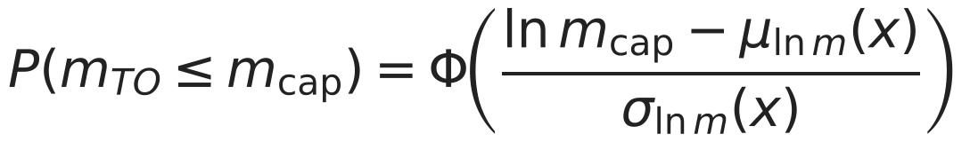
The inverse query under the 4 kg cap
On the low model the answer is a box corner with 6 of six inputs at a bound, 13.31 h at 2.43 kg with P(mass at most cap) = 1.000, so the cap never binds there; the SU2-pool answer is PENDING (runs/drone_inverse_hf/2026-11-09/inverse.json).
 | Value
Low pool GPs: design | span_m 3, aspect_ratio 16, taper_ratio 0.3, battery_fraction 0.45, camber_pct 6, thickness_pct 8
Low pool GPs: endurance | 13.307 h, 90 % interval [13.228, 13.386]
Low pool GPs: take-off mass | median 2.435 kg, 90 % interval [2.428, 2.441]; P(mass <= 4 kg) = 1.000
Low model, evaluated directly | 13.245 h and 2.438 kg: inside both intervals
SU2 pool GPs | PENDING: runs/drone_inverse_hf/2026-11-09/inverse.json
sources: runs/drone_inverse_lf/2026-11-09/inverse.json, drone/evaluate.py, PENDING: runs/drone_inverse_hf/2026-11-09/inverse.json (inverse query on the SU2 pool, T10.10a)
D37 | 43
Notes:
The cap and the probability were fixed in the spec before any run. The low-fidelity answer is a diagnostic: the GP extrapolates to a corner the Sobol pool never sampled, and the direct evaluation lands inside its intervals. The query is a computation on the fitted surrogate, never a choice by the language model.

Slide 44
The confirmation run
PENDING: runs/drone_confirm/2026-11-09/confirm.json (confirmation run, T10.10d) does not exist yet. One SU2 polar at the SU2-pool answer checks the inverse query.
PENDING: no number is shown here until the record exists.
Predicted against simulated endurance and take-off mass
PENDING: runs/drone_confirm/2026-11-09/confirm.json
The confirmation is one SU2 polar (five cases) at the SU2-pool answer, through the queue, then analysis.confirm --family drone.
Pass: both objectives inside their 90 % intervals (C2).
sources: PENDING: runs/drone_confirm/2026-11-09/confirm.json (confirmation run, T10.10d)
D38 | 44
Notes:
The check passes if both simulated objectives fall inside their predicted 90 % intervals. A miss is documented and explained, as in the inlet study.

Slide 45
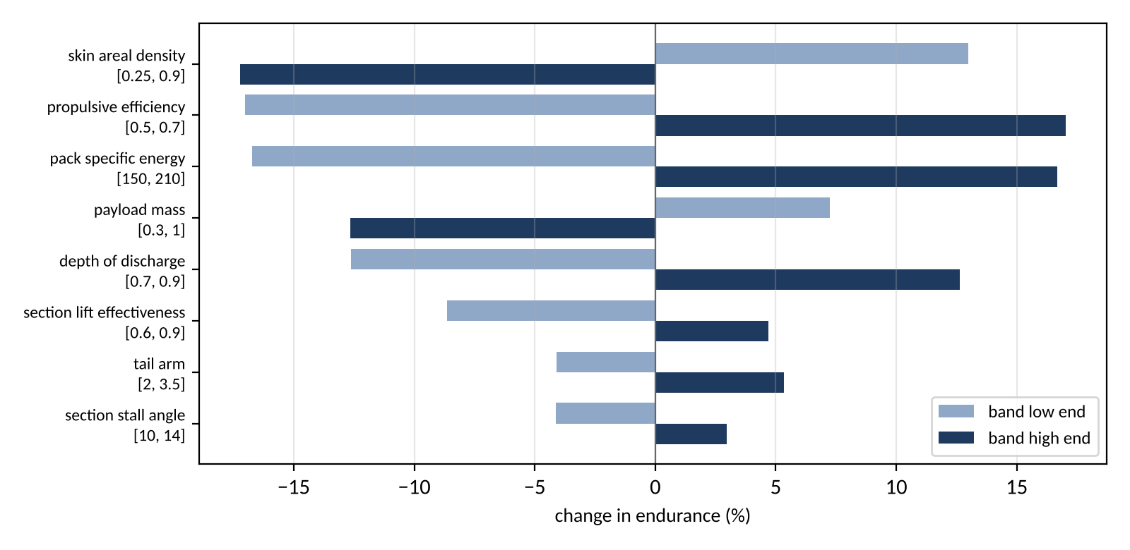
Which fixed quantities move the answer
At the low-fidelity answer the largest of the 21 banded quantities are skin areal density (17.2 %), propulsive efficiency (17.0 %), pack specific energy (16.7 %); the sweep at the SU2 answer is PENDING (runs/drone_bias_hf/2026-11-09/bias_sweep.csv).
One quantity at a time, to each end of its ledger band, at the low-fidelity answer of D37.
Full table: backup DB8.
Sweep at the SU2 answer: PENDING (runs/drone_bias_hf/2026-11-09/bias_sweep.csv)
Figure: docs/talk/figures/drone/bias_sweep.png. Record: runs/drone_bias_lf/2026-11-09/bias_sweep.csv.
sources: runs/drone_bias_lf/2026-11-09/bias_sweep.csv, PENDING: runs/drone_bias_hf/2026-11-09/bias_sweep.csv (bias sweep at the SU2 answer, T10.10d)
D39 | 45
Notes:
Each quantity is moved alone to its band ends with everything else at the ledger value. The ranking is for one design and is not a global sensitivity.

Slide 46
Coarse against medium on the pool
On the 10 pool cases with both meshes, medium over coarse is 0.5 % low to 2.8 % high in cl and 5.5 % low to 1.6 % high in cd: the coarse mesh the pool runs on is checked case by case.
Design | Re | alpha (deg) | cl coarse | cl medium | ratio | cd coarse | cd medium | ratio
0 | 121,945 | 6 | 0.7227 | 0.7236 | 1.0013 | 0.01855 | 0.01794 | 0.9674
1 | 170,204 | 2 | 0.5858 | 0.5923 | 1.0112 | 0.01207 | 0.01203 | 0.9966
1 | 170,204 | 6 | 0.9833 | 0.9886 | 1.0053 | 0.01658 | 0.01642 | 0.9902
1 | 170,204 | 10 | 1.2393 | 1.2439 | 1.0037 | 0.03183 | 0.03232 | 1.0157
2 | 149,605 | 2 | 0.5091 | 0.5140 | 1.0096 | 0.01356 | 0.01376 | 1.0149
2 | 149,605 | 6 | 0.8538 | 0.8564 | 1.0031 | 0.01872 | 0.01810 | 0.9668
2 | 149,605 | 10 | 1.1287 | 1.1603 | 1.0280 | 0.03035 | 0.02870 | 0.9454
3 | 156,312 | 2 | 0.4584 | 0.4654 | 1.0152 | 0.01252 | 0.01260 | 1.0067
3 | 156,312 | 6 | 0.8145 | 0.8175 | 1.0036 | 0.01729 | 0.01672 | 0.9667
3 | 156,312 | 10 | 1.0930 | 1.0873 | 0.9948 | 0.02933 | 0.02959 | 1.0087
sources: runs/pool_af/2026-11-09/bias.csv, designs/pool_af_cases.csv
D40 | 46
Notes:
Decision 7 put the pool on the coarse mesh for cost and kept the first four designs at three angles on the medium mesh as this check. A pair where either case ran out of budget is not in the table, because the aggregator does not keep it.

Slide 47
6. Limitations and conclusions
5 minutes

Slide 48
Biases that travel with every number
The model's named biases stay beside every figure; the high level carries the V6e miss (at Re 203,800 SU2's cl is 8.0 to 11.6 % high and its cd 10.3 % low to 1.6 % high) and a drift band of 0.4 to 12.6 % in cl and 0.1 to 7.5 % in cd over the kept pool cases.
Spec section 13 and the records
Carried by every SU2 section polar (decision 8)
No trim drag
Fully turbulent skin friction on the non-wing parts above Re 5e5
The fixed propulsive efficiency
The closed-form structure
The section polar at one Reynolds number per design (the cruise one) while the wing's chord varies along the span
Drift band of the kept pool cases: cl 0.4 to 12.6 %, cd 0.1 to 7.5 %
Section lift effectiveness 0.75, band [0.6, 0.9]: V6f's tunnel value lies outside it (open ruling)
v6e:cl_alpha:Re203800=+5.5%:fail
v6e:cd_ratio:Re203800=+8.0%:pass
v6e:cl_alpha:Re305200=+6.4%:fail
v6e:cd_ratio:Re305200=+5.7%:pass
v6e_ruling=decision8_accepted_with_bias
sources: docs/specs/task10_drone_sizing.md, runs/drone/validation/2026-11-08/v6.json, runs/e387/airfoil2d-498b156761/result.json, analysis/high_level_bias.py, runs/pool_af/2026-11-09/results.csv
D41 | 48
Notes:
The flags are generated from the validation record, so they cannot drift from it. A reader of any single design record sees the miss without opening this deck. The drift band is the size of the movement the stopping rule tolerates, which is the floor of what the pool can resolve.

Slide 49
What the record keeps that was wrong first
Each of these was wrong at its first recording and is kept on the record beside its correction: the corrections were made on evidence, and none moved a tolerance after a verdict.
First recorded | The record now says | Found by
SU2 "drags 3 to 10 % low" (task ledger) | per point cd is 10.3 % low to 1.6 % high; the block is corrected in place | the deck builder reading runs/e387
V6a AR 100: a rectangular wing against 2 pi AR / (AR + 2) | that is the elliptic slope; the rectangular wing sits -1.44 % below it, so the row tests an elliptic wing (addendum 2) | the solver's own refinement, before any verdict
Induced drag from the midpoint point-vortex sum | Trefftz-plane drag of the Glauert series (drone/vlm.py) | the V6a rows on the first lattice run
Online replay: plain EHVI at regret 0.317 against random's 0.294 | kept as published, with the feasibility-weighted run (0.092) beside it | the plan's rule to publish a loss
Fine mesh refused at the 1 nm fingerprint | fingerprint at 1 micrometer, the refused attempt kept as .first_attempt | the worker's mesh check
Airfoil budget 3,000 iterations | 6,000 with a Cauchy stop (decision 6) | the first smoke case
sources: docs/specs/task10_tasks.md, docs/specs/task10_drone_sizing.md, runs/drone/validation/2026-11-08/v6.json, runs/replay_drone_online/2026-11-08/online.csv, runs/mesh/airfoil2d-e161fb7e6b.first_attempt/error.json, runs/drone_inverse_lf/2026-11-09/inverse.json
D42 | 49
Notes:
The first online replay is the most useful entry, because it is the result the plan asked to publish if active learning lost. Two of the corrections were references and not the solver, which the solver's own convergence study showed. Any row the builder adds itself is a statement in the task file that the record contradicts.

Slide 50
Limits of the model
The study sizes one cruise point at sea level with a fixed propeller efficiency and closed-form structure; what the spec puts out of scope bounds what the front means.
Out of scope (spec section 13)
Open validation items and rulings
Stability and control beyond the static margin
Structural analysis beyond the spar rule
Propeller design (a fixed efficiency)
Take-off and landing distances
Wind and altitude envelopes (a candidate Task 11, in the form of Task 9's envelope)
Cost
Certification beyond the class C2 mass cap
V6e mesh: medium vs fine mesh at Re 203800, not run (no medium and fine pair of records at Re 203800)
V6g: Ultra Stick 25e CL_alpha and CD0, not run (Ultra Stick data not retrieved)
V6b Warren-12 fine: Cm_alpha (about root LE, reference chord 1.0) vs benchmark: pending (reference point not yet sourced)
Acceptance rule for budget-exhausted SU2 runs in the pool (currently dropped; the record keeps them with their drift).
The section_lift_effectiveness band in the ledger against the V6f finding (re-centring moves the low-fidelity grid; a re-run is 4.6 h).
The Warren-12 moment reference point (V6b Cm_alpha pending).
sources: docs/specs/task10_drone_sizing.md, docs/validation/2026-11-08_task10_report.md, runs/drone/validation/2026-11-08/v6.json
D43 | 50
Notes:
Wind, altitude and the take-off phase are the first things a real sizing study would add, and the inlet's Task 9 shows the form an envelope study takes. Nothing here claims more than one cruise point.

Slide 51
Conclusions: the four questions as far as the records go
Active learning wins on this problem only with a feasibility model; the front, the two-level model and the inverse query are answered at the low level and wait on the SU2 pool at the high level, each stated as the records stand at build time.
Question | Answer from the records | Evidence | Pending
1. The front | Exact low-fidelity front of 249 designs over 531,441 points; aspect ratio and span drive endurance | drone_grid, drone_pareto_lf | SU2-pool front
2. Active learning | Plain EHVI loses online (0.317 against 0.294); with P(feasible) it wins (0.092) | replay_drone_online | SU2-pool replay
3. Two-level model | With 8 SU2 designs the two-level endurance error is 0.869 h against 1.277 h for SU2 alone; SU2 alone does not reach it within 8 designs (mean over seeds, runs/drone_mf/2026-11-09/mf.csv). | pool_af results.csv | none
4. Inverse query | Low model: a corner at 13.31 h, 2.43 kg; the 4 kg cap does not bind there | drone_inverse_lf | SU2 answer and confirmation
sources: runs/drone_grid/2026-11-08/record.json, runs/replay_drone_online/2026-11-08/online.csv, runs/replay_drone_online/2026-11-08_feas/online.csv, runs/drone_inverse_lf/2026-11-09/inverse.json, runs/pool_af/2026-11-09/record.json, PENDING: runs/drone_mf/2026-11-09/mf.csv, runs/drone_pareto_hf/2026-11-09/pareto.csv, runs/drone_confirm/2026-11-09/confirm.json (pool analyses)
D44 | 51
Notes:
The pipeline carried over with its gates, queue and replay unchanged, and the new parts are the airfoil family, the two-level model and the sharded workers. The method's answer on question 2 is the result I would lead with, because it includes a loss. Anything still PENDING on this slide is a run in progress, not an estimate.

Slide 52
Discussion
about 20 minutes, outside the 40

Slide 53
Questions, and where the answers are
The discussion is open; these are the questions the study invites, and the backup slides that answer them.
Prompts
Backup slides
Where would you trust the low level alone, and where not?
Is a fixed propulsive efficiency acceptable for a sizing study?
Should budget-exhausted SU2 runs enter the pool, and with what flag?
What would a feasibility model need to beat a hard gate in the acquisition?
How would wind and altitude change the front (an envelope study)?
What would make the two-level model worth its SU2 cost here?
DB1 the V6 table, part 1 (V6a to V6d)
DB2 the V6 table, part 2 (V6e to V6g)
DB3 E387 point by point at both Reynolds numbers
DB4 the mesh table (coarse, medium, fine)
DB5 the budget-exhausted runs
DB6 the low-pool Pareto record
DB7 the 21^6 inverse record
DB8 the bias sweep, full table
DB9 the online replays, full tables
DB10 the decision log
DB11 the ledger provenance
DB12 the cost ledger
DB13 the equations index
DB14 the study guide
DB15 carried over from the inlet study, and new
DB16 the open rulings
DB17 record status, what exists and what is pending
D45 | 53
Notes:
Start with the limit that matters to the person asking, then open the matching backup slide. Do not quote a number that is not on a slide.

Slide 54
Backup
not timed

Slide 55
Backup: the V6 table, part 1 (V6a to V6d)
Every V6a to V6d row of the validation record, report rows included.
Row | Measured | Reference | Deviation | Tol. | Verdict
V6a elliptic AR 8 fine: e at 4 deg vs 1 | 0.9974 | 1 | -0.26 % | 1 % | pass
V6a elliptic AR 8 fine: CL_alpha vs Helmbold | 4.81 | 4.906 | -1.95 % | 3 % | pass
V6a elliptic AR 8 fine: CDi vs CL^2/(pi AR_planform e) | 0.00448 | 0.00448 | 0.0e+00 | 1e-09 | pass
V6a elliptic AR 100 fine: CL_alpha vs 2 pi AR/(AR+2) | 6.154 | 6.16 | -0.09 % | 1 % | pass
V6a (report) rectangular AR 100 fine: CL_alpha vs 2 pi AR/(AR+2) | 6.072 | 6.16 | -1.44 % | report | report
V6a (report) elliptic AR 8 coarse: CL_alpha vs Helmbold | 4.829 | 4.906 | -1.56 % | report | report
V6a (report) elliptic AR 8 coarse: e vs 1 | 0.9994 | 1 | -0.06 % | report | report
V6a (report) elliptic AR 8 medium: CL_alpha vs Helmbold | 4.817 | 4.906 | -1.82 % | report | report
V6a (report) elliptic AR 8 medium: e vs 1 | 0.9981 | 1 | -0.19 % | report | report
V6b Warren-12 fine: CL_alpha vs benchmark | 2.771 | 2.743 | +1.01 % | 2 % | pass
V6b Warren-12 fine: Cm_alpha (about root LE, reference chord 1.0) vs benchmark | -3.137 | -3.1 | +1.19 % | 2 % | PENDING
V6c nominal: CL_alpha, medium vs fine | 4.991 | 4.983 | +0.17 % | 1 % | pass
V6c nominal: e at 4 deg, medium vs fine | 0.9775 | 0.9801 | -0.26 % | 1 % | pass
V6c nominal: endurance_h, medium vs fine | 6.748 | 6.757 | -0.13 % | 2 % | pass
V6c (report) nominal: CL_alpha, coarse vs medium | 5.008 | 4.991 | +0.34 % | report | report
V6c (report) nominal: e at 4 deg, coarse vs medium | 0.9728 | 0.9775 | -0.49 % | report | report
V6c (report) nominal: endurance_h, coarse vs medium | 6.734 | 6.748 | -0.22 % | report | report
V6d closure_residual below 1e-9 | 5.606e-10 | 0 | 5.6e-10 | 1e-09 | pass
V6d energy balance: spent vs usable battery energy | 2.35e+05 | 2.35e+05 | 2.2e-16 | 1e-09 | pass
V6d endurance_h vs closed form | 6.748 | 6.748 | 0.0e+00 | 1e-06 | pass
V6d sum of masses vs mtow | 1.511 | 1.511 | 0.0e+00 | 1e-09 | pass
sources: runs/drone/validation/2026-11-08/v6.json
DB1 | 55
Notes:
Report rows have no tolerance and show the lattice convergence the toleranced rows rest on. The Warren-12 moment row stays pending until the benchmark's reference point is sourced.

Slide 56
Backup: the V6 table, part 2 (V6e to V6g)
Every V6e and V6f row, and the rows not run with their reason.
Row | Measured | Reference | Deviation | Tol. | Verdict
V6f cl_alpha Re 101800 | 0.08225 | 0.1063 | -22.65 % | report | report
V6f alpha_L0 Re 101800 | -3.961 | -3.063 | -89.76 % | report | report
V6f cd ratio Re 101800 | 0.5199 | 0 | +51.99 % | report | report
V6f cl_max Re 101800 | 1.312 | 1.169 | +12.19 % | report | report
V6f cl_alpha Re 203800 | 0.08225 | 0.1017 | -19.15 % | report | report
V6f alpha_L0 Re 203800 | -3.961 | -3.202 | -75.83 % | report | report
V6f cd ratio Re 203800 | 0.4745 | 0 | +47.45 % | report | report
V6f cl_max Re 203800 | 1.312 | 1.164 | +12.67 % | report | report
V6f cl_alpha Re 305200 | 0.08225 | 0.103 | -20.16 % | report | report
V6f alpha_L0 Re 305200 | -3.961 | -3.131 | -83.00 % | report | report
V6f cd ratio Re 305200 | 0.4341 | 0 | +43.41 % | report | report
V6f cl_max Re 305200 | 1.312 | 1.156 | +13.45 % | report | report
V6e cl_alpha Re 203800 | 0.1044 | 0.09901 | +5.49 % | 5 % | FAIL
V6e cd ratio Re 203800 | 0.07992 | 0 | +7.99 % | 20 % | pass
V6e cl_max Re 203800 | 1.129 | 1.164 | -3.00 % | report | report
V6e cl_alpha Re 305200 | 0.1062 | 0.09979 | +6.44 % | 5 % | FAIL
V6e cd ratio Re 305200 | 0.0574 | 0 | +5.74 % | 20 % | pass
V6e cl_max Re 305200 | 1.111 | 1.156 | -3.92 % | report | report
V6e mesh: medium vs fine mesh at Re 203800 |  |  |  |  | not run
V6g: Ultra Stick 25e CL_alpha and CD0 |  |  |  |  | not run
sources: runs/drone/validation/2026-11-08/v6.json
DB2 | 56
Notes:
The V6e fails are kept as fails under decision 8. The not-run rows are shown, not hidden.

Slide 57
Backup: E387 point by point at both Reynolds numbers
At every matched angle SU2 lifts more than the tunnel, and its drag runs from below to slightly above it.
Re 203,800 (medium mesh, SA-BCM; tunnel: data/validation/e387_uiuc.yaml)
alpha | SU2 cl | tunnel cl | ratio | SU2 cd | tunnel cd | ratio
1.27 | 0.5067 | 0.4540 | +11.6 % | 0.01046 | 0.01160 | -9.8 %
2.67 | 0.6588 | 0.5990 | +10.0 % | 0.01166 | 0.01300 | -10.3 %
4.23 | 0.8226 | 0.7610 | +8.1 % | 0.01302 | 0.01420 | -8.3 %
5.59 | 0.9646 | 0.8930 | +8.0 % | 0.01438 | 0.01490 | -3.5 %
7.23 | 1.1290 | 1.0420 | +8.4 % | 0.01655 | 0.01630 | +1.6 %
Re 305,200 (medium mesh, SA-BCM; tunnel: data/validation/e387_uiuc.yaml)
alpha | SU2 cl | tunnel cl | ratio | SU2 cd | tunnel cd | ratio
1.04 | 0.4835 | 0.4290 | +12.7 % | 0.00851 | 0.00920 | -7.5 %
2.53 | 0.6478 | 0.5870 | +10.4 % | 0.00962 | 0.01000 | -3.8 %
4.07 | 0.8145 | 0.7480 | +8.9 % | 0.01063 | 0.01130 | -5.9 %
5.93 | 1.0056 | 0.9310 | +8.0 % | 0.01278 | 0.01250 | +2.3 %
6.93 | 1.1107 | 1.0130 | +9.6 % | 0.01391 | 0.01400 | -0.6 %
sources: runs/e387/airfoil2d-498b156761/result.json, data/validation/e387_uiuc.yaml
DB3 | 57
Notes:
The comparison is at the tunnel's own angles with no interpolation. The lift offset is nearly uniform, so most of the slope miss is an offset plus a slightly steeper line.

Slide 58
Backup: the mesh table (coarse, medium, fine)
On the nominal section the three meshes differ by less than the fine run's own drift, so the table resolves the drift band and not the mesh.
Level | Cells | Iterations | Wall (s) | cl | cd | cm | cl / cd drift (%) | cl, cd against fine
coarse | 21,760 | 3,595 (Cauchy) | 498 | 1.02115 | 0.017348 | 0.08280 | 1.5 / 4.0 | +0.7 %, +1.1 %
medium | 43,008 | 4,867 (Cauchy) | 1,385 | 1.02599 | 0.016710 | 0.08358 | 2.2 / 5.3 | +1.2 %, -2.6 %
fine | 84,152 | 6,000 (budget) | 3,162 | 1.01381 | 0.017157 | 0.08230 | 4.4 / 10.3 | reference
Cost per iteration per cell: 6.26 to 6.62 microseconds on 4 Colab ranks at all three levels.
NACA 4412-type section, Re 200,000, 6 deg, SA-BCM; drift over the last fifth.
sources: runs/mesh/airfoil2d-59cd4287e9/result.json, runs/smoke2/airfoil2d-51d551f2cc/result.json, runs/mesh/airfoil2d-e161fb7e6b/result.json
DB4 | 58
Notes:
The cost per iteration per cell is the same at all three levels, so cost scales with cells and iterations together. The pool runs coarse on this evidence, with the medium bias check on D40.

Slide 59
Backup: the budget-exhausted runs
Every SU2 run that used its whole budget, with its drift: which to accept is an open ruling, and one large drift is a division by a lift coefficient near zero.
Tag | Case | Design, alpha | Mesh | cl | cd | cl drift (%) | cd drift (%) | Kept
mesh | e161fb7e6b | nominal, 6 deg | fine | +1.0138 | 0.01716 | 4.4 | 10.3 | not a pool case
nominal | a41849e173 | nominal, 0 deg | medium | +0.4320 | 0.01063 | 3.0 | 0.6 | not a pool case
nominal | a5fd159bde | nominal, 10 deg | medium | +1.3338 | 0.02643 | 4.2 | 11.1 | not a pool case
pool_af | 0b9023e0fd | 2, -2 deg | coarse | -0.0020 | 0.01411 | 98.2 | 0.7 | no
pool_af | 12f036d368 | 16, -2 deg | coarse | -0.1617 | 0.01115 | 3.1 | 1.2 | no
pool_af | 1370546c89 | 14, -2 deg | coarse | -0.0360 | 0.01239 | 61.6 | 10.2 | no
pool_af | 193d42b455 | 15, -2 deg | coarse | +0.2522 | 0.01858 | 2.8 | 2.4 | no
pool_af | 1c301beea9 | 9, 14 deg | coarse | +1.3888 | 0.06705 | 1.8 | 4.2 | no
pool_af | 1c925a7eca | 13, 14 deg | coarse | +1.2694 | 0.07220 | 4.8 | 10.2 | no
pool_af | 3d4f607289 | 5, 10 deg | coarse | +1.2572 | 0.03736 | 22.1 | 58.6 | no
pool_af | 61a3515037 | 8, 14 deg | coarse | +0.6758 | 0.18617 | 4.7 | 3.4 | no
pool_af | 6972285e49 | 8, -2 deg | coarse | -0.1317 | 0.01034 | 41.6 | 9.6 | no
pool_af | 69c267e5f3 | 3, -2 deg | coarse | -0.0740 | 0.01353 | 4.2 | 0.7 | no
pool_af | 6faf3a1952 | 11, 10 deg | coarse | +1.0037 | 0.05086 | 4.4 | 4.6 | no
pool_af | 8657ed0db6 | 8, 10 deg | coarse | +0.6541 | 0.11821 | 54.1 | 44.8 | no
pool_af | 9cf9dc0247 | 6, 2 deg | coarse | +0.2656 | 0.01036 | 14.1 | 8.0 | no
pool_af | c16e9eb26f | 4, 14 deg | coarse | +1.3594 | 0.08557 | 4.0 | 7.6 | no
pool_af | dd71c47980 | 1, 14 deg | coarse | +0.7871 | 0.18430 | 1.5 | 0.4 | no
pool_af | e251ef33d0 | 6, -2 deg | coarse | -0.1957 | 0.00977 | 11.3 | 5.9 | no
pool_af | fd08d0864e | 11, -2 deg | coarse | -0.0781 | 0.01155 | 57.2 | 11.2 | no
pool_af_bias | 5bfe6fe9ef | 0, 2 deg | medium | +0.3972 | 0.01417 | 2.7 | 0.3 | no
pool_af_bias | f6cde9b3f4 | 0, 10 deg | medium | +0.8590 | 0.04055 | 18.9 | 39.7 | no
A drift of tens of percent at cl near zero is the division by |f_n| in the drift rule, not a moving solution: read the cl column beside it.
Design, alpha from designs/pool_af_cases.csv; kept = analysis.pool_af_results.kept.
sources: runs/pool_af_bias/airfoil2d-5bfe6fe9ef/result.json, runs/pool_af/airfoil2d-0b9023e0fd/result.json, runs/nominal/airfoil2d-a41849e173/result.json, runs/mesh/airfoil2d-e161fb7e6b/result.json, designs/pool_af_cases.csv
DB5 | 59
Notes:
The drift rule divides the range over the window by the final value, so a case near zero lift reports a huge relative drift on a tiny absolute one. The aggregator drops budget-exhausted runs today and the record keeps them; accepting some of them is ruling 1 on DB16.

Slide 60
Backup: the low-pool Pareto record
The Pareto analysis exists end to end on the low pool as a diagnostic: candidates, gates, observed and predicted fronts, band and length scales.
Item | Record
training rows | 192 of 192
candidates | 4,096 kept of 4,544 drawn (420 failed the closed-form gates, 4 the full gates)
observed front | 15 designs, 3.47 h at 0.953 kg to 11.71 h at 2.283 kg
predicted front | 57 points
band | 25 mass levels, 50 joint samples per level
Input | Length scale
aspect_ratio | 5.49
span_m | 7.57
battery_fraction | 10.50
camber_pct | 12.47
taper_ratio | 22.31
thickness_pct | 46.90
sources: runs/drone_pareto_lf/2026-11-09/notes.json, runs/drone_pareto_lf/2026-11-09/pareto.csv
DB6 | 60
Notes:
This run was made so that the analysis is proven before the SU2 pool lands. It is not a study answer, because the questions are asked of the high level.

Slide 61
Backup: the 21^6 inverse record
The inverse query walks the whole 21^6 grid in chunks; on the low model the answer is a box corner and the cap never binds.
Item | Record
grid | 21^6 = 85,766,121 points
pass the closed-form gates | 76,587,147
training rows | 192
query | P(mass <= 4 kg) >= 0.9
answer: design | span_m 3, aspect_ratio 16, taper_ratio 0.3, battery_fraction 0.45, camber_pct 6, thickness_pct 8
answer: endurance | 13.307 h, 90 % interval [13.228, 13.386]
answer: take-off mass | median 2.435 kg, 90 % interval [2.428, 2.441]; P(mass <= 4 kg) = 1.000
closure gates at the answer | passed
lightest observed design | 0.953 kg
interval | 90 percent, predictive (includes noise)
sources: runs/drone_inverse_lf/2026-11-09/inverse.json
DB7 | 61
Notes:
The closed-form gates are applied to the whole grid and the closure gates to the best candidates. The GP extrapolates to the corner, which is why the direct evaluation is shown on D37.

Slide 62
Backup: the bias sweep, full table
All banded ledger quantities, moved one at a time to their band ends at the low-fidelity answer, ranked by the largest endurance change.
# | Quantity | Value | Band | Endurance (%) | Mass (%) | Effect
1 | structure: skin areal density | 0.45 | 0.25 to 0.9 | +13.0 / -17.2 | -27.2 / +62.0 | moves the result
2 | propulsion: propulsive efficiency | 0.6 | 0.5 to 0.7 | -17.0 / +17.0 | +0.6 / -0.4 | moves the result
3 | battery: pack specific energy | 180 | 150 to 210 | -16.7 / +16.7 | -0.2 / +0.2 | moves the result
4 | rules: payload mass | 0.5 | 0.3 to 1 | +7.2 / -12.7 | -16.2 / +40.4 | moves the result
5 | battery: depth of discharge | 0.8 | 0.7 to 0.9 | -12.6 / +12.6 | +0.0 / +0.0 | moves the result
6 | rules: section lift effectiveness | 0.75 | 0.6 to 0.9 | -8.6 / +4.7 | +0.0 / -0.0 | moves the result
7 | rules: tail arm | 2.5 | 2 to 3.5 | -4.1 / +5.3 | +4.5 / -5.1 | moves the result
8 | rules: section stall angle | 12 | 10 to 14 | -4.1 / +3.0 | +0.0 / -0.0 | moves the result
9 | rules: rate of climb | 2 | 1.5 to 4 | +0.5 / -1.8 | -0.6 / +2.6 | moves the result
10 | rules: climb allowance | 60 | 30 to 120 | +0.5 / -1.0 | +0.0 / +0.0 | moves the result
11 | structure: spar allowable stress | 6e+08 | 3e+08 to 1e+09 | -0.9 / +0.4 | +2.4 / -0.9 | moves the result
12 | rules: tail aspect ratio vertical | 1.5 | 1 to 2.5 | +0.6 / -0.9 | -0.0 / +0.0 | moves the result
13 | rules: tail aspect ratio horizontal | 4 | 3 to 6 | +0.5 / -0.8 | -0.0 / +0.0 | moves the result
14 | propulsion: specific power | 2500 | 1500 to 4000 | -0.8 / +0.4 | +2.0 / -1.1 | moves the result
15 | rules: fuselage fineness | 6 | 4 to 8 | -0.7 / +0.1 | -0.3 / +0.2 | moves the result
16 | rules: tail thickness ratio | 0.1 | 0.08 to 0.12 | +0.5 / -0.6 | -0.0 / +0.0 | moves the result
17 | battery: volumetric energy density | 350 | 250 to 450 | -0.3 / +0.2 | +0.4 / -0.2 | moves the result
18 | rules: installed power margin | 2 | 1.5 to 3 | +0.0 / +0.0 | +0.0 / +0.0 | no effect at this design
19 | rules: cruise cl fraction of clmax | 0.7 | 0.6 to 0.8 | +0.0 / +0.0 | +0.0 / +0.0 | no effect at this design
20 | rules: static margin target | 0.1 | 0.05 to 0.15 | +0.0 / +0.0 | +0.0 / +0.0 | no effect at this design
21 | rules: freestream turbulence intensity | 0.001 | 0.0005 to 0.005 | +0.0 / +0.0 | +0.0 / +0.0 | no effect at this design
sources: runs/drone_bias_lf/2026-11-09/bias_sweep.csv
DB8 | 62
Notes:
Quantities with no effect at this design are read by the model but do not bind here. The sweep is repeated at the SU2 answer when that exists.

Slide 63
Backup: the online replays, full tables
Mean regret and gated picks at every budget for both online runs, on the same seeds and candidate sets.
Mean hypervolume regret against the exact front
n | random | lhs | al_ehvi | al_ehvi_feas | al_maxvar | al_maxvar_feas
8 | 0.409 | 0.409 | 0.409 | 0.409 | 0.409 | 0.409
12 | 0.374 | 0.377 | 0.365 | 0.314 | 0.396 | 0.387
16 | 0.344 | 0.365 | 0.347 | 0.246 | 0.382 | 0.365
20 | 0.330 | 0.312 | 0.327 | 0.195 | 0.378 | 0.345
24 | 0.321 | 0.312 | 0.323 | 0.158 | 0.368 | 0.326
32 | 0.310 | 0.292 | 0.317 | 0.116 | 0.354 | 0.293
40 | 0.294 | 0.271 | 0.317 | 0.092 | 0.353 | 0.268
Mean gated picks (cumulative)
n | random | lhs | al_ehvi | al_ehvi_feas | al_maxvar | al_maxvar_feas
8 | 0.0 | 0.0 | 0.0 | 0.0 | 0.0 | 0.0
12 | 0.3 | 1.6 | 3.0 | 1.4 | 1.7 | 1.0
16 | 0.5 | 1.7 | 6.7 | 2.6 | 4.5 | 2.3
20 | 0.7 | 1.9 | 10.3 | 3.2 | 7.4 | 3.5
24 | 0.9 | 2.4 | 14.0 | 4.2 | 10.8 | 4.7
32 | 1.3 | 2.7 | 21.7 | 5.8 | 17.8 | 6.4
40 | 1.9 | 4.0 | 29.7 | 7.5 | 25.4 | 7.6
sources: runs/replay_drone_online/2026-11-08/online.csv, runs/replay_drone_online/2026-11-08_feas/online.csv, runs/replay_drone_online/2026-11-08/record.json, runs/replay_drone_online/2026-11-08_feas/record.json
DB9 | 63
Notes:
Equal regret at the first budget is the shared initial design, which makes the rows comparable. The first run's loss and the second run's win are both on the record.

Slide 64
Backup: the decision log
The three rulings that shaped the SU2 level, as recorded with their dates.
Decision | Who and when | As recorded | What it changed
6 | Éder, 2026-11-08 06:50 UTC | Éder chose the recommendation: rerun the same case once with max_iter 6000 and a Cauchy stopping criterion on the lift and drag coefficients (both templates: CONV_FIELD= ( LIFT, DRAG ), CONV_CAUCHY_ELEMS= 200, CONV_CAUCHY_EPS= 1E-5, CONV_STARTITER= 500), read the drift and the iteration at which it stopped, and only then fix the iteration budget and cut the pool to 64 designs at 3 angles. | budget 6,000 with a Cauchy stop on lift and drag
7 | Éder, 2026-11-08 20:45 UTC | "Colab is running now" | the SU2 pool staged: 32 designs at five angles on the coarse mesh, plus the medium bias check
8 | Éder, 2026-11-08 22:35 UTC | "accept the medium mesh as the high level with the bias recorded" | the V6e fail kept, its flags written into every SU2 polar; no SST-LM attempt
sources: docs/specs/task10_tasks.md
DB10 | 64
Notes:
Each ruling was put with a recommendation and its evidence, and each is recorded verbatim where the person gave words. Decision 8 is also why no SST with Langtry-Menter attempt was run.

Slide 65
Backup: the ledger provenance
Every fixed quantity carries a source and a grade; every assumed one carries a band.
Set | Quantities | Published | Derived | Assumed | With a band
data/drone/air.yaml | 3 | 3 | 0 | 0 | 0
data/drone/battery.yaml | 3 | 0 | 0 | 3 | 3
data/drone/propulsion.yaml | 2 | 0 | 0 | 2 | 2
data/drone/structure.yaml | 5 | 3 | 0 | 2 | 2
data/drone/rules.yaml | 33 | 11 | 8 | 14 | 14
total | 46 | 17 | 8 | 21 | 21
The loader (drone/ledger.py) refuses a quantity without a source, and an assumed one without a band that contains its value.
Validation data (E387, Warren-12) live in data/validation/ and are not counted.
sources: data/drone/air.yaml, data/drone/battery.yaml, data/drone/propulsion.yaml, data/drone/structure.yaml, data/drone/rules.yaml
DB11 | 65
Notes:
The counts are computed from the YAML files at build time. The bands are what the bias sweep moves.

Slide 66
Backup: the cost ledger
Wall time per SU2 case by mesh level and the worker-hours spent so far, from every result record.
Mesh level | Cases | Wall (s): median | min to max | Iterations: median | Worker-hours
coarse | 84 | 635 | 336 to 1,158 | 4,430 | 15.9
medium | 30 | 1,372 | 786 to 1,882 | 5,037 | 11.5
fine | 1 | 3,162 | 3,162 to 3,162 | 6,000 | 0.9
Tag | Worker-hours so far
e387 | 3.3
mesh | 1.0
nominal | 2.4
pool_af | 15.8
pool_af_bias | 5.1
smoke | 0.2
smoke2 | 0.4
Low-fidelity grid: 4.65 h on 8 workers.
Low pool: 669 s on 2 workers.
Online replays: 2496 s and 851 s.
SU2 wall times are from each result.json; every case ran on 4 Colab ranks.
sources: runs/pool_af/airfoil2d-2862718ac9/result.json, runs/e387/airfoil2d-498b156761/result.json, runs/drone_grid/2026-11-08/record.json, runs/drone_pool_lf/2026-11-08/record.json, runs/replay_drone_online/2026-11-08/record.json
DB12 | 66
Notes:
All SU2 cases ran on four Colab ranks. The worker-hours count only the cases that have landed, so the pool total grows with every ingest.

Slide 67
Backup: the equations index
Every equation on the talk slides, with the module that implements it.
Slide | Relation | Module
D7 | cruise speed rule and stall speed | drone/mission.py (cruise_point, v_stall)
D9 | mass closure as a fixed point | drone/evaluate.py (_closure)
D9 | level-flight speed and power | drone/mission.py (power_required)
D11 | Biot-Savart velocity of a vortex segment | drone/vlm.py
D11 | no-flow condition at the control points | drone/vlm.py (_lattice)
D11 | Trefftz-plane induced drag, span efficiency | drone/vlm.py (_forces)
D12 | Helmbold lift slope (V6a reference) | drone/evaluate.py (_helmbold)
D12 | induced drag identity | drone/drag.py (total)
D12 | deviation of a validation row | analysis/drone_validation.py
D13 | the seven component masses | drone/evaluate.py (_closure)
D13 | cruise power | drone/mission.py (power_required)
D13 | installed power | drone/evaluate.py (_closure)
D13 | endurance from the energy balance | drone/mission.py (endurance_h)
D14 | chord Reynolds number | drone/evaluate.py
D14 | first-cell height for a target y+ | geometry/airfoil2d.py (first_cell)
D15 | drift over the last fifth | postprocess/history.py (drift_pct)
D15 | the drift window | postprocess/history.py (drift_pct)
D15 | SU2's Cauchy stop | cases/templates/inc_rans_airfoil.cfg
Slide | Relation | Module
D18 | closed-form section cl_max | drone/section.py (low_fidelity)
D18 | closed-form profile drag | drone/section.py (low_fidelity)
D18, D19 | mean drag deviation over cl 0.3 to 0.9 | analysis/drone_validation.py
D19 | least-squares lift slope | analysis/drone_validation.py (v6e)
D29 | Matern 5/2 kernel with ARD | surrogate/gp.py (GP.kernel)
D29 | GP posterior mean | surrogate/gp.py (GP.predict)
D29 | GP posterior variance | surrogate/gp.py (GP.predict)
D29 | the two objectives, minimized | surrogate/replay.py (family drone)
D29 | hypervolume improvement | surrogate/acquisition.py (hvi_2d)
D29 | expected hypervolume improvement | surrogate/acquisition.py (ehvi_mc)
D29 | max-variance score | surrogate/acquisition.py (max_variance)
D31 | hypervolume regret | surrogate/replay.py
D32 | feasibility-weighted EHVI | analysis/replay_drone_online.py
D32 | logistic feasibility model | surrogate/feasibility.py (Feasibility)
D33 | two-level model | surrogate/mf_gp.py (TwoLevelGP)
D33 | two-level posterior | surrogate/mf_gp.py (predict)
D33 | generalized least squares for rho and c | surrogate/mf_gp.py (fit)
D37 | the inverse query | analysis/inverse.py (family drone)
D37 | probability under the cap | analysis/inverse.py (family drone)
sources: docs/talk/build_deck_drone.py, docs/talk/outline_drone.md
DB13 | 67
Notes:
The index is generated from the same constants the slides render. A relation the code does not implement does not appear on a slide.

Slide 68
Backup: the study guide
The study guide has entries for the new physics of this deck, in the same form as the inlet entries.
docs/talk/study_guide.html, section E. Low-speed aircraft sizing (Task 10, drone deck)
29. The vortex-lattice method
30. Mass closure as a fixed point
31. Electric endurance
32. Airfoil RANS at low Reynolds number
Shared with the inlet talk: the GP, calibration, hypervolume and EHVI entries, and the automation layer.
Open the file in a browser; entries carry checkboxes for the rehearsal schedule.
sources: docs/talk/study_guide.html
DB14 | 68
Notes:
The entries cover the vortex lattice, the mass closure, electric endurance and airfoil RANS at low Reynolds number. The surrogate and automation entries are shared with the inlet talk.

Slide 69
Backup: carried over from the inlet study, and new
The queue, the gates, the GP, EHVI, the replay and the feasibility model carried over unchanged; the two-level model on section polars, the Cauchy stop and the sharded workers are new.
Carried over from the inlet study | New in this study
Drive queue and restart-safe worker (worker/run_worker.py) | airfoil2d family: C-mesh, SA-BCM template (geometry/airfoil2d.py)
Strict schema, physics gates, mesh fingerprint, digest (mcp_server/) | Cauchy stop on lift and drag (cases/templates/inc_rans_airfoil.cfg)
Exact GP with Matern 5/2 and ARD (surrogate/gp.py) | Section polars aggregated per design (analysis/drone_polar.py)
EHVI, max-variance, the replay (surrogate/acquisition.py, replay.py) | Online replay against an exact front (analysis/replay_drone_online.py)
Logistic feasibility model (surrogate/feasibility.py) | Two-level model on a new problem (surrogate/mf_gp.py, analysis/mf_drone.py)
Pareto, inverse query, confirmation (analysis/) | Sharded workers, --shard K/N (worker/run_worker.py)
sources: worker/run_worker.py, surrogate/gp.py, surrogate/feasibility.py, surrogate/mf_gp.py, analysis/drone_polar.py, cases/templates/inc_rans_airfoil.cfg
DB15 | 69
Notes:
The inlet study took seven days with the tools built along the way, and this study reused them from the first day. The feasibility model failed to help in the inlet's Task 9 and decided the result here, for the reason on D32.

Slide 70
Backup: the open rulings
Three rulings are open for Éder, each with the evidence that frames it.
Ruling | Evidence | Either way
1. Accept budget-exhausted SU2 runs into the pool? | 19 pool cases used their whole budget (DB5); today they are dropped | accepting adds angles to incomplete designs, with their drift as a flag
2. The section lift-effectiveness band | ledger 0.75, band [0.6, 0.9]; V6f lift slope 19 to 23 % low against the tunnel | re-centring moves the low-fidelity grid and the replays (a full re-run)
3. The Warren-12 moment reference point | Cm_alpha +1.2 % about the root leading edge, verdict pending | sourcing the point closes V6b; no tolerance moves
sources: docs/validation/2026-11-08_task10_report.md, runs/drone/validation/2026-11-08/v6.json, data/drone/rules.yaml
DB16 | 70
Notes:
None of these is decided by the deck. Each one moves a number only after it is ruled, and the record keeps both states.

Slide 71
Backup: record status, what exists and what is pending
Every file this deck reads or waits for, with whether it exists at build time.
File | Written by | Status
runs/drone/validation/2026-11-08/v6.json | validation V6 (T10.8) | exists
runs/drone_grid/2026-11-08/record.json | 9^6 grid | exists
runs/replay_drone_online/2026-11-08_feas/online.csv | online replay | exists
runs/drone_inverse_lf/2026-11-09/inverse.json | low-fidelity inverse | exists
runs/drone_bias_lf/2026-11-09/bias_sweep.csv | low-fidelity bias sweep | exists
runs/pool_af/2026-11-09/results.csv | pool ingestion, hourly | exists
runs/drone_mf/2026-11-09/mf.csv | multi-fidelity, T10.10c | exists
runs/drone_pareto_hf/2026-11-09/pareto.csv | SU2-pool front, T10.10a | PENDING
runs/drone_inverse_hf/2026-11-09/inverse.json | SU2-pool inverse, T10.10a | PENDING
runs/drone_confirm/2026-11-09/confirm.json | confirmation run, T10.10d | PENDING
runs/drone_bias_hf/2026-11-09/bias_sweep.csv | bias sweep at SU2 answer | PENDING
runs/viz/airfoil2d-731806baea/flow.dat.gz | viz batch | PENDING
runs/viz/airfoil2d-0ae85f2779/flow.dat.gz | viz batch | PENDING
sources: runs/pool_af/2026-11-09/record.json, runs/drone/validation/2026-11-08/v6.json, PENDING: runs/drone_mf/2026-11-09/mf.csv, runs/drone_pareto_hf/2026-11-09/pareto.csv, runs/drone_inverse_hf/2026-11-09/inverse.json, runs/drone_confirm/2026-11-09/confirm.json, runs/drone_bias_hf/2026-11-09/bias_sweep.csv (pool analyses)
DB17 | 71
Notes:
The status column is computed when the deck is built. The talk claims nothing beyond what the existing files show.

