Slide 1
1. Problem and why it matters
5 minutes

Slide 2
Aero-thermal inlet design: surrogate and automation
A physics-ML engineer who automates his own workflow.
Mach 4 at 30 km, two-ramp inlet, two design variables.
Status 2026-11-02: every number comes from a record in this repository; the confirmation run passed (C2).
S1 | 2
Notes:
The talk covers a supersonic inlet, an active-learning surrogate and a thin agent layer, in that order of importance. The agent layer is convenience; the physics and the statistics are the substance.

Slide 3
The questions this study answers
Five questions drive the study, each answered on a later slide, and the same loop applies to any validated simulator with a few inputs and competing outputs.
Question | Answered on
Design trade: how much pressure recovery does a lower peak heat flux on ramp 2 cost? | S18, Pareto front with 90% bands
Inverse design: which ramp angles give the most recovery with peak heat flux at most 40 kW/m2, and does a new SU2 run confirm it? | S19, confirmation run (C2)
Sampling cost: does active learning find the answers with fewer CFD runs than random or Latin hypercube sampling? | S15, reported whichever way it goes
Trust: does the solver match analytic cases first, and do the 90% intervals hold? | S5 to S8, S16
Automation: can an agent run the pipeline while the surrogate, not the LLM, picks every point? | S9 to S12
Where the same loop applies
Illustrations of the method; not run in this study.
Heat exchanger or cold plate: pressure drop against heat transfer.
Nozzle, diffuser or duct shape: total pressure loss against flow distortion.
Leading edge or nose radius: drag against stagnation heating.
Electronics or HVAC cooling: fan power against peak temperature.
Transfers: validation ladder, input gates, run queue, GP with uncertainty, acquisition, replay against random and LHS.
Does not transfer as is: the physics choices (laminar flow, 300 K wall, tolerances). An exact GP suits a few inputs and up to a few thousand runs; past that, another surrogate.
Why it matters: recovery sets how much useful air reaches the engine; wall heating sets the cooling and thermal-protection load. Each CFD run is expensive, so the number of runs is the budget.
sources: PLAN.md (Framing, Problem), docs/specs/00_decisions.md (section 3)
S1a | 3
Notes:
Pressure recovery sets how much useful air the engine gets, and wall heating sets the cooling and thermal-protection load, so the designer needs the trade between them, not one number. Each CFD run is expensive, so the real question is how few runs answer these questions with an uncertainty you can check. The physics is specific to this inlet, but the loop of validated solver, gates, surrogate with uncertainty and acquisition is not.

Slide 4
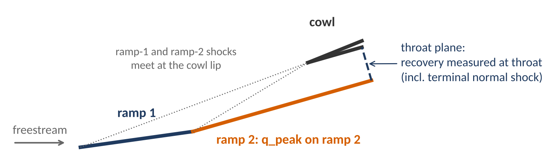
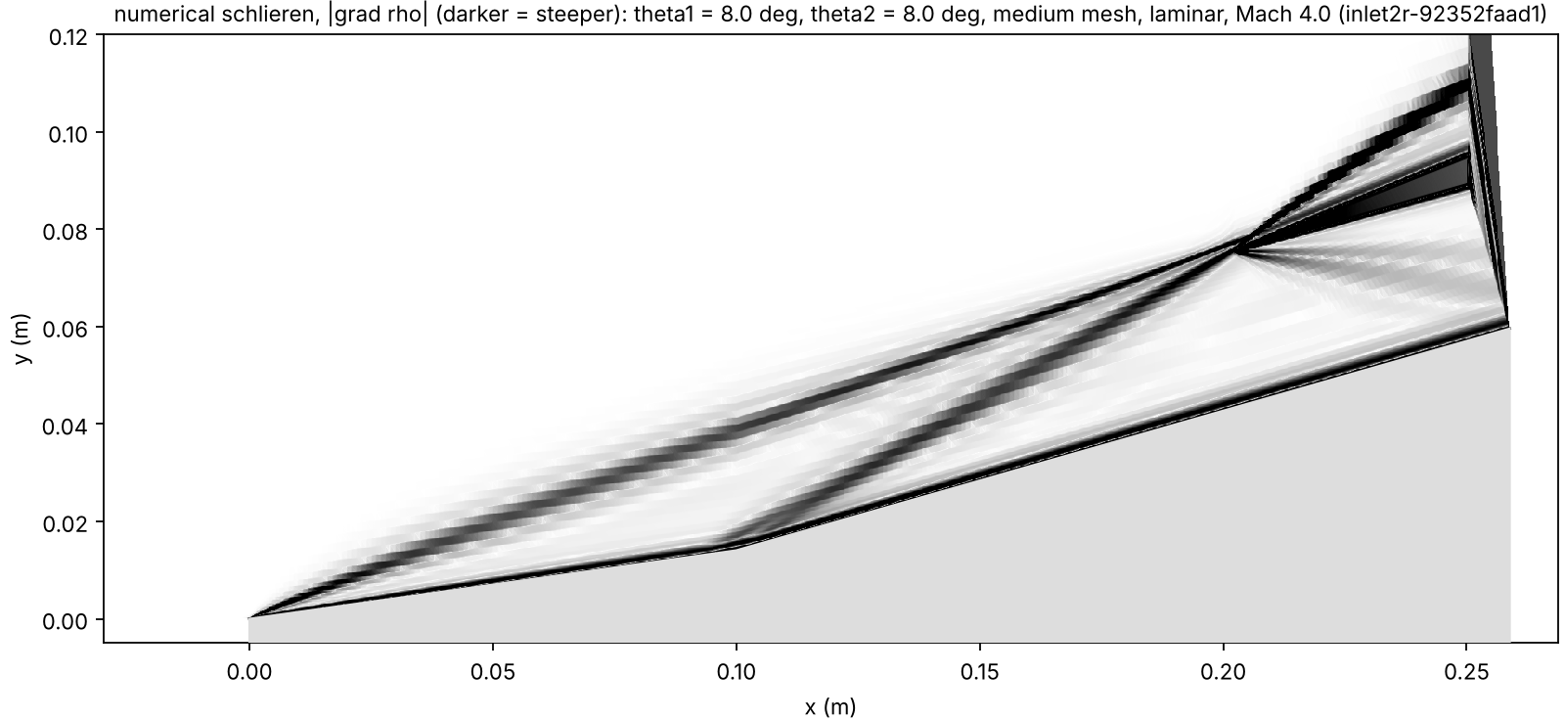
The design question
The inlet trades total pressure recovery against peak wall heating, and neither objective alone is a design.
Numerical schlieren of the laminar SU2 solution at 8/8 (medium mesh): the two ramp shocks meet at the cowl lip. Figure: runs/dev/2026-11-02_flow_fields/figures/inlet_8_8_schlieren.png. Record: runs/dev/2026-11-02_flow_fields/inlet2r-92352faad1.
Maximize: total pressure recovery at the throat plane, including the terminal normal shock.
Minimize: peak wall heat flux on ramp 2, including the duct wall; not on the sharp leading edge.
Left: docs/talk/figures/inlet_schematic.png, drawn by docs/talk/build_deck.py from geometry.inlet.design_points(8, 8), the geometry function of geometry/inlet.py (theta1 = theta2 = 8 deg); dotted lines: the shock-on-lip rule. Definitions: docs/specs/00_decisions.md, sections 2 and 3.
sources: geometry/inlet.py, docs/specs/00_decisions.md (sections 2, 3), runs/dev/2026-11-02_flow_fields/README.md
S2 | 4
Notes:
Recovery includes the terminal normal shock, which is what makes external compression worth anything. Peak heating is taken on ramp 2 including the duct wall, not on the sharp leading edge, where the computed peak is a mesh artifact.

Slide 5
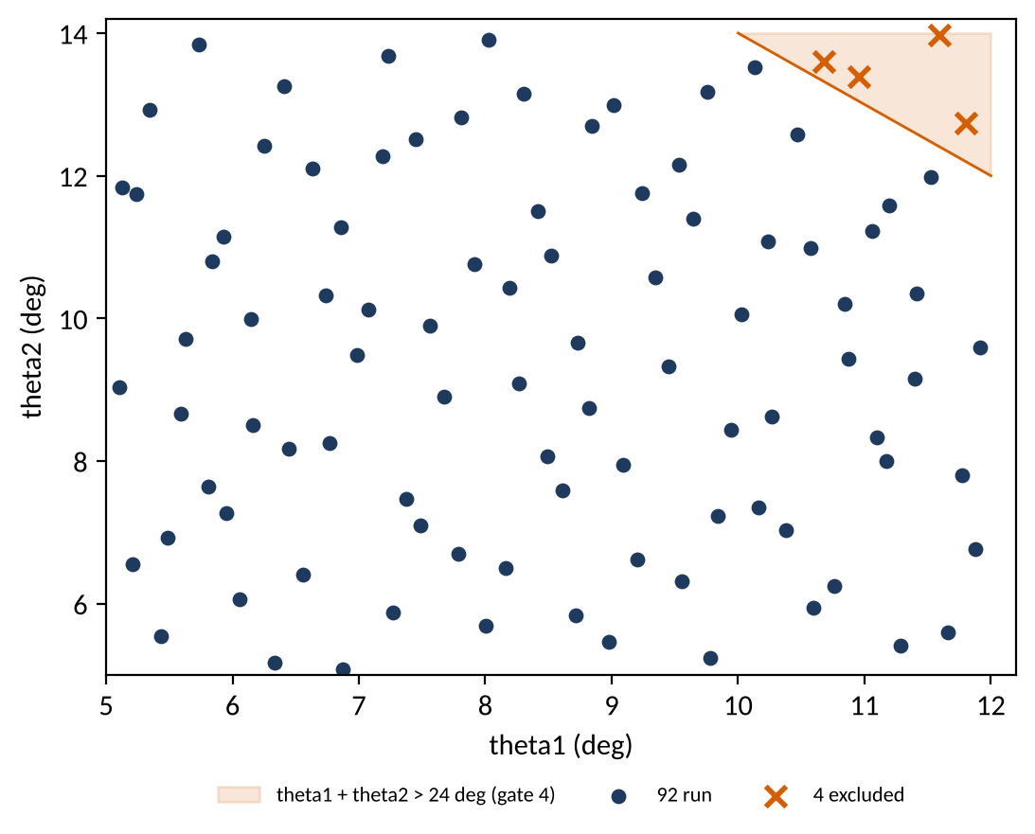
The design box
Two ramp angles, theta1 and theta2, set the geometry, and the box is trimmed to 24 deg total turning on evidence.
96 Sobol points, 4 excluded by gate 4 (theta1 + theta2 > 24 deg), 92 run.
Box: theta1 in [5, 12] deg, theta2 in [5, 14] deg, total turning at most 24 deg.
Excluded pool indices: 0, 40, 72, 80.
Figure: docs/talk/figures/design_box.png, drawn by docs/talk/build_deck.py from designs/pool_sobol96.csv. Record: runs/dev/2026-11-01_inlet_box_diagnostics/README.md.
sources: designs/pool_sobol96.csv, runs/dev/2026-11-01_inlet_box_diagnostics/README.md
S3 | 5
Notes:
The cowl position is not a design variable, because with these two objectives the Pareto set would sit on its bound. Wall temperature is a boundary condition, not a design choice, and the reasons are in the decisions file.

Slide 6
2. Physics setup and validation
9 minutes

Slide 7
Flight condition, and why laminar
Mach 4 at 30 km for a sub-scale body keeps the flow laminar, and we state that as an argument, not a measurement.
Input | Value | Where it comes from
Mach number | 4.0 | wedge-381c48d17f/case.cfg
Freestream temperature | 226.509 K | wedge-381c48d17f/case.cfg
Wall | isothermal, 300 K | wedge-381c48d17f/case.cfg
Altitude | 30 km | docs/specs/00_decisions.md, section 1
Body | sub-scale, about 0.3 m | docs/specs/00_decisions.md, section 1
The laminar choice is an argument (sub-scale, high altitude), not a measurement.
Transition argument: PENDING: no run record. It is an analytic estimate in docs/specs/00_decisions.md, section 1.1; no number from it is quoted here.
sources: runs/dev/2026-11-01_numerics/wedge-381c48d17f/case.cfg, docs/specs/00_decisions.md (section 1)
S4 | 7
Notes:
Mach 5 was rejected on analytic grounds, not by a run. The laminar choice is a sub-scale, high-altitude condition; a full-scale vehicle would need RANS, and B1 covers the one sensitivity run planned for that.

Slide 8
The validation ladder
Analytic checks run before any machine learning; hard checks must pass, soft and report checks are reported.
Check | Tolerance | Type | Verdict as the report gives it | Record
V1 oblique shock: beta, p2/p1, M2 | 0.5 deg; 2%; 2% | hard | PASS (+0.132 deg, -0.12%, -0.19%) | official (Colab)
V2a plateau pressure vs inviscid | +0 to +6% | report | REPORT (+1.69%) | official (Colab)
V2b wall heat flux vs Eckert | mean 10%, max 15% | hard | PASS (mean 1.60%, max 1.95%) | development
V3 q_stag vs Fay-Riddell, fine mesh; medium to fine change | 15%; 5% | hard | first numerics: FAIL (+216.84%; +628.92%) final numerics: PASS (-4.49%; -3.46%) | development
V3 stand-off vs Billig | 15% | report | REPORT (+5.6%, run 2026-11-02 with volume output) | development
V4e throat p0 and Mach, Euler 8/8 | 2% | hard | PASS (-0.34%, -0.14%) | development
V4v core p0, laminar | 5% | soft | PASS (-0.04% to +0.50% on the 6 laminar 8/8 runs) | development
V4m grid, 8/8: recovery; q_peak | 2%; 5% | hard | PASS (+0.09%; -1.68%); 12/14 not run | development
X1 AVG_TOTALPRESS vs mass average | 0.5% | hard | PASS on the 7 runs at 8/8; 12/14 not run | development
PASS and FAIL are checked against the tolerance; REPORT is reported without a gate; not run means the check could not run. Record: docs/validation/2026-11-01_report.md.
sources: docs/validation/2026-11-01_report.md
S5 | 8
Notes:
A hard failure means a bug in mesh, boundary condition, units or scheme, so we fix the cause and do not change the tolerance. The verdicts are shown as the report gives them, including the one that failed.

Slide 9
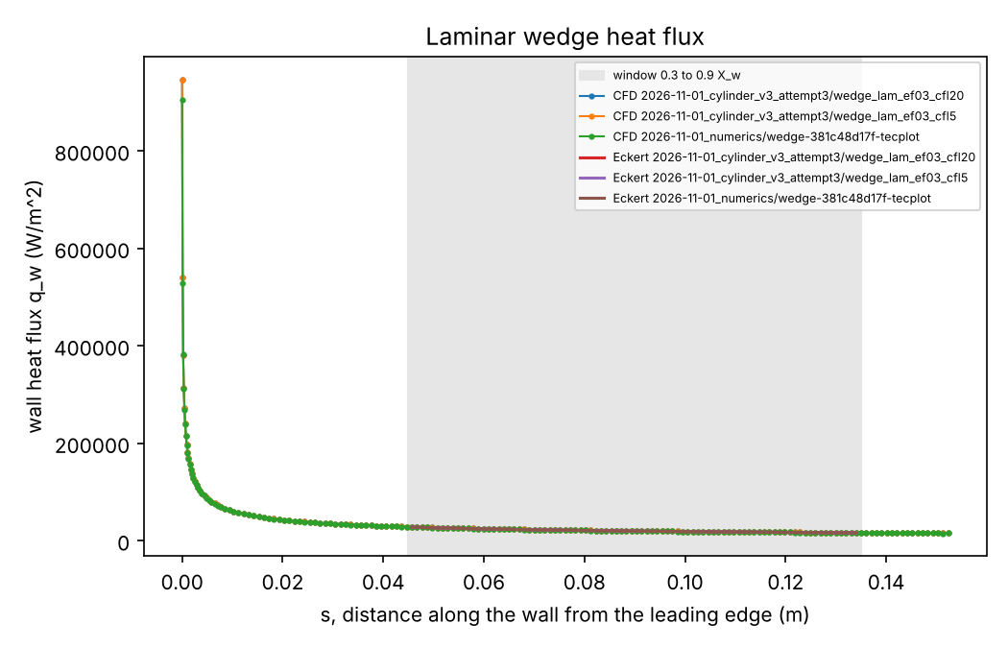
Oblique shock and laminar heating
The Euler wedge matches the oblique-shock relation within the hard tolerances, and the laminar wedge heating matches the Eckert flat-plate reference within the window.
Check | Measured | Tolerance
V1 beta (ref 22.234 deg) | 22.366 deg, +0.132 deg | 0.5 deg
V1 p2/p1 (ref 2.5060) | 2.5030, -0.12% | 2%
V1 M2 (ref 3.2861) | 3.2799, -0.19% | 2%
V2a plateau vs inviscid | +1.69% | +0 to +6%
V2b Eckert, mean | 1.60% | 10%
V2b Eckert, max | 1.95% | 15%
V1 and V2a: official Colab records, runs/task1/README.md and runs/task1/v1_oblique_shock.json, v2a.json. V2b: development run, final numerics (wedge_lam_ef03_cfl20), report V2b row, 88 nodes.
Figure: docs/validation/2026-11-01_wedge_heat_flux.png. Record: docs/validation/2026-11-01_report.md.
sources: runs/task1/README.md, runs/task1/v1_oblique_shock.json, runs/task1/v2a.json, docs/validation/2026-11-01_report.md
S6 | 9
Notes:
The V1 check is the official Colab record, so it is the one to quote for the solver setup. The V2b check is a development run with the final numerics; the entropy-fix change moved its deviation, and B4 shows the comparison.

Slide 10
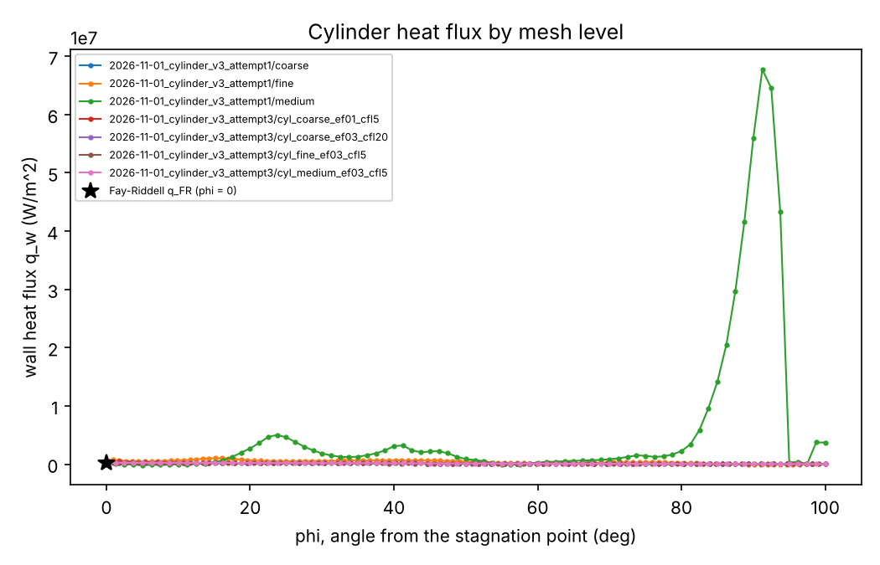
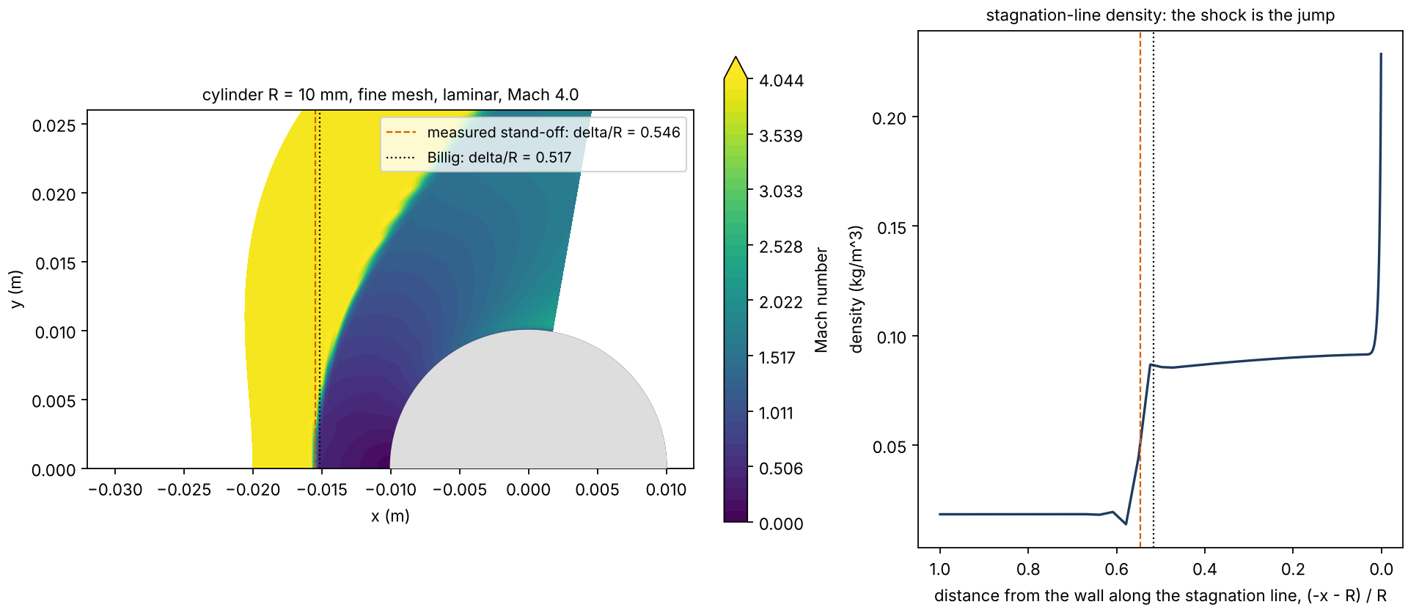
The cylinder: the hard check failed first
With the first numerics (Roe, entropy fix 0.1) the stagnation heating failed Fay-Riddell on the fine mesh; with entropy fix 0.3 it passes on that mesh.
Bow shock of the final numerics (fine mesh, development run with volume output): measured stand-off delta/R = 0.546 against Billig 0.517 (+5.6 percent, report tolerance 15 percent). Figure: runs/dev/2026-11-02_flow_fields/figures/cylinder.png. Record: runs/dev/2026-11-02_flow_fields/cylinder-04b6b912c5/standoff.json.
Figure: docs/validation/2026-11-01_cylinder_heat_flux.png. Record: docs/validation/2026-11-01_report.md.
Cylinder, hard checks | q_stag vs Fay-Riddell, fine mesh (15%) | Medium to fine change (5%)
Roe, entropy fix 0.1 (attempt 1) | FAIL: +216.84% | FAIL: +628.92%
Roe, entropy fix 0.3 (attempt 3) | PASS: -4.49% | PASS: -3.46%
sources: docs/validation/2026-11-01_report.md, runs/dev/2026-11-01_cylinder_v3_attempt1/README.md, runs/dev/2026-11-01_cylinder_v3_attempt3/README.md, runs/dev/2026-11-02_flow_fields/cylinder-04b6b912c5/standoff.json
S7 | 10
Notes:
The failure was kept and not tuned away, and the fix was chosen from a six-scheme comparison and a split test. The grid study passes on two levels only, so no order of convergence is claimed.

Slide 11
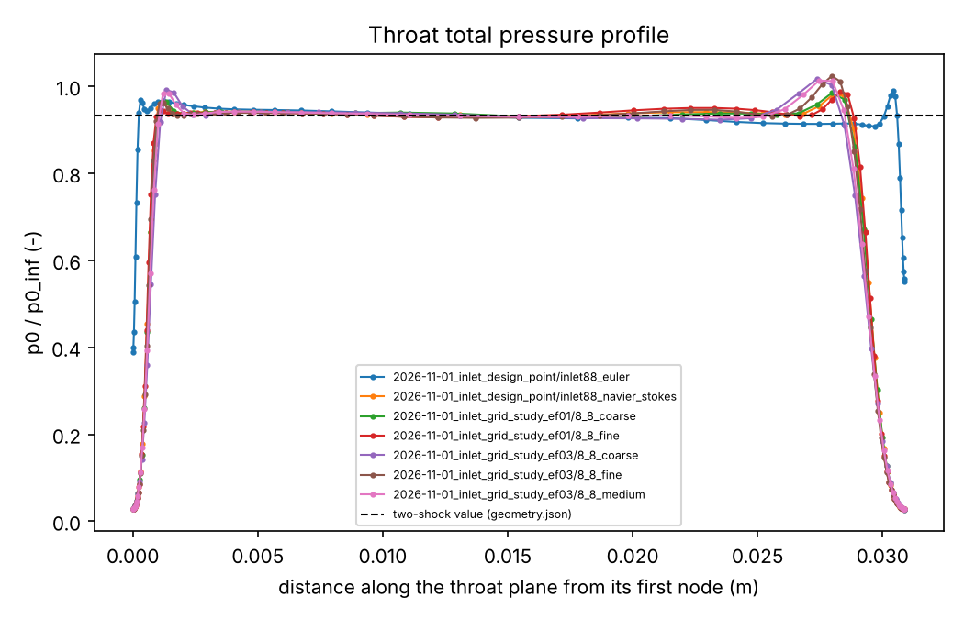
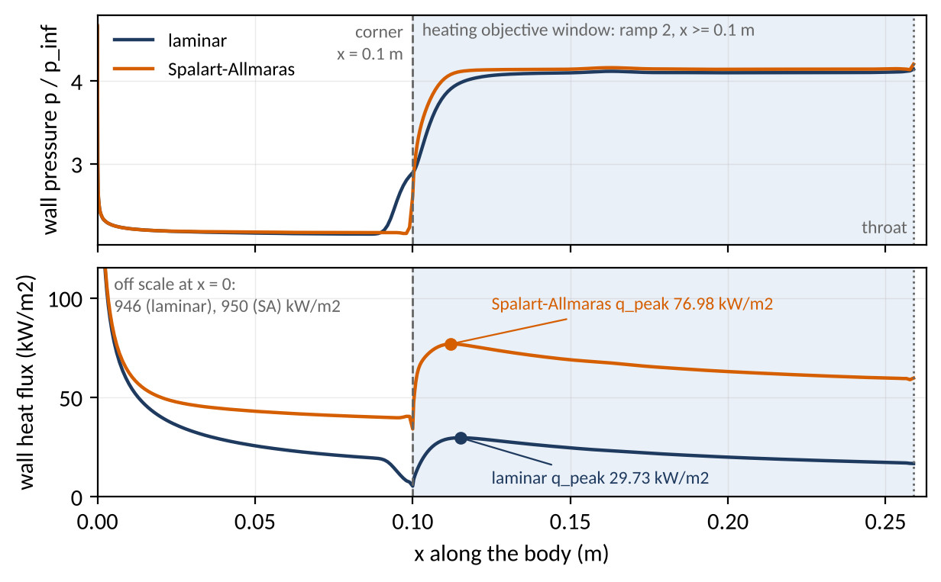
Inlet design point at 8/8
At the design point the inviscid throat matches the two-shock relations within the hard tolerance, and the laminar core is within the soft band.
Figure: docs/validation/2026-11-01_inlet_throat_p0.png. Record: docs/validation/2026-11-01_report.md and runs/dev/2026-11-01_inlet_design_point/README.md. Development run, not the official Task 2 record.
Figure: docs/talk/figures/wall_8_8_laminar_vs_sa.png, drawn by docs/talk/build_deck.py from the body-wall nodes of surface_flow.dat.gz in runs/dev/2026-11-01_inlet_grid_study_ef03/8_8_medium (laminar) and runs/dev/2026-11-01_turbulence_sensitivity_SA/8_8_medium_SA (Spalart-Allmaras, a sensitivity bound). Labeled q_peak values equal metrics.json of each run; p_inf = 1197.03 Pa.
Check (8/8, medium) | Measured | Tolerance | Verdict
V4e throat p0/p0_inf, Euler | 0.9284 vs 0.9316 two-shock, -0.34% | 2% hard | PASS
V4e throat Mach, Euler | 2.958 vs 2.962, -0.14% | 2% hard | PASS
V4v core p0/p0_inf, laminar | 0.9351 vs 0.9316, +0.39% | 5% soft | PASS
Laminar, whole throat | area average 0.8824; mass-averaged 0.9114 | shown, not gated | boundary-layer loss about 2%
sources: runs/dev/2026-11-01_inlet_design_point/README.md, docs/validation/2026-11-01_report.md, runs/dev/2026-11-01_inlet_grid_study_ef03/8_8_medium/surface_flow.dat.gz, runs/dev/2026-11-01_turbulence_sensitivity_SA/README.md, runs/dev/2026-11-01_turbulence_sensitivity_SA/8_8_medium_SA/surface_flow.dat.gz
S8 | 11
Notes:
This is a development run, not the official Task 2 record, which comes from the validation batch. The laminar core is a soft check, and the boundary-layer loss is shown beside it rather than hidden.

Slide 12
3. Automation layer: MCP tools, gates, queue
5 minutes

Slide 13
The pipeline on one slide
A design passes the schema, the physics gates and the mesh gate before SU2 sees it, and the LLM sits outside this chain.
Claude Code (MCP client)
parameters
schema
physics gates
mesh quality
typed tools
create_case
validate_config
submit
list_results
postprocess
config check
Drive queue
Colab worker
SU2
result or error
metrics
surrogate
acquisition
never chooses a sampling point
Shaded boxes: the gates a design passes before SU2 sees it.
sources: docs/specs/01_interfaces.md
S9 | 13
Notes:
Each step is a function a person can read, and each gate fails with the offending value. The language model calls typed tools and never picks a sampling point.

Slide 14
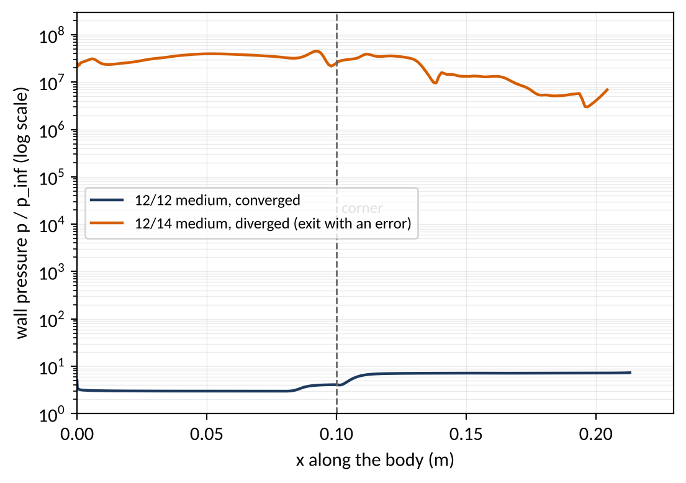
Gates reject before any CFD
The gates stop a design that would not converge, and the design box was trimmed on that evidence.
Case (medium mesh unless stated) | Total turning | Outcome | recovery_total | q_peak [kW/m2]
12/14, entropy fix 0.1 and 0.3, medium and fine | 26 deg | diverged (2300 to 4350 iterations) | - | -
12/14 medium, CFL max 5 | 26 deg | residual fell to -7.4 then grew to +1.7: diverging | - | -
12/12 | 24 deg | converged (2063 iterations) | 0.4065 | 46.9
8/14 | 22 deg | converged (2160 iterations) | 0.3876 | 47.9
5/14 | 19 deg | converged (1952 iterations) | 0.3481 | 43.1
Gate 4: total turning at most 24 deg; 4 of the 96 pool points (indices 0, 40, 72, 80) are excluded.
12/14 diverged on both meshes, medium and fine, with both entropy fixes and both CFL caps (20 and 5).
Figure: docs/talk/figures/wall_12_14_diverged.png, drawn by docs/talk/build_deck.py from surface_flow.dat.gz of runs/dev/2026-11-01_inlet_grid_study_ef03/12_14_medium (exited with an error after 4347 iterations; runs/dev/2026-11-01_inlet_grid_study_ef03/README.md) and runs/dev/2026-11-01_inlet_box_diagnostics/12_12_medium. Largest pressure in the 12/14 surface file: 8.0e10 Pa; p_inf = 1197.03 Pa.
sources: runs/dev/2026-11-01_inlet_box_diagnostics/README.md, runs/dev/2026-11-01_inlet_grid_study_ef03/README.md, runs/dev/2026-11-01_inlet_grid_study_ef03/12_14_medium/surface_flow.dat.gz, runs/dev/2026-11-01_inlet_box_diagnostics/12_12_medium/surface_flow.dat.gz
S10 | 14
Notes:
The 26 deg corner diverged, so the gate rejects total turning above 24 deg, and four of the 96 pool points are excluded. The 25 deg band was not tested, and any pool point near the limit that fails is recorded as a failure.

Slide 15
Drive queue and a restart-safe worker
Colab cannot take inbound connections, so jobs go through a Drive folder, and a restarted worker resumes without losing or repeating finished runs.
jobs/<case_id>.json
(uploaded job file)
Colab worker
(polls the folder)
runs/<case_id>/
Ingest refuses a result that does not match the sha256 digest the worker wrote next to it.
2026-11-02: the worker on Colab restarted with --retry-reason config_mismatch and re-ran the 63 refused pool jobs without repeating the 29 finished ones; all 92 pool points converged.
F8: a killed worker is found by its stale heartbeat and the job is re-run once (local test with the fake solver).
runs/<case_id>/status/ flags
2-done
result.json + .sha256
0-seen
1-running
2-failed
error.json + .sha256
heartbeat.json (a stale one marks a killed worker)
Layout from docs/specs/01_interfaces.md (job directory); flags and records as listed there.
sources: docs/specs/01_interfaces.md, docs/transcripts/2026-11-02_worker_restart_and_retry.md, docs/validation/2026-11-01_colab_records.md, docs/faults/fault_matrix.md
S11 | 15
Notes:
The worker never decides physics; it rebuilds the mesh from the uploaded parameters and checks a fingerprint before it runs SU2. Failure reasons come from a fixed list, so a failed job always says why.

Slide 16
The first live agent call
The agent reads the queue through a typed tool and answers from flag files and result records; it chose no sampling point.
Call: list_results(tag="val"), 2026-11-01. Ten rows, all status pending, metrics null.
Family | Design (theta1/theta2 deg) | Case ids | Rows | Status
cylinder | none (theta null) | cylinder-941780775b, cylinder-fd9d9778c5, cylinder-854aee41c4 | 3 | pending
wedge | theta1 10.0 | wedge-b39d378f9c | 1 | pending
inlet2r | 8/8 | inlet2r-619144f64c, -bb81bb26f0, -d4d29884be, -5e844a838c | 4 | pending
inlet2r | 12/14 (staged before gate 4 was trimmed to 24 deg; kept as a recorded failure case) | inlet2r-20b8dcc9ec, -dbccca19df | 2 | pending
The claim is limited to what the tool returned: it read flag files and result.json only and chose no sampling point.
Record: docs/transcripts/2026-11-01_first_mcp_call.md (a transcript, not a runs/ record). Rows grouped by family here; the transcript lists them one per case.
sources: docs/transcripts/2026-11-01_first_mcp_call.md
S12 | 16
Notes:
This is a convenience layer over validated tools, and the transcript shows what the tool read and what it did not choose. Anything stronger rests on the Task 6 transcripts and injected faults, which have not been run yet.

Slide 17
4. Surrogate, active learning, UQ
9 minutes

Slide 18
One exact Gaussian process per objective
With two inputs and a small number of runs, an exact Gaussian process gives calibrated intervals from its posterior, and it needs no GPU.
GP: recovery_total
mean and 90 percent interval
recovery_total
inputs
theta1, theta2
(scaled to the unit box)
GP: log q_peak
mean and 90 percent interval
q_peak (from the log prediction)
Exact GP, pure PyTorch, Matern 5/2 kernel with automatic relevance lengths, fitted by marginal likelihood.
One GP per objective; the Colab GPU is not needed.
Interval check: the replay calibration (slide S16).
Specification: docs/specs/task4_surrogate_active_learning.md. Drawing, no data.
sources: docs/specs/task4_surrogate_active_learning.md
S13 | 18
Notes:
The model is pure PyTorch with a Matern 5/2 kernel with automatic relevance lengths, fitted by marginal likelihood. The Colab GPU is not needed, and we say so rather than suggest otherwise; deep ensembles are the alternative for high-dimensional inputs.

Slide 19
Acquisition, and who chooses
Expected hypervolume improvement picks the next run, a max-variance rule is the control, and the LLM chooses nothing.
EHVI (Monte-Carlo)
posterior mean + variance
(both GPs)
next design
max-variance (control)
deterministic given the seed; LLM not in the loop
EHVI: Monte-Carlo expected hypervolume improvement on (-recovery_total, log q_peak).
Max-variance: sum of the standardized posterior variances; pure exploration, the control.
Candidates: in the replay, the unselected pool points.
Specification: docs/specs/task4_surrogate_active_learning.md. Drawing, no data.
sources: docs/specs/task4_surrogate_active_learning.md
S14 | 19
Notes:
Both rules are deterministic given a seed, so every run can be reproduced from its record. The max-variance rule is in the comparison so that the audience can see what the hypervolume term adds.

Slide 20
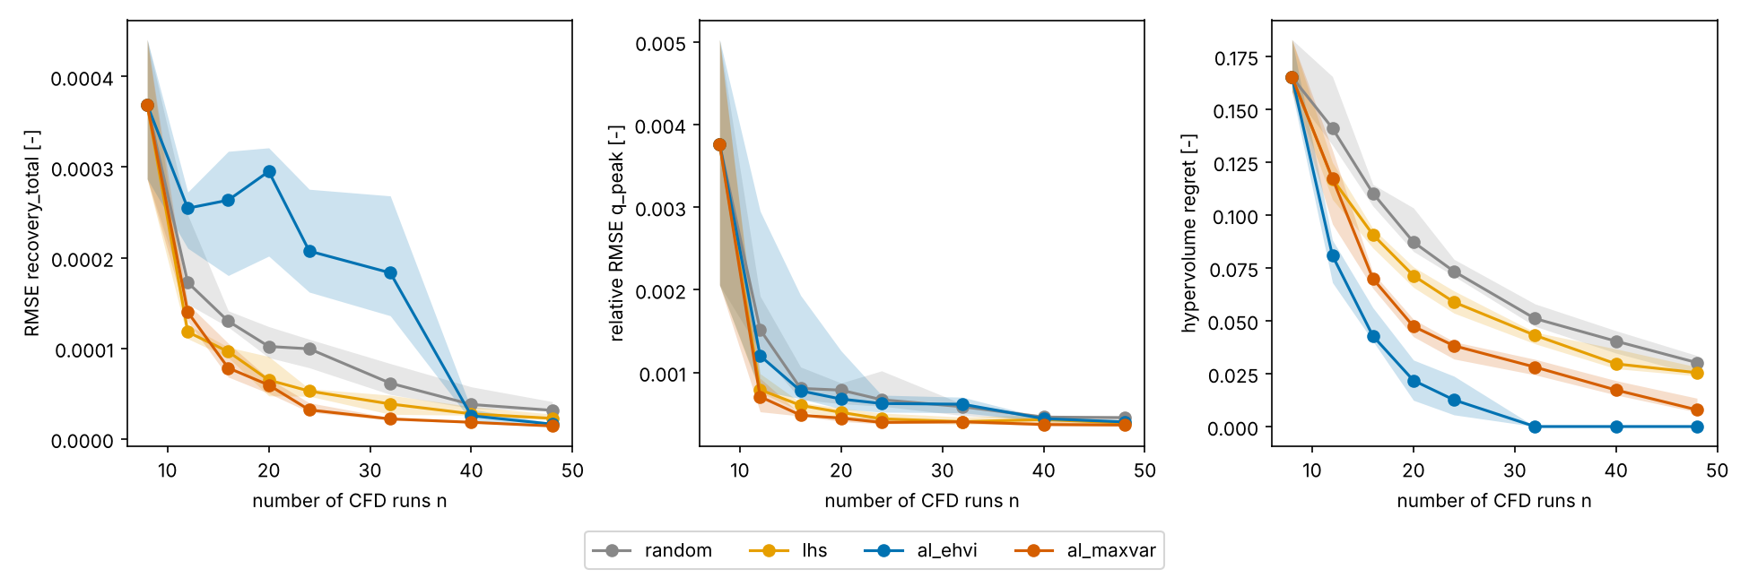
Active learning against random and LHS
On the same pool, EHVI finds the Pareto front fastest and max-variance learns the whole box fastest; active learning beats random and Latin hypercube on the objective it targets, not on global error, and both are shown.
Final replay: all 92 pool points, 10 seeds, n = 8 to 48. Median and interquartile band.
Hypervolume regret: EHVI is lowest at every budget from n = 12; 0 in 10 of 10 seeds from n = 32 (the 26-point true front is contained). No other strategy reaches 0 by n = 48.
Figure: docs/validation/2026-11-02_replay_full_error_vs_n.png. Record: docs/validation/2026-11-02_replay.md and docs/validation/2026-11-02_replay_full_summary.md.
Held-out error: EHVI has the highest recovery RMSE of the four from n = 12 to 32 and overtakes random and LHS only at n = 40. Recovery RMSE at n = 48: EHVI 1.6e-5, random 3.1e-5, LHS 2.3e-5, max-variance 1.4e-5.
Max-variance has the lowest recovery RMSE from n = 16 on. All four strategies share one pool, so no extra CFD.
sources: docs/validation/2026-11-02_replay_full_error_vs_n.png, docs/validation/2026-11-02_replay_full_summary.md, docs/validation/2026-11-02_replay.md
S15 | 20
Notes:
Every strategy uses the same pool, so the ground truth is shared and no extra CFD is needed. If active learning does not beat the baselines, the slide says so and the next step is to investigate, not to retune.

Slide 21
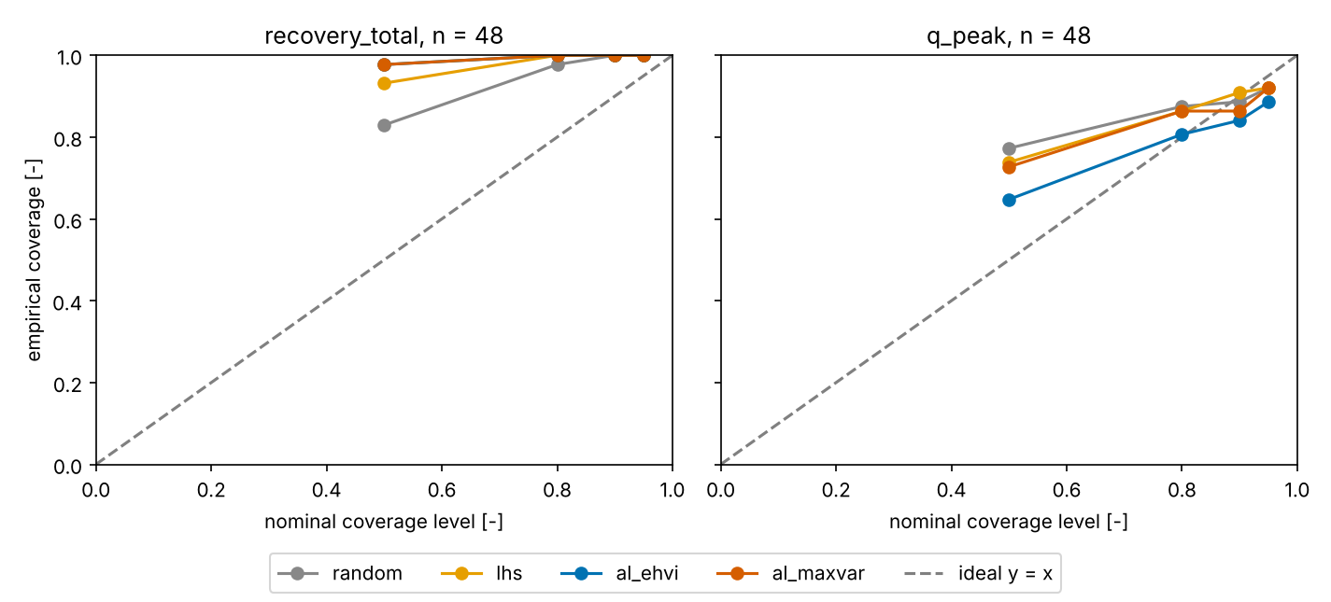
Calibration
The 90 percent intervals should cover about 90 percent of held-out points, and coverage outside 80 to 97 percent is flagged.
Final replay, 92 pool points, n = 48, 44 held-out points.
q_peak coverage is inside the band: 0.84 to 0.91 at the 90 percent level.
Recovery is over-covered: 1.0 at the 90 percent level for every strategy. Flagged and explained, not refitted.
Flag band 80 to 97 percent: tolerance C1, docs/specs/00_decisions.md, section 5.
Figure: docs/validation/2026-11-02_replay_full_calibration.png. Record: docs/validation/2026-11-02_replay.md.
sources: docs/validation/2026-11-02_replay_full_calibration.png, docs/validation/2026-11-02_replay.md, docs/specs/00_decisions.md (section 5)
S16 | 21
Notes:
Coverage is the check that the uncertainty means something, and it is reported whatever it shows. A flagged result gets an explanation, not a refit.

Slide 22
5. Results, Pareto front, inverse query
7 minutes

Slide 23
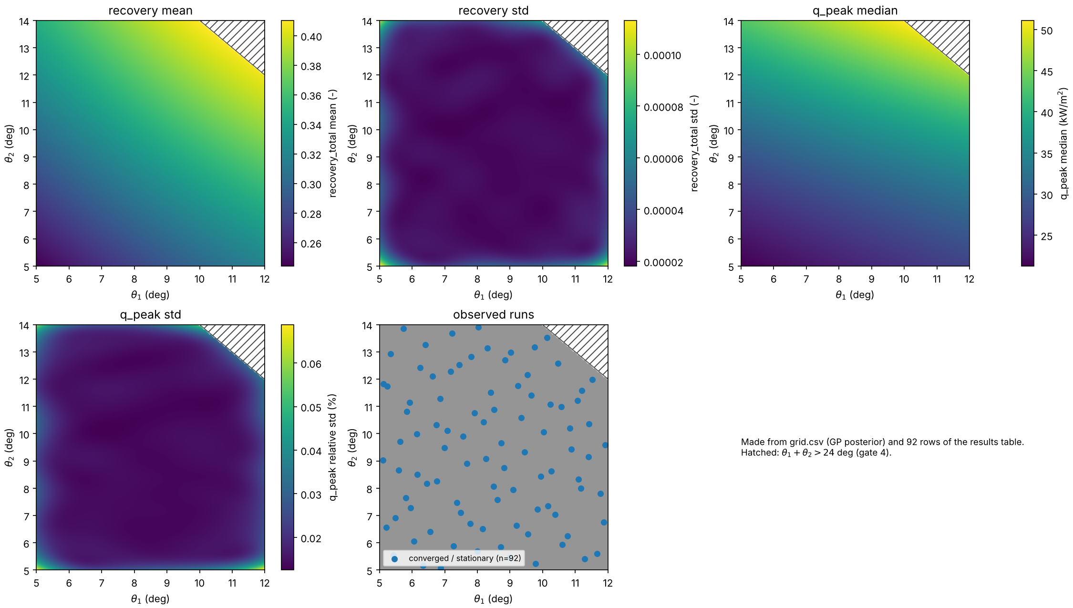
The pool across the box
The 92 runnable points span the trimmed box, and their objective values are the ground truth for every comparison.
92 converged, 0 failed (runs/pool/results.csv).
The 4 of the 96 Sobol points in designs/pool_sobol96.csv with theta1 + theta2 > 24 deg were refused by gate 4 and never staged.
Shaded corner: theta1 + theta2 > 24 deg (gate 4). The full design map, with the GP maps, is on slide S20.
Figure: runs/analysis/2026-11-02/design_map.png (panel "observed runs" cropped). Record: runs/pool/results.csv.
sources: runs/analysis/2026-11-02/design_map.png, runs/pool/results.csv, docs/validation/2026-11-01_colab_records.md, designs/pool_sobol96.csv
S17 | 23
Notes:
Only converged and stationary runs enter the surrogate, and each point keeps its status. Points rejected by a gate are listed as excluded, not dropped.

Slide 24
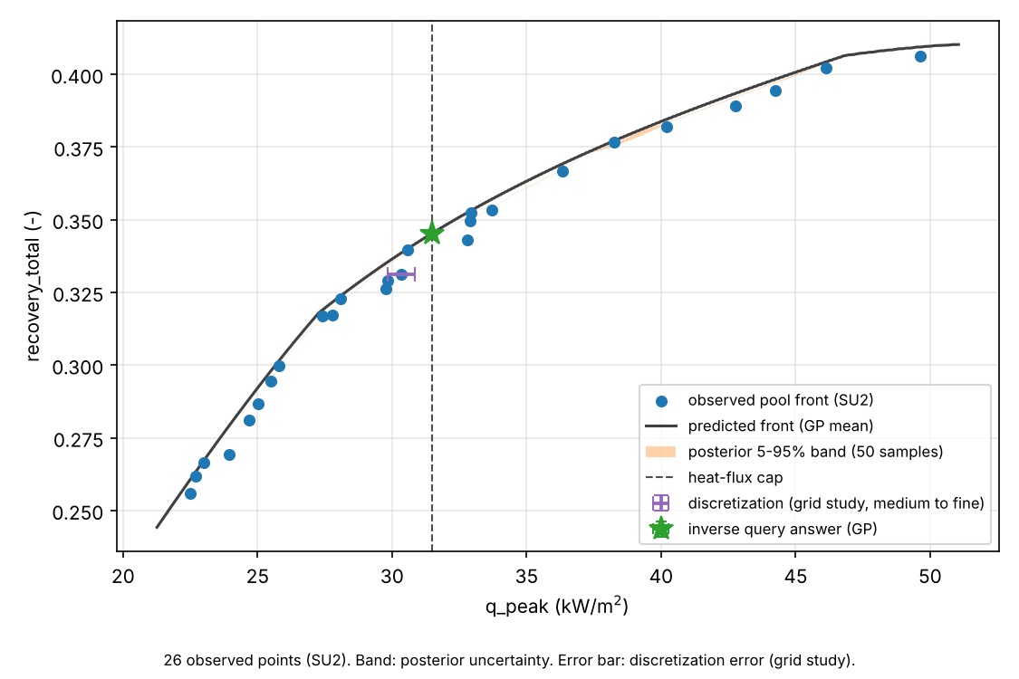
Pareto front with uncertainty
Observed points, the predicted front, the posterior band and the discretization error bar, shown together, say how far the front can be trusted.
26 observed front points of 92.
Posterior band: 1.2e-4 to 1.8e-3 wide in recovery.
Discretization error bar (V4m grid study): 3.1e-4 in recovery and 530 W/m2 in q_peak; 25 times the posterior uncertainty in heat flux.
Source: docs/validation/2026-11-02_pareto_inverse.md, section 2.
Figure: runs/analysis/2026-11-02/pareto_front.png. Record: runs/analysis/2026-11-02/pareto.csv.
sources: runs/analysis/2026-11-02/pareto_front.png, runs/analysis/2026-11-02/pareto.csv, docs/validation/2026-11-02_pareto_inverse.md (section 2)
S18 | 24
Notes:
The band is posterior uncertainty and the error bar is discretization error from the grid study, and both are shown separately. The front is only as good as the mesh levels behind it (B3).

Slide 25
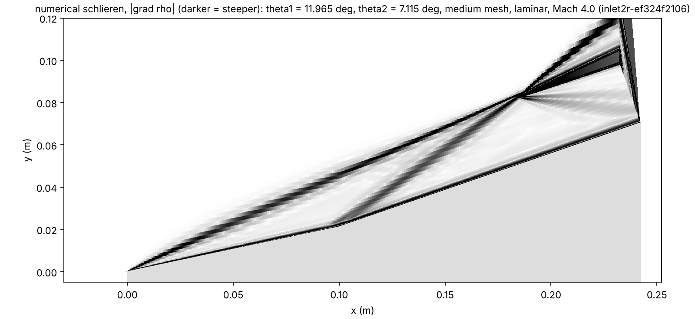
Inverse query under a heat-flux cap
The surrogate answers "highest recovery with peak heat flux under the 40th percentile of pool heating", and one real SU2 run checks the answer.
Query | Surrogate answer (90 percent interval) | Confirmation run result | Inside interval?
Highest recovery with q_peak under the 40th percentile of pool heating (cap 31493 W/m2); answer theta1 = 11.965 deg, theta2 = 7.115 deg | recovery_total 0.34515 (0.34506 to 0.34523) | 0.34513 (z = -0.41) | yes
 | q_peak 31470 W/m2 (31450 to 31490); P(q <= cap) = 0.972 | 31462 W/m2 (z = -0.66) | yes
C2 pass: the SU2 run inlet2r-374dad241f (Colab, 2026-11-02 14:38 UTC, 1248 iterations, converged) falls inside both 90 percent intervals and below the cap.
The cap is fixed from the pool before the answer is known (40th percentile of the pool's q_peak).
One run inside a 90 percent interval is one draw, not a calibration statistic; the calibration evidence is the replay (S16).
Refitting the GPs with this one new point shrinks the predictive std at the design from 5.1e-5 to 4.6e-5 in recovery and from 3.9e-4 to 3.5e-4 in log q_peak (ratios 0.90 and 0.92).
Schlieren of the confirmed design (development run with volume output, same metrics as the Colab run): runs/dev/2026-11-02_flow_fields/figures/inlet_confirm_schlieren.png.
sources: runs/analysis/2026-11-02/inverse_q40/result.json, runs/confirm/inlet2r-374dad241f/result.json, runs/analysis/2026-11-02/confirm/confirm.json, docs/validation/2026-11-02_pareto_inverse.md (section 3), runs/dev/2026-11-02_flow_fields/inlet2r-ef324f2106/result.json
S19 | 25
Notes:
The cap is set from the pool before the answer is known. The check passes if the confirmation run falls inside the predicted interval; a miss is documented and explained.

Slide 26
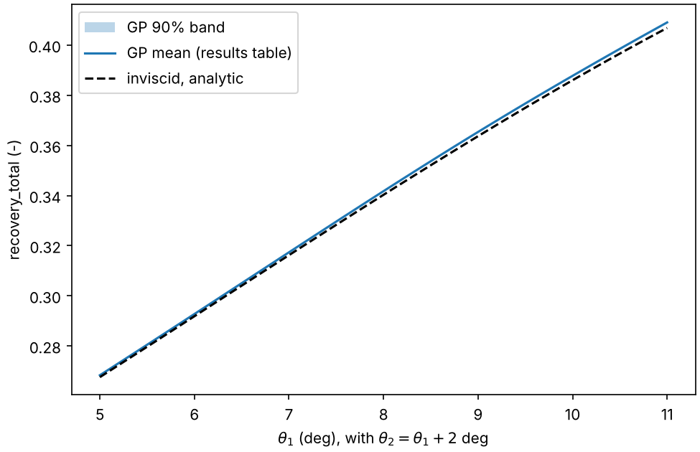
Design maps over the box
Design maps show recovery and heat flux over the trimmed box, with the surrogate and the observed points on top.
Figure: runs/analysis/2026-11-02/oswatitsch_cut.png.
Recovery std 1.8e-5 to 1.1e-4 over the box.
Oswatitsch cut: GP mean 0.0008 to 0.0022 above the inviscid analytic curve, explained from the recorded throat Mach.
Figure: runs/analysis/2026-11-02/design_map.png. Records: runs/analysis/2026-11-02/grid.csv, docs/validation/2026-11-02_pareto_inverse.md, section 4.
sources: runs/analysis/2026-11-02/design_map.png, runs/analysis/2026-11-02/oswatitsch_cut.png, runs/analysis/2026-11-02/grid.csv, docs/validation/2026-11-02_pareto_inverse.md (section 4)
S20 | 26
Notes:
The maps show where the trade-off bends for an aerodynamics audience. They are interpolations between runs and are labeled that way.

Slide 27
6. What failed, limits, next steps
5 minutes

Slide 28
What failed, in order
Five things failed on the way, each was recorded, and each change was made on that evidence.
What failed | What the record shows | What changed
1. Cylinder carbuncle, Roe at entropy fix 0.1 | Fine mesh q_stag +216.84% against Fay-Riddell (FAIL); medium run diverged | Entropy fix 0.3: fine mesh -4.49%, grid change -3.46%, PASS; the CFL cap alone did not help
2. Euler wedge with AUSM+-up2 diverged or stalled | Variants A, B, D: diverged at iteration 50 or stalled for 800 iterations | Roe with CFL adapt (0.5, 1.05, 1.0, 20): converged (variant C)
3. 12/14 corner diverged | Residual to -7.5, then growth, on both meshes and both entropy fixes | Gate 4: total turning at most 24 deg; 4 of 96 pool points excluded
4. Diverged surface file reported as "check the units" | Pressures up to about 8e10 Pa in the 12/14 surface file | Divergence check placed before the cross-check; the report now says "solution diverged"
5. Pool job refused as config mismatch | One number in a comment line (h_duct) differed by 3e-18 between container and Colab; 63 jobs refused | Config hash covers only the lines SU2 reads; worker restarted with --retry-reason; 92 of 92 converged
sources: runs/dev/2026-11-01_cylinder_v3_attempt1/README.md, runs/dev/2026-11-01_cylinder_v3_attempt3/README.md, runs/dev/2026-11-01_numerics/README.md, runs/dev/2026-11-01_inlet_grid_study_ef03/README.md, docs/faults/README.md, runs/pool/inlet2r-db92dcf68d/error.json (commit 915f5f8), docs/transcripts/2026-11-02_worker_restart_and_retry.md
S21 | 28
Notes:
Failures 4 and 5 are failures of the tooling, not of the physics, and they are the ones an agent layer must surface rather than hide: a wrong message and an over-strict guard. Both are closed with a test.

Slide 29
Limits of the model
The model is laminar, sub-scale and two-dimensional with two variables, and the corner of the box that does not converge limits what the front means.
Limit | Consequence for the Pareto front
Laminar flow at a sub-scale, high-altitude condition (Re_L at most 5e5) | Spalart-Allmaras sensitivity (development runs, a bound): peak heating 2.5 to 2.6 times laminar; throat recovery 0.857 against 0.909 at 8/8. The trade-off keeps its direction, the heating level does not
Two-dimensional, two design variables | The front is a front in theta1 and theta2 only; cowl position and wall temperature are not design variables
12/14 corner (26 deg total turning) does not converge | Gate 4 trims total turning to 24 deg, so the front holds inside the trimmed box; the 25 deg band was not tested
Sharp leading edge: wall-node temperature departs from 300 K within about 30 mm (750 K at the tip) | Both objectives are placed away from it: ramp 2 only, x >= 0.1 m
Mesh level | Discretization error bar 3.1e-4 in recovery and 530 W/m2 in q_peak (V4m, 8/8); no converged grid study at 12/14
sources: runs/dev/2026-11-01_inlet_grid_study_ef03/README.md, runs/dev/2026-11-01_numerics/README.md, runs/dev/2026-11-01_turbulence_sensitivity_SA/README.md, docs/validation/2026-11-02_pareto_inverse.md (section 2)
S22 | 29
Notes:
A full-scale vehicle at lower altitude would be turbulent, and the talk does not claim a turbulent result. Objective values near sharp leading edges are excluded by construction, not because they were checked.

Slide 30
What is still to be recorded
The official validation batch, the fault matrix, the turbulence sensitivity on Colab, the 92-point pool, the replay, the Pareto analysis and the confirmation run are all recorded; nothing on the talk's list is pending.
Item | State | Record
Validation checks V1 to V4, X1 | done (development runs; V1 and V2a official) | docs/validation/2026-11-01_report.md
Official validation batch: V3, V4m, V4e metrics form, X1, two 12/14 failures | done | docs/validation/2026-11-01_colab_records.md
Fault matrix F1 to F10b (run without SU2) | done | docs/faults/fault_matrix.md
Turbulence sensitivity (Spalart-Allmaras) | done (development, a bound) | runs/dev/2026-11-01_turbulence_sensitivity_SA/README.md
92-point pool | done: 92 of 92 converged, 0 failures | docs/validation/2026-11-01_colab_records.md
Replay: active learning against random and LHS | done | docs/validation/2026-11-02_replay.md
Pareto front and inverse query | done | docs/validation/2026-11-02_pareto_inverse.md
Confirmation run inlet2r-374dad241f | done: C2 pass (both objectives inside the 90 percent interval) | runs/confirm/, runs/analysis/2026-11-02/confirm/confirm.json
Spalart-Allmaras sensitivity on Colab (3 runs) | done (a bound, no transition model) | runs/sensitivity/, docs/validation/2026-11-02_sa_sensitivity.md
sources: docs/validation/2026-11-01_report.md, docs/validation/2026-11-01_colab_records.md, docs/faults/fault_matrix.md, docs/validation/2026-11-02_replay.md, docs/validation/2026-11-02_pareto_inverse.md, runs/analysis/2026-11-02/confirm/confirm.json, docs/validation/2026-11-02_sa_sensitivity.md
S23 | 30
Notes:
Every item on the list has a record in the repository. The talk claims nothing beyond what those records show.

Slide 31
Discussion
about 20 minutes, outside the 40

Slide 32
Questions, and where the answers are
The discussion is open, and the backup slides answer the fidelity questions.
B1 Turbulence model (why laminar?)
B2 Wall boundary condition (is the wall really at 300 K?)
B3 Mesh convergence (is the mesh converged?)
B4 The numerics story (why this scheme?)
B5 Design-box trim (why 24 degrees?)
B6 Full validation table (what did not run?)
B7 Neural-network ensemble against the GP (why a GP?)
B8 Neural operator for the heat-flux profile (why not the whole profile?)
S24 | 32
Notes:
Start with the limit that matters to the person asking, then open the matching backup slide. Do not quote a number that is not on a slide.

Slide 33
Backup
not timed

Slide 34
Backup: turbulence model
Laminar is the model for this sub-scale condition; a Spalart-Allmaras sensitivity run shows what a turbulent layer would change and is labeled as a bound, not a result.
Case | Model | Record | recovery_total | recovery_throat | q_peak [kW/m2] | wall y+ (dev run)
8/8 medium | laminar | runs/val/inlet2r-d4d29884be | 0.3163 | 0.9085 | 29.73 | -
8/8 medium | SA | runs/sensitivity/inlet2r-1731bdea74 | 0.3112 | 0.8565 | 76.98 | 2.3 / 3.0
8/8 fine | laminar | runs/val/inlet2r-5e844a838c | 0.3166 | 0.9105 | 29.23 | -
8/8 fine | SA | runs/sensitivity/inlet2r-8a09596911 | 0.3109 | 0.8592 | 76.29 | 1.7 / 2.6
12/12 medium | laminar | runs/dev/.../12_12_medium | 0.4065 | 0.8222 | 46.86 | -
12/12 medium | SA | runs/sensitivity/inlet2r-d7e3815b57 | 0.3925 | 0.7441 | 118.20 | 3.1 / 3.6
Peak heating 2.59, 2.61 and 2.52 times laminar; recovery_total lower by 0.005 to 0.014; throat recovery 0.857 against 0.909 at 8/8.
Colab runs (RANS_SA, 4 ranks) equal the container development runs to every printed digit. SA without a transition model and with y+ above 1: a sensitivity bound, not a validated turbulent prediction.
sources: runs/sensitivity/results.csv, docs/validation/2026-11-02_sa_sensitivity.md, runs/dev/2026-11-01_turbulence_sensitivity_SA/README.md
B1 | 34
Notes:
The SA run has no transition model and y+ above 1, so it bounds the effect rather than predicting it. The trade-off keeps its direction; the heating level does not.

Slide 35
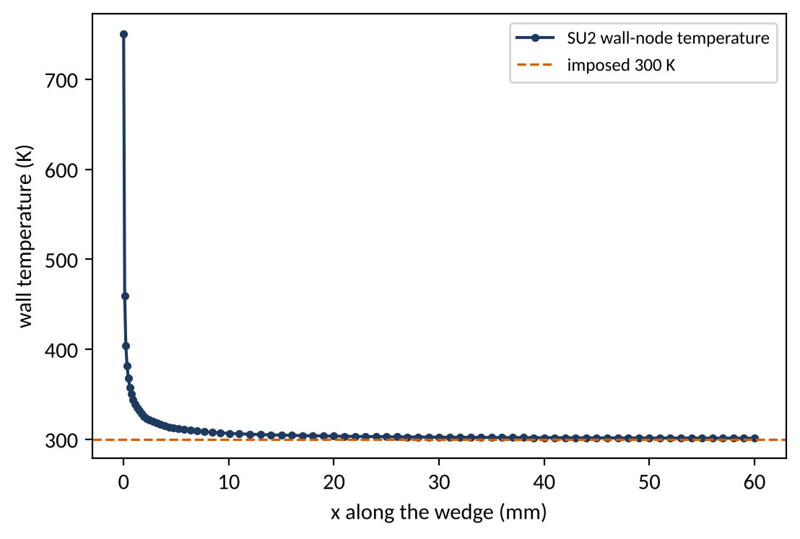
Backup: wall boundary condition
The isothermal 300 K wall is imposed weakly near a sharp leading edge, and both objectives are placed away from that region.
x along the wedge | SU2 wall-node temperature
tip | 750 K
0.1 mm | 459 K
1.3 mm | 335 K
beyond about 30 mm | below 301 K
The heat-flux objective starts at x = 0.1 m on ramp 2, outside this region.
Values: runs/dev/2026-11-01_numerics/README.md.
Figure: docs/talk/figures/wall_temperature.png, drawn by docs/talk/build_deck.py from runs/dev/2026-11-01_numerics/wedge-381c48d17f-tecplot/surface_flow.dat.gz (laminar wedge, development run).
sources: runs/dev/2026-11-01_numerics/README.md, runs/dev/2026-11-01_numerics/wedge-381c48d17f-tecplot/surface_flow.dat.gz
B2 | 35
Notes:
The wall-node temperature departs from 300 K within about 30 mm of the sharp edge, and the heat-flux objective starts at x of 0.1 m on ramp 2, outside that region. The Eckert window agrees within tolerance, which is the evidence that matters for the objective.

Slide 36
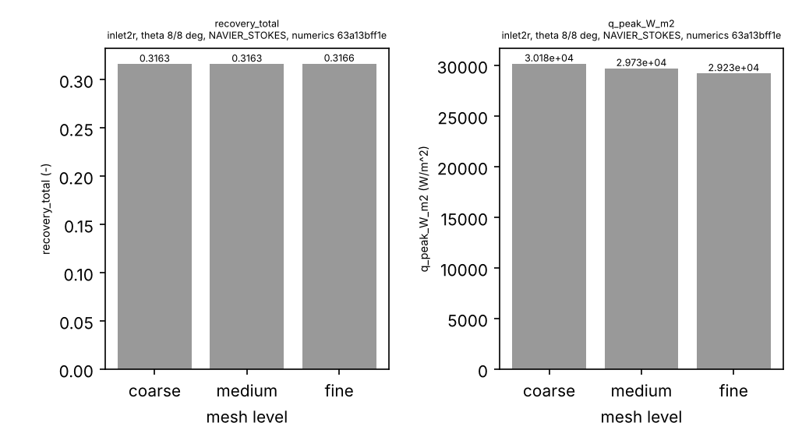
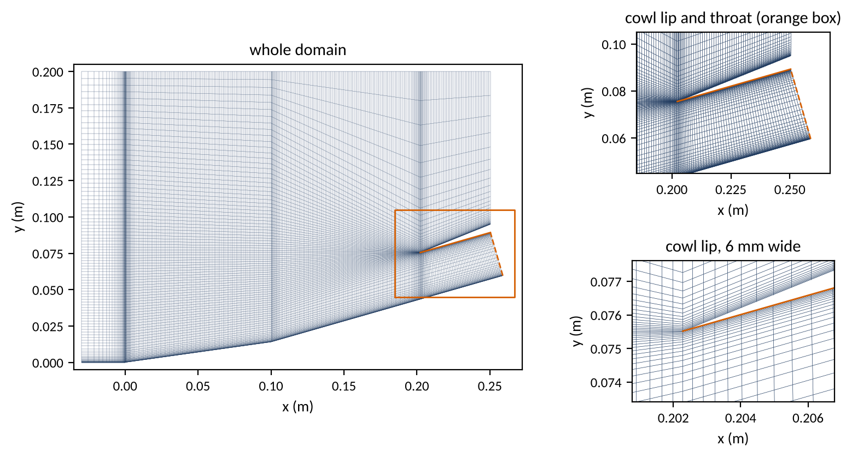
Backup: mesh convergence
On the 8/8 design, medium-to-fine changes are small for recovery and peak heating; the 12/14 corner has no converged grid study.
Figure: docs/validation/2026-11-01_grid_study.png, panels 3 and 4 of 6 (inlet 8/8, final numerics; the other panels are on S7 and in the report). Record: docs/validation/2026-11-01_report.md.
8/8 laminar inlet | Cells | recovery_total | q_peak [kW/m2]
coarse | 19 620 | 0.3163 | 30.18
medium | 30 600 | 0.3163 | 29.73
fine | 55 640 | 0.3166 | 29.23
medium to fine |  | +0.09% (tolerance 2%) | -1.68% (tolerance 5%)
12/14 medium, fine | 25 000, 45 240 | diverged | diverged
Figure: docs/talk/figures/mesh_8_8_medium.png, drawn by docs/talk/build_deck.py. The mesh of runs/dev/2026-11-01_inlet_grid_study_ef03/8_8_medium is rebuilt from its params.json by worker/make_case.py and matches the run's mesh_quality.json. Structured, 30 600 cells, 31 063 nodes; first cell 19.8 um on the body and 20.0 um on the cowl (mesh_quality.json).
sources: docs/validation/2026-11-01_report.md, runs/dev/2026-11-01_inlet_grid_study_ef03/README.md, runs/dev/2026-11-01_inlet_grid_study_ef03/8_8_medium/mesh_quality.json
B3 | 36
Notes:
The report leaves the observed order undefined because the changes are too small for a Richardson estimate at this ratio, so no order is quoted. The cylinder grid study at the earlier numerics fails, which is why the final numerics are part of the record.

Slide 37
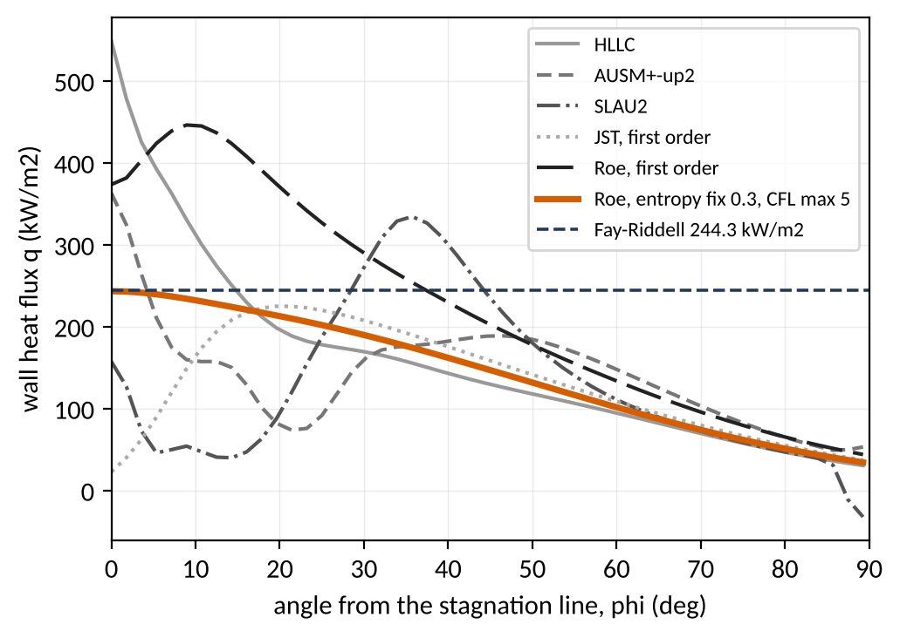
Backup: the numerics story
The numerics were chosen on recorded comparisons: four Euler-wedge variants (A to D), a six-scheme cylinder comparison, and the entropy-fix split.
Variant (Euler wedge) | Change | Outcome
A_fixedcfl5 | CFL 5 fixed | diverged at iteration 50
B_adapt_max20 | CFL adapt (0.5, 1.05, 1.0, 20) | stalled, 800 iterations
C_roe | Roe, entropy fix 0.1, CFL adapt | converged in 603 iterations
D_venkat | Venkatakrishnan limiter | stalled, 800 iterations
Cylinder scheme (coarse) | q_stag vs Fay-Riddell | Verdict
HLLC | +125% | no
AUSM+-up2 | +49% | no (carbuncle pattern)
SLAU2 | -35% | no (carbuncle pattern)
JST, first order | -91% | no (stagnation point smeared)
Roe, first order | +53% | no
Roe, entropy fix 0.3, CFL max 5 | -0.3% | yes
Attempt 3: only the entropy fix cured the carbuncle; the CFL cap did not.
Wedge Eckert window: mean 0.75% at entropy fix 0.1, 1.60% at 0.3.
Figure: docs/talk/figures/cylinder_schemes.png, drawn by docs/talk/build_deck.py from surface_flow.dat.gz of the six schemes in runs/dev/2026-11-01_cylinder_v3_attempt2/schemes/ (coarse mesh, 57 wall nodes, R = 10 mm); Fay-Riddell 244.3 kW/m2 from the same runs/dev/2026-11-01_cylinder_v3_attempt2/README.md. Records: runs/dev/2026-11-01_numerics/README.md (A to D), runs/dev/2026-11-01_cylinder_v3_attempt3/README.md.
sources: runs/dev/2026-11-01_numerics/README.md, runs/dev/2026-11-01_cylinder_v3_attempt2/README.md, runs/dev/2026-11-01_cylinder_v3_attempt3/README.md, runs/dev/2026-11-01_cylinder_v3_attempt2/schemes/*/surface_flow.dat.gz
B4 | 37
Notes:
Only the entropy fix cured the carbuncle; the CFL cap did not. The entropy fix costs a little on flat-plate heating, and that cost is stated with its number in the attempt 3 record.

Slide 38
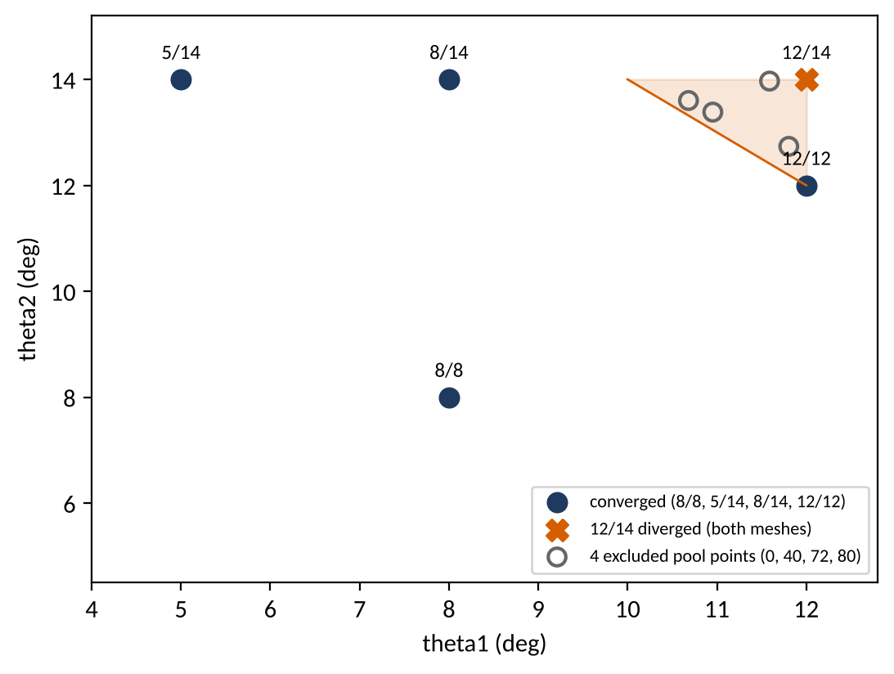
Backup: design-box trim
The 12/14 corner diverges on two meshes with both entropy fixes and two CFL caps, so total turning is capped at 24 deg.
12/14 diverged on two meshes, with both entropy fixes and both CFL caps.
12/12, 8/14 and 5/14 converged.
Gate 4: total turning at most 24 deg; 4 of 96 pool points excluded.
The 25 deg band between 24 and 26 was not tested.
Figure: docs/talk/figures/design_box_diagnostics.png, drawn by docs/talk/build_deck.py from runs/dev/2026-11-01_inlet_box_diagnostics/README.md and designs/pool_sobol96.csv.
sources: runs/dev/2026-11-01_inlet_box_diagnostics/README.md, runs/dev/2026-11-01_inlet_grid_study_ef03/README.md, designs/pool_sobol96.csv
B5 | 38
Notes:
The trim was made on evidence, and the gate records it; the 25 deg band was never tested. A pool point near the limit that fails is a recorded failure, not a retuned one.

Slide 39
Backup: full validation table
Every check in the report is shown, including the ones not run and why.
Check | Type | Verdict | Records
V1 beta, p2/p1, M2 | hard | PASS | official (Colab)
V2a plateau pressure | report | REPORT +1.69% | official (Colab)
V2b Eckert heat flux | hard | PASS, mean 0.75 to 1.60% | development, 3 runs
V3 q_stag, fine; grid | hard | first numerics FAIL; final PASS | development
V4e throat p0, Mach | hard | PASS | development
V4v core p0 | soft | PASS on the 6 laminar 8/8 runs | development
V4m grid, 8/8 | hard | PASS | development
Check | Type | Verdict | Records
X1 AVG_TOTALPRESS | hard | PASS on the 7 runs at 8/8 | development
V3 stand-off vs Billig | report | +5.6% (development run 2026-11-02) | 1 case
V1 on two dev runs | hard | not run: flow.dat absent | development
V2b on four cases | hard | not run: surface_flow.dat absent | task1 and numerics
V4v, V4m, X1 at 12/14 | soft, hard | not run: diverged runs | development
V4m grid at 12/14 | hard | not run: diverged runs | development
Record: docs/validation/2026-11-01_report.md. Not-run rows are shown, not hidden.
sources: docs/validation/2026-11-01_report.md
B6 | 39
Notes:
The not-run rows are shown, not hidden: the stand-off check, the 12/14 grid study and the pressure cross-check on some runs. Official and development rows are labeled, and the report says which are which.

Slide 40
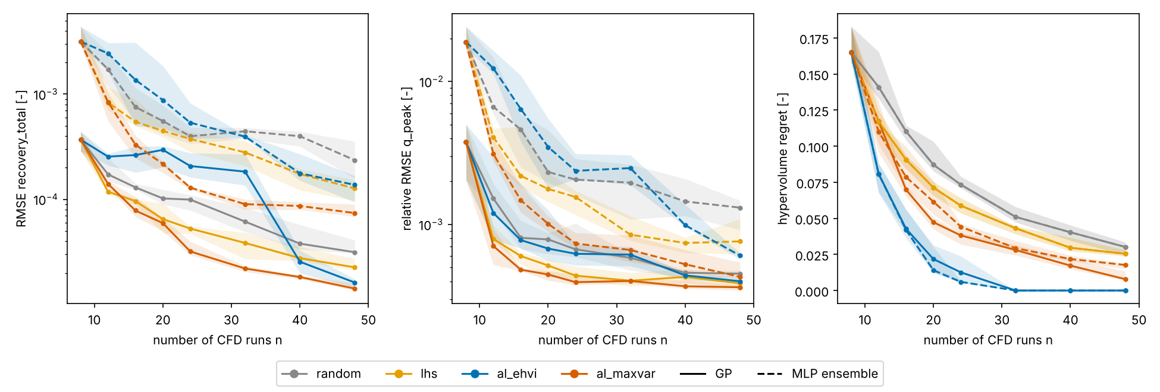
Backup: a neural-network ensemble against the GP
On the same replay, an ensemble of five neural networks is 2 to 10 times less accurate than the GP on held-out designs, but EHVI driven by it still finds the whole front by 32 runs.
Figure: docs/validation/2026-11-02_replay_gp_vs_mlp.png (GP solid, MLP ensemble dashed; median and interquartile band over 10 seeds). Records: runs/replay/2026-11-02_full/replay.csv, runs/replay/2026-11-02_mlp/replay.csv.
At n = 48 (median of 10 seeds) | GP | MLP ensemble (5 x 2-64-64-1)
RMSE recovery_total, lhs / al_maxvar | 2.26e-5 / 1.42e-5 | 1.27e-4 / 7.41e-5
Relative RMSE q_peak, lhs / al_maxvar | 3.9e-4 / 3.6e-4 | 7.6e-4 / 4.3e-4
EHVI: seeds with zero regret from n = 32 | 10 of 10 | 10 of 10
EHVI step (fit both outputs + acquisition) | 1.7 s | 6.2 s
sources: runs/replay/2026-11-02_mlp/replay.csv, docs/validation/2026-11-02_replay_mlp.md, docs/validation/2026-11-02_replay_gp_vs_mlp.md, docs/specs/task4b_mlp_ensemble.md
B7 | 40
Notes:
The ensemble was not tuned, by rule, so this answers the question for this problem only: with two inputs and under fifty smooth samples, the GP's prior wins on accuracy and cost. The front-finding result does not depend on the surrogate, which is the stronger statement. B8 tests a neural operator on the 92 wall heat-flux profiles, where the output is a function.

Slide 41
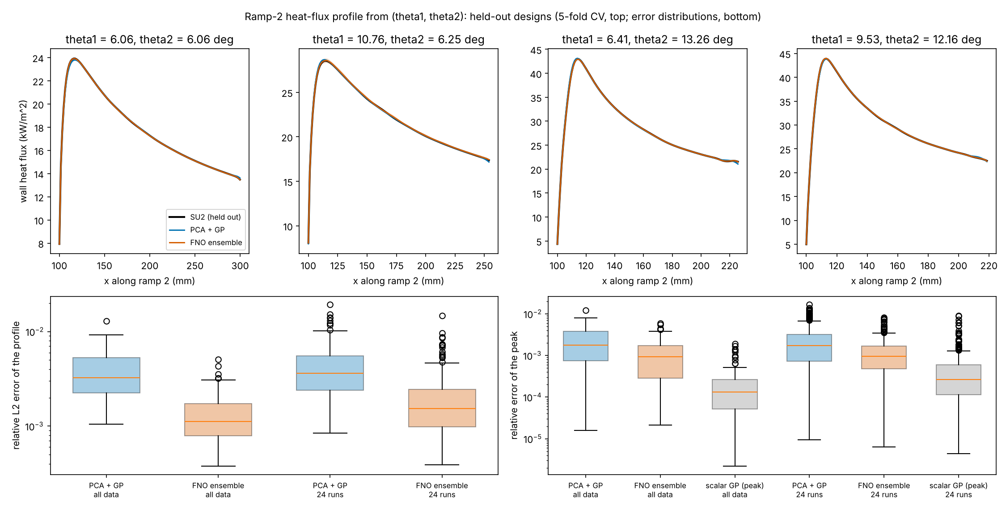
Backup: a neural operator for the heat-flux profile
A Fourier neural operator predicts the whole ramp-2 heat-flux profile about 3 times more accurately than PCA plus GP, but the scalar GP still predicts the peak 7 times better than the operator.
Median, held out | PCA + GP | FNO | scalar GP
Profile L2 error, all data | 0.32% | 0.11% | -
Profile L2 error, 24 runs | 0.36% | 0.15% | -
Peak error, all data | 0.18% | 0.092% | 0.013%
Points in 90% band, all data | 0.11 | 0.93 | -
Fit time per split, all data | 4.7 s | 1030 s | -
92 of 92 re-runs matched their Colab records; 128-point profiles along ramp 2.
Post hoc: the PCA + GP error equals its 3-component truncation floor; more components were not run.
For the objective q_peak, the scalar GP stays the right tool.
Figure: docs/validation/2026-11-02_operator.png. Top: four held-out designs (5-fold CV), SU2 in black; bottom: error over held-out designs, all data and 24 runs. Record: runs/profiles/2026-11-02/operator_compare.csv.
sources: runs/profiles/2026-11-02/operator_compare.csv, docs/validation/2026-11-02_operator_profiles.md, runs/profiles/2026-11-02/pca_floor.csv, docs/specs/task4c_operator_profiles.md
B8 | 41
Notes:
All 92 pool cases were re-run on the container to recover the wall profiles, and every one matched its Colab record. The PCA plus GP error equals its three-component truncation floor, so the FNO margin comes from the 99.9 percent rule fixed in the spec; more components were not run. For the design objective the scalar GP remains the right tool; the operator adds where the peak sits and the shape of the whole load.

