Slide 1
A gated, automated design pipeline
An automated, gated simulation pipeline that sizes a small electric aircraft: what it does, what it caught, and how much engineering time it saves.
Version 2
Status at build time: SU2 pool 32 of 32 designs complete; confirmation of the answer on 30 designs: pass; confirmation of the answer on 32 designs: FAIL.
1
Notes:
I made a pipeline that sends design questions to a CFD solver and brings the answers back. A person does not do the routine steps. The pipeline does not give a result that it cannot check.
I show it on one small electric aircraft, from start to end. The status line at the bottom comes from the records.

Slide 2
The problem, and why it needs a pipeline
Size a small electric aircraft for endurance at a fixed 0.5 kg payload under the 4 kg cap of the EASA open-category class C2; every high-fidelity answer is slow, set up by hand, and can fail silently.
The design question: the longest endurance at a fixed 0.5 kg payload, with the take-off mass under the 4 kg cap of the EASA open category, class C2.
Six inputs: span, aspect ratio, taper, battery fraction, camber and thickness. Everything else is fixed in a graded ledger of 46 quantities.
Slow
Manual
Silent
One SU2 angle costs a median 11.8 min on the coarse mesh; a design needs five angles.
Each case needs a mesh, a configuration and a check written for it.
The first SU2 case exited with code 0 and its lift and drag were -10.5 % and +24.7 % off (slide 3).
So the loop of propose, simulate, check, decide has to run unattended and check every result before anyone sees it.
2
Notes:
This is the problem. The aircraft carries a payload of 0.5 kg. The C2 class of the EASA open category limits the take-off mass to 4 kg. We want the longest endurance in that limit.
Six inputs define the design: span, aspect ratio, taper, battery fraction, camber and thickness. A graded ledger of 46 quantities fixes all other values.
Design work is a loop: propose, simulate, check, decide. The simulation takes the most time. One SU2 angle takes a median of 11.8 minutes on the coarse mesh, and a design needs five angles.
Each case also needs a mesh, a configuration and a check. A person usually writes these by hand.
The third problem is the worst. A solver can stop correctly and still give incorrect numbers. Slide 3 shows an example.
Thus the loop must run without a person, and it must check each result before a person sees it.

Slide 3
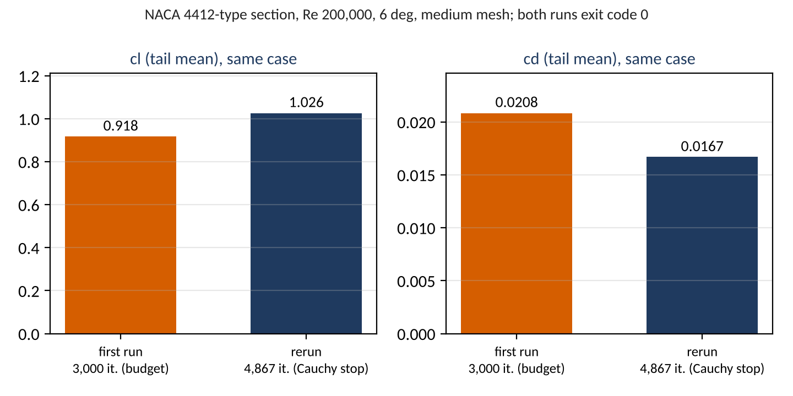
A clean exit is not a correct result
The first SU2 airfoil case exited with code 0 after its whole 3,000-iteration budget, with lift -10.5 % and drag +24.7 % against its own properly stopped rerun; only checks after the solver could see it.
SU2 exits with code 0
after 3,000 iterations, files written
postprocess looks for rms[rho]
and records a postprocess error
drift rule on the history:
cl 5.6 %, cd 17.4 % over the last fifth
ruling: budget 6,000 with a Cauchy stop;
the rerun stops at 4,867
3
Notes:
This is the design principle of the pipeline, so I show it early.
The first SU2 airfoil case stopped with exit code 0. It used all of its 3,000 iterations and wrote all of its files. The solver reported success.
But we compared it with a rerun that stopped correctly. The lift error was -10.5 %. The drag error was +24.7 %.
Follow the chain on the right. The drift rule read the history. Lift still moved 5.6 % and drag moved 17.4 % in the last fifth of the run.
The ruling set a budget of 6,000 iterations with a Cauchy stop. The rerun stopped at iteration 4,867.
Thus the pipeline does not trust the exit code. It decides convergence from the history.

Slide 4
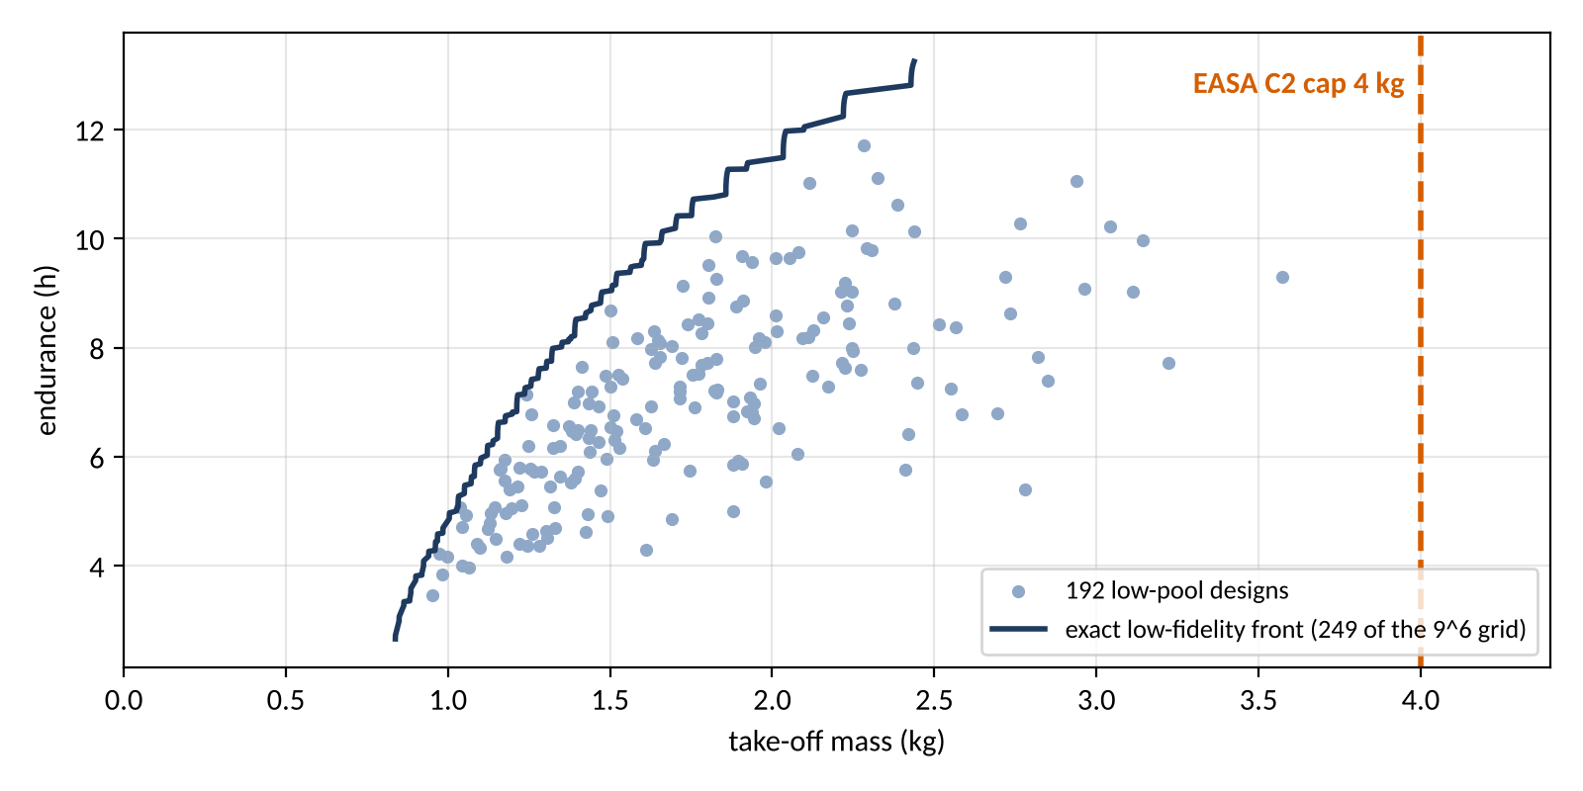
The test problem
Endurance against take-off mass at a fixed 0.5 kg payload, under the 4 kg cap of the EASA open-category class C2, over six design inputs.
Input | Range
span m | 1.2 to 3
aspect ratio | 6 to 16
taper ratio | 0.3 to 1
battery fraction | 0.2 to 0.45
camber pct | 0 to 6
thickness pct | 8 to 15
Payload fixed at 0.5 kg; cap 4 kg at P(mass <= cap) >= 0.9, fixed before any run.
Heaviest low-pool design: 3.57 kg, so only SU2 tests the cap.
4
Notes:
This is the test problem. The trade is endurance against take-off mass, at a fixed payload of 0.5 kg.
The vertical line is the C2 limit of 4 kg. The requirement is a probability of 0.9 or more to stay below the limit. We set this requirement before the first run.
The table gives the range of each of the six inputs.
The ledger has 46 quantities. 21 of them are assumptions, and each assumption has a band.
Note one point: the heaviest design in the low-fidelity pool is 3.57 kg. Thus only SU2 tests the limit.

Slide 5
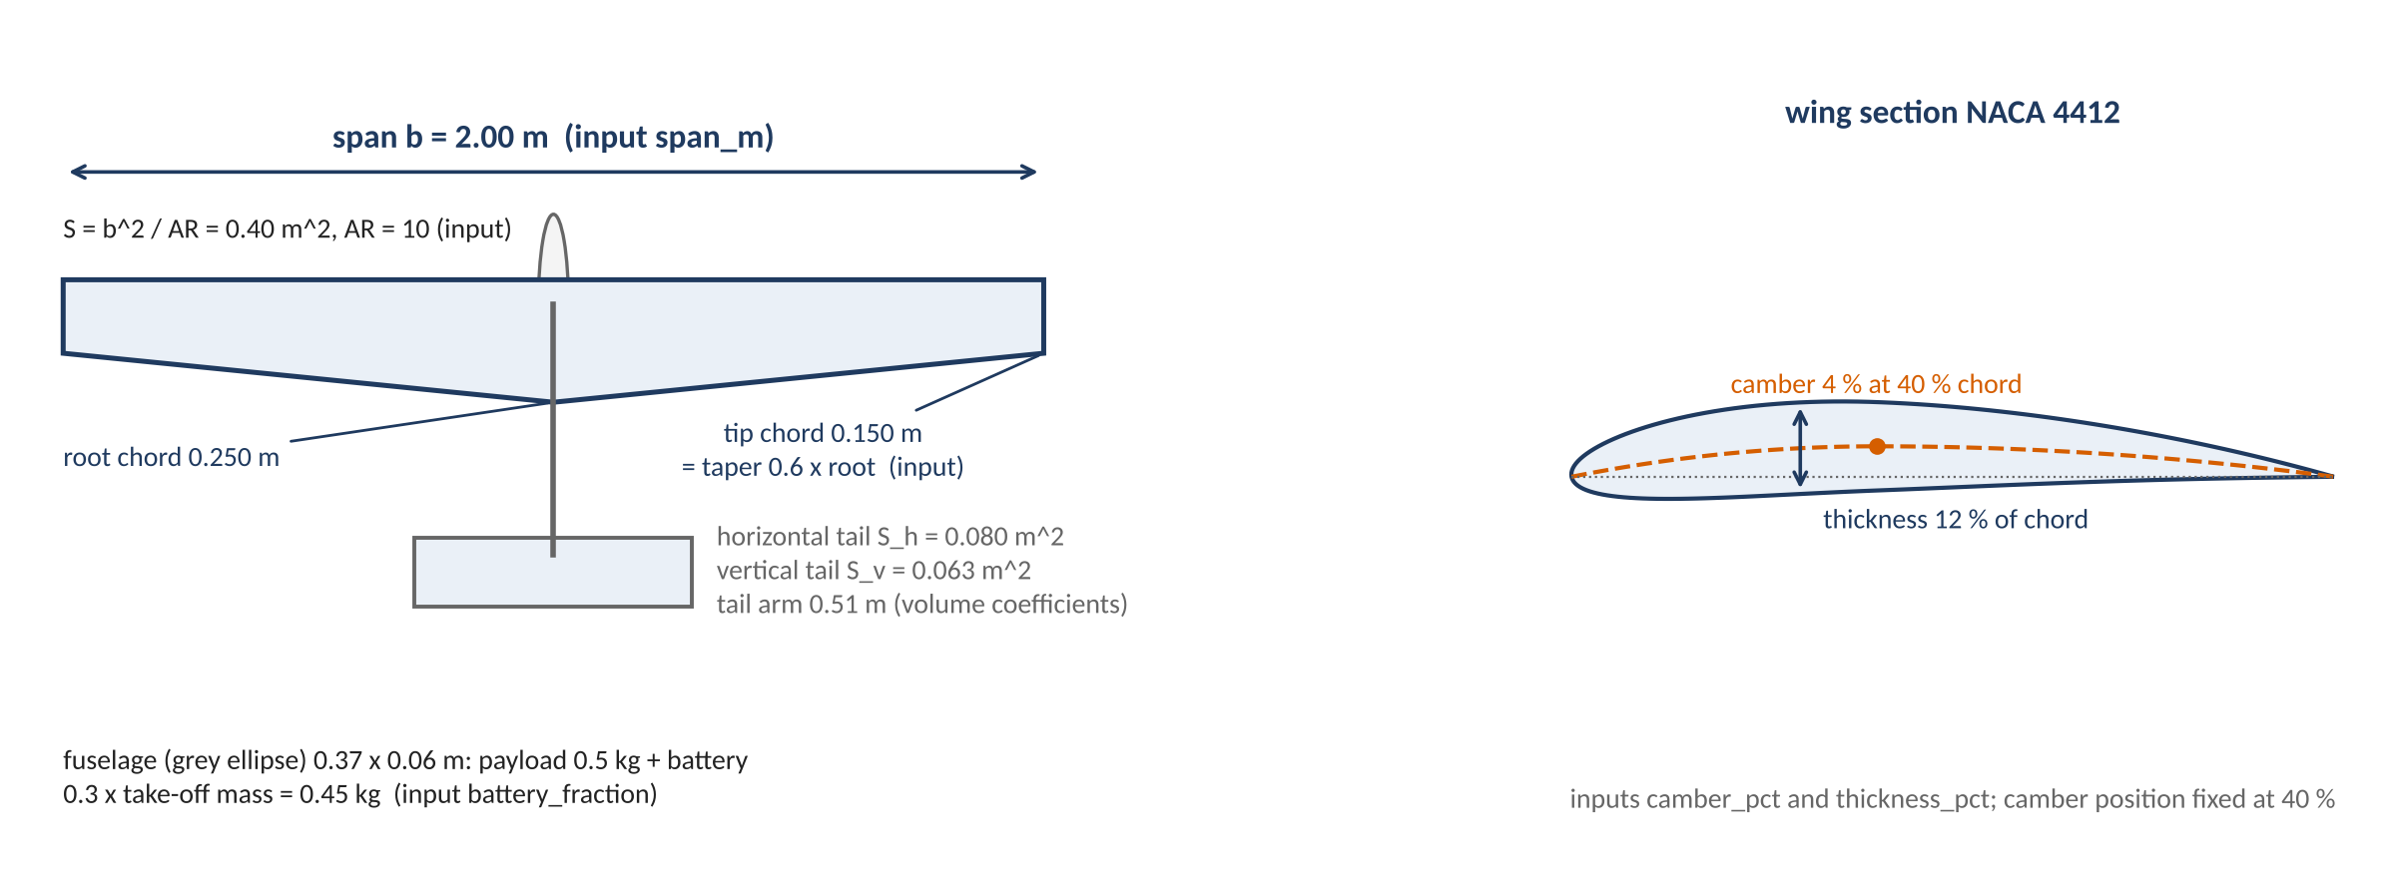
The nominal design in one top view
The nominal design has a 2 m span, aspect ratio 10 and taper 0.6: 0.40 m^2 of wing and a closed take-off mass of 1.51 kg; tail and fuselage follow from the wing by rule.
5
Notes:
This is the nominal design, in one top view. It is at the middle of the design box.
The span is 2 m, the aspect ratio is 10 and the taper is 0.6. The wing area is 0.40 square meters. The closed take-off mass is 1.51 kg.
The span and the aspect ratio set the wing area. The taper sets the chords.
Rules set the tail and the fuselage from the wing. The tail size comes from volume coefficients with a fixed arm. The fuselage holds the payload and the battery.
The inset shows the wing section. Camber and thickness are the two section inputs.

Slide 6
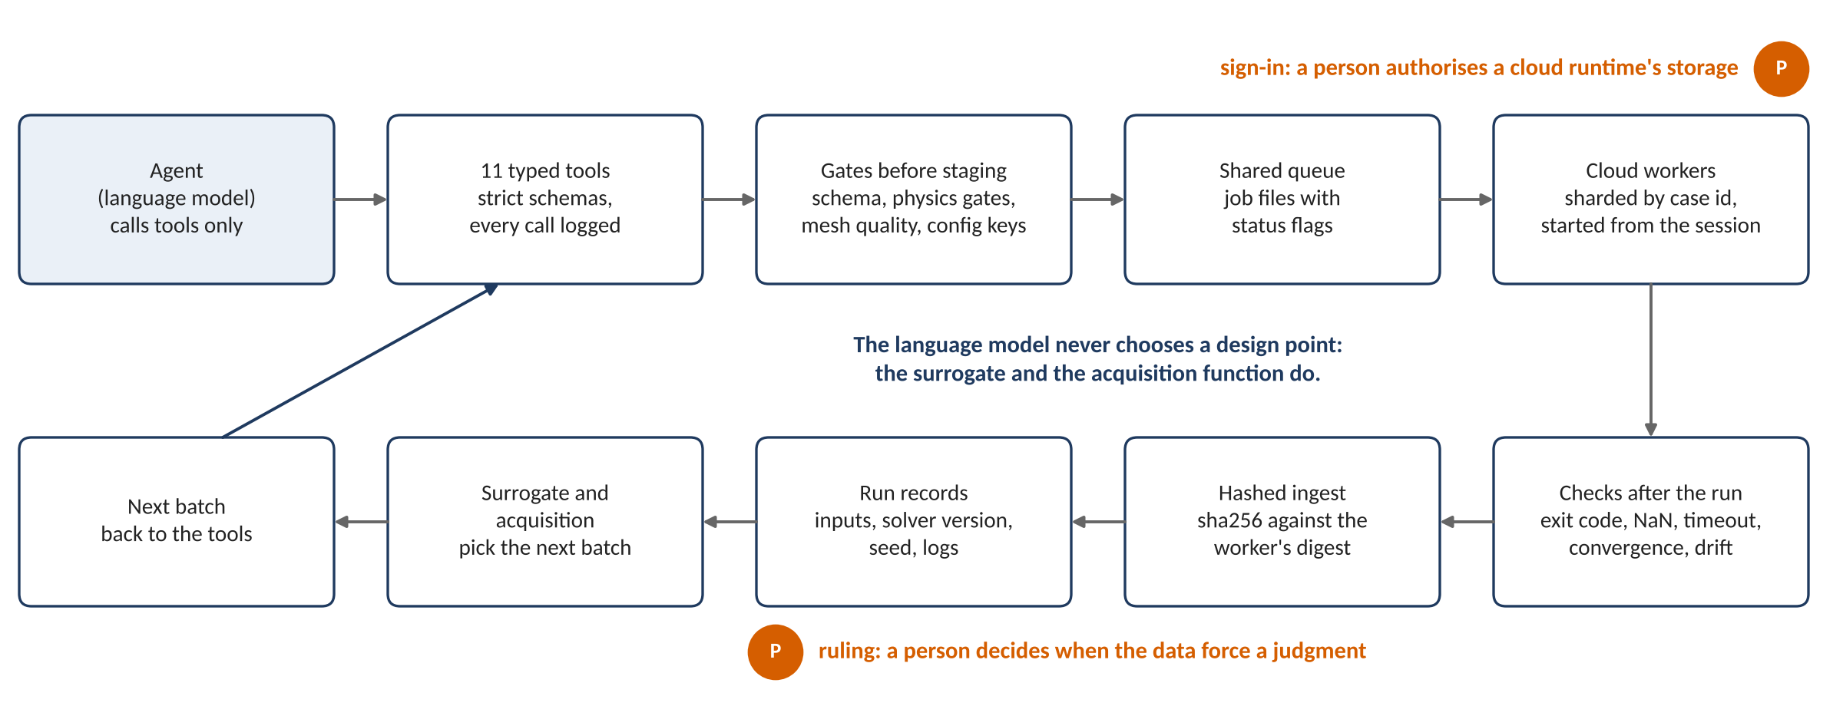
The pipeline at a glance
Requests enter through typed tools and gates, run on cloud workers through a shared queue, and come back through checks into versioned records that the surrogate learns from; the language model never chooses a design point.
6
Notes:
This drawing shows the full pipeline. Read it from left to right.
The agent does not touch the solver. It calls typed tools. Each request goes through the gates first. A design that fails a gate stops here, with a message.
A request that passes becomes a job file in a shared queue. Cloud workers take the jobs from the queue.
A result does not go directly into the study. Checks after the run decide if it converged. Then a hash goes with it into a run record.
The surrogate learns from the records. An acquisition function selects the next batch. The language model never selects a design point.
A person must act at two marked points only: a ruling on the data, and a sign-in for a cloud runtime.

Slide 7
The agent's interface, and what runs behind it
The agent reaches the pipeline only through 11 typed tools; the session starts the Colab runtimes and moves the files, and each worker checks every job again before SU2 runs.
11 typed tools
The session, outside the tools
Each Colab worker, for each job
Check: validate_config
Stage: create_case, submit, queue_batch, export_batch
Move and log: record_transfer
Bring back: ingest_result, ingest_error, postprocess
Look: status, list_results
Starts, restarts and watches the Colab runtimes with the Colab command-line tool.
Moves the job files to the shared Drive folder and brings the result files back.
Divides the queue again when one runtime has no more jobs.
Asks a person only for a Drive sign-in and for rulings.
Takes only the jobs in its shard: the case id hash, modulo N, equals K.
Makes the mesh and the configuration again, and refuses a mismatch.
Runs the physics gates again before SU2 starts.
Writes a heartbeat. An old heartbeat marks a crash, and the job runs again.
After SU2, checks the exit code, NaN values and the time limit, then writes the result with its SHA-256 digest.
A strict schema for each case type: unknown fields and wrong types are refused.
Nothing is staged when a check fails.
Each call writes one audit line.
The language model selects no design point: design tables and acquisition code do.
7
Notes:
The agent reaches the pipeline only through 11 typed tools. Each tool has a strict schema, and an unknown field or a wrong type gets a refusal.
The left column groups the tools by task: check, stage, move and log, bring back, and look. None of them runs the solver.
The tools only stage, submit, ingest and report. The session does the rest. It starts and restarts the Colab runtimes with the Colab command-line tool, and it moves the files to and from the Drive folder.
Each Colab worker checks every job again. It takes only the jobs in its own shard, and it makes the mesh and the configuration again from the job parameters.
It runs the physics gates again before SU2 starts. After SU2, it checks the exit code, NaN values and the time limit. A heartbeat shows that the worker is alive, and an old heartbeat means that the job runs again.
The language model never selects a design point. Design tables and acquisition code select them.

Slide 8
Gates before any solver
A design passes 5 gates before any solver runs, and an airfoil case passes a mesh-quality gate; a gated design costs nothing.
Gate | Checks | Note
1. Reynolds range | cruise Reynolds number in [80000, 500000] | where the section data are validated
2. Stall margin | V_cruise >= 1.3 V_stall; cruise CL <= 0.7 CL_max | two checks on one margin
3. Mass closure | structure and propulsion at least 0.15 of take-off mass | closure is a fixed point, at most 100 iterations
4. Manufacturing floor and wing loading | manufacturing floor (study rule): tip chord >= 0.08 m, root thickness >= 0.008 m; wing loading in [20, 150] N/m^2 | one gate, two checks
5. Lattice quality | lattice tip panel aspect ratio <= 20 | keeps the lattice panels well shaped
Mesh quality (airfoil cases) | no inverted cells; minimum angle >= 40 deg; first cell within 10% of the request; growth <= 1.25; cell aspect ratio <= 5000 | before a case is staged; the worker re-checks the mesh fingerprint
Low-fidelity grid: 72,009 of 531,441 designs stopped by the gates, each with the offending value in its message.
8
Notes:
A design must pass 5 gates before a solver runs.
Read the table from top to bottom. Gate 1 checks the cruise Reynolds number. Gate 2 checks the stall margin. Gate 3 closes the mass. Gate 4 checks the manufacturing floor, which is a study rule, and the wing loading. Gate 5 checks the quality of the lattice.
An airfoil case also passes a mesh-quality gate.
The gates are fast functions. In the low-fidelity grid, the gates stopped 72,009 of 531,441 designs.
Each refusal gives the value that caused it. A gated design costs no solver time.

Slide 9
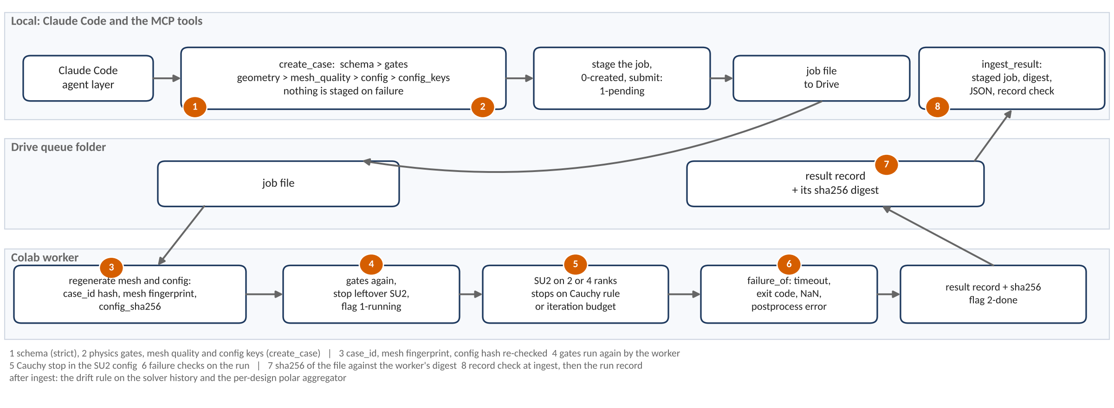
What runs where: Claude Code, Drive, Colab
Every request passes the same ordered checks before SU2 starts, and every result passes more before it becomes a record; the numbered marks show where.
9
Notes:
This drawing shows what runs where.
The top band is the session: Claude Code and the typed tools. The tools validate the request, apply the gates, stage the job and later ingest the result.
The middle band is a folder on Google Drive. Colab cannot accept inbound connections. Thus the jobs and the results move through this folder as files.
The bottom band is the Colab worker. It makes the mesh and the configuration again from the job parameters. It refuses a job if the fingerprint or the hash does not agree.
Then SU2 runs, and the worker checks for a timeout, a bad exit code and NaN values.
Each result comes back with a SHA-256 digest. The ingest step checks the digest and the record. The numbered marks show where each check is.

Slide 10
Two fidelity levels
A low-fidelity design costs 0.25 s of one core; one SU2 angle costs a median 11.8 min on the coarse mesh, 23.2 min on the medium mesh and 94.5 min on the fine mesh, and a design needs five angles.
Level | Section data | Measured cost | Used for
Low (container) | closed-form thin-airfoil lift and flat-plate drag | 0.25 s per design per core: the 531,441-point grid in 4.7 h on 8 workers; the 192-point pool in 669 s | exact front, low pool, replays, the low level of the two-level model
High (cloud, 2 or 4 ranks) | SU2 polar of the design's own section at its cruise Reynolds number | per angle, median: 11.8 min coarse (173 cases); 23.2 min medium (35); 94.5 min fine (11, range 52.7 to 136.2). Five angles per design. | the SU2 pool: 172 cases, on the coarse mesh with a medium-mesh check; the fine mesh is for the tunnel and mesh checks
Medians over every SU2 run record at build time, by mesh level. Both levels share geometry, lattice, closure and mission.
10
Notes:
There are two fidelity levels.
The low level uses closed-form section data. It costs 0.25 seconds of one core for each design.
The high level runs SU2 on the design's own section, at its cruise Reynolds number. One angle costs a median of 11.8 minutes on the coarse mesh, 23.2 minutes on the medium mesh and 94.5 minutes on the fine mesh. A design needs five angles.
The pool runs on the coarse mesh. The fine mesh is for the tunnel and mesh checks, and its median cost is 8.0 times the coarse mesh.
Look at the last line of the table. The two levels use the same geometry, lattice, closure and mission. Only the section data are different.
Thus the expensive level corrects the cheap level. It does not replace it. Slide 17 uses this fact.

Slide 11
Validation before any machine learning
The solver's own checks pass (12 rows pass, 0 fail); against the wind tunnel SU2's lift slope misses by 5.49 % against a 5 % tolerance, a fail that is kept and travels with every result.
Group | Verdict | Rows | Which
Solver's own checks | pass | 12 | vortex lattice against closed forms (V6a, 4); Warren-12 benchmark wing (V6b, 1); lattice refinement (V6c, 3); mass closure and energy balance (V6d, 4)
 | fail | 0 | none
 | PENDING | 1 | Warren-12 fine Cm_alpha (reference point not yet sourced)
SU2 against the wind tunnel | pass | 2 | cd ratio Re 203800: +7.99 % against 20 %; cd ratio Re 305200: +5.74 % against 20 %
 | FAIL | 2 | cl_alpha Re 203800: +5.49 % against 5 %; cl_alpha Re 305200: +6.44 % against 5 %
Not run | not run | 1 | Ultra Stick 25e CL_alpha and CD0
11
Notes:
We did the validation before any machine learning. We set the tolerances before the runs.
The top group is the checks of the method itself. 12 rows pass and 0 fail. 1 row is pending, because its reference point has no source yet.
The next group is SU2 against the wind tunnel. The drag ratio passes at both Reynolds numbers, 7.99 % and 5.74 % against 20 %.
The lift slope fails at both Reynolds numbers, 5.49 % and 6.44 % against 5 %.
The fail stays a fail. Each SU2 result carries it as a flag.

Slide 12
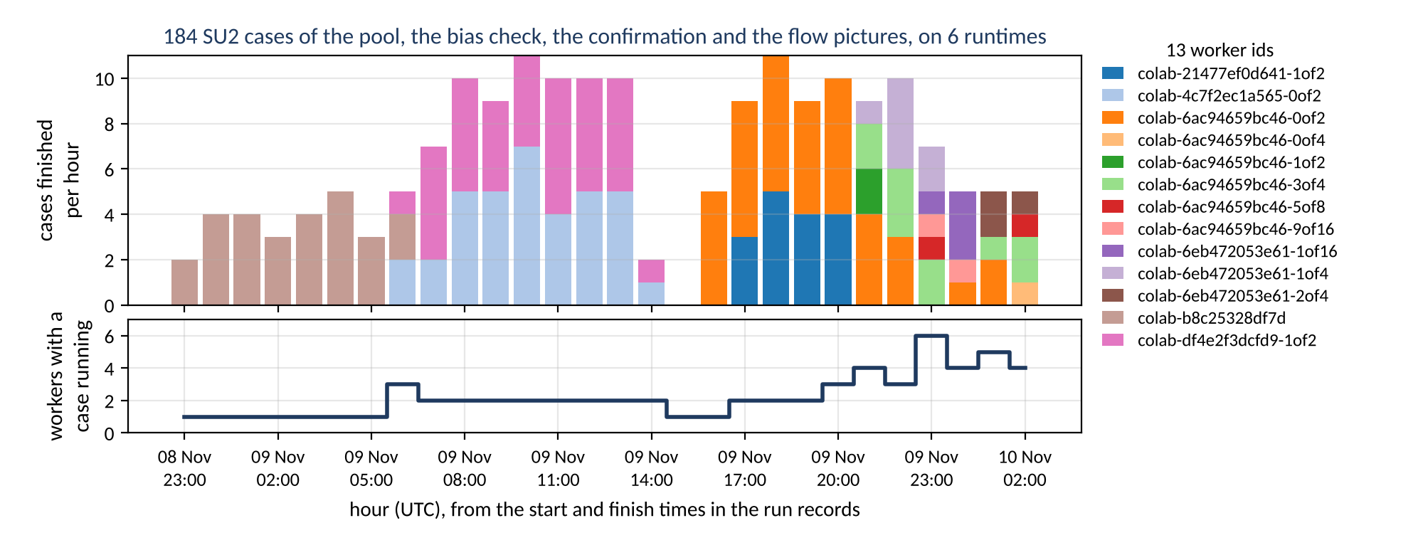
The session runs the compute
The session starts, deploys, watches, rebalances and restarts the cloud runtimes itself; a person is needed only to authorise a runtime's storage and to rule on the data.
A worker id is a runtime and its shard (for example 1of2); a new shard suffix on the same runtime marks a re-split of the queue.
12
Notes:
This slide shows what version 2 changed. The figure is a timeline of the pool day, from the run records.
The top shows the cases that finished in each hour. The bottom shows the live workers. A gap is where a runtime stopped.
Before, a person restarted the workers by hand. Both runtimes stopped at 14:10 UTC, and no case ran until 15:50.
Now the session does this work. It starts the cloud runtimes through a command-line interface. It reads the heartbeats and finds a dead worker. It restarts the runtime.
When one runtime finishes its shard, the session divides the queue again. Thus no runtime waits while the other has jobs.
A person must still do two things: sign in to give a runtime access to storage, and make the rulings.

Slide 13
What the checks caught
Each of these was found by a check or a recorded run before it reached a result.
Caught | By | Resolution
Postprocess looked for the compressible residual rms[rho] | the first airfoil case failing at postprocess | the classifier reads rms[P]
First case not converged: cl drift 5.6 %, cd drift 17.4 % | the drift rule on the recorded history | budget 6,000 with a Cauchy stop (a ruling)
Fine mesh not reproduced at the 1 nm fingerprint | the worker's mesh fingerprint check | refused attempt kept beside the rerun
Fine E387 mesh has 8 inverted cells | the mesh inversion gate | wall-tangent smoothing on every mesh (a ruling); medium against fine +0.35 %, pass
Point-vortex induced drag under-counts | the elliptic-wing validation rows | Trefftz-plane drag from a Glauert series
Volume file unreadable: the zone declares 22,102 nodes, the file holds more rows | a structure check on reading the file | re-run on local disk; one case still unreadable, nothing drawn from it
The pool was planned on one 4-rank worker | the solver block of every record: 72 pool cases on 2 ranks, 100 pool cases on 4 ranks | costs and rank counts quoted from the records
13
Notes:
Each row here is a problem. A check or a recorded run found it before it got into a result.
The postprocess step read the incorrect residual. The first case also did not converge. Its lift moved 5.6 % and its drag moved 17.4 % at the end of the run.
That first case did not diverge. It used its full budget and did not settle. Thus "not converged" is the correct term.
A fine mesh did not agree with its fingerprint, and the worker refused it. Another fine mesh had inverted cells, and the inversion gate stopped it.
The last row is my own error. I said that the pool ran on 4 ranks. The records show 2 ranks for some cases and 4 for others.
The solver reported none of these problems as an error.

Slide 14
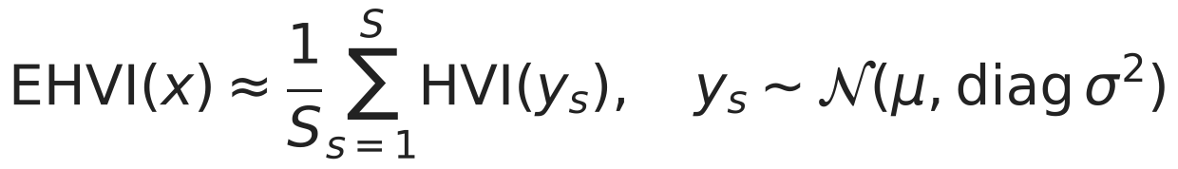

How each strategy picks the next design
One Gaussian process on endurance and one on log take-off mass give a mean and an interval everywhere; five strategies use them differently to pick the next design, and the language model chooses nothing.
Strategy | How it picks the next design | Uses
random | A uniform random draw among the designs not run yet. | no model
Latin hypercube | A space-filling plan of the whole budget: each input's range is cut into equal slices and every slice gets one design. | no model
maximum variance | Fits both GPs and runs the design where the two scaled predictive variances add up to the most: it explores where the model is least sure, whether the design is good or not. | both GPs
expected hypervolume improvement | Fits both GPs, draws 128 samples of endurance and mass at each candidate and averages how much each would grow the area of the current front: good and uncertain designs both score. | both GPs
the same, times P(feasible) | Multiplies that score by the probability that the design passes the gates, from a logistic regression on the gate outcomes so far; used on the open box (slide 16). | both GPs + a classifier
Every strategy starts from the same 8 designs per seed; the language model calls tools and never picks a point.
14
Notes:
The checks decide which results count. Now we decide which design to run next, using only those results.
Two Gaussian processes make the surrogate. One models endurance. The other models the logarithm of take-off mass.
Each process gives a mean and an interval at each design in the box. Five strategies use them in different ways.
Random selects a design that has not run yet. The Latin hypercube spreads the full budget over the range of each input. These two use no model. They are the baselines.
Maximum variance runs the design where the model is least sure. It does not ask if the design is good.
Expected hypervolume improvement draws 128 samples at each candidate. It measures how much each sample increases the area of the current front. Good designs and uncertain designs both get a high score.
The last strategy multiplies that score by the probability to pass the gates. Slide 16 shows why we need it.
The language model calls tools. It never selects a point.

Slide 15
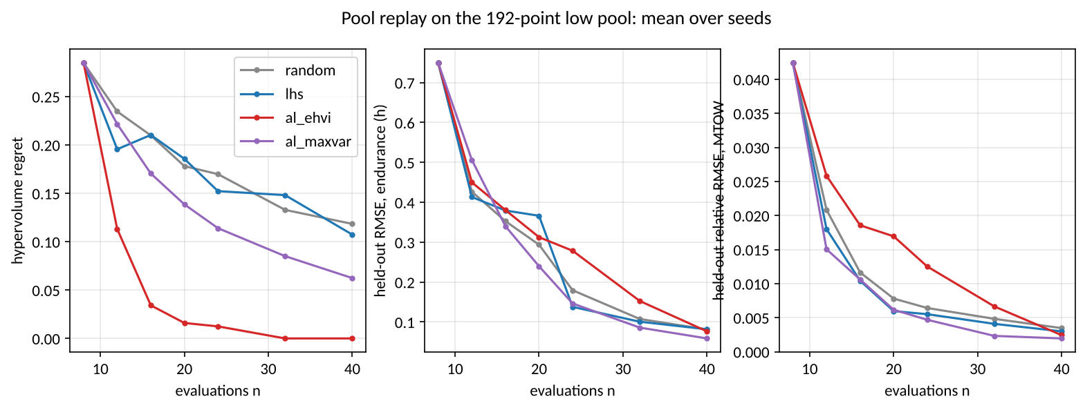
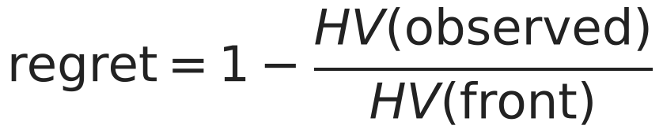
Active learning on a fixed pool
On a 192-point pool, expected hypervolume improvement reaches regret 0.000 at 32 evaluations, while random sampling is still at 0.118 after 40.
Mean hypervolume regret, 10 seeds
n | random | lhs | al_ehvi | al_maxvar
8 | 0.285 | 0.285 | 0.285 | 0.285
16 | 0.210 | 0.210 | 0.034 | 0.170
24 | 0.170 | 0.152 | 0.012 | 0.114
32 | 0.133 | 0.148 | 0.000 | 0.085
40 | 0.118 | 0.107 | 0.000 | 0.062
Same 8 initial points for every strategy of a seed.
The pool is smooth and gate-free: the easy case.
15
Notes:
First, the easy case: a fixed pool of 192 points. The response is smooth, and no design fails a gate.
The figure shows the hypervolume regret against the number of evaluations. Regret is the part of the true front that is still missing. Backup slide 41 defines it.
Each curve is a mean of 10 seeds. Each strategy of a seed starts from the same 8 points.
Follow the EHVI line. At 16 evaluations it is 0.034. At 32 evaluations it is 0.000: it has found the full front.
Random is at 0.118 after 40 evaluations. The Latin hypercube is at 0.107, and maximum variance at 0.062.
On a smooth pool, active learning is clearly better. But this is the easy case.

Slide 16
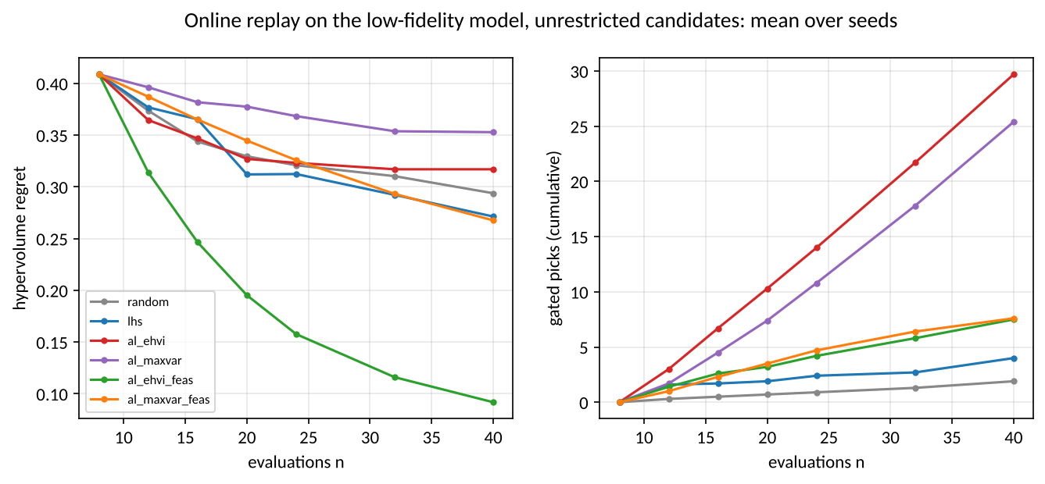
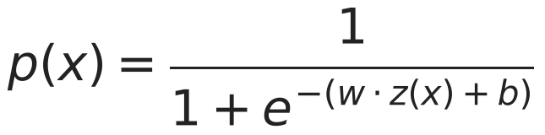
Active learning on the open box, honestly
On the open box plain expected improvement loses to random (0.317 against 0.294) because it keeps picking designs the gates reject; weighted by the probability of passing the gates it reaches 0.092.
Strategy | Regret at 40 | Gated picks
random | 0.294 | 1.9
lhs | 0.271 | 4.0
al_ehvi | 0.317 | 29.7
al_ehvi_feas | 0.092 | 7.5
al_maxvar | 0.353 | 25.4
al_maxvar_feas | 0.268 | 7.6
The front lies against the gated edge, and the GPs do not know the gates.
Both runs are published; neither replaces the other.
16
Notes:
This is the result that I show first, because it includes a loss.
On the open box, the full space with its gates, plain EHVI is worse than random. At 40 evaluations its regret is 0.317. Random has 0.294.
The reason is in the column of gated picks. EHVI selected a mean of 29.7 designs that the gates rejected. Random selected 1.9.
The front is near the gated edge, and the Gaussian processes do not know the gates. Thus EHVI goes to the edge again and again.
The correction is a small feasibility model. It gives the probability to pass the gates, and the acquisition multiplies by it. Then EHVI gets a regret of 0.092, with 7.5 gated picks.
We keep both results on the record. Without the feasibility model, the method is worse than chance.

Slide 17
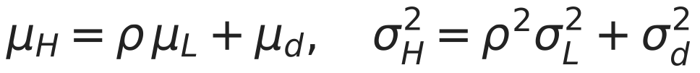

Two levels: fewer expensive runs
With 8 SU2 designs the two-level endurance error is 0.824 h against 1.525 h for SU2 alone; SU2 alone reaches it at 24 designs; 90 % interval coverage is in the table.
SU2 designs n | endurance RMSE (h): SU2 only | two-level | 90 % coverage: SU2 only | two-level | mass rel. error: SU2 only | two-level
8 | 1.525 | 0.824 | 0.43 | 0.61 | 0.0869 | 0.0022
12 | 1.112 | 0.808 | 0.62 | 0.61 | 0.0198 | 0.0024
16 | 0.865 | 0.747 | 0.71 | 0.68 | 0.0133 | 0.0021
24 | 0.704 | 0.726 | 0.78 | 0.69 | 0.0071 | 0.0022
Means over ten seeds; coverage is the share of held-out designs inside the 90 % interval, and it is below 0.9 for both models.
17
Notes:
This is the two-level model. The cheap model runs at each design. SU2 must learn only a scale and a correction.
Read the first row of the table. With 8 SU2 designs, the endurance error is 0.824 hours for the two-level model and 1.525 hours for SU2 alone. SU2 alone needs 24 designs to get the same error.
Go down the rows. The benefit decreases when SU2 has more designs. At 24 designs, SU2 alone is slightly better.
Thus the benefit is real at small budgets. That is where it is important.
Look at the coverage columns. Coverage is the part of the held-out designs inside the 90 % interval. It is below 0.9 for both models. Thus I use the mean, not the interval.

Slide 18
How much engineering time this saves
531,441 low-fidelity designs ran in 4.7 h; 172 SU2 cases ran in 37.0 worker-hours over 24.9 h of elapsed time; the two-level model reaches with 8 SU2 designs the error SU2 alone needs 24 for.
What ran | How many | How long | What a person had to do
Low-fidelity grid | 531,441 designs | 4.7 h on 8 workers | nothing: one command
SU2 pool and its bias check | 172 cases | 37.0 worker-hours over 24.9 h elapsed | sign in to 6 cloud runtimes
Two-level model | 8 SU2 designs | reaches the endurance error SU2 alone needs 24 designs for | nothing: computed from the records
Rulings | 11 recorded | each when the data forced a judgment | read the evidence and decide
Runtimes counted from the worker ids in the SU2 records; rulings counted from the decision headings of the task ledger.
18
Notes:
This slide shows the engineering time that the pipeline saves. Read the last column: what a person had to do.
The low-fidelity grid ran 531,441 designs in 4.7 hours on 8 workers. A person typed one command.
The SU2 pool ran 172 cases in 37.0 worker-hours, over 24.9 hours of elapsed time. A person signed in to 6 cloud runtimes. That was all the manual work.
With 8 SU2 designs, the two-level model gets the error that SU2 alone needs 24 designs for.
We recorded 11 rulings. A person made each ruling when the data needed a judgment.
The important point is not the speed of the computer. The loop runs at night, checks itself, and gives a person only the decisions that need judgment.

Slide 19
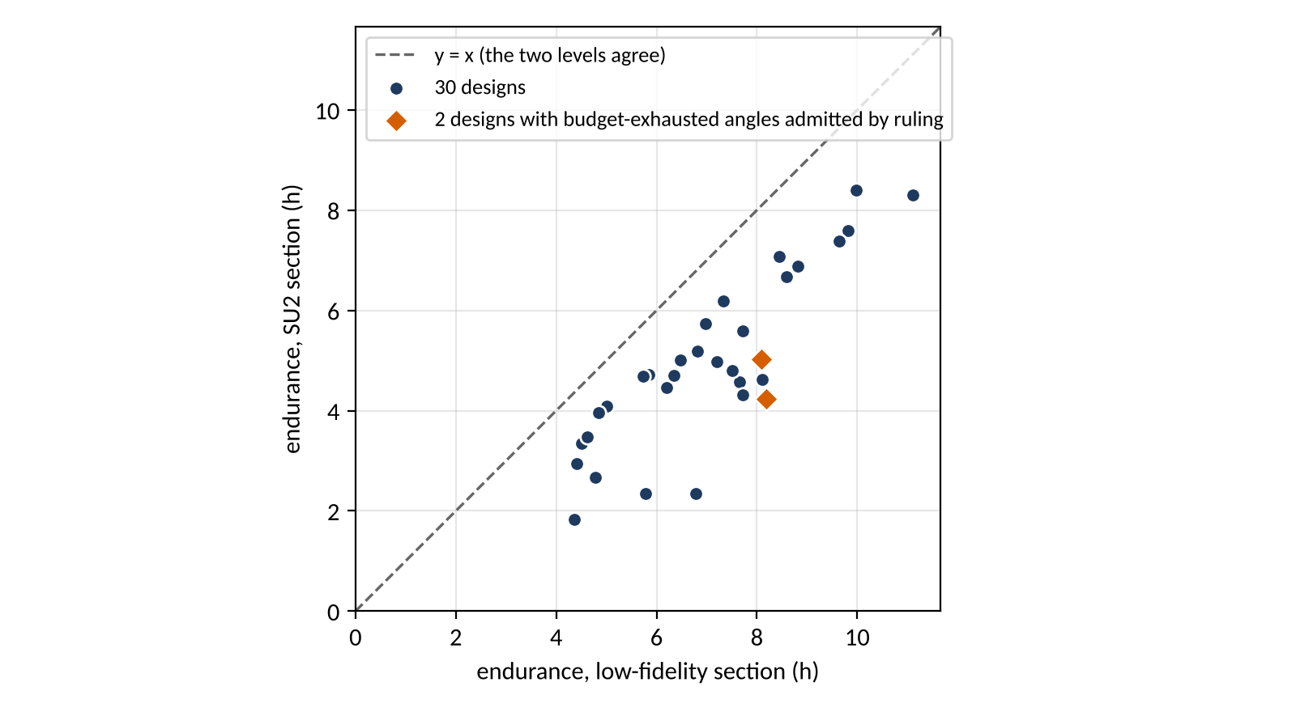
The expensive level against the cheap one
Of the 32 SU2 designs, 32 are complete; on every one the SU2 endurance is 15.8 to 65.5 % low against the low model's.
32 complete designs, every one below the line: SU2 endurance is 15.8 to 65.5 % low against the low model.
Largest gaps: design 30 (-65.5 %), design 19 (-59.5 %), design 17 (-58.0 %).
A gap of one sign is what a scale and a correction surface can learn.
19
Notes:
This slide compares the expensive level with the cheap level on the SU2 pool. All 32 of 32 designs are complete.
Each point is one design: SU2 endurance against low-fidelity endurance. The diagonal is agreement.
All points are below the line. The SU2 endurance is 15.8 to 65.5 % low against the low model.
That is a large difference, and I do not hide it. But the difference has the same sign on each design.
A difference with one sign is easy for a scale and a correction to learn. That is why the two-level model works.

Slide 20
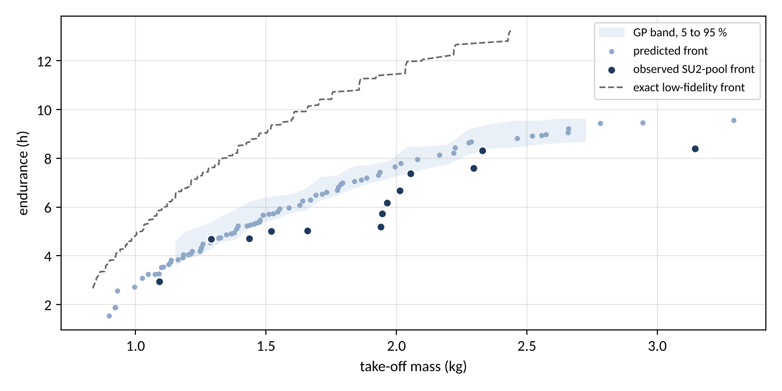
The front
On the SU2 pool the observed front has 13 designs, from 2.95 h at 1.09 kg to 8.40 h at 3.14 kg; the band is the GPs' posterior, and every point carries the lift-slope bias against the tunnel.
20
Notes:
This is the front on the SU2 pool: endurance against take-off mass. Up and to the left is better.
On the SU2 pool the observed front has 13 designs, from 2.95 h at 1.09 kg to 8.40 h at 3.14 kg; the band is the GPs' posterior, and every point carries the lift-slope bias against the tunnel.
The band comes from the Gaussian processes. It is a model band, not a measurement. Backup slide 40 shows that these intervals are too narrow.
Beside it is the low-fidelity front. That front is exact, because the cheap model ran on the full grid of 531,441 points.
Each point on the SU2 front carries the lift-slope error against the tunnel.

Slide 21
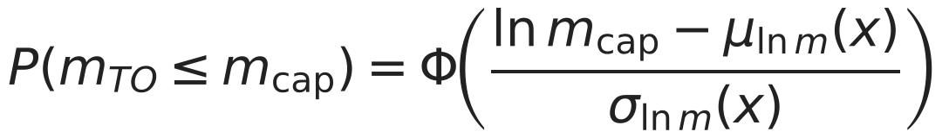
The inverse query under the 4 kg cap
On the low model the answer is a box corner and the cap never binds; on the SU2 pool the answer is 10.14 h at 3.92 kg with P = 0.991.
 | Value
Low pool GPs: design | span 3 m, aspect ratio 16, taper ratio 0.3, battery fraction 0.45, camber 6 %, thickness 8 %
Low pool GPs: endurance | 13.307 h, 90 % interval [13.228, 13.386]
Low pool GPs: take-off mass | median 2.435 kg, 90 % interval [2.428, 2.441]; P(mass <= 4 kg) = 1.000
Low model, evaluated directly | 13.245 h and 2.438 kg: inside both intervals
SU2 pool GPs: design | span 3 m, aspect ratio 7, taper ratio 0.3, battery fraction 0.45, camber 3.9 %, thickness 10.8 %
SU2 pool GPs: endurance | 10.139 h, 90 % interval [9.116, 11.163]
SU2 pool GPs: take-off mass | median 3.918 kg, 90 % interval [3.862, 3.975]; P(mass <= 4 kg) = 0.991
21
Notes:
The inverse query asks for the longest endurance below the 4 kg limit, with a high probability to stay below it.
On the low model, the answer is a corner of the box. It predicts 13.31 hours at a median mass of 2.43 kg. The probability to stay below the limit is 1.000. The limit does not bind.
On the SU2 pool, the answer moves away from the corner, and the cap now binds. The table gives the numbers.
Thus the limit now binds. The cheap model never showed that.
This is the value of the second level, in one slide.

Slide 22
Limits that travel with every number
One cruise point at sea level, a fixed propeller efficiency, a closed-form structure, and an SU2 lift-slope bias of 5.49 %: these bound what the front and the answer mean.
Biases that travel with every figure
Out of scope
No trim drag
Fully turbulent skin friction on the non-wing parts above Re 5e5
The fixed propulsive efficiency
The closed-form structure
The section polar at one Reynolds number per design (the cruise one) while the wing's chord varies along the span
Drift band of the kept pool cases: cl 0.4 to 12.6 %, cd 0.0 to 7.5 %
Section lift effectiveness 0.75, band [0.6, 0.9]: the tunnel value lies outside it (open ruling)
Stability and control beyond the static margin, structural analysis beyond the spar rule, propeller design (a fixed efficiency), take-off and landing distances, wind and altitude envelopes, cost, and certification beyond the class C2 mass cap.
Carried by every SU2 section polar
v6e:cl_alpha:Re203800=+5.5%:fail
v6e:cd_ratio:Re203800=+8.0%:pass
v6e:cl_alpha:Re305200=+6.4%:fail
v6e:cd_ratio:Re305200=+5.7%:pass
v6e_ruling=decision8_accepted_with_bias
22
Notes:
Each number in this talk depends on these limits.
The model has one cruise point, at sea level. It has no trim drag. The propulsive efficiency is fixed. The structure is a closed form.
The section polar uses one Reynolds number for each design, at cruise. But the chord changes along the span.
The kept pool cases drift by 0.4 to 12.6 % in lift and 0.0 to 7.5 % in drag.
The most important limit is on the right. The SU2 lift slope has a bias of 5.49 % against the tunnel. Each SU2 polar carries this flag.
The records contain these limits. I do not only say them here.

Slide 23
Conclusions
The pipeline runs the design loop unattended, refuses what it cannot check, and asks a person only for rulings; on this problem it cut the expensive runs at small budgets and answered the capped design question; one confirmation run passed and the final one found the endurance below its predicted interval, which is the honest limit of the surrogate.
Question | Answer from the records | Status
1. The front | Exact low-fidelity front of 249 designs over 531,441 points | low level done; SU2 level done
2. Active learning | Pool: EHVI regret 0.000 at 32 against random 0.118 at 40. Open box: plain EHVI loses (0.317 against 0.294), weighted by P(feasible) it wins (0.092) | answered on the low level
3. Two-level model | Endurance error with 8 SU2 designs: 0.824 h against 1.525 h for SU2 alone, which needs 24 designs to match it; both intervals under-cover | recorded
4. Inverse query | Low level: a box corner at 13.31 h, the cap does not bind. SU2 pool: 10.14 h at 3.92 kg, P = 0.991 | answer on 30 designs: pass; answer on 32 designs: FAIL
What version 2 changed: the cloud runtimes are managed from the session; the records show 13 worker ids on 6 runtimes.
23
Notes:
Four questions, and the records answer each one.
First, the front. The exact low-fidelity front has 249 designs from 531,441 points. The SU2 front is also complete, with its band and its bias.
Second, active learning. On the pool, EHVI gets a regret of 0.000 at 32 evaluations. Random is at 0.118. On the open box, plain EHVI is worse than random, and the feasibility weight makes it better, at 0.092.
Third, the two-level model. With 8 SU2 designs, its endurance error is 0.824 hours against 1.525 for SU2 alone.
Fourth, the inverse query. One confirmation passed. The final confirmation failed on endurance, and the mass stayed inside its interval. That is the honest limit of the surrogate.
Thus the pipeline runs the loop without a person, refuses what it cannot check, and asks a person only for rulings.
One idea to keep: put the checks after the solver, not only before it. And make each claim calculable from the records.

Slide 24
Questions
Discussion; the backup slides hold the detail behind every number.
Likely question | Slides
How was the SU2 solver validated, row by row? | 29 Validation table, solver checks; 36 SU2 against the tunnel, and the decision to accept the bias; 37 Tunnel points at both Reynolds numbers
How do you know a run converged? | 32 Two stopping rules: Cauchy stop and drift; 33 A solver history
What does the mesh do to the answer? | 31 The airfoil mesh; 34 What the mesh does to the pressure distribution
How good is the low-fidelity model? | 35 The low-fidelity section against the tunnel; 38 Section polars; 42 The exact low-fidelity front
Why a Gaussian process, and what does it learn? | 40 Why a Gaussian process, and against what; 39 What the surrogate learned about the box
What is regret? | 41 Hypervolume regret: what the replay slides measure; 43 Online replays, full tables
How do the workers share the queue? | 44 Queue, workers and shards; 9 What runs where: Claude Code, Drive, Colab
Where do the equations come from? How is endurance calculated? | 30 Mass closure and the endurance balance; 46 The endurance calculation, step by step; 28 The vortex lattice and its checks
What did it cost? | 45 Cost ledger; 18 How much engineering time this saves
24
Notes:
Thank you. I am glad to answer your questions.
This table gives the questions that I expect, and the slide number that answers each one.
When you ask a question, I open that slide. I do not describe it from memory.

Slide 25
Backup
Opened only on a question

Slide 26
Confirmation: does the prediction hold?
At the answer on 30 designs SU2 gives 9.95 h, inside [8.60, 10.07], and 2.963 kg, inside [2.919, 2.988]: pass; at the answer on 32 designs SU2 gives 8.95 h, below [9.12, 11.16], and 3.936 kg, inside [3.862, 3.975]: FAIL.
Run | Objective | Predicted | 90 % interval | SU2 | Position | Pass
answer on 30 designs | endurance | 9.334 h | [8.596, 10.073] | 9.951 h | inside | pass
 | mtow | 2.953 kg | [2.919, 2.988] | 2.963 kg | inside
answer on 32 designs | endurance | 10.139 h | [9.116, 11.163] | 8.955 h | below | FAIL
 | mtow | 3.918 kg | [3.862, 3.975] | 3.936 kg | inside
Pass condition fixed before the run: endurance and mass both inside their 90 % intervals, and the mass under the cap.
Each run is one SU2 polar (five angles) at the answer of the inverse query, sent through the same queue and checks as the pool.
26
Notes:
A prediction has value only when we test it. Each confirmation run is one SU2 polar of five angles, at the answer of the inverse query. It goes through the same queue and checks as the pool.
We set the pass condition before the run. Endurance and mass must both be inside their 90 % intervals, and the mass must be below the limit.
There are two runs, because we calculated the answer twice. At the answer on 30 designs SU2 gives 9.95 h, inside [8.60, 10.07], and 2.963 kg, inside [2.919, 2.988]: pass; at the answer on 32 designs SU2 gives 8.95 h, below [9.12, 11.16], and 3.936 kg, inside [3.862, 3.975]: FAIL.
Thus the final confirmation failed on endurance. The design flies for less time than the surrogate predicted.
This agrees with the coverage results: the intervals are too narrow. I report it as a fail, with its direction.

Slide 27
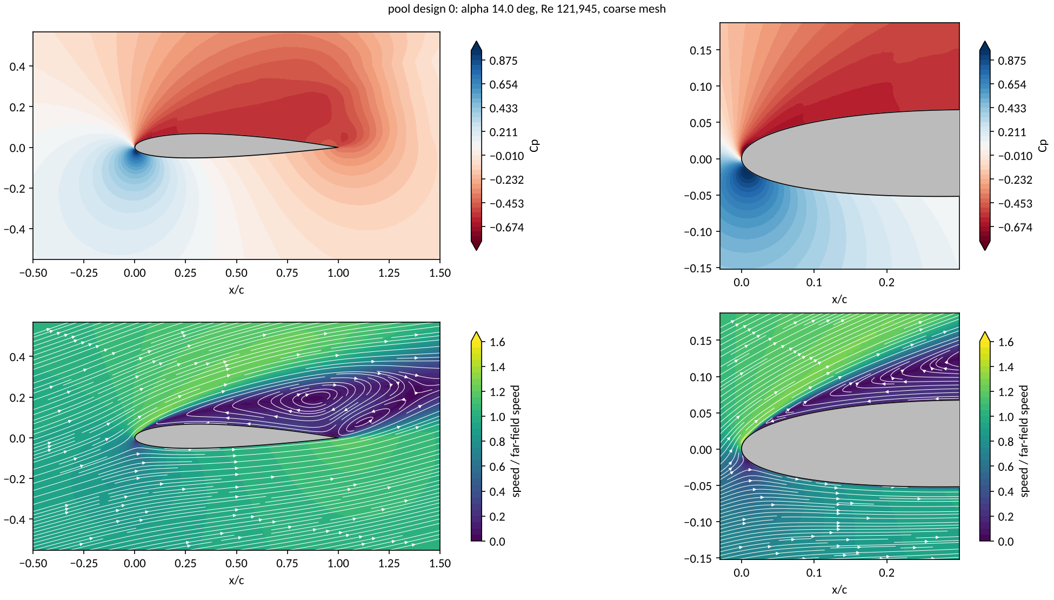
What the flow looks like at stall
At 14 degrees the upper surface of pool design 0 is separated over most of the chord; this is the stall the cheap section model cannot show.
27
Notes:
This picture shows the flow: pressure contours and streamlines.
At 14 degrees, the flow on the upper surface of pool design 0 is separated over most of the chord. Look at the streamlines behind the leading edge.
The cheap section model cannot show this stall.
The picture agrees with the numbers: after 10 degrees, lift decreases and drag increases.

Slide 28
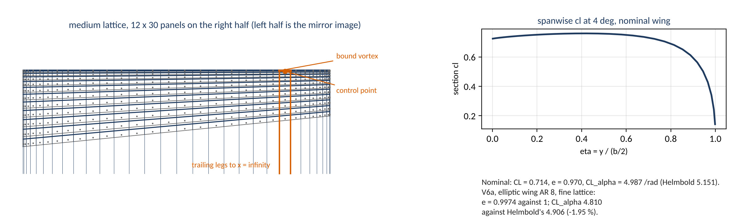
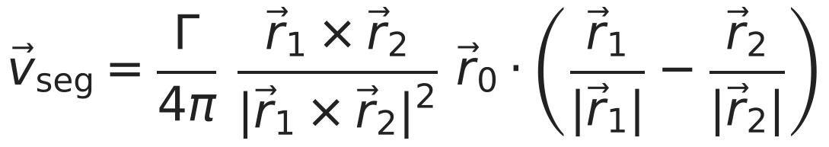
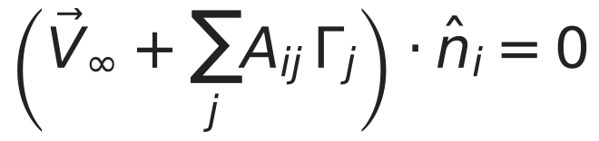
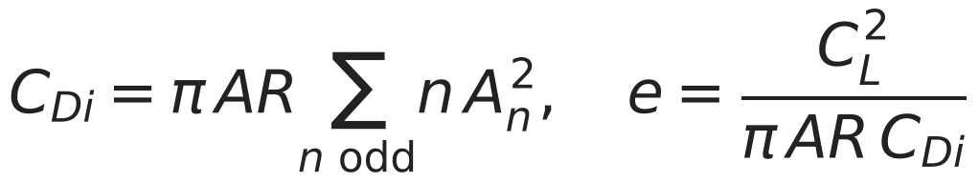
The vortex lattice and its checks
28
Notes:
This slide shows how we calculate the low-fidelity aerodynamics: a vortex lattice.
Each panel has one horseshoe vortex. The bound vortex is on the quarter chord. The control point is on the three-quarter chord.
The Biot-Savart law gives the velocity of each segment. The condition of no flow through the control points gives the circulations.
We calculate the induced drag in the Trefftz plane. An earlier method under-counted it, and the elliptic-wing checks found the error.

Slide 29
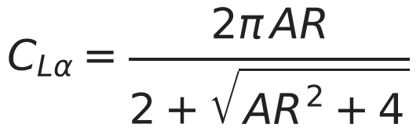
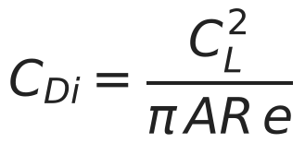
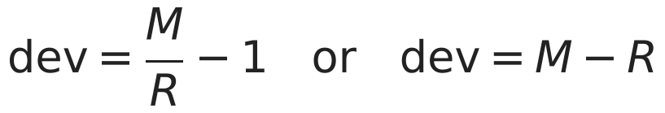
Validation table, solver checks
Row | Measured | Reference | Deviation | Tol. | Verdict
V6a elliptic AR 8 fine: e at 4 deg vs 1 | 0.9974 | 1 | -0.26 % | 1 % | pass
V6a elliptic AR 8 fine: CL_alpha vs Helmbold | 4.81 | 4.906 | -1.95 % | 3 % | pass
V6a elliptic AR 8 fine: CDi vs CL^2/(pi AR_planform e) | 0.00448 | 0.00448 | 0.0e+00 | 1e-09 | pass
V6a elliptic AR 100 fine: CL_alpha vs 2 pi AR/(AR+2) | 6.154 | 6.16 | -0.09 % | 1 % | pass
V6a (report) rectangular AR 100 fine: CL_alpha vs 2 pi AR/(AR+2) | 6.072 | 6.16 | -1.44 % | report | report
V6a (report) elliptic AR 8 coarse: CL_alpha vs Helmbold | 4.829 | 4.906 | -1.56 % | report | report
V6a (report) elliptic AR 8 coarse: e vs 1 | 0.9994 | 1 | -0.06 % | report | report
V6a (report) elliptic AR 8 medium: CL_alpha vs Helmbold | 4.817 | 4.906 | -1.82 % | report | report
V6a (report) elliptic AR 8 medium: e vs 1 | 0.9981 | 1 | -0.19 % | report | report
V6b Warren-12 fine: CL_alpha vs benchmark | 2.771 | 2.743 | +1.01 % | 2 % | pass
V6b Warren-12 fine: Cm_alpha (about root LE, reference chord 1.0) vs benchmark | -3.137 | -3.1 | +1.19 % | 2 % | PENDING
V6c nominal: CL_alpha, medium vs fine | 4.991 | 4.983 | +0.17 % | 1 % | pass
V6c nominal: e at 4 deg, medium vs fine | 0.9775 | 0.9801 | -0.26 % | 1 % | pass
V6c nominal: endurance_h, medium vs fine | 6.748 | 6.757 | -0.13 % | 2 % | pass
V6c (report) nominal: CL_alpha, coarse vs medium | 5.008 | 4.991 | +0.34 % | report | report
V6c (report) nominal: e at 4 deg, coarse vs medium | 0.9728 | 0.9775 | -0.49 % | report | report
V6c (report) nominal: endurance_h, coarse vs medium | 6.734 | 6.748 | -0.22 % | report | report
V6d closure_residual below 1e-9 | 5.606e-10 | 0 | 5.6e-10 | 1e-09 | pass
V6d energy balance: spent vs usable battery energy | 2.35e+05 | 2.35e+05 | 2.2e-16 | 1e-09 | pass
V6d endurance_h vs closed form | 6.748 | 6.748 | 0.0e+00 | 1e-06 | pass
V6d sum of masses vs mtow | 1.511 | 1.511 | 0.0e+00 | 1e-09 | pass
M measured, R reference
29
Notes:
This table gives each validation row of the method itself.
For the elliptic wing of aspect ratio 8, the span-efficiency error is -0.26 %, and the lift-slope error is -1.95 %. Both are inside their tolerances.
The moment row of the benchmark wing stays pending. Its reference point has no source yet.

Slide 30
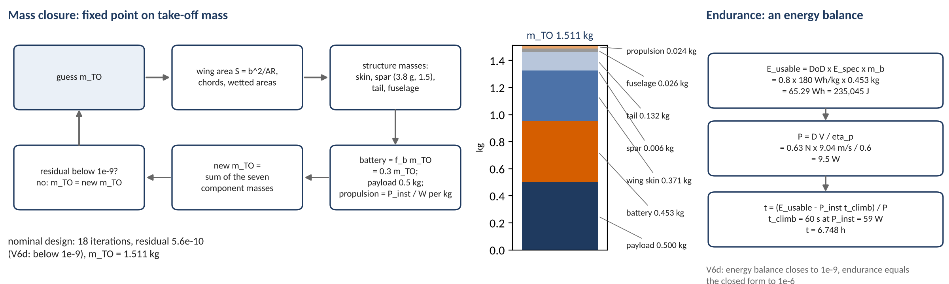
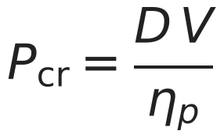
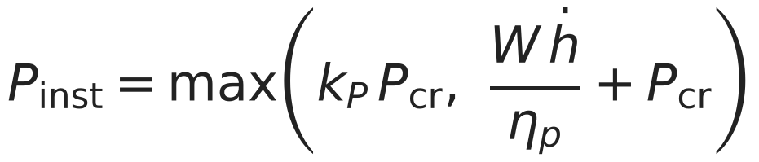
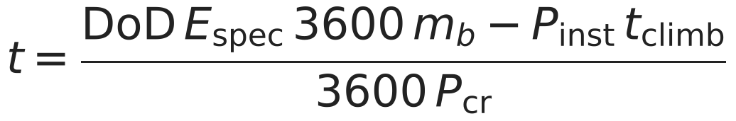
Mass closure and the endurance balance
30
Notes:
Two parts give the endurance number.
The first part is the mass closure. The battery mass is the battery fraction times the take-off mass. Thus the mass sum depends on itself. We solve it as a fixed point.
The second part is the energy balance. The usable battery energy, less the climb energy, divided by the cruise power, gives the endurance.
The nominal design closes in 18 iterations, at 6.75 hours.

Slide 31
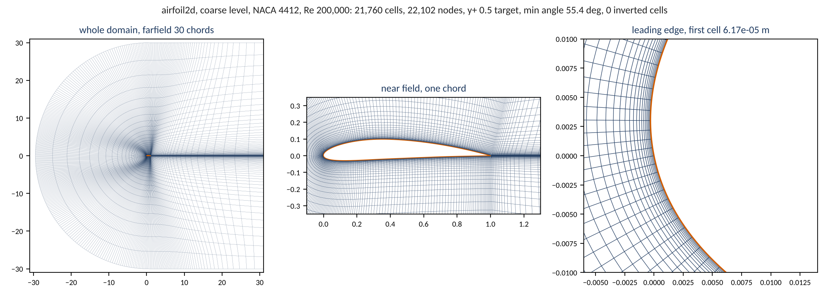
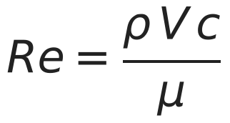
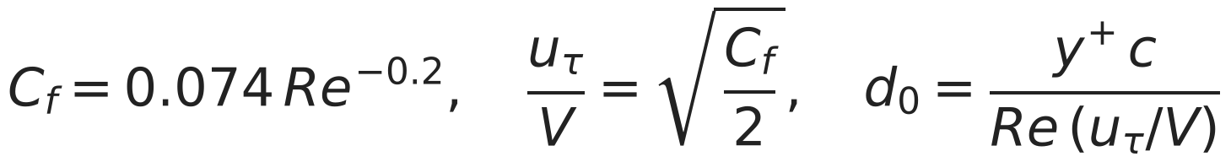
The airfoil mesh
31
Notes:
This is the airfoil mesh. It is a structured C-mesh around the section.
The coarse mesh has 21,760 cells, the medium mesh 43,008 and the fine mesh 84,152.
The first cell height comes from the chord Reynolds number. On this mesh it is 6.17e-05 m.
Each mesh passes the quality gate before we stage a case. The worker checks its fingerprint before the run.

Slide 32
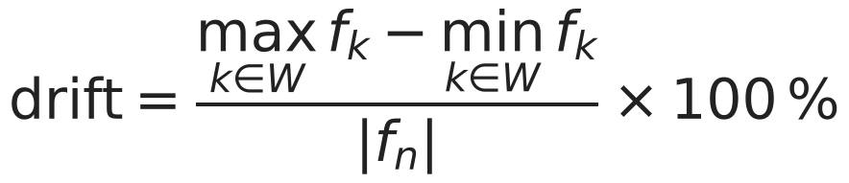
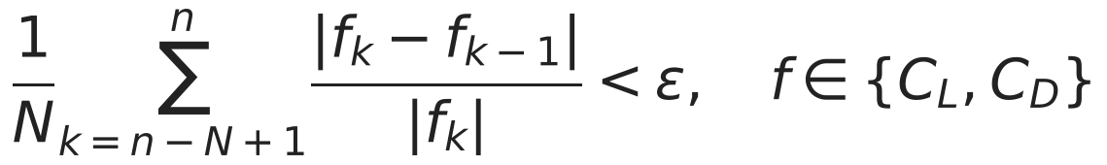
Two stopping rules: Cauchy stop and drift
Run | Budget | Iterations | cl drift (%) | cd drift (%) | Status
first smoke case | 3000 | not recorded (postprocess error) | 5.62 | 17.38 | error
rerun with Cauchy stop | 6000 | 4867 | 2.15 | 5.34 | not_converged
Drift rule, applied after ingest
SU2 Cauchy rule, as the case template states it
Cauchy settings of the airfoil case template
The drift rule and SU2's Cauchy rule measure different things; the record carries both.
A run that ends on its budget is flagged, not silently kept.
CONV_FIELD= ( LIFT, DRAG )
CONV_CAUCHY_ELEMS= 200
CONV_CAUCHY_EPS= 1E-5
CONV_STARTITER= 500
32
Notes:
How do we know that a run converged? We use two rules, and they measure different things.
The SU2 Cauchy stop examines lift and drag over a window of iterations, from iteration 500.
My drift rule reads the history after the run. It measures how much lift and drag change in the last fifth.
The first smoke case drifted 5.6 % in lift and 17.4 % in drag. The rerun stopped at iteration 4,867.
A run that stops at its budget gets a flag.

Slide 33
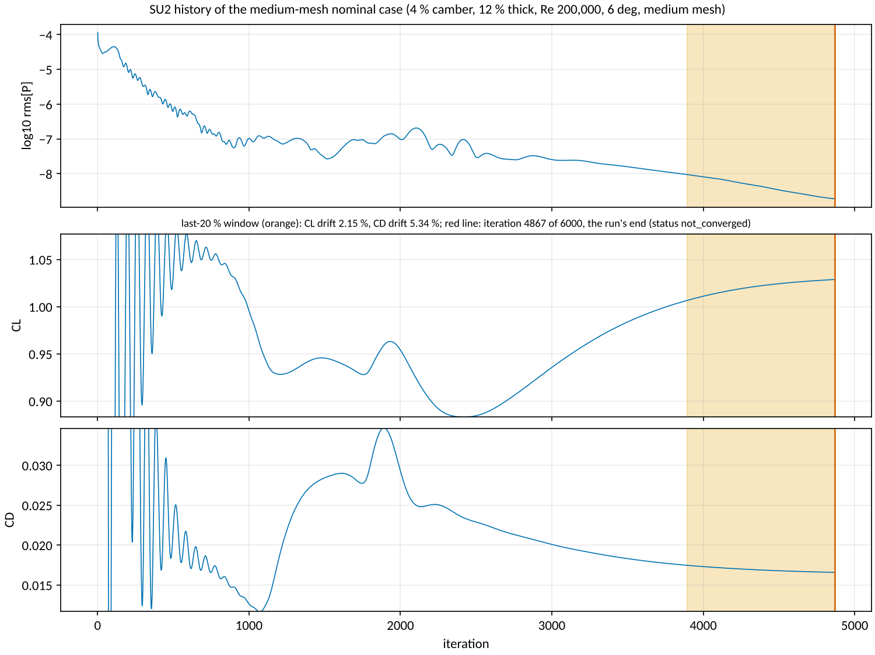
A solver history
33
Notes:
This is one solver history.
The residual decreases by many orders of magnitude. If you look only at the residual, the run seems converged.
But look at the shaded window, the last fifth of the run. Lift and drag still change there. The drift rule reads that window.
A run that still changes gets a flag, also when the solver stopped correctly.

Slide 34
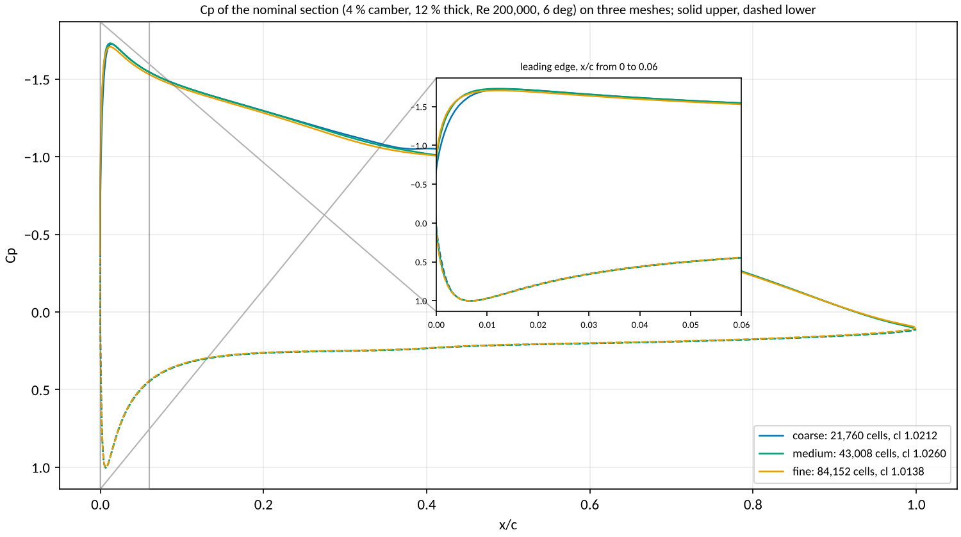
What the mesh does to the pressure distribution
34
Notes:
This figure shows three meshes on one axis, on the nominal section: coarse, medium and fine.
The curves agree away from the leading edge. The differences are at the suction peak.
The peak pressure coefficient is -1.726 on the coarse mesh, -1.731 on the medium mesh and -1.708 on the fine mesh.
One caution: the drift rule flags all three runs. Thus these differences include a convergence effect, not only a mesh effect.

Slide 35

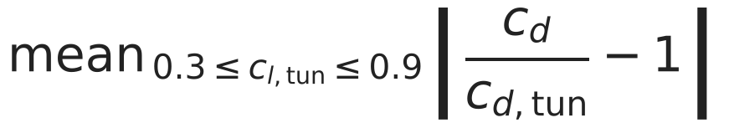
The low-fidelity section against the tunnel
Quantity | Re 101,800 | Re 203,800 | Re 305,200
lift slope | -22.6 % | -19.1 % | -20.2 %
zero-lift angle | -0.90 deg | -0.76 deg | -0.83 deg
profile drag, mean ratio | +52.0 % | +47.5 % | +43.4 %
cl_max | +12.2 % | +12.7 % | +13.5 %
Report-only rows by the spec: the closed-form section at the E387's measured camber and thickness against tunnel runs 211, 213 and 215.
The ledger's assumed lift effectiveness does not contain the value the tunnel implies: a ledger ruling, not a number to move here.
35
Notes:
How good is the cheap section model? Against the tunnel it is not good, and I say so.
Its lift slope is 19 to 23 % low. Its profile drag is 43 to 52 % high. Its maximum lift is 12 to 13 % high.
The ledger lift effectiveness does not contain the tunnel value. That is a ruling. It is not a number to change here.

Slide 36
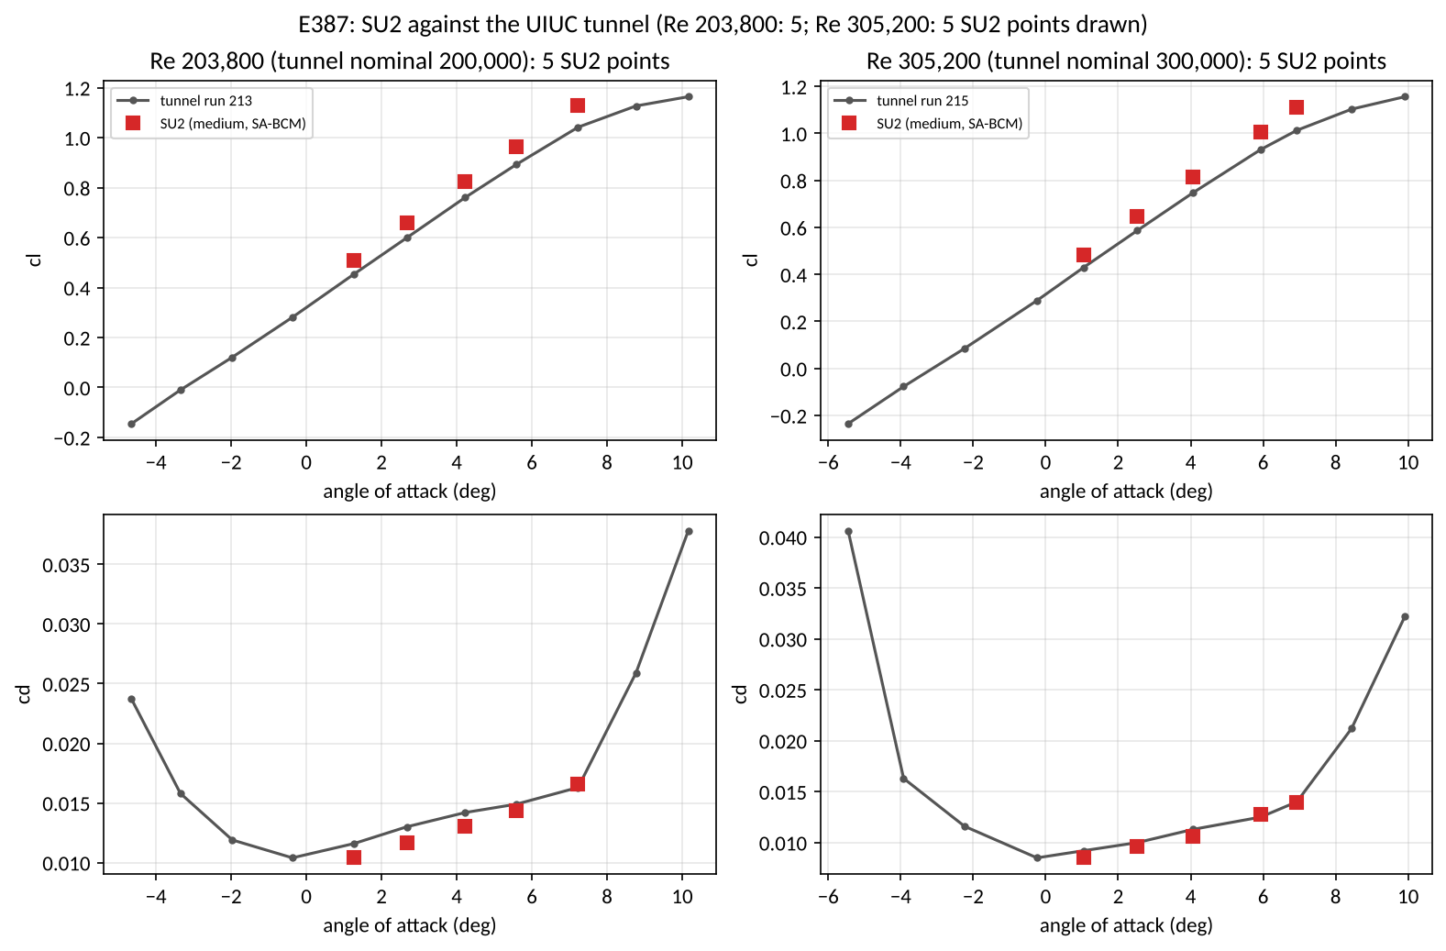
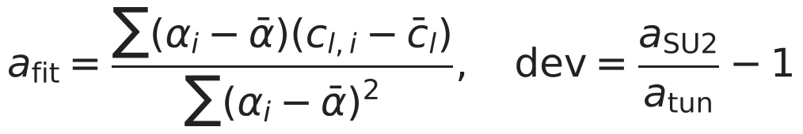
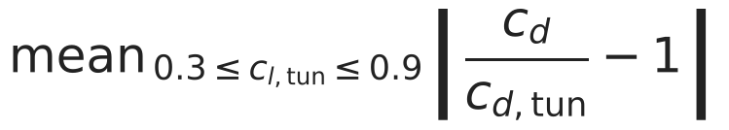
SU2 against the tunnel, and the decision to accept the bias
Row | Deviation | Tol. | Verdict
cl_alpha Re 203800 | +5.49 % | 5 % | FAIL
cd ratio Re 203800 | +7.99 % | 20 % | pass
cl_max Re 203800 | -3.00 % | report | report
cl_alpha Re 305200 | +6.44 % | 5 % | FAIL
cd ratio Re 305200 | +5.74 % | 20 % | pass
cl_max Re 305200 | -3.92 % | report | report
mesh medium vs fine, cd at cl 0.6 | +0.35 % | 5 % | pass
mesher fix, medium before vs after smoothing, cd at cl 0.6 | -0.0002 % | report | report
Against the tunnel at the five angles of Re 203,800: cl is 8.0 to 11.6 % high; cd is 10.3 % low to 1.6 % high.
Decision 8 (Éder, 2026-11-08 22:35 UTC): "accept the medium mesh as the high level with the bias recorded".
Not run: Ultra Stick 25e CL_alpha and CD0 (Ultra Stick data not retrieved).
36
Notes:
Why did we accept a failed validation? Because the other option was to tune the error away.
The lift slope fails at both Reynolds numbers: 5.49 % and 6.44 %, against 5 %.
The drag ratio passes at both: 7.99 % and 5.74 %, against 20 %.
Decision 8 accepted the medium mesh with the bias recorded. The fail stays a fail.

Slide 37
Tunnel points at both Reynolds numbers
Re 203,800 (medium mesh, SA-BCM; tunnel: UIUC low-speed airfoil data)
alpha | SU2 cl | tunnel cl | ratio | SU2 cd | tunnel cd | ratio
1.27 | 0.5067 | 0.4540 | +11.6 % | 0.01046 | 0.01160 | -9.8 %
2.67 | 0.6588 | 0.5990 | +10.0 % | 0.01166 | 0.01300 | -10.3 %
4.23 | 0.8226 | 0.7610 | +8.1 % | 0.01302 | 0.01420 | -8.3 %
5.59 | 0.9646 | 0.8930 | +8.0 % | 0.01438 | 0.01490 | -3.5 %
7.23 | 1.1290 | 1.0420 | +8.4 % | 0.01655 | 0.01630 | +1.6 %
Re 305,200 (medium mesh, SA-BCM; tunnel: UIUC low-speed airfoil data)
alpha | SU2 cl | tunnel cl | ratio | SU2 cd | tunnel cd | ratio
1.04 | 0.4835 | 0.4290 | +12.7 % | 0.00851 | 0.00920 | -7.5 %
2.53 | 0.6478 | 0.5870 | +10.4 % | 0.00962 | 0.01000 | -3.8 %
4.07 | 0.8145 | 0.7480 | +8.9 % | 0.01063 | 0.01130 | -5.9 %
5.93 | 1.0056 | 0.9310 | +8.0 % | 0.01278 | 0.01250 | +2.3 %
6.93 | 1.1107 | 1.0130 | +9.6 % | 0.01391 | 0.01400 | -0.6 %
37
Notes:
This table compares the tunnel and SU2 at each point.
At a Reynolds number of 203,800, the SU2 lift is 8.0 to 11.6 % high. The SU2 drag is from 10.3 % low to 1.6 % high.
The second table gives the same comparison at the higher Reynolds number.

Slide 38
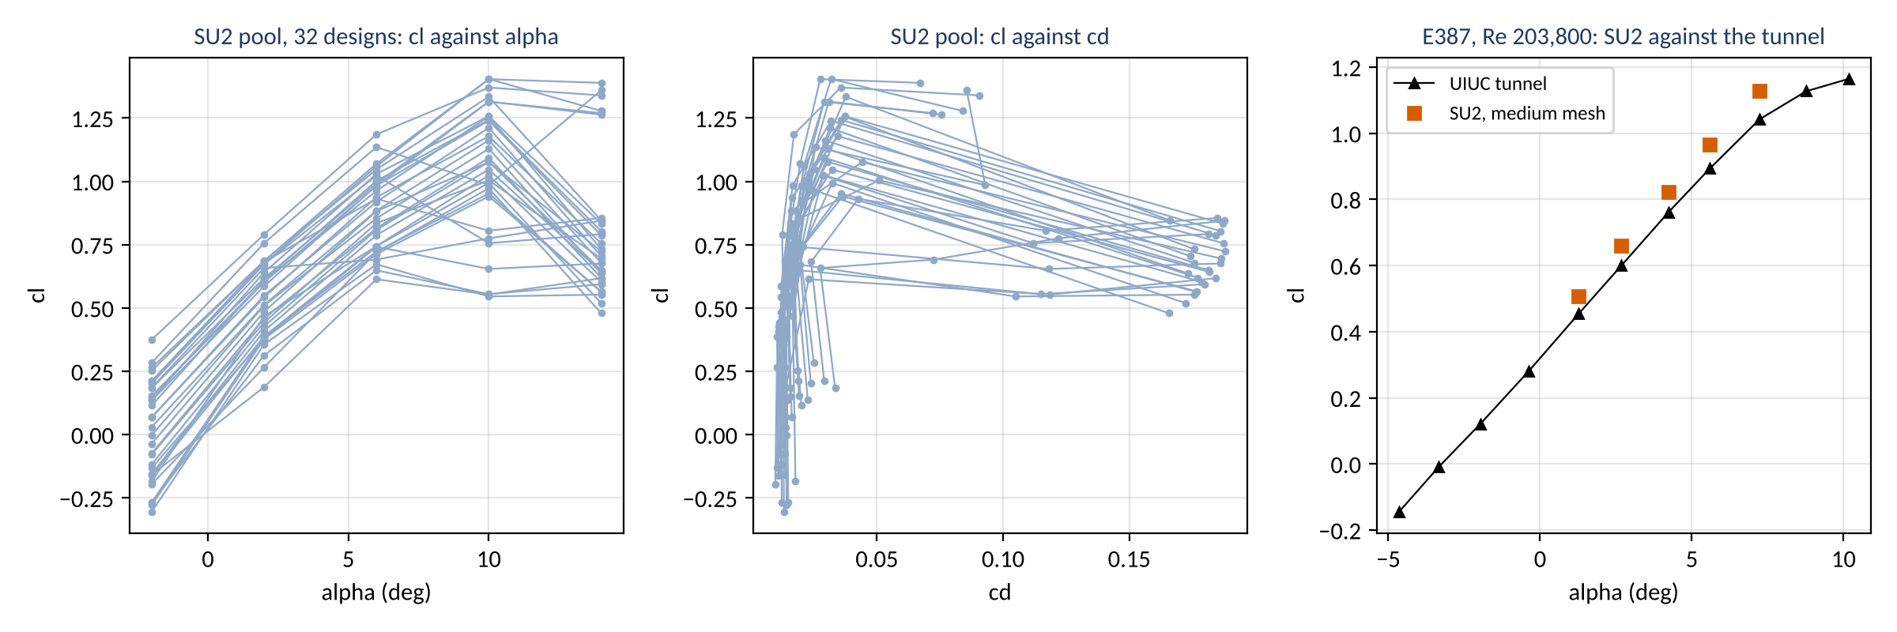
Section polars
38
Notes:
These are the section polars. The left plot is lift against angle. The right plot is drag against lift.
The closed form is a straight line to a limit, with constant drag. It has no stall and no drag increase.
SU2 shows the stall at the top of the angle range.
Open circles are cases that the pool did not keep.

Slide 39
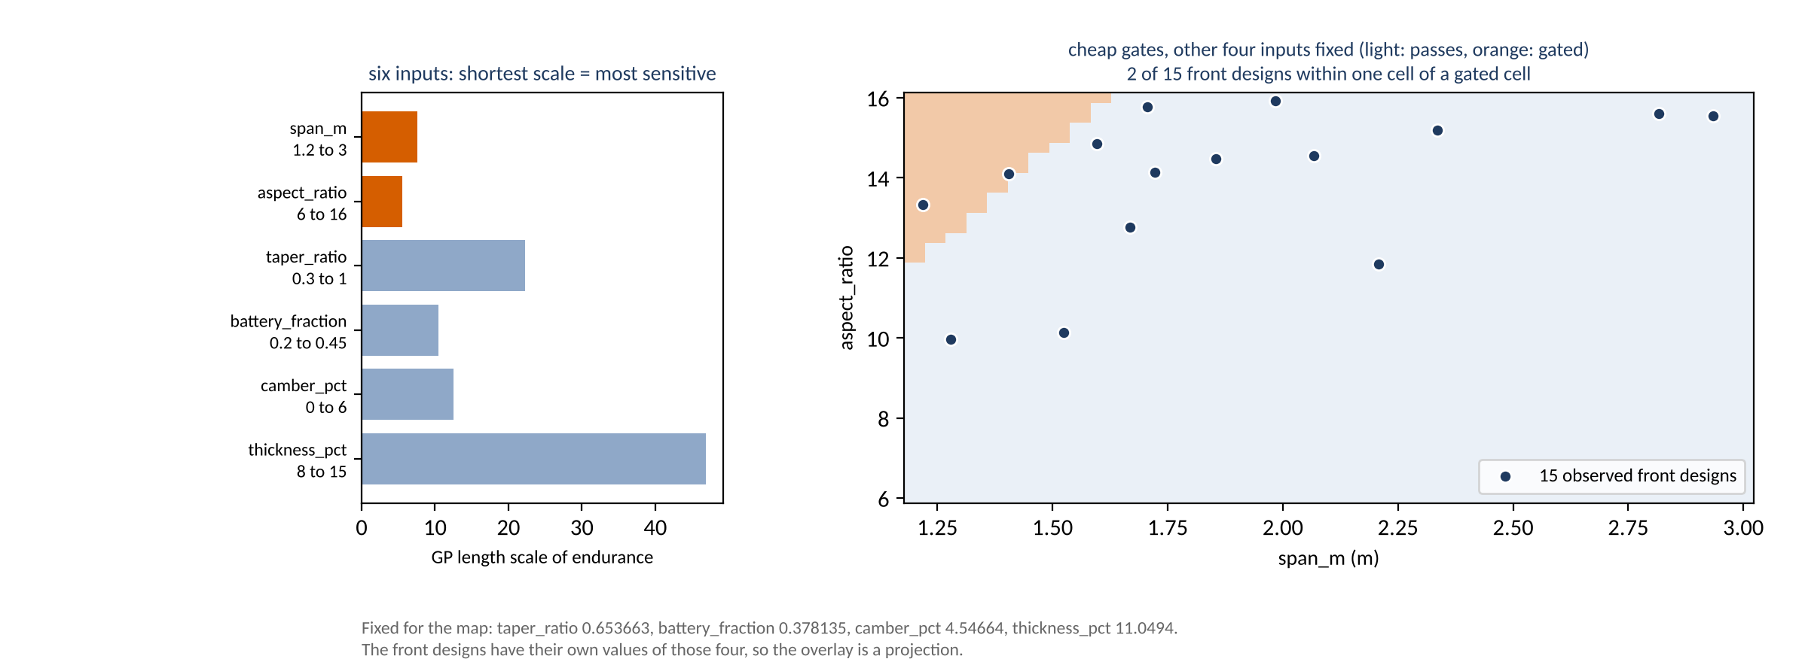
What the surrogate learned about the box
39
Notes:
Which inputs does the surrogate think are important?
The left plot ranks the six inputs by the length scale of the endurance model. A short length scale means that endurance changes quickly along that input. Aspect ratio and span are first.
The right map shows the region that passes the gates, over those two inputs, with the observed front.
The map is a projection: it holds the other four inputs at one point. In this view, 2 of the 15 front designs are within one cell of a gated cell.

Slide 40
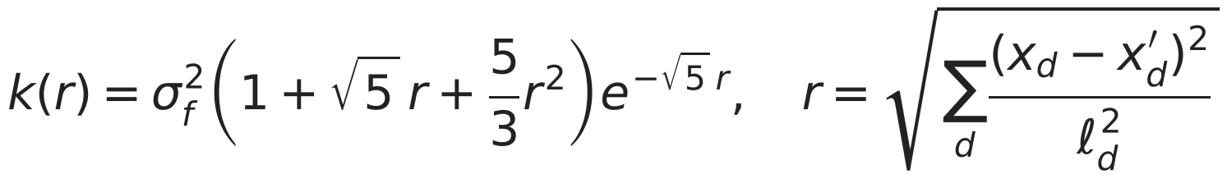


Why a Gaussian process, and against what
With 32 SU2 designs a model must give an interval, not only a mean; on this data the GP corrected by the low model has the lowest endurance error up to 16 SU2 designs (at 24 the GP on SU2 alone is lower).
Few expensive points: 32 SU2 designs; an exact GP fits them in seconds.
The acquisition and the confirmation test both need an interval, not only a mean; a GP gives one at every design.
Nine numbers per GP (six length scales, two variances, a mean), fitted by marginal likelihood: nothing is tuned by hand.
The length scales say which inputs matter (backup slide 39).
Model, fitted on | Endurance RMSE (h) at n = 8, n = 12, n = 16, n = 24 | 90 % interval covers (n = 8)
Low model alone, no SU2 | 2.299 (no fit) | no interval
GP on SU2 designs only | 1.525, 1.112, 0.865, 0.704 | 0.43
GP on SU2 with the low model as its trend (two-level) | 0.824, 0.808, 0.747, 0.726 | 0.61
Means over ten seeds on held-out designs. No neural network or tree model was fitted on this study's data; this table is the whole comparison in the record.
40
Notes:
Why a Gaussian process? There are four reasons, and each comes from how the study uses the model.
First, the SU2 data are small. We have 32 SU2 designs. An exact Gaussian process fits this quantity in seconds.
Second, the acquisition and the confirmation test need an interval, not only a mean. A Gaussian process gives an interval at each design.
Third, each process has nine numbers: six length scales, two variances and a mean. The marginal likelihood sets them. Nobody tunes them by hand.
Fourth, the length scales show which inputs are important. Backup slide 39 shows them.
The table shows each model that we fitted on this data. The low model alone has an endurance error of 2.299 hours.
With 8 SU2 designs, the Gaussian process on SU2 alone has an error of 1.525 hours. The two-level model has 0.824 hours.
At 24 designs, the order changes: 0.704 hours for SU2 alone and 0.726 for the two-level model.
We did not fit a neural network or a tree model on this data. This table is the full comparison in the record.
The intervals cover less than 90 % of the held-out designs. Thus I use the mean, not the interval.

Slide 41
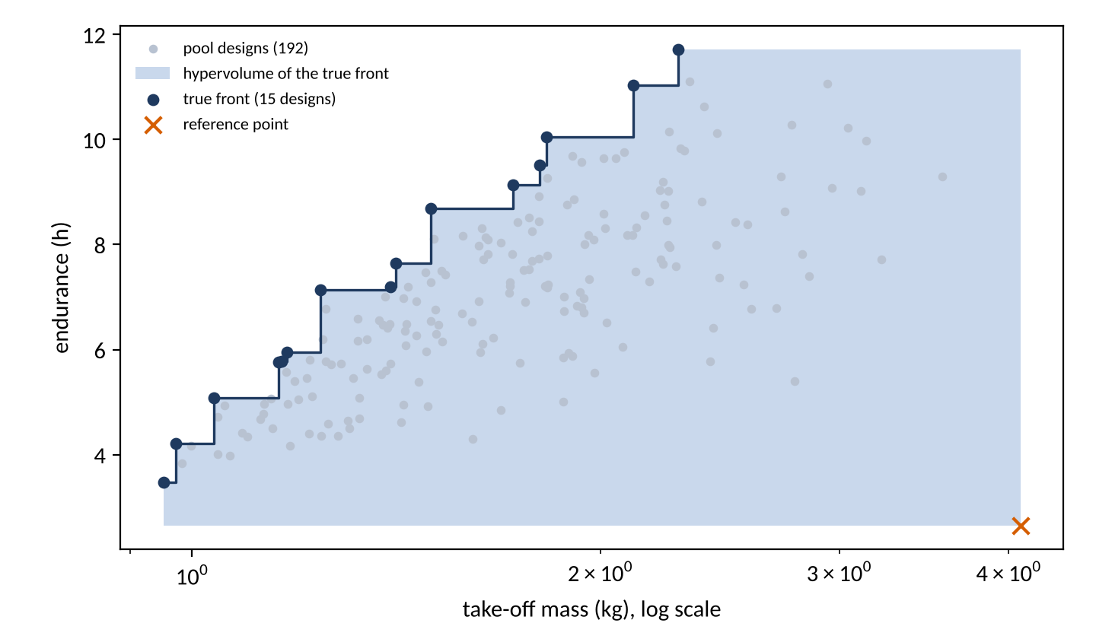
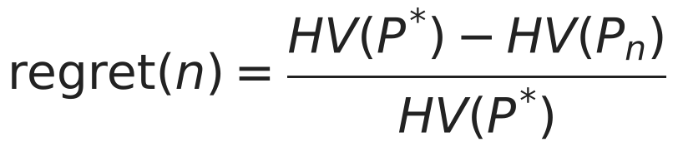
Hypervolume regret: what the replay slides measure
Regret is the share of the true front's hypervolume that the designs found so far do not cover: 0 when the whole front has been found, 1 when nothing of it has.
n | random | Latin hypercube | max. variance | EHVI
8 | 0.285 | 0.285 | 0.285 | 0.285
12 | 0.235 | 0.195 | 0.222 | 0.113
16 | 0.210 | 0.210 | 0.170 | 0.034
20 | 0.178 | 0.186 | 0.139 | 0.016
24 | 0.170 | 0.152 | 0.114 | 0.012
32 | 0.133 | 0.148 | 0.085 | 0.000
40 | 0.118 | 0.107 | 0.062 | 0.000
Objectives: endurance (maximised) and the logarithm of take-off mass (minimised).
r: the worst value of each objective over the pool plus a tenth of its range.
P*: the true front of the pool; P_n: the front of the n designs run so far.
Mean over ten seeds, from the pool replay.
41
Notes:
Regret measures how much of the true front a strategy has not found.
Hypervolume is the area between a front and a reference point. The reference point is a little beyond the worst design. We measure endurance and the logarithm of mass.
The figure shows the true front of the pool and its hypervolume, shaded.
Regret is the true hypervolume, less the hypervolume of the designs found, divided by the true hypervolume. It is 1 when the strategy has found nothing of the front. It is 0 when it has found all of it.
The table gives the mean regret for each strategy and budget. For example, at 16 evaluations EHVI has 0.034 and random has 0.210.

Slide 42
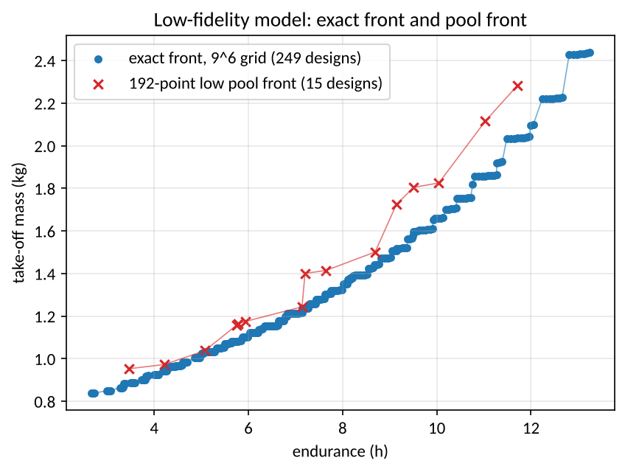
The exact low-fidelity front
Grid: 531,441 points, 459,432 clean, 72,009 gated, 0 failed.
Exact front: 249 designs.
Wall time: 16747 s on 8 workers.
Low pool: 192 designs, 0 gated, front of 15, 669 s.
Both runs are at the medium lattice level.
42
Notes:
How do we know that the low-fidelity front is exact? The cheap model ran at each grid point.
The grid has 531,441 points. The gates stopped 72,009 of them.
The exact front has 249 designs. The run took 4.7 hours on 8 workers.

Slide 43
Online replays, full tables
Mean hypervolume regret against the exact front
n | random | lhs | al_ehvi | al_ehvi_feas | al_maxvar | al_maxvar_feas
8 | 0.409 | 0.409 | 0.409 | 0.409 | 0.409 | 0.409
12 | 0.374 | 0.377 | 0.365 | 0.314 | 0.396 | 0.387
16 | 0.344 | 0.365 | 0.347 | 0.246 | 0.382 | 0.365
20 | 0.330 | 0.312 | 0.327 | 0.195 | 0.378 | 0.345
24 | 0.321 | 0.312 | 0.323 | 0.158 | 0.368 | 0.326
32 | 0.310 | 0.292 | 0.317 | 0.116 | 0.354 | 0.293
40 | 0.294 | 0.271 | 0.317 | 0.092 | 0.353 | 0.268
Mean gated picks (cumulative)
n | random | lhs | al_ehvi | al_ehvi_feas | al_maxvar | al_maxvar_feas
8 | 0.0 | 0.0 | 0.0 | 0.0 | 0.0 | 0.0
12 | 0.3 | 1.6 | 3.0 | 1.4 | 1.7 | 1.0
16 | 0.5 | 1.7 | 6.7 | 2.6 | 4.5 | 2.3
20 | 0.7 | 1.9 | 10.3 | 3.2 | 7.4 | 3.5
24 | 0.9 | 2.4 | 14.0 | 4.2 | 10.8 | 4.7
32 | 1.3 | 2.7 | 21.7 | 5.8 | 17.8 | 6.4
40 | 1.9 | 4.0 | 29.7 | 7.5 | 25.4 | 7.6
43
Notes:
These are the full tables of the open-box replay, at each budget.
Plain EHVI ends at 0.317 against 0.294 for random. The feasibility-weighted version ends at 0.092.
The lower table explains why. By 40 evaluations, plain EHVI has 29.7 gated picks. The weighted version has 7.5.

Slide 44
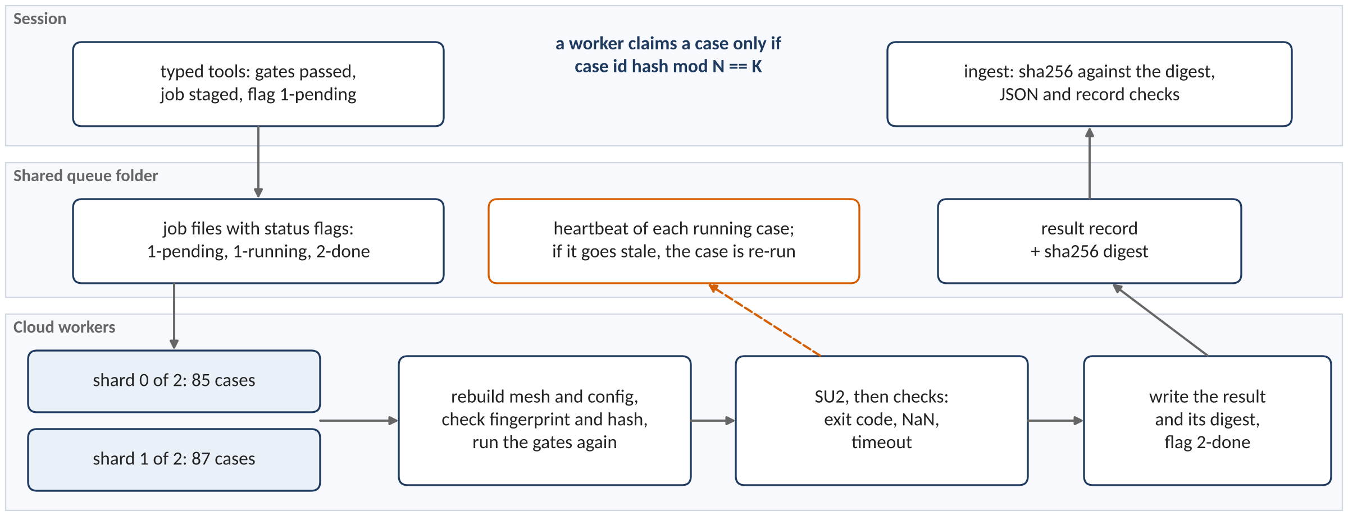
Queue, workers and shards
Workers split the queue by a hash of the case id, so they never race for a case; a worker that dies leaves a heartbeat that goes stale, and its case is re-run.
Every case id lands in exactly one shard: the 172 pool cases split 85 and 87 over two shards. Adding a worker changes N, nothing else.
44
Notes:
The queue is a shared folder of job files with status flags. Cloud machines cannot accept inbound connections. Thus the workers read the folder at intervals.
Each worker takes only the cases whose identifier hash is in its own shard. Each case is in exactly one shard. The 172 pool cases divided into 85 and 87 over two shards.
Thus two workers never take the same case, and there is no lock.
Each worker writes a heartbeat. When a worker stops, its heartbeat gets old, and the case runs again.
To add a worker, change the number of shards. Nothing else changes.

Slide 45
Cost ledger
Mesh level | Cases | Wall (s): median | min to max | Iterations: median | Worker-hours
coarse | 173 | 705 | 305 to 2,053 | 4,388 | 35.7
medium | 35 | 1,392 | 786 to 1,882 | 5,020 | 13.8
fine | 11 | 5,668 | 3,162 to 8,170 | 7,041 | 17.5
Tag | Worker-hours
confirm | 3.4
e387 | 20.0
e387 smooth | 2.3
mesh | 1.0
nominal | 2.4
pool af | 31.9
pool af bias | 5.1
smoke | 0.2
smoke2 | 0.4
viz | 0.4
Low-fidelity grid: 4.65 h on 8 workers.
Low pool: 669 s on 2 workers.
Online replays: 2496 s and 851 s.
SU2 wall times are from each run record; ranks per case: 72 cases on 2 ranks, 147 cases on 4 ranks.
45
Notes:
What did it cost? The table gives the wall time of each mesh level, from the run records.
The SU2 pool used 37.0 worker-hours. The low-fidelity grid took 4.7 hours on 8 workers.
The run records give the wall time of each SU2 case. The table does not use estimates.

Slide 46
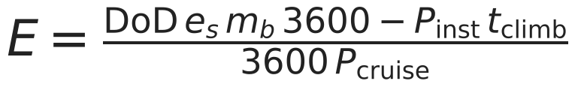
The endurance calculation, step by step
Endurance is the usable battery energy divided by the cruise power; for one low-pool design the model finds the take-off mass, the cruise point and the installed power, then divides.
Step | What the model does | Design 48 of the low pool
1. Take-off mass | adds the masses of the parts until the total stops changing | 0.953 kg after 14 iterations; battery 0.204 kg
2. Cruise point | finds the lift with the least power, P = D V / efficiency | C_L 0.692, V 11.58 m/s, C_D 0.0318, P 8.29 W
3. Installed power | the larger of twice the cruise power and the climb power | 39.43 W
4. Usable energy | 0.8 × 180 Wh/kg × battery, less 60 s of climb at installed power | 103,631 J
5. Endurance | usable energy ÷ cruise power ÷ 3600 | 3.471 h (recorded 3.471 h)
No reserve and no descent are included, so the endurance is an upper bound for this design.
46
Notes:
This slide shows how the model works out endurance for one design. The design is number 48 of the low pool. Read the table from top to bottom. Each row uses the result of the row above it.
The model first finds the take-off mass. It adds the masses of the parts until the total no longer changes. The battery is a fixed fraction of that total.
Next the model finds the cruise point. It tries many lift values and keeps the one that needs the least power. The power is drag times speed, divided by the propulsive efficiency.
The installed power is the larger of two values: twice the cruise power, or the power to climb. The climb takes one minute, and that energy is taken away from the battery first.
The endurance is the usable energy divided by the cruise power. The last row matches the recorded value of the design. The model has no reserve and no descent, so the value is an upper bound.

