Slide 1







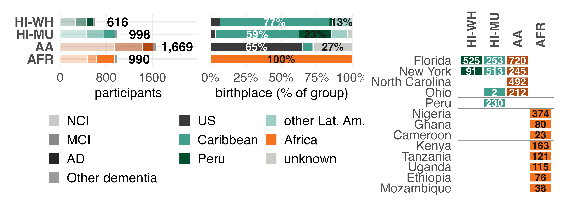
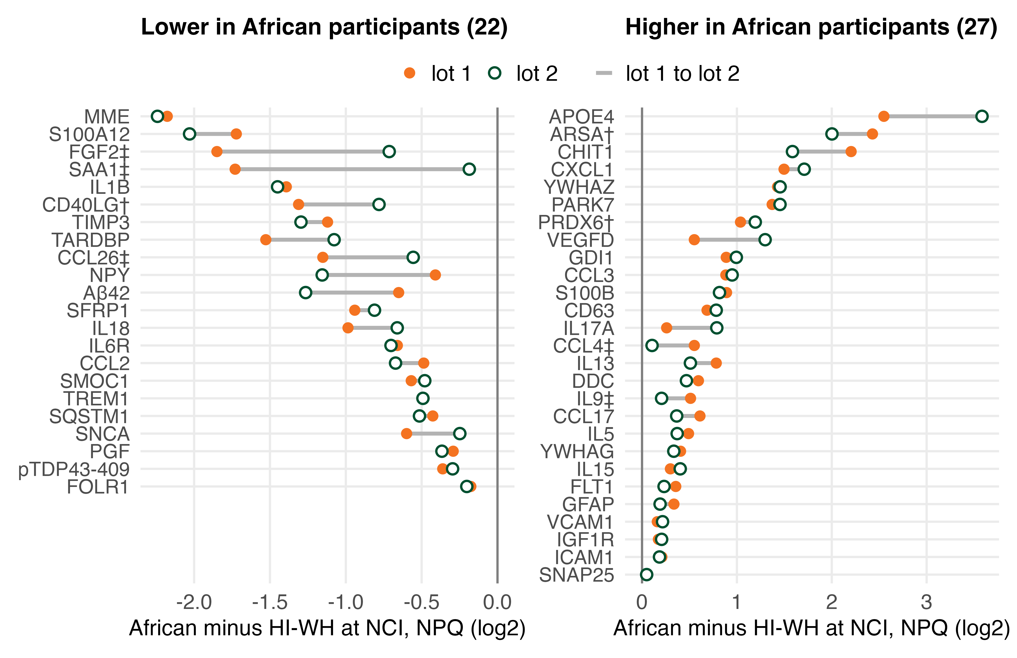
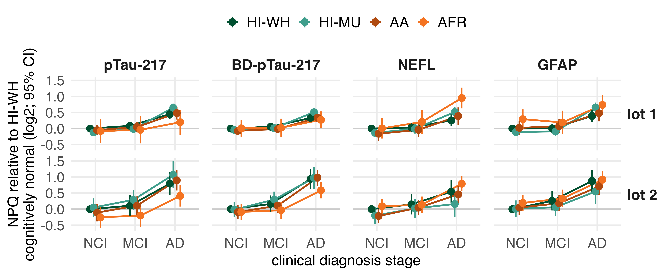
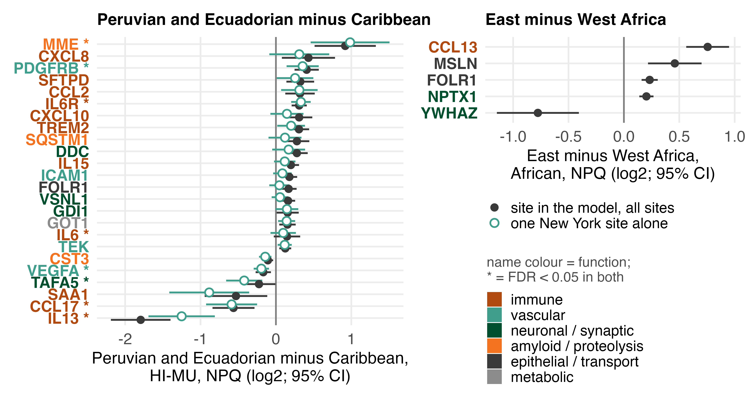
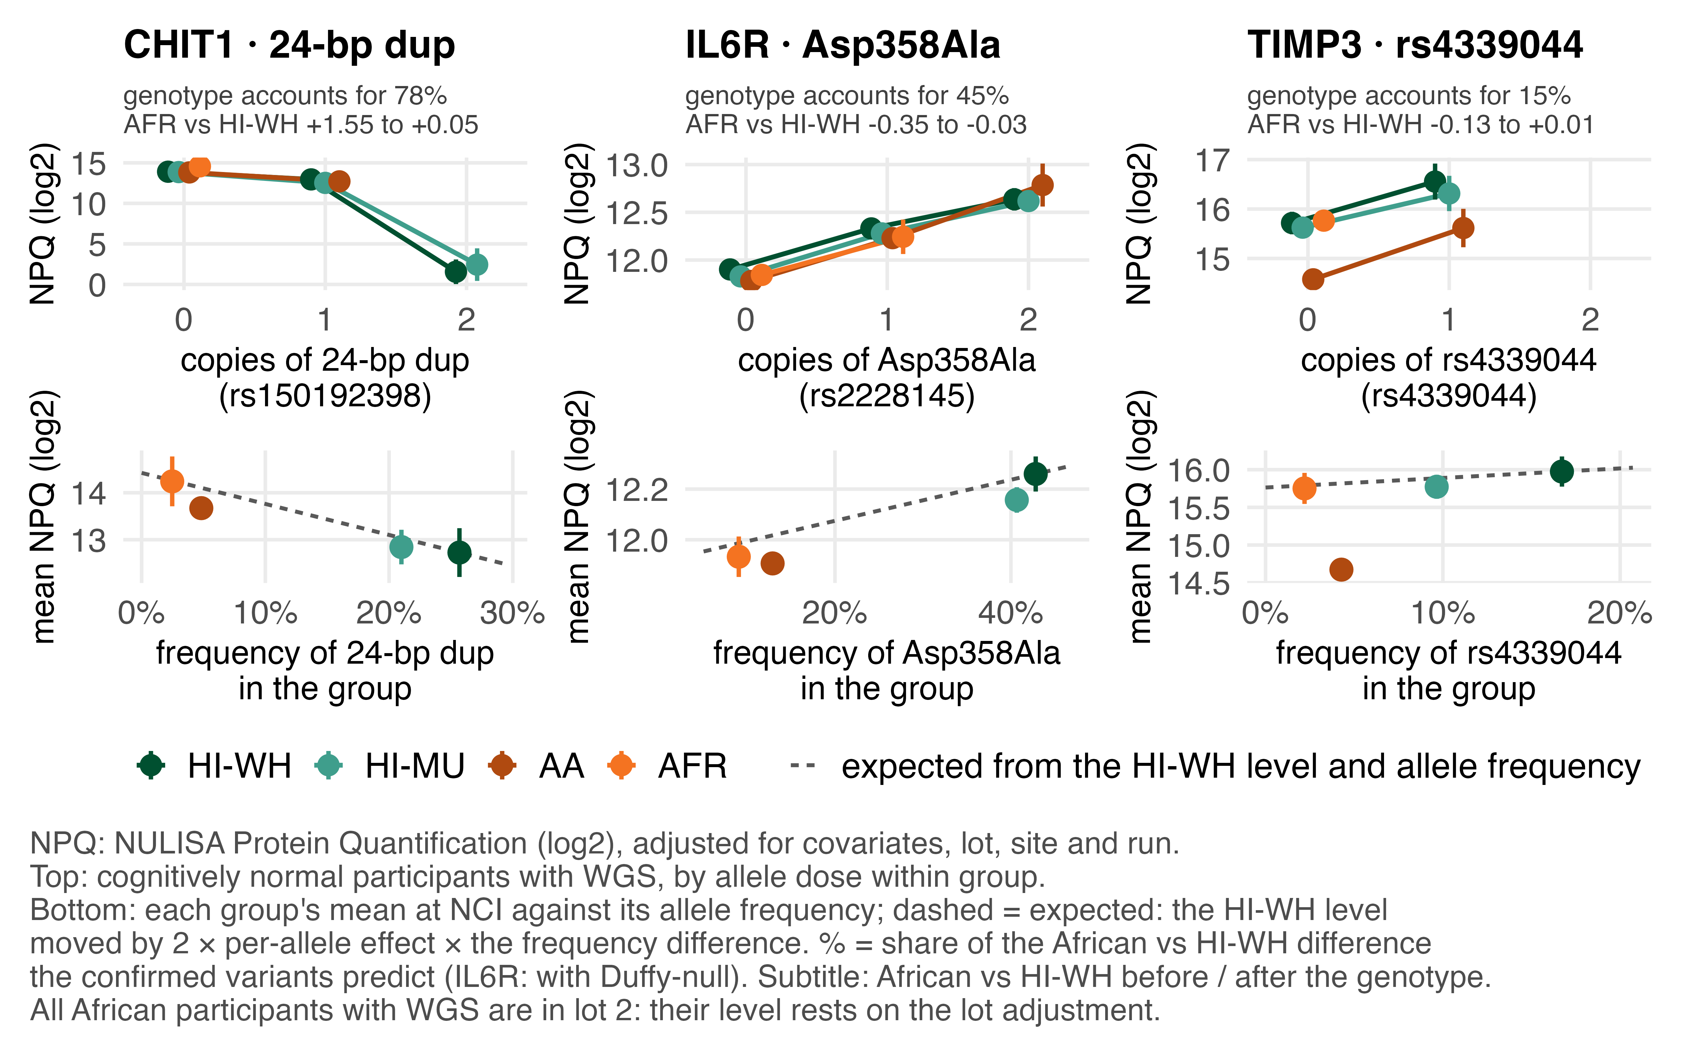
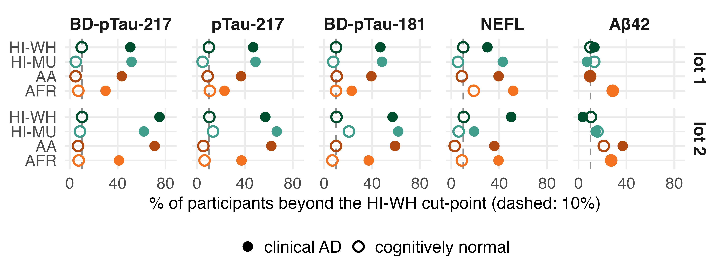

African and Indigenous American ancestry shape plasma CNS biomarker baselines within and across populations, modifying Alzheimer’s disease trajectories
Board 1003W · emartin1@miami.edu
Eden R. Martin¹, Tianjie Gu¹, Olabode Omotoso², Lissette Gomez¹, Maryanella Illanes-Manrique³, Kazeem Sanjo Akinwande⁴, Patrice Whitehead¹, Michael Cuccaro¹, Alfred Kongnyu Njamnshi⁵, Njideka Okubadejo⁶, Jean Ikanga⁷, Damas Andrea⁸, Michelle Nichols⁹, Olusegun Baiyewu⁴, Mayowa Owolabi¹⁰, Rajesh Kalaria¹¹, Brian Kunkle¹, Jeffery Vance¹, Christiane Reitz¹², Giuseppe Tosto¹², William Bush¹³, Jonathan Haines¹³, Adesola Ogunniyi⁴, Goldie Byrd¹⁴, Farid Rajabli¹, Rufus Akinyemi⁴, Mario Cornejo-Olivas³, Margaret A. Pericak-Vance¹, Anthony Griswold¹
¹ Hussman Institute for Human Genomics, University of Miami, Miami, FL, USA; ² Neurology, University of Ibadan, Nigeria; ³ Instituto Nacional de Ciencias Neurológicas, Lima, Peru; ⁴ Institute for Advanced Medical Research and Training, University of Ibadan, Nigeria; ⁵ Brain Research Africa Initiative, Yaoundé, Cameroon; ⁶ Medicine, University of Lagos, Nigeria; ⁷ Psychiatry, University of Kinshasa, DRC; ⁸ Psychiatry, Mirembe National Mental Hospital, Dodoma, Tanzania; ⁹ Health Sciences and Rehabilitation, Medical University of South Carolina, Charleston, SC, USA; ¹⁰ Translational and Clinical Research Institute, University of Ibadan, Nigeria; ¹¹ Translational and Clinical Research Institute, Newcastle University, UK; ¹² Vagelos College of Physicians and Surgeons, Columbia University, New York, NY, USA; ¹³ Population and Quantitative Health Sciences, Case Western Reserve University, Cleveland, OH, USA; ¹⁴ Biostatistics and Data Science, Wake Forest School of Medicine, Winston-Salem, NC, USA
THE QUESTION
A biomarker reads differently in two populations: disease, ancestry, or recruitment site? Does it change the test?
THE ANSWER
Ancestry moves the baseline
62 of 126 proteins differ; African vs HI-WH 49, all the same sign in both lots
a known variant accounts for CHIT1 (78%) and part of IL6R (45%)
Ancestry rarely moves the AD signal
p-tau rises with AD in every group, in both lots
one BD-pTau-217 cut: same share of normals above it, fewer clinical AD at most African sites
Few regional differences survive site
Peruvian and Ecuadorian vs Caribbean 10; East vs West Africa 5
6 of the 15 immune
WHO AND HOW
1. ANCESTRY MOVES THE BASELINE
2. ANCESTRY RARELY MOVES THE AD SIGNAL
3. REGIONS WITHIN A GROUP
4,273
22
50
126
All 49 African vs HI-WH differences point the same way in both lots
p-tau rises from NCI through MCI to AD in every group, in both lots; BD-pTau-217 rises least in African participants
Peruvian and Ecuadorian vs Caribbean: 10 differ inside one New York site; 22 across three sites, where the Peru site and Peruvian origin cannot be separated
participants
sites
countries of birth
plasma proteins
female 72 / 74 / 79 / 56%; median age 73 / 71 / 71 / 72 (HI-WH / HI-MU / AA / AFR)
62 of 126 differ; vs HI-WH at NCI: African 49, AA 38, HI-MU 3
ρ 0.93 between lots, size ratio 0.99; 19 above 2-fold; lots disagree for 5 (‡), reagent changed for 3 (†): lot 1 shown
HI-MU, Peruvian and Ecuadorian vs Caribbean: 10 in one site, 22 across three (section 3)
HI-WH Hispanic, European descent · 3 sites
Cross-sectional: different people at each stage, not one person followed over time.
HI-MU Hispanic, mixed origin · 6 sites
AA African American · 6 sites
12 group × diagnosis interactions of 126; BD-pTau-217 holds in lot 2 alone (p 0.002), pTau-217 and NEFL do not
AFR African · 13 sites
22 sites in all: five serve more than one group
One BD-pTau-217 cut flags 5 to 10% of normals in every group, and fewer clinical AD at most African sites
Filled: all sites, site in the model (848 HI-MU); hollow: the New York site alone, 53 vs 379. The Peru site holds 197 of the 260 Peruvian and Ecuadorian and no Caribbean; * = FDR < 0.05 in both; the 14 that differ only across sites are all higher in Peruvian and Ecuadorian.
Alamar NULISAseq CNS panel: 131 targets, 126 proteins after the hemolysis filter
NPQ: NULISA Protein Quantification, a log2 relative level
2 reagent lots, each fitted alone: lot 1, 2,467 participants (2025); lot 2, 1,806 (2026)
model: ancestry, sex, age, diagnosis, reads and a blood-cell score, with site and assay run as random effects; ancestry p-values by parametric bootstrap; full methods in the supplement
The CHIT1 difference is the allele frequency; for IL6R, about half of it
East vs West Africa 5; 6 of the 10 + 5 are immune
IL6R higher in Peruvian and Ecuadorian, as rs2228145 predicts
CAVEATS
clinical diagnosis, not amyloid-confirmed; one draw per person
groups: self-identified (US) or born in Africa; no genetic PCs
African: own 13 sites, one assay run in lot 1
handling, storage, diagnostic workup differ by site
APOE ε4: THE COUNTER-EXAMPLE
among the cognitively normal, no evidence that the ε4 effect on p-tau differs by group (pTau-217 p 0.75 in lot 1, 0.55 in lot 2)
the group difference in the ε4 slope is a lot-1 result that comes with the diagnosis mix (clinical AD: African 38%, AA 9% of those fits)
ε4 dose at NCI 0.22 / 0.20 / 0.44 / 0.49; figure in the supplement
Top: by allele dose within group, cognitively normal with WGS. Bottom: each group's mean NPQ at NCI against its frequency; dashed = expected from the HI-WH level and the per-allele effect; % = whole-cohort share. Before / after the genotype enters the model, sequenced participants, both lots in one fit with a lot term: CHIT1 +1.55 to +0.05 log2, IL6R −0.35 to −0.03, TIMP3 −0.13 to +0.01 (cohort −1.23). WGS 2,278 of 4,273; 30 of the 49 have no variant in the WGS set, 9 have one that does not move the protein.
SUPPLEMENT
Cut: 90th percentile of HI-WH cognitively normal, within lot (10th for Aβ42). BD-pTau-217, clinical AD above the cut: African 30% vs 43 to 52% (lot 1), 41% vs 62 to 75% (lot 2; HI-WH 28 AD / 58 NCI, HI-MU 21 / 82); by site in lot 2, 5 of 8 African sites 31 to 44%, 3 (50 to 75%) with the other groups’ 50 to 76%; the same pattern on pTau-217 and BD-pTau-181.
detailed methods and the model, the model-term table, the ε4 figure, the six-arm interaction matrix, the five-panel cohort figure, per-lot tables, the full genotype table · github.com/emartin-um/ASHG2026-supplement
WHAT THIS MEANS
Normals cross the cut-point equally in every group; clinical AD does not.
p-tau: confirm AD with amyloid PET or CSF in every group before recalibrating the cut-point · plasma Aβ42 and Aβ42/40 do not separate AD in any group · a one-site population difference is a site difference until shown otherwise
ACKNOWLEDGMENTS We are grateful to the individuals and families who generously participate in these studies. Contributing studies: DAWN, PeADI and PRADI. Support: NIH/NIA AG084545, AG076482, AG066767, AG072547, AG081817 and AG070864. Disclosure: nothing to disclose. Proteins are named by HGNC symbol; per-marker estimates on request.
REFERENCES 1. Griswold AJ, Rajabli F, et al. Alzheimers Dement 2025;21:e14367. 2. Sun BB, et al. Nature 2023;622:329-338. 3. Yang C, et al. Nat Commun 2025;16:7412.
Notes:
LOGISTICS. ASHG 2026, Montréal. Board 1003W, Wednesday 21 Oct, 2:30 to 4:30 PM; set up 9:30 to 10:00 AM; down by 4:30. Canvas 24 x 48 in: print at 150% for 36 x 72 in.
30 SECONDS. The question: when a blood biomarker reads differently in two populations, is that disease, ancestry, or where the sample was collected, and does it change the test? Three answers. Baselines differ by group for 62 of 126 proteins; the 49 African vs HI-WH differences in cognitively normal adults hold in both reagent lots, and the cohort's own genotypes account for CHIT1 and part of IL6R. The AD signal mostly holds: p-tau rises with AD in every group, and one BD-pTau-217 cut flags the same share of normals everywhere, with fewer clinical AD above it at most African sites. And once site is in the model, few regional differences remain: 10 Peruvian and Ecuadorian vs Caribbean, 5 East vs West Africa.
2 MINUTES. Who and how (10 s): 4,273 participants, 22 sites, 50 countries of birth, four groups, two reagent lots. Site and assay run are random effects; log2 reads and a blood-cell score are covariates; on runs 1332 and 1407 half of each plate's offset in the pooled-plasma control is removed. Each lot is fitted alone because the reagent changed between lots. No single term moves the 49 by more than a median 0.06 log2; site matters most. Section 1 (30 s): 49 proteins differ between African and HI-WH cognitively normal participants; all 49 have the same sign in both lots, Spearman 0.93, median size ratio 0.99; 19 are above 2-fold. Fig 3, left: the ε4 association with p-tau differs by group in the lot 1. Right: the difference this cohort's genotypes predict, beside the one we see: 78% of CHIT1, 45% of IL6R, 15% of TIMP3; ε4 predicts 104% of the APOE4 assay's, the control. 30 of the 49 have no variant in the WGS set; 9 have one that does not move the protein. Section 2 (30 s): p-tau rises from NCI through MCI to AD in every group in both lots (different people at each stage, so it reads like a trajectory without being one); BD-pTau-217 rises least in African participants in both (0.26 in lot 1, 0.67 in lot 2). 12 group by diagnosis interactions; BD-pTau-217 holds in the lot 2 alone. A BD-pTau-217 cut at the HI-WH normals' 90th percentile flags 5 to 10% of normals in every group; among clinical AD, 30% of African participants are above it vs 43 to 52% in lot 1, 41% vs 62 to 75% in lot 2, and five of eight African sites sit at 31 to 44%. Clinical diagnosis, no amyloid confirmation in any group, so how much amyloid pathology each AD group carries is unknown. Section 3 (15 s): Peruvian and Ecuadorian vs Caribbean, 10 proteins differ inside one New York site (53, 25 born in Peru, 27 in Ecuador, 1 in Bolivia, vs 379 Caribbean). Across all three sites it's 22, but the 14 extra are all higher in Peruvian and Ecuadorian participants, and the Peru site has no Caribbean participants, so there I can't separate site from origin. East vs West Africa, 5; six of the 15 that hold with site separated are immune; IL6R goes the way rs2228145 predicts (gnomAD, the C allele: Latino 0.53, European 0.40, African 0.13). What I'd like from you: a look at the groups you work with, and whether your cut-points travel.
Q&A CARDS. (1) Ancestry or site? Site is in the model and matters most: without it the African count goes from 49 to 68, HI-MU from 3 to 36. Every 2025 African sample is on run 1332; all 49 keep their sign in the lot 2, where the African samples are on many runs. (2) Is it genetic? Esther's WGS: CHIT1 78%, CCL26 70%, IL6R 45% predicted; CCL2 and CCL17 more predicted than seen (193%, 195%); MME, ARSA, NPY, CCL3, SNCA, VCAM1, ICAM1, IGF1R and SNAP25 have covered variants that move nothing. The 182 African participants with WGS are all in the lot 2 and only 11 genotyped HI-WH are there, so dose cannot be fitted inside a lot. (3) Pre-analytics, blood cells? The blood-cell score is in the model; it moves the 49 by a median 0.03 log2 and took the interactions from 17 to 12. S100A12, SAA1 and FGF2 are among the 49. (4) Fewer p-tau-positive AD at African sites: assay or diagnosis? Same share of normals above the cut; BD-pTau-217 AUC is lower in African participants (0.69 in lot 1, 0.74 in lot 2, vs 0.72 to 0.89 elsewhere); NEFL's AD effect is largest in African participants in lot 1 (0.94). No PET or CSF, so it cannot be settled here. Three African sites (KBTH, CMUL, KATH) sit with the other groups at 50 to 75%. (5) ε4 slope by group: in lot 1, pTau-217 runs from +0.10 in HI-WH (CI through 0) to +0.35 in HI-MU; in lot 2 every group's slope rises except HI-MU, which holds level (+0.35, +0.31). The group difference in slope is a lot-1 result, except BD-pTau-181 (p 0.017 in lot 2). Local ancestry at APOE from the WGS is next. (6) Why is the AD effect larger in lot 2, and which lots differ? The reagent changed between lots, so p-tau is compared within a lot and the 12 do-not-cross markers among the 126 never pool (pTau-217 and BD-pTau-217 among them; 14 on all 131). Of the 49 African differences, 5 disagree between lots (I2 >= 50%: SAA1 83%, CCL26 79%, FGF2 74%, CCL4 67%, IL9 51%) and are not pooled; the other 44 agree, rho 0.93, size ratio 0.99. Lot 1 holds every African sample on run 1332, lot 2 spreads them over 13 sites and many runs, so the lot difference and the run structure are not separable. (7) 62 of 126 with three HI-WH sites? The count is from a parametric bootstrap that redraws the site and run effects under the null, 999 draws per marker and lot, not from the chi-square reference, which gives 68 (the simulated null chi-square runs about 10% above its degrees of freedom). The six the bootstrap loses are at the margin (ACHE, HTT, ICAM1, SAA1, NPTX1, FOLR1; bootstrap p 0.03 to 0.045). Of the 49 African differences, 39 are in the omnibus by the bootstrap, 42 by chi-square. (8) What is the anchor? The pooled-plasma control read high on runs 1332 and 1407 (a November 2025 bay drift); half of each plate's per-target offset is removed from the study samples on those plates. It moves the 49 by a median 0.03 log2, most for CHIT1. (9) What does your Aβ show? Not amyloid status: plasma Aβ42/40 is 0.14 log2 lower in clinical AD than in normals, the same in every group, but it barely separates them (AUC 0.44 to 0.65 by group and lot), and Aβ42 alone does no better. That is why the next step is amyloid PET or CSF, in every group.
DETAIL OFF THE FACE. 65 of 126 differ in cognitively normal adults alone (the plan's estimand, by chi-square; all diagnoses: 62 by the bootstrap, 68 by chi-square). Of the 49, FDR < 0.05 in the lot 1 alone 24, in the lot 2 alone 35, in both 18. AD markers among the 49: Aβ42, TARDBP and SNCA lower, GFAP higher; p-tau and NEFL are not among them. Mean ε4 dose at NCI 0.22 / 0.20 / 0.44 / 0.49 (HI-WH / HI-MU / AA / AFR). BD-pTau-217 AD minus NCI: 0.26 to 0.55 (2025), 0.67 to 1.07 (2026). NEFL rises with AD in every group except HI-MU in lot 2 (+0.36, CI from -0.02; 21 AD). Of the 12 interactions, six hold at FDR < 0.05 in the lot 2 alone: ACHE, IL18, TIMP3, BD-pTau-217, IL1B, CXCL1; pTau-217 (p 5e-5) and NEFL (p 6e-4) do not. Aβ42: 7 very low lot-2 values are out (MULH 4; ABTH, COMI, UJTH 1 each; seven runs); with them out, Aβ42 separates AD in no group (AUC 0.37 to 0.61). TREM2: no AD signal in any group, not among the 49. Fig 6 is NPQ with runs 1332 / 1407 anchored. Fig 5: IL6 rests on the lot 2 (the lots disagree, I² 90%). The model-term table, the six-arm interaction matrix and the five-panel Fig 1 go to the supplement.
Figures: scripts/03_poster_figures.R -> poster/figures_36x72/ (Fig 3b from scripts/15_wgs_pqtl.R). Numbers: output/poster/poster_numbers.txt, output/term_contributions/numbers.txt, output/wgs_pqtl/.

