Slide 1

Garbage Collector Problem
Angel Astudillo Aguilar
Daniel García Zapata
Darío Perez Principi
Emanuel Sánchez Aimar
Pablo Reynoso Aguirre

Slide 2

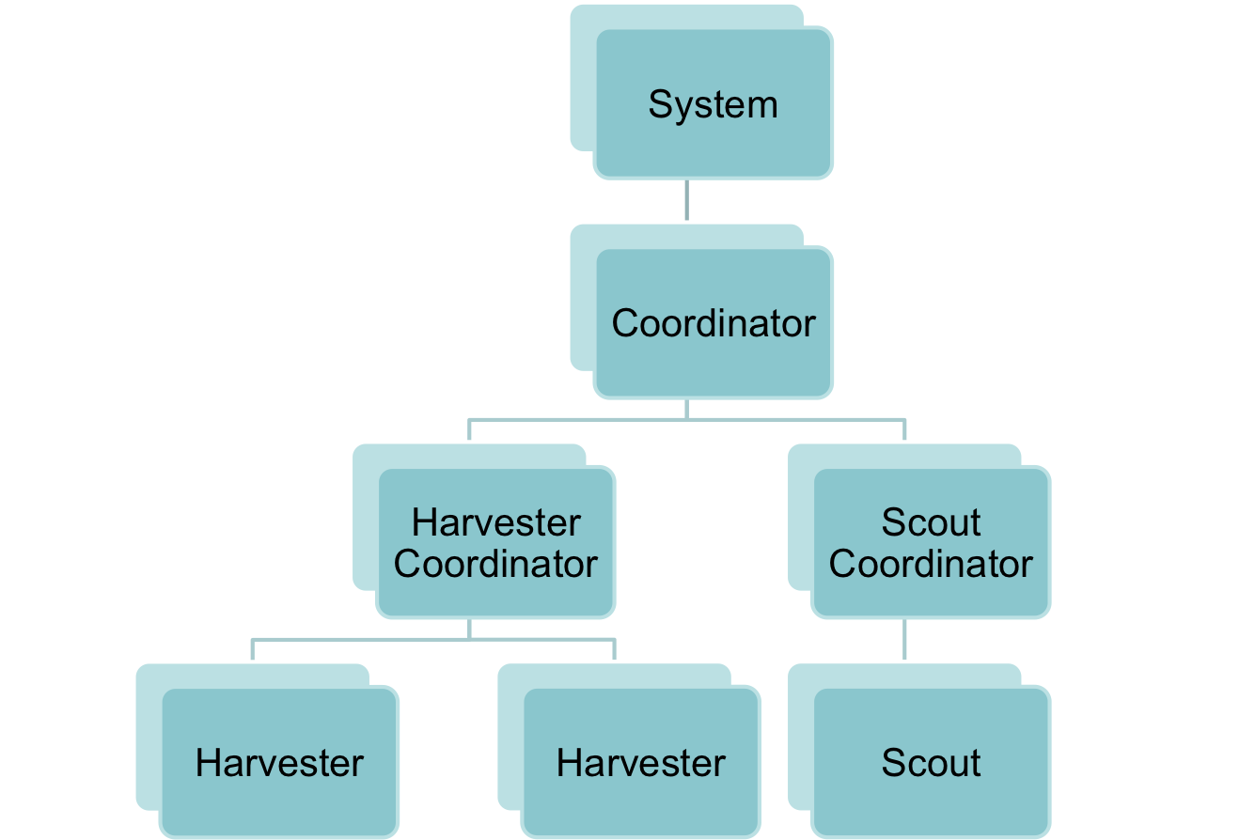


Arquitechture
Request
Contract Net
Request
Coalition
Request

Slide 3

Scout Behaviour
Scouts follow a predefined path.
Each one has a different path that will guarantee all the city will be swept.
Their behaviour is as follows:
  Go straight ahead.
  If it can go clockwise, otherwise counter clockwise.
They always react to the buildings they cross to see if there is garbage.

Slide 4
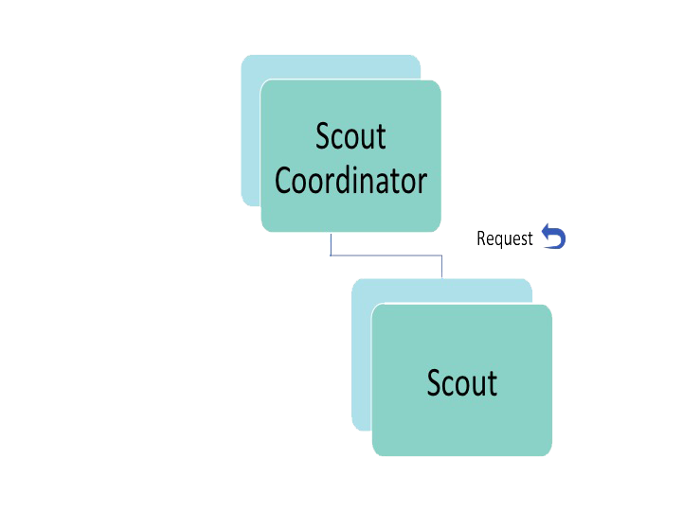
Scouts and Scout Coordinator
The scouts are constantly looking for garbage.
At the end of each step, the Scout Coordinator makes a request protocol to the scouts to inform if they found garbage in a building.

Slide 5
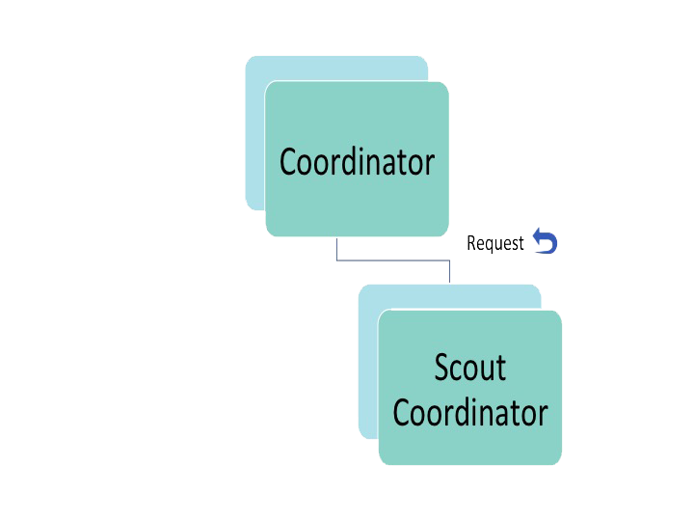
Coordinator and Scout Coordinator
The scout coordinator receives the location of the garbage found by each scout.
After very step, the scout coordinator makes a list that contains the garbage found in that step.
Then, it sends an inform protocol with the list of garbage.

Slide 6
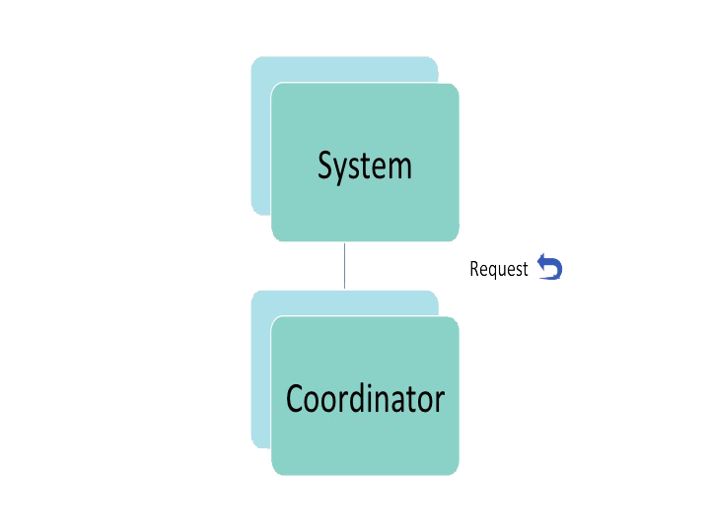
Coordinator and System Agent

Slide 7
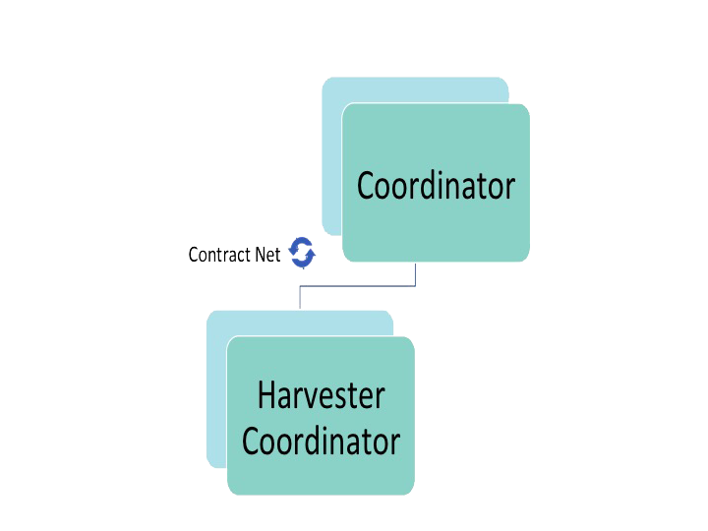
Coordinator and Harvester Coordinator
The coordinator agent creates a Contract Net with the list of garbage provided by the Coordinator Agent.
The two agents always accepts the proposal.
When the task is finished, the Coordinator agent keeps a list of garbage collected.

Slide 8
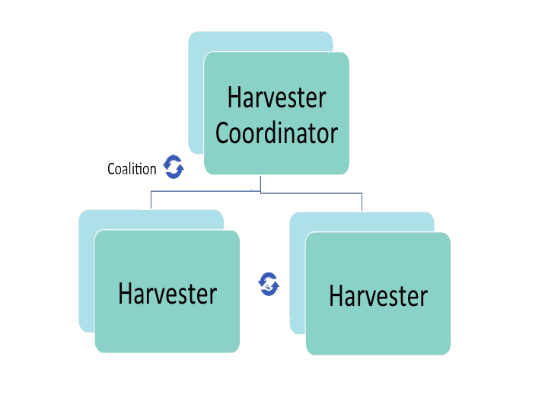
Harvester Coordinator and Harvesters
When the harvester coordinator has been assigned to a contract, it starts the coalition protocol to delegate the task to the harvesters.
The coalition is set using different criteria
Once the coalition is formed, the harvester coordinator calculates the optimal path using the algorithm Floyd Warshall.

Slide 9
Statistics

Slide 10
Q & A

