Slide 1
AWS SMART ASSET
LIFECYCLE TRACKER
COGNITO
API GATEWAY
Final project presentation
LAMBDA
Four weeks of secure serverless delivery
DYNAMODB + S3
BEDROCK + CLOUDWATCH
Emiliana Sena | October 2026

Slide 2
Project at a glance
A secure system for asset registration, financial tracking, photo analysis, and maintenance planning
PROJECT OBJECTIVE
5
13
Give each role the asset information and actions it needs while protecting private data and keeping AI output under human control.
Cognito roles with scoped access
Protected business API operations
300s
4
Authorized photo URL lifetime
Delivery milestones completed
Manual entry
Secure photo upload
Depreciation
Maintenance
Monitoring
Private asset data stays behind Cognito authentication and backend authorization.
Bedrock suggests information, while users review and correct the result before saving.
AWS SAM defines the application and CloudWatch provides operational evidence.
AWS Smart Asset Lifecycle Tracker
02

Slide 3
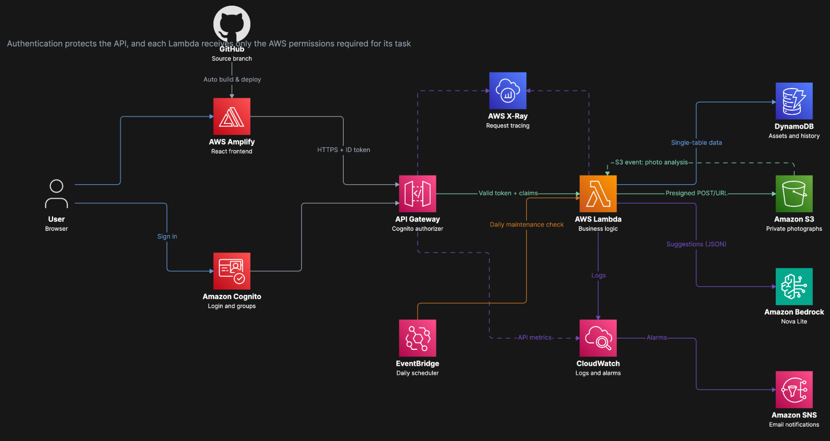
AWS solution architecture

Slide 4
Week 1: Secure foundation
The first milestone established authentication, protected APIs, asset persistence, and role scoped access
01
AWS SAM defines the API, Lambda functions, Cognito resources, DynamoDB table, and health endpoint.
The React frontend uses Amplify Authenticator for login and logout.
Asset create, list, get, and update operations validate every request.
Unique tag reservations prevent duplicate asset tags during concurrent writes.
Foundation
ADMIN
AUDITOR
MANAGER
TECHNICIAN
EMPLOYEE
All assets
Read only
Department
Department work
Assigned assets
AWS Smart Asset Lifecycle Tracker
04

Slide 5
Week 2: Secure photographs and AI analysis
Private uploads trigger Bedrock analysis, but users decide which information becomes authoritative
1
2
3
4
5
Request upload
Private S3 upload
Bedrock analysis
Human review
Create asset
Role and file rules checked
Presigned POST to pending/
Nova Lite returns JSON
Correct or enter manually
Validated data is stored
CONTROLS
S3 public access is blocked and all objects use server side encryption.
Upload and download access expires automatically.
The model can return NeedsManualEntry when the image lacks enough information.
Only assets authorized by Cognito role appear in the photo gallery.
AWS Smart Asset Lifecycle Tracker
05

Slide 6
Week 3: Depreciation and replacement planning
Application code calculates values from verified asset data
STRAIGHT LINE METHOD
Monthly depreciation
Calculated output
(purchase value − salvage value) ÷ useful life in months
Current book value
Accumulated depreciation
Monthly depreciation amount
Estimated replacement date
The calculation never reduces book value below the salvage value.
Missing or invalid legacy values return a safe unavailable result.
Unit tests cover month boundaries, useful life, salvage value, and replacement dates.
AWS Smart Asset Lifecycle Tracker
06

Slide 7
Week 3: Maintenance intelligence
Service history, deterministic schedules, and reviewed AI advice share one asset record
RECORD
MAINTENANCE#date#id
Recommendation output
IDENTITY
performedBy from Cognito
recommendedActions
riskLevel
SCHEDULE
Calculated in application code
rationale
AI ADVICE
1 to 5 validated actions
reviewStatus
Administrators manage all maintenance records. Technicians create and edit eligible records for their department.
AWS Smart Asset Lifecycle Tracker
07

Slide 8
Week 4: Security and operational readiness
Seven required controls were tested in the application and against the deployed AWS environment
01
Login required
02
401 response
Signed-out users see Cognito login
Missing or invalid token is rejected
03
Auditor blocked
04
Private photos
Read-only role cannot modify assets
Direct S3 access returns 403
05
Authorized photos
06
No secrets in code
Scoped request returns a 300-second URL
Tokens and credentials stay outside source
07
Input validation
Malformed and unsupported input is rejected
AWS Smart Asset Lifecycle Tracker
08

Slide 9
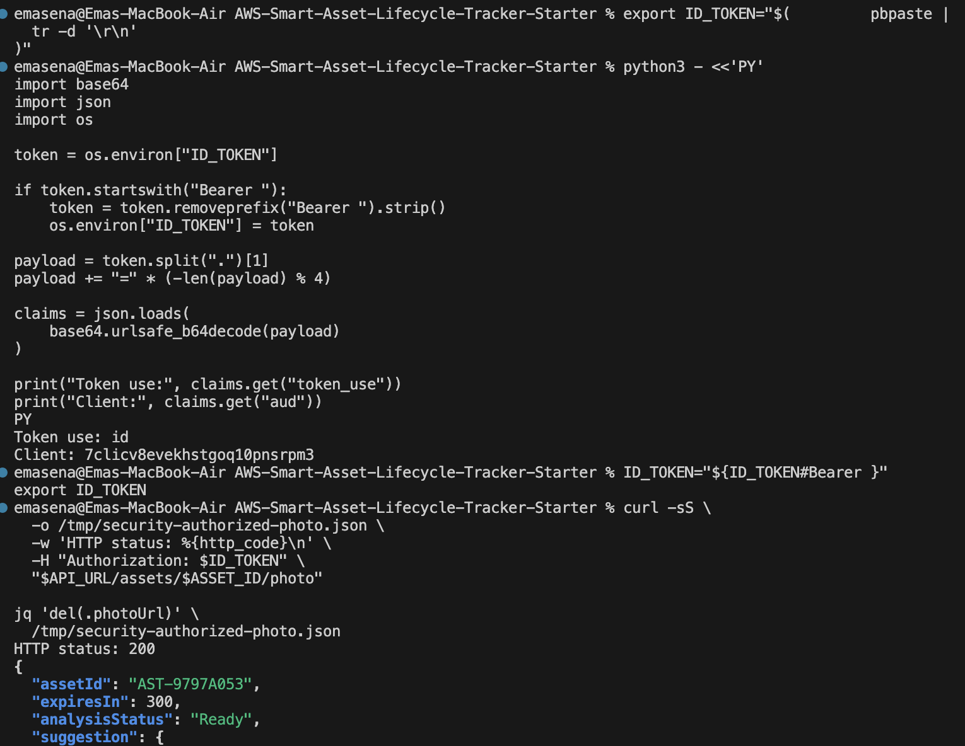
Security evidence: Cognito ID token
What the test proves
The API request uses a Cognito ID token. The decoded claim shows token_use: id before the authorized photo request runs.
PASS
Token contents were checked locally without storing the token in source control.
Week 4 security evidence
09

Slide 10
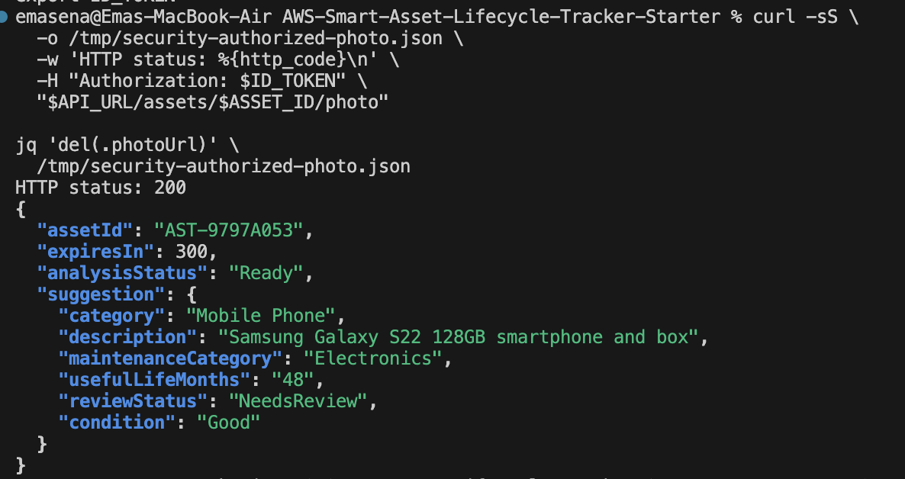
Security evidence: Authorized photo access
The backend authorizes the asset before returning temporary access to the private image
HTTP 200
The authenticated request returned the asset analysis and expiresIn: 300. The photo URL was removed from the displayed evidence.
300
seconds
Short-lived access limits exposure while allowing authorized users to view the photograph.
Week 4 security evidence
10

Slide 11
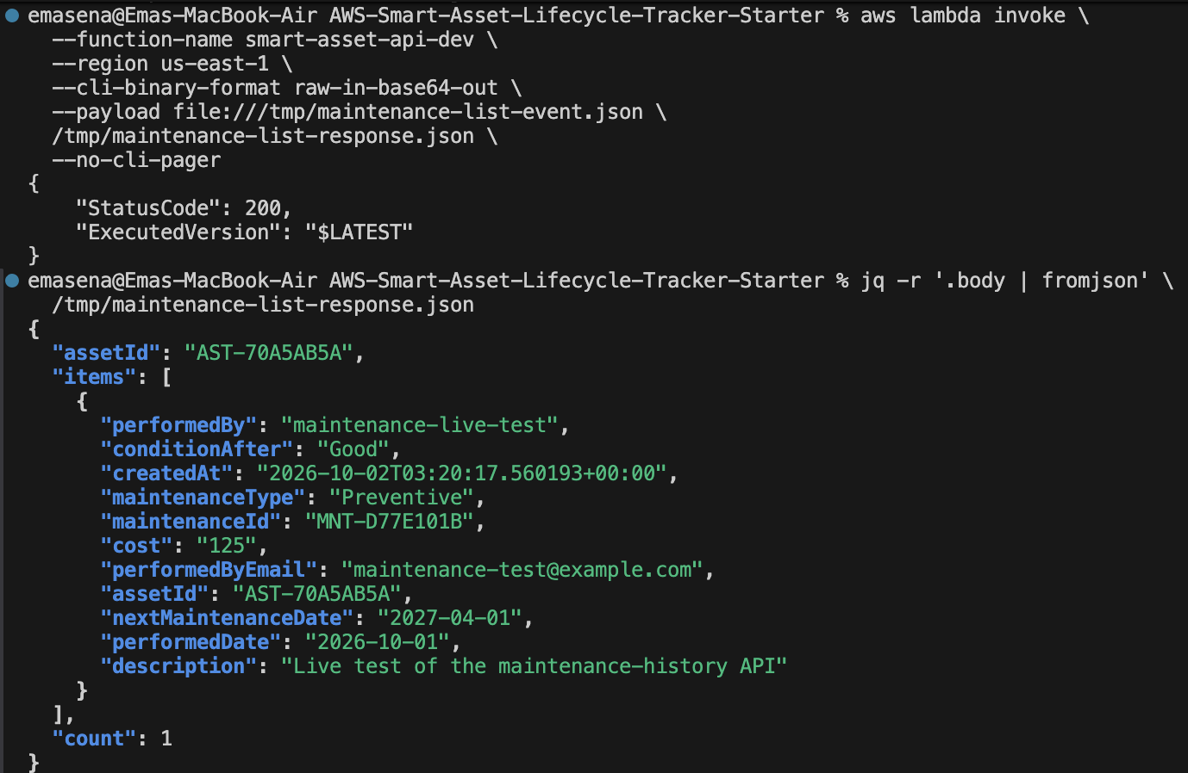
Security evidence: Maintenance identity
The maintenance API returns a record whose performer identity came from authenticated server-side context
Lambda status 200
The response includes maintenanceId, performedDate, cost, condition, and performedByEmail.
performedBy
Trusted Cognito identity
The client cannot select another user as the service performer.
Week 4 security evidence
11

Slide 12
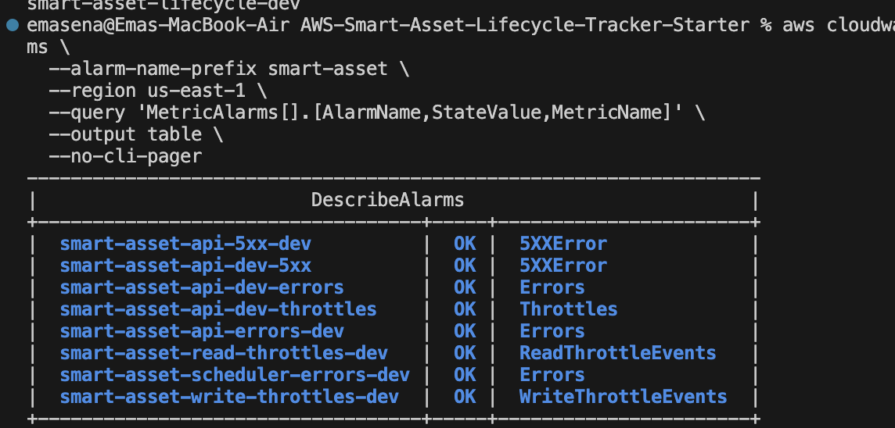
Operational evidence: CloudWatch alarms
All listed alarms: OK
The monitored signals include API 5XX errors, Lambda errors, throttles, scheduler errors, and DynamoDB read/write throttles.
8
alarm checks
CloudWatch dashboard, X-Ray tracing, SNS actions, and defined log retention support operations after deployment.
Week 4 monitoring evidence
12

Slide 13
Testing and deployment evidence
Automated tests, infrastructure validation, and production builds supported the final release
169
5
2
0
Backend tests passed during final integration
Week 4 security requirement tests passed
DynamoDB indexes verified ACTIVE
Unresolved conflict markers after cleanup
Python modules compiled successfully and the full test suites covered roles, photos, depreciation, maintenance, AI validation, scheduling, and security.
AWS SAM validate and SAM build completed successfully.
The Vite production build completed successfully. The bundle-size message remained a non-blocking optimization recommendation.
CloudFormation updated smart-asset-tracker-dev in us-east-1, and Amplify deploys the main branch.
AWS Smart Asset Lifecycle Tracker
13

Slide 14
Final demonstration sequence
The demonstration moves from denied access to authenticated lifecycle management and monitored logout
1
Signed-out access blocked
2
Cognito login
3
Manual asset
4
Photo asset
5
AI review
6
Manual fallback
7
Depreciation
8
Maintenance record
9
AI recommendation
10
Restricted action
11
CloudWatch
12
Logout
Each step produces visible evidence of a required project capability.
AWS Smart Asset Lifecycle Tracker
14

Slide 15
Project complete
WORKING APP
The application now protects asset data, supports lifecycle decisions, and provides operational evidence in AWS.
main.dx980x98nt3d5
.amplifyapp.com
Cognito-protected application and APIs
Private photographs with temporary authorized access
Human-reviewed Bedrock analysis and recommendations
Depreciation and maintenance lifecycle tracking
CloudWatch monitoring and security test evidence
TEAM REPOSITORY
PellizzoniCode/saltracker
Thank you

