Slide 1
WEEK 3
Depreciation and
maintenance intelligence
AWS Smart Asset Lifecycle Tracker
Book value automation • maintenance history • Bedrock recommendations • scheduled alerts
3 October 2026
AWS Region us-east-1

Slide 2
Week 3 milestone achieved
The application now turns asset age and condition into financial and maintenance decisions
Live
Daily
Role-aware
Human review
straight-line book value
scheduled maintenance check
history and recommendations
required for AI guidance
01
Financial lifecycle
03
Actionable intelligence
Purchase value, salvage value, useful life and in-service date produce current book value, life used and replacement date.
Deterministic schedules and Bedrock advice identify cleaning, maintenance and replacement priorities.
02
Maintenance record
04
Proactive notification
Authorized technicians and administrators add preventive or corrective work to the asset history.
EventBridge runs the daily check and SNS emails a summary of overdue and upcoming work.
AWS Smart Asset Lifecycle Tracker | Week 3
02

Slide 3
Straight-line depreciation
A deterministic calculation keeps financial values explainable and testable
Month-aware age
Monthly depreciation
A month counts only after the monthly anniversary; future service dates create no depreciation.
(purchase value − salvage value) ÷ useful-life months
Book value never falls below salvage value.
End-of-life protection
Assets older than useful life stop at salvage value instead of becoming negative.
Example asset
Replacement forecast
Useful life is added to the in-service date, including end-of-month handling.
Purchase value
$1,500
Salvage value
$100
Useful life
48 months
After 24 months
$800 book value
AWS Smart Asset Lifecycle Tracker | Week 3
03

Slide 4
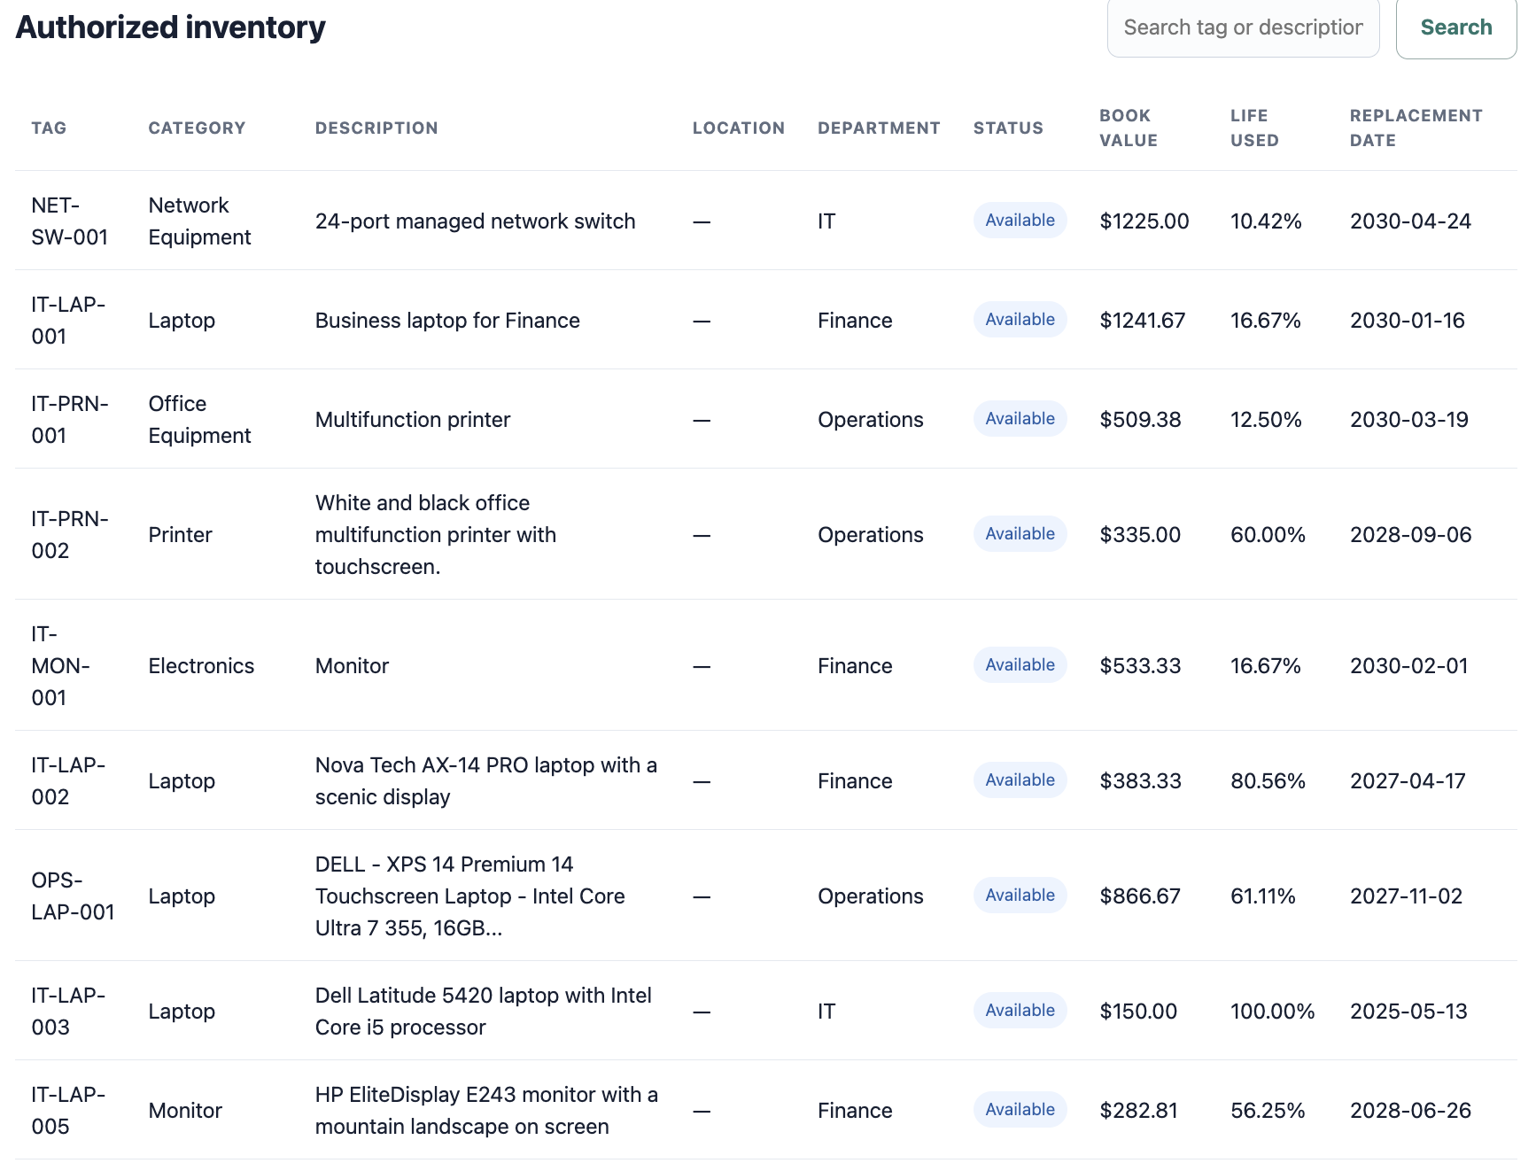
Lifecycle values in the inventory
Every authorized asset can display current book value, life used and estimated replacement date
No manual spreadsheet
Values are calculated by the API from the asset record.
Visible aging
Life-used percentage makes asset age comparable across categories.
Replacement planning
Forecast dates support budgeting before assets reach end of life.
AWS Smart Asset Lifecycle Tracker | Week 3
04

Slide 5









Week 3 AWS architecture
Secure asset lifecycle management with depreciation, maintenance intelligence and scheduled alerts
AWS Cloud us-east-1
APPLICATION REQUEST
USER
App
HTTPS
JWT
Invoke
Browser
AWS Amplify
Amazon Cognito
API Gateway
Asset API Lambda
React frontend
Identity and JWT claims
Cognito authorizer
Authorization and lifecycle logic
Read / write
Invoke model
Presign URL
Amazon DynamoDB
Amazon Bedrock
Amazon S3
Query asset history
Assets and maintenance history
Nova Lite recommendations
Private asset photos
DAILY MAINTENANCE AUTOMATION
✉
Trigger
Publish maintenance summary
Notification email
Operations email
EventBridge
Scheduler Lambda
Amazon SNS
Daily schedule
Checks due dates
Email notification
AWS Smart Asset Lifecycle Tracker | Week 3
05

Slide 6
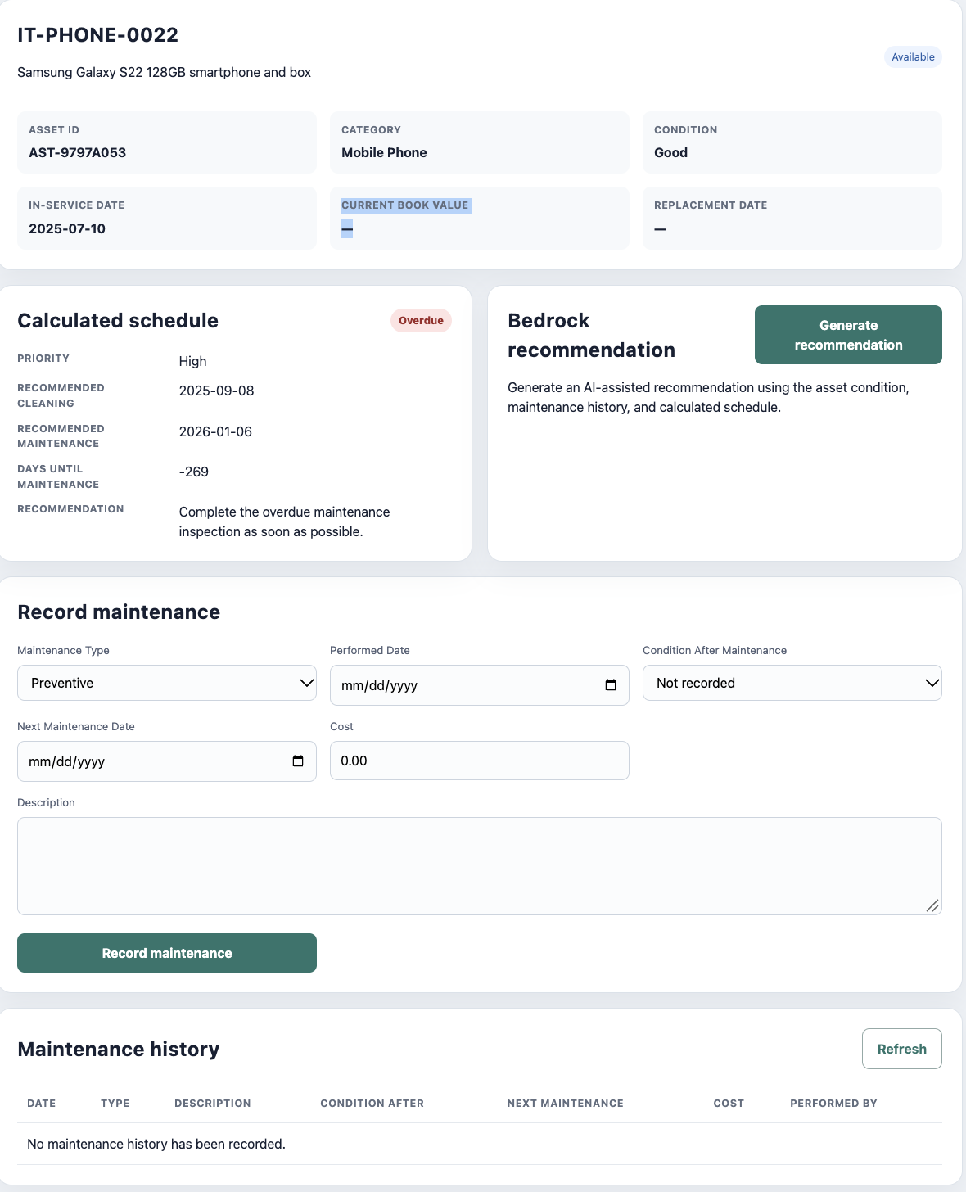
Maintenance workspace
One asset page combines schedule, history capture and AI-assisted recommendations
01
Calculated schedule
Condition and maintenance history determine cleaning and service dates, priority and status.
02
Record work
Authorized roles capture type, date, post-maintenance condition, cost and next date.
03
Generate guidance
Bedrock receives a minimized, server-selected context and returns actions, risk and rationale.
AI output is advisory and remains marked NeedsReview.
AWS Smart Asset Lifecycle Tracker | Week 3
06

Slide 7
Daily maintenance alert flow
EventBridge turns lifecycle rules into a proactive operations queue
EventBridge rule
Daily
Scheduler Lambda
Evaluate
Deterministic engine
Publish
Amazon SNS
cron(0 13 * * ? *)
Loads all asset pages and maintenance history
Current • Due soon • Overdue
One concise summary message
Notification policy
Overdue
Due soon
Current
Maintenance date has passed; include immediately.
Approaching the configured maintenance horizon.
No email entry; avoid alert fatigue.
Amazon CloudWatch logs each run; AWS X-Ray traces Lambda execution.
AWS Smart Asset Lifecycle Tracker | Week 3
07

Slide 8
Security, testing and delivery
Week 3 extends the existing security boundary instead of moving decisions into the browser
Server-side authorization
Week 3 result
Cognito claims and asset scope are checked before maintenance reads, writes, AI requests or photo URLs.
The tracker automatically displays an asset’s depreciated value and produces a reasonable maintenance or replacement recommendation.
Least-privilege IAM
Lambda roles receive only the DynamoDB, Bedrock, S3 or SNS actions required by their function.
Coverage across edge cases
Tests include future dates, end-of-month replacement, salvage floors, damaged assets and overdue schedules.
Ready for demonstration
Deployment validation
Python compilation, unit tests, SAM lint/build and the Vite production build validate the release path.
Inventory → View maintenance → Record history → Generate recommendation → Review scheduled alert
AWS Smart Asset Lifecycle Tracker | Week 3
08

