Slide 1
The Purchasing Power
of the Tech Worker
A Data Warehousing project: from three heterogeneous sources to OLAP answers
Emanuele Smisi · Fabrizio Pietrobono
Data Management A.Y. 2025/26 — Sapienza University of Rome
Notes:
Introduce yourselves. One sentence: we built a data warehouse that answers where a tech salary actually buys the most, integrating survey, geographic and cost-of-living data. Agenda implicit: sources, design, ETL, results, demo.

Slide 2
The business question
Where does a tech salary buy the most?
A nominal salary is a misleading signal: 60,000 $ in Zurich and in Buenos Aires are two different lives. To compare countries fairly, salaries must be adjusted for the local cost of living, and that requires integrating data nobody publishes together.
65,437
3
69
survey responses collected
(Stack Overflow 2024)
heterogeneous sources
integrated via ETL
countries with statistically
usable samples
The Purchasing Power of the Tech Worker · 2
Notes:
Motivation: comparing tech salaries across countries is meaningless in nominal terms. Our DW adjusts by cost of living. The three numbers: raw volume, sources, final analyzable coverage.

Slide 3
Three sources, three roles
Stack Overflow Survey 2024
ISO Country Mapping
Cost of Living Index 2024
PRIMARY → the facts
MASTER → the canonical key
CONTEXT → the adjustment
65,437 responses × 114 columns
Grain: one respondent
Measure: ConvertedCompYearly (USD)
Individual attributes → dimensions
249 countries, ISO alpha-3 codes
Grain: one country
Hierarchy: country → sub-region → region
Anchor for all name reconciliation
121 countries (Numbeo, NY = 100)
Grain: one country
Cost of living, rent, purchasing power
Enables the adjusted measure
No source alone can answer the question, the value is in the integration.
The Purchasing Power of the Tech Worker · 3
Notes:
One sentence per source. Stress the ROLES: facts / canonical geographic master / context. The master exists because country names are fragile join keys — next slides.

Slide 4
Source profiling → explicit cleaning rules
Every rule is documented, motivated, and implemented in the ETL. No silent cleaning.
Valid compensation only
keep respondents with ConvertedCompYearly → 23,435 of 65,437 (35.8%)
Outlier trimming, 1st–99th pct
self-reported pay from 1 $ to 16.2 M$ — keep 222 → 398,026 $ (22,909 facts)
R1
R2
Industry: 'Unknown' member
31.8% nulls that become an explicit dimension member, no fact is lost
Country threshold at query time
n ≥ 30 enforced in OLAP (HAVING), never in ETL → the DW keeps full grain
R3
R4
Documented exclusions
'Nomadic' (not a country) and Kosovo (no ISO code): 8 respondents total
Master validated and fixed
row named 'South Korea' carried PRK (North Korea!) → renamed, joins on codes
R5
R6
The Purchasing Power of the Tech Worker · 4
Notes:
Profiling found: implausible self-reported salaries (trim), a heavy-null dimension (Unknown member), and an error inside the geographic master itself (Korea). R4 is a principle: the warehouse never loses information; analytical thresholds live in queries. Median 65k vs mean 86k also motivated median aggregation.

Slide 5
The central ETL challenge: country-name reconciliation
Stack Overflow
country names: 21 variants mapped
('United States of America', 'Viet Nam'…)
ISO master
canonical key: alpha-3
all joins happen on codes, never on names
Cost of Living
country names: 5 variants mapped
('Hong Kong (China)', 'South Korea'…)
105 / 185
SO names matching the cost-of-living source without cleaning → the miss list included the heaviest countries (USA: 4,677 respondents, UK: 1,391)
100%
coverage after reconciliation: all 69 relevant countries matched, verified end-to-end (every mapping target checked, applied result re-checked)
KOR ≠ PRK
the master itself had a bug: a row named 'South Korea' carrying North Korea's code → names fail silently in both directions, codes don't
The Purchasing Power of the Tech Worker · 5
Notes:
Names are the only shared attribute across the three sources — but they are fragile keys. Strategy: converge both sources onto the ISO master once, then join on alpha-3. Tell the Korea story: it proves even the master must be validated. False negatives (Viet Nam vs Vietnam) AND false positives (South Korea/PRK).

Slide 6
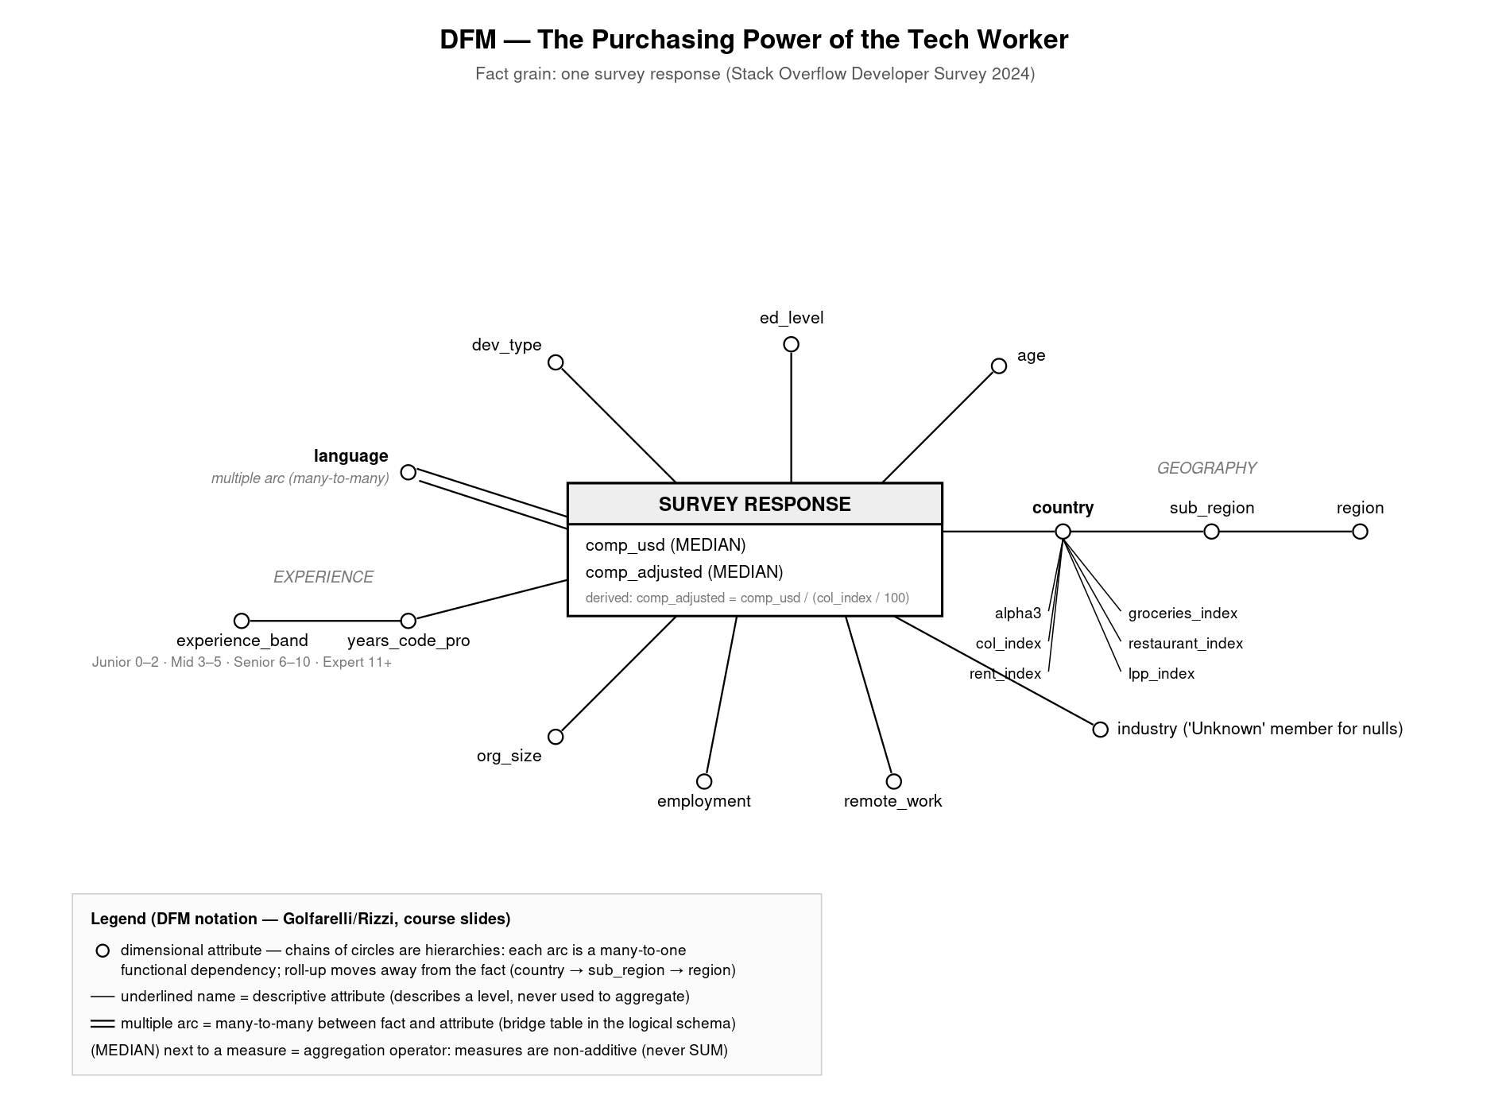
Conceptual design: the Dimensional Fact Model
Grain
one survey response: the finest available; aggregating is always possible, disaggregating never
Measures (MEDIAN)
comp_usd and derived comp_adjusted = comp_usd / (COL/100). Non-additive: never SUM
Hierarchies
country → sub-region → region: each arc a verified many-to-one functional dependency
Multiple arc
languages are many-to-many (5.3 per respondent) → bridge table, double-counting declared
The Purchasing Power of the Tech Worker · 6
Notes:
DFM in official Golfarelli-Rizzi notation: circles = dimensional attributes, underlined = descriptive attributes (ISO code and Numbeo indices on country), (MEDIAN) = aggregation operator declaring non-additivity, double line = multiple arc. Decision D1: indices at country grain live as descriptive attributes; the adjusted measure is pre-computed in ETL.

Slide 7
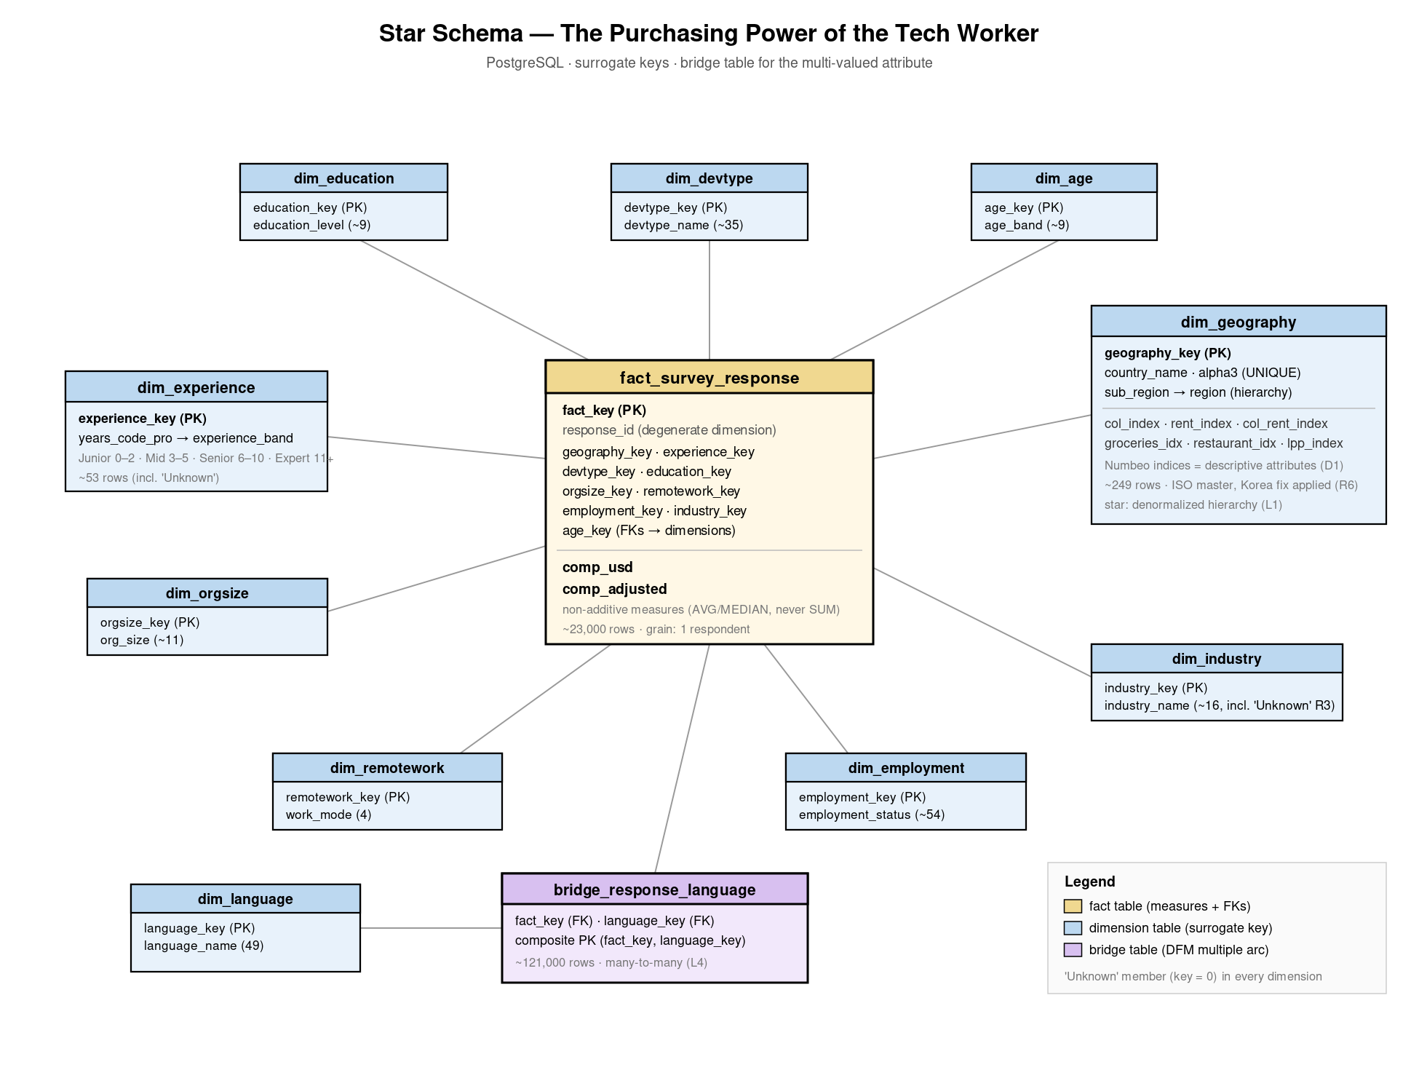
Logical design: star schema on PostgreSQL
Star, not snowflake
hierarchies denormalized in the dimension tables: redundancy is harmless in a read-only, ETL-loaded DW and queries need fewer joins
Surrogate keys
integer keys generated in ETL; natural keys (alpha-3) kept as attributes. Source-independent joins, uniform 'Unknown' member (key 0)
Bridge table
121,055 rows realize the many-to-many with languages
Degenerate dimension
response_id kept in the fact table for lineage back to the source CSV
The Purchasing Power of the Tech Worker · 7
Notes:
Fact table ~23k rows with FKs to 10 dimensions + two measures; 12 tables total. Why star: normalization protects against update anomalies, which cannot occur in a warehouse written only by controlled ETL — so we trade harmless redundancy for simpler, faster queries.

Slide 8
ETL: a single idempotent Python pipeline
EXTRACT
kagglehub download
3 sources, cached
TRANSFORM
rules R1–R6
mappings · banding
derived measure
LOAD
dimensions → facts
→ bridge (FK order)
QUALITY CHECK
row counts · NULL audit
smoke-test query
Idempotent by design — every run rebuilds the schema from scratch (DROP SCHEMA … CASCADE) → re-running N times yields the same warehouse. No manual updates, ever: the DW is non-volatile.
Load order = referential integrity — dimensions first, then facts, then the bridge: every foreign key must point to an existing surrogate key. FKs are declared and enforced. ETL violations are impossible by construction.
Every transformation is traceable — each code block cites the documented rule it implements (R1–R6, D1–D3, L1–L6). 22,909 facts loaded; 140 facts keep comp_adjusted NULL (countries without a cost index); kept, not deleted.
The Purchasing Power of the Tech Worker · 8
Notes:
Walk the four stages. Idempotence: rule of reproducibility. Load order: FK integrity. If asked what breaks loading facts first: FK violations — the DDL makes wrong ETL impossible. QC prints expected counts and a smoke-test ranking straight after load.

Slide 9
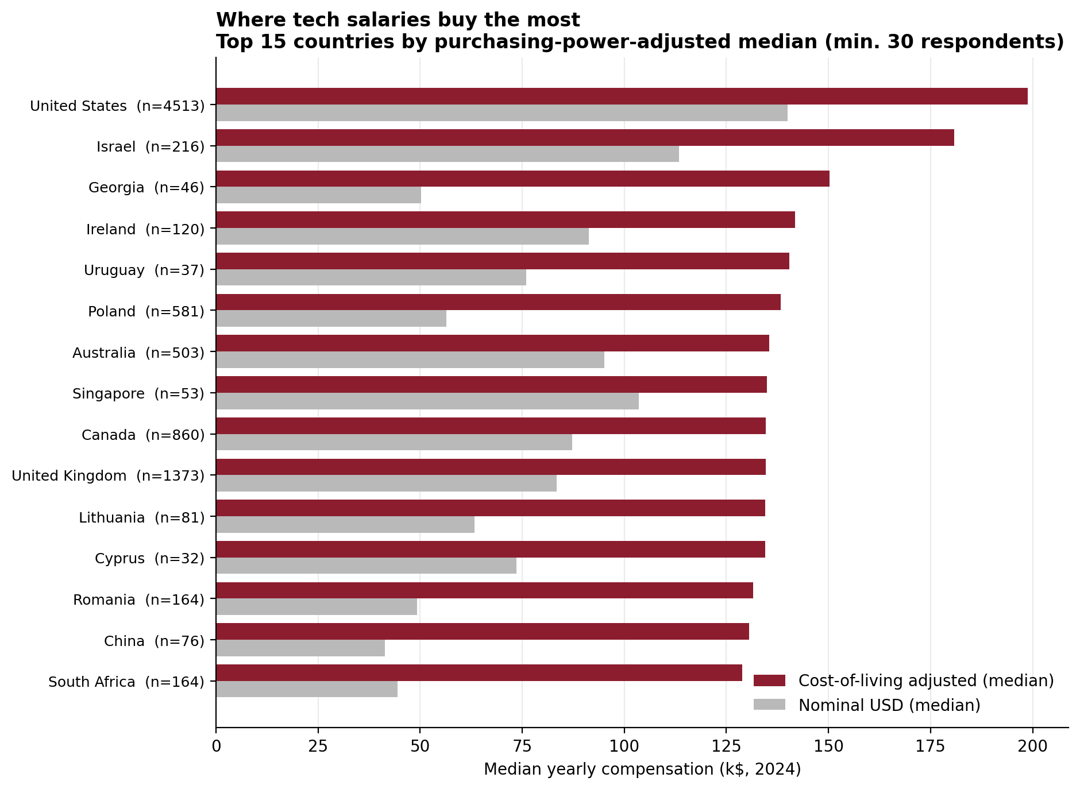
The answer: where salaries buy the most
199k$
US adjusted median — first even in real terms
Below the top, the ranking reshuffles completely: Georgia 3rd, Poland 6th → ahead of Canada and the UK.
Median, not mean: measures are non-additive and the distribution is right-skewed.
Sample sizes always displayed (threshold n ≥ 30, rule R4).
The Purchasing Power of the Tech Worker · 9
Notes:
Q1, percentile_cont with HAVING n>=30. The US stays first, but everything below changes vs the nominal ranking. Georgia n=46: above threshold yet flagged — honesty scores points.

Slide 10
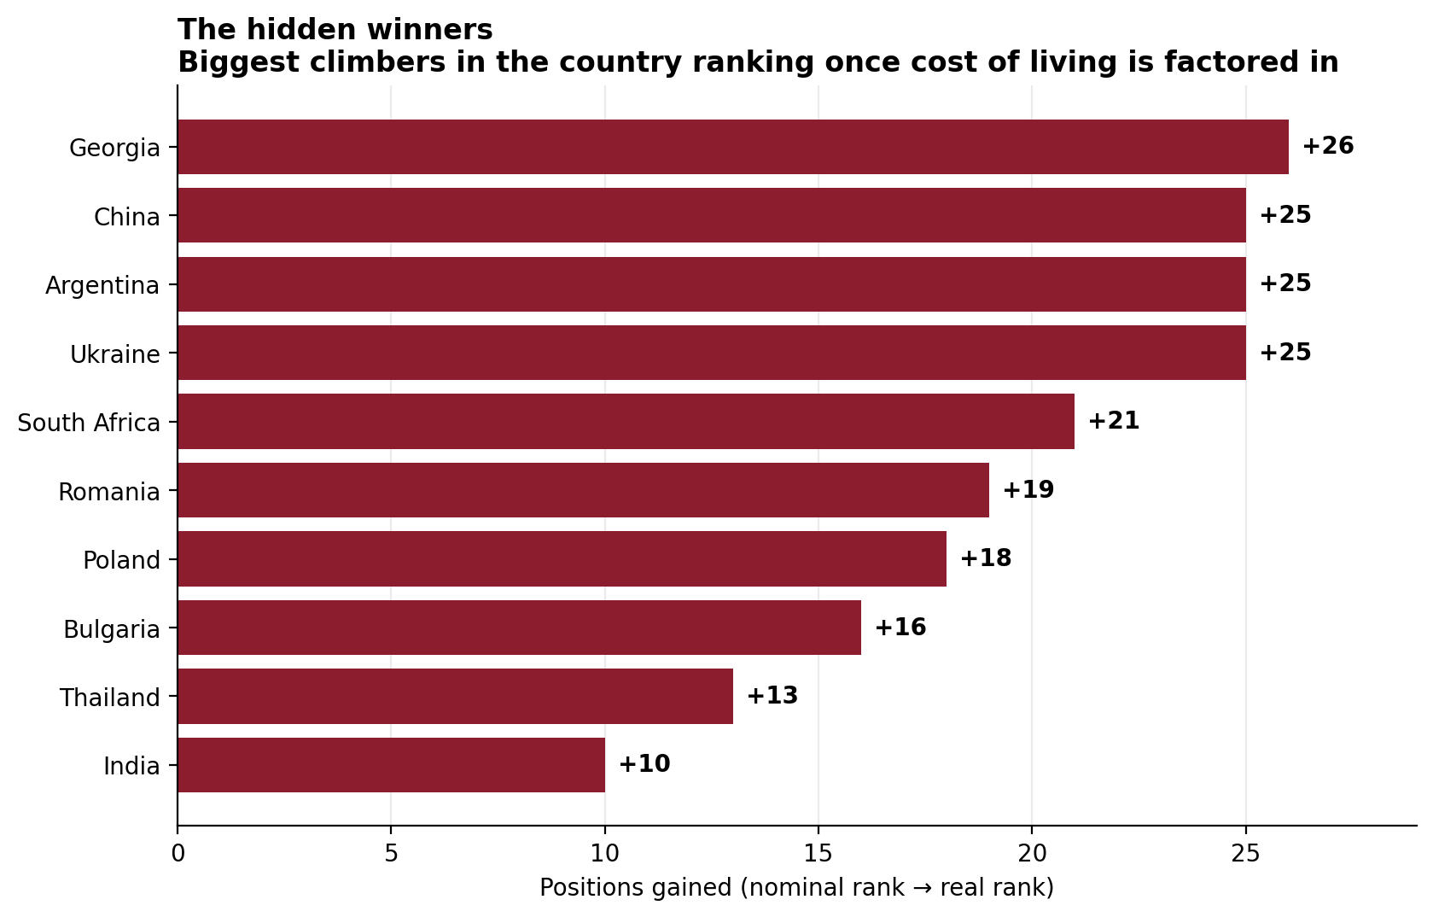
The hidden winners
+26
positions gained by Georgia (nominal → real rank)
China, Argentina and Ukraine climb 25 positions each → Ukraine with a rock-solid n = 1,410.
The phenomenon is invisible in raw data: mid salaries + low cost of living beat high salaries + high costs.
Window functions (RANK) over the same warehouse. No reload needed.
The Purchasing Power of the Tech Worker · 10
Notes:
Q2, RANK() OVER on nominal vs adjusted medians. This is 'the phenomenon not explicitly evident from the data' the project brief asks for. Ukraine's n makes it statistically strong.

Slide 11
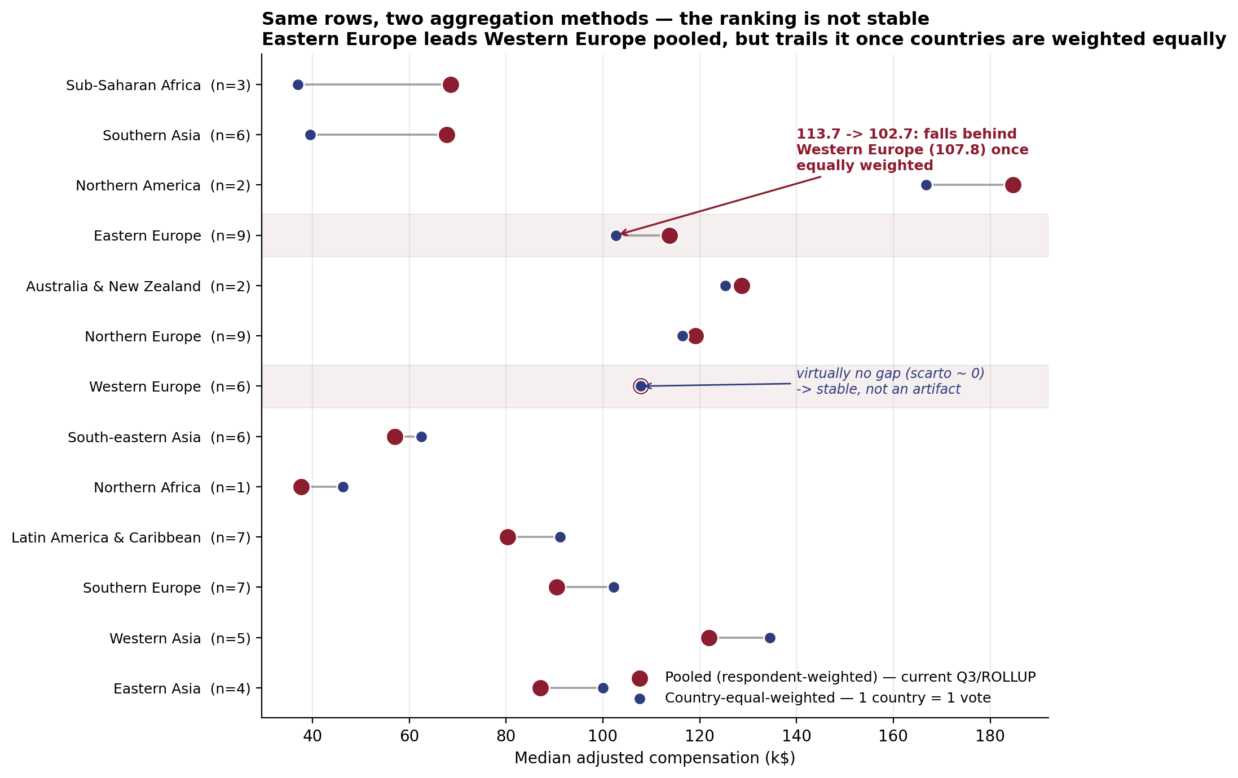
Roll-up, stress-tested: does the geography really flip?
E < W
not "E > W" as the first pass (pooled) suggested
GROUP BY ROLLUP on the pooled fact rows said Eastern Europe overtakes the West: 113.7 k$ vs 107.8 k$
But pooling implicitly weights each country by its Stack Overflow respondent count, not by anything real.
Re-computing with one median per country, then a median of those medians (Q9): Eastern Europe drops to 102.7 k$; Western Europe barely moves (107.8 k$, scarto ~ 0 → its 6 countries have comparable samples, so pooling doesn't distort it there).
Same direction at world level: pooled median 120.7 k$ falls to 102.2 k$ equally weighted. Both queries stay in the workload, documented; they answer different questions, and only one supports the headline we almost wrote.
The Purchasing Power of the Tech Worker · 11
Notes:
This is the critical-thinking moment, not just a SQL trick: we drafted a claim from Q3/ROLLUP, then designed Q9 specifically to stress-test it — and it failed. Western Europe's scarto ~ 0 is the control case: it proves the effect is a real sampling artifact, not a query bug, since a sub-region with balanced country samples is untouched. If asked why not just switch to equal-weighting everywhere: the two methods answer different questions — 'what does the typical respondent see' (pooled) vs 'what does the typical country look like' (equal-weighted) — and we kept both, documented, rather than picking the one that made the better headline.

Slide 12
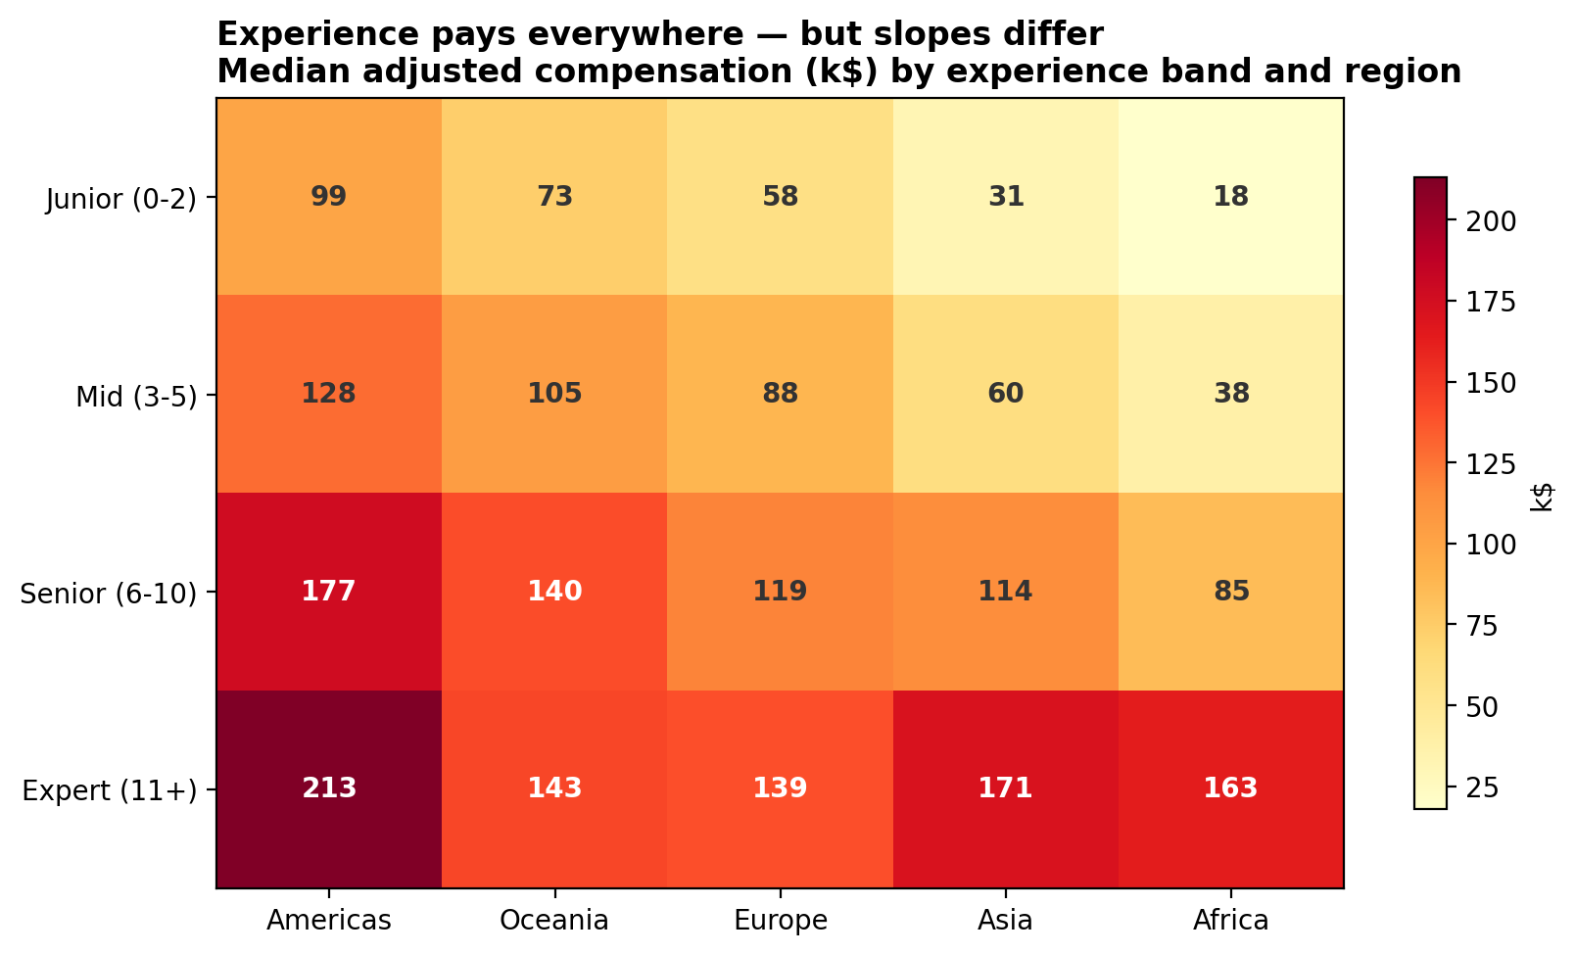
Experience pays with very different slopes
9×
junior → expert multiplier in Africa (18k → 163k)
The seniority gradient exists everywhere, but emerging markets reward experience far more: Asia ~5.5×, Americas ~2.2×.
Expert medians in Asia (170.8k) and Africa (163.2k) approach the Americas.
Dice on two dimensions: experience band × region.
The Purchasing Power of the Tech Worker · 12
Notes:
Q4. The banding (Junior/Mid/Senior/Expert) is a designed hierarchy over YearsCodePro — thresholds documented, changeable without touching facts. Steepest slopes in emerging markets.

Slide 13
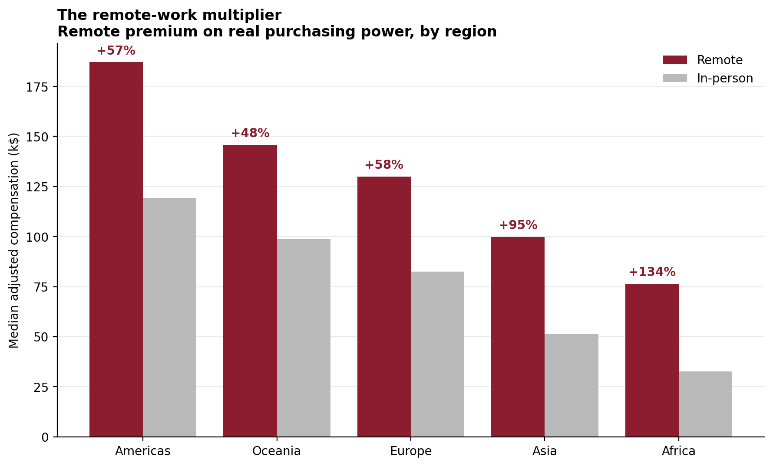
The remote-work multiplier
+134%
remote premium on real purchasing power in Africa
Remote work decouples the salary from the local market but not from the local cost of living.
The premium grows where costs are lowest: +57% Americas, +95% Asia, +134% Africa.
Conditional aggregates side by side (FILTER clause).
The Purchasing Power of the Tech Worker · 13
Notes:
Q6, FILTER conditional medians. This is the mechanism behind the hidden winners: remote pay + low local costs. Tie back to slide 10.

Slide 14
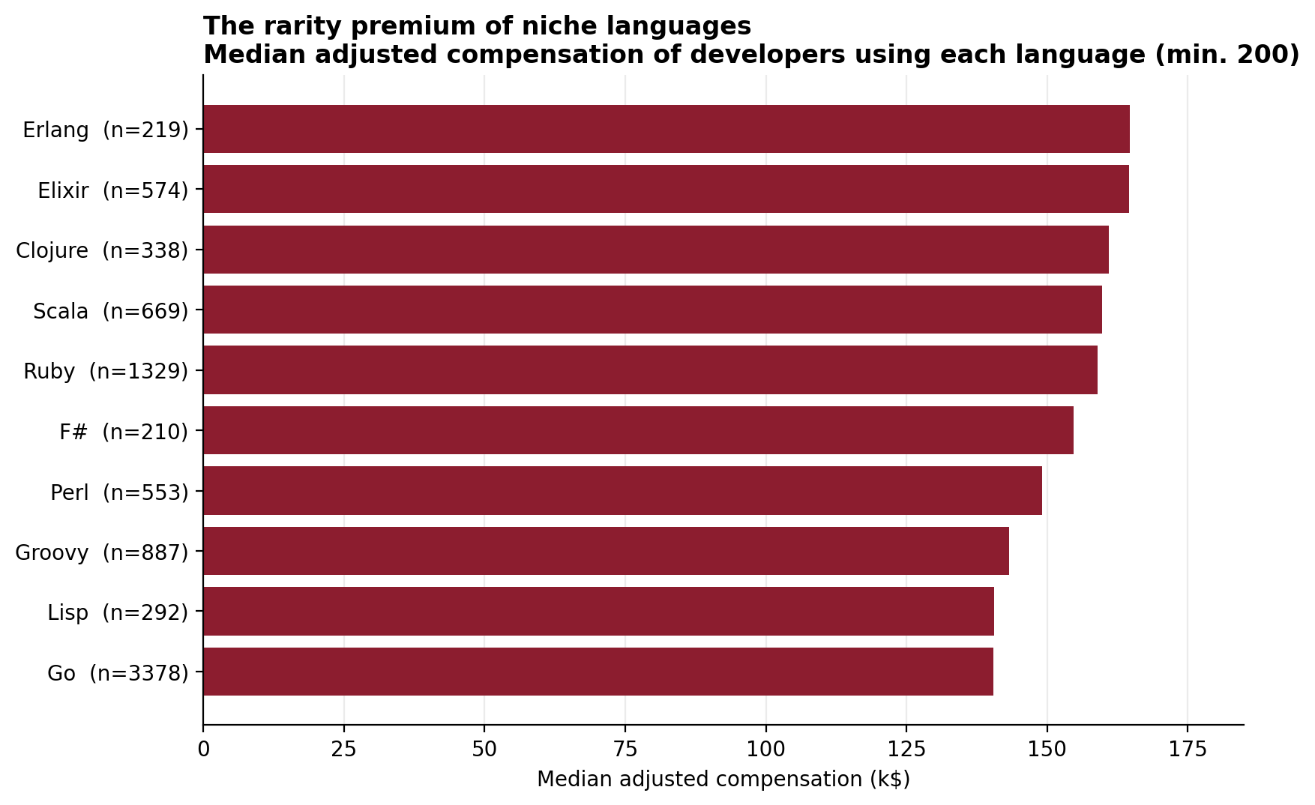
Through the bridge: language premiums
5.28
languages per respondent → the many-to-many the bridge resolves
Niche and functional languages top the ranking (Erlang, Elixir, Clojure): a rarity/seniority premium, not causation.
Double-counting guard: each respondent contributes to every language they use; medians per group are legitimate, sums across groups are not.
121,055 bridge rows queried through two joins.
The Purchasing Power of the Tech Worker · 14
Notes:
Q7. Declare the double-counting rule before anyone asks. And say 'correlation, not causation' about Erlang — it defuses the obvious objection.

Slide 15
What we would not claim — declared limitations
Self-reported data
salaries are respondent-declared; mitigated by percentile trimming (R2), not eliminated
1
Small samples at the top
Georgia n=46, Uruguay n=37: above threshold, still fragile → the pattern is confirmed by large samples (Poland 581, Ukraine 1,410)
2
Country-grain indices
cost of living is national: Tbilisi ≠ the Georgian average, San Francisco ≠ the US average
3
A 2024 snapshot
all sources are single-year: cross-country comparison, deliberately no time dimension
4
The Purchasing Power of the Tech Worker · 15
Notes:
State limitations before being asked — it demonstrates critical awareness. Each one has a mitigation: trimming, thresholds + large-sample confirmation, explicit caveat, deliberate design choice.

Slide 16
Conclusions
Cost of living redraws the geography of tech work, but headline regional claims can be artifacts of how you aggregate; remote work is the one multiplier that holds up under every weighting we tried.
Three sources that never met became one consistent star schema → reconciled on ISO codes, cleaned by six documented rules, loaded by one idempotent pipeline.
Every number in this deck is one SQL query away, as the live demo is about to show.
Live demo: the warehouse answering in real time (5 minutes)
Notes:
Close in under 30 seconds and hand over to the demo: 'let us show you the warehouse answering live'. The demo script takes over from here (D1→D5).

