Slide 1
The Purchasing Power
of the Tech Worker
A Data Warehousing project — from three heterogeneous sources to OLAP answers
Emanuele Smisi · Fabrizio Pietrobono
Data Management A.Y. 2025/26 — Sapienza University of Rome
Notes:
Introduce yourselves. One sentence: we built a data warehouse that answers where a tech salary actually buys the most, integrating survey, geographic and cost-of-living data. Agenda implicit: sources, design, ETL, results, demo.

Slide 2
The business question
Where does a tech salary buy the most?
A nominal salary is a misleading signal: 60,000 $ in Zurich and in Buenos Aires are two different lives. To compare countries fairly, salaries must be adjusted for the local cost of living — and that requires integrating data nobody publishes together.
65,437
3
69
survey responses collected
(Stack Overflow 2024)
heterogeneous sources
integrated via ETL
countries with statistically
usable samples
The Purchasing Power of the Tech Worker · 2
Notes:
Motivation: comparing tech salaries across countries is meaningless in nominal terms. Our DW adjusts by cost of living. The three numbers: raw volume, sources, final analyzable coverage.

Slide 3
Three sources, three roles
Stack Overflow Survey 2024
ISO Country Mapping
Cost of Living Index 2024
PRIMARY — the facts
MASTER — the canonical key
CONTEXT — the adjustment
65,437 responses × 114 columns
Grain: one respondent
Measure: ConvertedCompYearly (USD)
Individual attributes → dimensions
249 countries, ISO alpha-3 codes
Grain: one country
Hierarchy: country → sub-region → region
Anchor for all name reconciliation
121 countries (Numbeo, NY = 100)
Grain: one country
Cost of living, rent, purchasing power
Enables the adjusted measure
No source alone can answer the question — the value is in the integration.
The Purchasing Power of the Tech Worker · 3
Notes:
One sentence per source. Stress the ROLES: facts / canonical geographic master / context. The master exists because country names are fragile join keys — next slides.

Slide 4
Source profiling → explicit cleaning rules
Every rule is documented, motivated, and implemented in the ETL — no silent cleaning.
Valid compensation only
keep respondents with ConvertedCompYearly — 23,435 of 65,437 (35.8%)
Outlier trimming, 1st–99th pct
self-reported pay from 1 $ to 16.2 M$ — keep 222 → 398,026 $ (22,909 facts)
R1
R2
Industry: 'Unknown' member
31.8% nulls — nulls become an explicit dimension member, no fact is lost
Country threshold at query time
n ≥ 30 enforced in OLAP (HAVING), never in ETL — the DW keeps full grain
R3
R4
Documented exclusions
'Nomadic' (not a country) and Kosovo (no ISO code) — 8 respondents total
Master validated and fixed
row named 'South Korea' carried PRK (North Korea!) — renamed, joins on codes
R5
R6
The Purchasing Power of the Tech Worker · 4
Notes:
Profiling found: implausible self-reported salaries (trim), a heavy-null dimension (Unknown member), and an error inside the geographic master itself (Korea). R4 is a principle: the warehouse never loses information; analytical thresholds live in queries. Median 65k vs mean 86k also motivated median aggregation.

Slide 5
The central ETL challenge: country-name reconciliation
Stack Overflow
country names — 21 variants mapped
('United States of America', 'Viet Nam'…)
ISO master
canonical key: alpha-3
all joins happen on codes, never on names
Cost of Living
country names — 5 variants mapped
('Hong Kong (China)', 'South Korea'…)
105 / 185
SO names matching the cost-of-living source without cleaning — the miss list included the heaviest countries (USA: 4,677 respondents, UK: 1,391)
100%
coverage after reconciliation: all 69 relevant countries matched, verified end-to-end (every mapping target checked, applied result re-checked)
KOR ≠ PRK
the master itself had a bug: a row named 'South Korea' carrying North Korea's code — names fail silently in both directions, codes don't
The Purchasing Power of the Tech Worker · 5
Notes:
Names are the only shared attribute across the three sources — but they are fragile keys. Strategy: converge both sources onto the ISO master once, then join on alpha-3. Tell the Korea story: it proves even the master must be validated. False negatives (Viet Nam vs Vietnam) AND false positives (South Korea/PRK).

Slide 6
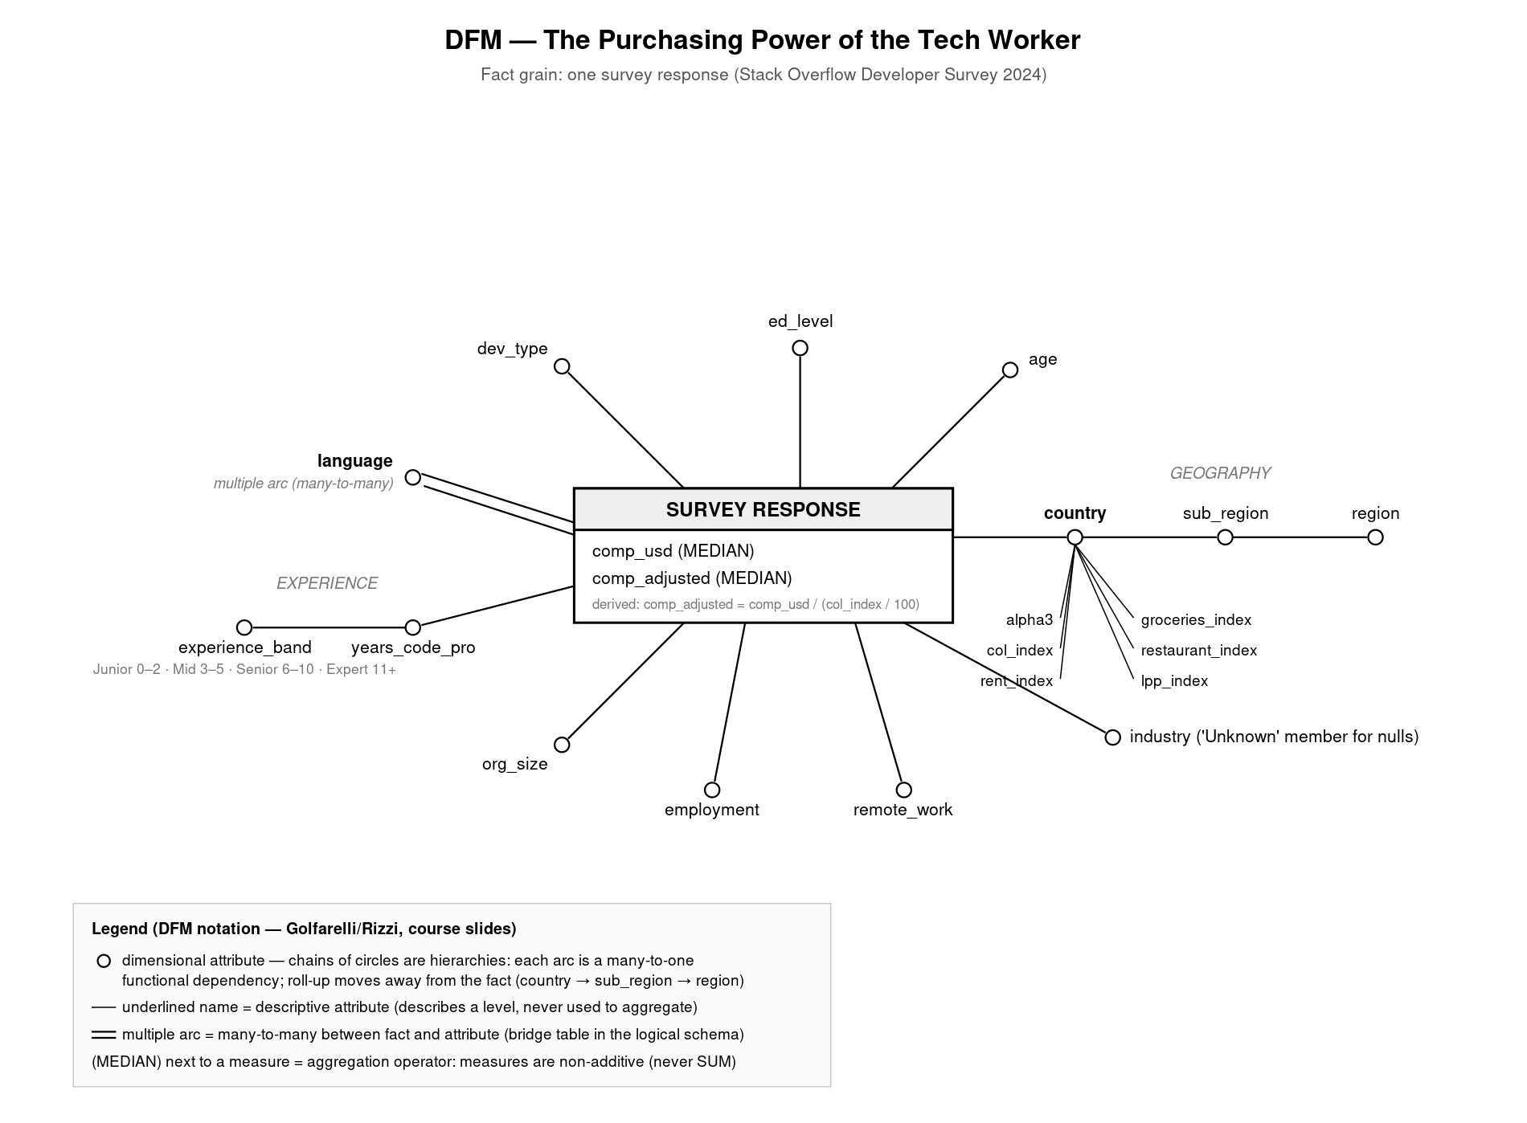
Conceptual design — the Dimensional Fact Model
Grain
one survey response — the finest available; aggregating is always possible, disaggregating never
Measures (MEDIAN)
comp_usd and derived comp_adjusted = comp_usd / (COL/100). Non-additive: never SUM
Hierarchies
country → sub-region → region: each arc a verified many-to-one functional dependency
Multiple arc
languages are many-to-many (5.3 per respondent) → bridge table, double-counting declared
The Purchasing Power of the Tech Worker · 6
Notes:
DFM in official Golfarelli-Rizzi notation: circles = dimensional attributes, underlined = descriptive attributes (ISO code and Numbeo indices on country), (MEDIAN) = aggregation operator declaring non-additivity, double line = multiple arc. Decision D1: indices at country grain live as descriptive attributes; the adjusted measure is pre-computed in ETL.

Slide 7
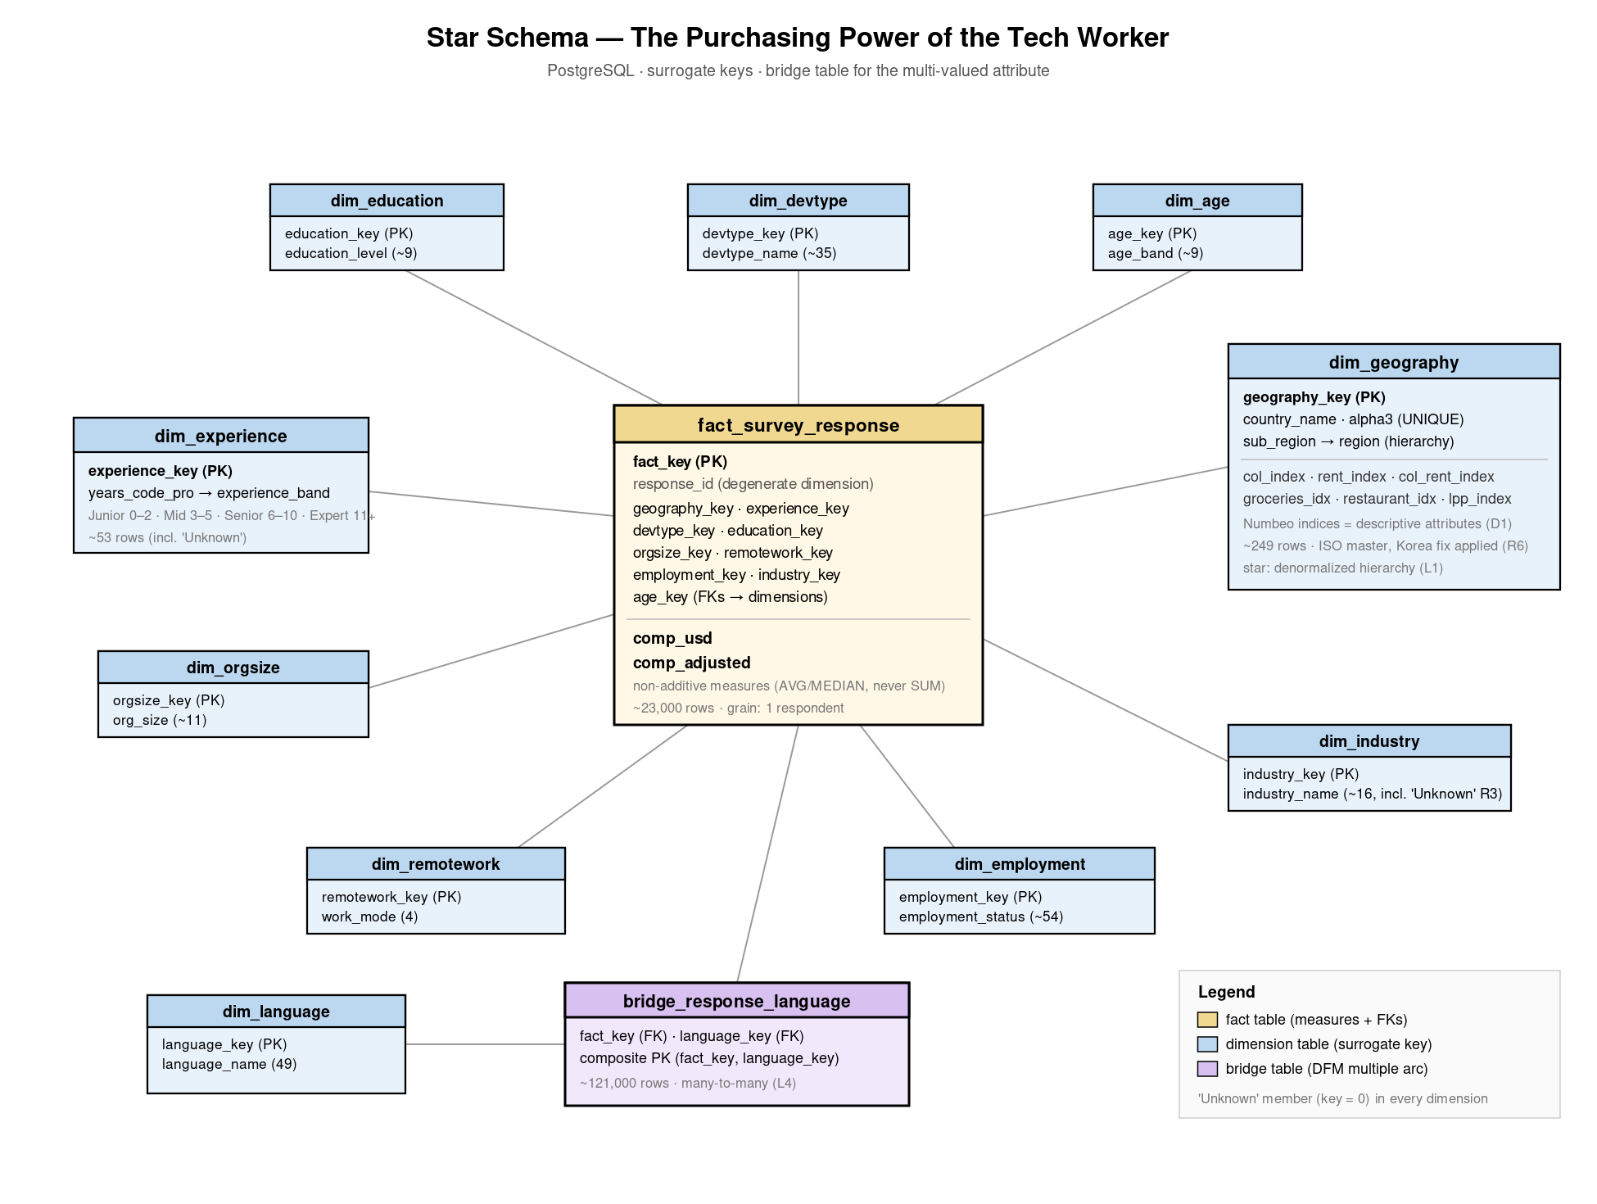
Logical design — star schema on PostgreSQL
Star, not snowflake
hierarchies denormalized in the dimension tables: redundancy is harmless in a read-only, ETL-loaded DW — and queries need fewer joins
Surrogate keys
integer keys generated in ETL; natural keys (alpha-3) kept as attributes. Source-independent joins, uniform 'Unknown' member (key 0)
Bridge table
121,055 rows realize the many-to-many with languages
Degenerate dimension
response_id kept in the fact table for lineage back to the source CSV
The Purchasing Power of the Tech Worker · 7
Notes:
Fact table ~23k rows with FKs to 10 dimensions + two measures; 12 tables total. Why star: normalization protects against update anomalies, which cannot occur in a warehouse written only by controlled ETL — so we trade harmless redundancy for simpler, faster queries.

Slide 8
ETL — a single idempotent Python pipeline
EXTRACT
kagglehub download
3 sources, cached
TRANSFORM
rules R1–R6
mappings · banding
derived measure
LOAD
dimensions → facts
→ bridge (FK order)
QUALITY CHECK
row counts · NULL audit
smoke-test query
Idempotent by design — every run rebuilds the schema from scratch (DROP SCHEMA … CASCADE) — re-running N times yields the same warehouse. No manual updates, ever: the DW is non-volatile.
Load order = referential integrity — dimensions first, then facts, then the bridge: every foreign key must point to an existing surrogate key. FKs are declared and enforced — ETL violations are impossible by construction.
Every transformation is traceable — each code block cites the documented rule it implements (R1–R6, D1–D3, L1–L6). 22,909 facts loaded; 140 facts keep comp_adjusted NULL (countries without a cost index) — kept, not deleted.
The Purchasing Power of the Tech Worker · 8
Notes:
Walk the four stages. Idempotence: rule of reproducibility. Load order: FK integrity. If asked what breaks loading facts first: FK violations — the DDL makes wrong ETL impossible. QC prints expected counts and a smoke-test ranking straight after load.

Slide 9
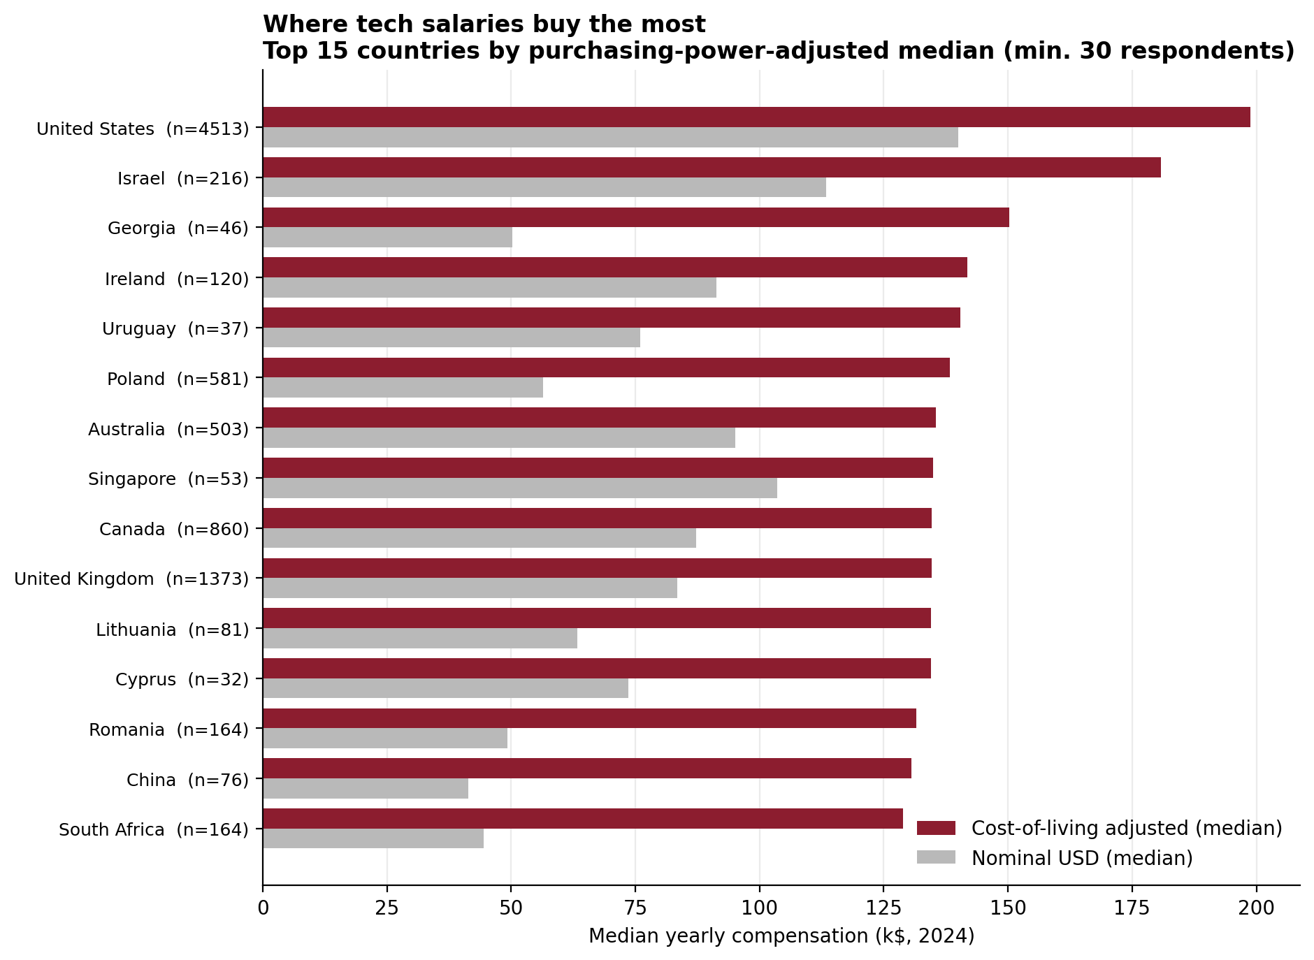
The answer: where salaries buy the most
199k$
US adjusted median — first even in real terms
Below the top, the ranking reshuffles completely: Georgia 3rd, Poland 6th — ahead of Canada and the UK.
Median, not mean: measures are non-additive and the distribution is right-skewed.
Sample sizes always displayed (threshold n ≥ 30, rule R4).
The Purchasing Power of the Tech Worker · 9
Notes:
Q1, percentile_cont with HAVING n>=30. The US stays first, but everything below changes vs the nominal ranking. Georgia n=46: above threshold yet flagged — honesty scores points.

Slide 10
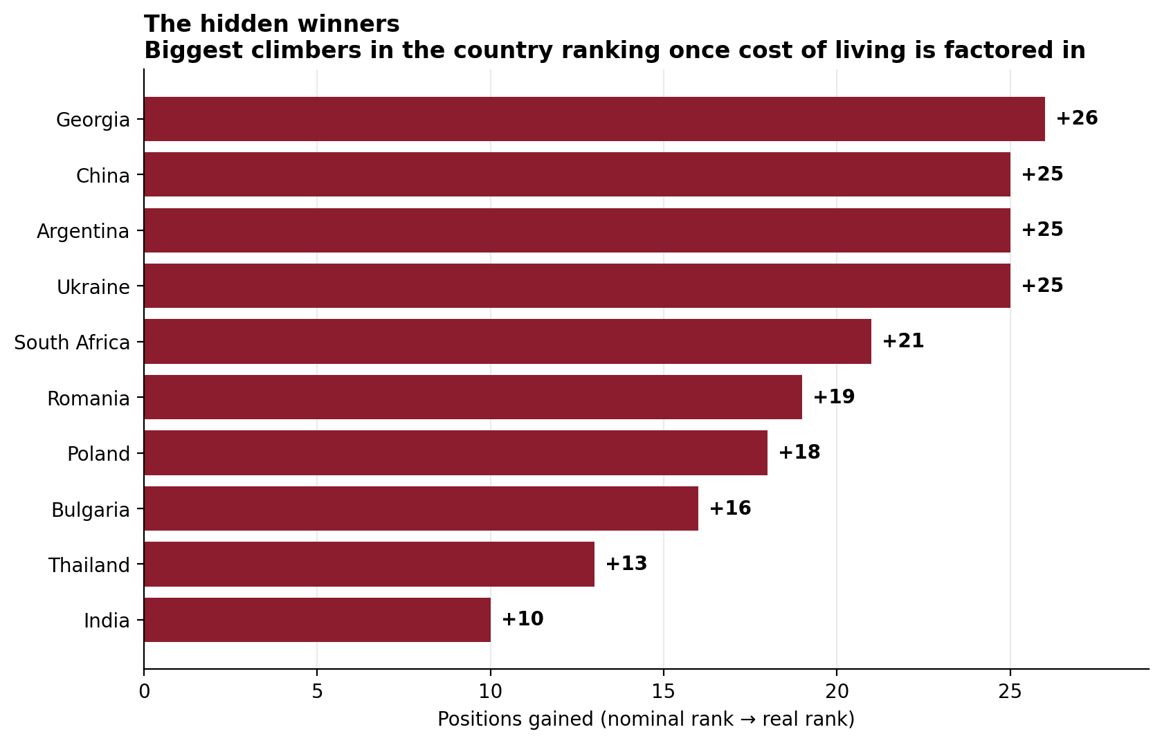
The hidden winners
+26
positions gained by Georgia (nominal → real rank)
China, Argentina and Ukraine climb 25 positions each — Ukraine with a rock-solid n = 1,410.
The phenomenon is invisible in raw data: mid salaries + low cost of living beat high salaries + high costs.
Window functions (RANK) over the same warehouse — no reload needed.
The Purchasing Power of the Tech Worker · 10
Notes:
Q2, RANK() OVER on nominal vs adjusted medians. This is 'the phenomenon not explicitly evident from the data' the project brief asks for. Ukraine's n makes it statistically strong.

Slide 11
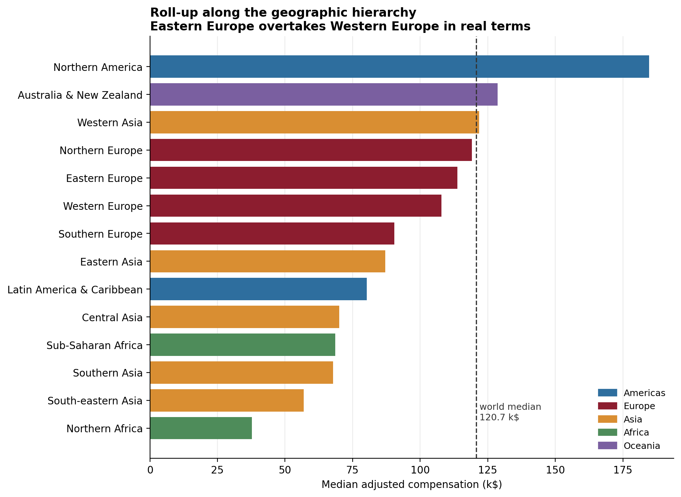
Roll-up: the geography flips
E > W
Eastern Europe overtakes Western Europe in real terms
113.7 k$ vs 107.8 k$ median adjusted: the roll-up along the DFM hierarchy reveals it in one query (GROUP BY ROLLUP).
Northern America stands alone at 184.7 k$; world median 120.7 k$.
Melanesia (n = 2) excluded — the threshold rule at work.
The Purchasing Power of the Tech Worker · 11
Notes:
Q3: this is the theory moment — ROLLUP mirrors the country→sub-region→region hierarchy designed in the DFM. Say explicitly: conceptual design and querying reconnect here.

Slide 12
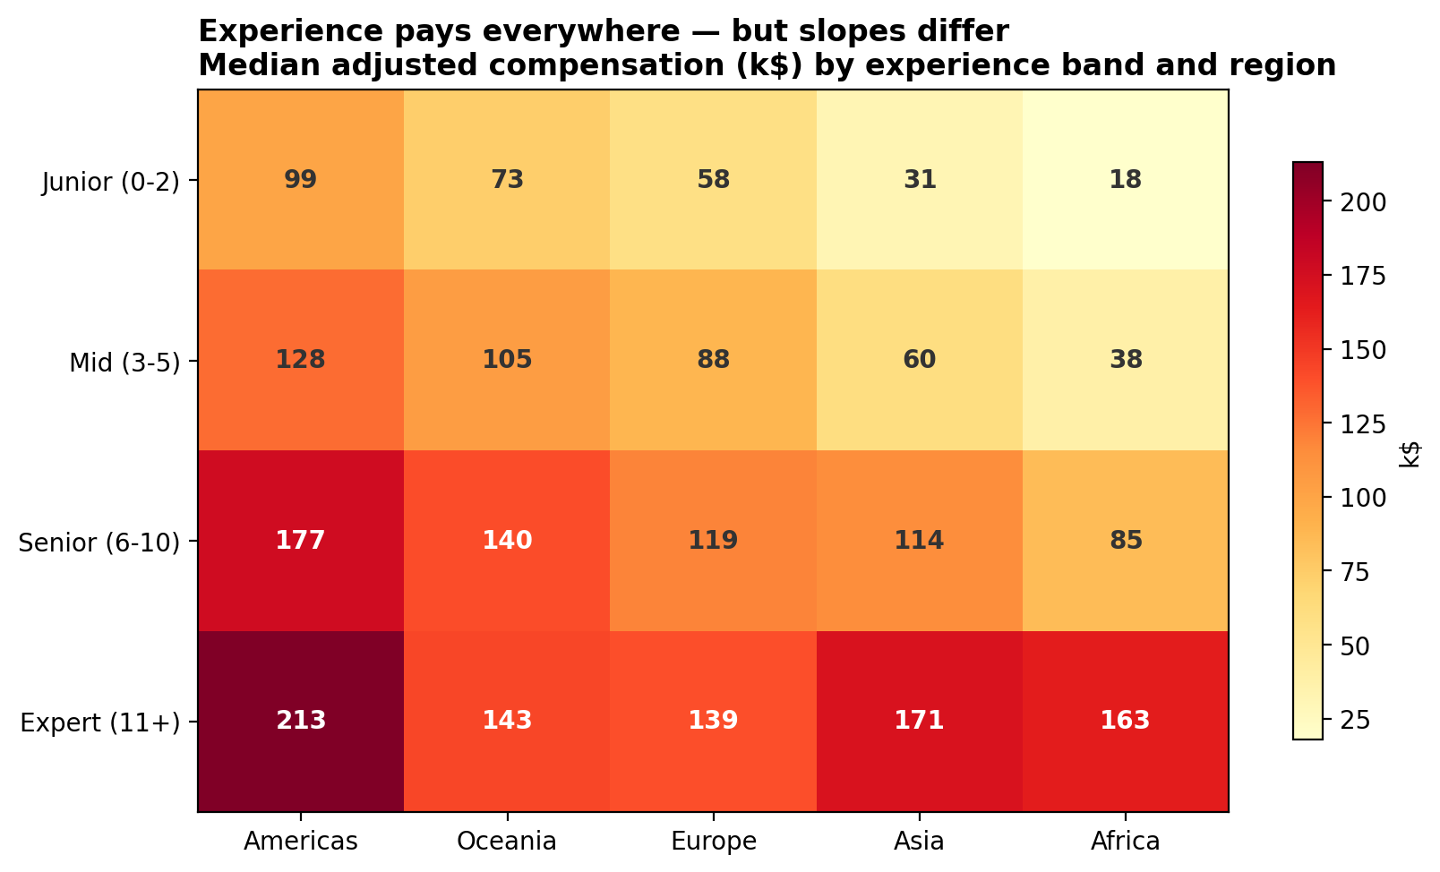
Experience pays — with very different slopes
9×
junior → expert multiplier in Africa (18k → 163k)
The seniority gradient exists everywhere, but emerging markets reward experience far more: Asia ~5.5×, Americas ~2.2×.
Expert medians in Asia (170.8k) and Africa (163.2k) approach the Americas.
Dice on two dimensions: experience band × region.
The Purchasing Power of the Tech Worker · 12
Notes:
Q4. The banding (Junior/Mid/Senior/Expert) is a designed hierarchy over YearsCodePro — thresholds documented, changeable without touching facts. Steepest slopes in emerging markets.

Slide 13
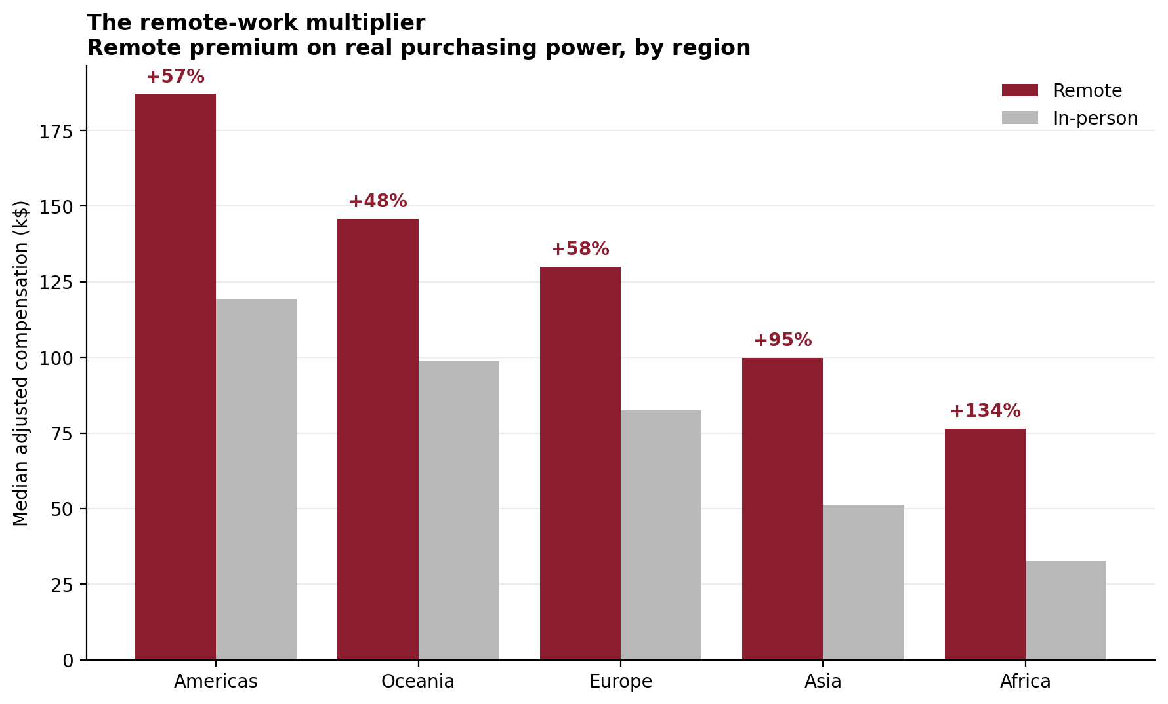
The remote-work multiplier
+134%
remote premium on real purchasing power in Africa
Remote work decouples the salary from the local market — but not from the local cost of living.
The premium grows where costs are lowest: +57% Americas, +95% Asia, +134% Africa.
Conditional aggregates side by side (FILTER clause).
The Purchasing Power of the Tech Worker · 13
Notes:
Q6, FILTER conditional medians. This is the mechanism behind the hidden winners: remote pay + low local costs. Tie back to slide 10.

Slide 14
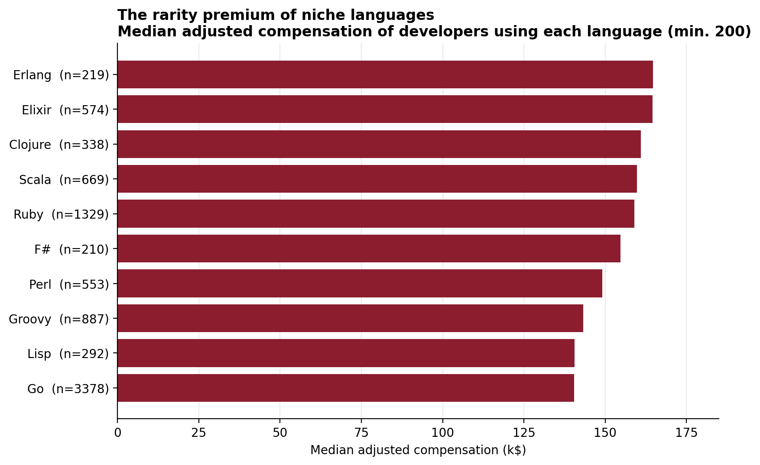
Through the bridge: language premiums
5.28
languages per respondent — the many-to-many the bridge resolves
Niche and functional languages top the ranking (Erlang, Elixir, Clojure): a rarity/seniority premium, not causation.
Double-counting guard: each respondent contributes to every language they use — medians per group are legitimate, sums across groups are not.
121,055 bridge rows queried through two joins.
The Purchasing Power of the Tech Worker · 14
Notes:
Q7. Declare the double-counting rule before anyone asks. And say 'correlation, not causation' about Erlang — it defuses the obvious objection.

Slide 15
What we would not claim — declared limitations
Self-reported data
salaries are respondent-declared; mitigated by percentile trimming (R2), not eliminated
1
Small samples at the top
Georgia n=46, Uruguay n=37: above threshold, still fragile — the pattern is confirmed by large samples (Poland 581, Ukraine 1,410)
2
Country-grain indices
cost of living is national: Tbilisi ≠ the Georgian average, San Francisco ≠ the US average
3
A 2024 snapshot
all sources are single-year: cross-country comparison, deliberately no time dimension
4
The Purchasing Power of the Tech Worker · 15
Notes:
State limitations before being asked — it demonstrates critical awareness. Each one has a mitigation: trimming, thresholds + large-sample confirmation, explicit caveat, deliberate design choice.

Slide 16
Conclusions
Cost of living redraws the geography of tech work: Eastern Europe overtakes the West in real terms, and remote work is the multiplier that makes it possible.
Three sources that never met became one consistent star schema — reconciled on ISO codes, cleaned by six documented rules, loaded by one idempotent pipeline.
Every number in this deck is one SQL query away — as the live demo is about to show.
Live demo — the warehouse answering in real time (5 minutes)
Notes:
Close in under 30 seconds and hand over to the demo: 'let us show you the warehouse answering live'. The demo script takes over from here (D1→D5).

