Slide 1
AutoUpdates
Over the Internet
A Modern Deployment Mechanism

Slide 2
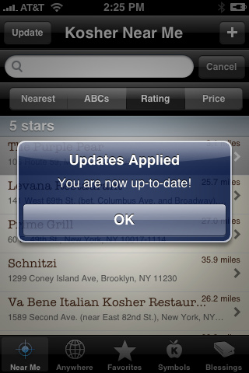
Why Do We Need It?
It’s common - customers have an expectation they can get updates quickly and easily. Everyone who has a smart phone uses it!
A visible expression of the client’s maintenance dollars at work
Enables timely delivery of bug fixes
Works through FireWalls (uses Web Services)
No need to update a static web page attached to CP in order to “publish” new updates internally for testing and use by DRAS
Optionally displays release notes to the user
Download sizes can be reduced to a bare minimum using Microsoft patching libraries or compression
Reports software version when checking for updates so we always know who is using licenses and what versions they are running

Slide 3
Additional Benefits
We know how many licenses are being used for each client and for what products
We can expire licenses for non-payment
We can limit any piracy/license violations
Easily create updates and monitor update progress
Flexible manifest driven installer like functionality:
Download and Run an installer or EXE silently
Patch files
Uncompress file(s)

Slide 4
Challenges
Database versioning
The framework must be able to apply database scripts OR prevent deployments requiring newer database versions
Client UAT environments
Clients will often test each release in a UAT environment and only deploy them after approval.

Slide 5
The Good News
Database versioning
Versioning can be handled we just need to decide which approach to take and test it
Client UAT environments
Clients can use the same AutoUpdate mechanism internally on their network to deploy releases that pass UAT

Slide 6

The AutoUpdate Pieces
UpdateServer
A SOAP based Web Service that supplies the incremental updates
Launcher
An application proxy that can be used to check for and apply updates (requires admin privileges) every time the application is launched
ClientUpdateService
A Windows NT Service that downloads and can optionally apply updates (requires admin privileges)
UpdateManager
A fully customizable application that creates an update manifest and copies it along with the updated files to a shared location accessible to the UpdateServer
Deployment database
A SQL Server shared information store used by the UpdateServer and UpdateManager

Slide 7
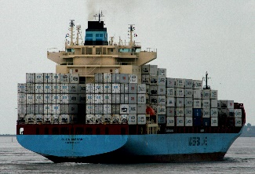
The Manifest
An update Manifest is an XML document that consists of a header and one or more deployment items:
<Manifest
LocationGUID="{050AEACC-2DA7-4859-BA28-0FE29ACB4BB1}"
ApplicationGUID="{1FA3579B-269E-4739-92B6-84F03E2500A0}"
UpdateVersion="5.0.21.2"
WhatsNew=""
IsMandatory="false"
IsSilent="false"
IsImmediate="false">
<Item
FileName="CAT.ZIP"
IsAPatch="false"
IsAZip="true"
Launch="false"
Version="5.0.20.49999"
TargetPath="{app}"/>
</Manifest>

Slide 8
DEMO

