Slide 1


GROW-BOX
Imri Koch
Stefano Antonio Putelli
Andrea Bassi

Slide 2
Problem Statement
Growing a plant can be frustrated
You do not know the optimal conditions for growing the plant.
You can not control its environment and conditions.
You do not know when to water the plant.

Slide 3
Basic Working Scheme
Our solution is to create a well monitored grow box
You can see all the relevant parameters for the plant.
You can control these parameters remotely.
Irrigation is automated (only when needed).
You can check the data from last week and compare it.

Slide 4
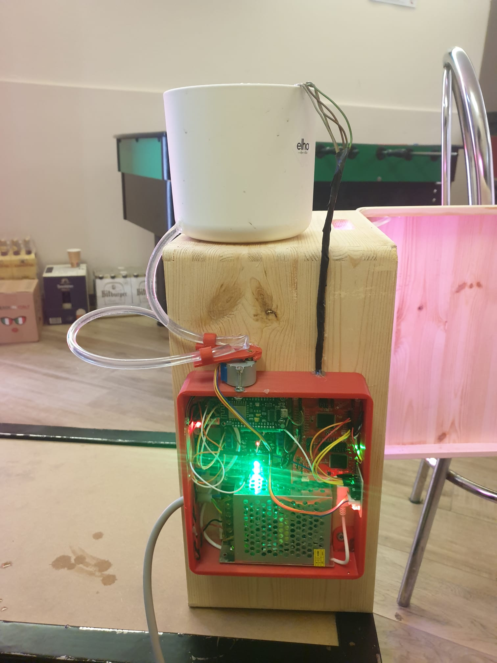
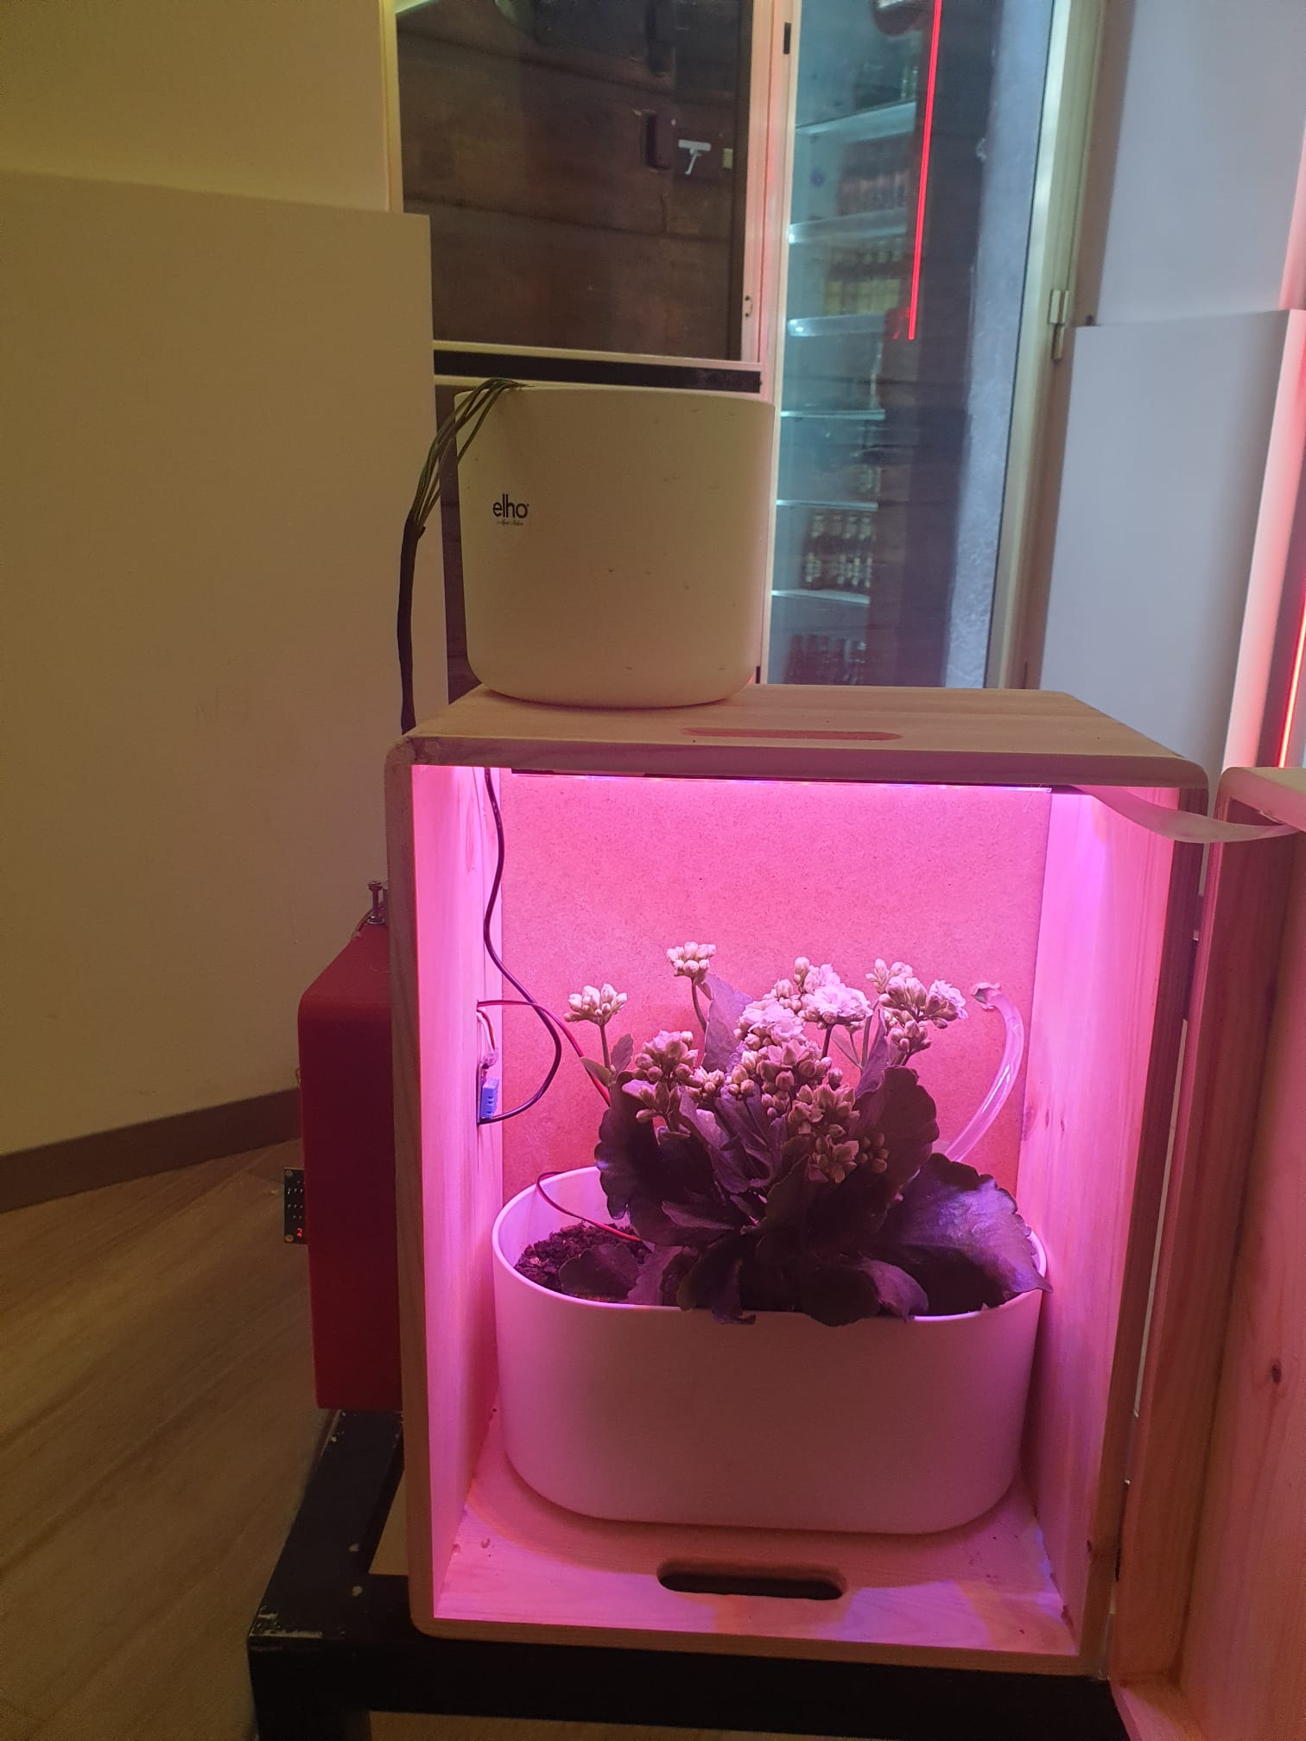
Our Project

Slide 5
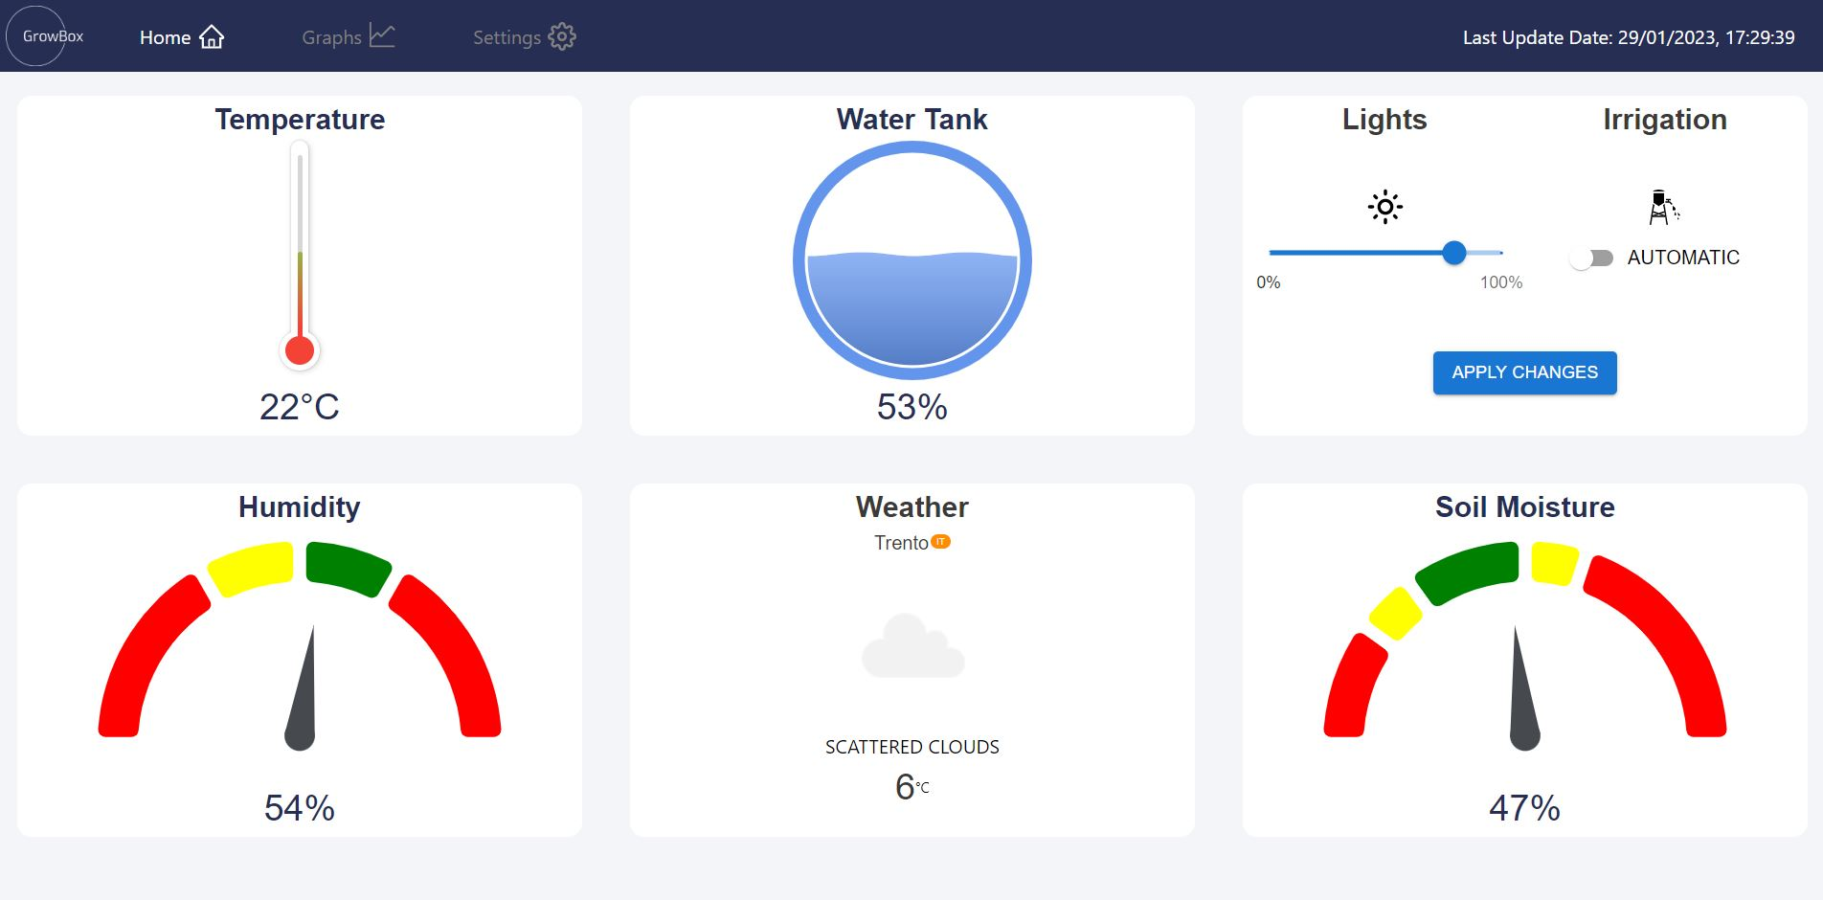
User Interface - Website

Slide 6
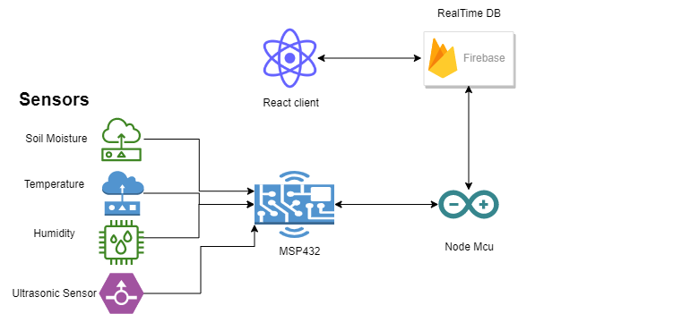
Architecture

Slide 7
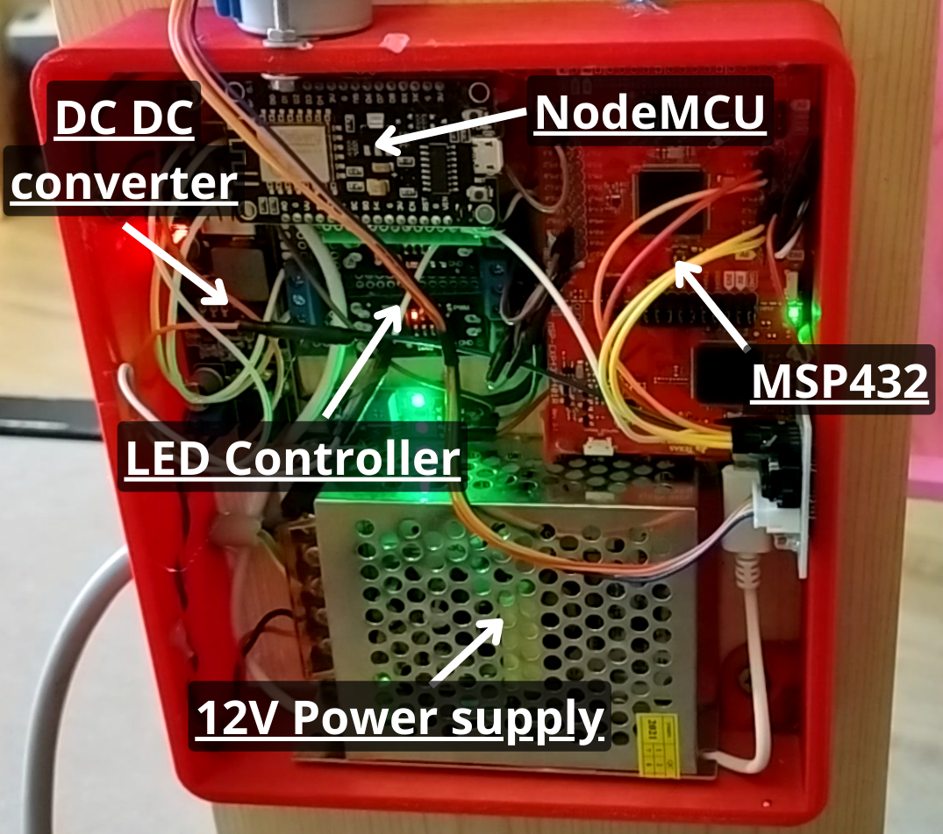
Hardware

Slide 8
Working Flow
MSP432
Every 1 second checks if control settings have changed
Every 4 seconds reads sample from the sensors and send to node MCU (UART)
Done by timer interrupt
Node MCU
Every 1 second checks if control settings have changed in FB (WIFI Board)
Every 4 seconds tries to read sensors data and send them to FB (UART)
Done by timer interrupt.

Slide 9
Testing Strategy
We tested:
Each feature separately (sensors, communication, control…)
Each board separately
Used voltameter to check voltage
The client was tested first with mock data data.

Slide 10
Future Work
Future Features
Configure specific plant and set the optimize parameters for this plant.
Control all parameters (including temperature and humidity).
Add camera to see plant growth and development.
Learn and analyze the best conditions for each plant.

