Slide 1
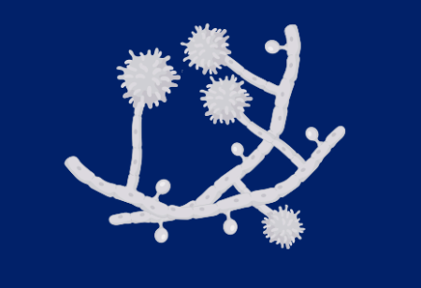
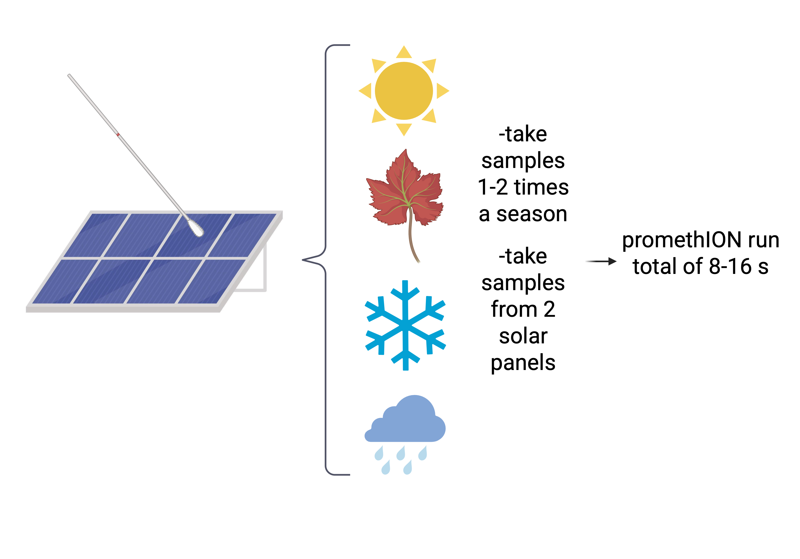
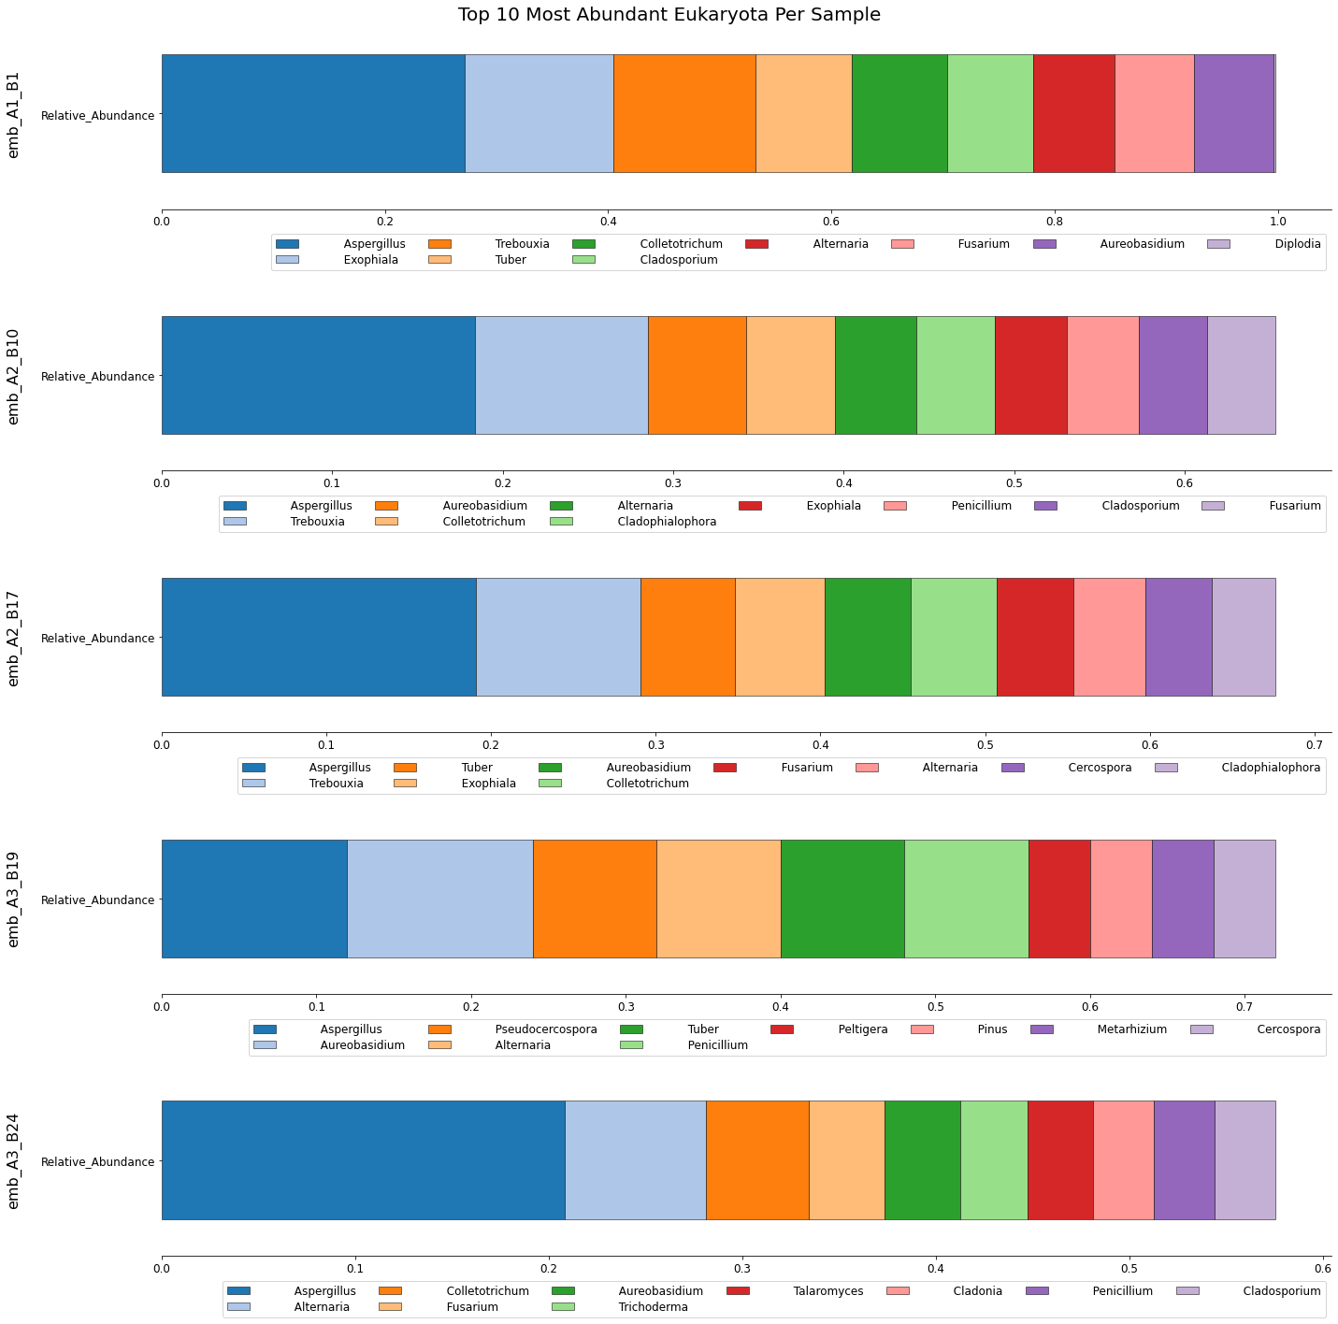
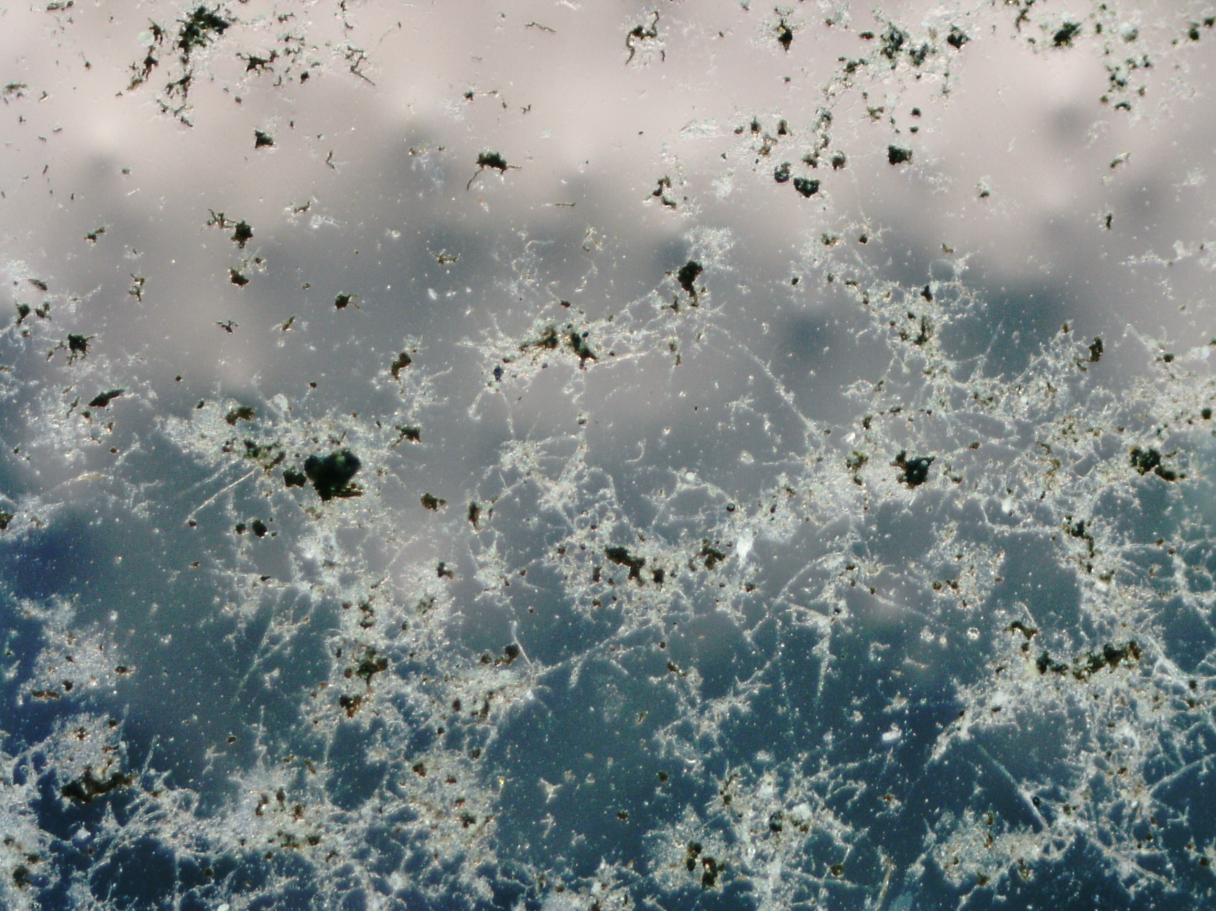
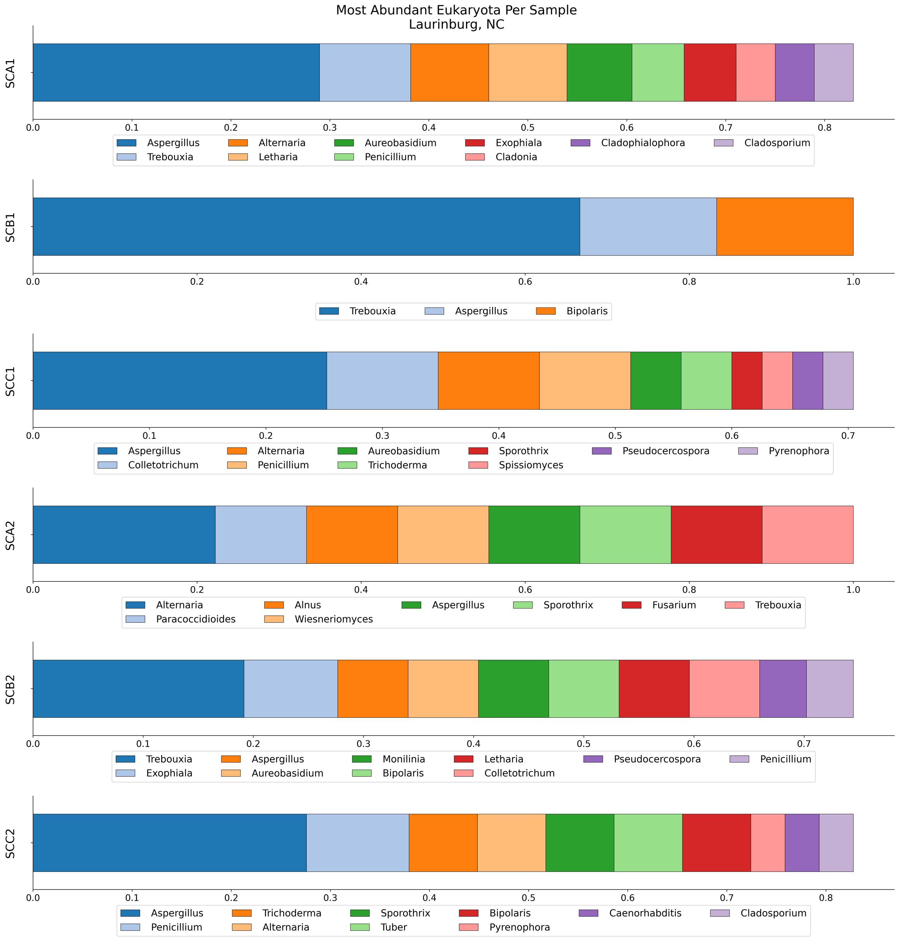
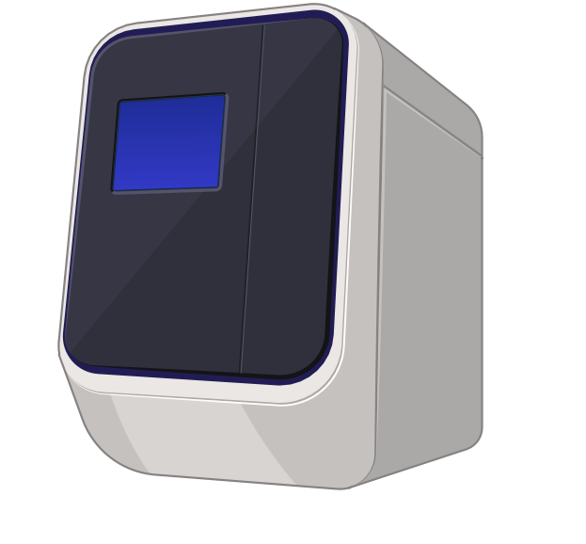
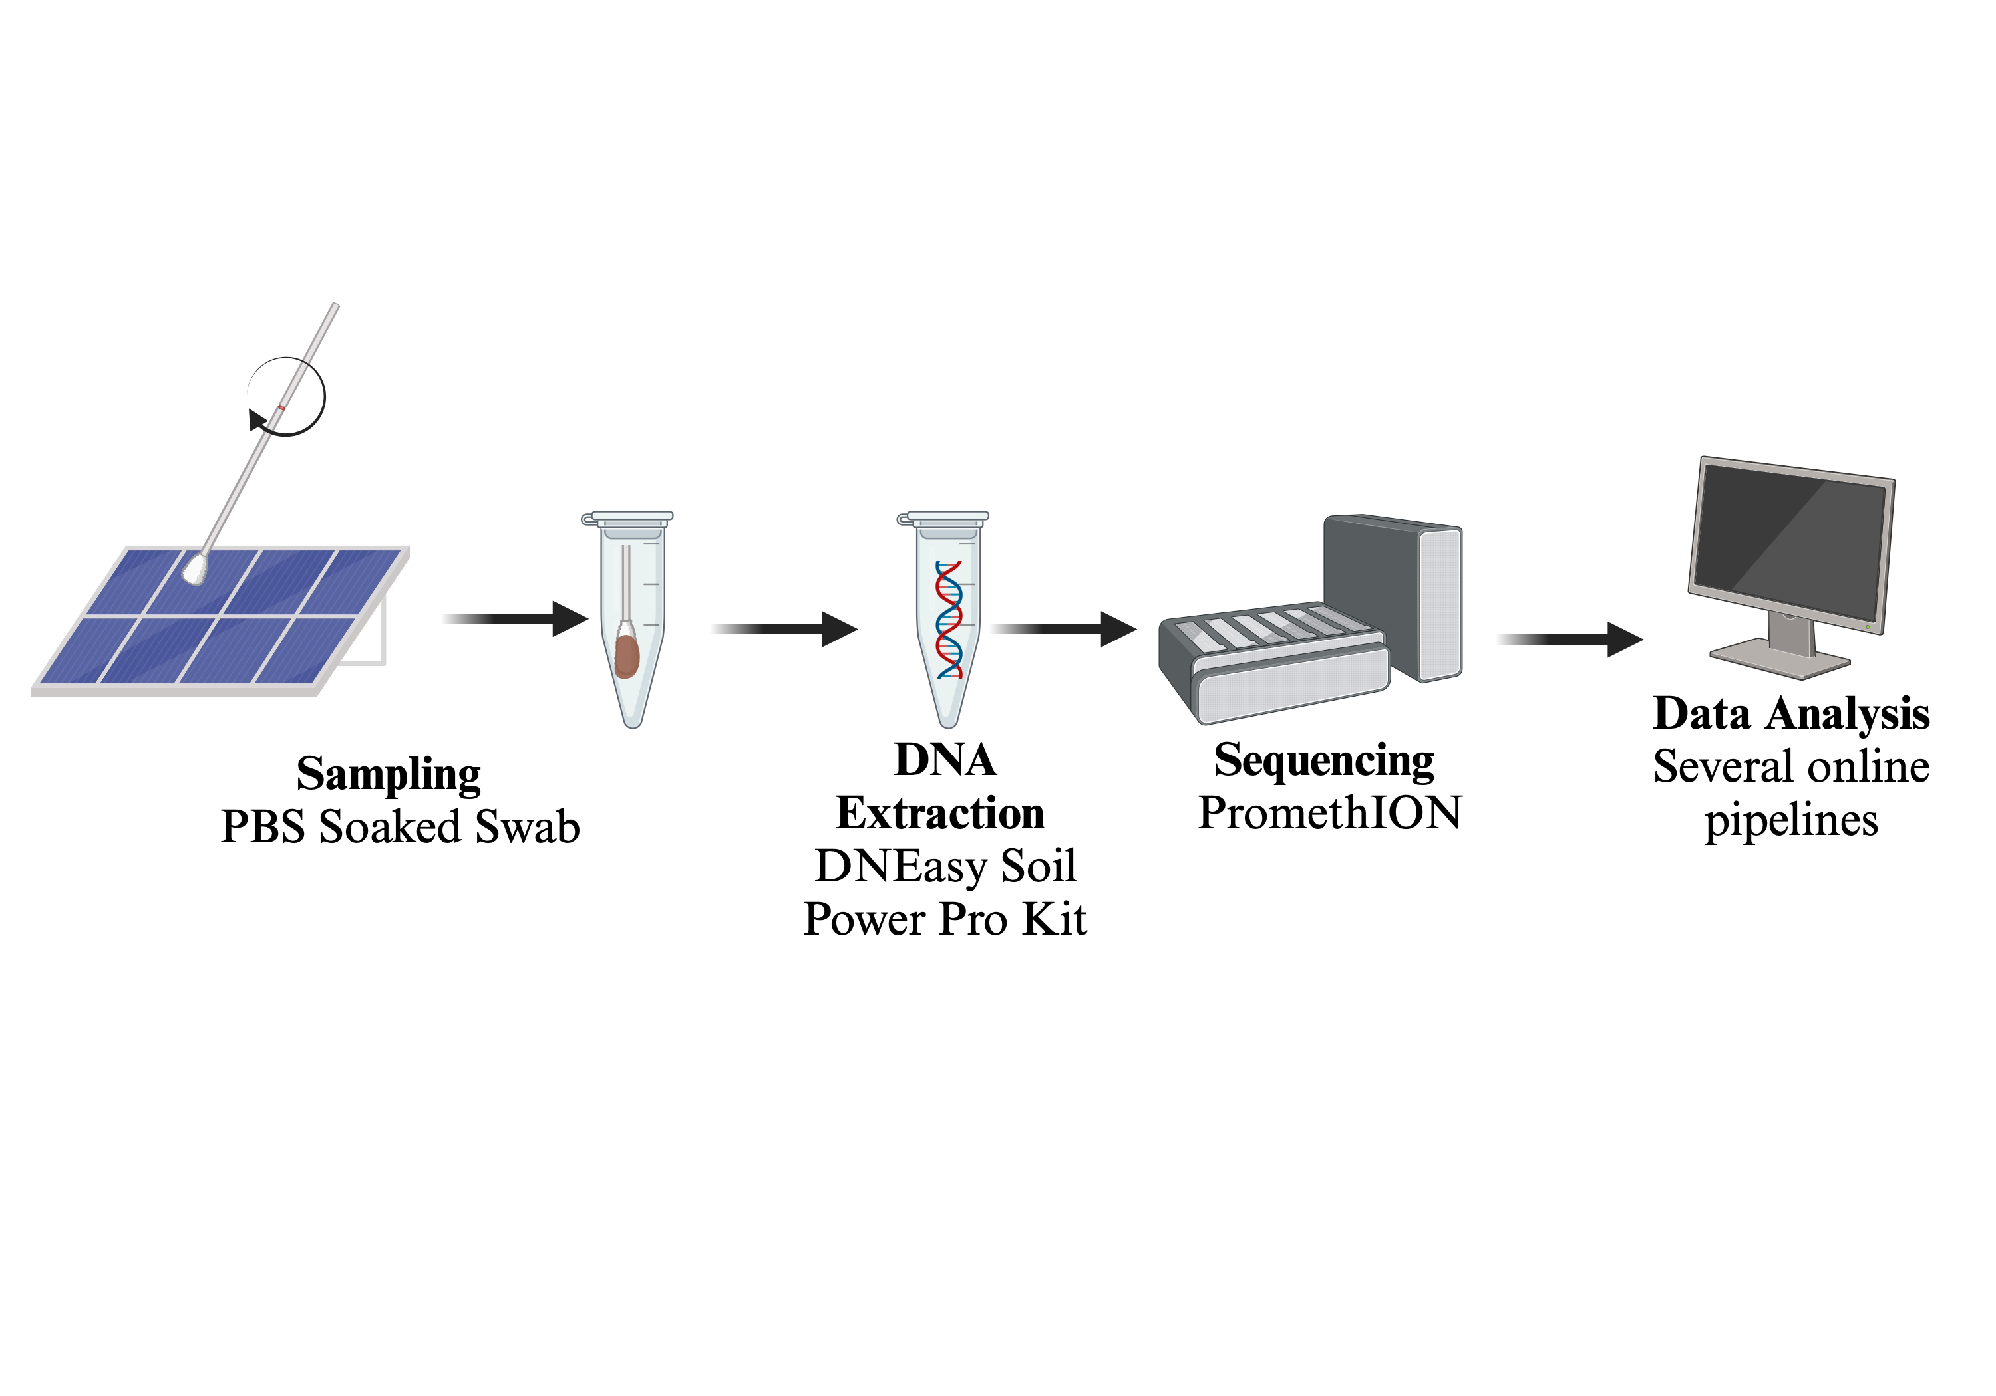
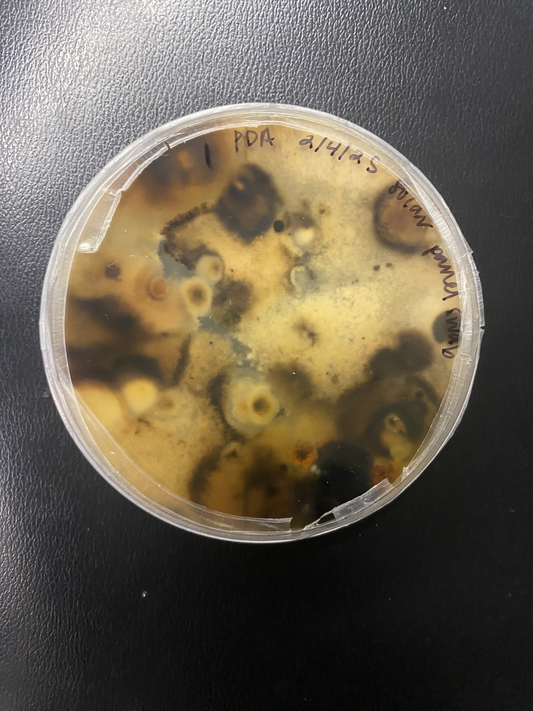
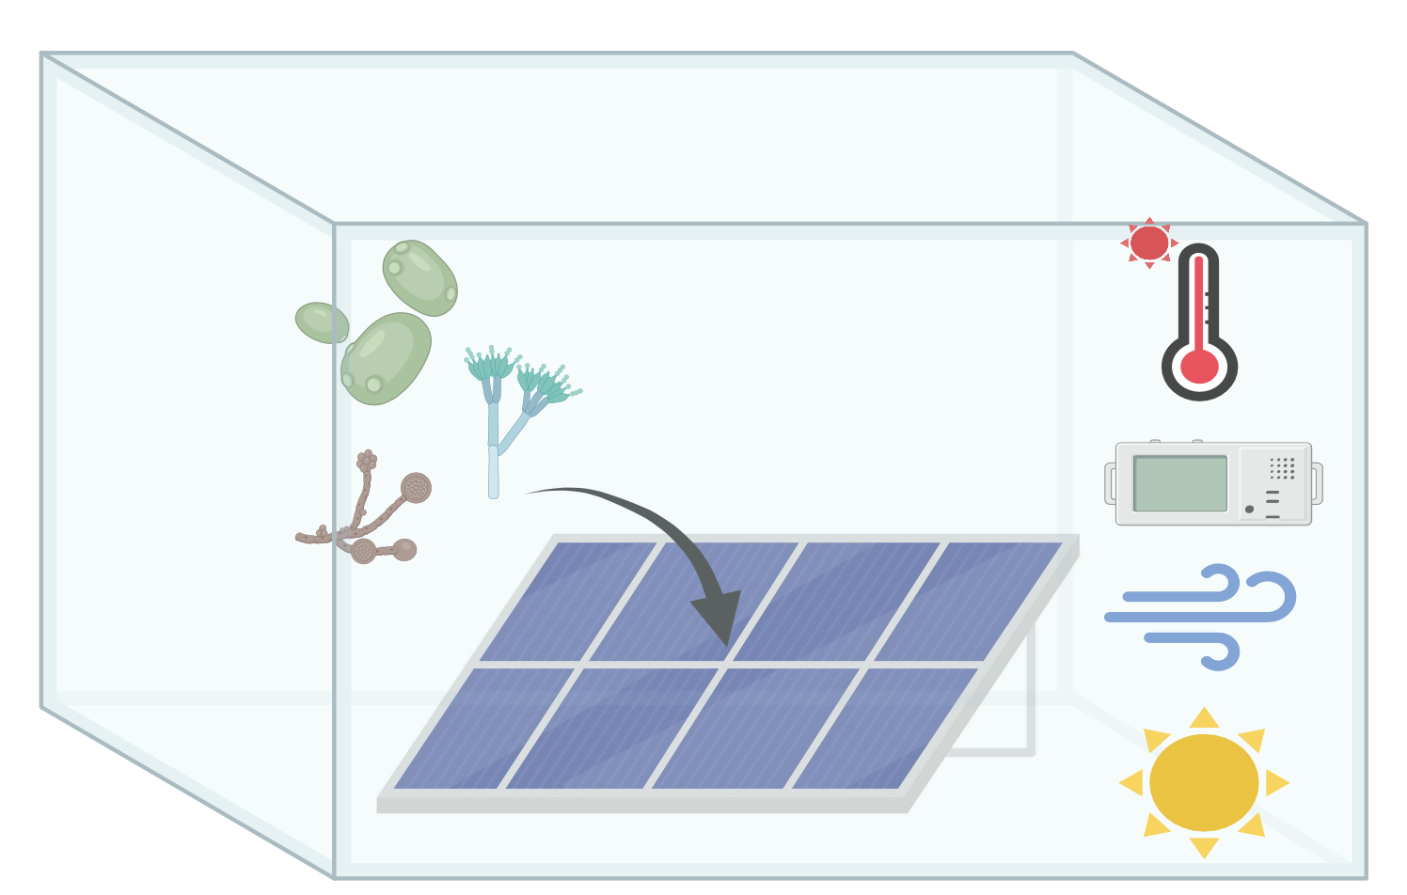
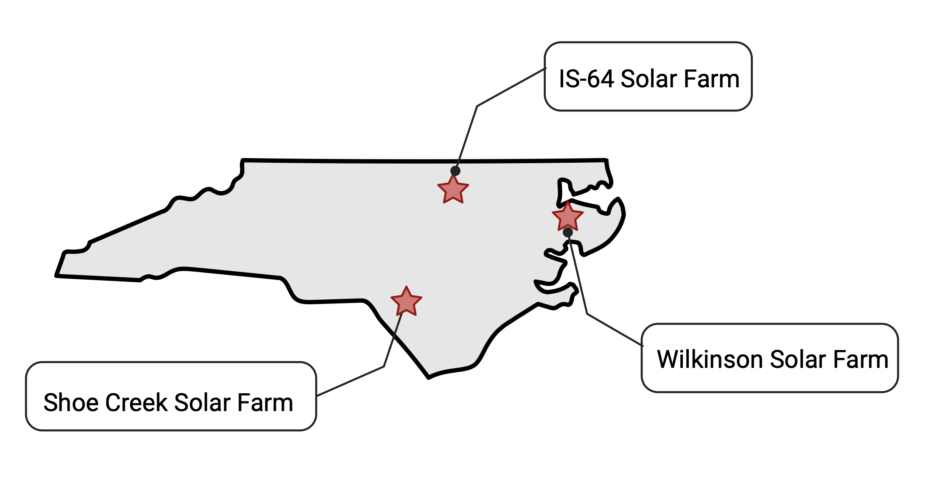
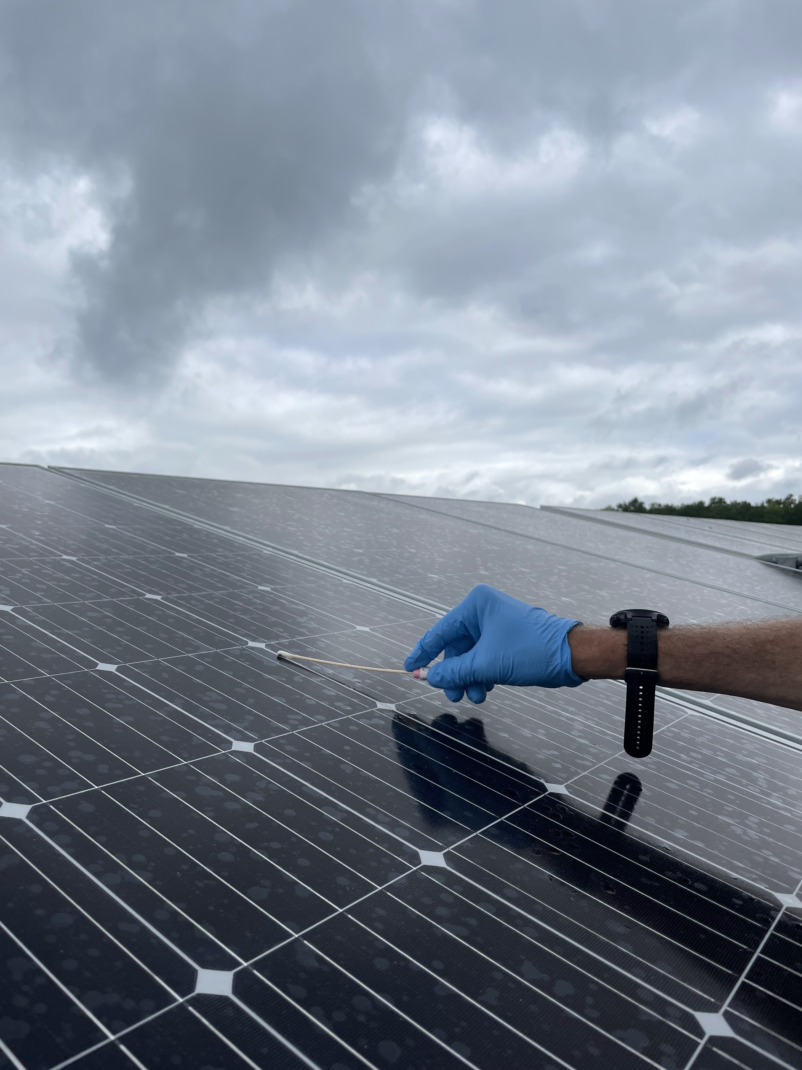
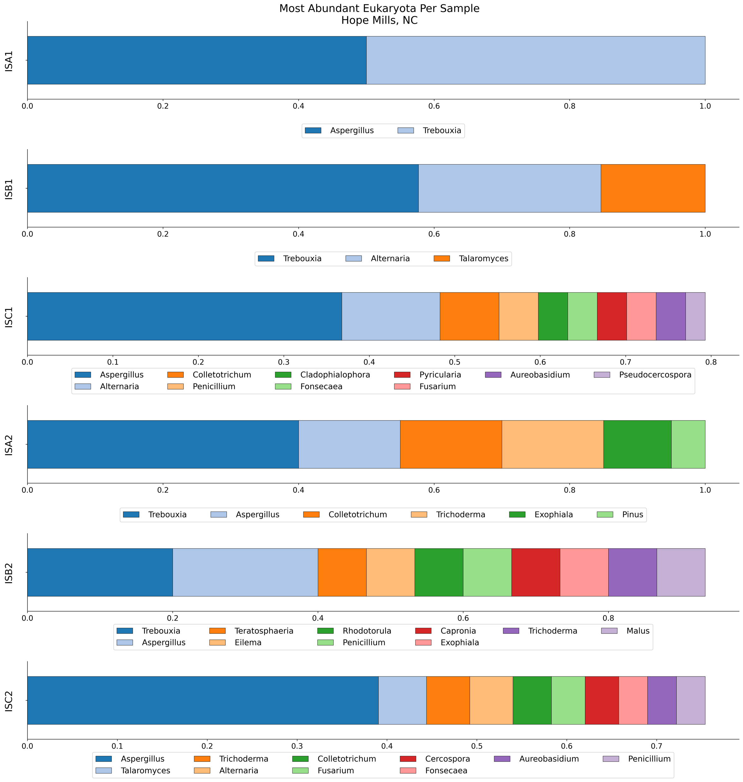
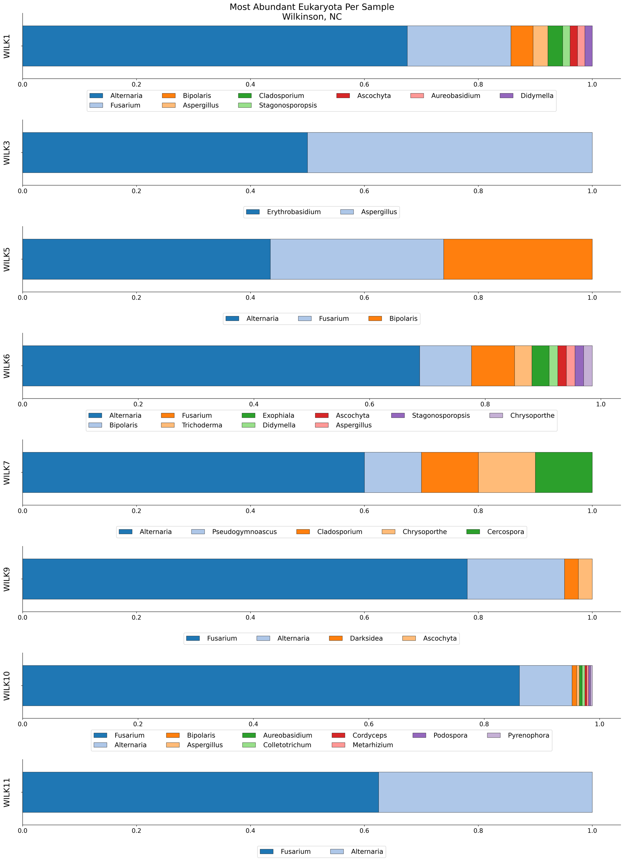





D u k e
U N I V E R S I T Y
Metagenomic Analysis of Microbial Genera on Solar Panels
Erica Babusci¹ Claudia K. Gunsch¹, Mike Valerino², Mike Bergin¹, Andrew A. Jones¹, Alexandra Rivera²
¹ Duke University, ² Solar Unsoiled
614-600-6861
Erica.babusci@duke.edu
Background
A
Future Directions
Results
Solar panels provide a renewable energy source that reduces the dependency on fossil fuels.¹ However, their energy output can be hindered by the accumulation of environmental particles, which affects the light absorption of solar panels.² Environmental particles, such as soil and pollen, were believed to be the primary contributors to this loss of efficiency. However, after imaging solar panels (Figure 1), it is hypothesized that microbial growth also affect solar panel efficiency.^{1,3}
The Dorado⁵ and pb-metagenomics-tools⁶ pipelines were used to take the PromethION raw reads and turn them into Megan reports, which were then used to make the graphs below.
A
Eukaryotic Genera Present at Shoe Creek Site
Test Run
Results
Nine samples from Shoe Creek were collected on a single day. Three were used as a test run, and the remaining six were used in the actual run to compare results.
Microbial composition is relatively similar between the same site on different runs, indicating that the PromethION ran accurately shows the microbial community
To address this, I am collaborating with Solar Unoiled⁴ to conduct a metagenomic analysis of solar panels in North Carolina, using a PromethION sequencer and several long-read pipelines to determine the microbial composition.
Eukaryotic Genera Present at Shoe Creek Site
Full Run
B
Look at microbial composition shifts based on season
Figure 1: Image of solar panel
Metagenomic analsysis
Figure 5 (A & B): This figure shows the metagenomic composition of fungi for the Shoe Creek test run (A) and the actual run (B). Samples were taken at the same time and split to see if the composition was preserved across runs to test the efficacy of the protocols.
Objectives
1. Characterize the fungal genera present on solar panels
2. Investigate genera characteristics to understand what traits lead to survival on solar panels
A broken solar panel stored in a garage for 6 weeks was swabbed and cultured on PDA plates to see if the genera isolated match what was identified from the PromethION. Fusarium, Alternaria, and Talaromyces are seen in the PromethION results. Sordariomycetes is a class-level identification and is not shown in the results
Quantify the abundance of fungi versus bacteria using qPCR
1
Isolate DNA and PCR amplify ITS/LSU region***
Unique Genera Found
Fusarium
Alternaria
Sordariomycetes
Talaromyces
2
hope
Swab of broken solar panel being stored indoors
3
Methods
4
5
Figure 6 : Schematic of experimental design for creating isolates from the solar panel and the genera names of the isolates found
A
Eukaryotic Genera Present at IS-64 Site
Hope Mills, NC
Regrow solar panel isolates in an environment that simulates solar panel conditions
Figure 2: Sites locations in NC
Figure 3: Swabbing procedure
Results show some variability between sites but have mostly similar microbial compositions.
Common Genera Across All Sites
Aspergillus
Alternaria
Fusarium
Trichoderma
These genera are found to be UV, heat, radiation resistant, and exhibit increased melanin production.^{1,3} These traits enable the fungi to survive, explaining why we observe growth in seemingly uninhabitable environments.
References and Acknowledgements
B
Eukaryotic Genera Present at Shoe Creek Site
Laurinburg, NC
[1] Pocar et al., (2018) Frontiers in Microbiology [2] Al-Sharafi et al., (2024). Cleaner Energy Systems [3]Tanner et al., (2017). Environmental Microbiology [4] Solar Unsoiled (2025) [5] Oxford Nanopore Technologies. (n.d.). Dorado: Oxford Nanopore's Basecaller. GitHub.[6] Pacific Biosciences. (n.d.). Taxonomic Profiling Tutorial: Minimap2 + MEGAN. GitHub.
This work is supported in part by the National Institute of Environmental Health Sciences Under Grant No. P42ES010356 and by the Engineering Research Centers Program of the National Science Foundation under NSF Cooperative Agreement No. EEC-2133504.
Figure 4: Schematic of data collection and processing
Site Locations
Site Name | Location | Nomenclature | # of Samples | # Unique Solar Panels
IS - 64 | Hope Mills, NC | IS | 6 | 2
Wilkinson | Wilkinson, NC | Wilk | 8 (1 lost) | 3
Shoe Creek | Laurinburg | SC | 6/9 | 2/3
C
Eukaryotic Genera Present at Wilkinson Site
Wilkinson, NC
Test Run Site Location
Site Name | Location | Nomenclature | # of Samples | # Unique Solar Panels
Shoe Creek | Laurinburg | SC | 3 | 1
Table 1: Table showing different sites and number of samples per site, showing the samples used as the test run from Shoe Creek
Figure 7 (A-C): Figure of the metagenomic composition of fungal genera at (A) IS-64, (B) Shoe Creek, and (C) Wilkinson. Highlighted genera indicate that the genus was isolated from the broken solar panel.

