Slide 1
Nuisance Law
William Fisher
January 2025

Slide 2
Nuisances
Public
--immoral activities;
--large-scale noxious
activities
Private
Nuisances per se
--bad under all circumstances;
--forbidden by statute
Nuisance per accidens
Factors:
Nature of D’s activity
Kind of harm to P
Degree of harm to P
Expediency
Usage
“Coming to the Nuisance”
Unintentional
--negligent;
--reckless;
--ultrahazardous
Intentional
“unreasonable under all
the circumstances”

Slide 3
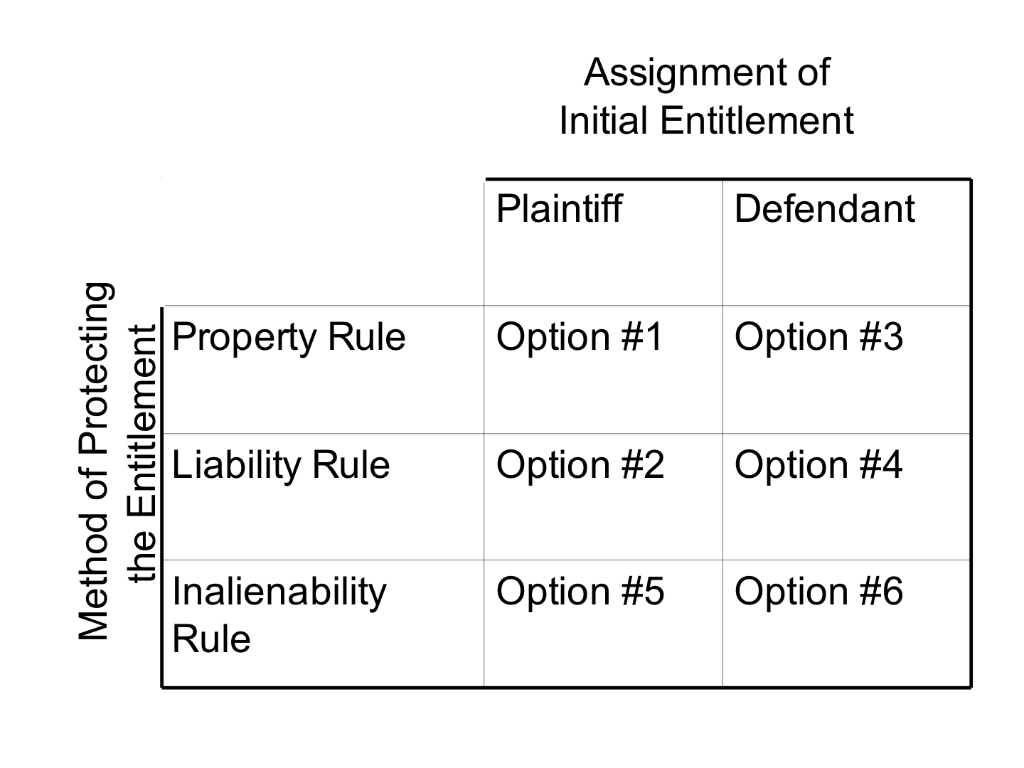
Calabresi & Melamed,
“Property Rules, Liability Rules, and Inalienability” (1972)
Arkansas
Middlesex
Boomer
Spur

