Slide 1

Understanding acute exercise response among girls and young women with and without eating disorders
Katherine Schaumberg

Slide 2
Objectives

Slide 3
Maladaptive exercise is present in the general population of adolescents and very common among those with EDs

Slide 4
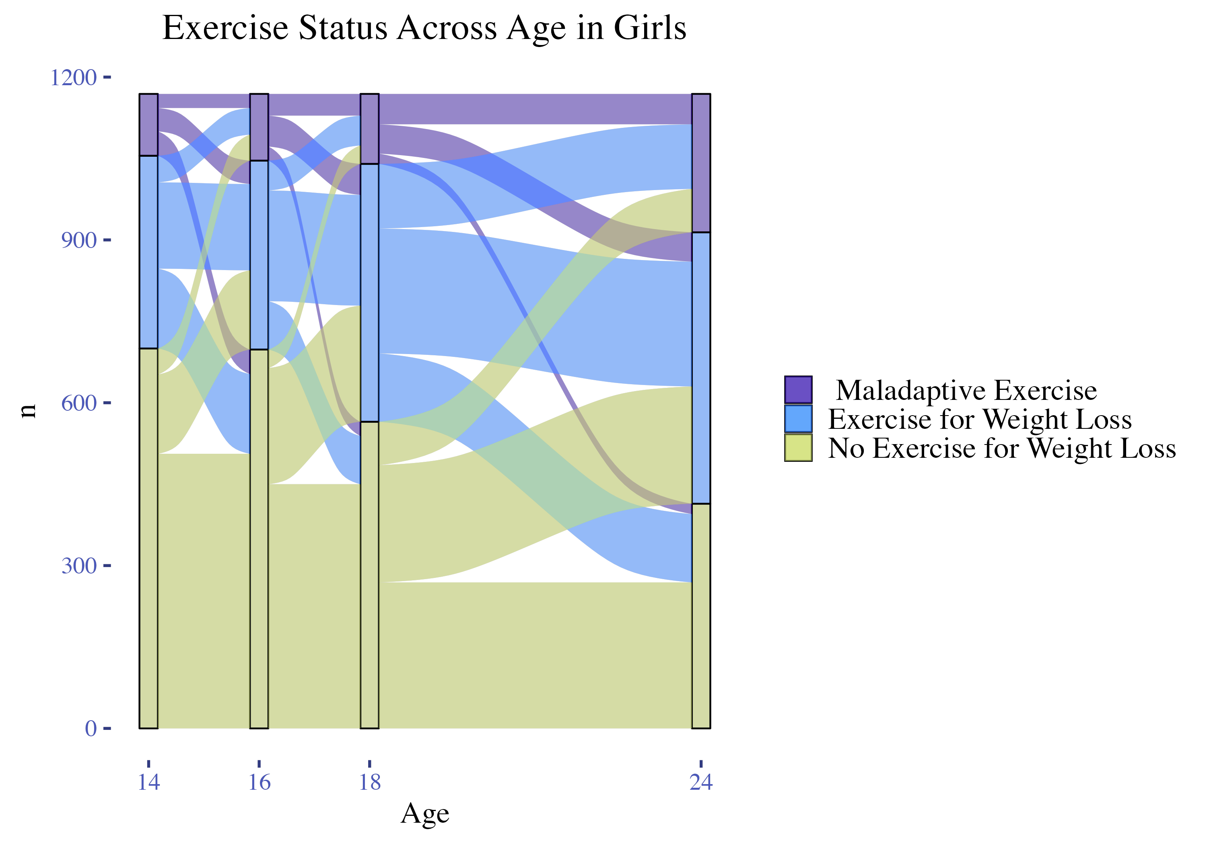

Slide 5
Background
Common Definitional Components of Maladaptive Exercise:
Feeling ‘driven’ to preform exercise
Having exercise obsessions
Exercising to reduce distress (e.g. guilt, anxiety)
Exercising to prevent weight gain
Exercise leading to functional impairment
It is unclear which features are most salient to the reinforcement of maladaptive exercise; Little is known about in the moment exercise experience
Notes:
Weak central coherence – perseveration on details/absence of big picture

Slide 6
Why Study In-Vivo Exercise?

Slide 7
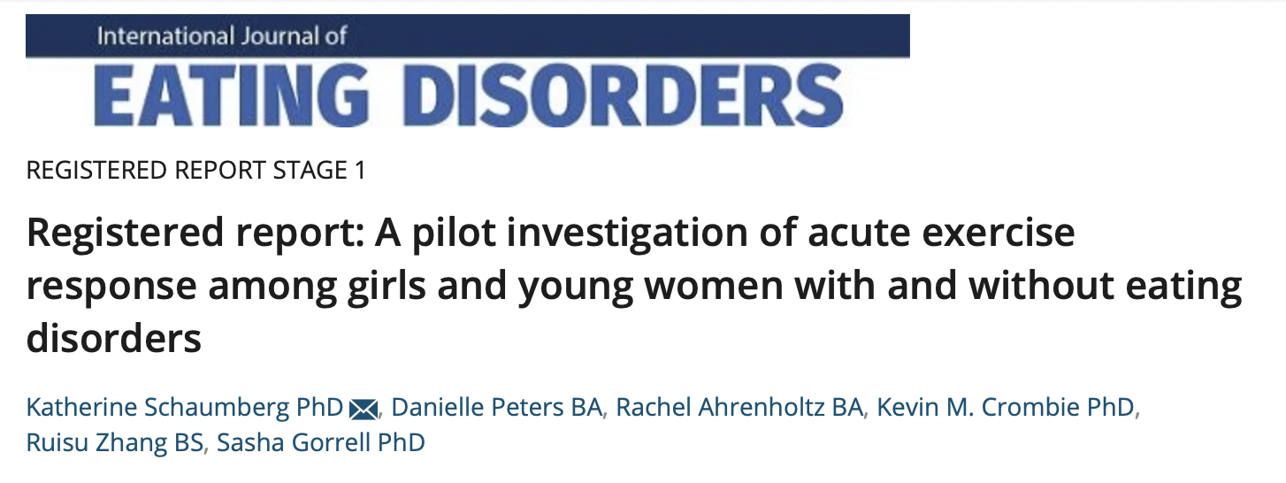
Aim 1: Confirm feasibility of paradigms evaluating acute response to exercise among outpatient individuals with EDs. a) study dropout, b) adverse events, c) completion rates of exercise tasks, d) completion rates of milkshake task across ED and HC participants.
Aim 2: Characterize variability in biobehavioral response to in-lab exercise. Characterize changes during exercise in state body image, mood, and biological markers in both ED and HC groups; specifically mean levels of, and variability in, response to exercise across ED and HC.

Slide 8





Study Procedures
DAY A: Prescribed Exercise Task - Rest Condition; Self-Paced Exercise - Exercise Condition
DAY B: Prescribed Exercise Task - Exercise Condition
State Measures
State Measures
30-min prescribed exercise
30-min Rest
Affect, Body Image
Affect, Body Image
Biomarker
Biomarker
Behavioral
DA, eCB, 5-HT, leptin, cortisol
Behavioral
DA, eCB, 5-HT, leptin, cortisol
Work for exercise
Work for $
Affect
Body Image
HR
Distance
Exertion
Affect
Body Image
Biomarker
Biomarker
DA, eCB, 5-HT, leptin, cortisol
DA, eCB, 5-HT, leptin, cortisol
30-min self-paced exercise
HR
Distance
Exertion
Affect
Body Image
DAY C: Self-paced Exercise Task - Rest Condition
Affect, Body Image
30-min Rest
State Measures
Affect, Body Image
Affect
Body Image
Affect, Body Image
State Measures
Affect, Body Image
Note. Day A-C order is randomized. Accelerometer-measured free-living activity; self-reported DEx; ED symptoms; anxiety and personality measures collected at screening; additional state self-report measures collected during Day C
Notes:
Acute exercise response
-Intro importance of exercise in EDs; significance; need to better understand for treatment how, how much, for whom.
-Not all individuals with EDs report DEx
-Amount of exercise not as important as psychological relationship with Ex
-we want individuals with EDs to be able tot have more normative relattionsihps with ex
-two main mechanisms that may influence risk for DEx, which I’ll talk about more on the next slide-threat and reward
Day A
Progressive ratio task – 50, 100, 250, etc. for $3
“exercise reward task” – baseline reward responding
Markov – measure of reward response that requires model-based learning and PFC engagement
Ex threat task – for many people getting to drink a milkshake is exciting, not necessarily for those with EDs,
This would be a threatening experience
Engage threat-based systems
Remember back to my job talk – fear and anxiety are relevant for eating disorder risk and maintenance. And the core/central fear among EDs is fear of weight gain.
This task is designed to specifically engage this fear of weight gain
Determine response to this disorder-relevant, threat-based engagement
Determine how effective exercise is in reducing self-reported negative affect and body image

Slide 9
Pilot Participants (through 8/15/2023)

Slide 10
Feasibility Summary
Mild recruitment resistance
Discomfort with blood draw
Relatively high study burden

Slide 11
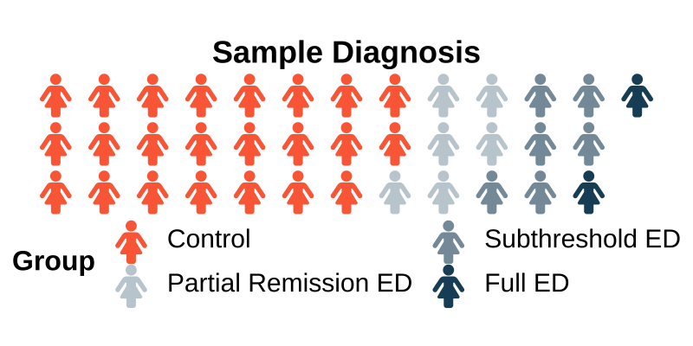
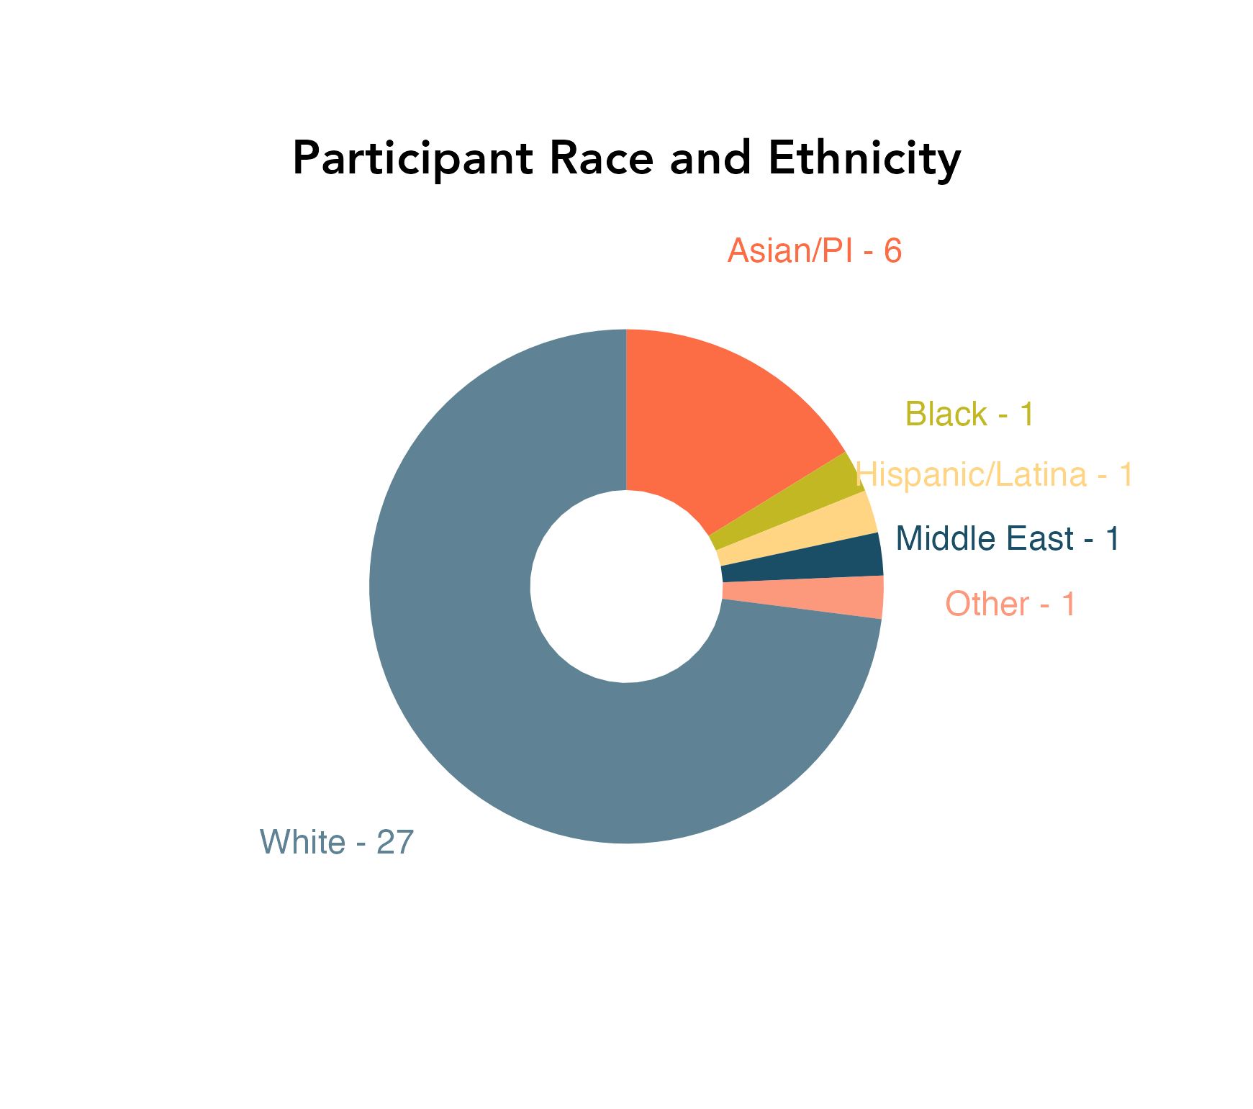
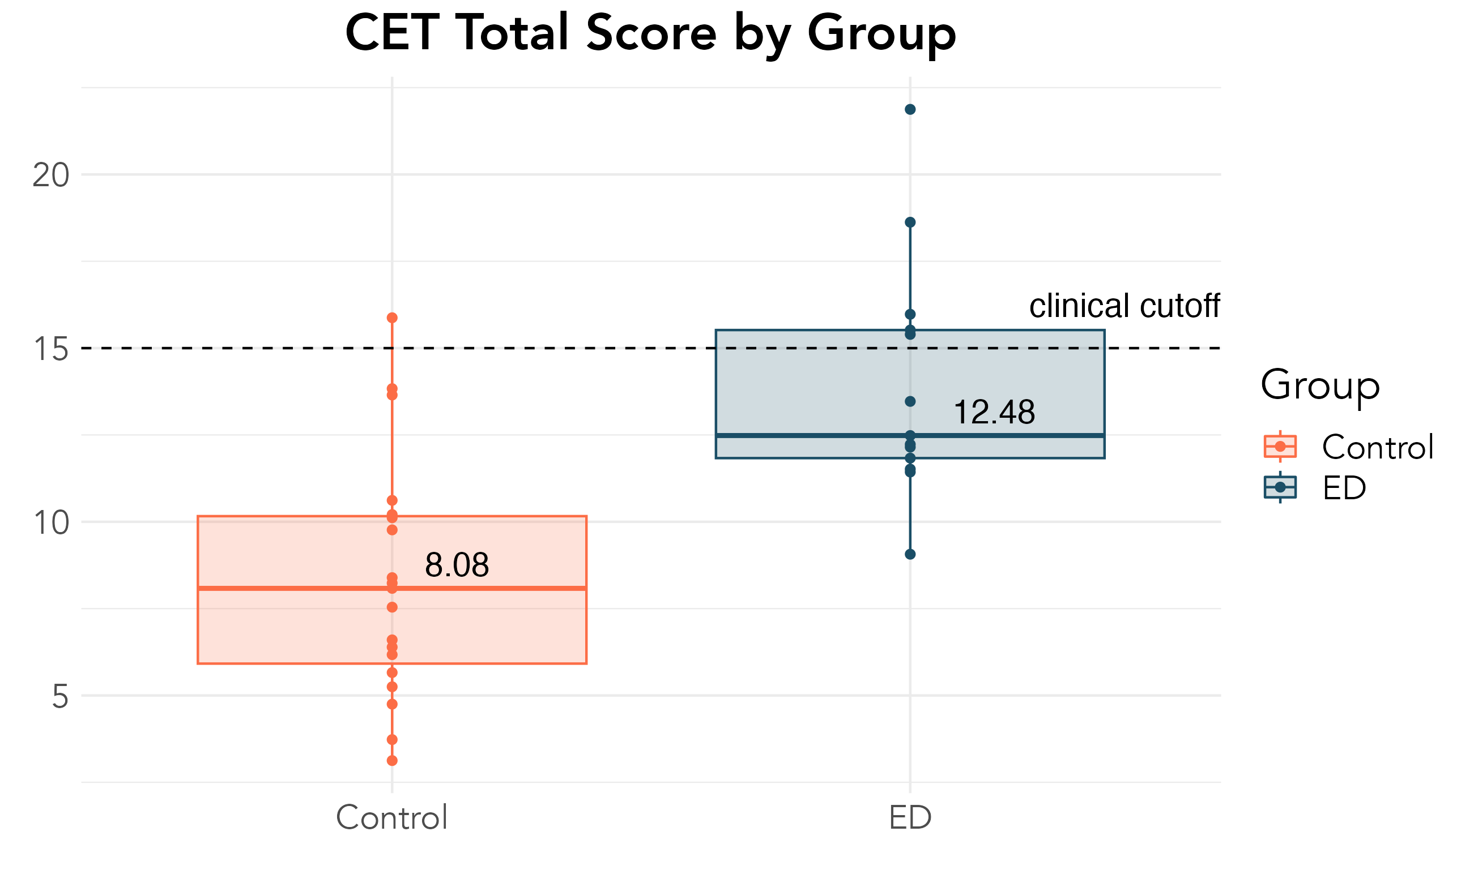
Pilot Participant Demographics
19 Median Age

Slide 12
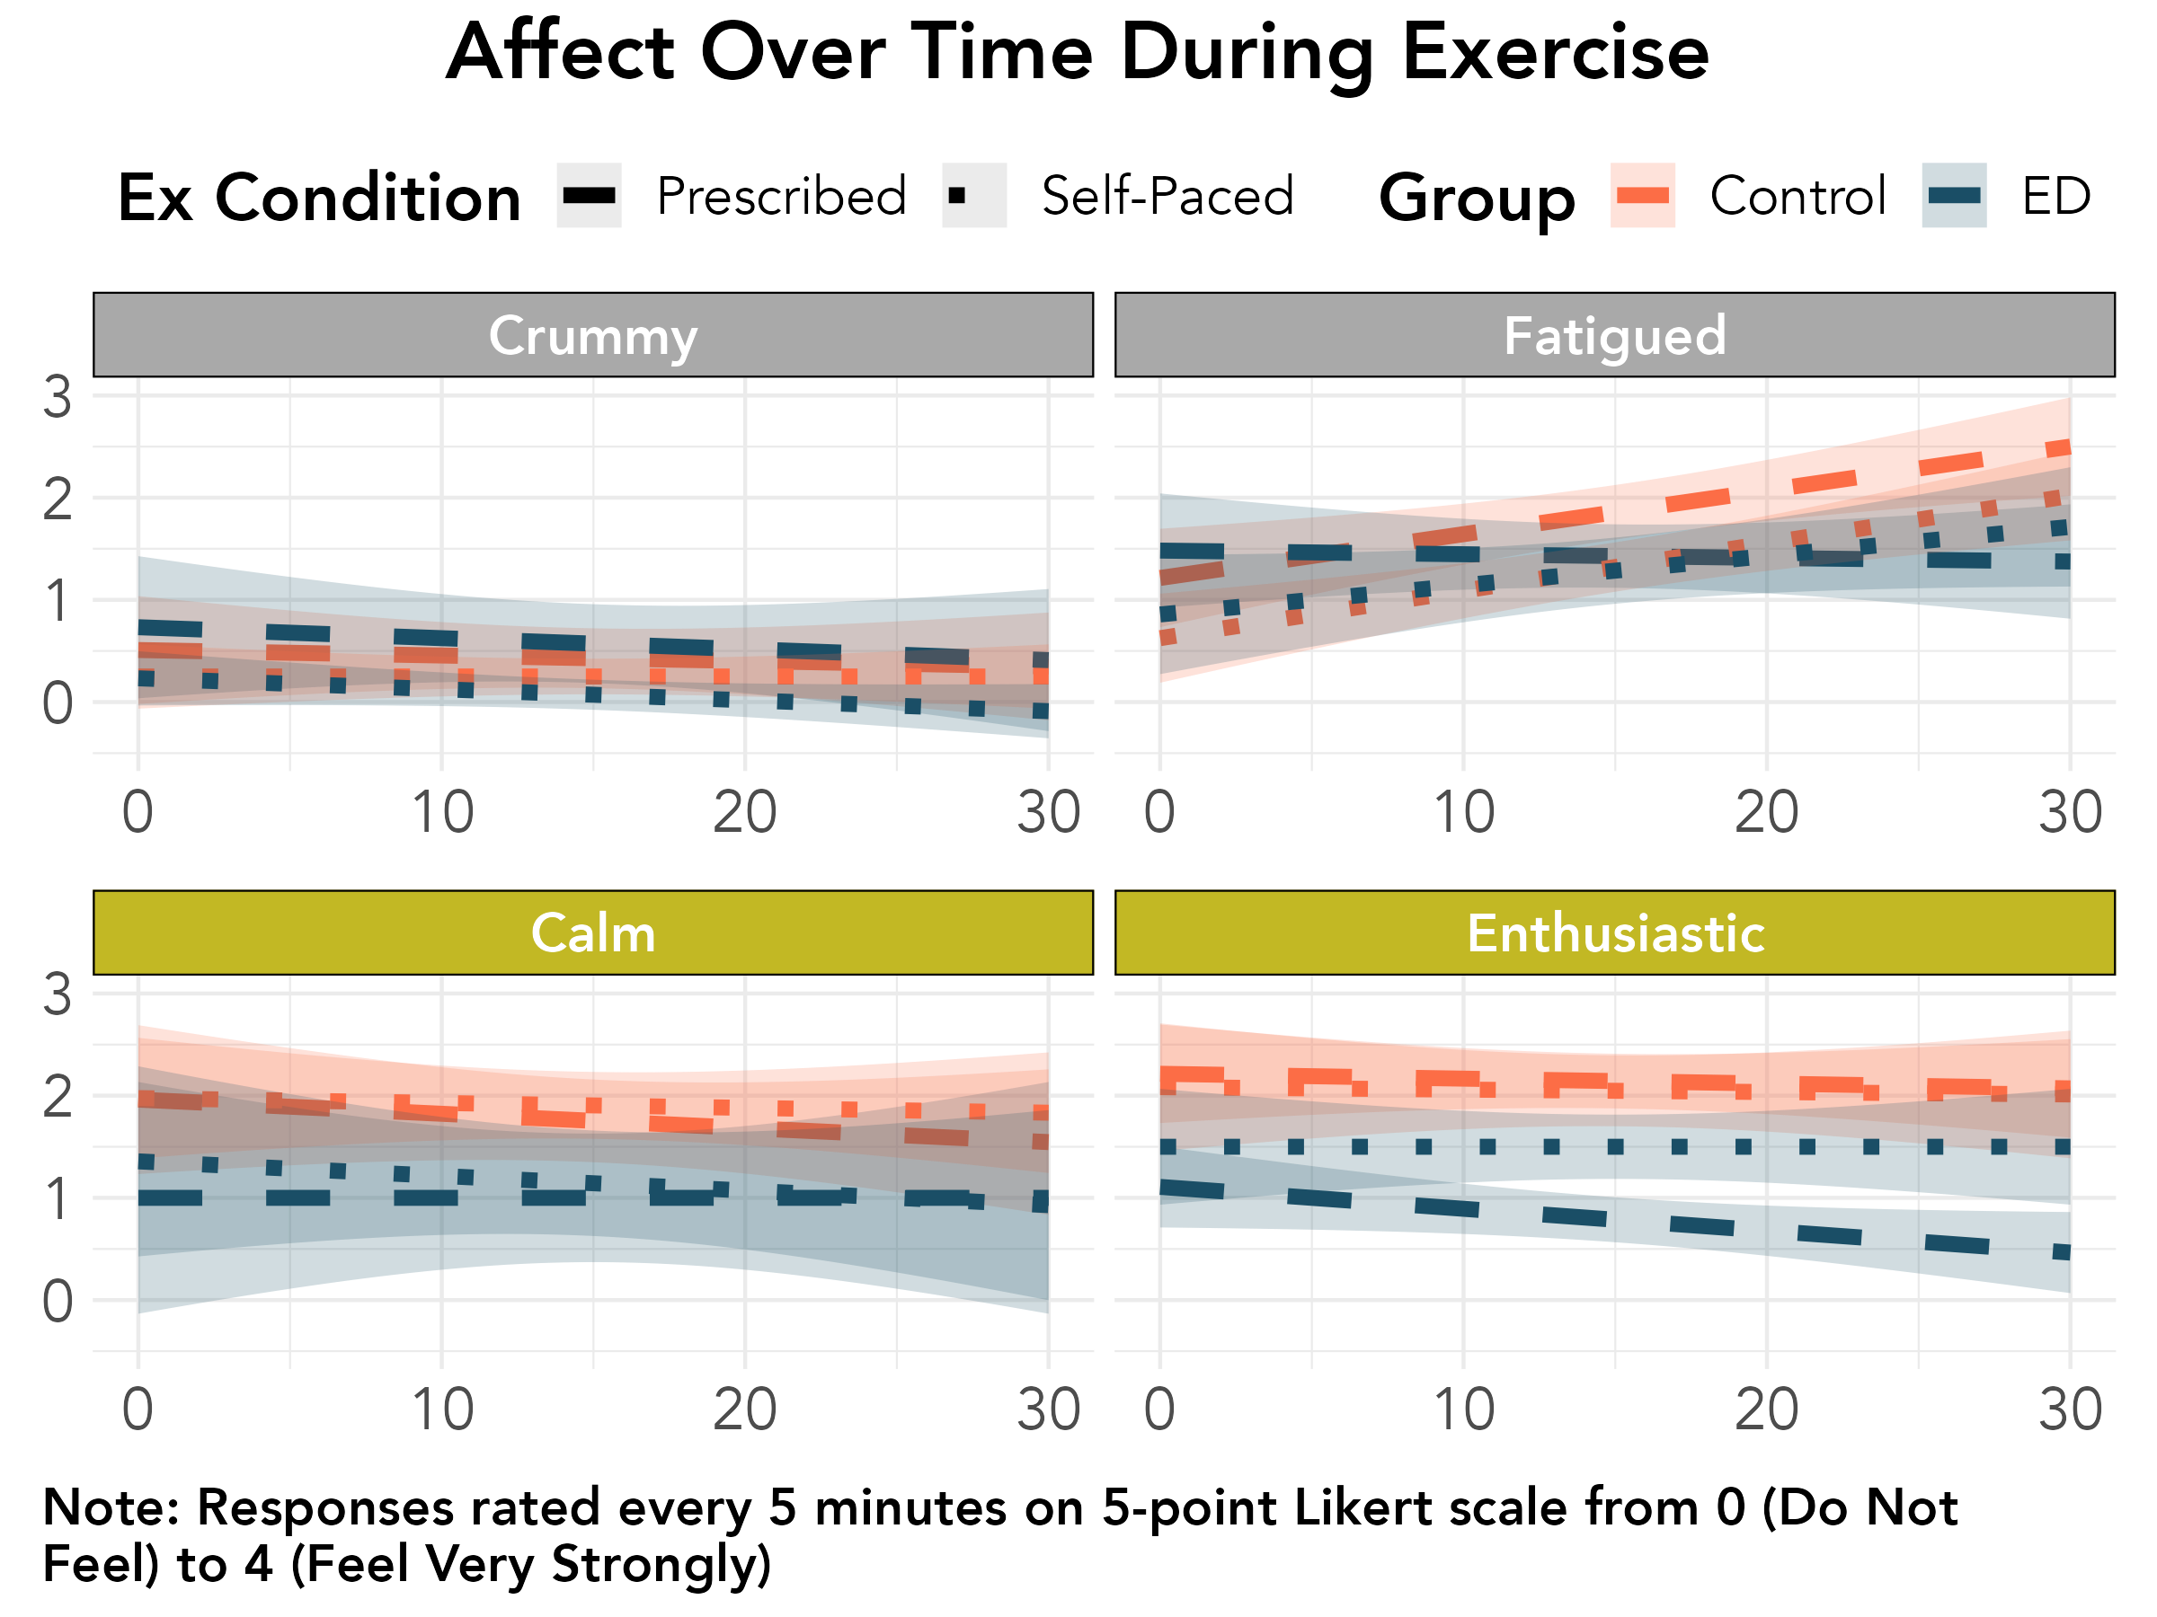

Slide 13
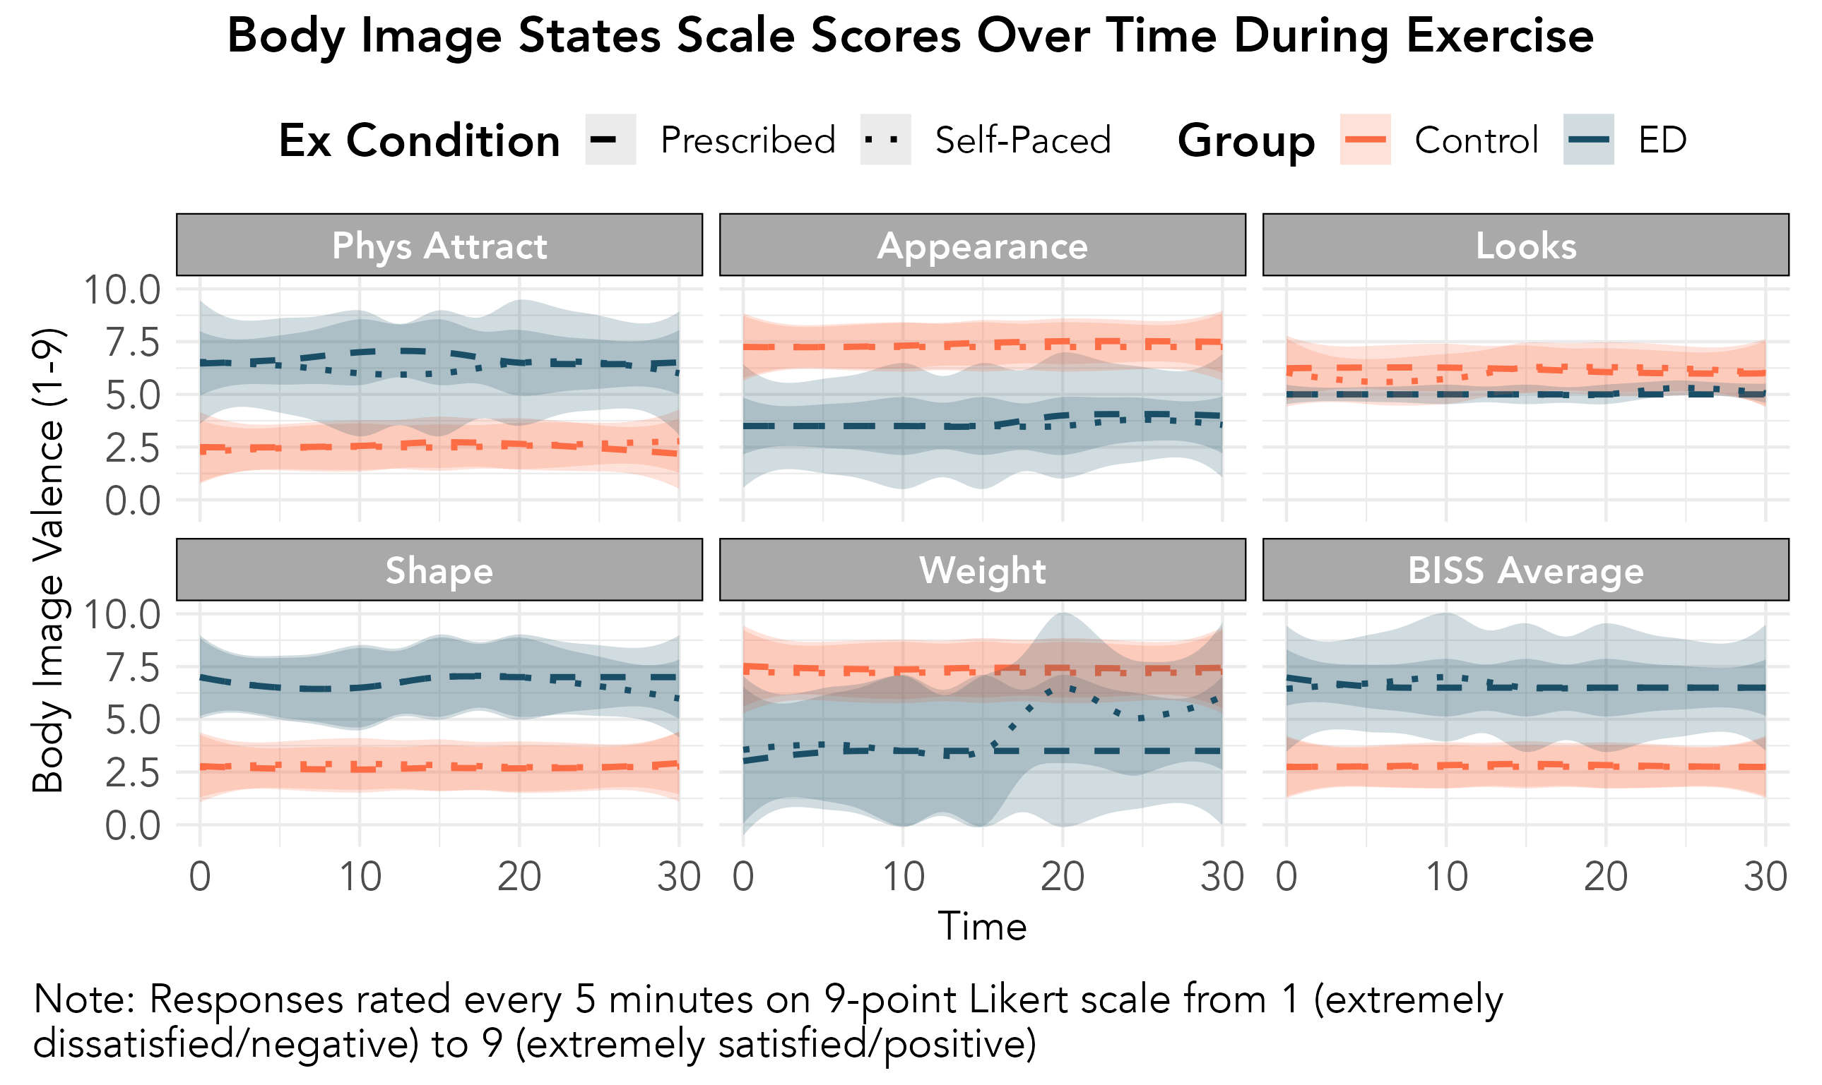

Slide 14
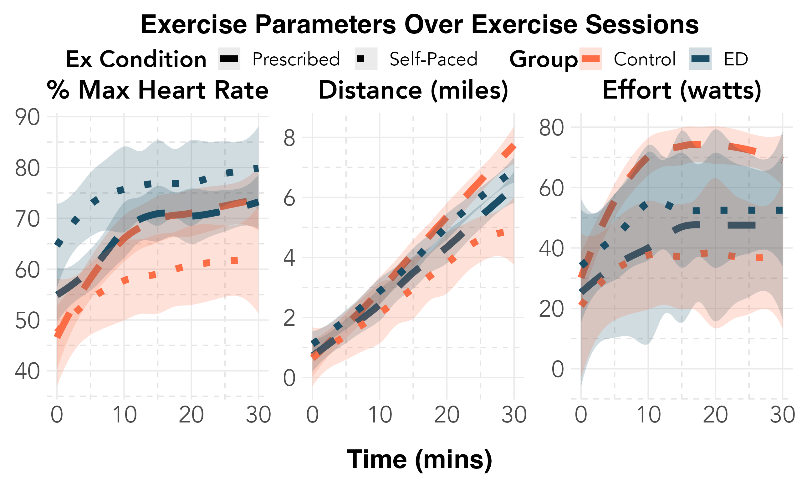

Slide 15
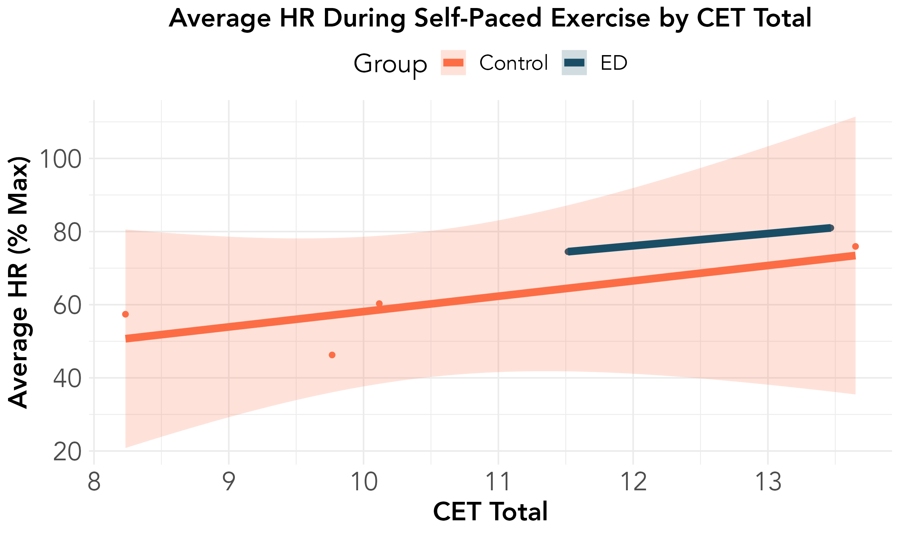
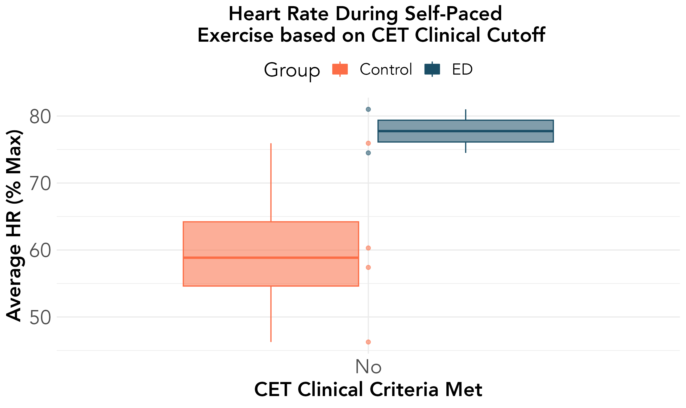
Self-Paced HR / Compulsive Exercise Test

Slide 16
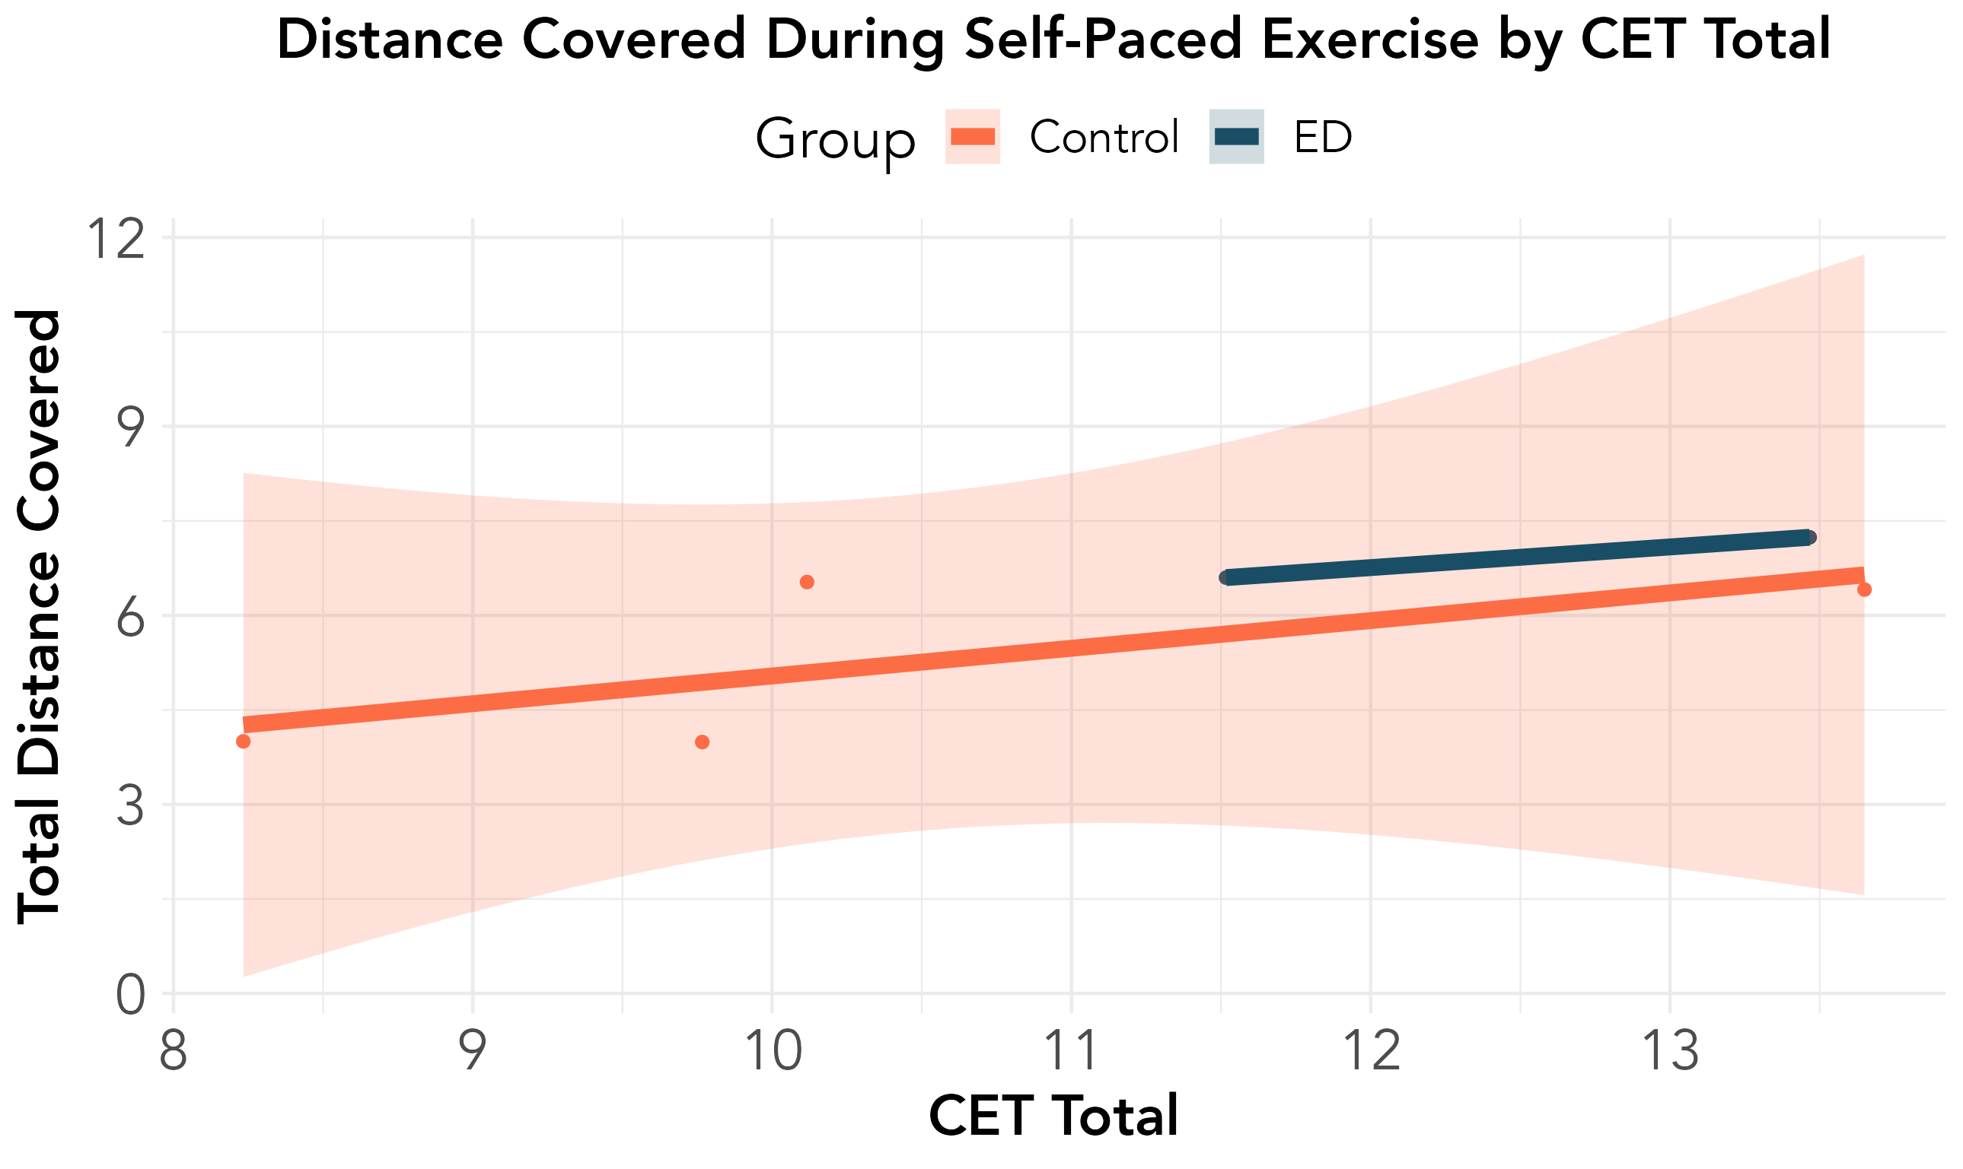
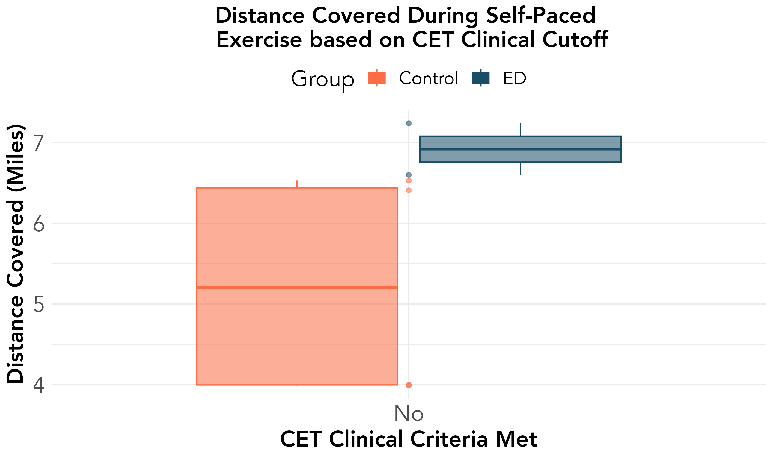
Distance Covered / Compulsive Exercise Test

Slide 17
PR Breakpoint

Slide 18
Takeaways
Those with EDs may vary in
Improved understanding acute response to exercise is necessary for exercise-based intervention development
As adaptive exercise has many benefits, reshaping exercise experiences xxx intervention goal
In-vivo exercise training may be an understudied intervention

Slide 19
Future Work
Examine impacts of exercise on key biomarkers
Continue to develop and diversify samples for hypothesis testing

Slide 20
Many Thanks!

