Slide 1
Problem Solving through Data Modeling
“In the ‘real world’ there are no model answers, no completely right or wrong solutions.”
How do we understand a problem to solve it?

Slide 2
Rome was not built in a day
In a 16 week class in the Information Science department at MIT it was explained to students that expertise in data modeling could not come from study alone and that none of them would be ‘experts’ at the conclusion of the course. Instead, it was emphasized that expertise comes largely from experience, from exposure to a wide range of modeling applications and situations, and from the ability to think creatively ‘outside the square.’

Slide 3
Basics of Data Modeling
Name the Entities
Add some Attributes
Verbalize their Relationships
Name the Nouns
Add some adjectives
Verbalize their verbs

Slide 4
Entities
Nouns, typically becomes a table.
Car
Driver
Road

Slide 5
Attributes (adjectives)
Properties or the things that describe the entity
Car
Color
Make
Model
Speed
Direction
Driver
Driver
Name
Sex

Slide 6
Relationships (Verbs)
How are the entitles related
There are many Cars MOVING on a ROAD and are DRIVEN by a Driver
Road 1:M Cars
Car 1:1 Driver

Slide 7
The old Order Problem
Model the traditional online order for a product.
Workflow: Customer orders a product that is fulfilled and shipped to the customer’s home.

Slide 8
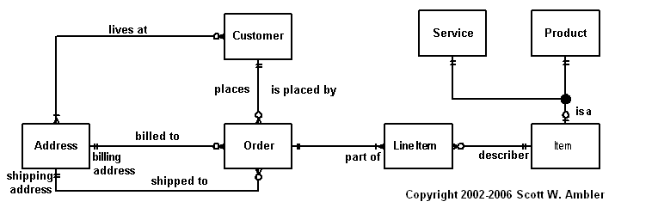
Customer Order Model

Slide 9
Data Types
CharField (Text Field)
TextField (Text Area)
Integer (Number) [multiple types]
Date (Date Object
Media Path
Boolean

Slide 10
Primary Keys and Foreign Keys
Primary Key
Foreign Key
An ID to relate and definitely call the particular record or row
Storage of a Primary Key from another table. Shows the relationship.

Slide 11
Relationships
1:1
1:M
One entity can be related to one other entity
One row can be related to one row on another table
Cars can have one driver
Car 1:1 Driver
One entity can be related to many other rows on another table
Father has many children but a child only has one father
Father 1:M Children

Slide 12
Relationships
Many to Many
Many Entities can have many rows and vice versa.
Classes have many students. Students have many classes
Classes M:M Students

Slide 13
Notation
Simple Outline for Entities and Attributes
Use () Foreign Key
(1:1) One to One
(1:M) One to Many
(M:M) Many to Many

Slide 14
Example notation
Car
Driver (1:1)
Color
Make
Model
Driver
Name

Slide 15
Problem 1
Write a short product description that examines this object and explain a usage, different from the usual or intended usage. Be creative.
Example:
This fuzzy foot massager provides a firm resistance and repetitive motion for stopping arch pain. The bright green color enhance your mood while you receive a comfortable touch to the bottom of your feet. Comes in packs of two, one for each foot and one for a backup just incase one rolls away.

Slide 16
Problem 2
Construct a grammatically correct and meaningful English sentence that has the word ‘and’ repeated five times with no other words in between; punctuation between the five ‘ands’ is allowed.
Notes:
“A man is painting a sign outside the Dog and Duck and the landlord comes out and says to him: ‘I’d like more space, please, between the ‘dog’ and ‘and’ and ‘and’ and ‘duck’!’”

