Slide 1
Hardware Modeling
Jeremy Bennett
Chip Hack, 21 April 2013
Notes:
This presentation provides a brief introduction to Embecosm, suppliers of services, tools and models for embedded software development.
Embecosm is very happy to visit you to present further detail and discuss your specific needs. Please contact us for further information:
Palamos House #104
66/67 High Street
Lymington SO41 9AL UK
Tel: +44 1590 610184
Email: info@embecosm.com
Our agent in the US is:
Leapahead Solutions Inc
Tel: +1 512 413 0506
Email: harshk@yahoo.com

Slide 2
Modeling Technologies
Event driven simulators
  model all of Verilog/VHDL, not just the synthesizable subset
  commercially: Modelsim, NC and VCS
  open source: Icarus Verilog, GHDL
Cycle accurate modeling tools
  model synthesizable Verilog/VHDL
  commercially: Carbon Design Systems SpeedCompiler
  open source: Verilator
  hand-writing: SystemC
High level models
  transaction level modelling with SystemC
Wave trace visualization
  GTKWave

Slide 3
GTKWave
Open source waveform viewer
  http://gtkwave.sourceforge.net/
  works on Verilog Change Dump (VCD) files
Features
  reads standard VCD
    also supports LXT, LXT2, VZT, FST, and GHW formats
  twinwave command for viewing two waveforms alongside
Example
  we need to generate VCD files from some sort of model or simulator.

Slide 4
Icarus Verilog
Open Source Verilog simulator
  http://iverilog.icarus.com/
Features
  all of Verilog 95/2001/2005
  some support for SystemVerilog 2005/2009
  no VHDL
  slower than commercial simulators
Example
$ iverilog -DSIMULATE -o basics basics.v basics_tb.v
$ vvp basics
ctrl-C
> finish
$

Slide 5
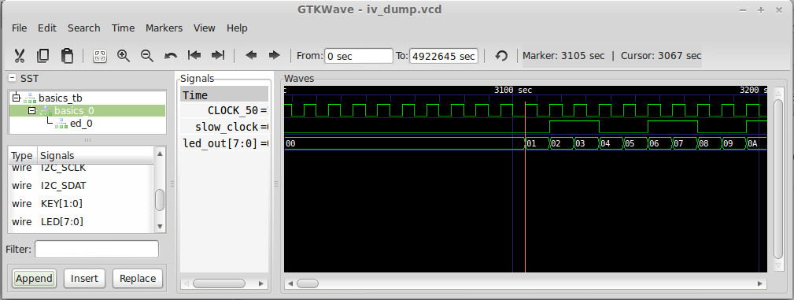
Icarus Verilog Wave Trace
Simulate
$ iverilog -DSIMULATE -DIV_DUMP -o basics basics.v basics_tb.v
$ vvp basics
ctrl-C
> finish
$
Visualize
$ gtkwave iv_dump.vcd

Slide 6
About Verilator
What is Verilator?
  open source tool synthesizing Verilog/SystemVerilog to C++/SystemC
    Note. synthesis only
  models are 2-state, zero delay and cycle accurate.
What is Verilator used for?
  system verification: fast cycle accurate models of BIG systems
  regression testing on server farms: no license fees to worry about
  processor models for firmware development: e.g Atmel Studio
How is Verilator developed?
  originated by DEC in 1994, open sourced in 1998
  taken over by Wilson Snyder in 2001, complete rewrite in C++
  Embecosm provide commercial support & development
Notes:
Verilator was originally developed by Digital Equipment Corporation starting in 1994 to allow them to convert Verilog designs to C models. It was released as open source in 1998. Over the past 16 years it has undergone extensive development. Now in its 3rd version, it is a mature tool, capable of generating high speed models with exact cycle accurate semantics.
The tool has been adopted by design houses to improve verification throughput in various areas. It is widely used by NXP. The UK based design house, Art of Silicon, uses Verilator based testing on a Linux farm, allowing them to run full hardware regressions of complex SoC designs overnight.
Benchmark performance indicates Verilator models are 2-4 times quicker than the best event driven simulators, such as NC and VCS. The mechanism of operations is completely different, so performance comparisons vary. The biggest gains are when designs are being driven hard (rather than just idle clocking).
Being open source, there are no restrictions on the number of users of the tool, the number of models generated or the number of users of those models. The sole cost is the effort of running the tool to generate the models. An active user community means that bugs and problems are quickly sold.
By comparison commercial tools from Virage Logic (VTOC) or Carbon Design Systems (Speed Compiler) charge time-based licenses for the tools and place restrictions on use of the generated models.
Verilator models follow strict zero-delay synthesis semantics, using 2-value logic. As such they are far closer to gate level simulation and the behavior of the final chip. This means they find bugs due to dependencies on 'X' and 'Z' behavior which conventional simulators miss.
Being C++ based, the models are easily integrated into standard firmware tool chains. The Embecosm Unified Debug Interface (open source) makes this even easier and ensures the test benches can be reused for simulation, FPGA emulation or final silicon in the future.
Dr Jeremy Bennett has a decade of senior experience with cycle accurate modeling. He is author of standard guides on using Verilator and its integration in SW tool flows.

Slide 7

Modeling Process
C based IP
(optional)
Test Bench
(C++/SystemC/DPI)
SystemC/C++
Cycle Accurate Model
Processor
DUT
(Verilog)
Results
Verilator
VCD
(optional)
Notes:
In the standard Verilator flow, the Verilog processor DUT is passed to Verilator, which converts it to SystemC/C++. The DUT must be synthesizable, with any non-synthesizable components replaced by synthesizable equivalents. This is quite common with behavioral memory modules.
The resulting model may be linked with other IP written in C/C++ or SystemC to build the complete model (this may happen during development, where only part of the design is available in Verilog, with other components available as architectural models.
The easiest way to drive the resulting processor model is through the GNU Debugger. The Embecosm Unified Debug Interface provides the simplest way to implement this. It also provides a reusable interface, so that the same tests will run in the future using event driven simulation, FPGA emulation or final silicon. Tests are implemented as GDB batch scripts.
Verilator models can optionally generate a VCD. Results of tests are logged to file for checking.

Slide 8
Verilator C++ Example
Need C++ test bench
#include "Vbasics.h"
#include "verilated.h"
#include <iostream>
int main (int argc,
char *argv[],
char *env[])
{
Verilated::commandArgs (argc, argv);
Vbasics *top = new Vbasics;
int old_led;
vluint64_t main_time = 0;
top->KEY = 0x3;
top->CLOCK_50 = 0;
old_led = top->LED - 1;
do
{
top->eval ();
if (top->LED != old_led)
{
std::cout << "led = " <<
std::hex << (int) top->LED
<< std::endl;
old_led = top->LED;
}
top->CLOCK_50 =
1 - top->CLOCK_50;
main_time += 1;
}
while (top->LED != 0xfc);
top->final();
}

Slide 9
Building a Verilator Model
Convert the Verilog to C++
$ verilator -DSIMULATE --cc basics.v --exe basics_main.cpp
%Warning-IMPLICIT: basics.v:77: Signal definition not found, creating implicitly: slow_clock
%Warning-IMPLICIT: Use "/* verilator lint_off IMPLICIT */" and lint_on around source to disable this message.
%Warning-IMPLICIT: basics.v:81: Signal definition not found, creating implicitly: reset
%Warning-IMPLICIT: basics.v:82: Signal definition not found, creating implicitly: button
%Error: Exiting due to 3 warning(s)
%Error: Command Failed /home/jeremy/gittrees/verilator/verilator_bin -DSIMULATE --cc basics.v --exe basics_main.cpp
Disable that warning!
verilator -Wno-IMPLICIT -DSIMULATE --cc basics.v --exe basics_main.cpp
To find all the warnings:
verilator -Wall -DSIMULATE --cc basics.v --exe basics_main.cpp

Slide 10
Running a Verilator Model
Change to the model directory
cd obj_dir
Compile the model
make -f Vbasics.mk Vbasics
Run the model
$ ./Vbasics
led = 0
led = 4
led = 8
led = c
led = 10
...
led = f4
led = f8
led = fc
$
Exercise: Print out the clock count as well.
Exercise: Add a stimulus for the reset button

Slide 11
Tracing with Verilator
Add header to test bench C++ program
#if VM_TRACE
# include <verilated_vcd_c.h> // Trace file format header
#endif
Set up tracing before the main loop
#if VM_TRACE
// Set if called with --trace
Verilated::traceEverOn(true);
VerilatedVcdC *tracer = new VerilatedVcdC;
top->trace (tracer, 99);
tracer->open ("basics_dump.vcd");
#endif
Dump values during each step in the loop after eval ()
#if VM_TRACE
tracer->dump (main_time);
#endif
Tidy up at the end
#if VM_TRACE
tracer->close ();
#endif

Slide 12
Generating Trace with Verilator
Generate the C++ with tracing enabled
$ verilator --trace -Wno-IMPLICIT -DSIMULATE --cc basics.v --exe basics_main.cpp
Build the model as before
$ cd obj_dir
$ make -f Vbasics.mk Vbasics
Run the model
$ ./Vbasics
The VCD is generated and can be viewed with GTKWave
$ ls *.vcd
basics_dump.vcd
gtkwave basics_dump.vcd
Exercise: use twinwave to compare with the Icarus VCD

Slide 13
SystemC
Template library for C++ to support modeling
  concept of modules
  modules connected via ports
    set of C++ types corresponding to different types of connection
  modules have processes
    threads which run forever and can be pre-empted
    methods with run once and cannot be pre-empted
    sensitive to module data
No main, instead sc_main ()
  called once from the kernel
  instantiate and connect all the modules
  then call sc_start ()

Slide 14
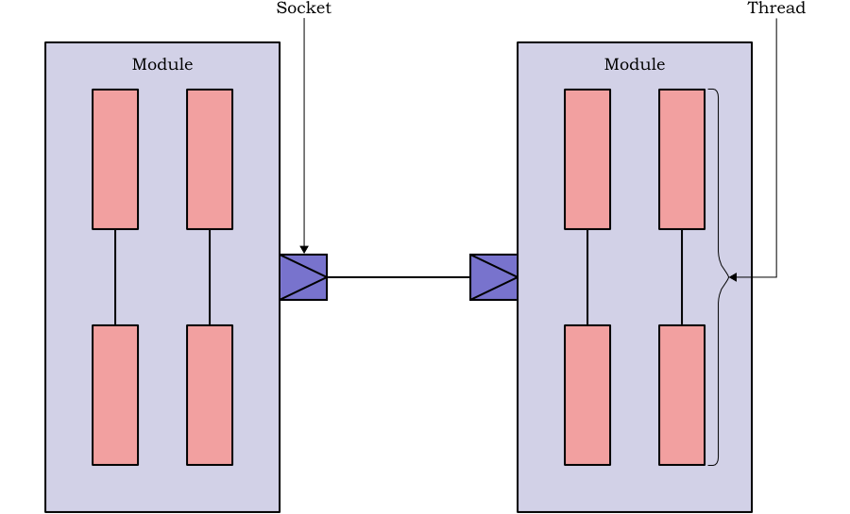
Transaction Level Modeling
What is TLM?
  conventionally advance clock, all components advance their state
  TLM instead have set of processes, communicating via messages
TLM is more efficient
  components only compute when they have something to do
  mirrors way components talk across buses

Slide 15
Further Reading
More on GTKWave, Icarus Verilog and Verilator
  http://iverilog.icarus.com/
  http://www.veripool.org/wiki/verilator
  http://gtkwave.sourceforge.net/
  Embecosm App Note #6: High Performance SoC Modeling with Verilator
    http://www.embecosm.com/appnotes/ean6/embecosm-or1k-verilator-tutorial-ean6-issue-1.html
More on SystemC:
  IEEE 1666 (it's free!)
    http://standards.ieee.org/findstds/standard/1666-2011.html
  www.systemc.org
More on TLM:
  Embecosm App Note #1: Building a Loosely Timed SoC Model with OSCI TLM 2.0
    http://www.embecosm.com/appnotes/ean1/ean1-tlm2-or1ksim-2.0.html
Notes:
This package is designed to allow customers to evaluate Verilator based verification for processor design. It is intended for small processors which are fully synthesizable and offer a JTAG debug interface.
The time on the customer's site allows Embecosm to install all the tools needed, build a working model and integrate that model with the software test bench.
Embecosm will install all the tools on a local workstation. If desired we can advise the customer's IT staff on system wide installation.
We provide an initial conversion of the customer DUT, resolving any issues that may arise, creating a script which will allow regeneration of the model as needed in the future (when DUT Verilog is changed).
We provide an initial integration with the software world using the Embecosm Unified Debug Interface. This uses the customer's existing GNU tool chain, allowing the user to drive the model with the basic GDB commands to set and read registers, set and read memory and to breakpoint, continue and single step the processor via JTAG.
This yields a model, which the customer can use for software verification. The customer can update the model as needed when the Verilog changes, and distribute the model to anyone they wish.
Embecosm provides ongoing support via telephone and email for 3 months, to allow resolution of additional issues as they arise.
The price for this package is less than that for one year's use of a conventional simulator. The competitive price means customers have a low risk route to evaluating this technology.
Note. Price (also for the next package) excludes travel and expenses.

Slide 16
Thank You
Thank You
Hope you enjoyed Chip Hack
www.embecosm.com
Notes:
Embecosm is very happy to visit you to present further detail and discuss your specific needs. Please contact us for further information:
Palamos House #104
66/67 High Street
Lymington SO41 9AL UK
Tel: +44 1590 610184
Email: info@embecosm.com

