Slide 1
Instructors Introduction to Shrimping.it
Jeremy Bennett & Simon Cook, Embecosm

Slide 2

Persistence of Vision

Slide 3
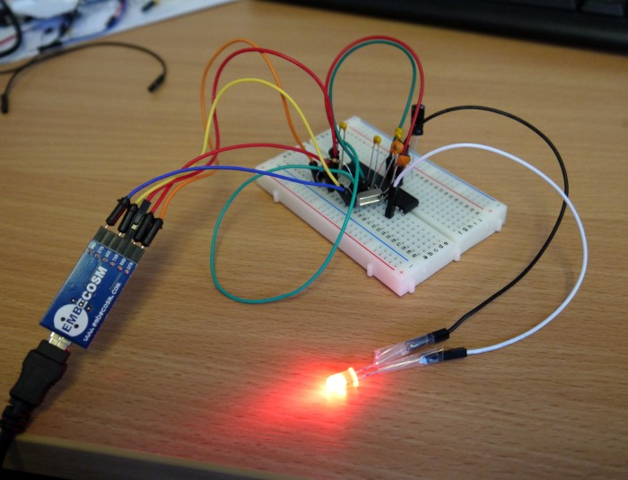

Arduino and Shrimping.it
Arduino
  low cost (~£20) 8-bit microcontroller for hobbyists
  based on Atmel ATMega328 chip
  1 million sold worldwide
Shrimping.it
  breadboard version of Arduino
  gives students hands-on experience
  much cheaper (£4 parts, £2 programming cable)

Slide 4
Preparation
Ensure your pupils can each access a USB port
Ensure the Arduino IDE is installed
  http://arduino.cc/en/main/software
Ensure the FTDI Windows/Mac drivers are installed
  http://www.ftdichip.com/FTDrivers.htm
  not needed with an recent Linux
Download and unzip the PoV software
  http://tinyurl.com/shrimpovcode
  or ensure your pupils have access to do this
Try it out for yourself first!

Slide 5
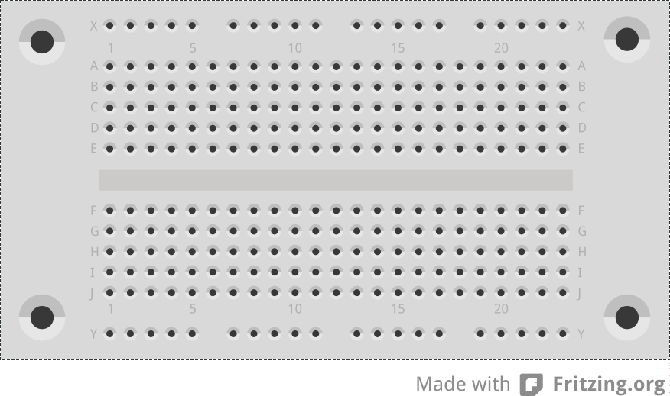
Breadboard

Slide 6
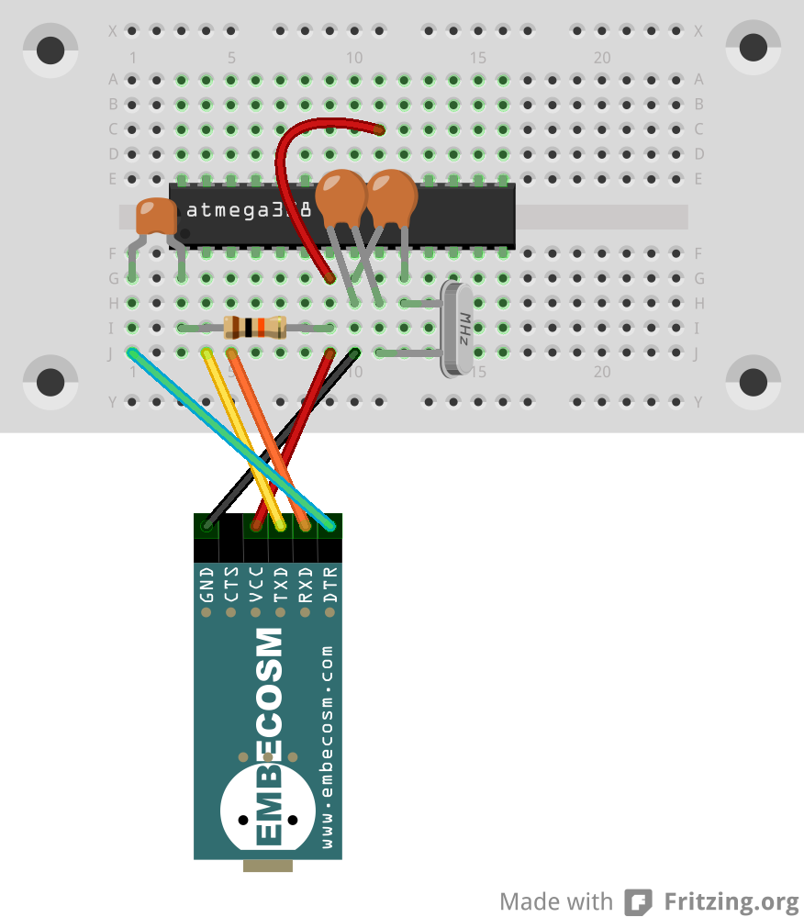
The Minimal Shrimp

Slide 7
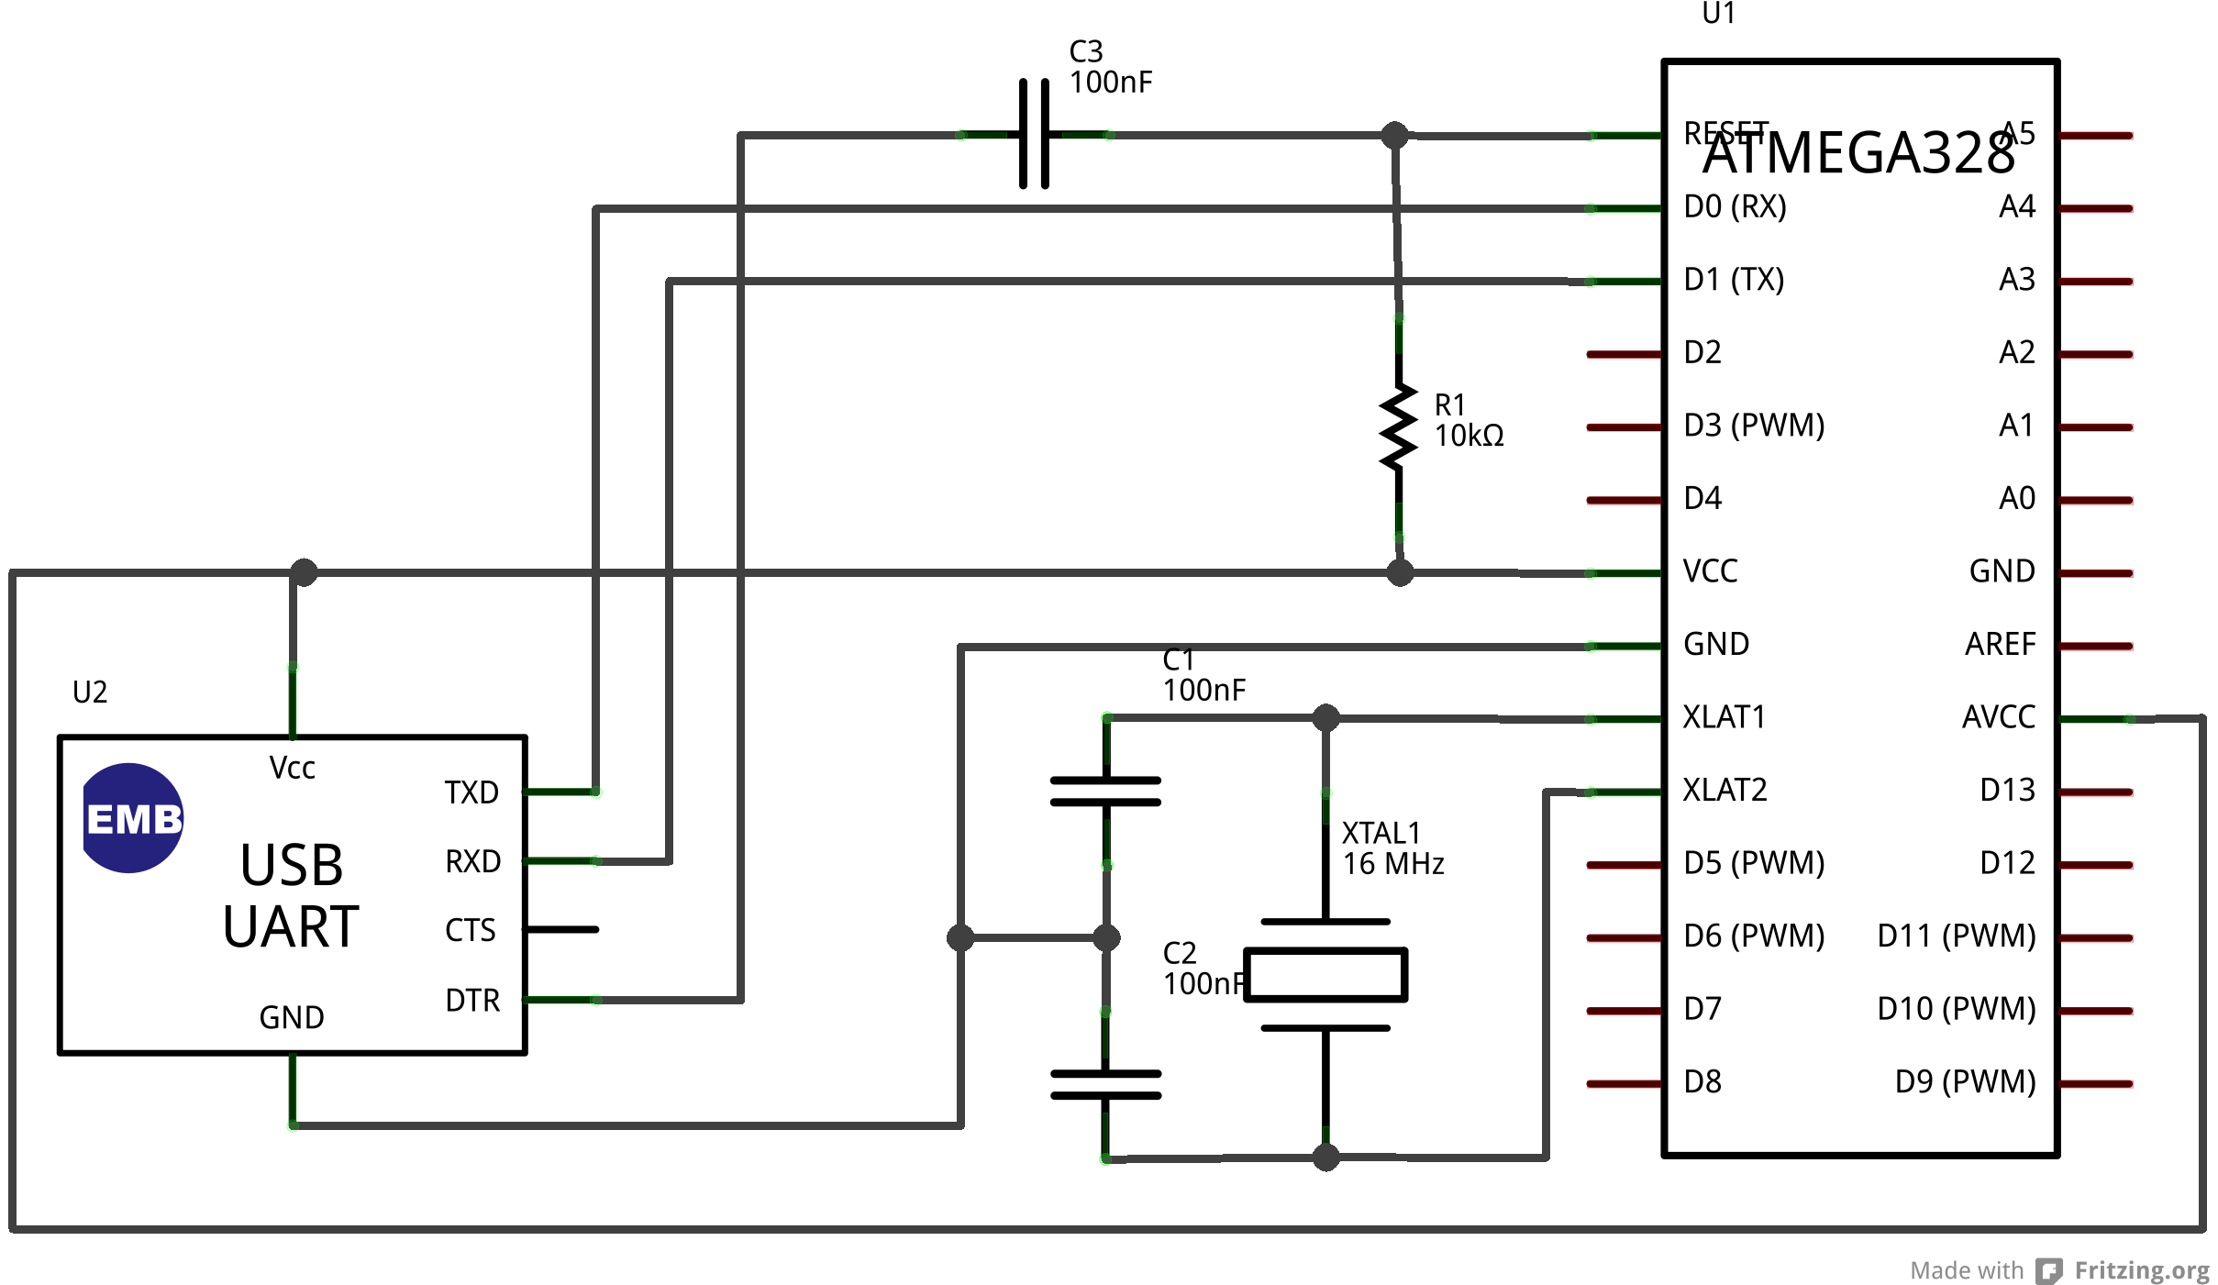
Minimal Shrimp Circuit

Slide 8
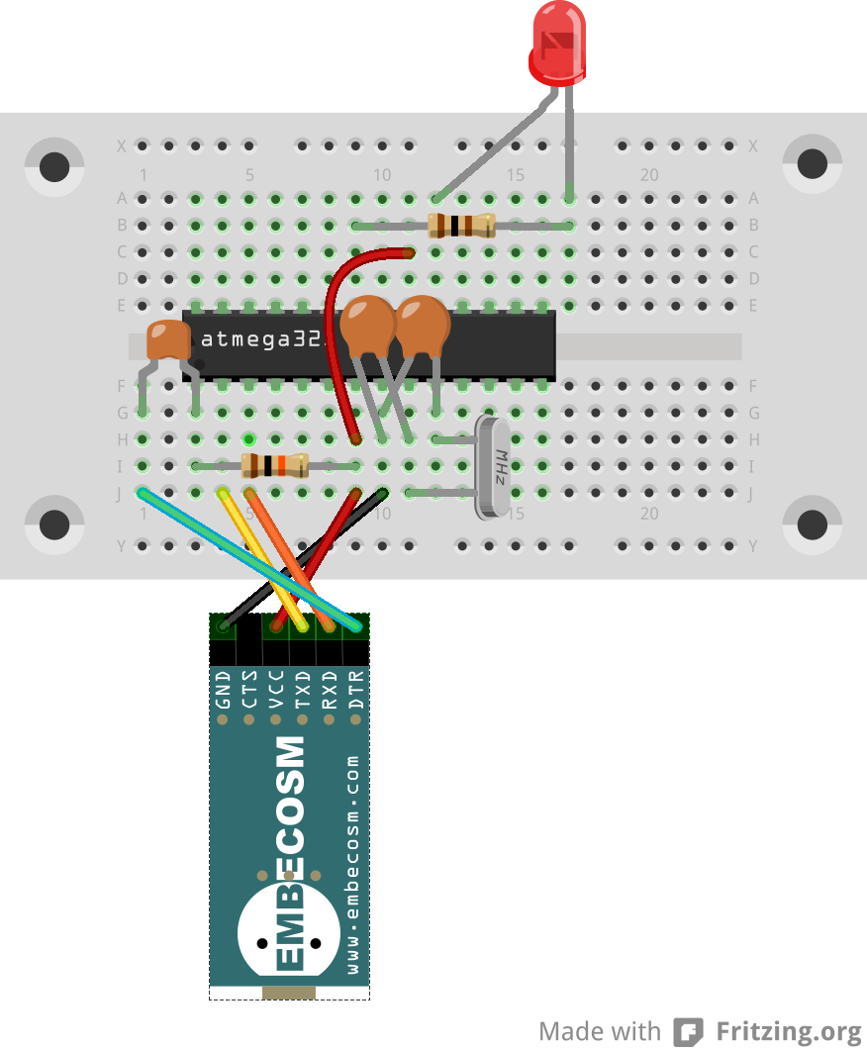
A Blinking Light
22pF capacitors
labeled “22J”
LED long leg on the left
100nF capacitor
labeled “104”
100Ω resistor
brown-black-brown
gold on the end
10kΩ resistor
brown-black-orange
gold on the end

Slide 9
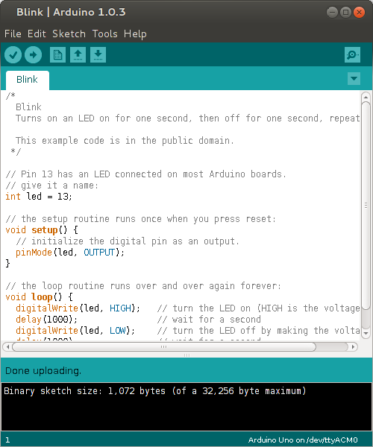
Loading the Blink Program
Note on Linux, you may have to be in the dialout and/or lock groups.

Slide 10
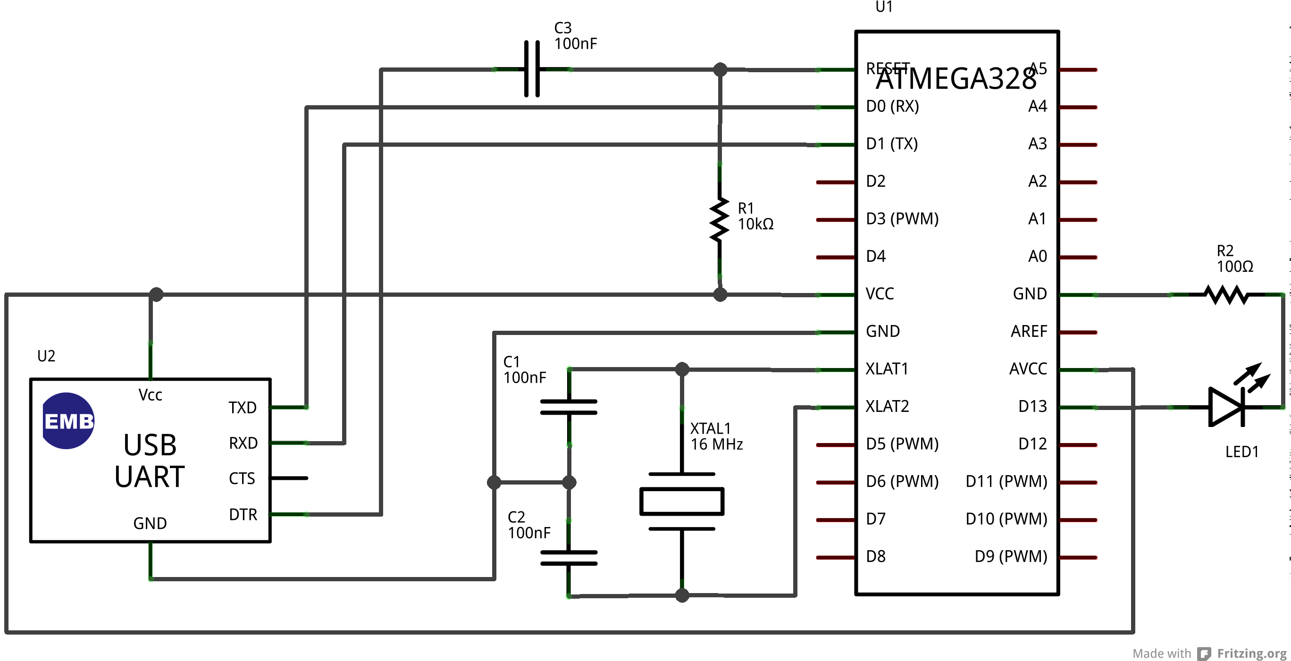
Blink Circuit Diagram

Slide 11
Ardunio/Shrimp Programming
Programmed in C/C++
Supplemented by the Wiring library
  makes common hardware operations easy
Only need to define two functions
  setup called once on reset
  loop called repeatedly thereafter
A good opportunity to learn a major language
  requires syntactic discipline
  but scales for BIG projects

Slide 12
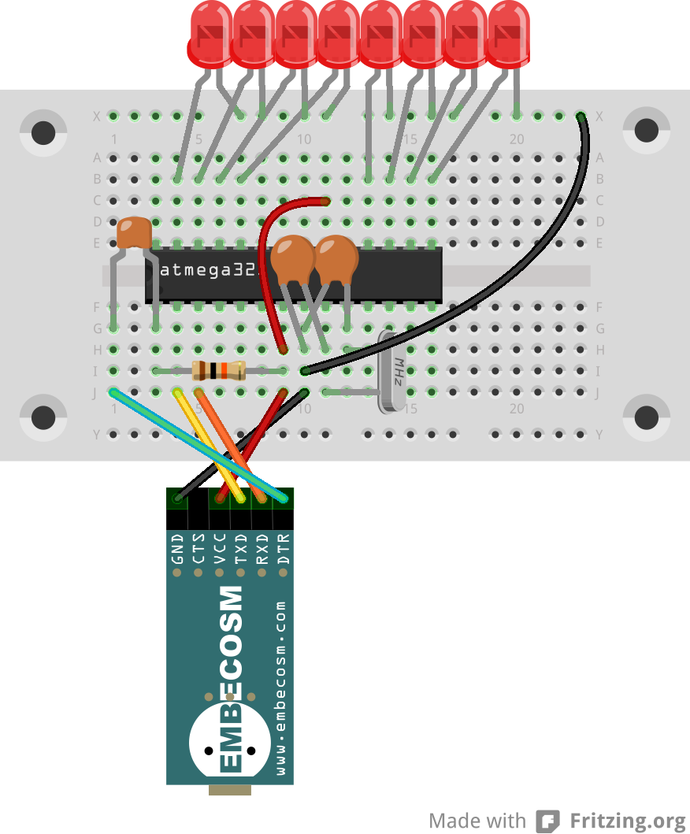
Persistence of Vision
22pF capacitors
labeled “22J”
LED long leg on the left
100nF capacitor
labeled “104”
10kΩ resistor
brown-black-orange
gold on the end

Slide 13
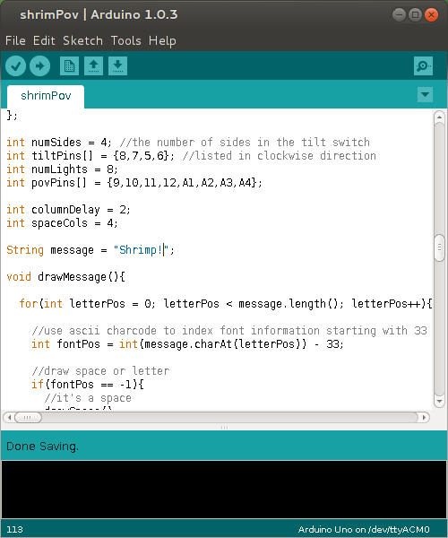
Loading the POV Program
http://tinyurl.com/shrimpovcode

Slide 14
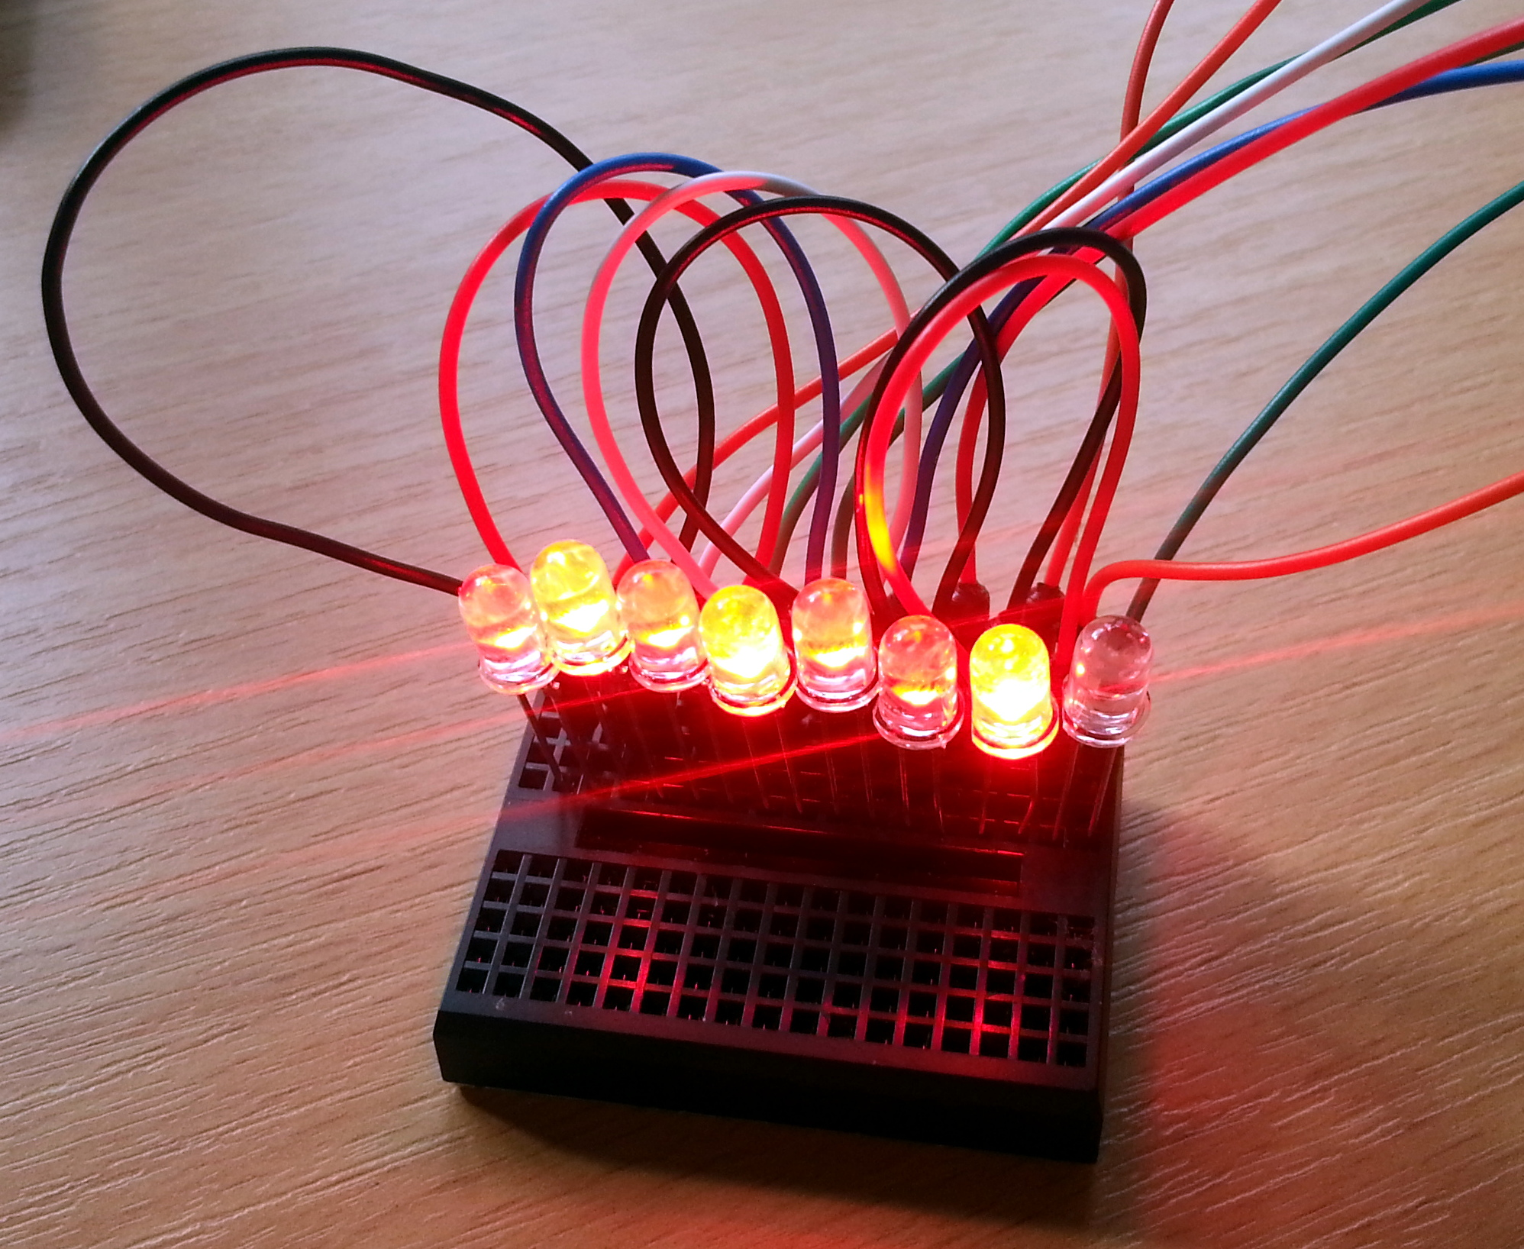
Shrimp Persistence of Vision

Slide 15
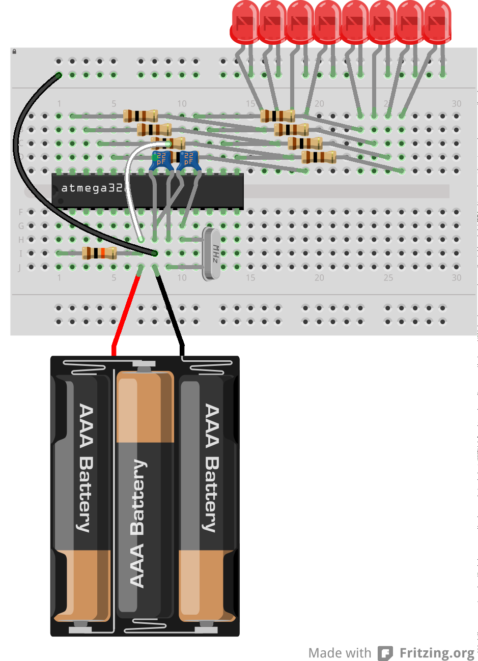
Shrimp PoV with a Battery

Slide 16
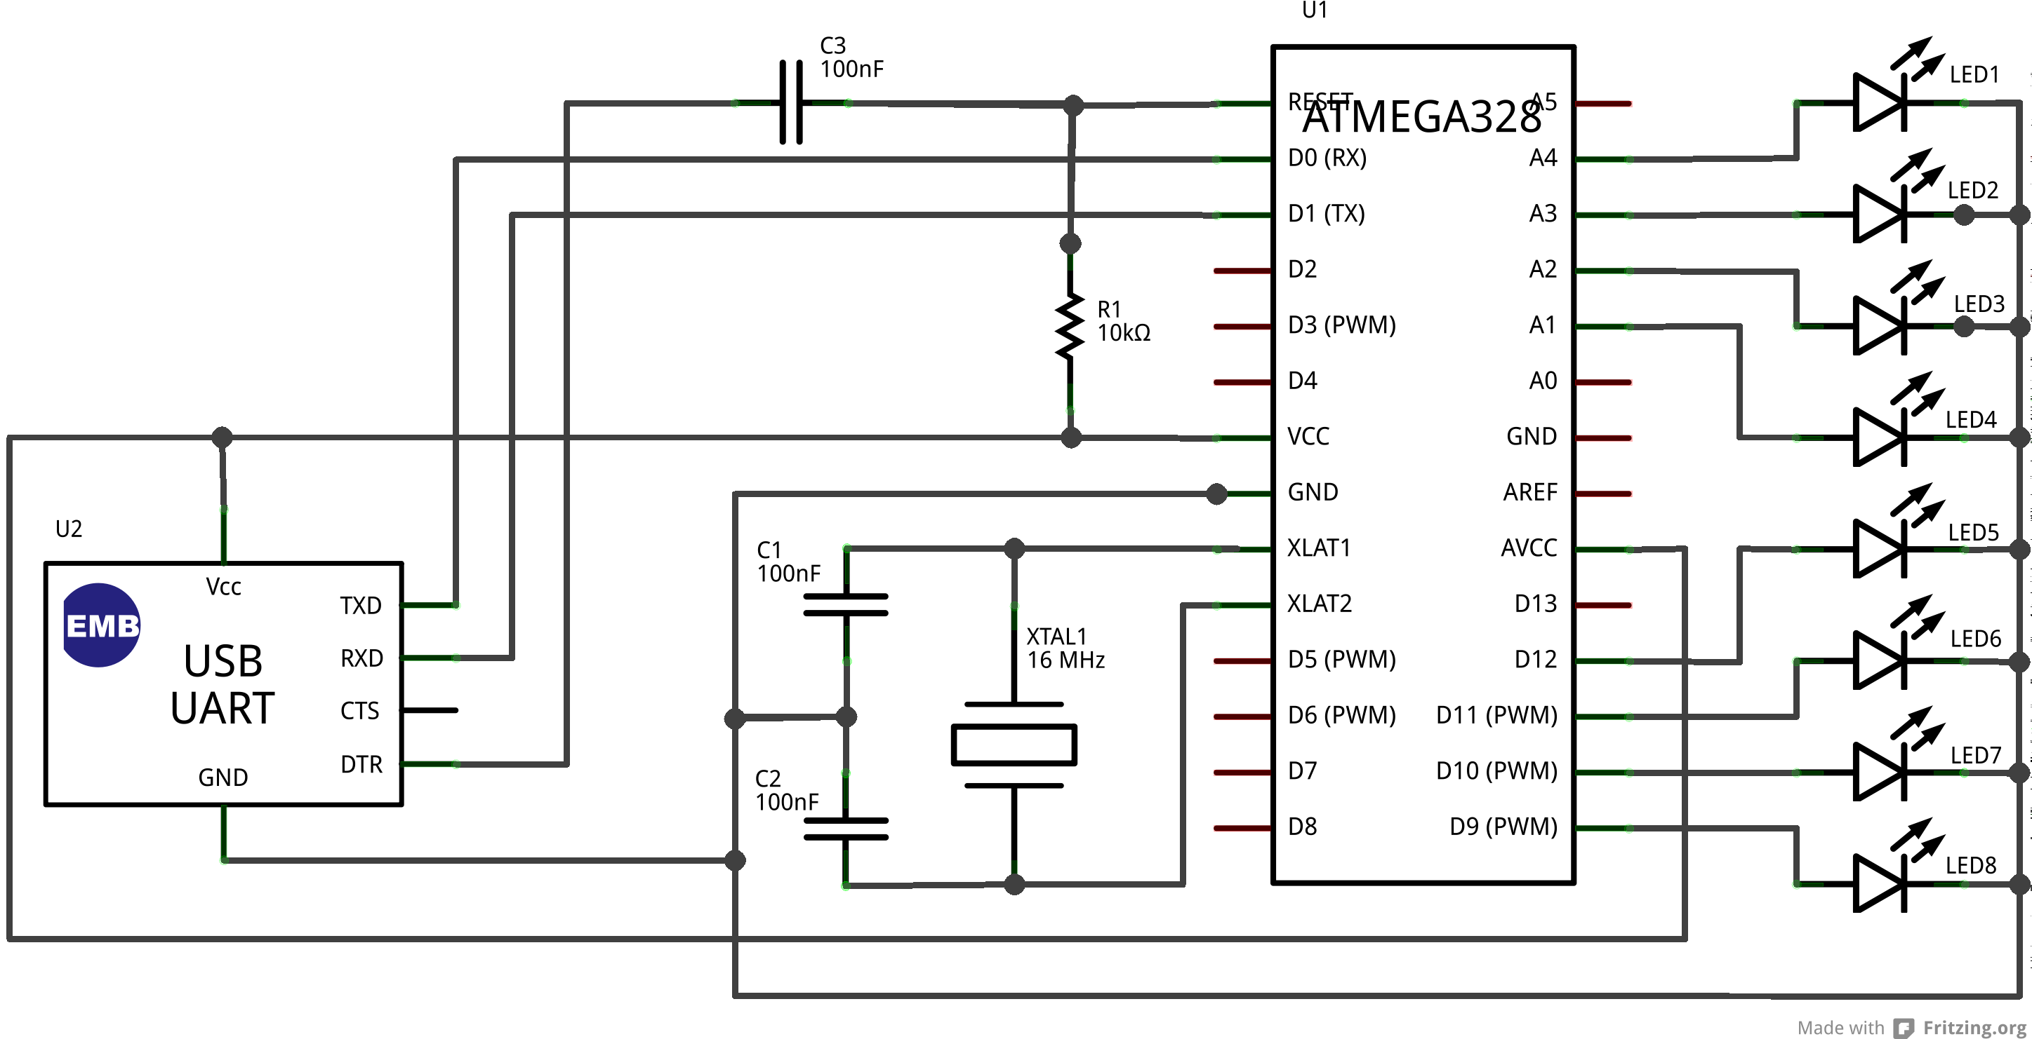
Shrimp PoV Circuit

Slide 17
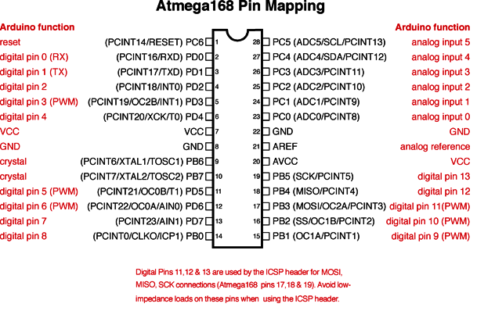
ATMega328 Pinout

Slide 18
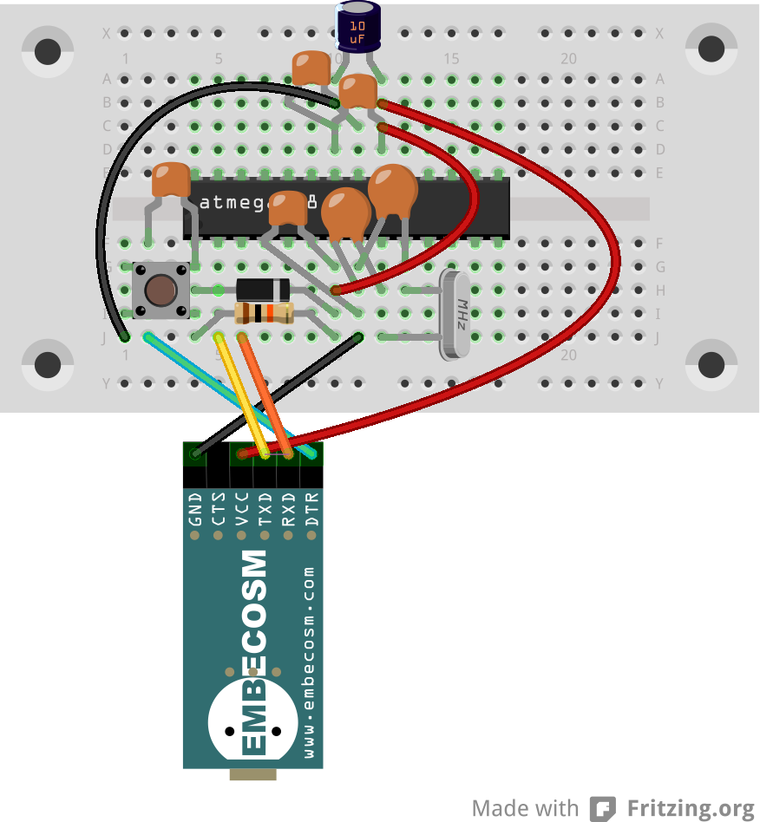
The Protected Shrimp

