Slide 1
Persistence of Vision with Shrimping.it
Training for #techmums Trainers
Jeremy Bennett, Embecosm

Slide 2



Thank You to Our Supporters

Slide 3

Who Makes Technology
Processor: ARM, Cambridge
Graphics: Imagination Technology, Kings Langley
Bluetooth: CSR, Cambridge
High speed data: Icera (nVidia), Bristol
Communications: Broadcom, Bristol & Cambridge

Slide 4


Engineering as a Career

Slide 5
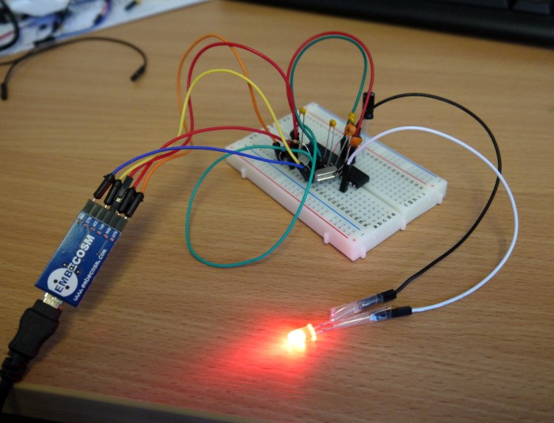

Arduino and Shrimping.it
Arduino
  low cost (~£20) 8-bit microcontroller for hobbyists
  based on Atmel ATMega328 chip
  1 million sold worldwide
Shrimping.it
  breadboard version of Arduino
  gives students hands-on experience
  much cheaper (£4 parts, £2 programming cable)

Slide 6
Arduino/Shrimp Programming
Programmed in C/C++ on laptop/PC
  compile (translate) and download to the Arduino/Shrimp
Supplemented by the Wiring library
  makes common hardware operations easy
Only need to define two functions
  setup called once on reset
  loop called repeatedly thereafter
A good opportunity to learn a major language
  requires syntactic discipline
  but scales for BIG projects

Slide 7
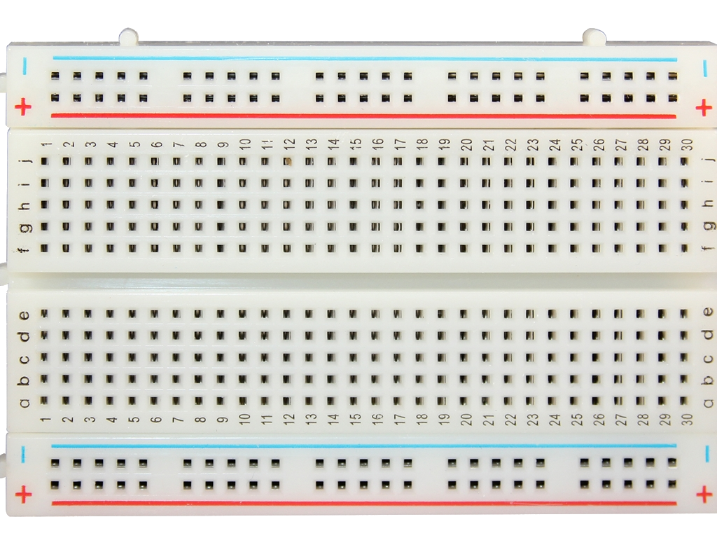
Breadboard

Slide 8
The Minimal Circuit

Slide 9
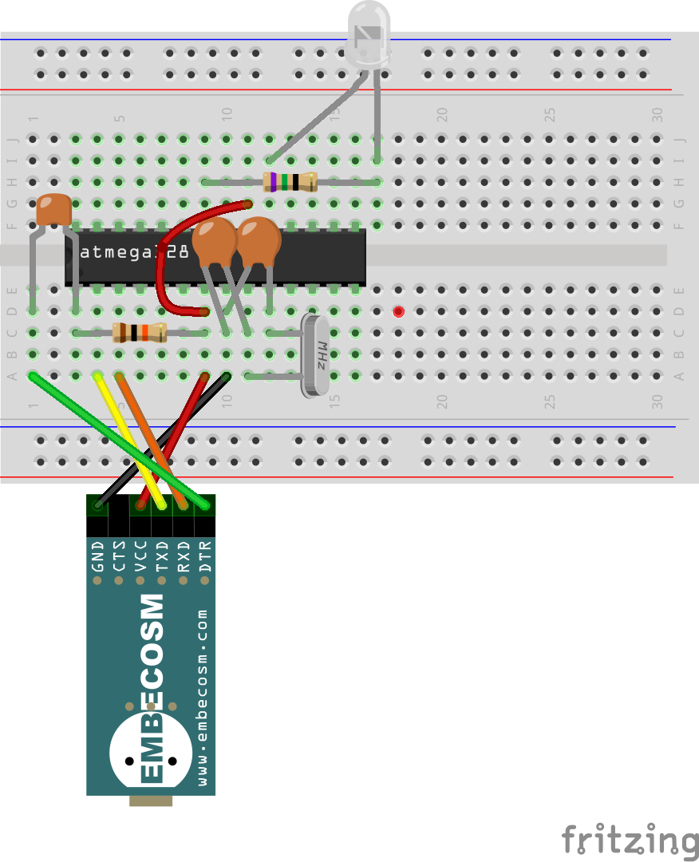
A Blinking Light
22pF capacitors
labeled “22J”
LED (shines red) long leg on the left
100nF capacitor
labeled “104”
75Ω resistor
violet-green-black
gold on the end
Notch in the end of the chip
Dot by pin 1 of the chip
10kΩ resistor
brown-black-orange
gold on the end

Slide 10
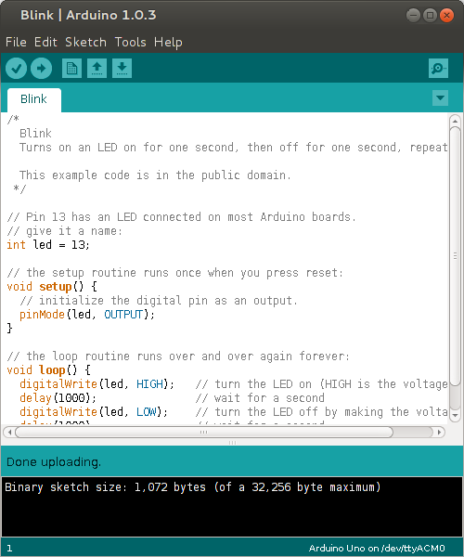
Loading the Blink Program
Note on Linux, you may have to be in the dialout and/or lock groups.

Slide 11
Persistence of Vision Circuit

Slide 12
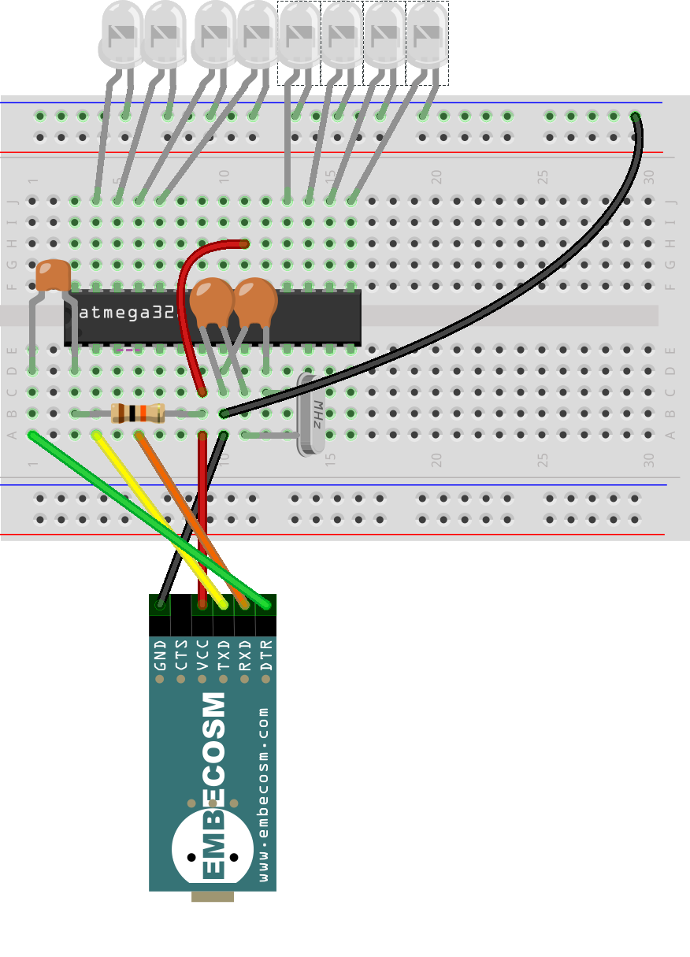
Persistence of Vision
22pF capacitors
labeled “22J”
LED (shines red) long leg at the bottom
100nF capacitor
labeled “104”
Notch in the end of the chip
Dot by pin 1 of the chip
10kΩ resistor
brown-black-orange
gold on the end

Slide 13
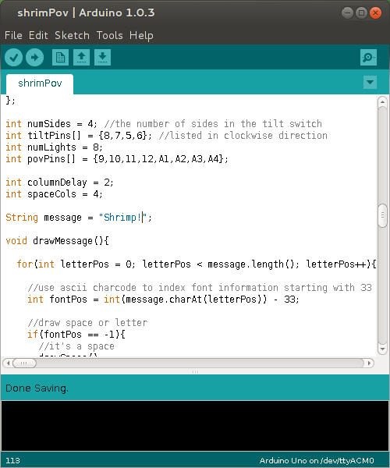
Loading the POV Program
http://tinyurl.com/shrimpovcode

Slide 14
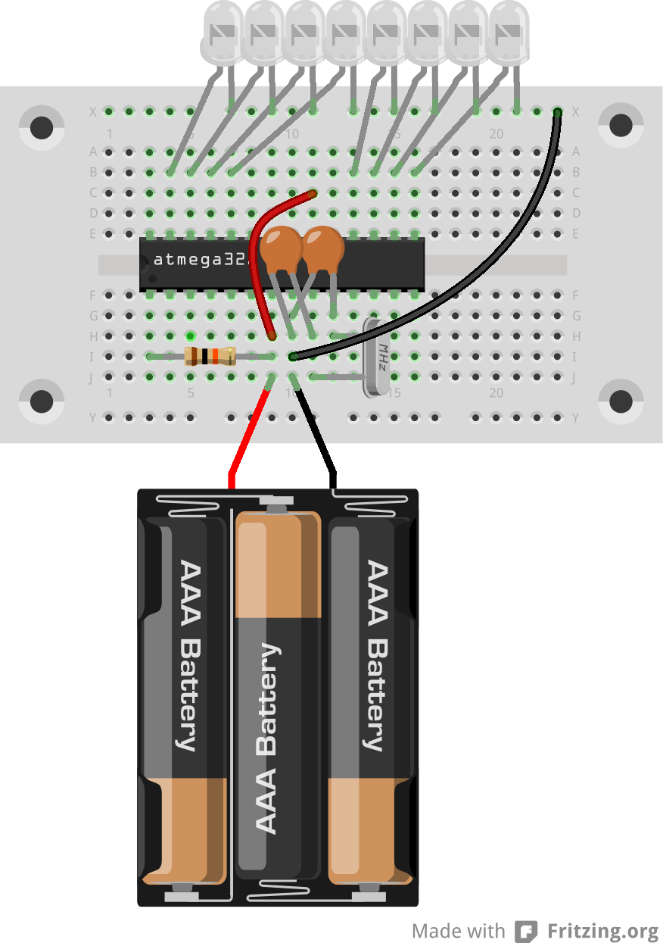
Shrimp PoV with a Battery

Slide 15
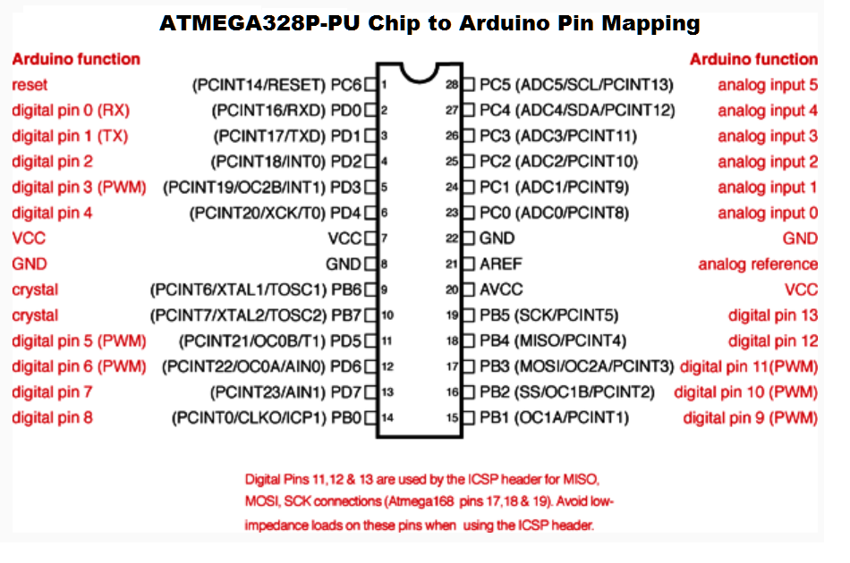
ATMega328 Pinout

Slide 16
Thank you
www.embecosm.com

