Slide 1
Persistence of Vision with Shrimping.it
#techmums
Jeremy Bennett, Embecosm

Slide 2



Thank You to Our Supporters

Slide 3

Who Makes Technology
Processor: ARM, Cambridge
Graphics: Imagination Technology, Kings Langley
Bluetooth: CSR, Cambridge
High speed data: Icera (nVidia), Bristol
Communications: Broadcom, Bristol & Cambridge

Slide 4


Engineering as a Career

Slide 5
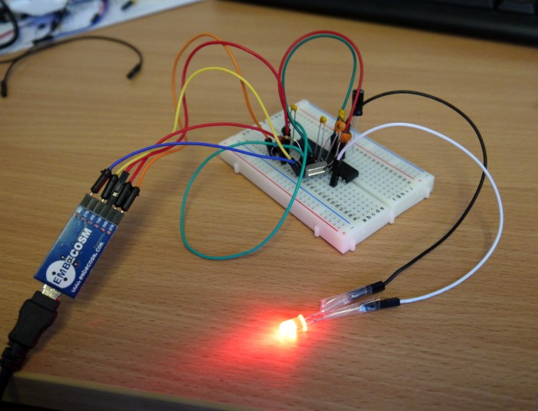

Arduino and Shrimping.it
Arduino
  low cost (~£20) 8-bit microcontroller for hobbyists
  based on Atmel ATMega328 chip
  1 million sold worldwide
Shrimping.it
  breadboard version of Arduino
  gives students hands-on experience
  much cheaper (£4 parts, £2 programming cable)

Slide 6
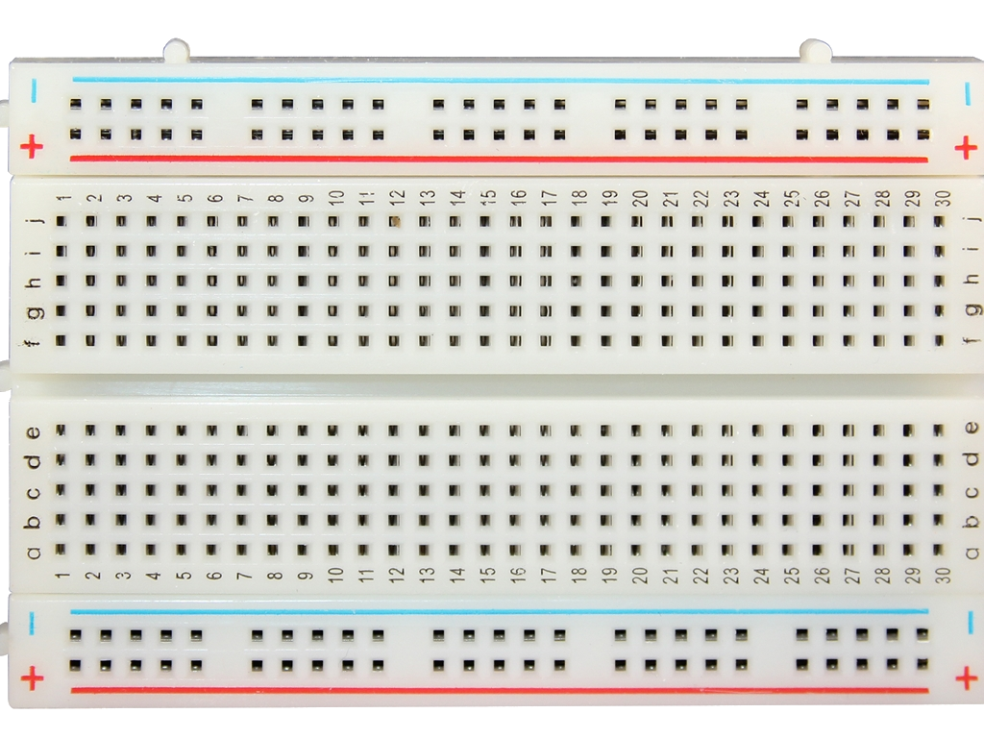
Breadboard

Slide 7
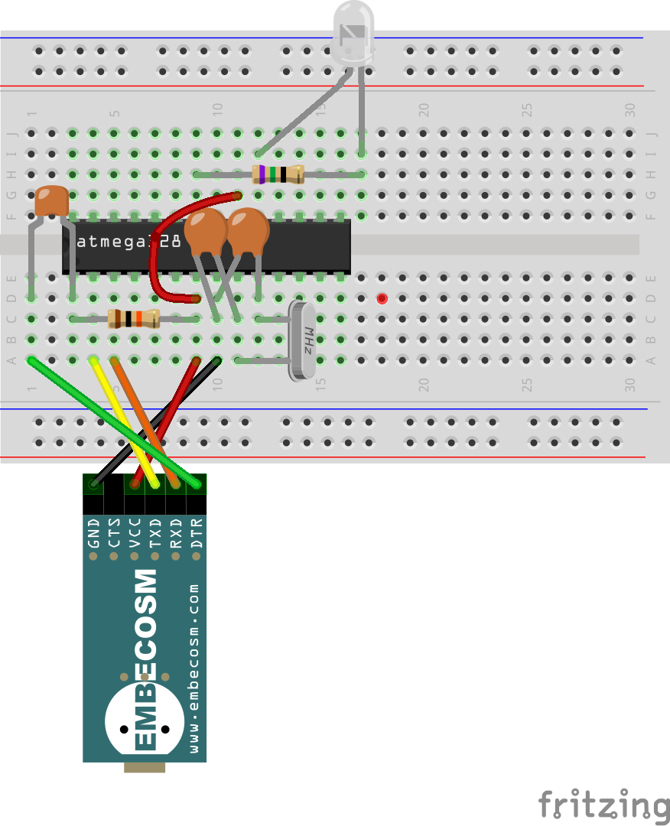
A Blinking Light
22pF capacitors
labeled “22J”
LED (shines red) long leg on the left
100nF capacitor
labeled “104”
75Ω resistor
violet-green-black
gold on the end
Notch in the end of the chip
Dot by pin 1 of the chip
10kΩ resistor
brown-black-orange
gold on the end

Slide 8
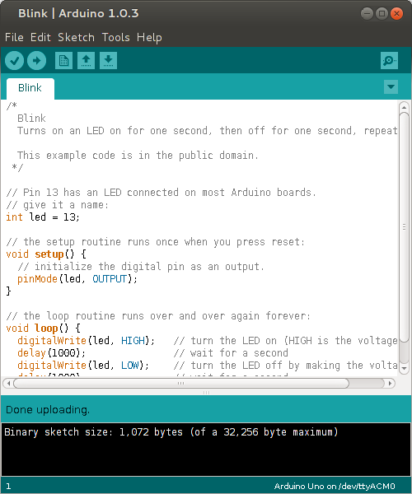
Loading the Blink Program

Slide 9
Arduino/Shrimp Programming
// Pin 13 has an LED connected on most Arduino boards.
// give it a name:
int led = 13;
// the setup routine runs once when you start up:
void setup() {
// initialize the digital pin as an output.
pinMode(led, OUTPUT);
}
// the loop routine runs over and over again forever:
void loop() {
digitalWrite(led, HIGH); // turn the LED on (HIGH voltage)
delay(1000); // wait for a second
digitalWrite(led, LOW); // turn the LED off (LOW voltage)
delay(1000); // wait for a second
}

Slide 10
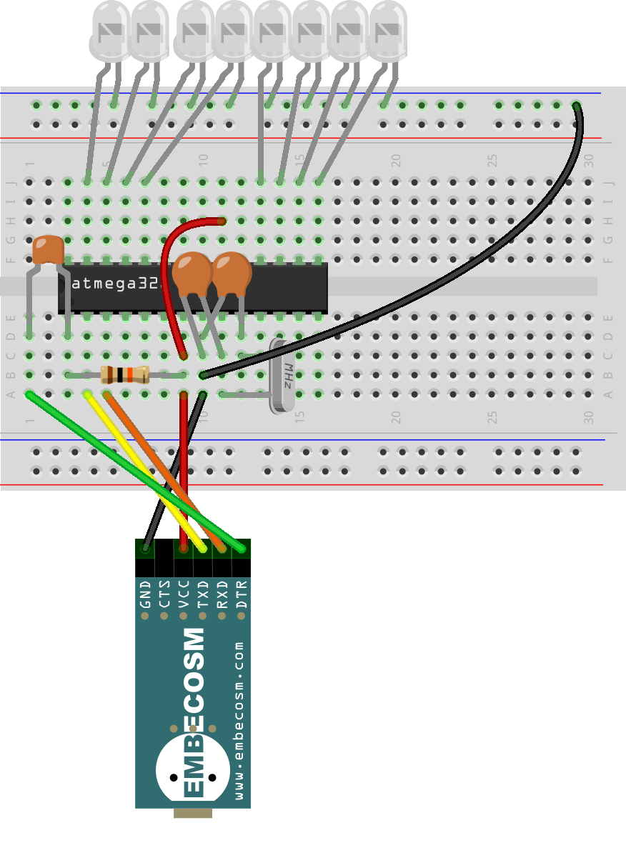
Persistence of Vision
22pF capacitors
labeled “22J”
LED (shines red) long leg at the bottom
100nF capacitor
labeled “104”
Notch in the end of the chip
Dot by pin 1 of the chip
10kΩ resistor
brown-black-orange
gold on the end

Slide 11
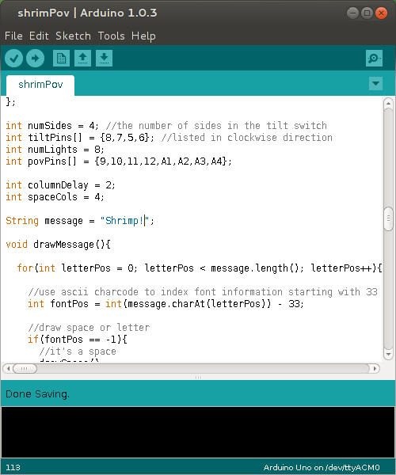
Loading the POV Program
http://tinyurl.com/shrimpovcode

Slide 12
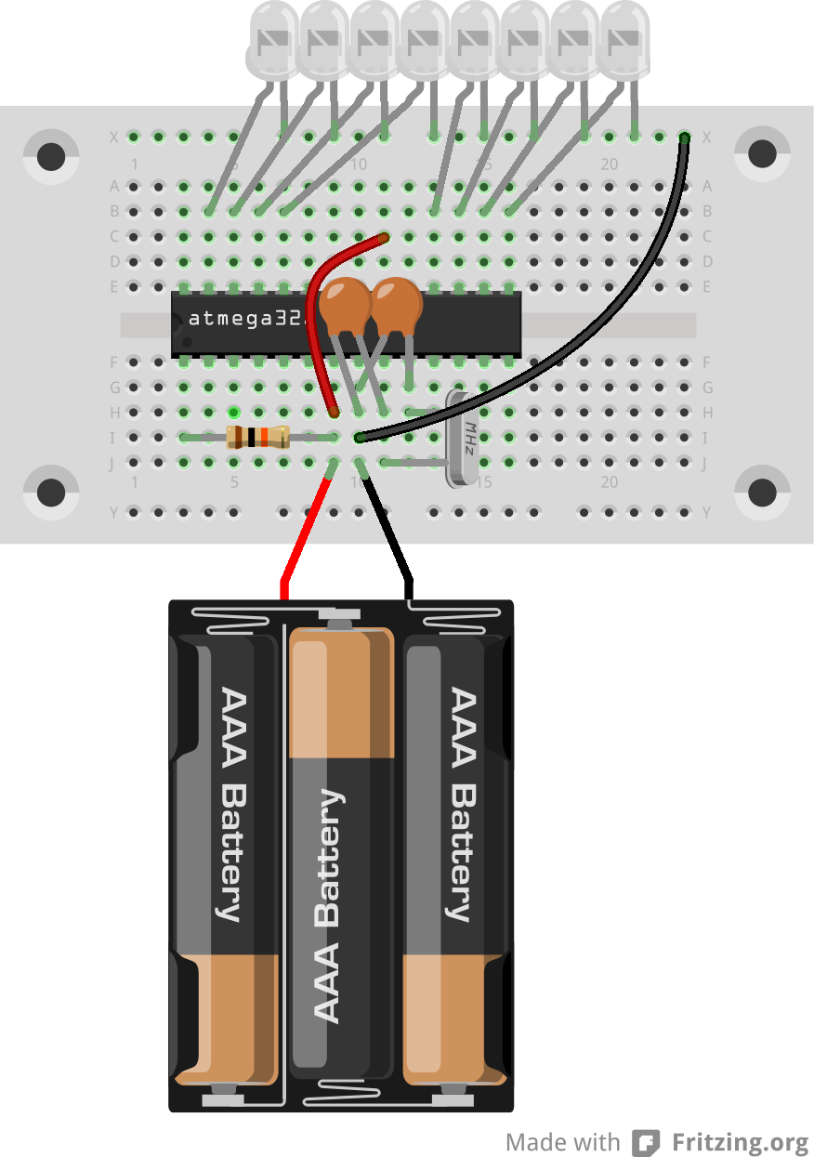
Shrimp PoV with a Battery

Slide 13
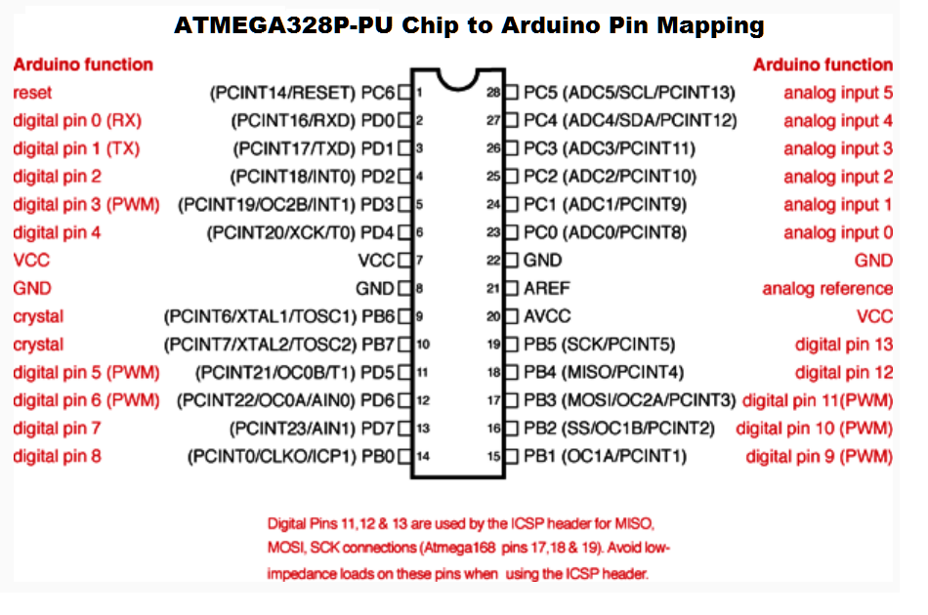
ATMega328 Pinout

Slide 14
The Minimal Circuit

Slide 15
Persistence of Vision Circuit

Slide 16
Thank you
www.embecosm.com

