Slide 1
Persistence of Vision with Shrimping.it
Jeremy Bennett & Simon Cook, Embecosm

Slide 2

Persistence of Vision

Slide 3
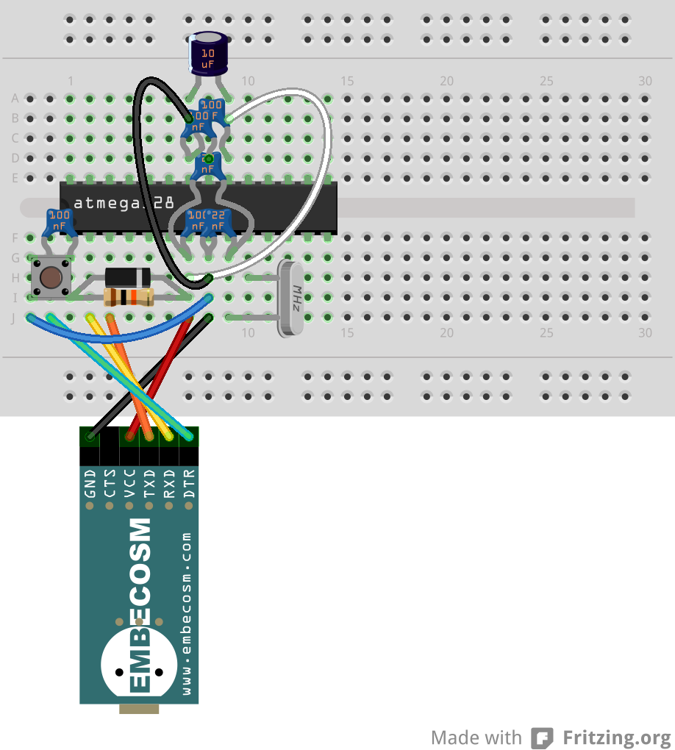
The Basic Protected Shrimp

Slide 4
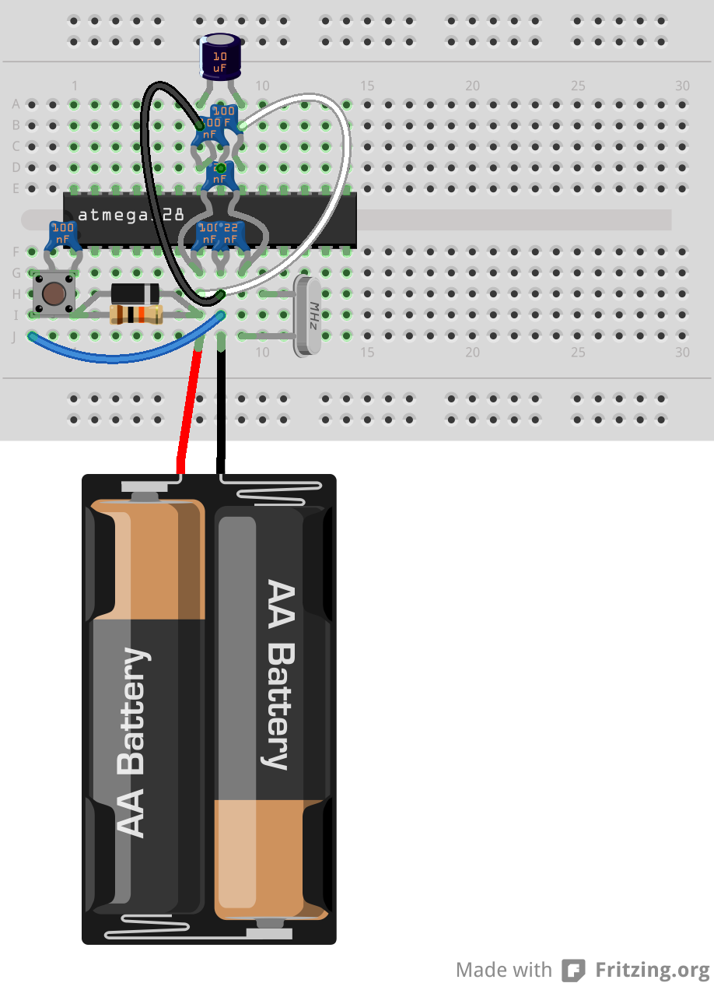
Protected Shrimp with Battery

Slide 5
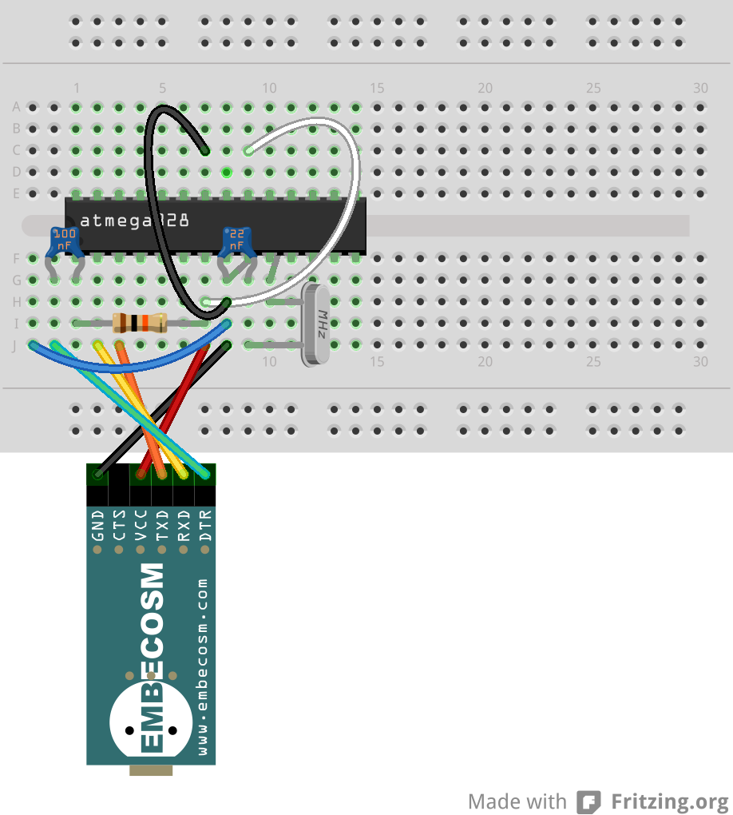
The Minimal Shrimp

Slide 6
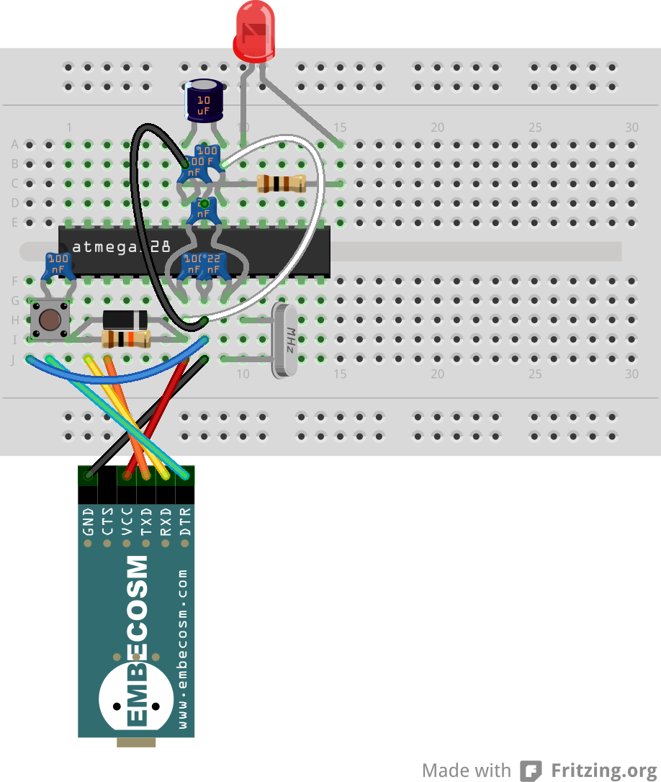
Shrimp Blink Circuit

Slide 7
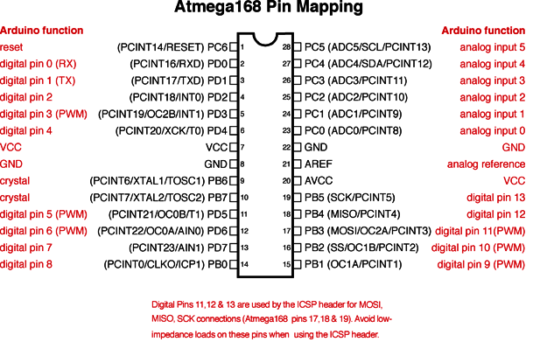
Shrimp Pinout

Slide 8
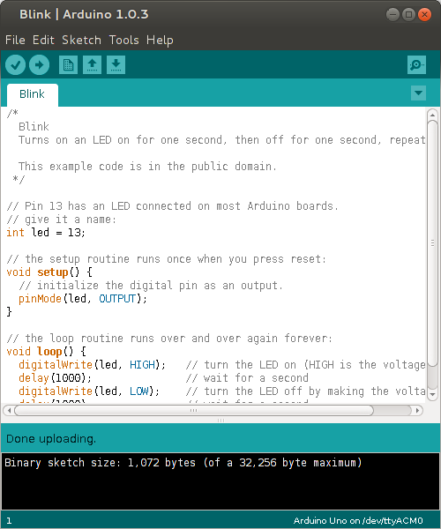
Loading the Blink Program
Note on Linux, you may have to be in the dialout and/or lock groups.

Slide 9
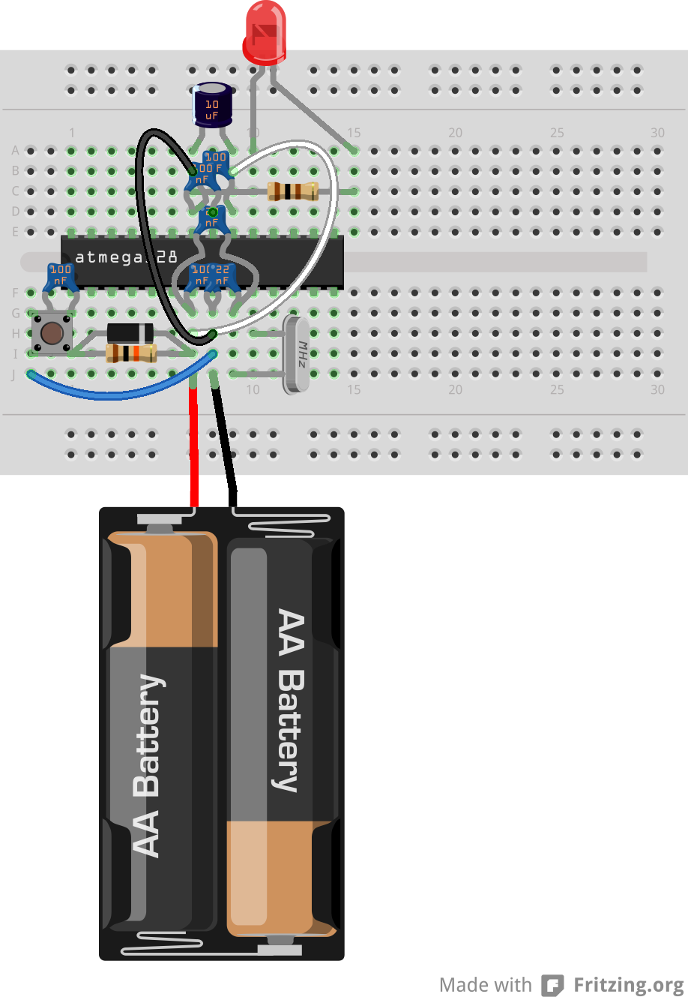
Shrimp Blink with a Battery

Slide 10
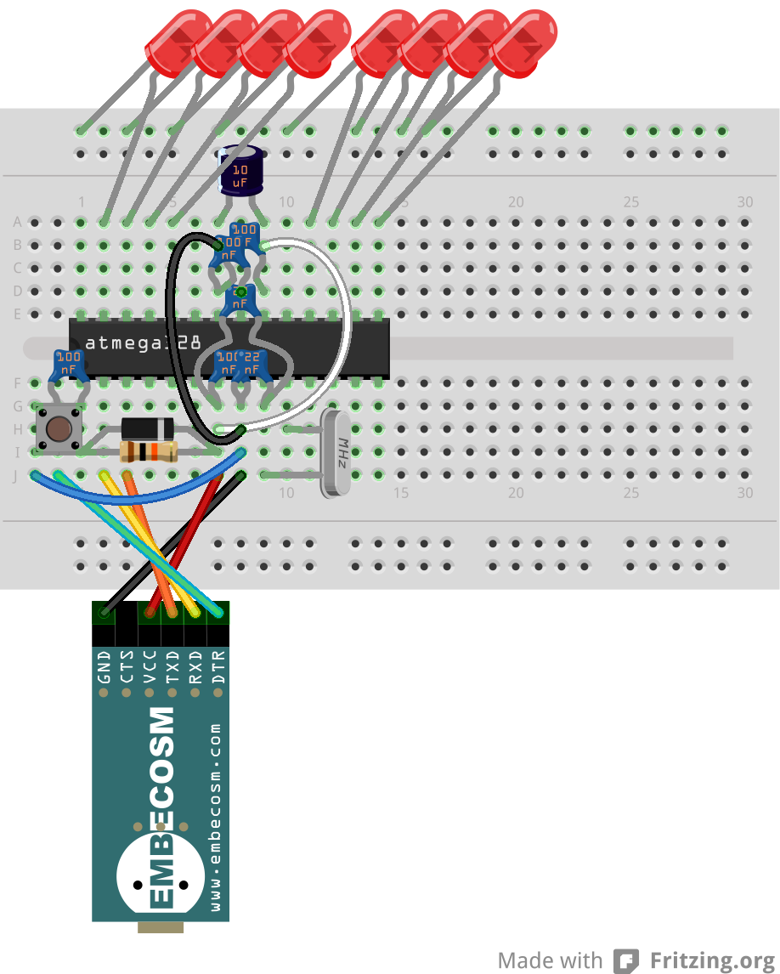
Basic Shrimp Persistence of Vision

Slide 11
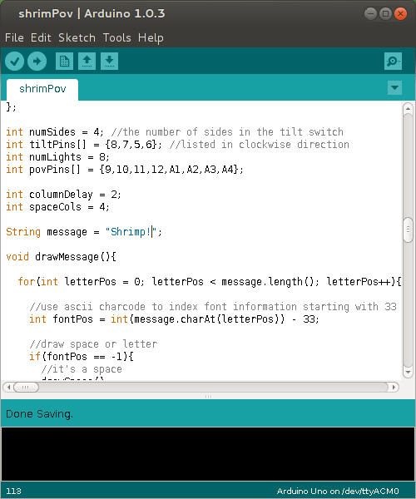
Loading the POV Program
http://tinyurl.com/shrimpovcode

Slide 12
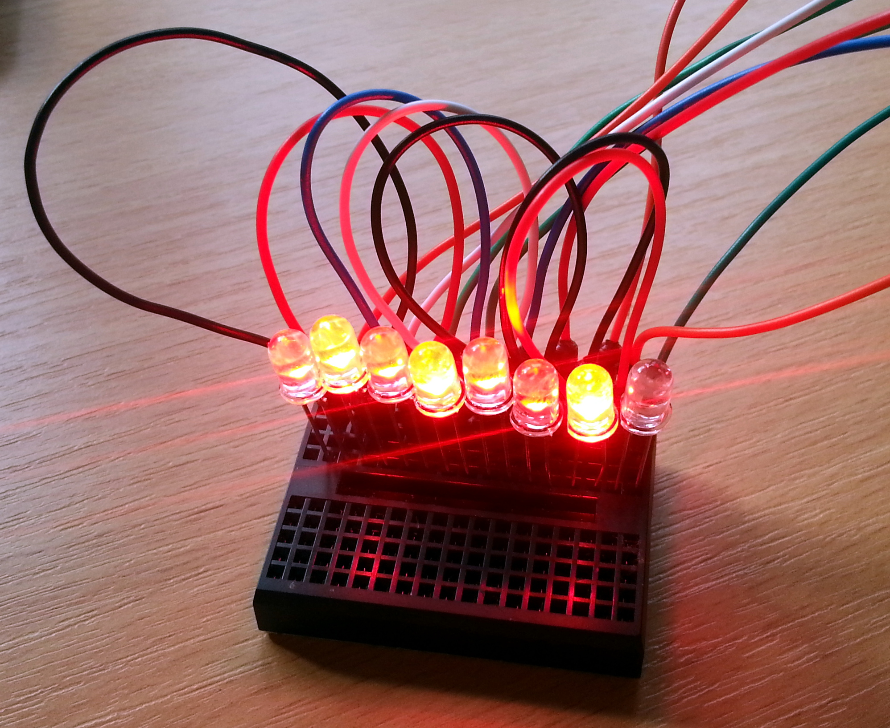
Shrimp Persistence of Vision

Slide 13
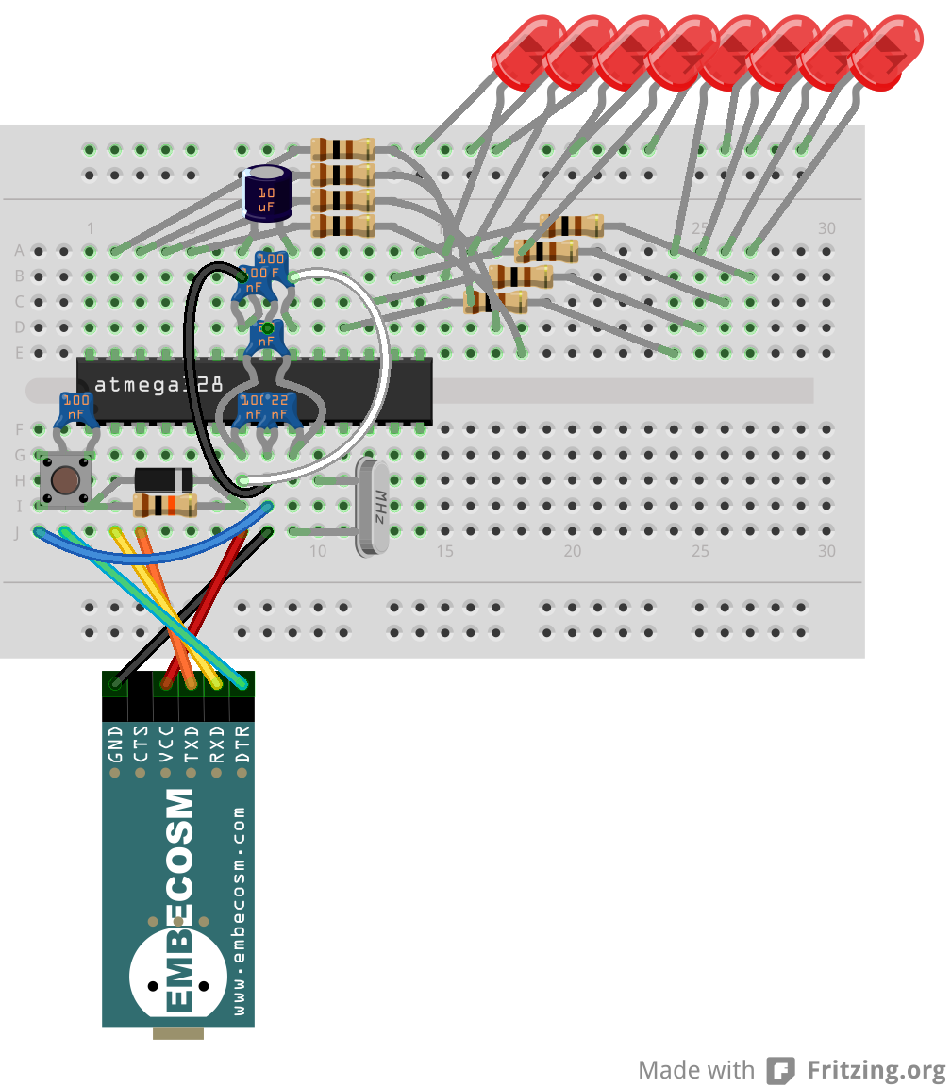
Saving the LEDs in Shrimp PoV

Slide 14
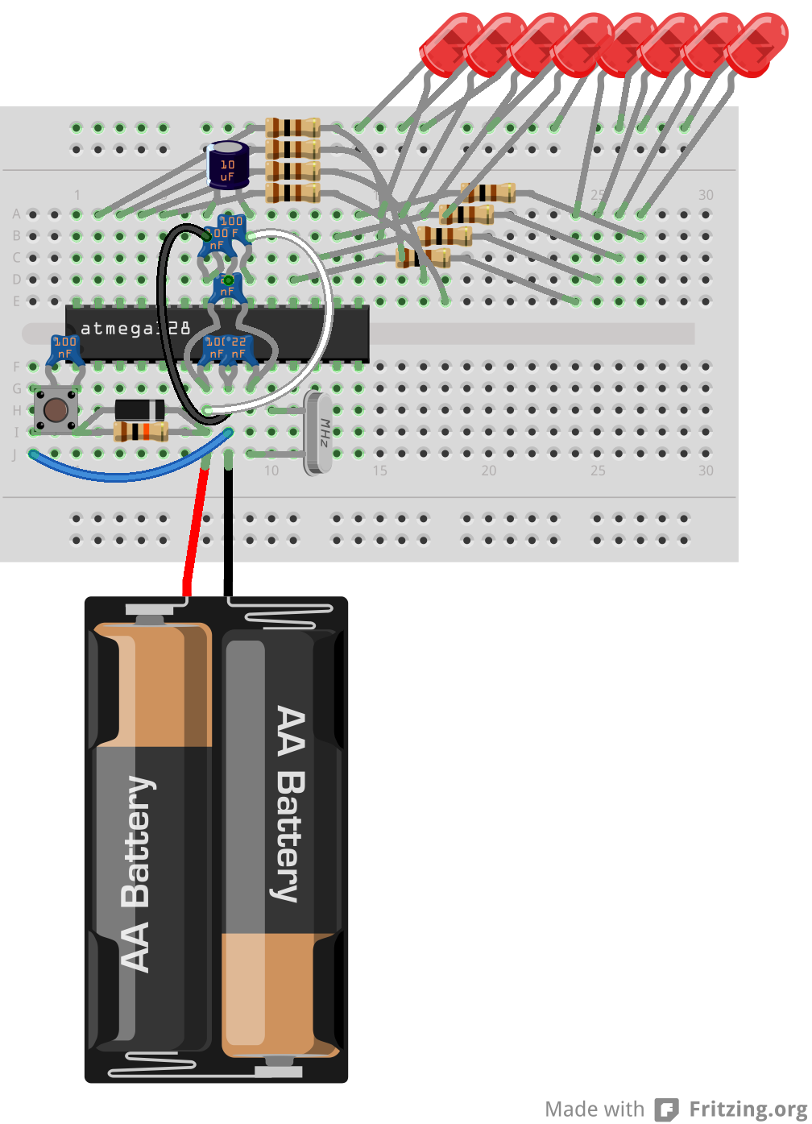
Shrimp PoV with a Battery

