Slide 1
nnUnet 사용법
https://github.com/MIC-DKFZ/nnUNet/blob/master/documentation/how_to_use_nnunet.md

Slide 2
환경 생성 및 설치
conda create -n nnunet python=3.10
conda activate nnunet
pip install nnunetv2
git clone https://github.com/MIC-DKFZ/nnUNet.git
cd nnUNet
pip install -e .
pip install --upgrade git+https://github.com/FabianIsensee/hiddenlayer.git
# torch와 nvcc 버전 맞게 설치
# conda install pytorch torchvision torchaudio pytorch-cuda=11.8 -c pytorch -c nvidia

Slide 3
사용할 터미널에서 환경설정(윈도우)
set nnUNet_raw=C:/Users/qwe14/0.code/nnUNet/nnUNet_raw
set nnUNet_preprocessed=C:/Users/qwe14/0.code/nnUNet/nnUNet_preprocessed
set nnUNet_results=C:/Users/qwe14/0.code/nnUNet/nnUNet_results
set KMP_DUPLICATE_LIB_OK=True

Slide 4


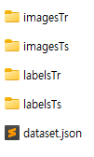
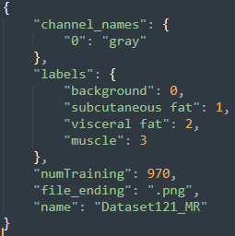
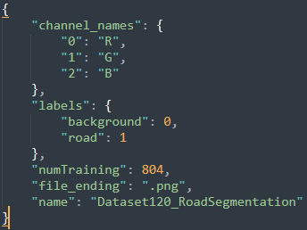
데이터 전처리(1단계 세팅)
nnUNet_raw/Data[숫자]_[데이터 이름]
→nnUNet_raw/Dataset121_MR/
아래에 imagesTr, imagesTs, labelsTr, labelsTs, dataset.json
imagesTr: training/val image
imagesTs: test image
labelsTr: training/val label
labelsTs: test label
dataset.json
Images: png로 만들 것
→img-[id]_0000.png
→img-00002_0000.png
Label: png로 만들 것
→img-[id].png
→img-00002.png

Slide 5
데이터 전처리(2단계 raw→preprocess 변환)
nnUNetv2_plan_and_preprocess -d [DATASET_ID] --verify_dataset_integrity
→nnUNetv2_plan_and_preprocess -d 121 --verify_dataset_integrity

Slide 6
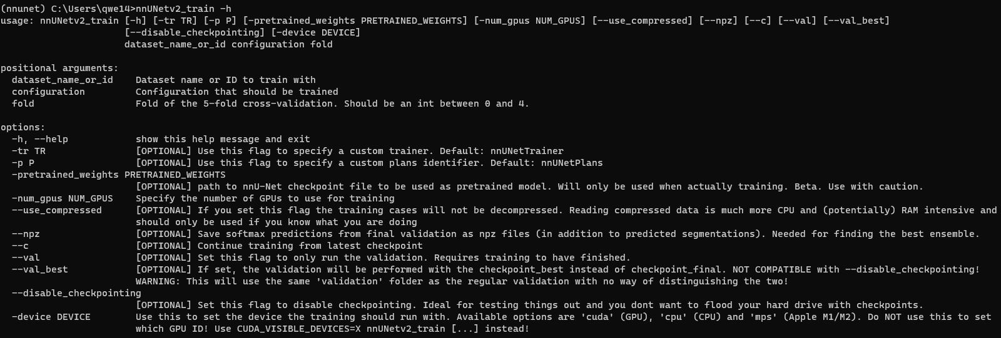
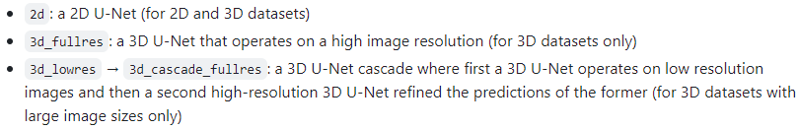
데이터 학습
nnUNetv2_train [DATASET_NAME_OR_ID] [UNET_CONFIGURATION] [FOLD] --val –npz
→nnUNetv2_train 121 2d 5 --val --npz
UNET_CONFIGURATION

Slide 7
데이터 학습 부록(예제)
nnUNetv2_train 121 2d 0 -tr nnUNetTrainerBenchmark_5epochs
nnUNetv2_train 121 3d_fullres 0 -tr nnUNetTrainerBenchmark_5epochs
nnUNetv2_train 121 2d 0 -tr nnUNetTrainerBenchmark_5epochs_noDataLoading
nnUNetv2_train 121 3d_fullres 0 -tr nnUNetTrainerBenchmark_5epochs_noDataLoading
Notes:
nnUNetv2_train 121 3d_fullres 5 –tr nnUNetTrainerBenchmark_5epochs

Slide 8
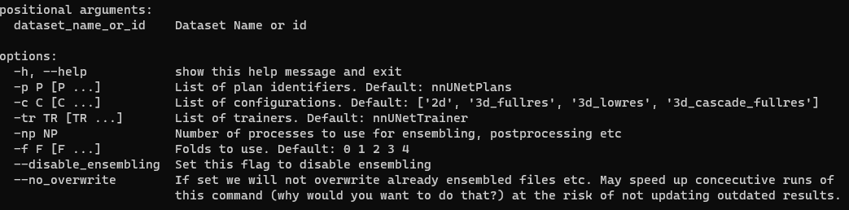
Best config 자동 결정
nnUNetv2_find_best_configuration [DATASET_NAME_OR_ID] -c [CONFIGURATIONS]
→nnUNetv2_find_best_configuration 121

Slide 9
추론(단일 configuration)
nnUNetv2_predict -i [INPUT_FOLDER] -o [OUTPUT_FOLDER] -d [DATASET_NAME_OR_ID] -c [CONFIGURATION] --save_probabilities
→nnUNetv2_predict -i / -o / -d 121 -c 2d --save_probabilities
단일 모델 추론(kfold 학습 모델 중 하나만 사용)
-f all
→nnUNetv2_predict -i C:\Users\qwe14\0.code\nnUNet\nnUNet_raw\Dataset121_MR\imagesTs -o C:\Users\qwe14\0.code\nnUNet\nnUNet_results\Dataset121_MR\nnUNetTrainer__nnUNetPlans__2d\fold_5 -d 121 -c 2d -f 5
nnUNetv2_predict -d Dataset121_MR -i INPUT_FOLDER -o OUTPUT_FOLDER -f 5 -tr nnUNetTrainer -c 2d -p nnUNetPlans

Slide 10
추론(여러 configuration 앙상블)
nnUNetv2_ensemble -i [FOLDER1 FOLDER2 ...] -o [OUTPUT_FOLDER] -np [NUM_PROCESSES]
→ nnUNetv2_ensemble -i / / -o / -np 4

Slide 11
후처리
nnUNetv2_apply_postprocessing -i [FOLDER_WITH_PREDICTIONS] -o [OUTPUT_FOLDER] --pp_pkl_file [POSTPROCESSING_FILE] -plans_json [PLANS_FILE] -dataset_json [DATASET_JSON_FILE]
nnUNetv2_apply_postprocessing
-i OUTPUT_FOLDER
-o OUTPUT_FOLDER_PP
-pp_pkl_file C:/Users/qwe14/0.code/nnUNet/nnUNet_results\Dataset121_MR\nnUNetTrainer__nnUNetPlans__2d\crossval_results_folds_5\postprocessing.pkl
-np 8
-plans_json C:/Users/qwe14/0.code/nnUNet/nnUNet_results\Dataset121_MR\nnUNetTrainer__nnUNetPlans__2d\crossval_results_folds_5\plans.json
nnUNetv2_apply_postprocessing -i C:\Users\qwe14\0.code\nnUNet\nnUNet_results\Dataset121_MR\nnUNetTrainer__nnUNetPlans__2d\fold_5\test -o C:\Users\qwe14\0.code\nnUNet\nnUNet_results\Dataset121_MR\nnUNetTrainer__nnUNetPlans__2d\fold_5\test\postprocess -pp_pkl_file C:/Users/qwe14/0.code/nnUNet/nnUNet_results\Dataset121_MR\nnUNetTrainer__nnUNetPlans__2d\crossval_results_folds_5\postprocessing.pkl -np 8 -plans_json C:/Users/qwe14/0.code/nnUNet/nnUNet_results\Dataset121_MR\nnUNetTrainer__nnUNetPlans__2d\crossval_results_folds_5\plans.json

Slide 12
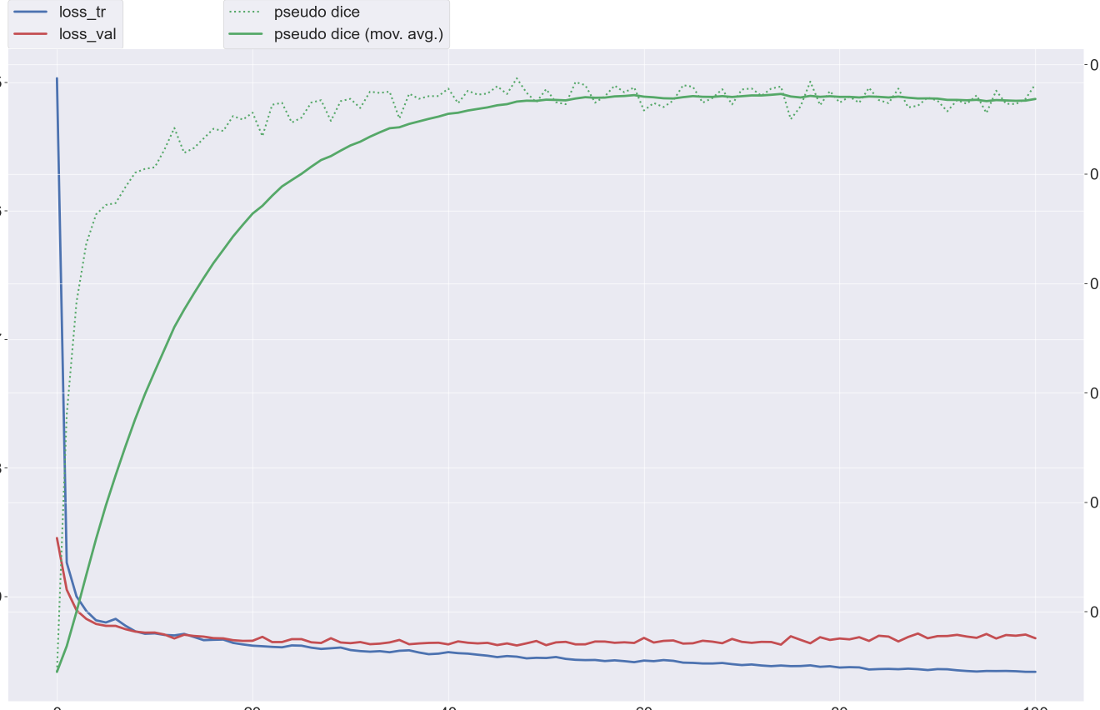

Slide 13
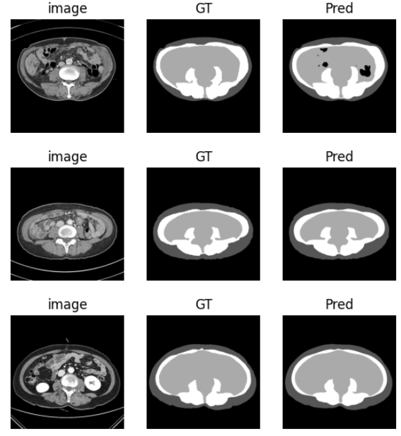
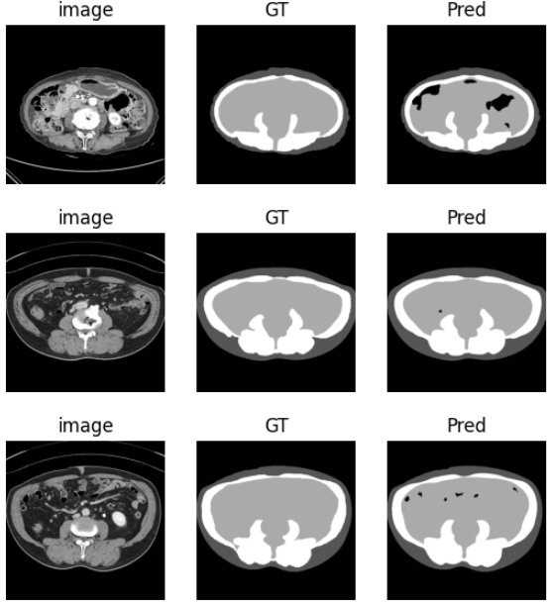
showPredict_rst.ipynb
테스트셋 예측결과

Slide 14
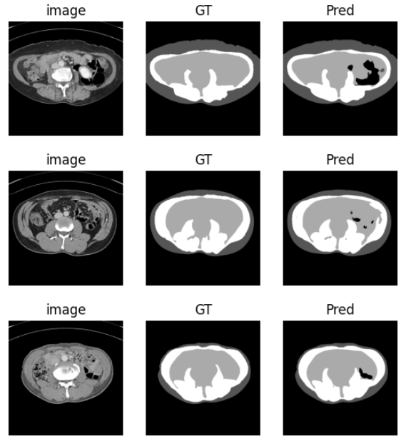
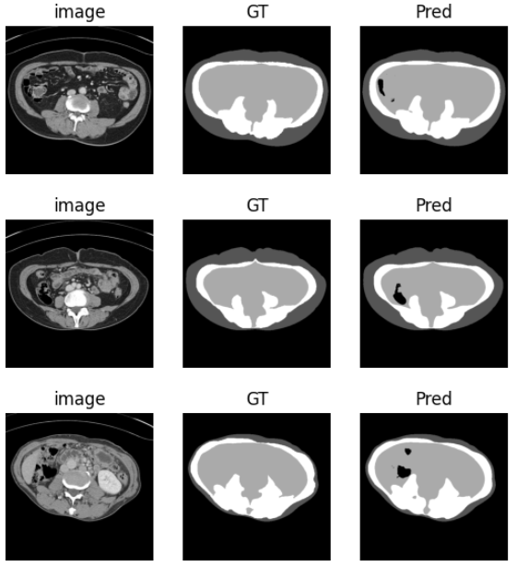
showPredict_rst.ipynb
테스트셋 예측결과

Slide 15


Slide 16
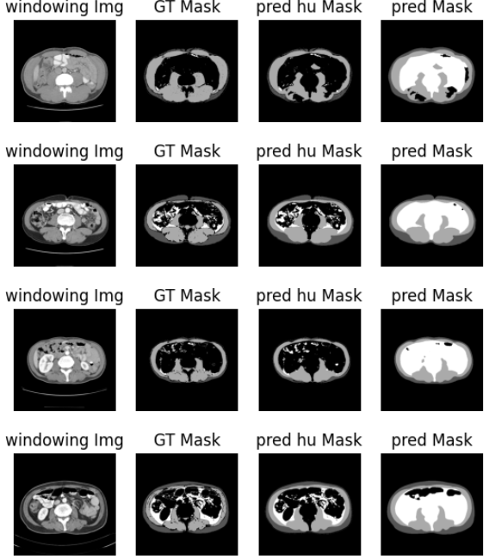
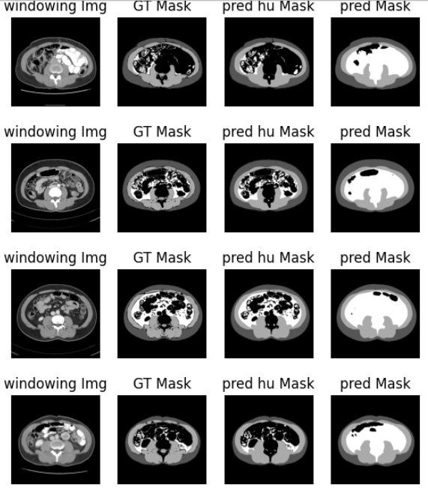
testPredict.ipynb
테스트셋2(900개 HU 적용된 test데이터) 예측결과

Slide 17


