Slide 1
Dante design sharing
Jan 2025

Slide 2
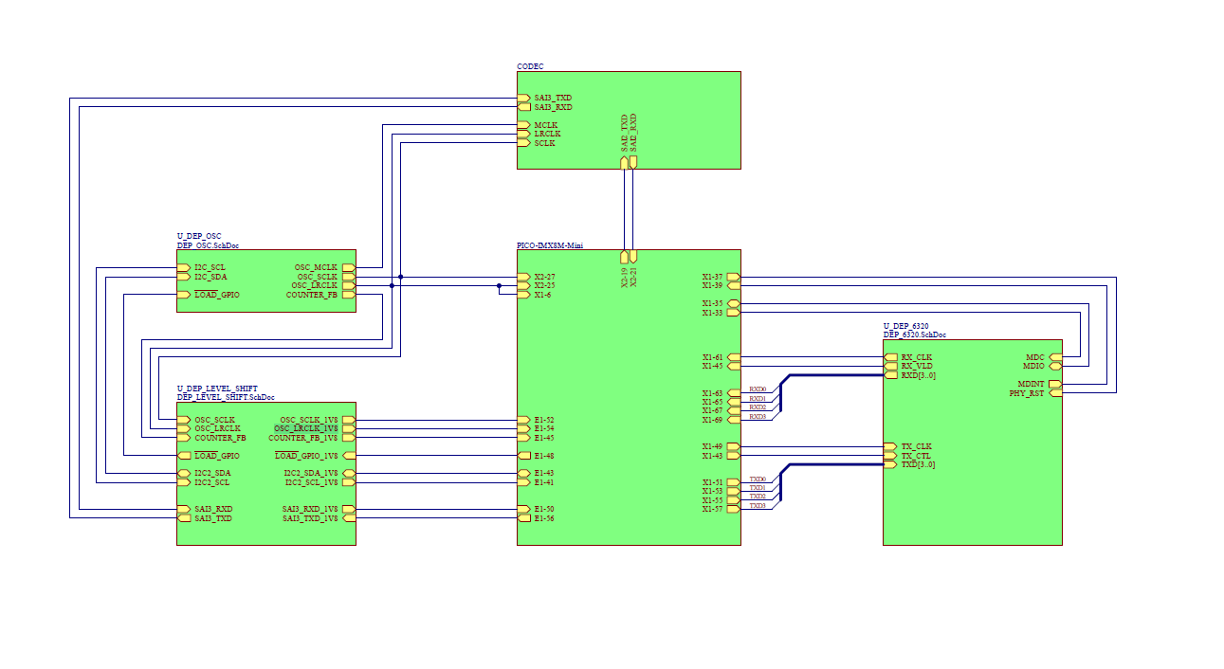
Top level schematic

Slide 3
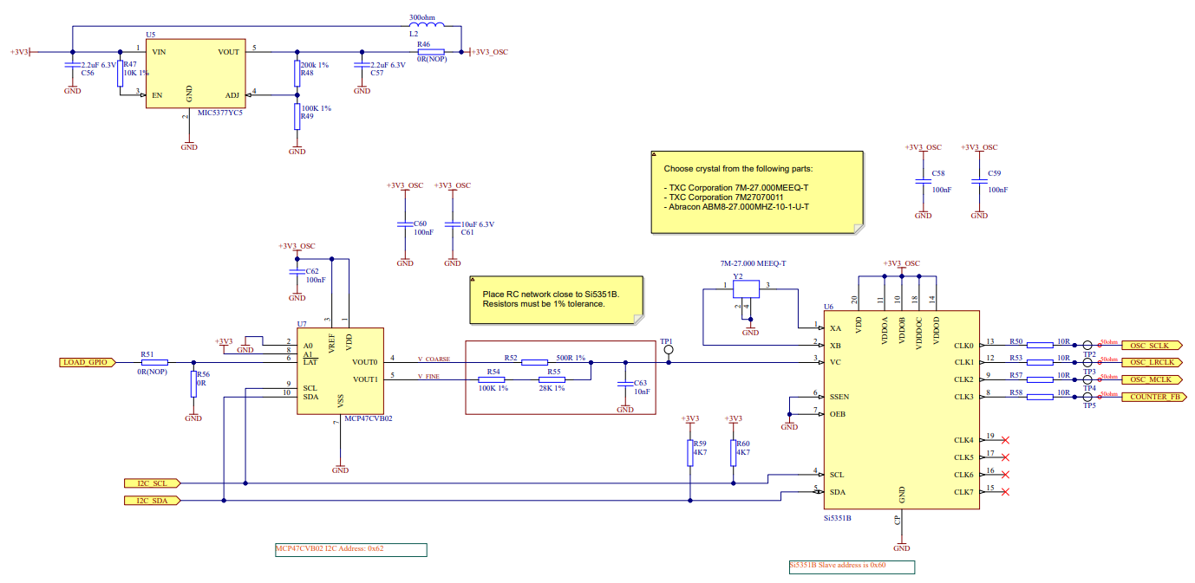
Clock schematic | from Audinate

