Slide 1

Dec 1, 2023
Predicting Diabetes Using Patient Medical Data and Machine Learning
ECE 381K Applied Machine Learning
Fall 2023
Prof. Joydeep Ghosh
Ahmet GunHan aydin
Awais Naweem
Neil Roy
Nick Strohmeyer
Chandra Family Department of Electrical and Computer Engineering
University of Texas at Austin
School of Information
University of Texas at Austin
Chandra Family Department of Electrical and Computer Engineering
University of Texas at Austin
Chandra Family Department of Electrical and Computer Engineering
University of Texas at Austin

Slide 2
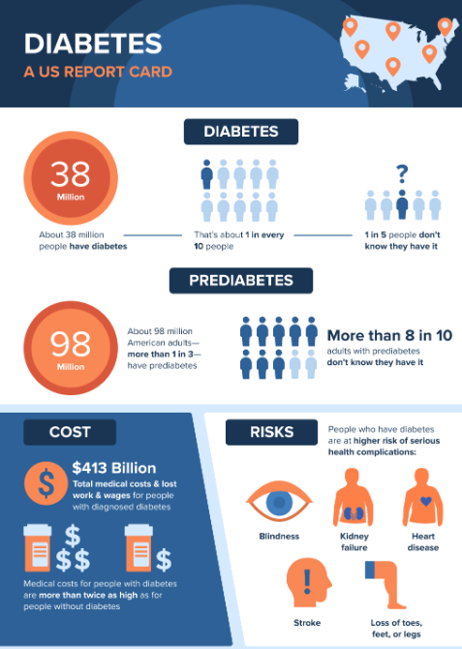
Problem Statement
Diabetes is the condition in which the body is unable to produce enough insulin to regulate blood glucose levels
Over time this can lead to complications such as kidney failure, heart disease, vision loss and lower limb amputation
It is also the world’s deadliest non-transmissible disease
Prediabetes describes the condition in which an individual has higher than normal blood sugar, but is not yet pass the threshold to be considered type 2 diabetes
An estimated 537 million adults have diabetes worldwide
632,000 thousand children
Including 11.7% of the US population
An additional 38% of US population has prediabetic
Roughly 75 % of adults with diabetes live in middle to low-income countries (healthcare access)
A 2023 CDC report estimated 3.8 % of US adults who were diabetic were either unaware or did not report it, meaning approximately 1/3 of diabetic adults are possibly unaware of their condition

Slide 3
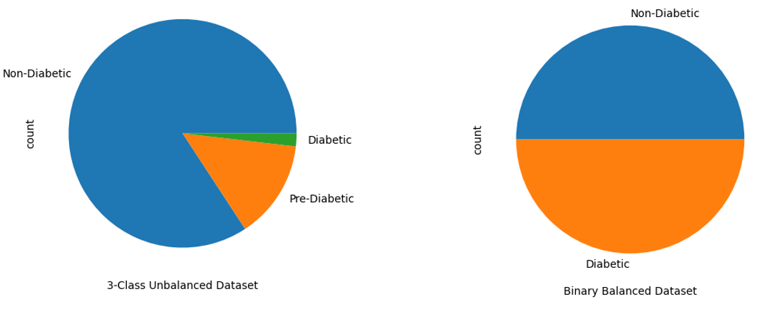
Kaggle Dataset
Our dataset is taken from Kaggle Competition, which originates from the 2015 Behavioral Risk Factor Surveillance System, a health-related survey collected by the CDC on an annual basis
A subset of 441,455 responses with 330 features, this data is reduced to 22 features representing a mixture of medical indicators and demographics for a total of 22 features to learn from
We had three datasets to work with and chose to work with the following two:
Binary target classes (Diabetic v. Non-Diabetic) with a balanced 50/50 split
An imbalanced dataset over 3 class labels : (Diabetic v. Prediabetic v. Not)
We take this to be a reliable representative sample of US adults although not the most recent and may not transfer to other countries/ regions of the world
3 Class Imbalanced
Non-Diabetic | 213,703
Diabetic | 35,346
Pre-Diabetic | 4,631
Total | 253,680
Binary 50/50 Split
Non-Diabetic | 35,346
Diabetic | 35,346
Total | 70,692

Slide 4
Preprocessing
Cleaning the original survey responses and medical indicators
Removal of invalid and null values
Bucketing certain features into ordinal levels, categorical encoding
Feature scaling :
Applied Standard Scaler Normalization to Continuous variables
Applied Min Max Scaling to Ordinal
Binary variables are One-Hot Encoded
For training and testing we used an 80/20 split, using the same random seed of 42 across all models
Additionally, we apply stratified split on the imbalanced data set to preserve the distribution of target classes in both the training and testing set
Feature Type | Feature Description
Continuous | BMI
Binary | HighBP , HighChol, CholCheck, PhyActivity, Stroke, HeartDiseaseorAttack, PhysActivity, Fruits, Veggies, HvyAlcoholConsump, NoDocbcCost, AnyHealthcare, Sex, Smoker, Veggies , DiffiWalk
Categorical /Ordinal | General Health, Phys Health, Mental Health, Education Level, Income, Age

Slide 5
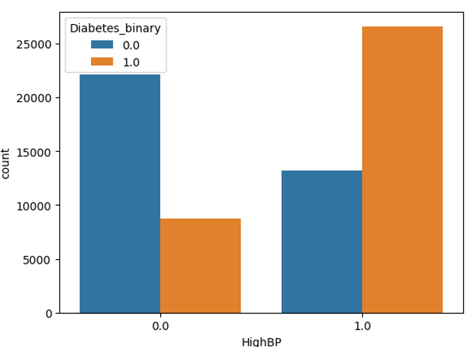
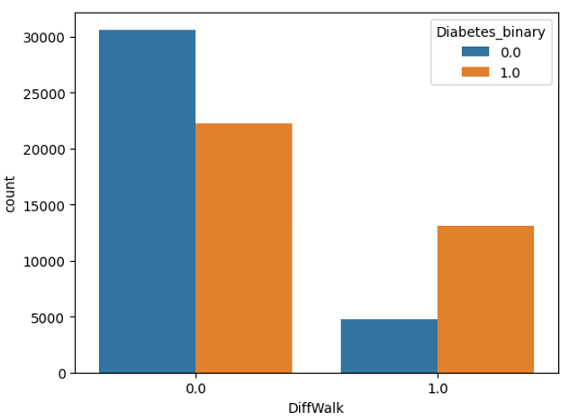
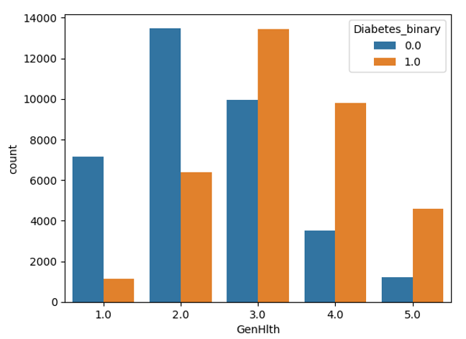
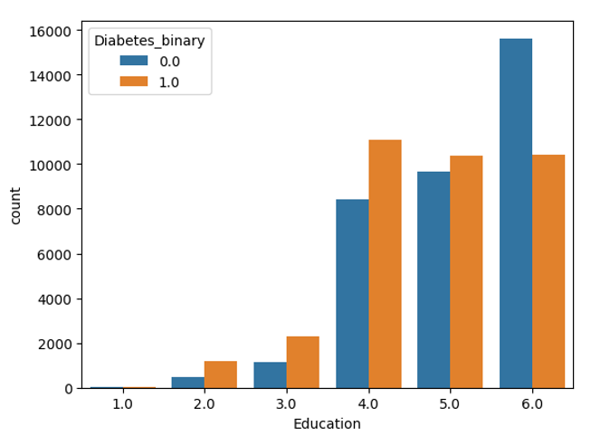
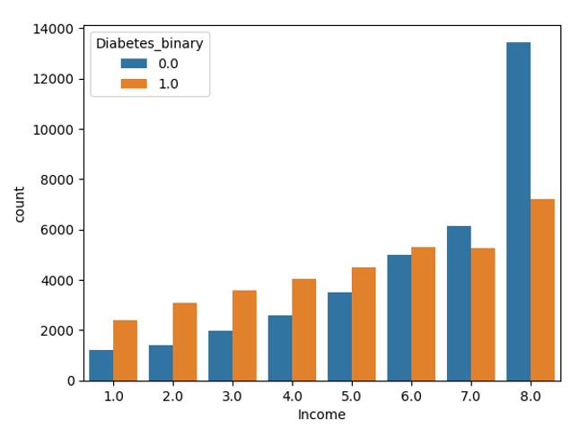
Data Exploration – Categorical Features
High Blood Pressure
Difficulty Walking​
General Health
Individuals who have trouble walking are nearly 3x more likely to have diabetes than not
Individuals with high blood pressure are nearly 2x as likely to have diabetes than not
People who have diabetes report a lower overall experience of general health
Education Level
Income Level
The data is mostly comprised of individuals with higher education, as education level increases the proportion of individuals with diabetes vs. not goes down.
A similar, slightly more exaggerated, effect in income level

Slide 6
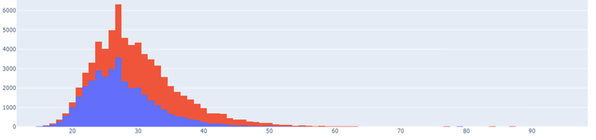
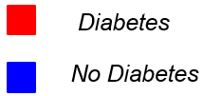
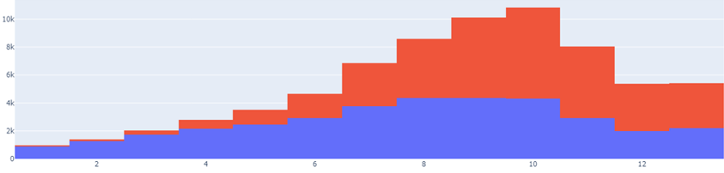
Data Exploration – Continuous Features
An individual with a higher BMI is more likely to have diabetes
Body Mass Index
As someone ages, they become progressively more likely to have diabetes
Age
Bucket | Age (yrs)
1 | 18-23
2 | 24-29
3 | 34-39
… | …
12 | 75-80
13 | 80+

Slide 7
Selected Models for Classification Task
Logistic Regression – finds a decision boundary in a linear space based on transformation with the sigmoid function and minimization of cross-entropy loss
Multi-Layer Perceptron – a “universal function approximator” that transforms input features to specified output by using a series of linear transformations and nonlinear activation functions. MLP minimizes a given loss by tuning linear layers using the backpropagation algorithm
Support Vector Machine – solves a constrained optimization problem to maximize avg distance of separate classes to the decision boundary in feature space or a transformed kernel space
Random Forest -- A bagging method which creates an ensemble exclusively of decision trees. Each tree makes a random selection of which features to split when it is fit to encourage a variety of possible decision pathways. The final decision is made based on the average decision of all trees
XG Boost – A powerful ensemble method based on gradient-boosting. A decision tree is fit as an initial “weak learner”, then subsequent trees are sequentially trained to minimize the residuals of previous trees
Each model comes with a variety of hyperparameters that need to be tuned to ensure best performance on the particular task

Slide 8
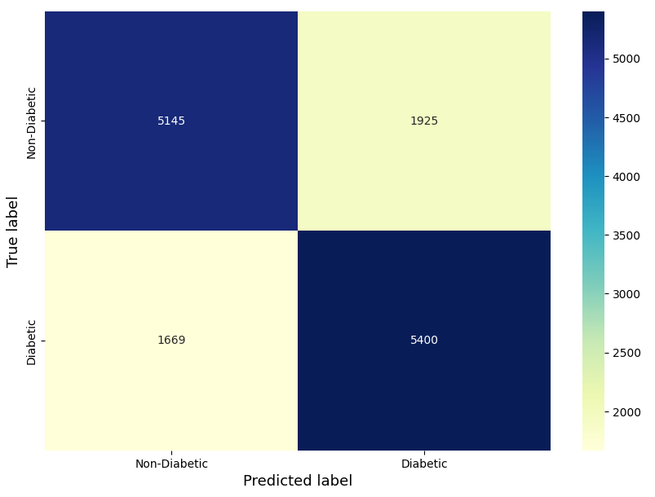
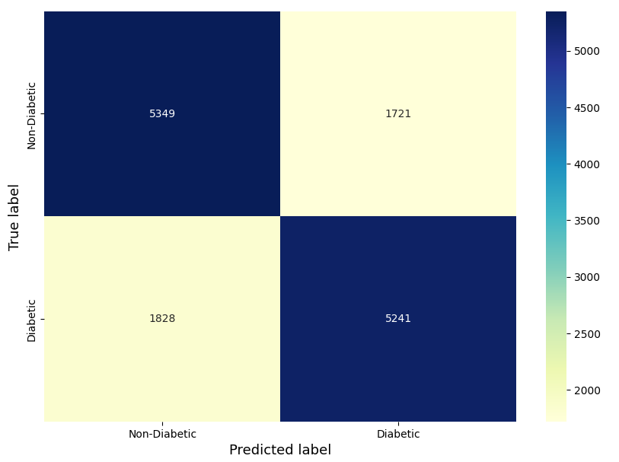
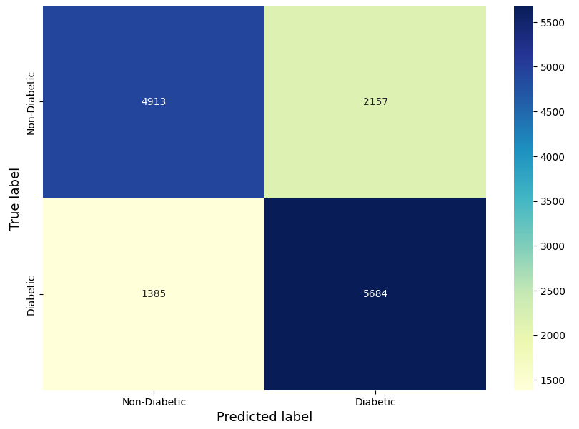
Binary Balanced Classification Results
Logistic Regression
MLP
SVM

Slide 9
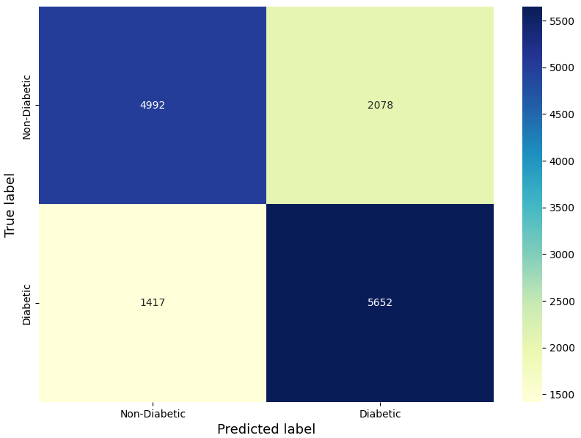
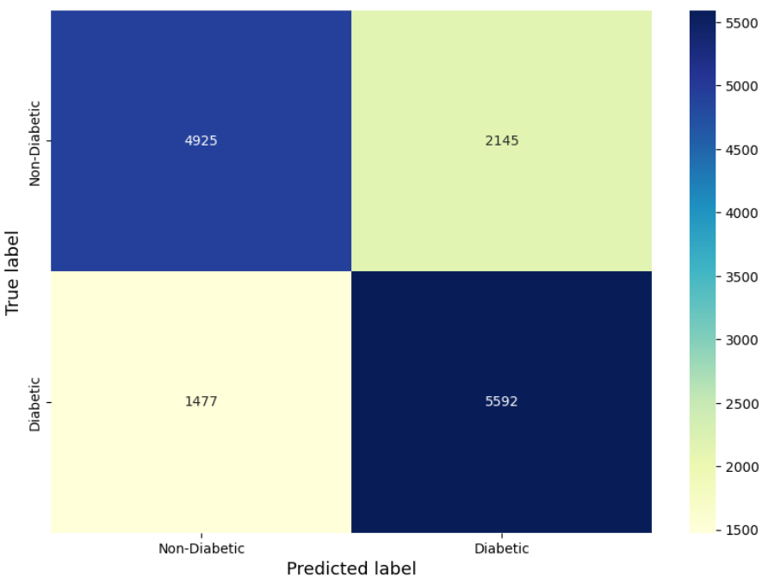
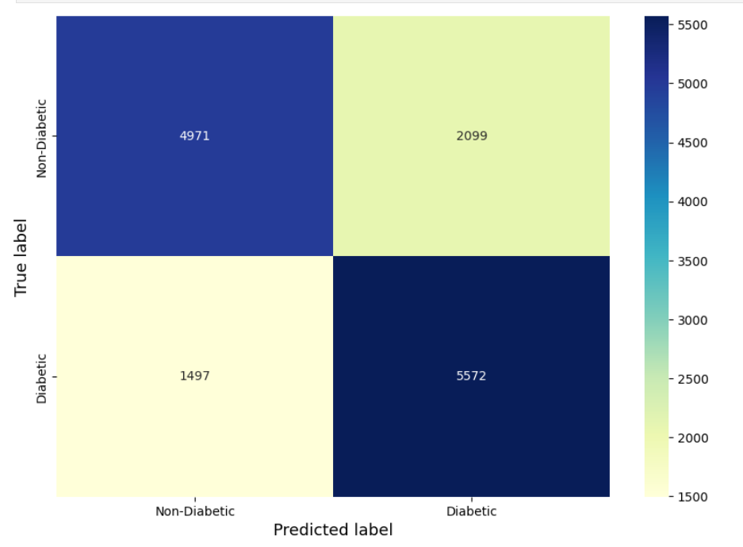
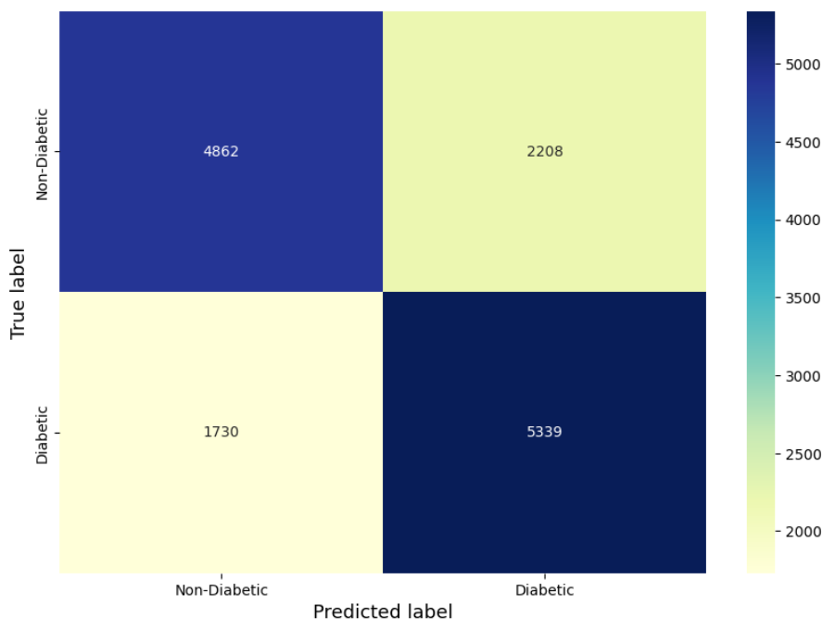
Binary Balanced Classification Results
XG Boost
XG Boost Top 5
Random Forest
Random Forest Top 5

Slide 10
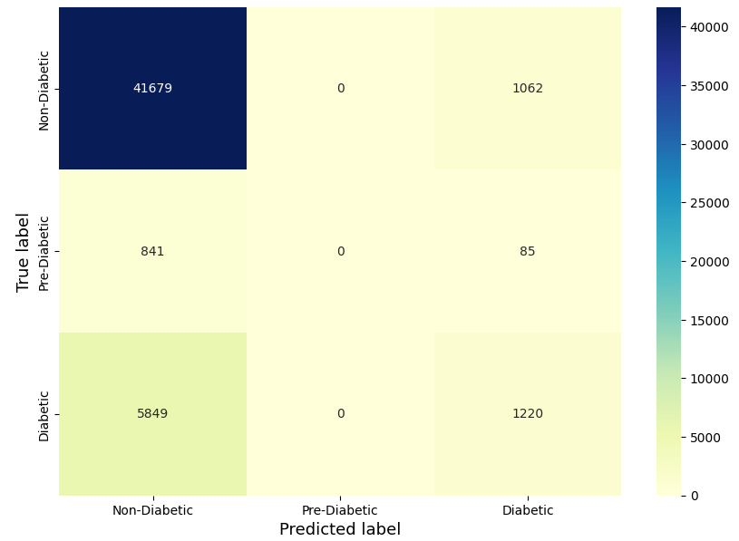
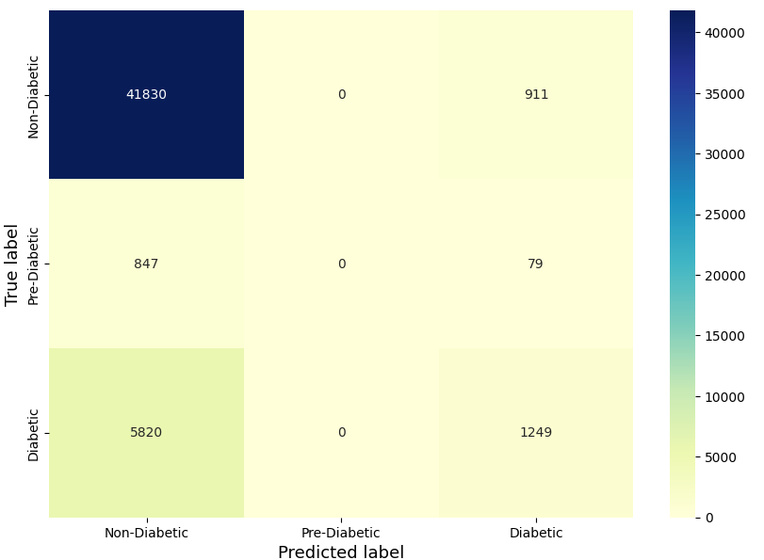
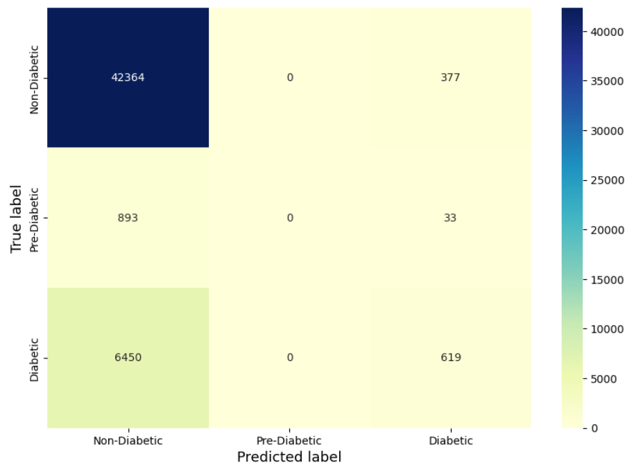
3 Class Imbalanced Classification Results
Logistic Regression
MLP
SVM

Slide 11
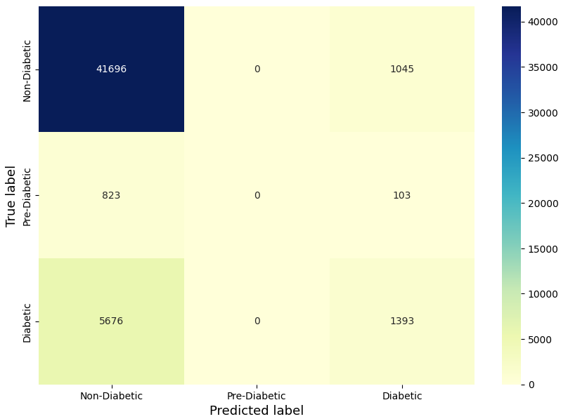

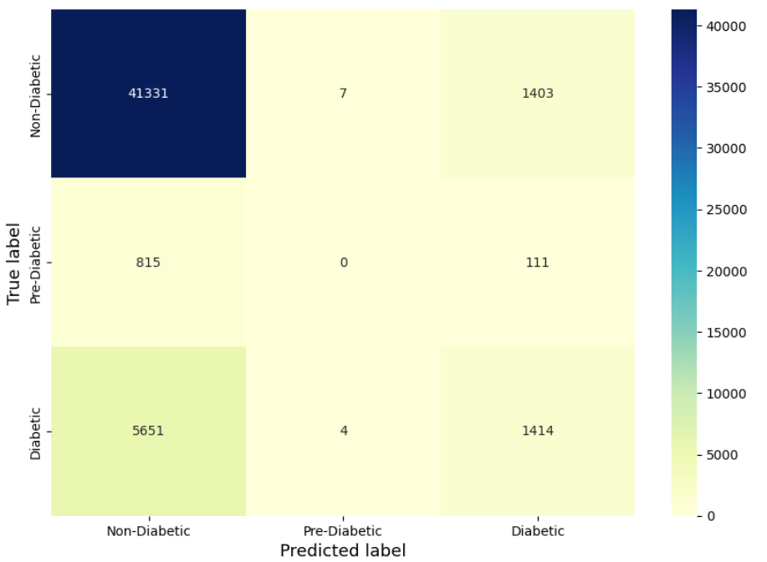
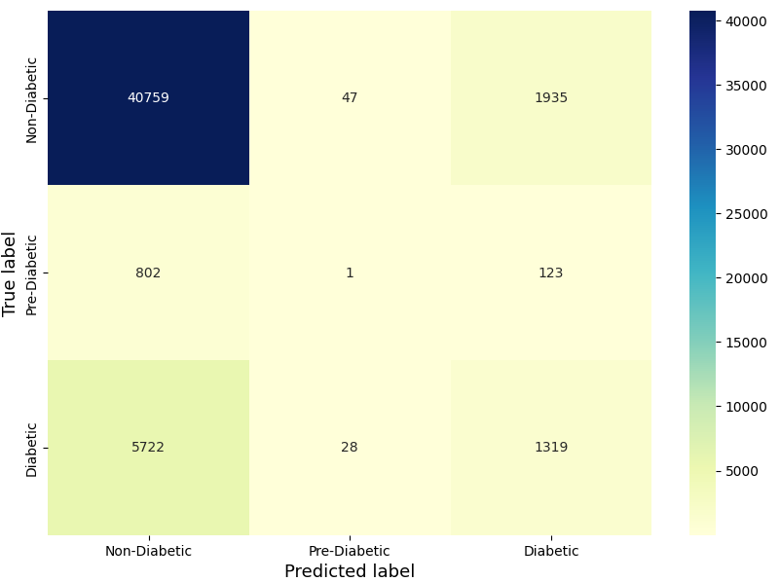
3 Class Imbalanced Classification Results
XG Boost
XG Boost top 5
Random Forest
Random Forest Top 5

Slide 12
And the winner is… no one?
 | Binary Split 50/50 |  |  |  | 3 Class Imbalanced
Model | Accuracy | Precision | Recall | F1 Score | Accuracy | Weighted Precision | Weighted F1
Logistic Regression | 0.75 | 0.74 | 0.76 | 0.75 | 0.85 | 0.8 | 0.81
Multi Layer Perceptron | 0.75 | 0.75 | 0.74 | 0.75 | 0.85 | 0.8 | 0.81
Support Vector Machine | 0.75 | 0.72 | 0.80 | 0.76 | 0.85 | 0.8 | 0.79
Random Forest | 0.75 | 0.73 | 0.79 | 0.76 | 0.84 | 0.8 | 0.81
Random Forest Top 5 | 0.72 | 0.71 | 0.76 | 0.73 | 0.83 | 0.78 | 0.8
XG Boost | 0.76 | 0.73 | 0.80 | 0.76 | 0.85 | 0.81 | 0.81
XG Boost Top 5 | 0.75 | 0.72 | 0.79 | 0.76 | 0.85 | 0.8 | 0.81

Slide 13
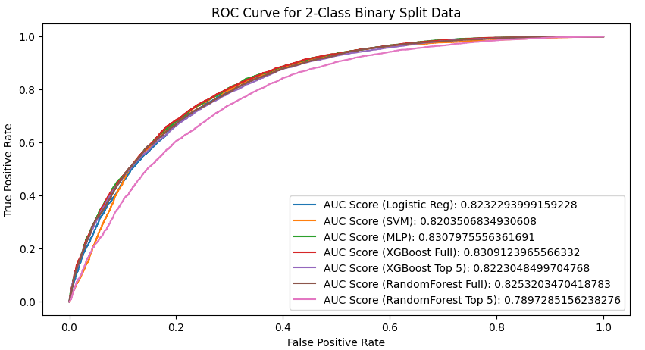
Why are the results so similar?
Correlated features
Lack of certain key indicators, descriptive power in features
Data Imbalance

Slide 14
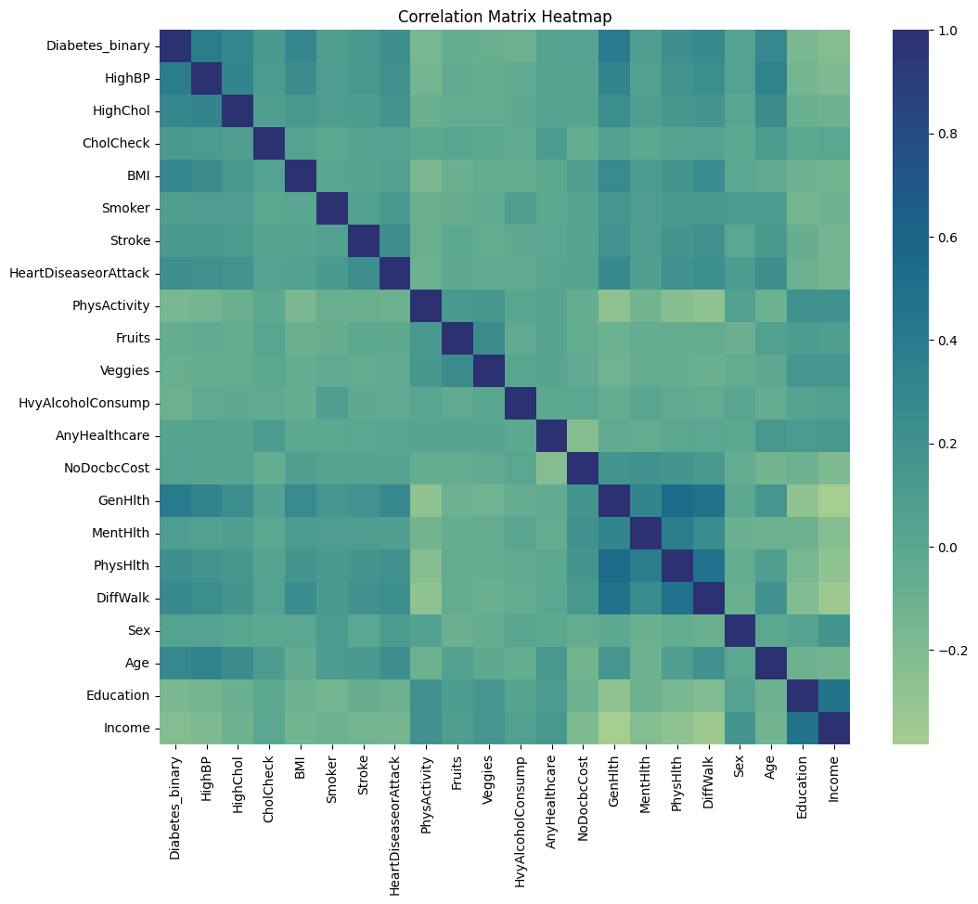
Correlated Features
The analysis reveals a strong correlation between diabetes and factors such as HighBP, HighChol, BMI, and GenHlth, all of which XGBoost identified as significant features.
Moreover, interesting patterns emerge in pairs of features, particularly in Education-Income and PhysHlth-DiffWalk-GenHlth, indicating potential interdependencies within these groups.

Slide 15
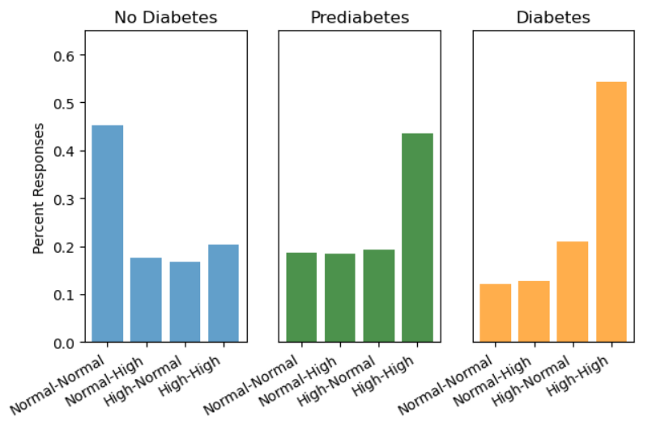
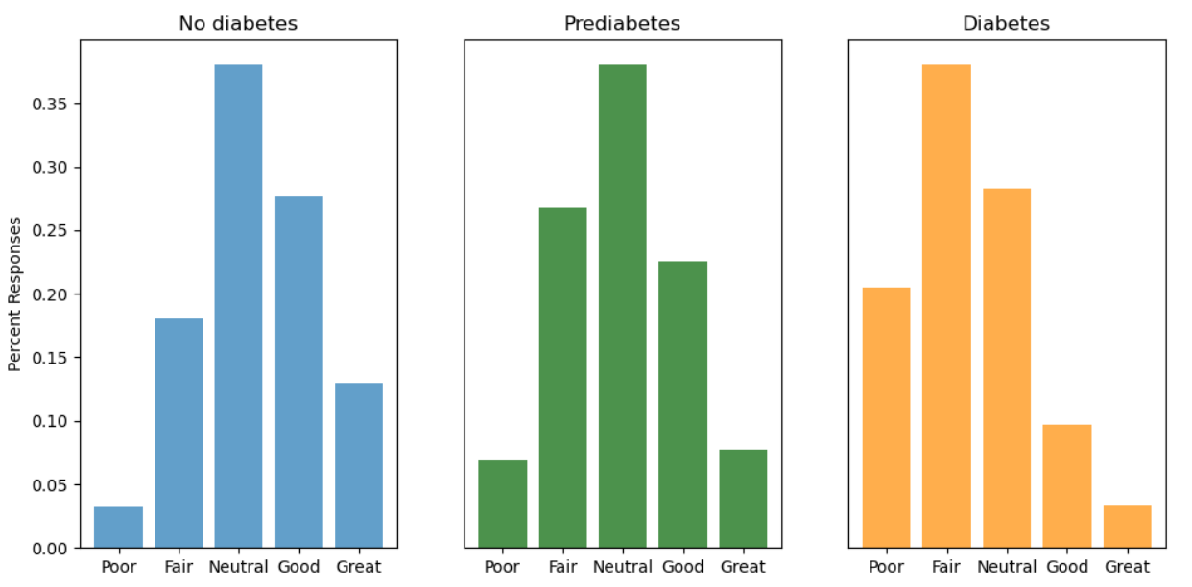
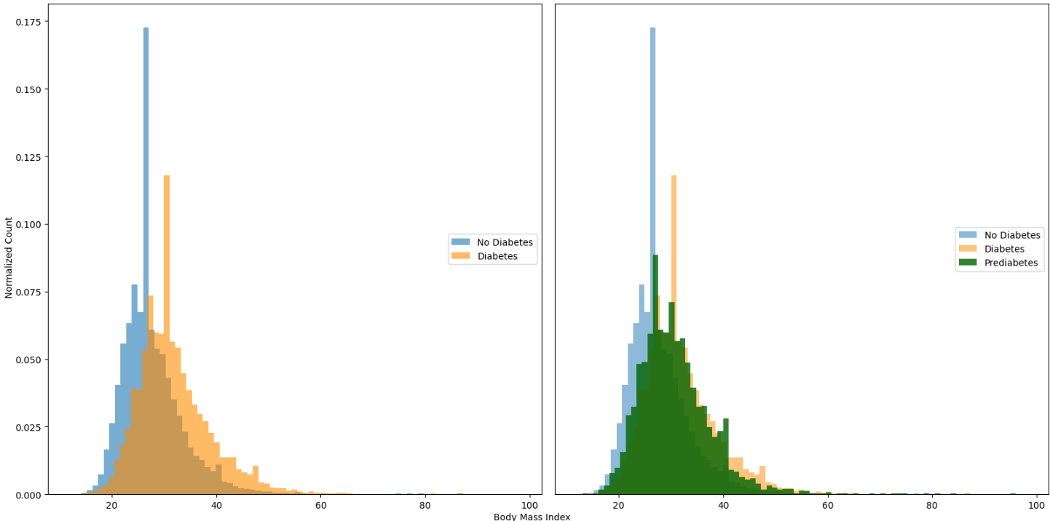
Why is Prediabetic Class Difficult ?
Blood Pressure/Cholesterol
Lowest number of samples
Given our features space, Class 1 seems to appear more like 0 or 2 or an avg case than own distinct class
Many binary features , only a few with the most predictive power : Cholesterol, Blood Pressure
General Health
Body Mass Index

Slide 16
Conclusions
We find that most of the traditional classification models perform very similarly, almost identical, on this particular dataset with XGBoost seeming to have a slight edge
The ability to return important features from Random Forest and XgBoost allows us to do an explanatory analysis of the predictions, which makes these models more desirable in a task such as diabetes prediction
The efficiency of the XGBoost method with the top 5 features is enhanced by correlated features, streamlining the model's performance.
The prediabetic class is the most difficult to predict with the lowest number of samples, and often appears as one or the other or an average case of the 2
Imbalanced data, binary features and other possible predictive limitations in the features likely explain the models inability to detect

Slide 17
Future Work
Comparing various methods to reduce the effects of data imbalance and increase model performance on underrepresented classes: oversampling, undersampling, SMOTE, or any combination
Trying a wider variety of models that might perform better given the dataset: Stacking, Mixture of Experts, CatBoost
Enhancing feature space, gathering more data

Slide 18
References
American Diabetes Association. "Diagnosis and classification of diabetes mellitus." Diabetes care 33.Supplement_1 (2010): S62-S69.
Centers for Disease Control and Prevention. Diabetes Basics: What is Diabetes? Accessed November 9, 2021. https://www.cdc.gov/diabetes/basics/diabetes.html
World Health Organization Fact Sheet: https://www.who.int/news-room/fact-sheets/detail/diabetes
Zou, Quan, et al. "Predicting diabetes mellitus with machine learning techniques." Frontiers in genetics 9 (2018): 515.
Sisodia, Deepti, and Dilip Singh Sisodia. "Prediction of diabetes using classification algorithms." Procedia computer science 132 (2018): 1578-1585.
Kaggle Dataset: https://www.kaggle.com/datasets/alexteboul/diabetes-health-indicators-dataset
Chen, T., He, T., Benesty, M., Khotilovich, V., Tang, Y., Cho, H., et al. Xgboost: extreme gradient boosting. R package version 0.4-2, 1(4):1–4, 2015.
Xie Z, Nikolayeva O, Luo J, Li D. Building Risk Prediction Models for Type 2 Diabetes Using Machine Learning Techniques. Prev Chronic Dis. 2019 Sep 19

