Slide 1
Individual Activity: 2_1 Task: Interfacing Panic Button and Buzzer with BBB
Submitted by: Submitted to:
Navjot Saini (C0751275) Prof. Mike Aleshams

Slide 2
List of Content
Project Block Diagram: IoT based Automatic Railway Gate Controller
Usage of Push Button and Buzzer in the Project
Interfacing Buzzer with Beaglebone Black
Interfacing Push Button with Beaglebone Black
Circuit Diagram
Steps to access GPIO Pins of the Beaglebone black
The software Coding: Eclipse IDE
The Main() function of the code
Steps to run the code on the Beaglebone black
Final Results

Slide 3
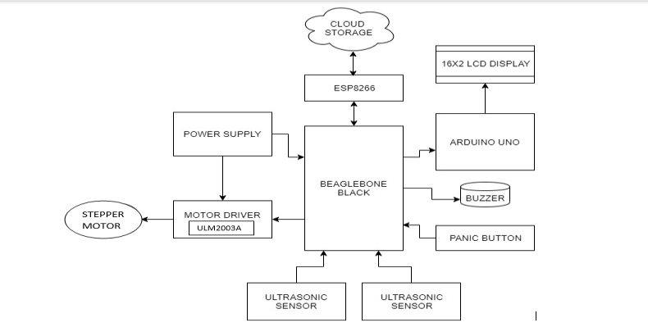
IoT based Automatic Railway Gate Controller

Slide 4
Usage of Push Button and Buzzer in the Project
The Push Button as a Panic button feature which will act as an interrupt thus will have critical code for that section.
Use of Panic Button that will be pressed in an emergency.
The buzzer will beep when Push button is pressed to alert the traffic and authorities about mishappening on the tracks.
Both the Buzzer and Push Button are interfaced over GPIO pins with BeagleBone Black.

Slide 5
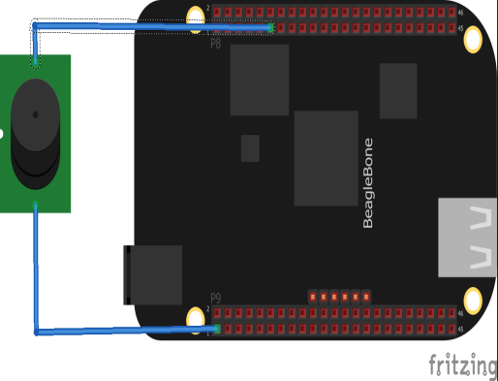
Interfacing Buzzer with Beaglebone Black
In interfacing of Buzzer with Beaglebone Black, Buzzer act as output device.
The negative end of the Buzzer is connected to P9.1 (GND)
The positive end of buzzer is connected to P8.11 (GPIO_45)
All GPIO pins of BBB are 3.3V and can be configured as inputs or outputs.

Slide 6
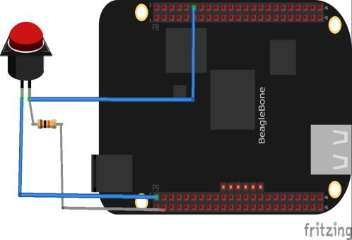
Interfacing Push Button with Beaglebone Black
Interfacing switch with Beaglebone Black where switch acts as an input device.
Push button has two terminals.
Any one of them connects with Ground (P9.2) of BeagleBone Black.
The VCC 3.3 V (P9.3) is connected through 1k ohm resistor to another terminal of push button.
Common end of resistor and push button is connected to pin number 12th of header P8 (GPIO_44).
Provide the supply to Beaglebone Black by connecting with Laptop through USB cable.

Slide 7
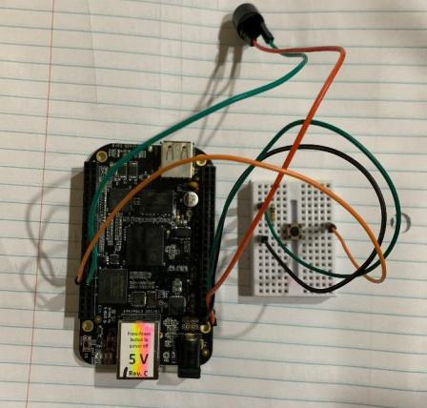
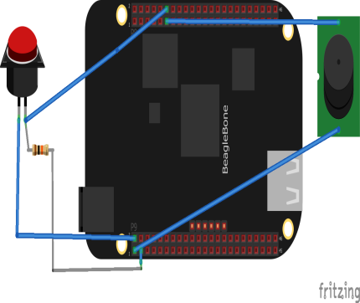
Circuit Diagram

Slide 8
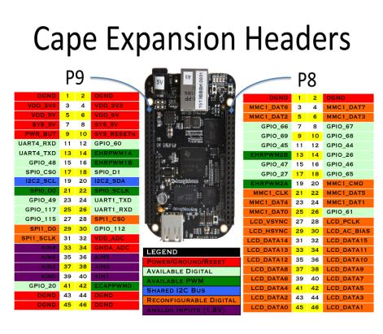
Steps to Access to GPIO Pins of Beaglebone Black
A maximum of 66 GPIO pins are accessible from the expansion header.
All of these pins are 3.3V and can be configured as inputs or outputs. Any GPIO can be used as an interrupt and is limited to two interrupts per GPIO Bank for a maximum of eight pins as interrupts.
The max output current varies by pin. For some pins it's 4mA and for some pins it's 6mA. The inputs are not 5V tolerant. The max voltage is 3.3V.

Slide 9
Continue...
GPIO Numbering Scheme:
The gpio pins of the bbb are grouped into 3 groups of 32: GPIO0, GPIO1, and GPIO2.
An individual pin can be refered to using the convention GPIOX_Y where X is its gpio register and Y is its number within that register.
A gpio’s absolute pin number is calculated in the following manner: Z = 32*X + Y where X is again the gpio register and Y is the position within that register.
i.e. GPIO2_24 is 32*2+24, making it GPIO_88. If this pin were to be referenced anywhere in software, the user would use the number 88.
Each gpio pin on the BBB has three different numbering schemes associated with it!
The physical pin location, in the form of PX_Y (P8_28)
The gpio name, in the form of GPIOX_Y (GPIO2_24)
The gpio number, in the form of 32*X + Y (88)
Only the last scheme, the GPIO number, is used in software!

Slide 10
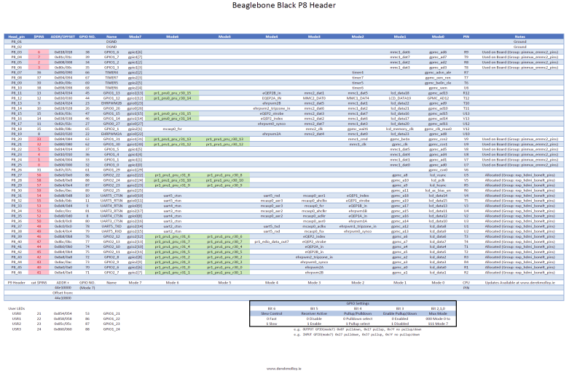
Continue..

Slide 11
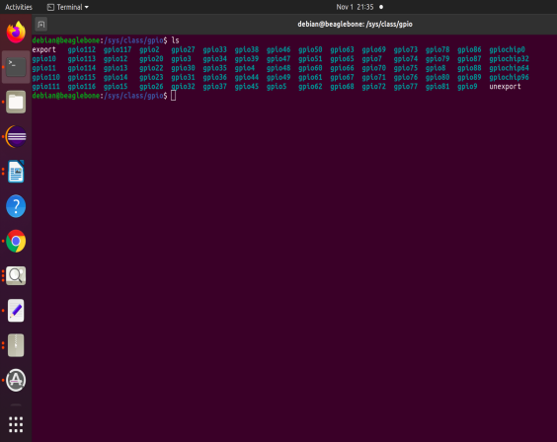
Continue..
Configuring Accessible GPIO Pins:
Once a GPIO pin is accessible, it is very easy to intereact with it directly from the terminal.
The /sys/ class/ gpio/ directory lists the available GPIOs
It is possible to control GPIO pins manually from command line, from bash script, and from any user-space program using file i/o.

Slide 12
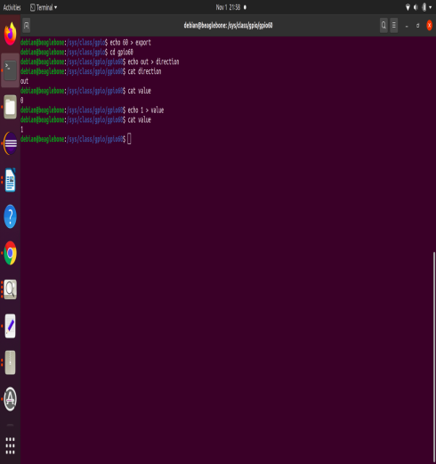
Continue..
Controlling GPIO pins from Command Line:
For example, I use GPIO60 (P9, pin 12)
cd /sys/class/gpio
echo 60 > export: Initialize pin and export pi for read write operation echo 1 > value: Set value of pin 1. It can be changed to 0 as well
echo out > direction: Set input or output direction of the pin
cat value: Check value of the pin.

Slide 13
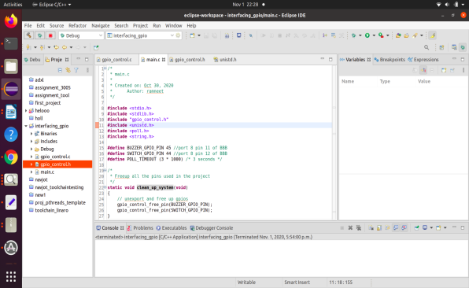
The Software coding: Eclipse IDE
The whole project is written and compiled in Ecpilse IDE.
In this project, we have controlled the GPIO pins through file system and taken interrput as an input from the push button to control the Buzzer.

Slide 14
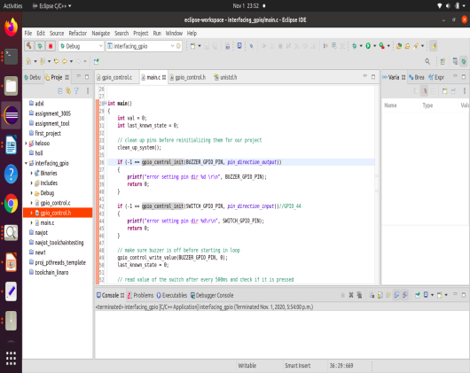
Programming steps to control GPIO pins
Steps to initialize GPIO pins :
To acess any GPIO pins, there are 4 steps:
1. Export: To export a pin, we write the pin name/number to the pseudo file /sys/class/gpio/export. This indicates that we want to use a specific GPIO pin and makes it visible in the sysfs file system hierarchy.
2. Set Direction: Input/Output of a pin
3. File Read/Write: actions to be performend on that pin.
4. Unexport: when we are done, we can unexport the pin

Slide 15
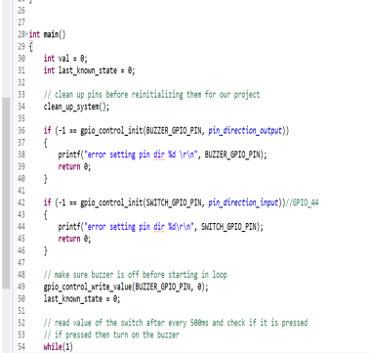
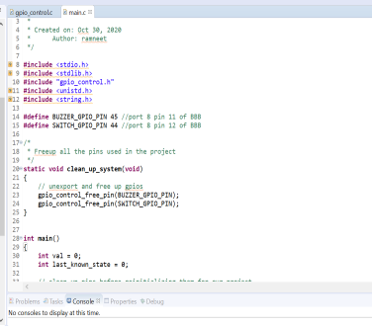
Continue:
In the main() code, two gpio pins are defined, that is, buzzer at GPIO pin 45 and Push Button at GPIO pin 44.
First of all, clean_up_system() function is defined.
This function free any of the given GPIO pins to be used in the code.
In the main () function, the first step is to initialize the buzzer GPIO pin and to set direction. The buzzer pin is output pin.
Initially, Buzzer is set to 0 value.
Similarly, Puah button pin is initialized and declared as input pin.

Slide 16
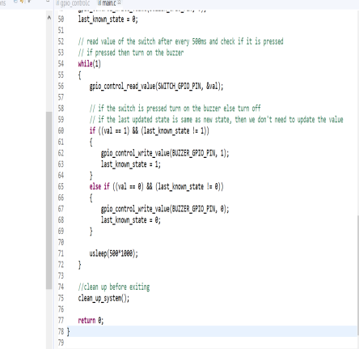
Overview of the code:
Once the GPIO pins are initialized, we will read the state of switch and according to the state of switch, the state of buzzer can be changed.
Steps:
1. Make sure the buzzer is initially off.
2.Continously Check the state of switch
If, switch is released- turn the buzzer OFF.
If, switch is pressed- turn the buzzer ON

Slide 17
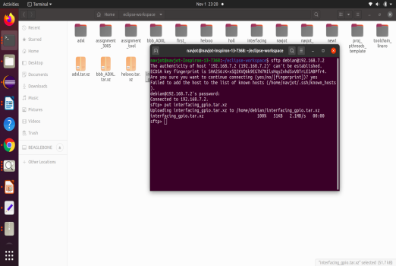
Steps to Run Code on Beaglebone Black
Compressed the project into tar.xz file of the whole project.
Login into debian using sftp command:
sftp debian@192.168.7.2
Put the interfacing_gpio.tar.xz file into Beaglebone black using command:
sftp> put interfacing_gpio.tar.xz

Slide 18
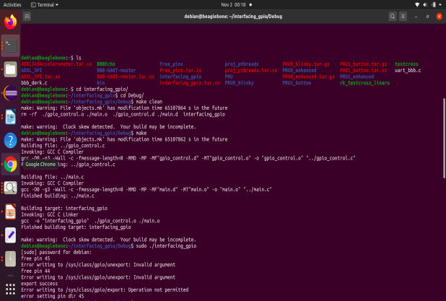
Continue:
Uncompress the file using command:
tar -xf archive.tar.xz
The project is debugged in Eclipse, so we perform the make operation in debug folfer.
The make command create object file named as interface_gpio of the project.
To run the object file, use sudo ./interface_gpio command.

Slide 19
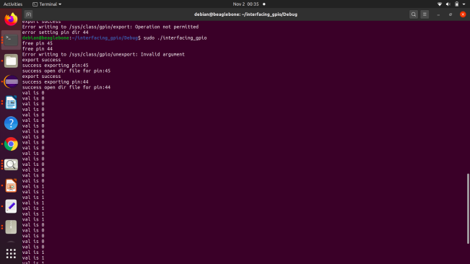
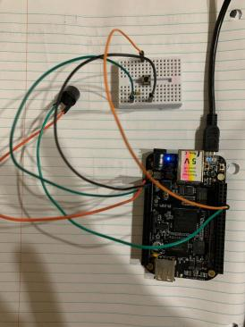
Final Results: The value 0 indicate that push button is not pressed and buzzer is not beeping. The value 1 indicate the push button is pressed and buzzer is beeping.

Slide 20
References
Developer.ridgerun.com. (n.d.). How to use GPIO signals. Retrieved from https://developer.ridgerun.com/wiki/index.php/How_to_use_GPIO_signals#GPIO_interrupts_from_user_space
Krishnan. (n.d.). gist_github.com_krishnan. Retrieved from github.com: https://gist.github.com/krishnan793/29c75261168040c99102
RidgeRun. (2011). Gpio-int-test.c. Retrieved from https://developer.ridgerun.com/: https://developer.ridgerun.com/wiki/index.php?title=Gpio-int-test.c
Vanderbilt Aerospace Design Lab. (n.d.). Setting Up the BeagleBone Black's GPIO Pins. Retrieved from https://vadl.github.io/beagleboneblack/2016/07/29/setting-up-bbb-gpio
Vara, A. (2008, April 21). Switch interfacing with Beaglebone black. Retrieved from EngineersGarage: https://www.engineersgarage.com/tutorials/switch-interfacing-with-beaglebone-black/
BeagleBoard.org. (n.d.). BeagleBone Black. Retrieved from https://beagleboard.org/black
Molloy, D. Exploring BeagleBone, Second Edition. Wiley.

