Slide 1
FINALIZING HARDWARE REQUIREMENTS AND COMPONENT ORDER Group #1
Submitted To– Submitted By –
Prof. Mike Aleshams Ramneet Kaur (C0752942)

Slide 2
Final Hardware Components for IoT based Automatic Railway Gate Controller
Beaglebone Black
Ultrasonic Sensors
Wifi Module (ESP-8266)
Arduino Uno
5V Stepper Motor with ULN2003A
16×2 LCD Display
Buzzer
Push Button
Toy Train
Soldering Iron Kit with ON/Off Switch, Welding Tool with Digital Multimeter
TRIAD Wall Adaptor and power Supply
Zero PCB Board
Jumper Wires

Slide 3
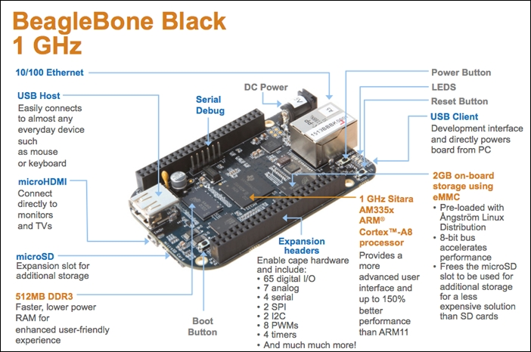
1. Beaglebone Black

Slide 4
Continue….
Power Supply | 5V/0.35A
Operation Temperature | 0 ~ 70℃
Operating Humidity | 20% ~ 90% (Non-Condensing)
Dimensions | 86.36 mm×54.61mm
SDRAM Memory | 512MB DDR3L 800 MHz
Onboard Flash | 4GB, 8-bit Embedded MMC
PMIC | TPS65217C PMIC regulator and one additional LDO
Debug Support | Optional Onboard 20-pin CTI JTAG, Serial Header
Power Source | miniUSB, USB or DC jack | 5V DC External Via Expansion Header
SD/MMC Connector | microSD, 3.3V
Video out | 16b HDMI, 1280 x 1024 (MAX) 1024 x 768 x 1280 x 720, 1440 x 900, 1920 x 1080@24 Hz w/EDID Support
Audio | Via HDMI Interface, Stereo
The BeagleBone Black is open-source hardware that combines the capabilities of a microcontroller and a Raspberry Pi into a single board.
It features a single-core Sitara AM335x ARM Cortex-A8 processor clocked at 1GHz, 512MB of DDR3 RAM, and 4GB of eMMC memory that holds the pre-installed Debian Linux operating system.
Technical Specifications:

Slide 5
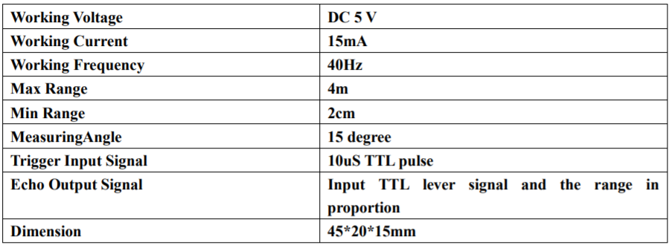
2. Ultrasonic Sensors (HC-SR04)
Product features:
Ultrasonic ranging module HC - SR04 provides 2cm - 400cm non-contact measurement function.
The ranging accuracy can reach to 3mm.
The modules includes ultrasonic transmitters, receiver and control circuit.
Specifications:

Slide 6
3. Wi-Fi Module (ESP 8266)
NodeMCU ESP8266 Specifications & Features
Microcontroller: Tensilica 32-bit RISC CPU Xtensa LX106
Operating Voltage: 3.3V
Input Voltage: 7-12V
Digital I/O Pins (DIO): 16
Analog Input Pins (ADC): 1
UARTs: 1
SPIs: 1
I2Cs: 1
Flash Memory: 4 MB
SRAM: 64 KB
Clock Speed: 80 MHz
USB-TTL based on CP2102 is included onboard, Enabling Plug n Play
Small Sized module to fit smartly inside your IoT projects

Slide 7
4. Arduino Uno
Arduino Uno Specification
Microcontroller: ATmega328P
Operating Voltage: 5V
Input Voltage (recommended): 7-12V
Digital I/O Pins: 14 (of which 6 provide PWM output)
PWM Digital I/O Pins: 6
Analog Input Pins: 6
DC Current per I/O Pin: 20 mA
DC current for 3.3V Pin: 50 mA
Flash Memory: 32 KB (ATmega328P) of which 0.5 KB used by bootloader
SRAM: 2 KB (ATmega328P)
EEPROM: 1 KB (ATmega328P)
Clock Speed: 16 MHz

Slide 8
5. Stepper motor 5V and ULN2003A
The most used stepper motor is the 28-BYJ48 Stepper Motors.
These motors has a stride angle of 5.625°/64, this means that the motor will have to make 64 steps to complete one rotation and for every step it will cover a 5.625° hence the level of control is also high.
However, these motors run only on 5V and hence cannot provide high torque.
Rated voltage ： 5VDC
Speed Variation Ratio: 1/64
Stride Angle: 5.625° /64
Stepper Motor Driver IC- ULN2003A
Contains 7 high-voltage and high current Darlington pairs. Each pair is rated for 50V and 500mA.
Input pins can be triggered by +5V.
All seven Output pins can be connected to gather to drive loads up to (7×500mA) ~3.5A.
Can be directly controlled by logic devices like Digital Gates, Arduino, PIC etc.
Available in 16-pin DIP

Slide 9
6. 16×2 LCD Display
Specifications of 16×2 LCD module
A 16x2 LCD means it can display 16 characters per line and there are 2 such lines. In this LCD each character is displayed in 5x7 pixel matrix.
Operating Voltage is 4.7V to 5.3V
Current consumption is 1mA without backlight
Alphanumeric LCD display module, meaning can display alphabets and numbers
Consists of two rows and each row can print 16 characters.
Each character is built by a 5×8-pixel box
Can work on both 8-bit and 4-bit mode
It can also display any custom generated characters
Available in Green and Blue Backlight

Slide 10
7. Buzzer
It is very small and compact 2-pin structure hence can be easily used. This buzzer can be used by simply powering it using a DC power supply ranging from 4V to 9V.
A simple 9V battery can also be used, but it is recommended to use a regulated +5V or +6V DC supply.
Buzzer Features and Specifications
Rated Voltage: 6V DC
Operating Voltage: 4-8V DC
Rated current: <30mA
Sound Type: Continuous Beep
Resonant Frequency: ~2300 Hz
Small and neat sealed package
Breadboard and Perf board friendly
Tone : Continuous
Operating Temperature : -25°C to +80°C
Storage Temperature : -30°C

Slide 11
8. Push Button
Feature momentary contact, 4 pins, round black push button, through hole mounting, 6 x 6 x 5mm size, etc.
Used in the fields of electronic products, household appliances and more.
High precision mechanism design offers acute operation and long service life. Specification:
Size: 6 x 6 x 5mm
Temperature: -30 ~ +70 Centigrade
Withstand voltage: AC 250V
Rated load: DC12V 50mA
Contact resistance: ≤0.03Ω
Insulation resistance: ≥100MΩ

Slide 12
9. Toy Train
Specifications and Features:
Locomotive dimensions: 7 x 1 ¾ x 2 ¾ inches
Package dimensions: 16 x 12 x 3.5 inches
Finely detailed steam locomotive and three wagons 40.5" x 30.7" oval of snap-fit tracks. That makes up to 10 feet of modular tracks!
Includes a bottle of environment-friendly smoke oil
Battery Operated - Requires 4 x 1.5V ‘AA’ size batteries
Function: Lights, steam, and train sound. Locomotive smokestack moves up and down
Safe and Durable - Made of high-quality, non-toxic certified materials.
Materials made in line with international health & safety standards. Environmentally-friendly, safe & non-toxic.

Slide 13
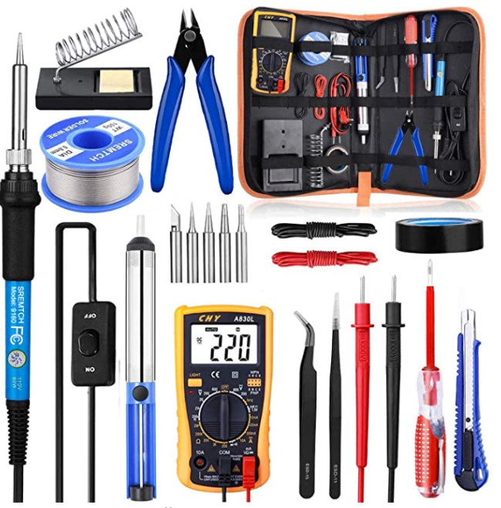
10. Soldering Iron Kit with ON/Off Switch, Welding Tool with Digital Multimeter
The inner-heated ceramic technology of the soldering gun make the soldering iron heat up quickly and save energy.
Easy use Digital Multimeter for measuring DC&AC voltage, DC and AC current, resistance, diode and continuity test.
Portable soldering iron stand with cleaning sponge holds the soldering iron to ensure safety and convenience.
The de-soldering pump is made of high-pressure vacuum tube and aluminum body frame
Soldering iron tools widely used for welding circuit board, appliance repair.

Slide 14
Continue…
Package Included
1 x Adjustable Temperature Welding Iron with ON/OFF Switch x 1
(Temp Rang: 200℃ - 450 ℃)
1 x Mini Digital Multimeter
5 x Soldering Iron Tips
1 x De-soldering Pump (Plastic and aluminum alloy)
2 x Anti-Static Tweezers
1 x Screwdrivers
1 x Soldering Iron Stand (Steel)
1 x Wire Stripper Cutter
1 x Electronic Wire
1 x Solder Wire
1 x Insulation tape
Parameters of Soldering Iron
Power Voltage - AC 110V 50HZp
Input Power - 60W
Temperature Range - 200℃ / 392℉ ~ 450℃ / 842℉

Slide 15
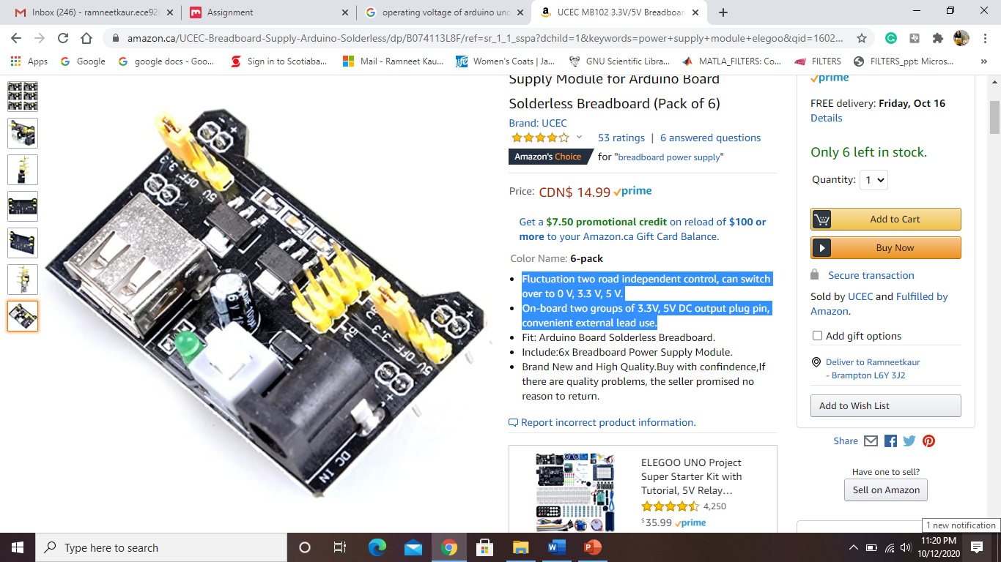
11. Wall adaptor and Power supply
Wall Adaptor Specifications
5V 10W AC/DC External Wall Mount Adapter Fixed Blade Input
Voltage - Input:-90 ~ 264 VAC
Voltage - Output:-5V
Current - Output (Max):-2A
Power (Watts)- 10W
No Load Power Consumption- 100mW (Max)
Polarization- Positive Center
Applications- ITE (Commercial)
Efficiency- Level VI, ≥78.70%.
Operating Temperature- 0°C ~ 40°C
Output Connector- Barrel Plug, 2.1mm I.D. x 5.5mm O.D. x 11.0mm
Size / Dimension- 2.80" L x 1.69" W x 1.18" H (71.0mm x 43.0mm x 30.0mm)
Cord Length- 60" (1.52m)
Power supply Specifications
Fluctuation two road independent control, can switch over to 0 V, 3.3 V, 5 V.
On-board two groups of 3.3V, 5V DC output plug pin, convenient external lead use.
Include:6x Breadboard Power Supply Module.

Slide 16
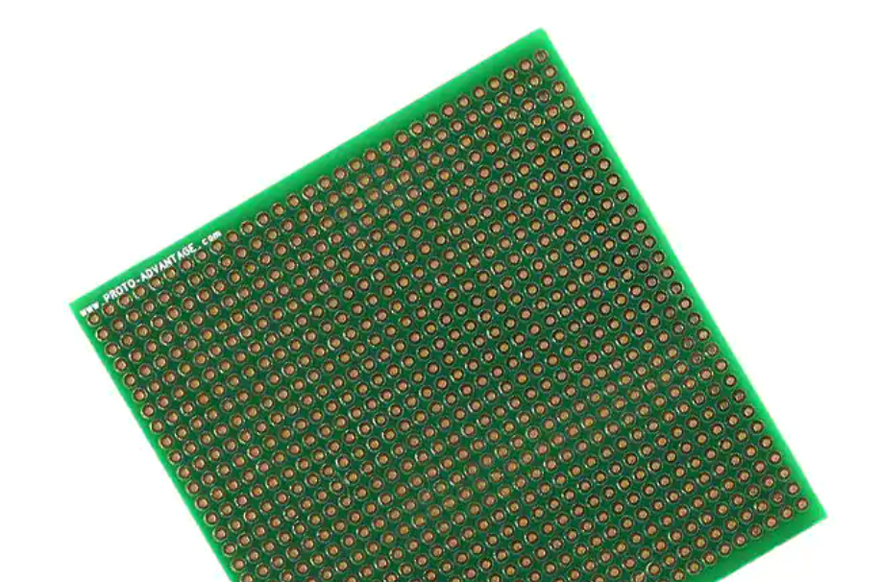
12. Zero PCB
Dimensions: 3.1" x 3.2" x 0.0625“
PCB operating temperature range: -40°C to +130°C
PCB reflow maximum temperature: +260°C
Hole size: 1.0mm (40 mils) diameter Holes accept 25 mil square wire wrap posts
13. Jumper wires
Elegoo 120pcs Multicolored Dupont Wire, each cable length: about 20 cm /8-inch
The cables can be separated to form an assembly containing the number of wires you require for your connection and to support non-standard odd-spaced headers
Includs:
1X 40-pin male to female jumper wires,
1X 40-pin male to male jumper wires,
1x40-pin female to female jumper wires

Slide 17
References
Active Passive Buzzer. (2017, September 25). Retrieved from Components 101: https://components101.com/buzzer-pinout-working-datasheet
Arduino.cc. (n.d.). Arduino Uno Rev3. Retrieved from https://store.arduino.cc/usa/arduino-uno-rev3
Coley, G. (2014, May 22). BeagleBone Black System Reference Manual. Retrieved from https://cdn.sparkfun.com/datasheets/Dev/Beagle/BBB_SRM_C.pdf
DAOKI 100-Pack 6x6x6 mm Miniature Micro Momentary Tactile Tact Touch Push Button Switch . (n.d.). Retrieved from Amazon.ca: https://www.amazon.ca/C-J-SHOP-Miniature-Momentary-Tactile/dp/B01CGMP9GY/ref=sr_1_16?dchild=1&keywords=push+button&qid=1602459222&sr=8-16
Elec Freaks. (n.d.). Ultrasonic Ranging Module HC - SR04. Retrieved from https://www.electroschematics.com/wp-content/uploads/2013/07/HCSR04-datasheet-version-1.pdf
Traid Magnetics.com. (2019, June 6). Triad Magnetics Wall plug Ins. Retrieved from http://catalog.triadmagnetics.com/Asset/WSU050-2000.pdf
Solder-in breadboard 900 plated holes . (n.d.). Retrieved from Proto Advantages: http://www.chipquik.com/datasheets/SBBTH3030-1.pdf

Slide 18
Continue…
How 16×2 LCDs work | Build a basic 16×2 character LCD. (2020, July 31). Retrieved from Elecforum.com: https://www.electronicsforu.com/resources/learn-electronics/16x2-lcd-pinout-diagram
Joseph, T. (2018, August 2). Arduino Uno Specification. Retrieved from Tomson Electronics: https://www.tomsonelectronics.com/blogs/news/arduino-uno-specification
NodeMCU ESP8266. (2020, April 22). Retrieved from Components 101: https://components101.com/development-boards/nodemcu-esp8266-pinout-features-and-datasheet
Soldering Iron Kit with ON/Off Switch. (n.d.). Retrieved from Amazon.ca: https://www.amazon.ca/Soldering-Iron-Kit-Rarlight-Multimeter/dp/B07NVL3BX6/ref=sr_1_11?crid=DP6AE3NHT5BX&dchild=1&keywords=soldering+kit+with+multimeter&qid=1601389466&sprefix=soldering+kit+%2Caps%2C192&sr=8-11
Elegoo 120pcs Multicolored Dupont Wire 40pin. (n.d.). Retrieved from Ama-zon.ca: https://www.amazon.ca/Elegoo-120pcs-Multicolored-Breadboard-arduino/dp/B01EV70C78/ref=sr_1_16?dchild=1&keywords=connecting+wire+electronics&qid=1601334485&sr=8-16
Haktoys Railway King Classical Freight Train Set Battery Operated. (n.d.). Retrieved from Amazon.ca: https://www.amazon.ca/Haktoys-Classical-Simulation-Locomotive-Authentic/dp/B015975ER2
HiLetgo 5pcs 3.3V 5V Power Supply Module for MB102 102 Prototype Breadboard DC 6.5-12V or USB Power Supply Module. (n.d.). Retrieved from Amazon.ca: https://www.amazon.ca/HiLetgo-Supply-Module-Prototype-Breadboard /dp/B00HJ6AE72/ref=sr_1_11?crid=2OKTY64QJ1057&dchild=1&keywords=elegoo+power+supply&qid=1602593875&sprefix=elegoo+power+%2Caps%2C164&sr=8-11

