Slide 1

Individual Activity 3_2 PCB Designing – Fritzing Software
Submitted by – Submitted to –
Navjot Saini (C0751275) Prof. Mike Aleshams

Slide 2

List of Contents
IoT based Automatic Railway Gate Controller
What is PCB Design
Printed Circuit Board (PCB) Design
Parts of PCB
Advantages of PCB
PCB Designing in Fritzing Software
Prepare Schematic Design
Switch to PCB View
Autorouting
Design Rule check – Autorouted Circuit
Hand Routing
Design Rule check – No error in final design
PCB View of final PCB design
Image View of PCB Design
Exporting Gerber files
Copper bottom view of Gerber file
Copper top view of Gerber file
Bill of Material

Slide 3
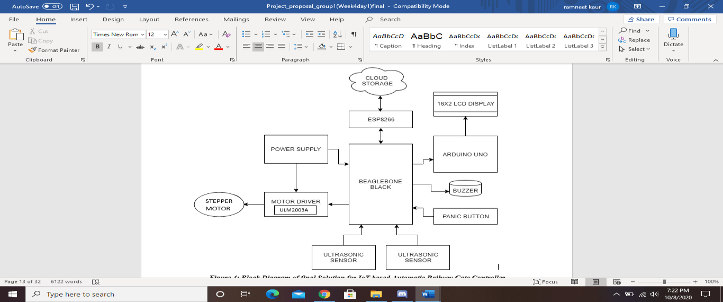
IoT based Automatic Railway Gate Controller

Slide 4
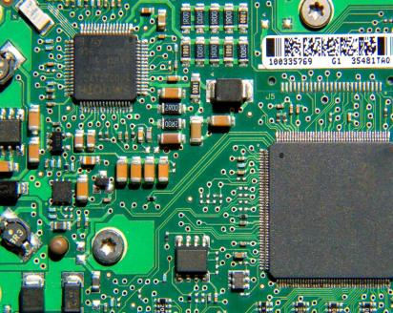
Printed Circuit Board (PCB) Design
PCB design is part of the design process of a product in electronics industry.
PCB is a piece of insulating plastic board, on and in which there are several layers of metal (copper) connections that connects parts mounted on the board.
Conducting layers are typically made of thin copper foil.
• The board is typically coated with a solder mask that is green in color.
PCB's can be single sided (one copper layer), double sided (two copper layers) or multi-layer.

Slide 5
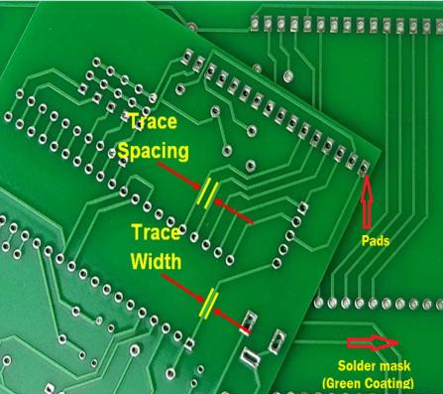
Parts of PCB
Component: Components are the actual devices used in the circuit.
Pads: Pads are location at which components are connected and pads have an inner diameter and outer diameter.
Traces: Traces are essentially the wiring of the PCB that is equivalent to wire for conducting signals.
Vias: Vias plated hole connecting traces from one layer of board to other layers.
Top metal layer: Most of the components reside on the top layer. Fewer traces on the top.
Bottom Metal Layer: Few components on this layer. • Many traces on this layer. •
Jumper wires: To avoid overlapping of traces, jumper wires are used.
Solder mask: It is a thin lacquer-like layer of polymer that is usually applied to the copper traces of a printed circuit board (PCB) for protection against oxidation.

Slide 6
Advantages of PCB design
Using a PCB brings many advantages to the electronic industry:
Compact Design
Ease of Testing and Repair
Lower Assembly Errors
Avoiding Short Circuits
Low Noise and Interference
Improved Repeatability and Reliability

Slide 7
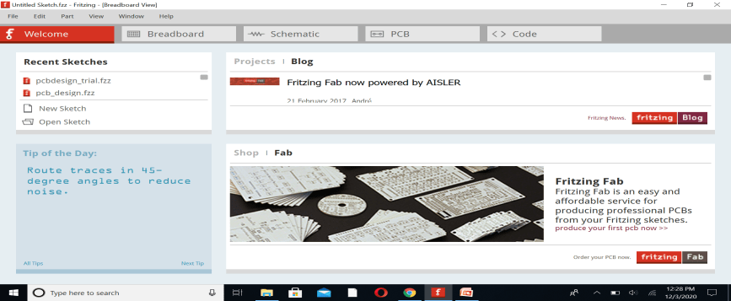
PCB Designing in Fritzing Software
Fritzing is a new open source PCB designer that supports Linux systems. Its power stems from its user-friendly interface, drag n drop features, pleasing visuals, and comprehensive views.
Fritzing's PCB View lets us to design and export layout files for single-sided, Double sided Printed Circuit Boards.
We can also export your sketch to Gerber files, and send them to a professional PCB manufacturing service.

Slide 8
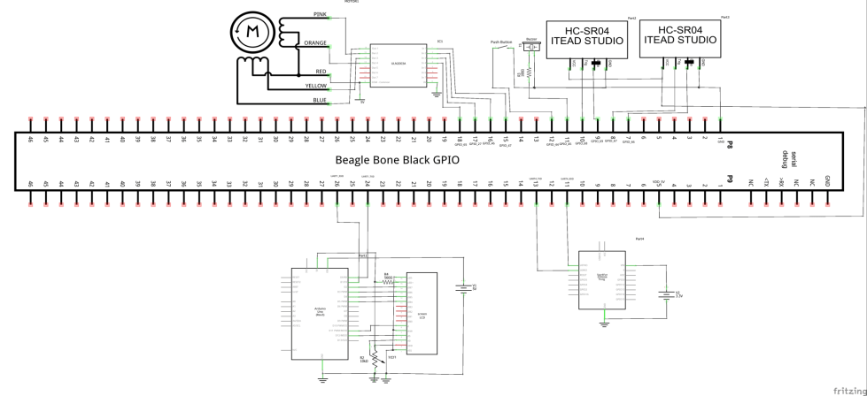
Prepare Schematic Design
To design PCB, it is essential to prepare Schematic Design of whole Project.
One of the previous task was Schematic designing. Considering Schematic design our base, we will further prepare PCB design.

Slide 9
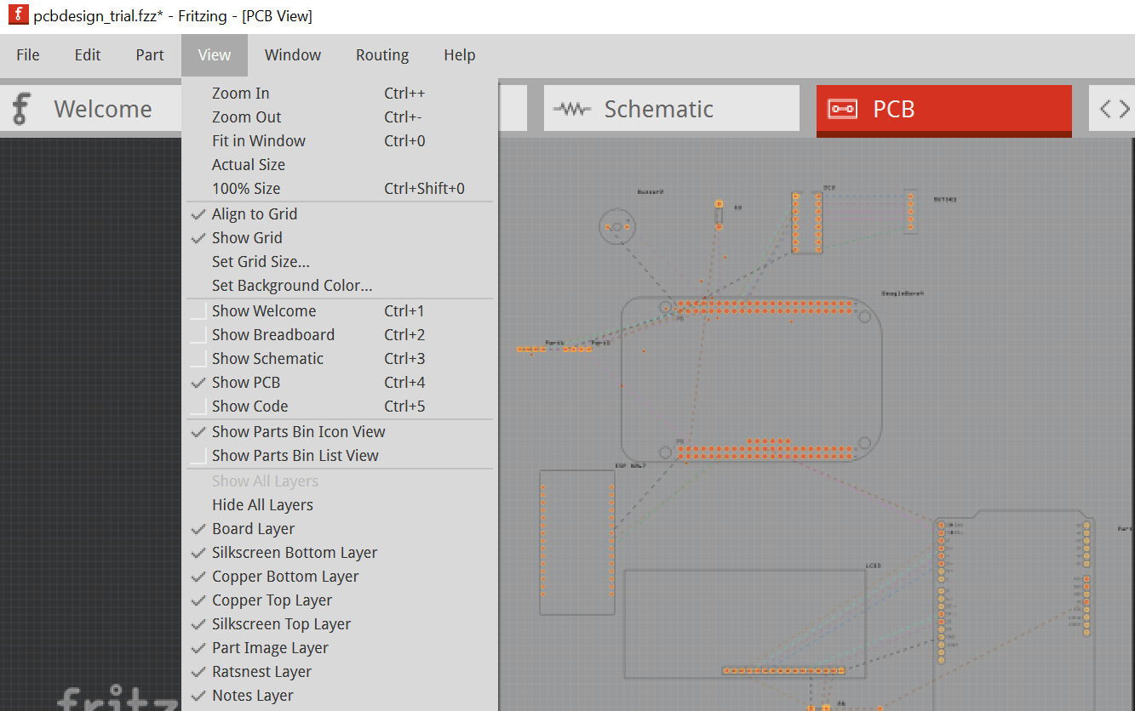
Switch to PCB View
To switch to the PCB View use the Navigator or the View Switcher.
While it is very easy to recognize parts in the Breadboard View, the PCB View might look a bit confusing at first glance.
The reason for this is that the PCB View only shows the necessary information needed for the PCB design.
This information is shown in different layers. To view or hide layers, use the View options in the menu bar.

Slide 10
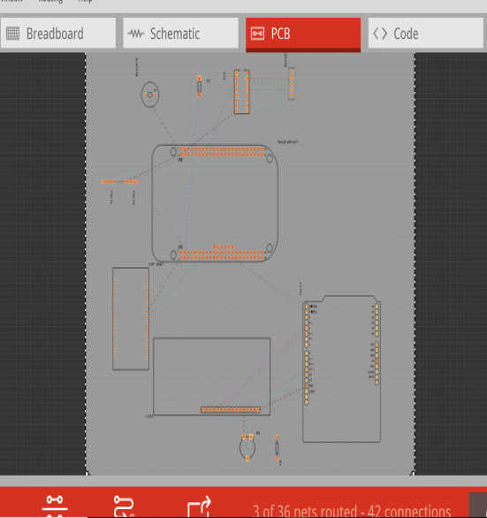
Rat’s Nest
The Grey rectangle is the PCB board itself, on which parts will be arranged. We can resize the board.
We can identify parts by selecting or placing the cursor on them to see their labels.
The thin connecting lines are the Rat's Nest that act as guidelines.
First of all , we need to arrange components to make clear and neat connections.
The Beaglebone Board is placed in the centre of PCB board as all interfacing devices are connected to Beaglebone Black.
Arduino Uno and LCD are placed in line and close to each other.
The motor driver IC and Stepper motor are also places close to each other.
In this way, all components are aligned and arranged in proper order.

Slide 11
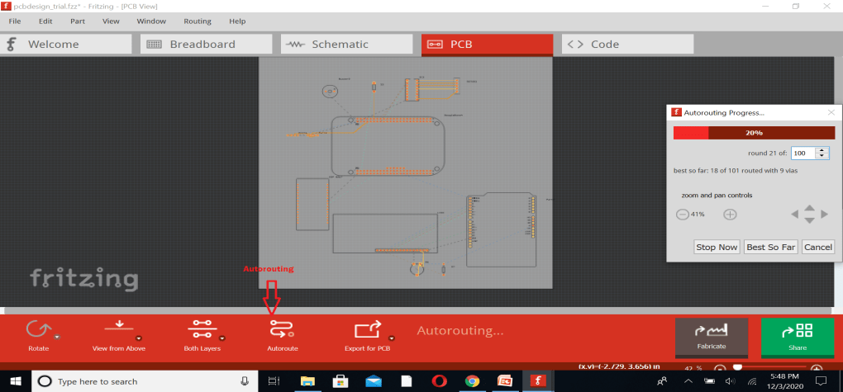
Autorouting
Fritzing can automatically generate the connection traces between parts.
Click the Auto-route function from the bottom menu bar or under Routing > Autoroute.
The Autorouting Progress window will pop up shownig progress in routing in percentage.
We can stop Autorouting in between if there is any issue.

Slide 12
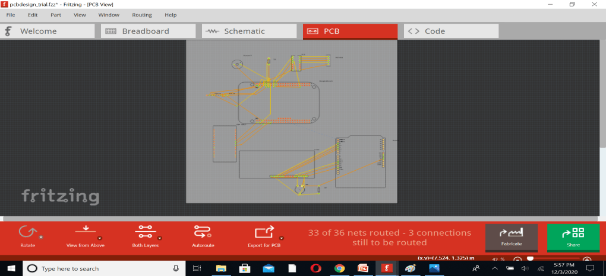
Continue…
The results of Autorouting are not up to mark.
The 3 connections out of 36 are still left for routing as autorouting does not able to route these connections.
Such a problem might happen because parts were not arranged properly on the board or when there is just no possible route. You will then need to Hand-route the trace (more about hand-route below) or create a jumper.

Slide 13
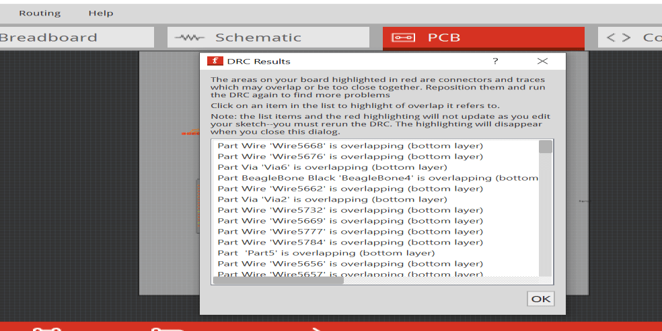
Design Rule Check - Autorouted Circuit
As we can see that there are wires that are overlapping , this shows that Auto routing does that yield the best results.
So, we will switchto Hand routing where all the connection are done manually.

Slide 14
Hand Routing
As Autorouting does not provide us with desired results, so we switched to Hand routing options.
The PCB is designed on both Top layer and Bottom layer.
The yellow traces represented Top layer traces and Orange traces represented Bottom layer traces.
Few connections are routed on top layer to avoid overlapping of traces.
2 connections are traced with the help of Jumper wires as that traces are overlapping.

Slide 15
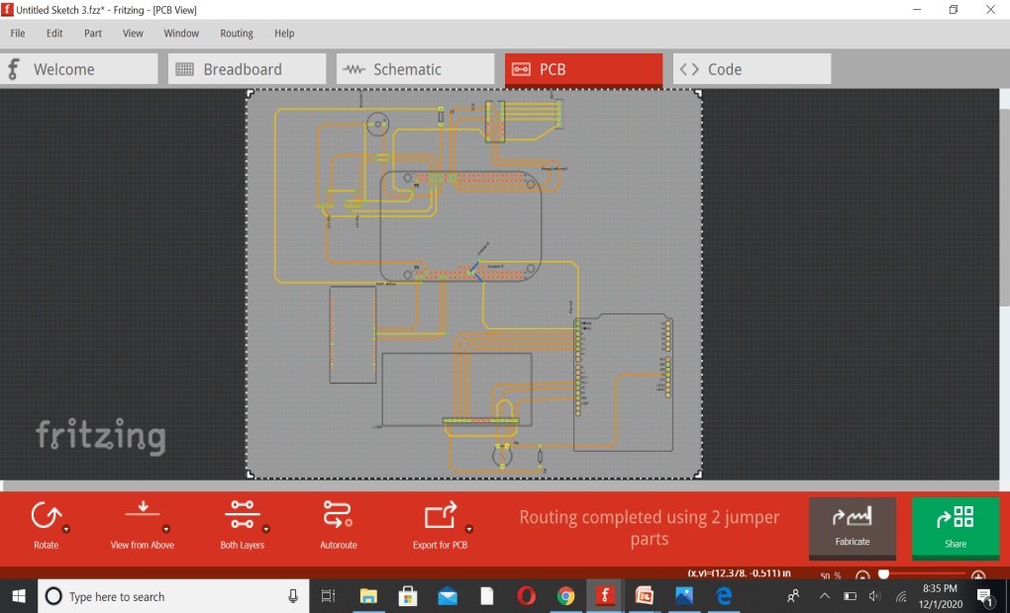
PCB design – Hand Routing

Slide 16
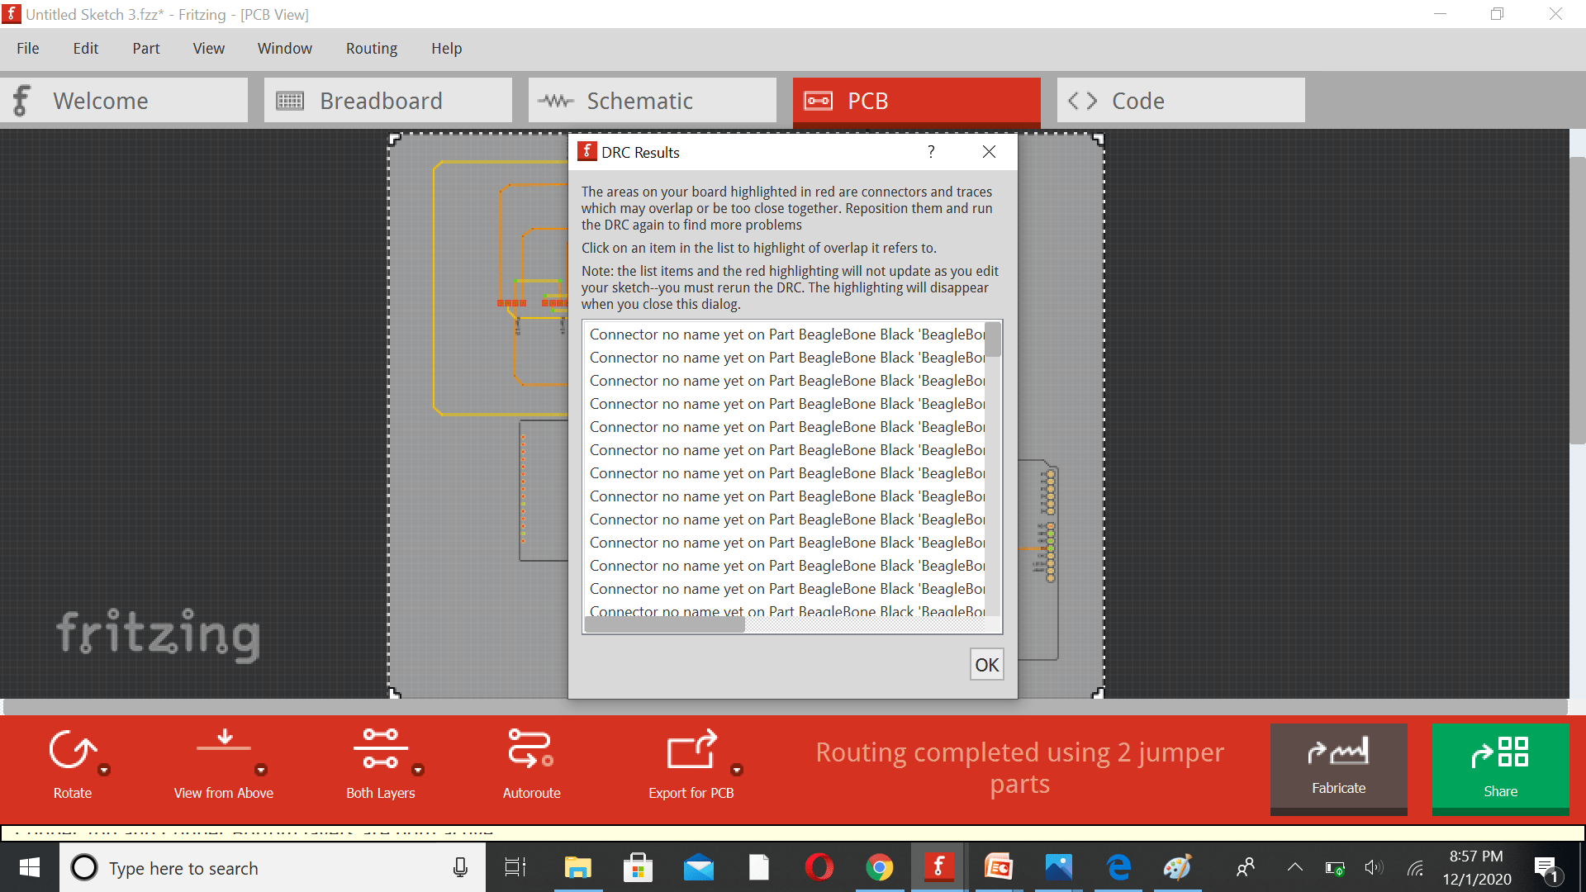
Design Rule Check– No Error in final Design
The final Hand routed design does not have any design error. The DRC results only represented all the unconnected pins of beaglebone black.
As we are not using all pins of Beaglebone black but there is no overlapping wire error.

Slide 17
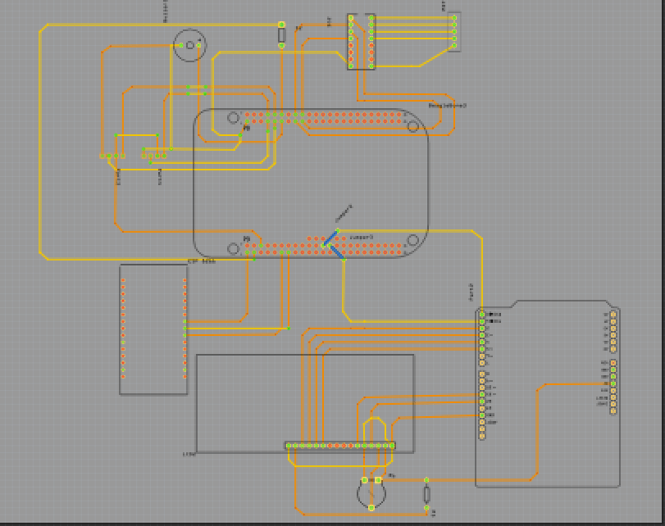
PCB View of Final PCB Design

Slide 18
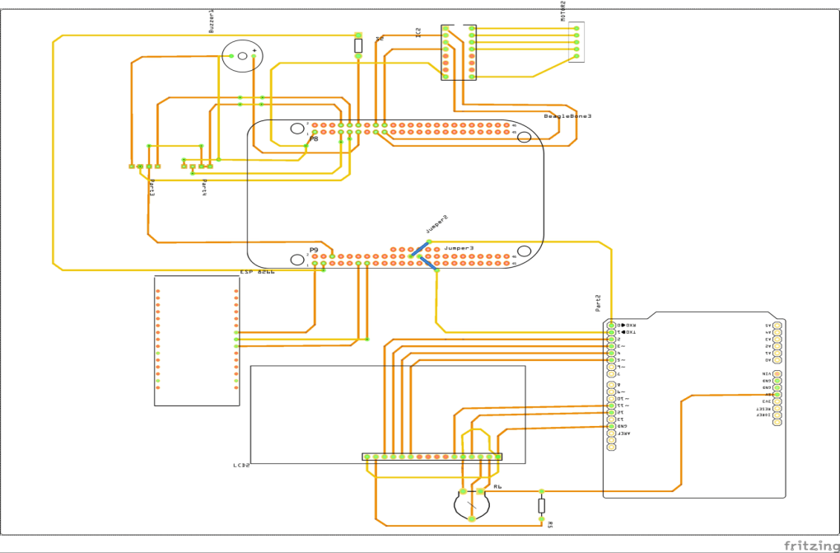
Image View ( JPG) of PCB Design

Slide 19
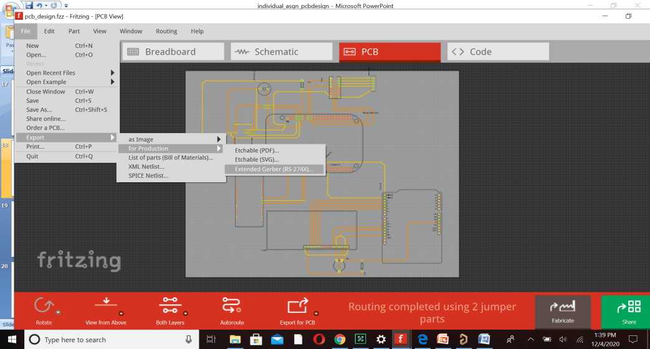
Exporting Gerber files
To export the Gerber files that are further send for PCB manufacturing, go to
File > export > for Production > Extended Gerber ( RS- 274X).

Slide 20
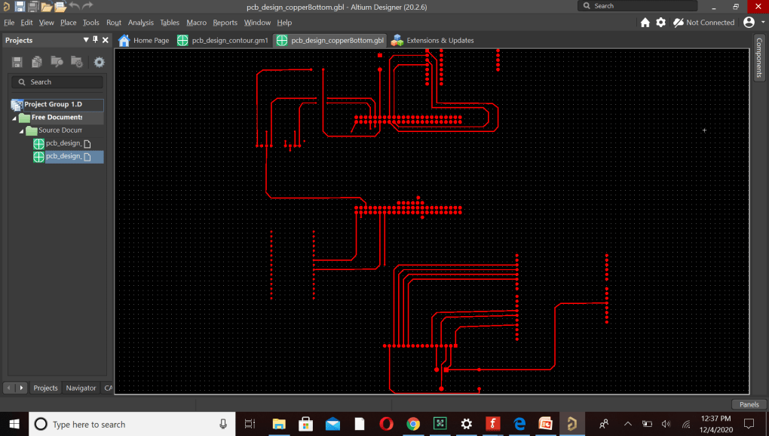
Copper Bottom View of Gerber file
Altium Designer 20.2.6 Software is used to view Gerber Files

Slide 21
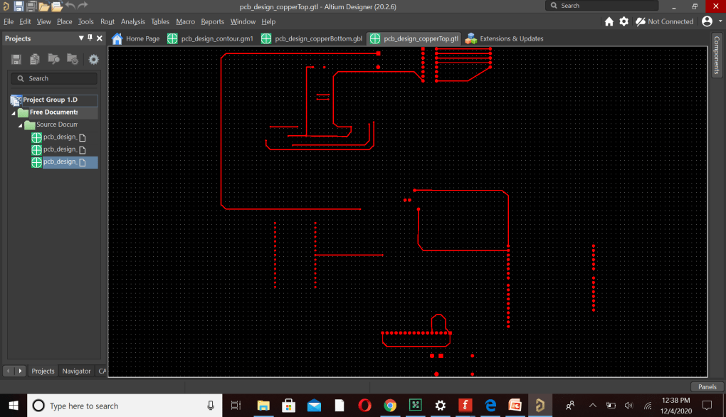
Copper Top view of Gerber file

Slide 22
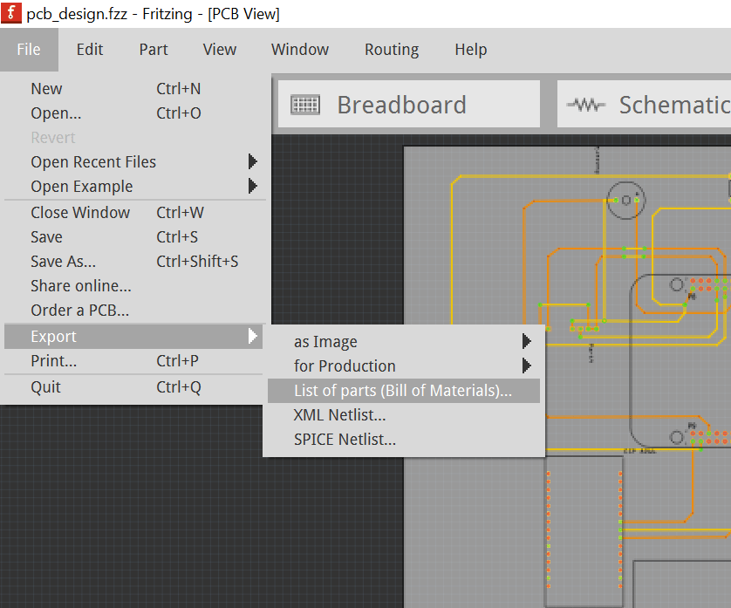
Bill of Material
Fritzing can also auto-generate the Bill of Materials in HTML format.
All this is done through the “File/Export” menu located on the top left.
This will generate a Bill of Material file link:
file:///C:/ESE_4009/pcb_design_bom.html

Slide 23
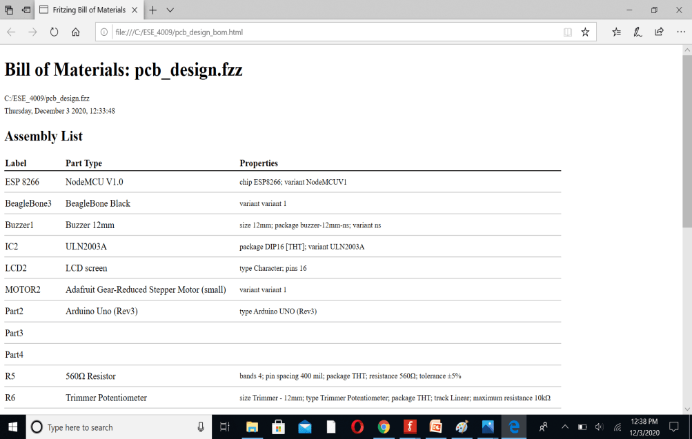
Continue…

Slide 24
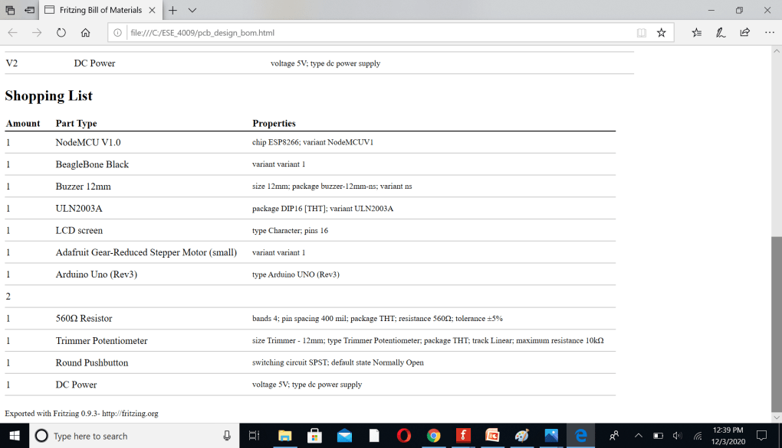
Continue..

Slide 25
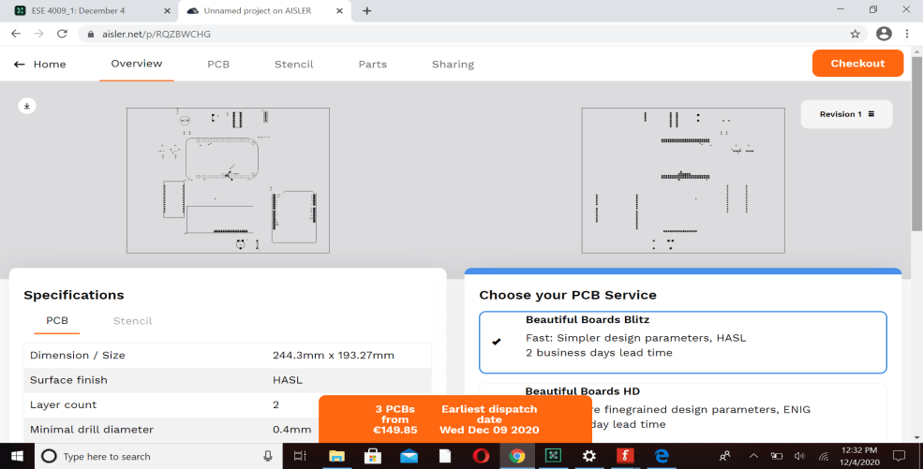
Uploading Gerber files in AISLER for manufacturing
In Fritzing Software, we have option to order PCB for fabrication.
It direct us to AISLER.net website where we can upload Gerber file and place order for PCB design.

Slide 26
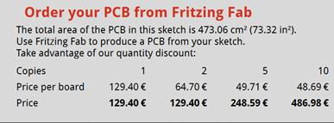
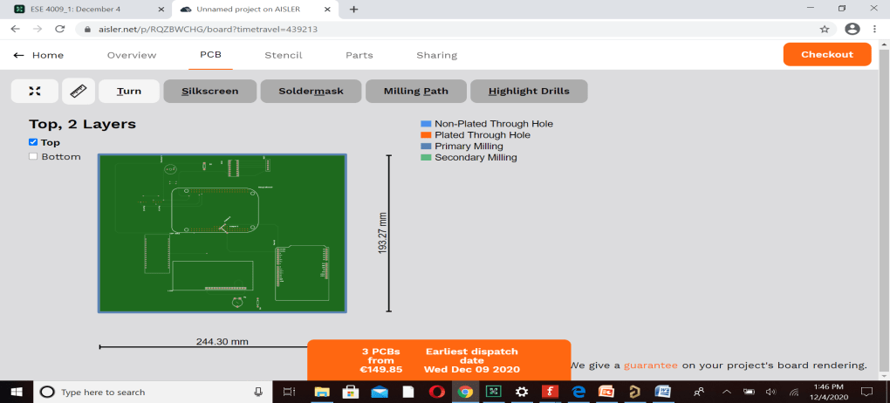
Order PCB on Fritzing Fab

Slide 27
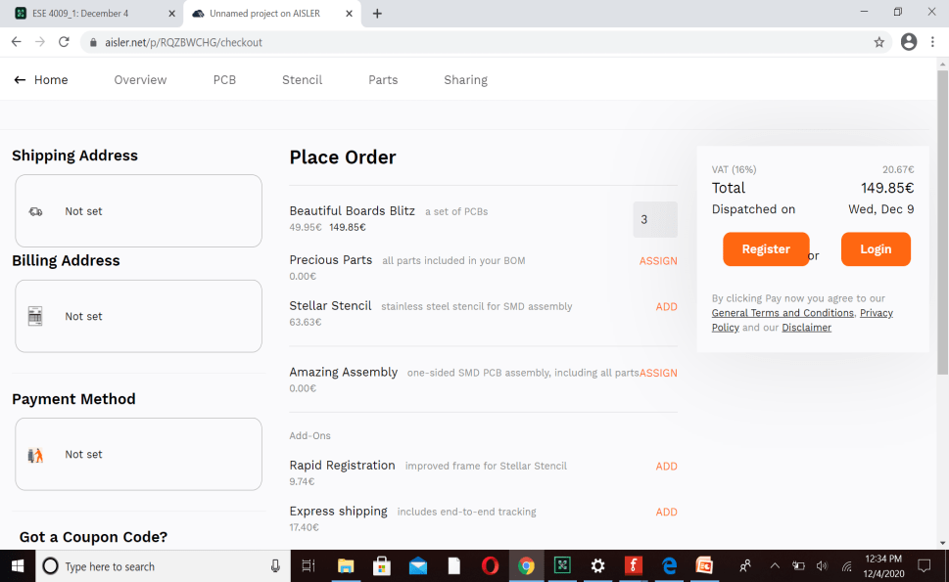
Placing Order

Slide 28
References
Importance of PCBs and PCB design. (2020, April 25). Retrieved from RushPCB: https://rushpcb.com/importance-of-pcbs-and-pcb-design/
PCB view. (n.d.). Retrieved from Fritizing: https://fritzing.org/learning/tutorials/designing-pcb/
Toulas, B. (n.d.). Design PCB and Generate Schematic Drawings with Fritzing on Linux. Retrieved from HowToForge: https://www.howtoforge.com/tutorial/design-pcb-and-generate-schematic-drawings-with-fritzing-on-linux/
E-radionica.com. (n.d.). What is Fritzing, How to use it and How does it work? Retrieved from https://e-radionica.com/en/blog/what-is-fritzing-what-is-does-and-how-to-use-it/

Slide 29
THANK YOU

