Slide 1
Group #1 INTERFACING ESP8266 WITH BEAGLEBONE BLACK
Submitted to – Prof. Mike Aleshams
Submitted by- Ramneet Kaur (C0752942)

Slide 2
LIST OF CONTENTS
•Introduction
•Hardware and software Requirements
•Purpose of using ESP8266 in the project
•ESP 8266 (NodeMCU ESP-12E)
•UART interfacing between Beaglebone Black and ESP8266
•Circuit diagram of interfacing ESP8266 with BBB
•Arduino IDE for writing code for ESP 8266
•UART code for BeagleBone Black
•Steps to Run the code
•Results
•References

Slide 3
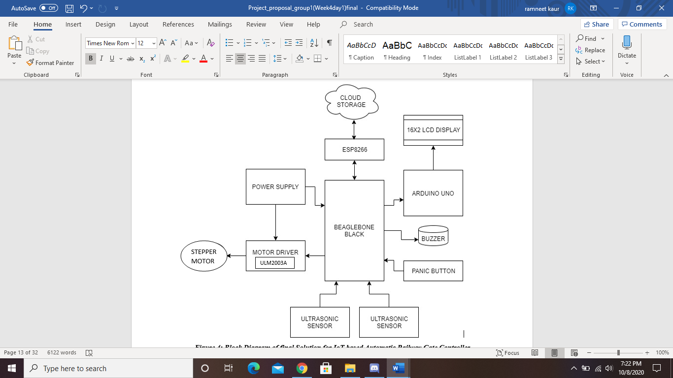
IoT based Automatic Railway Gate Controller

Slide 4
Hardware and Software Requirements
Hardware Requirements
Node MCU ESP8266
Beaglebone Black
USB Wire
Connecting Wires
Breadboard
Software Requirements
Debian OS
Linux Operating System
Nano Editor
GCC compiler to run code
Arduino IDE for writing code for ESP 8266

Slide 5
Purpose of using ESP8266 in the Project
In our project we need to send messages about gate status to the cloud so we need wireless connectivity.
As Beaglebone Black does not have inbuilt Wi-Fi module, so external Wi-Fi module ESP8266 is used as Wi-Fi module for IoT connectivity.
For establishing communication between two boards we are using UART interfacing.
NodeMCU ESP-12E (ESP8266) support wireless 802.11b/g/n standard.
Notes:
In our project we need to send messages about gate status over the internet

Slide 6
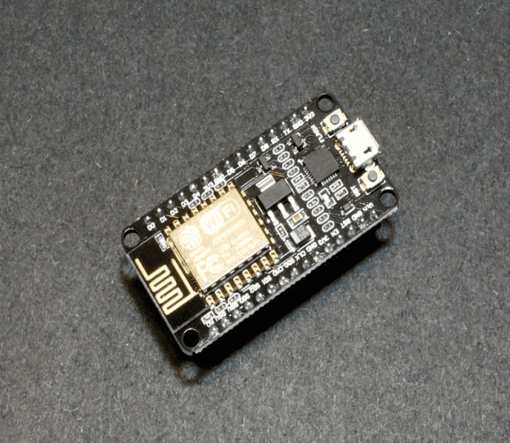
ESP 8266 (NodeMCU ESP-12E)
The NodeMCU ESP8266 development board comes with the ESP-12E module having Tensilica Xtensa 32-bit LX106 RISC microprocessor.
NodeMCU ESP8266 Specifications & Features
Operating Voltage: 3.3V
Input Voltage: 7-12V
Digital I/O Pins (DIO): 16
UARTs: 1
SPIs: 1
I2Cs: 1
Flash Memory: 4 MB
SRAM: 64 KB
Clock Speed: 80 MHz

Slide 7
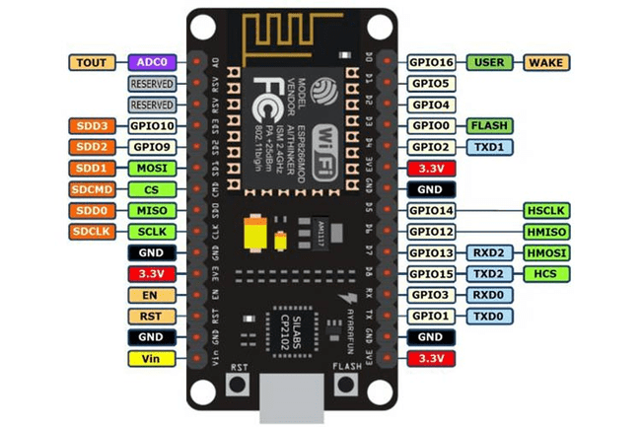
Pin description of Node MCU ESP-8266
NodeMCU can be powered through the micro-USB port.
NodeMCU has two UART interfaces, UART0 (RXD0 & TXD0) and UART1 (only TXD1). UART0 is used to upload the firmware/program.
NodeMCU has 16 general purpose input-output pins on its board.
We have used D5 and D6 GPIO pins as software UART to display data that we will receive from BBB

Slide 8
UART interfacing between Beaglebone Black and ESP8266
The Beagle Bone has five available on-board serial UART ports.
These ports are named as BB-UART1, BB-UART2, BB-UART4, BB-UART5.
We have used BB-UART4 for interfacing with ESP8266 serially.
 | RX | TX | Device | Remark
UART0 | J1_4 | J1_5 | /dev/ttyO0 | BeagleBone Black only
UART1 | P9_26 | P9_24 | /dev/ttyO1
UART2 | P9_22 | P9_21 | /dev/ttyO2
UART3 |  | P9_42 | /dev/ttyO3 | TX only
UART4 | P9_11 | P9_13 | /dev/ttyO4
UART5 | P8_38 | P8_37 | /dev/ttyO5

Slide 9
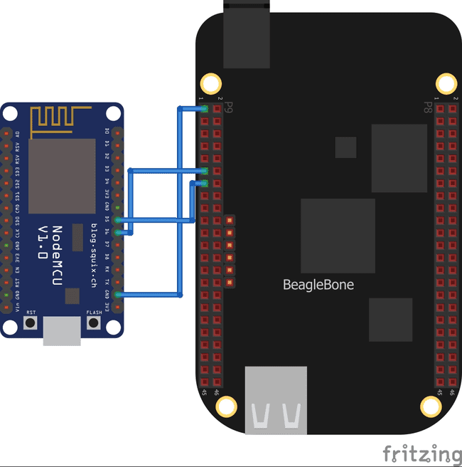
Continue…
On port 9 of BBB, pin 11 and pin 13 are designated to UART4.
The D6 (GPIO 12) TX pin of ESP 8266 is connected to P9.11 (UART4_RXD).
The D5 (GPIO 14) RX pin of ESP 8266 is connected to P9.13 (UART4_TXD).
The GND pin of ESP 8266 is connected to P9.1(GND) pin of BBB.
The ESP 8266 is powered through micro-USB cable.

Slide 10
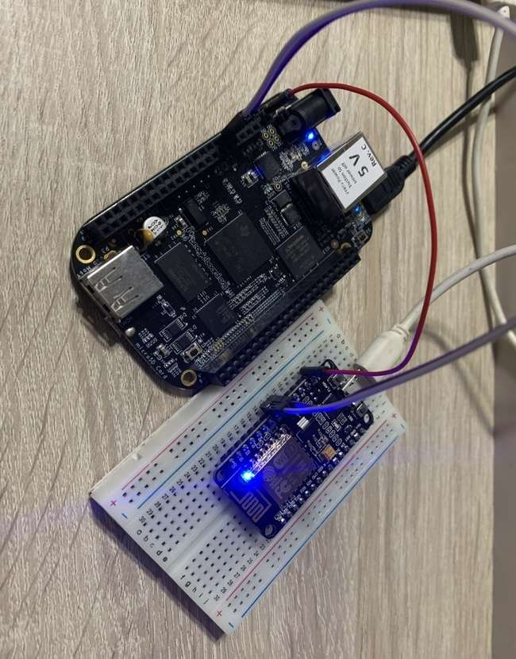
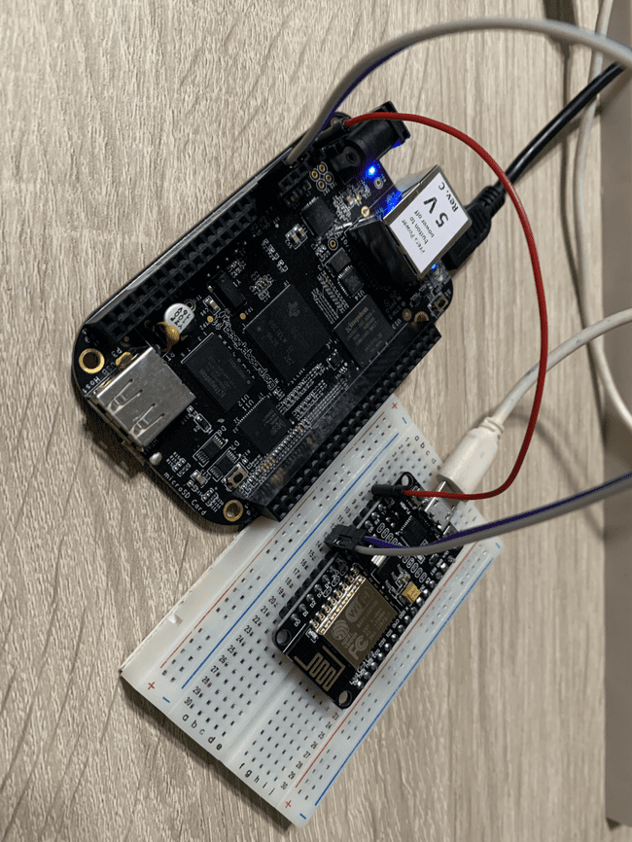
Circuit Diagram of Interfacing ESP8266 with BBB

Slide 11
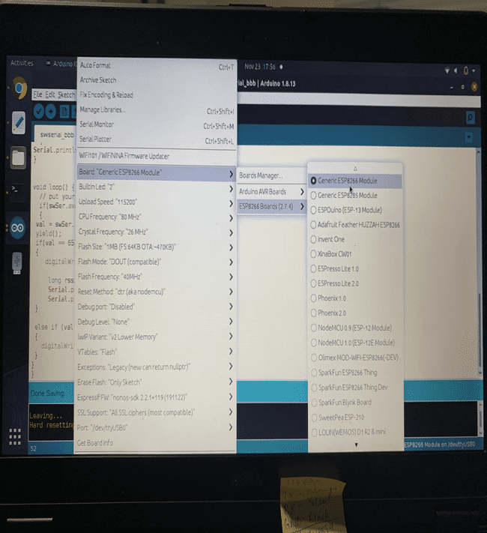
Arduino IDE for writing code for ESP 8266
Arduino IDE will be used writing the code and flashing the code to ESP module
How to select the ESP 8266 board:
Open Arduino IDE and from the Tools Button, Select the board as “Generic ESP8266 Module”.
Select the ESP 8266 Boards(2.7.4) and further select Generic ESP8266 module.

Slide 12
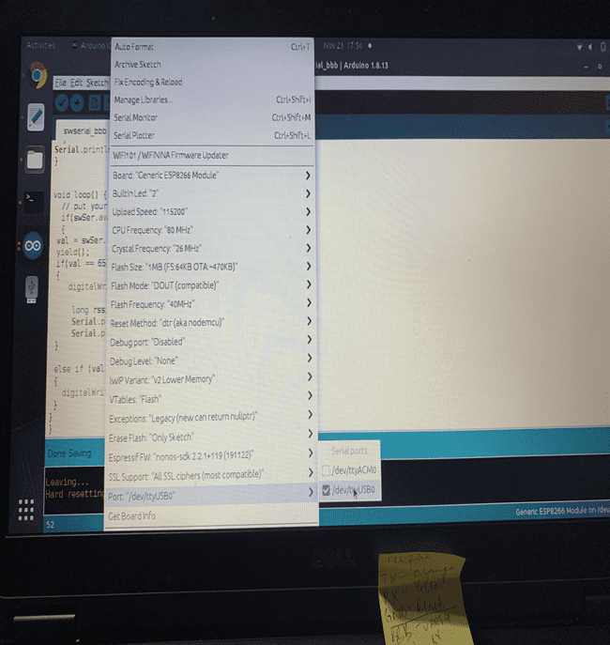
Continue..
Next for uploading the code we need to select the port to which the ESP has been connected.
The port is selected from tool-box, choose the port from available options with which ESP 8266 board is connected.
Here, the board is connected to USB0.

Slide 13
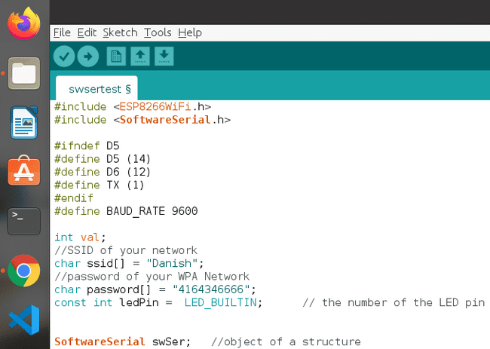
Overview of code in Arduino IDE
Header files:
ESP8266wifi.h
SoftwareSerial.h
Setting Baud Rate to 9600
Defining variables for wifi ID and Password

Slide 14
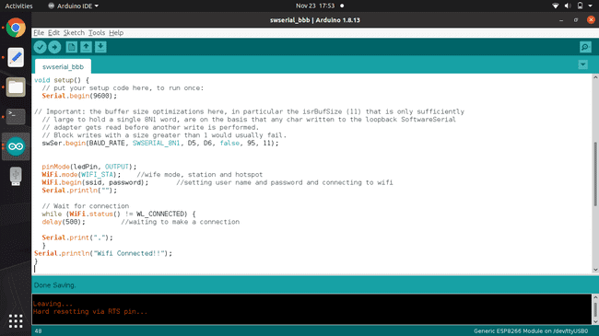
Continue..
Void Setup(): One-time operations.
Setting direction of built-in LED as output.
Setting baudrates for hardware serial and software serial (UART0 and GPIO pins D5 D6)to 9600.
Setting WiFi mode and connecting to given network ID and Password.
Reading the status of WiFi.
Printing the status of WiFi.

Slide 15
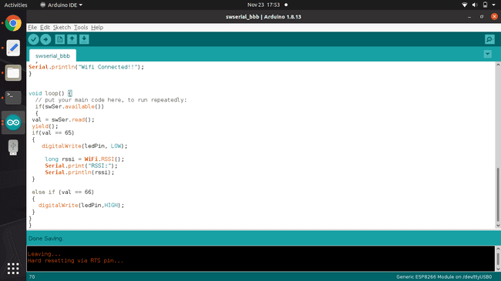
Continue..
Void loop(): Task to be done repeatedly.
Read the contents available at software serial pins (D5-D6)
Passing control to other tasks when called. As read functions will take a while to complete.
If we receive “A” from BBB over UART0 interface, the in-built LED of ESP will turn ON and also the strength of WiFi signal will be displayed over Software UART(D5 and D6)
If we receive “B” from BBB over UART0 interface , the in-Built LED of ESP will turn OFF.

Slide 16
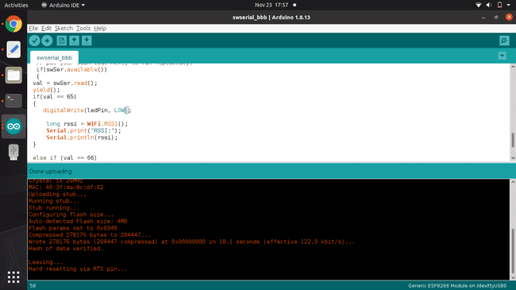
Uploading code in ESP 8266
Uploading code to ESP8266 is like uploading code to Arduino. The only difference is the log while uploading.
After the code is successfully uploaded to ESP8266, we are required to reset the ESP manually.

Slide 17
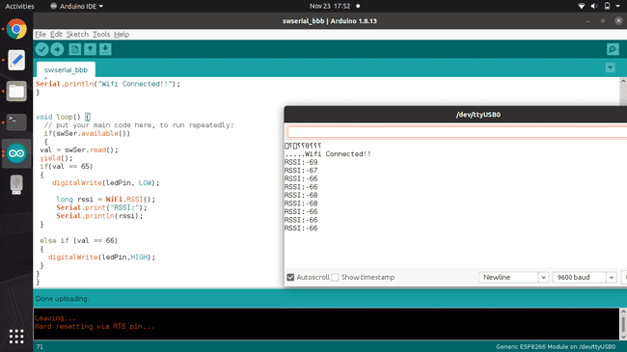
Results showing Wi-Fi signal strength

Slide 18
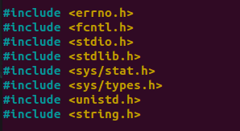
C code for controlling ESP 8266 through UART port of BBB
The following libraries are included in the main code:
Stdio.h is standard input and output library
Unistd.h is included for usleep function.
Stdlib.h is for memory allocation and process control
Errno.h header file provides system error number.
Fcntl.h header file provide file control options like file open.
Sys.stat.h header file provide structure of data returned by the functions
Sys/types.h includes definition for the data types (size_t, clock_t).
String.h defines functions for manipulating array of characters.

Slide 19
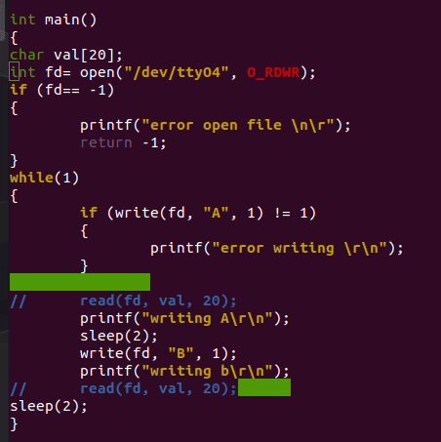
Main function
We have used nano editor to write the code that we have uploaded into the BBB.
First, for writing the code for UART we need to open the file description related to UART4 of BBB.
Once the file is opened successfully, we can write any data that we want to send over UART interface to this file.
The default configuration of the UART is Baud rate: 9600, 8 data bits followed by 1 stop bit and no parity.
In our program we write A and B over the UART one after another with some delay.

Slide 20
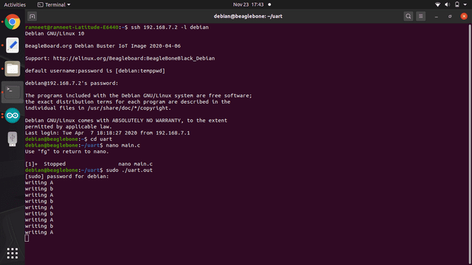
Running main.c code on linux terminal
To compile the c code we have used the following command :
gcc main.c –o uart.out
Once the code is compiled without errors, we will get an executable file that we can run directly through terminal, using the following command:
sudo ./uart.out

Slide 21
Results
We can see the program is running successfully as writing A and writing B sequence is printed on the terminal.
Corresponding to this sequence of A and B we can see the signal strength is displayed over software serial port.

Slide 22

Continue…
Also as per the sequence of A and B the state of in-built LED is toggled.
If A is received from BBB
If B is received from BBB

Slide 23
References
Serial ports / UART. (n.d.). Retrieved from Cameon Beaglebone: https://sites.google.com/a/cameon.net/beaglebone/home/serial-ports-uart
NodeMCU ESP8266. (2020, April 22). Retrieved from Components 101: https://components101.com/development-boards/nodemcu-esp8266-pinout-features-and-datasheet
NodeMCU ESP8266. (2020, April 22). Retrieved from Component 101: https://components101.com/development-boards/nodemcu-esp8266-pinout-features-and-datasheet
Station Class. (n.d.). Retrieved from ESP8266 Arduino Core: https://arduino-esp8266.readthedocs.io/en/latest/esp8266wifi/station-class.html#:~:text=DE%3AC1%3A68-,RSSI,Signal%20Strength%20Indication%20(RSSI).&text=Signal%20strength%20value%20is%20provided,of%20returned%20value%20is%20int32_t%20.

Slide 24
Continue…
Trev. (2018, February 9). How to get UART serial ports working on the beaglebone black. Retrieved from Trevor's electronics blog: https://electronics.trev.id.au/2018/02/09/get-uart-serial-ports-working-beaglebone-black/
Component101. (2018, July 9). BeagleBone Black. Retrieved from https://components101.com/microcontrollers/beaglebone-black-pinout-datasheet

Slide 25

THANK YOU!!

