Slide 1
Individual Activity_ 3.1 Interfacing LCD with Beaglebone Black using Arduino Uno
Submitted by: Submitted to:
Navjot Saini (C0751275) Prof. Mike Aleshams

Slide 2
List of Content
IoT based Automatic Railway Gate Controller
Purpose of LCD(16*2) in the Project
16×2 LCD Display
Specification of LCD Display
Hardware and Software Requirements
Interfacing LCD with Beaglebone Black using Arduino Uno
4 bit Mode interfacing Arduino Uno and LCD
UART interfacing between Arduino Uno and Beaglebone black
Circuit Diagram of interfacing LCD with BBB
Software Code – Arduino IDE
UART code for sending Data from BBB to Arduino Uno
Header files used in C code
Main code
Run UART code on Beaglebone Black
Results
References

Slide 3
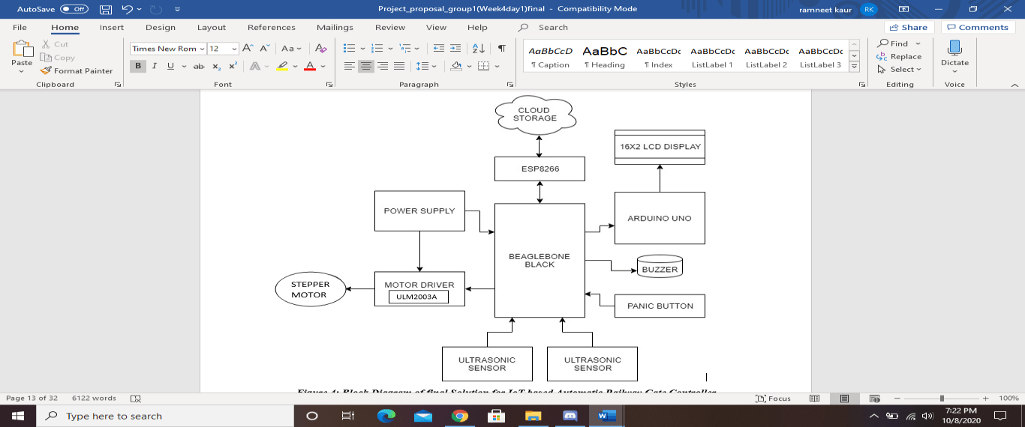
IoT based Automatic Railway Gate Controller

Slide 4
Purpose of LCD(16*2) in the Project
Use of Arduino Uno for interfacing LCD Display with BeagleBone Black.
UART Protocol is used to interface Arduino Uno with BeagleBone Black.
Parallel communication is used between Arduino Uno and LCD Display.
Use of LCD to display messages in case of Emergency and status of the train.
When the ultrasonic sensor 1 detect the arrival of the train, the Beaglebone black will send message to the LCD to be displayed about train arrival.
Similarly, when ultrasonic sensor 2 detect departure of the train, then message is send to the LCD to display train departed.
When Panic button is pressed, buzzer starts beeping and LCD display Emergency message to notify incoming traffic.

Slide 5
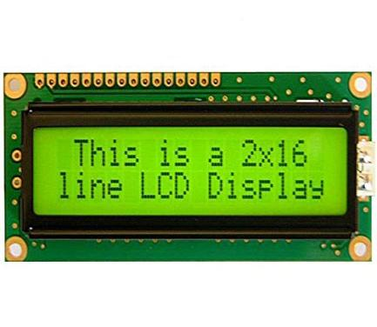
16×2 LCD Display
An LCD (Liquid Crystal Display) screen is an electronic display module and has a wide range of applications.
A 16x2 LCD display is very basic module and is very commonly used in various devices and circuits.
A 16x2 LCD means it can display 16 characters per line and there are 2 such lines. In this LCD each character is displayed in 5x8 pixel matrix.
The 16 x 2 intelligent alphanumeric dot matrix display is capable of displaying 224 different characters and symbols.
This LCD has two registers, namely, Command and Data.
Below is the Digikey link of the LCD that we used in our project.
https://www.digikey.ca/en/products/detail/matrix-orbital/MOP-AL162A-BYFY-25J-3IN/9602838

Slide 6
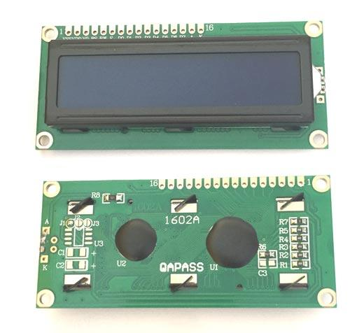
Specifications of LCD
Operating Voltage is 4.7V to 5.3V
Current consumption is 1mA without backlight
Alphanumeric LCD display module, meaning can display alphabets and numbers
Consists of two rows and each row can print 16 characters.
Each character is build by a 5×8 pixel box
Can work on both 8-bit and 4-bit mode
It can also display any custom generated characters
Available in Green and Blue Backlight

Slide 7
Hardware and Software Requirements
Hardware Requirements:
16 × 2 LCD Display
Arduino Uno
Beaglebone Black
Power supply
Jumper wires
USB wire
Breadboard
Potentiometer
Software Requirements:
Debian OS
Linux Operating System
Nano Editor
GCC compiler to run code
Arduino IDE

Slide 8
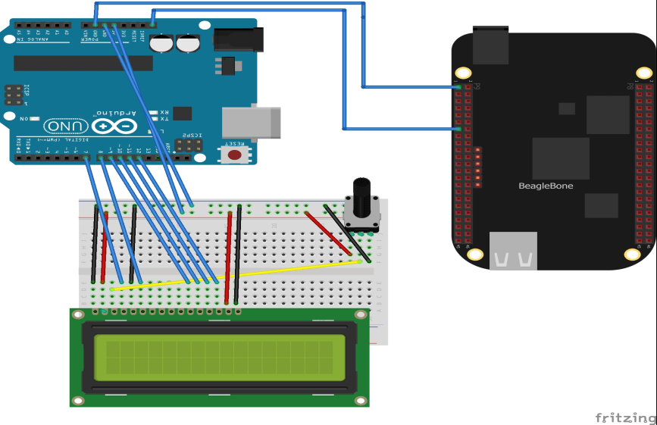
Interfacing LCD with Beaglebone Black using Arduino Uno

Slide 9
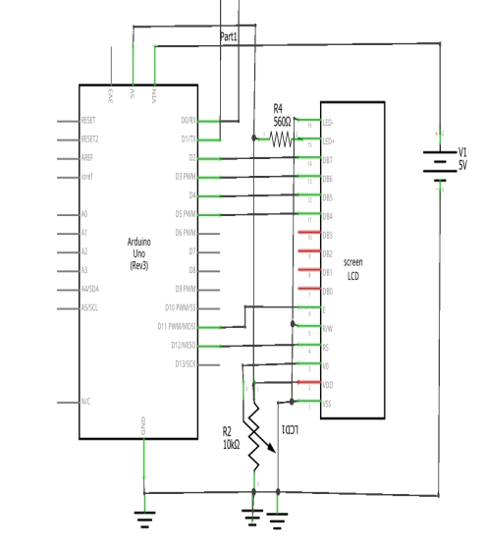
4 bit Mode interfacing Arduino Uno and LCD
LCD Pin interfacing with Arduino Uno
Pin 1 (VSS): GND
Pin2 (VDD): +5V
Pin 3( VD): This Contrast adjustment pin. This is done by connecting the ends of a 10K potentimeter to +5V and ground and then connecting the slider pin to the VD pin. The voltage at the VEE pin defines the contrast. The normal setting is between 0.4 and 0.9V.
Pin 4(RS): This pin (Register select pin) of the LCD module is connected to digital pin 12 of the arduino. The Logic HIGH at RS pin selects data register and logic LOW at RS pin selects command register.

Slide 10
Continue..
Pin 5 (R/W pin): Read/Write modes. Logic HIGH at this pin activates read mode and logic LOW at this pin activates write mode. R/W pin of the LCD is grounded(write mode).
Pin 6 (E): Enable pin of the LCD module is connected to digital pin 11 of the arduino. This pin will enable the module.
LCD module and arduino are interfaced in the 4-bit mode. Digital lines DB4, DB5, DB6 and DB7 are interfaced to digital pins 5, 4, 3 and 2 of the Arduino Uno.
+5V required in some other parts of the circuit can be tapped from the 5V source on the arduino board.
Pin15(LED+): Anode of the back light LED. When operated on 5V, a 560 ohm resistor should be connected in series to this pin. 560 ohm resistor R1 limits the current through the back light LED.
Pin16(LED-): Cathode of the back light LED. This pin is grounded.

Slide 11
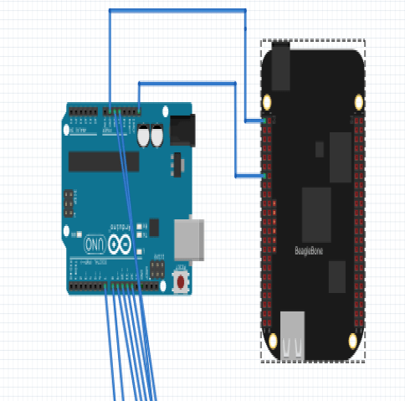
UART interfacing between Arduino Uno and Beaglebone black
The BeagleBone has five available on-board serial UART ports.
These ports are named as BB-UART1, BB-UART2, BB-UART4, BB-UART5.
Arduino Uno is interfaced with BeagleBone Black over UART_4.
The data is only transmitted from Beaglebone Black to Arduino Uno.
So, P9_13(TX) pin of BBB is connected to Receiver pin (RX) pin of Arduino Uno.
This represent that there is only one way communication from BBB to Arduino uno.
As message to be displayed on the LCD is transmitted from BBB to Arduino Uno.

Slide 12
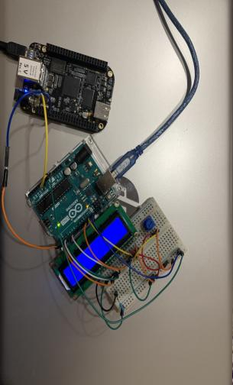
Circuit Diagram of interfacing LCD with BBB

Slide 13
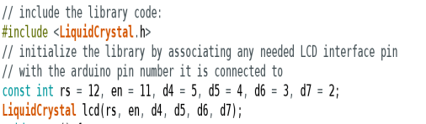
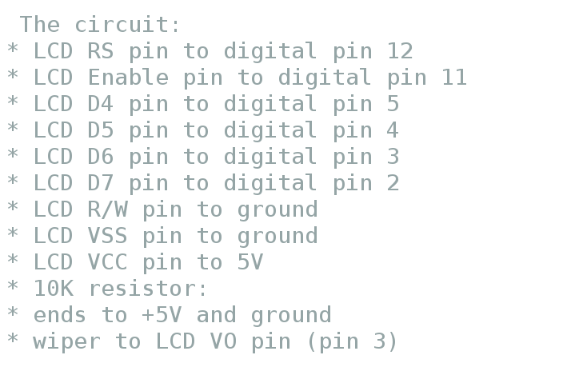
Software Code – Arduino IDE
The open-source Arduino Software (IDE) makes it easy to write code and upload it to the board. This software can be used with any Arduino board.
The LCD is interfaced with Arduino Uno, so Arduino IDE is used for writing code for LCD display.
LiquidCrystal Library allows an Arduino board to control LiquidCrystal displays (LCDs).
The library works with in either 4- or 8-bit mode (i.e. using 4 or 8 data lines in addition to the rs, enable, and, optionally, the r/w control lines). To use this library #include <LiquidCrystal.h>

Slide 14
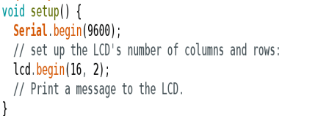
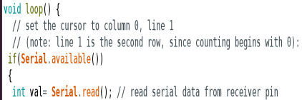
Continue..
Serial.begin():
Sets the data rate in bits per second (baud) for serial data transmission.
Lcd.begin():
The part 16×2 means that the LCD has 2 lines, and can display 16 characters per line. Therefore, a 16×2 LCD screen can display up to 32 characters at once.
Serial.available():
Serial.available() returns the number of characters (i.e. bytes of data) which have arrived in the serial buffer and that are ready to be read.
Serial.read():
Read data from serial pin and store that data in val variable.

Slide 15
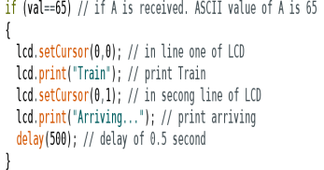
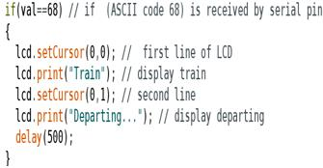
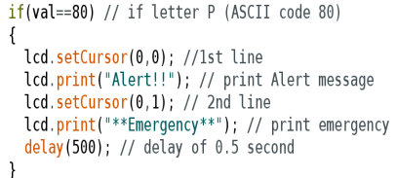
Continue..
In the main loop, if data read from serial pin is 65
(ASCII code for A), then, print on LCD “Train Arriving..” and delay of 0.5 second.
If data read is 68, ASCII code for D, then print train departing on LCD.
If data read is 80 (ASCII code for P), then print Alert Emergency on LCD.

Slide 16
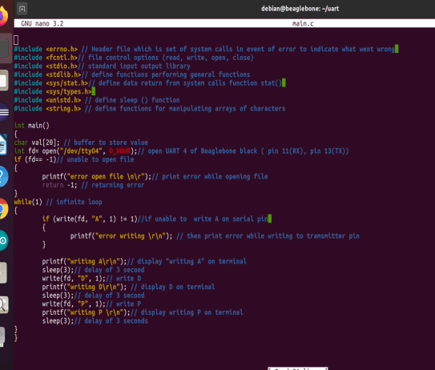
UART code for sending Data from BBB to Arduino Uno
The c code is written to transmit data serially on UART port 4 of Beaglebone Black.
In this code, UART 4 port is opened for serial communication with Arduino.
Only, TX(P9_13) pin of BBB is initialized as data is only transmitted from BBB to Arduino Uno.
There is no back communication from Arduino Uno to BBB.

Slide 17
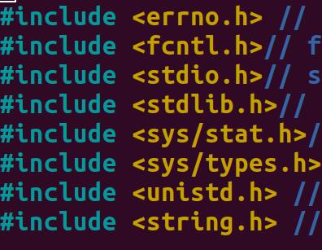
Header files used in C code
Errno.h header file contain a set of system calls in event of error to indicate what went wrong.
Fcntcl.h contains file control options.
Stdio.h is standard input output library.
Stdlib.h define functions performing general functions such as size_t, EXIT_Failure, Exit_Success.
Sys/stat.h define data return from system calls function stat()
<sys/types. h> File header contains a number of basic derived types that should be used whenever appropriate. In particular, the following are of special interest: clock_t
unistd.h define sleep () function
string.h define functions for manipulating arrays of characters.

Slide 18
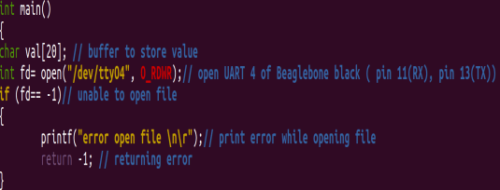
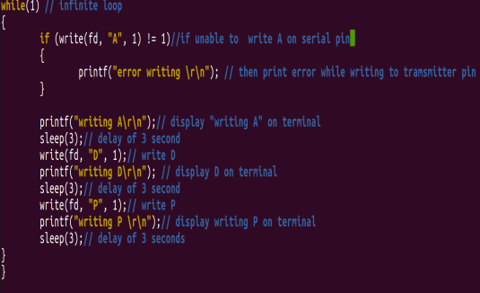
Main code
Inside main () function, an array is declared of length 20.
The file open function open(“/dev/tty04”,O_RDWR) function UART_4 of Beaglebone black for both read and write operation.
In case there is error in opening file, then display error message.
In the infinite while loop, write letter A to the serial transmitter pin(P9_13) of BBB to be transmitted to Arduino Uno.
After delay of 3 second, transmit letter D and followed by letter P that is written on TX pin.
This is how letters are transmitted to Arduino Uno from BBB.

Slide 19
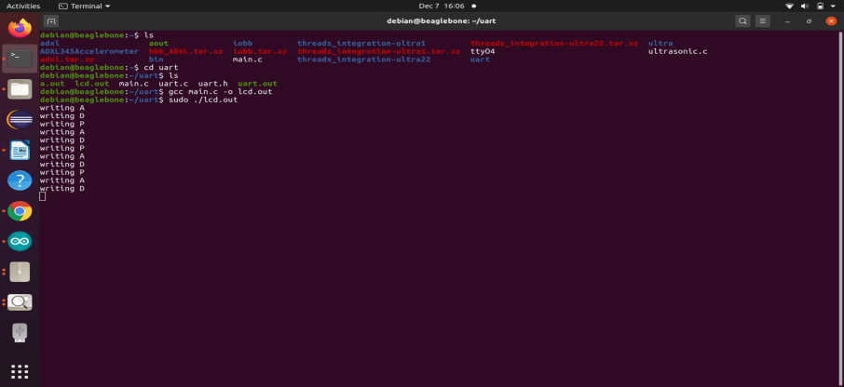
Run UART code on Beaglebone Black
The nano editor in BBB is used to write c code for UART functioning of BBB.
To compile the code and to create object file lcd.out, the following command is used:
gcc main.c –o lcd.out
To run the9 code in debian, run the following command as root user by using sudo in front of that command: Sudo ./lcd.out

Slide 20
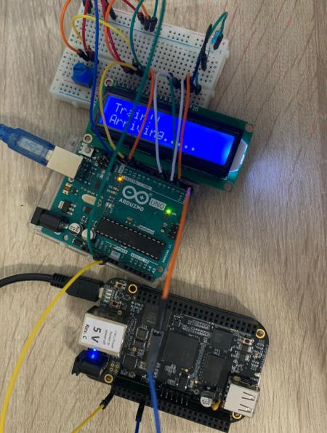
Results
The results are shown on LCD,
Whenever letter A is received from Beaglebone black, then message of Train arriving is displayed on Beaglebone black.
Similarly, when letter D is transmitted, then Train departing message is displayed.
Lastly, when letter p is received by Arduino, then message of Emergency is displayed.

Slide 21
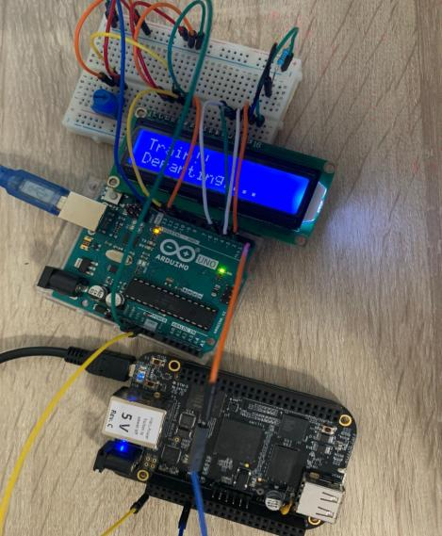
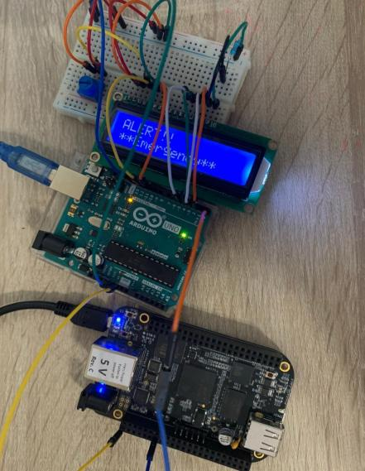
Results

Slide 22
References
How 16×2 LCDs work | Build a basic 16×2 character LCD. (2020, July 31). Retrieved from Elecforum.com: https://www.electronicsforu.com/resources/learn-electronics/16x2-lcd-pinout-diagram
Joseph, T. (2018, August 2). Arduino Uno Specification. Retrieved from Tomson Electronics: https://www.tomsonelectronics.com/blogs/news/arduino-uno-specification
Circuits Today. (n.d.). Interfacing LCD to Arduino – Display Text and Characters on LCD Screen using Arduino. Retrieved from https://www.circuitstoday.com/interfacing-lcd-to-arduino
Agnihotri, N. (2020, May 12). Arduino compatible coding 11: Interfacing character LCD with Arduino. Retrieved from Engineersgarage: https://www.engineersgarage.com/microcontroller-projects/articles-arduino-16x2-character-lcd-interfacing-driver/
LCD MOD 32DIG 16X2 TRANS YLW/GRN. (n.d.). Retrieved from Digikey electronics: https://www.digikey.ca/en/products/detail/matrix-orbital/MOP-AL162A-BYFY-25J-3IN/9602838
How 16×2 LCDs work | Build a basic 16×2 character LCD. (2020, July 31). Retrieved from Elecforum.com: https://www.electronicsforu.com/resources/learn-electronics/16x2-lcd-pinout-diagram
Molloy, D. Exploring BeagleBone, Second Edition. Wiley.

Slide 23
THANK YOU

