Slide 1


Project IoT based Automatic Railway Gate Controller Task 2 Schematic Design of the Project Group 1
Submitted by - Submitted to -
Navjot Saini (C0751275) Prof. Mike Aleshams

Slide 2
List of Contents
Fritzing Software version 0.9.3
Arranging an Environment for New Project
My Parts and Parts Inspector
Interfacing Ultrasonic Sensors with BBB over GPIO Pins,
Interfacing Arduino Uno with LCD Display
UART Interfacing between Arduino Uno and Beaglebone Black
Connections between Stepper Motor and ULN2003 Motor Driver IC
GPIO Interfacing between ULN2003 Driver IC and Beaglebone black
Interfacing Buzzer and Push button with BBB over GPIO Pins
Interfacing ESP 8266 with Beaglebone Black
Schematic Diagram of the Project
Exporting a Circuit
Image View of the Project
References

Slide 3
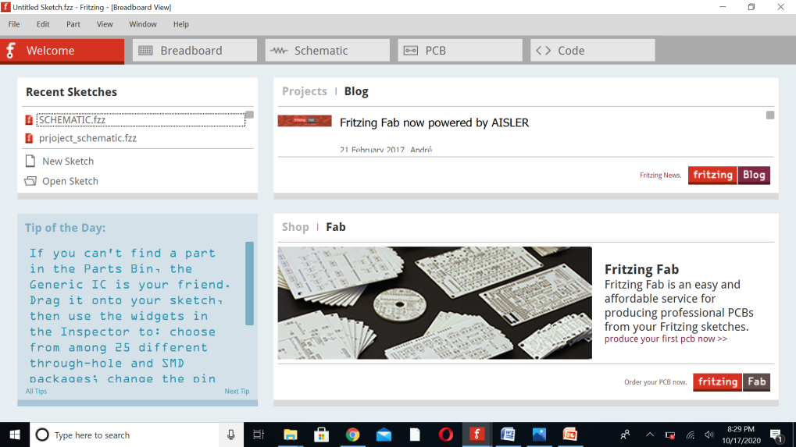

Fritzing Software version 0.9.3
Fritzing is Open Source design tool for PCBs, electrical sketches, and schematics for designers and artists to move from a prototype to real hardware.
There are three viewing modes to choose from “Breadboard“, “Schematic“, and “PCB“.
Fritzing allow users to document their prototypes, share them with others, and layout and manufacture professional pcbs.

Slide 4
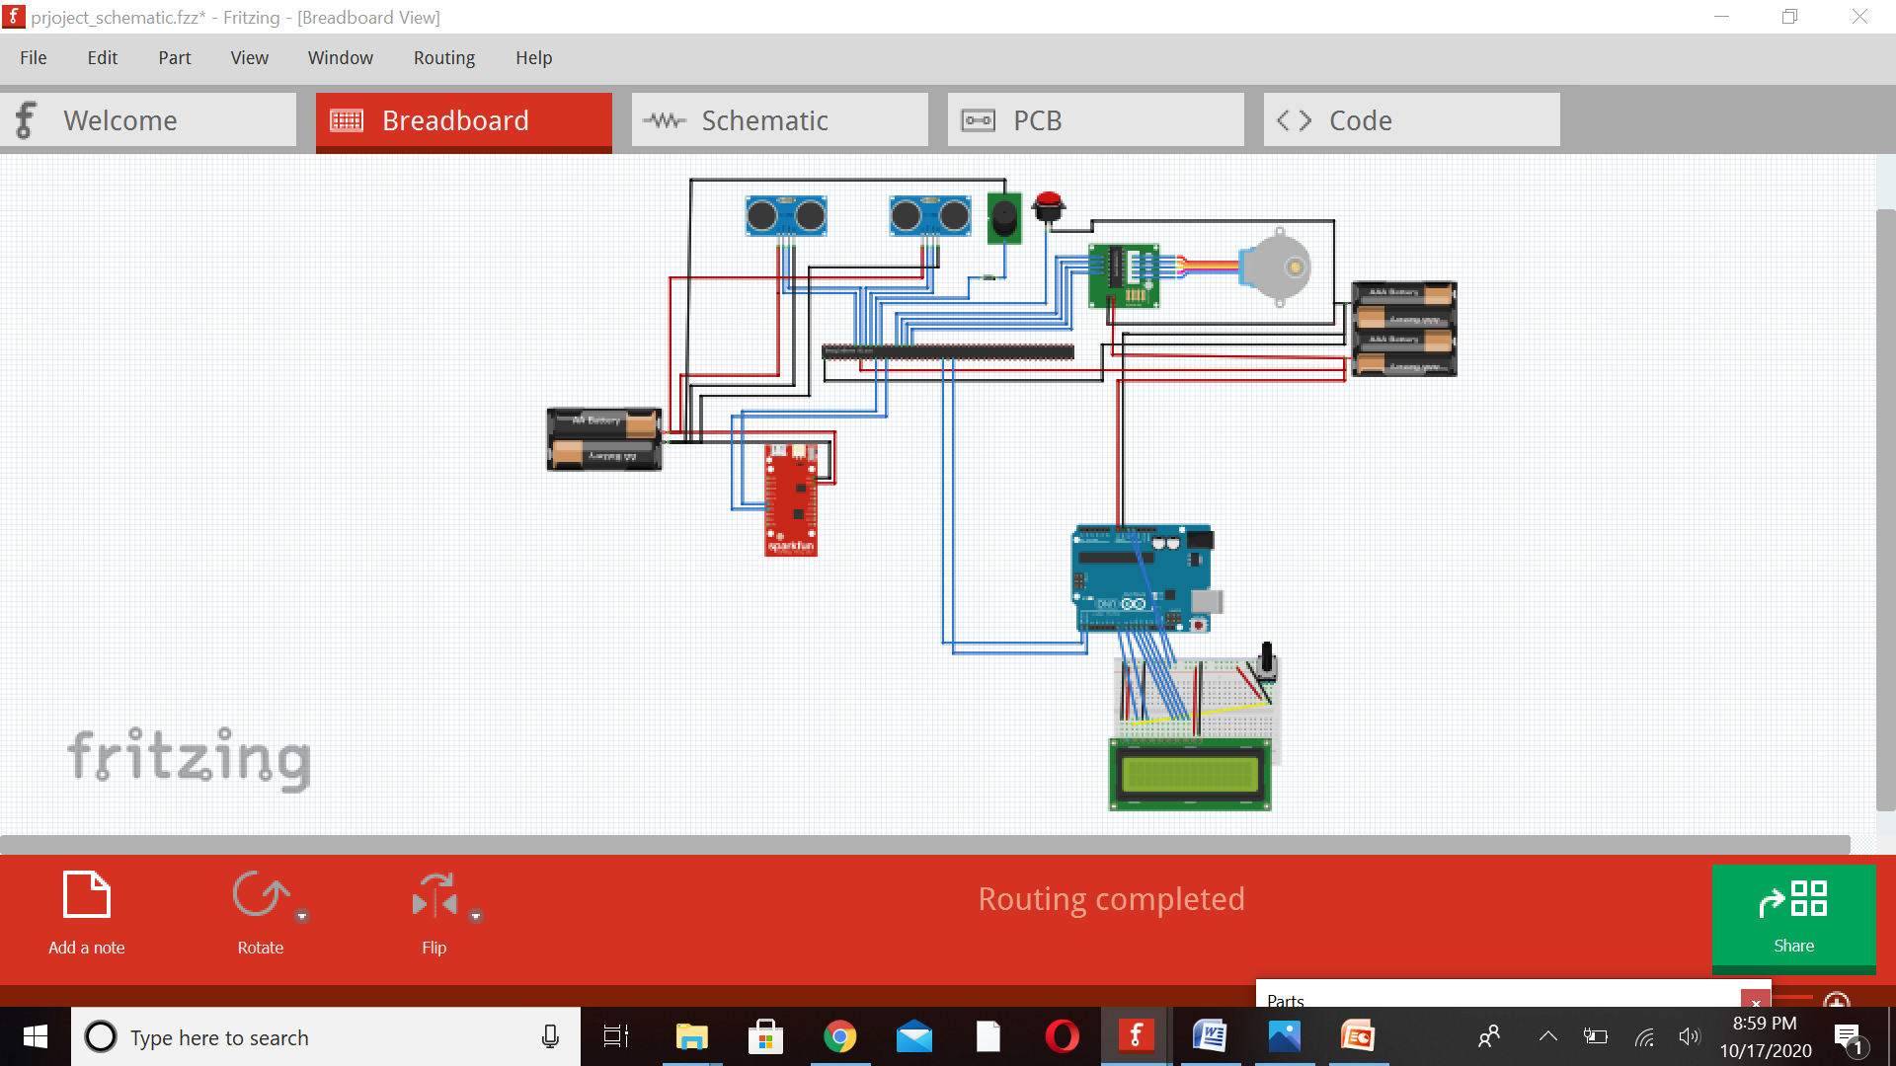
Continue…
BreadBoard View:
It allows breadboard (experimental board) view, that gives the feeling of physical stacking of components.

Slide 5
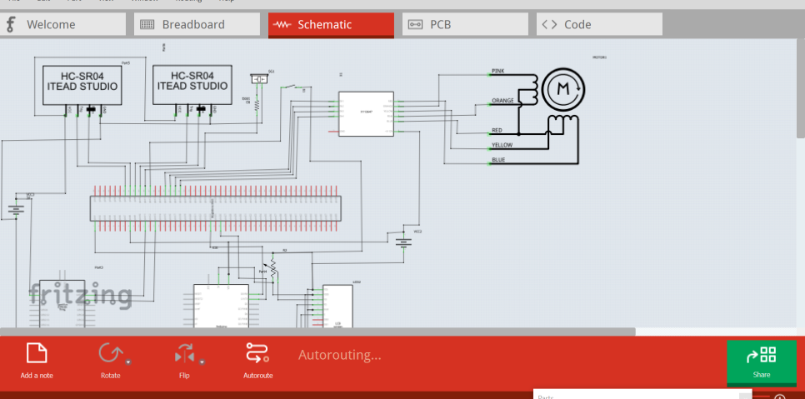
Continue..
Schematic: A tool for creating electronic chart. The components and modules used in one of these views are automatically in others, too, and only thing that's important is to create special links for them (route them).

Slide 6
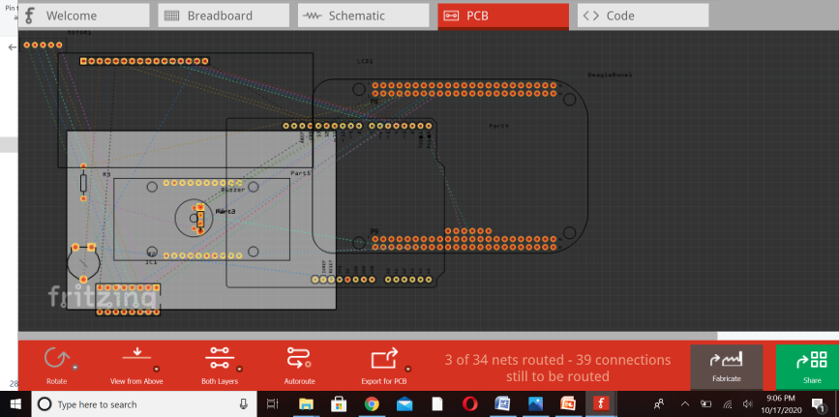
Continue..
PCB
A tool for creating printed electronic circuit board. Fritzing Fab allows us to create plates designed by Fritzing.

Slide 7
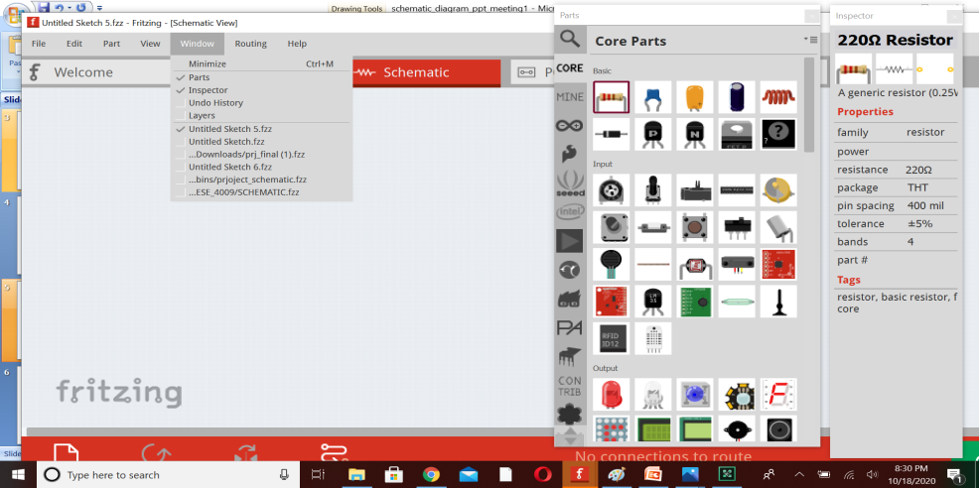
Arranging an Environment for New Project
Before we start working, we might want to arrange the environment according to our needs and preferences.
From the Fritzing Menu Bar, select Window > and mark the palette windows you would like to see in the environment.
Drag & drop palette windows anywhere in the environment.
In this Project, most needed windows are Parts and Inspector.

Slide 8
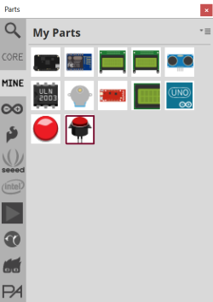
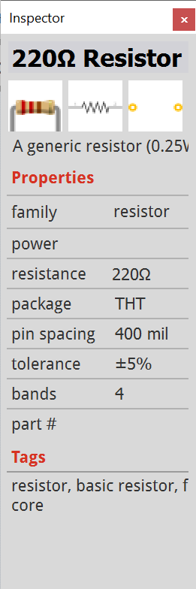
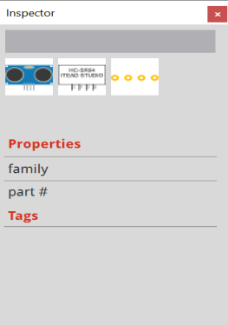
My Parts and Parts Inspector
The Part Library Fritzing comes with a Core bin which features a nice collection of parts, but it also lets you create your own part bins ("Mine" bin).
The parts that are imported to fritzing are:
Beaglebone Black .fzpz
ESP8266.fzpz file
My parts include Beaglebone Black, LCD Display, ULN2003, Stepper motor, Buzzer, Push button, ESP8266, Arduino Uno, Ultrasonic sensors
The Part Inspector shows information about a selected part (name, icon, properties and tags). Some of this information, such as a part's name or property, can be directly modified through this window.

Slide 9
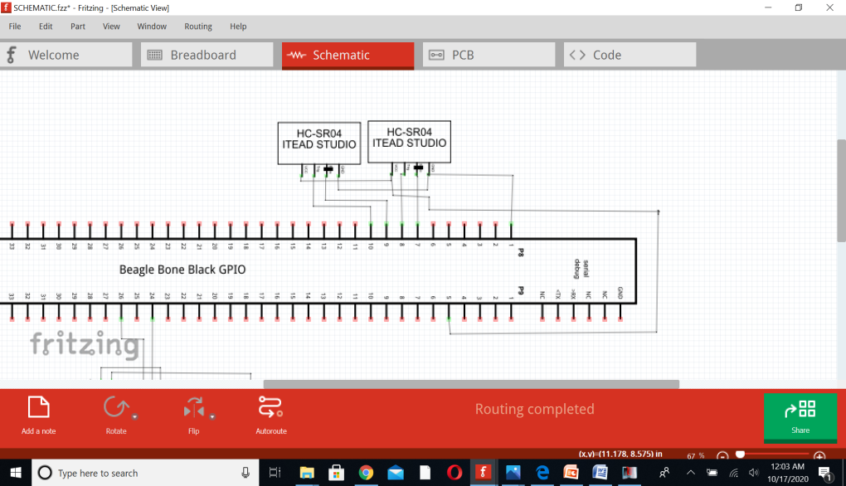
Interfacing Ultrasonic Sensor with BBB over GPIO pins

Slide 10
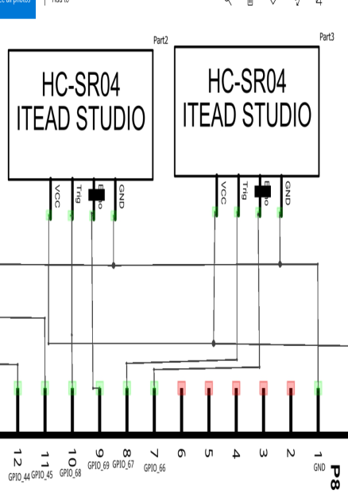
Description
Ultrasonic Sensor 1:
VCC on the Ultrasonic sensor 1 is connected to the P9.5 , i.e., VDD_5V pin on the Beaglebone Black.
The Trig pin on the ultrasonic sensor is connected to P8.8 ( GPIO_67) on the BBB.
The Echo pin on the ultrasonic sensor to P8.7 ( GPIO_66) on the BBB.
The GND on the ultrasonic sensor is connected to P8.1(GND) on the BBB.
Ultrasonic Sensor 2:
VCC on the Ultrasonic sensor 2 is connected to the P9.5 , i.e., VDD_5V pin on the Beaglebone Black.
The Trig pin on the ultrasonic sensor is connected to P8.10 ( GPIO_68) on the BBB.
The Echo pin on the ultrasonic sensor to P8.9 ( GPIO_69) on the BBB
The GND on the ultrasonic sensor is connected to P8.1(GND) on the BBB.

Slide 11
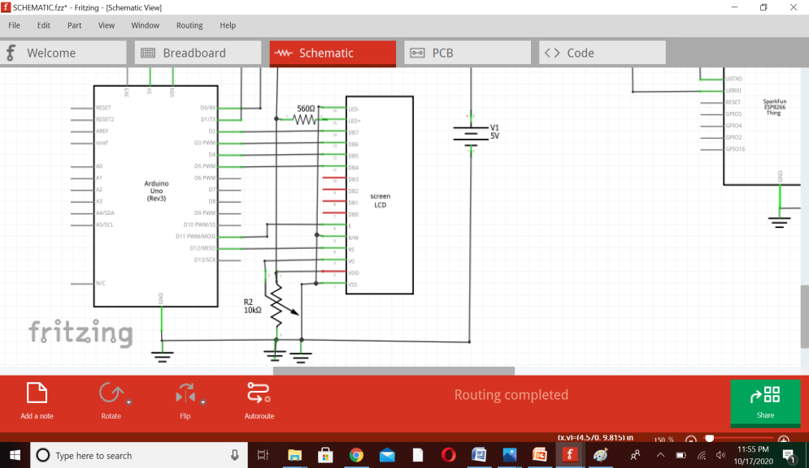
Interfacing Arduino Uno with LCD Display

Slide 12
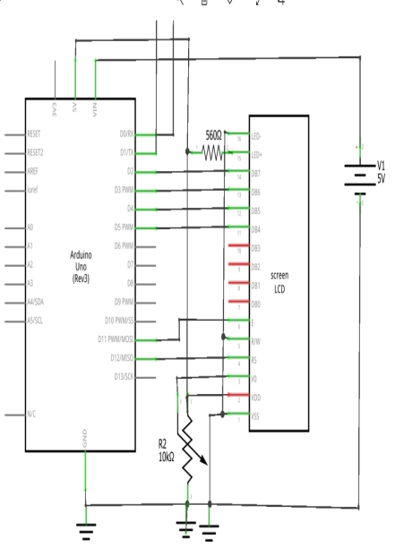
Description
LCD Pin interfacing with Arduino:
Pin 1 (VSS): GND
Pin2 (VDD): +5V
Pin 3( VD): Connected to 10K potentiometer used for adjusting the contrast of the display.
Pin 4(RS): This pin (Register select pin) of the LCD module is connected to digital pin 12 of the arduino. The Logic HIGH at RS pin selects data register and logic LOW at RS pin selects command register.
Pin 5 (R/W pin): Read/Write modes. Logic HIGH at this pin activates read mode and logic LOW at this pin activates write mode.
Pin 6 (E): Enable pin of the LCD module is connected to digital pin 11 of the arduino. A HIGH to LOW signal at this pin will enable the module.
LCD module and arduino are interfaced in the 4-bit mode. Digital lines DB4, DB5, DB6 and DB7 are interfaced to digital pins 5, 4, 3 and 2 of the Arduino.

Slide 13
Continue…
+5V required in some other parts of the circuit can be tapped from the 5V source on the arduino board.
Pin15(LED+): Anode of the back-light LED. When operated on 5V, a 560 ohm resistor should be connected in series to this pin. 560 ohm resistor R1 limits the current through the back light LED.
Pin16(LED-): Cathode of the back light LED. This pin is grounded.

Slide 14
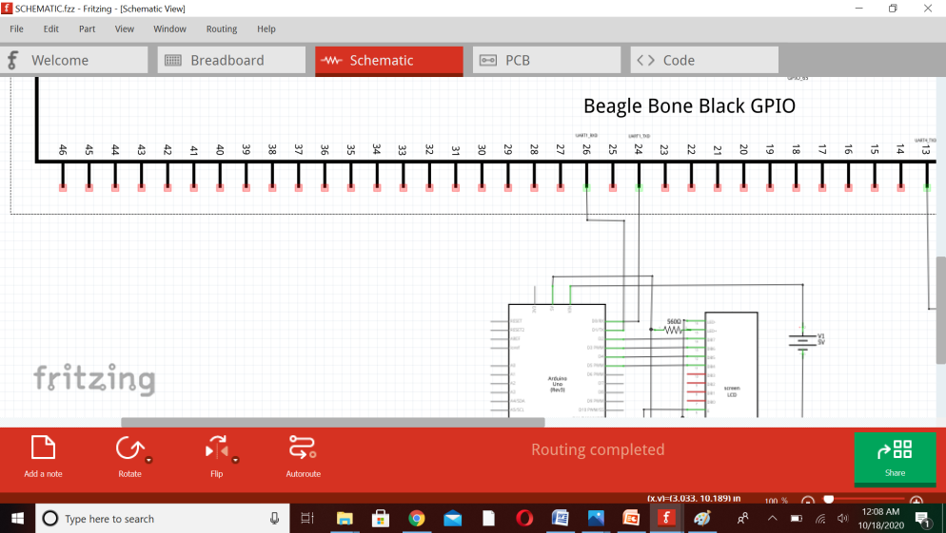
UART interfacing between Arduino Uno and Beaglebone black

Slide 15
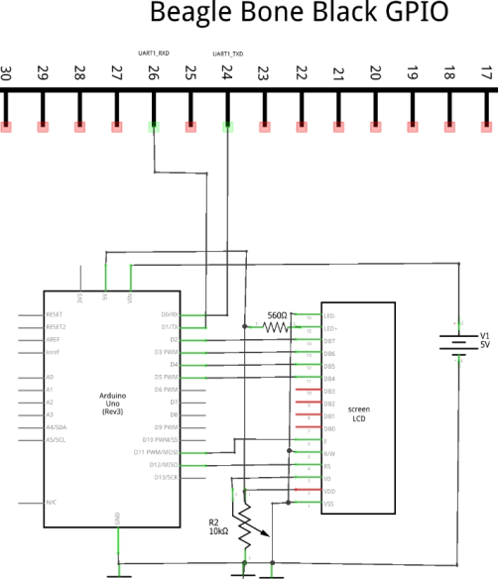
Description
The BeagleBone has five available on-board serial UART ports.
These ports are named as BB-UART1, BB-UART2, BB-UART4, BB-UART5.
Arduino Uno is interfaced with BeagleBone Black over UART_1.
On Port 9, pin 24 and 26 are TXD and RXD pins of UART_1 respectively.
The Receiver RX pin of Arduino Uno is connected to P9.24 ( UART1_TXD) pin of BBB.
The Transmitter TX pin of Arduino is connected to P9.26 (UART1_RXD) pin of BBB.

Slide 16
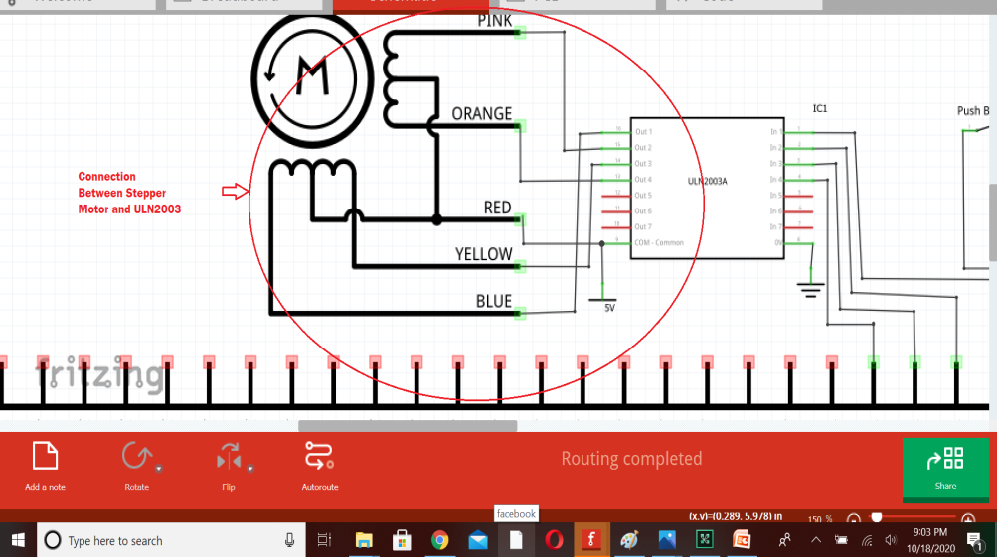
Connections between Stepper motor and ULN2003 motor Driver IC

Slide 17
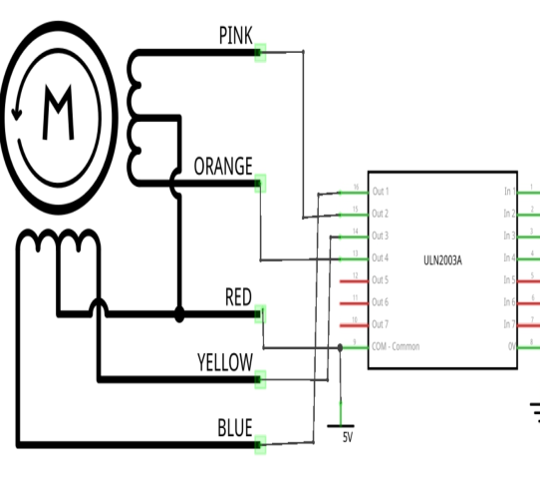
Description
Usually, the 28BYJ-48 stepper motor comes with a 5-pin connector that will fit to the ULN2003 driver board.
Schematic of the pin arrangement is as described below:
The ULN2003 gives a higher current gain that enables the low voltage and low current output of a microcontroller to drive a higher current stepper motor.
The Stepper motor has 4 coils and a common.
The Blue (coil 4) of stepper motor is connected to Driver Out 1 pin.
Pink (coil 3) is connected to Out 2.
Yellow (coil 2) is connected to Out 3 pin.
Orange (coil 1) is connected to Out 4 pin.
The red wire is connected to common point that is supplied with +5V.

Slide 18
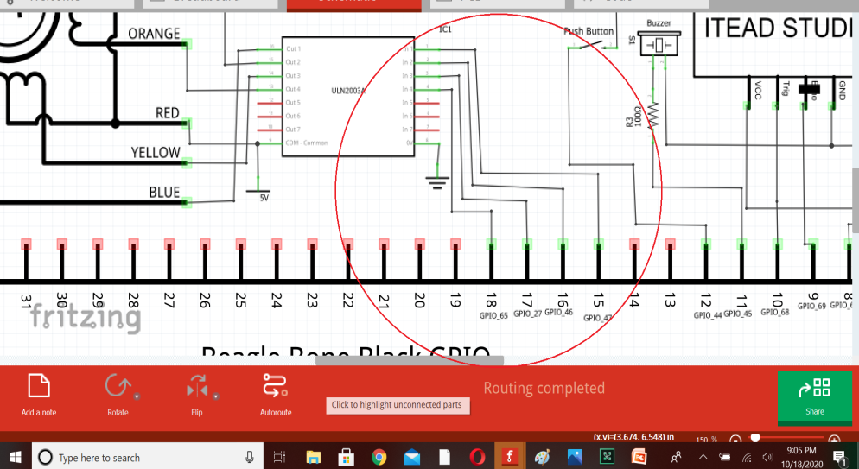
GPIO Interfacing between ULN2003 Driver IC and Beaglebone Black

Slide 19
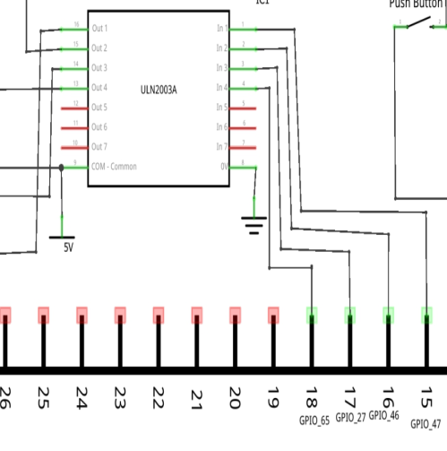
Description
The driver pin In 1 is connected to P8.15 (GPIO_47) on BBB.
The driver pin In 2 is connected to P8.16 (GPIO_46) on BBB.
The driver pin In 3 is connected to P8.17 (GPIO_27) on BBB.
The driver pin In 4 is connected to P8.18 (GPIO_65) on BBB.
The driver board has two pins which are labeled GND and VCC, which are two pins for the power supply.

Slide 20
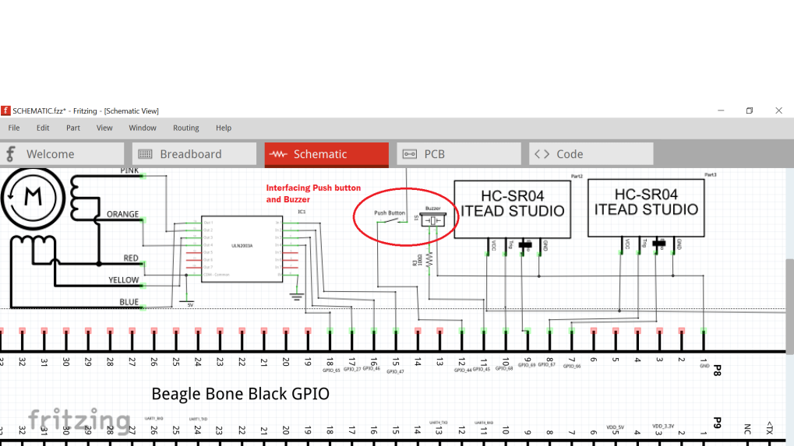
Interfacing Buzzer and Push Button with BBB on GPIO pins.

Slide 21
Description
Interfacing Buzzer with BBB:
Connect the Ground wire (BLACK) of the buzzer to any Ground Pin on the BBB.
Connect the Supply wire (RED) of the buzzer to the P8.11 (GPIO_45) of the BBB through a 100 ohm resistor.
The resistor is used in order to protect the board/micro-controller from any damage due to the audio output device.
Interfacing Push Button with BBB:
A push button is an electronic component that is attached to two points in a circuit. It is also called a tact switch. When it is pressed, it joins these two points and the circuit is completed. The circuit is disconnected when the button is not pressed.
One point of Push button is connected to P9.3 (3.3V).
Other point is connected to P8.12 (GPIO_44).

Slide 22
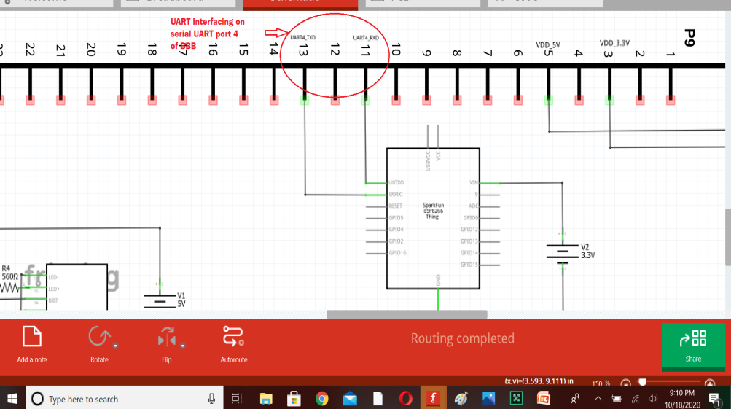
Interfacing ESP 8266 with Beaglebone Black

Slide 23
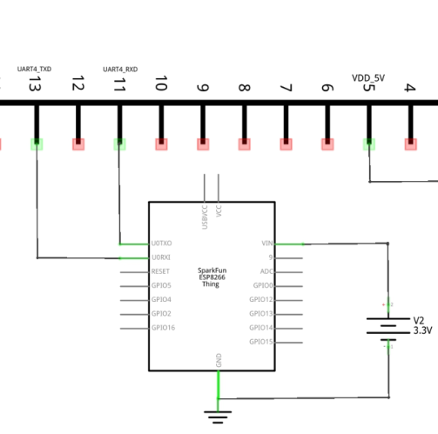
Description
The input voltage to ESP8266 is 3.3V supply at Vin pin.
This Wi-Fi module is interfaced oner UART port 4.
On port 9 of BBB, pin 11 and pin 13 are designated to UART4.
The Tx (Transmitter) pin of ESP 8266 is connected to P9.11 (UART4_RXD).
The Rx (Receiver) pin of ESP 8266 is connected to P9.13 (UART4_TXD).

Slide 24
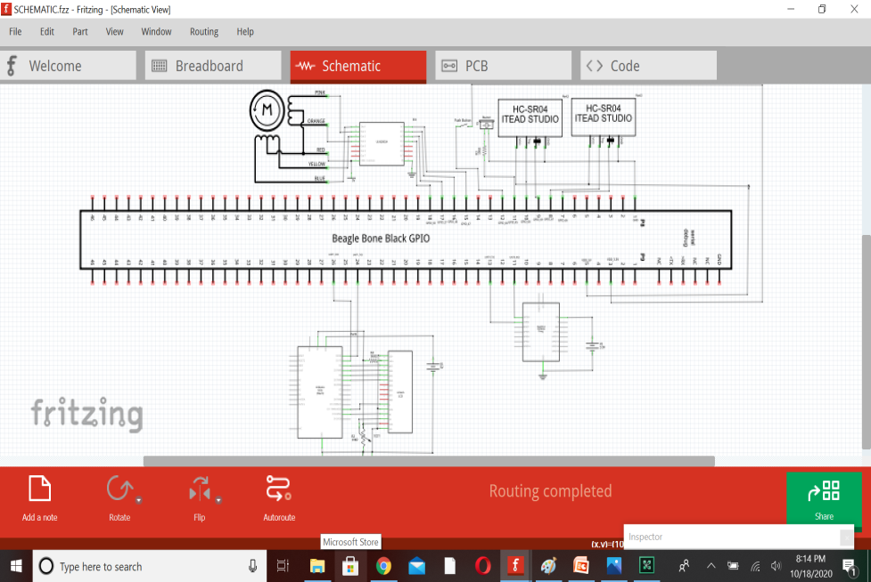
Schematic Diagram of the Project

Slide 25
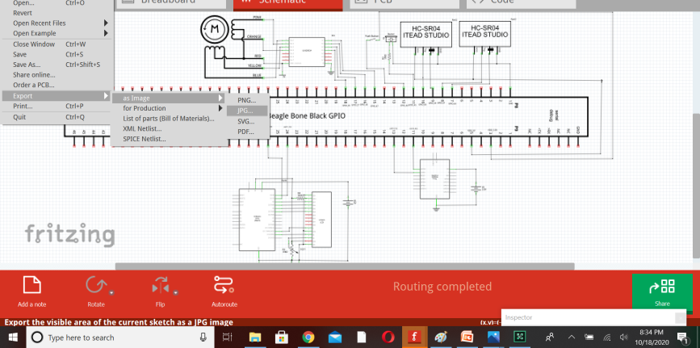
Exporting a circuit
After finishing building the circuit, save your project. You might want to export your circuit as an image file or PDF.
Select the desired Project View to be exported (breadboard,schematic or pcb).
From the Fritzing menu bar, select File > Export > and the desired format.

Slide 26
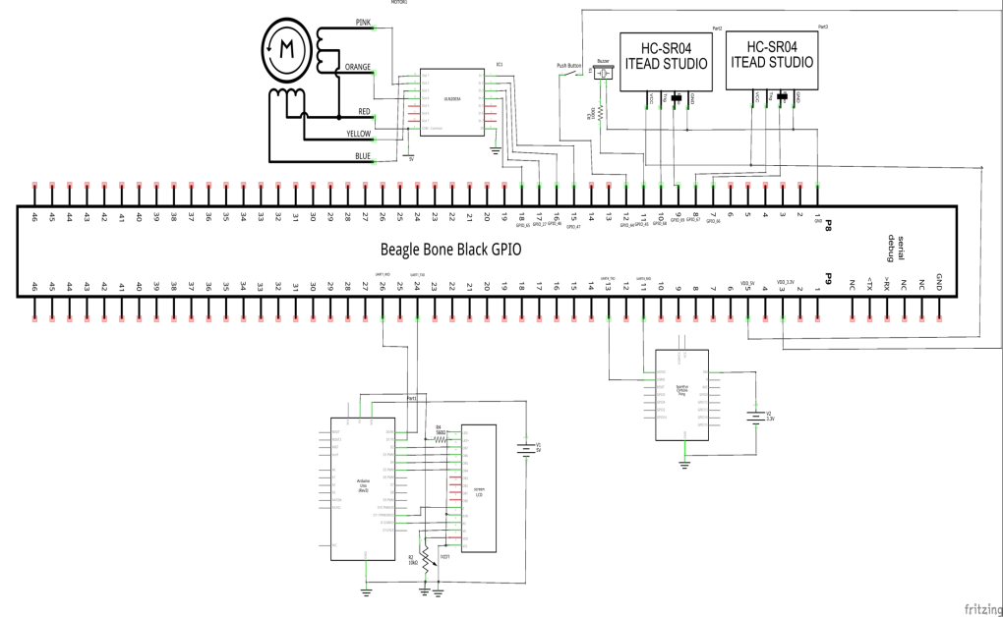
Image View of Schematic Diagram

Slide 27
References
Circuits Today. (n.d.). Interfacing LCD to Arduino – Display Text and Characters on LCD Screen using Arduino. Retrieved from https://www.circuitstoday.com/interfacing-lcd-to-arduino
E-radionica.com. (n.d.). What is Fritzing, How to use it and How does it work? Retrieved from https://e-radionica.com/en/blog/what-is-fritzing-what-is-does-and-how-to-use-it/
Fritzing Electronics made easy. (n.d.). Pallete Window. Retrieved from https://fritzing.org/learning/get-started/palette-window
Fritzing electronics made easy. (n.d.). Parts Library. Retrieved from https://fritzing.org/parts/
Helen. (2018). Dummies guide on driving a 28BYJ-48 Stepper Motor with a ULN2003 Driver Board and Arduino. Retrieved from www.seeedstudio.com: https://www.seeedstudio.com/blog/2019/03/04/driving-a-28byj-48-stepper-motor-with-a-uln2003-driver-board-and-arduino/
Push button circuit setup. (n.d.). Retrieved from Packt: https://subscription.packtpub.com/book/hardware_and_creative/9781784390013/4/ch04lvl1sec33/push-button-circuit-setup

