Slide 1
Linux File System

Slide 2
For Flash
JFFS2
  Journalling Flash FileSystem, for Nor
Yaffs
  Yet Another Flash File System, for Nand
Cramfs
  Compressed ROM File System
Ubifs
  Unsorted Block Image File System, UBIFS
  for Nand

Slide 3
For RAM
Ramdisk
  initrd
ramfs/tmpfs
NFS
  Network File System

Slide 4
For Disk
Ext/2/3
FAT32
NTFS

Slide 5
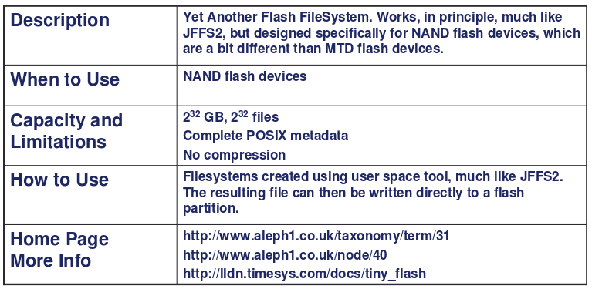
YAFFS/YAFFS2

Slide 6
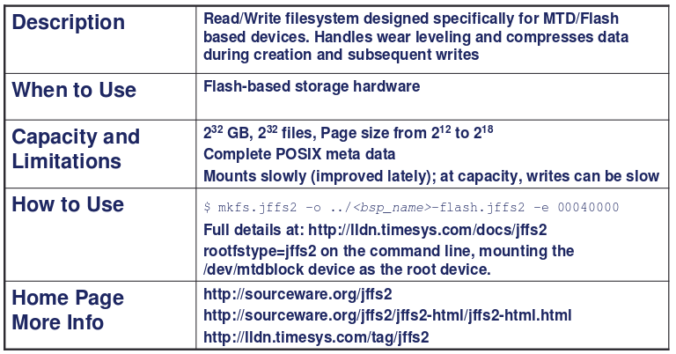
JFFS2

Slide 7
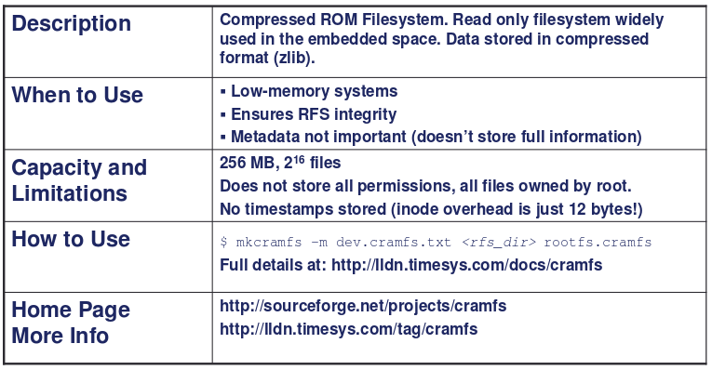
CRAMFS

Slide 8
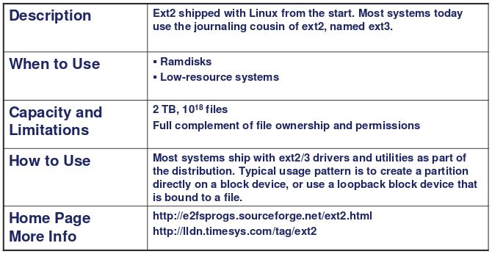
Ext2/3

Slide 9
File System in Linux
Directory
Virtual File System (VFS)
JFFS
YAFFS
RAMFS
EXTx
MTD
Nor Flash
Nand Flash
RAM
SD/MMCCARD

Slide 10
MTD
MTD – Memory Technology Device
  /dev/mtdblockx
  Block driver
For Flash device
  NOR, NAND, OneNAND ...

Slide 11
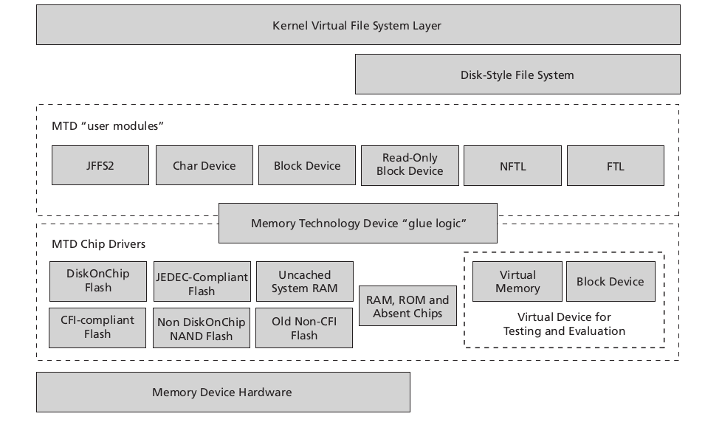
MTD Subsystem Architecture

Slide 12
ROOTFS

Slide 13
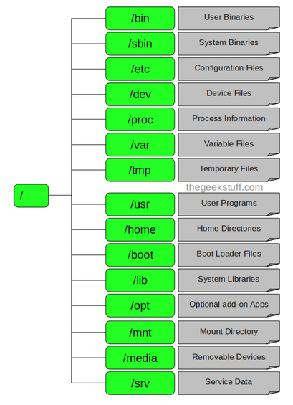
Linux Directory Structure

Slide 14
Root
Every single file and directory starts from the root directory
Only root user has write privilege under this directory
Please note that /root is root user’s home directory, which is not same as /

Slide 15
/bin – User Binaries
Contains binary executables.
Common linux commands you need to use in single-user modes are located under this directory.
Commands used by all the users of the system are located here.
For example: ps, ls, ping, grep, cp.

Slide 16
/sbin – System Binaries
Just like /bin, /sbin also contains binary executables.
But, the linux commands located under this directory are used typically by system aministrator, for system maintenance purpose.
For example: iptables, reboot, fdisk, ifconfig, swapon

Slide 17
/etc – Configuration Files
Contains configuration files required by all programs.
This also contains startup and shutdown shell scripts used to start/stop individual programs.
For example: /etc/resolv.conf, /etc/logrotate.conf

Slide 18
/dev – Device Files
Contains device files.
These include terminal devices, usb, or any device attached to the system.
For example: /dev/tty1, /dev/usbmon0

Slide 19
/proc – Process Information
Contains information about system process.
This is a pseudo filesystem contains information about running process. For example: /proc/{pid} directory contains information about the process with that particular pid.
This is a virtual filesystem with text information about system resources. For example: /proc/uptime

Slide 20
/var – Variable Files
var stands for variable files.
Content of the files that are expected to grow can be found under this directory.
This includes — system log files (/var/log); packages and database files (/var/lib); emails (/var/mail); print queues (/var/spool); lock files (/var/lock); temp files needed across reboots (/var/tmp);

Slide 21
/tmp – Temporary Files
Directory that contains temporary files created by system and users.
Files under this directory are deleted when system is rebooted.

Slide 22
/usr – User Programs
Contains binaries, libraries, documentation, and source-code for second level programs.
/usr/bin contains binary files for user programs. If you can’t find a user binary under /bin, look under /usr/bin. For example: at, awk, cc, less, scp
/usr/sbin contains binary files for system administrators. If you can’t find a system binary under /sbin, look under /usr/sbin. For example: atd, cron, sshd, useradd, userdel
/usr/lib contains libraries for /usr/bin and /usr/sbin
/usr/local contains users programs that you install from source. For example, when you install apache from source, it goes under /usr/local/apache2

Slide 23
/home – Home Directories
Home directories for all users to store their personal files.
For example: /home/john, /home/nikita

Slide 24
/boot – Boot Loader Files
Contains boot loader related files.
Kernel initrd, vmlinux, grub files are located under /boot

Slide 25
/lib – System Libraries
Contains library files that supports the binaries located under /bin and /sbin
Library filenames are either ld* or lib*.so.*

Slide 26
/opt – Optional add-on Applications
opt stands for optional.
Contains add-on applications from individual vendors.
add-on applications should be installed under either /opt/ or /opt/ sub-directory.

Slide 27
/mnt – Mount Directory
Temporary mount directory where sysadmins can mount filesystems.

Slide 28
/media – Removable Media Devices
Temporary mount directory for removable devices.
For examples, /media/cdrom for CD-ROM; /media/floppy for floppy drives; /media/cdrecorder for CD writer

Slide 29
BusyBox

Slide 30
BusyBox
Linux system needs a basic set of programs to work
  Init program
  shell
In normal Linux systems, these programs are independent
  Binary size large
BusyBox down size these program

Slide 31
BusyBox
Rewrite of many useful Unix command
  Down size
All the program are compiled into a single executable, /bin/busybox
It can configure all command
http://www.busybox.net/

Slide 32
Usr space
ls
find
ifconfig
grep
...........................

Slide 33
Usr space
BusyBox
ls
find
ifconfig
grep
...........................

Slide 34
Busybox init
Busybox provides an implementation of an init program
A single configuration file: /etc/inittab
  Each line has the form <id>::<action>:<process>
Check examples/inittab in Busybox for details on the configuration

Slide 35
Configuring BusyBox
http://busybox.net
  wget http://www.busybox.net/downloads/busybox-1.24.0.tar.bz2
Configure BusyBox
  make menuconfig
  make defconfig
Install it
  Make install

