Slide 1
Linux kernel

Slide 2
Linux kernel key features
Portability and hardware support
Scalability
Compliance to standards and interoperability
Exhaustive networking support
Stability and reliability
Modularity
Easy to program.

Slide 3
Linux kernel in the system
Application
…..
Application
Library
…..
Library
C Library
Linux Kernel
Hardware

Slide 4
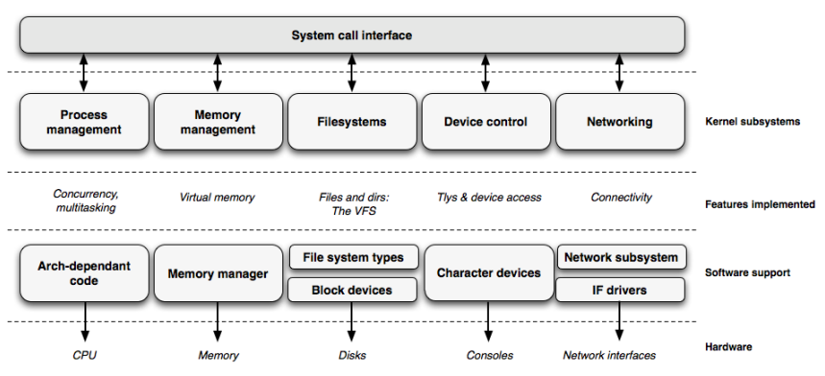
Linux kernel

Slide 5
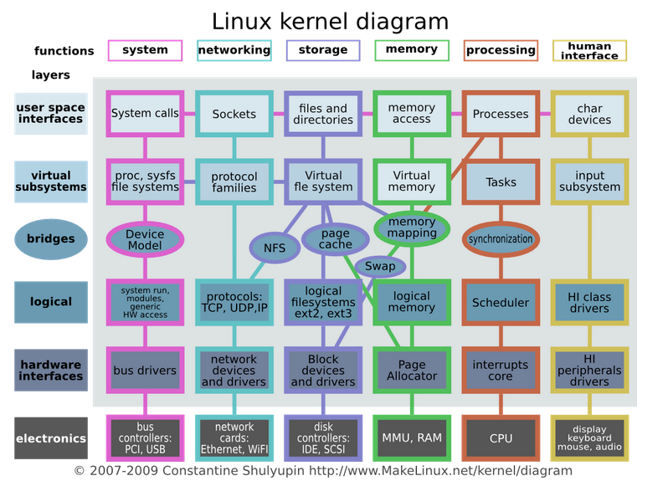
Linux kernel

Slide 6
Kernel Source
https://www.kernel.org/
Many chip vendors
kernel sub-communities
  Architecture communities
    ARM, MIPS, PowerPC ...
  device drivers communities
    I2C, SPI, USB, PCI, network ...

Slide 7
Linux kernel size
Linux 3.10 sources, Raw size: 573 MB
Minimum Linux 3.17 compiled kernel size, booting on the ARM board
  876 KB (compressed)
  2.3 MB (raw)

Slide 8
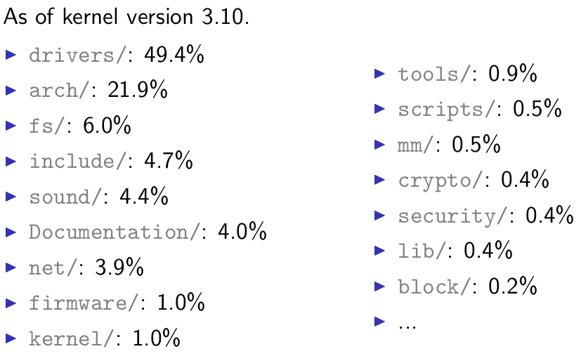
Linux kernel size

Slide 9
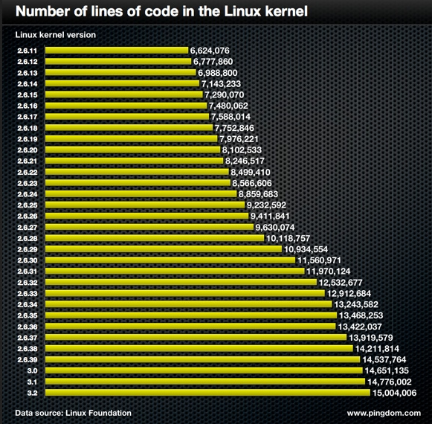
Linux kernel size

Slide 10
Programming language
Implemented in C like all Unix systems
A little Assembly is used too
No C++ used
No C library
No floating point computation
Kernel code has to supply its own library implementations
  X : printf(), memset(), malloc(),...
  O: printk(), memset(), kmalloc()

Slide 11
Linux sources structure
arch/<ARCH>
Architecture specific code
  arch/<ARCH>/mach-<machine>
  arch/<ARCH>/include/asm
  arch/<ARCH>/boot/
driver/
Documentation/

Slide 12
Kernel configuration
The kernel configuration and build system is based on multiple Makefiles
The configuration is stored in the .config file at the root of kernel sources
As options have dependencies, typically never edited by hand, but through graphical or text interfaces
  make menuconfig → Text
  make xconfig → graphical

Slide 13
Kernel or module?
The kernel image is a single file, resulting from the linking of all object files that correspond to features enabled in the configuration
Some features (device drivers, filesystems, etc.) can however be compiled as modules

Slide 14
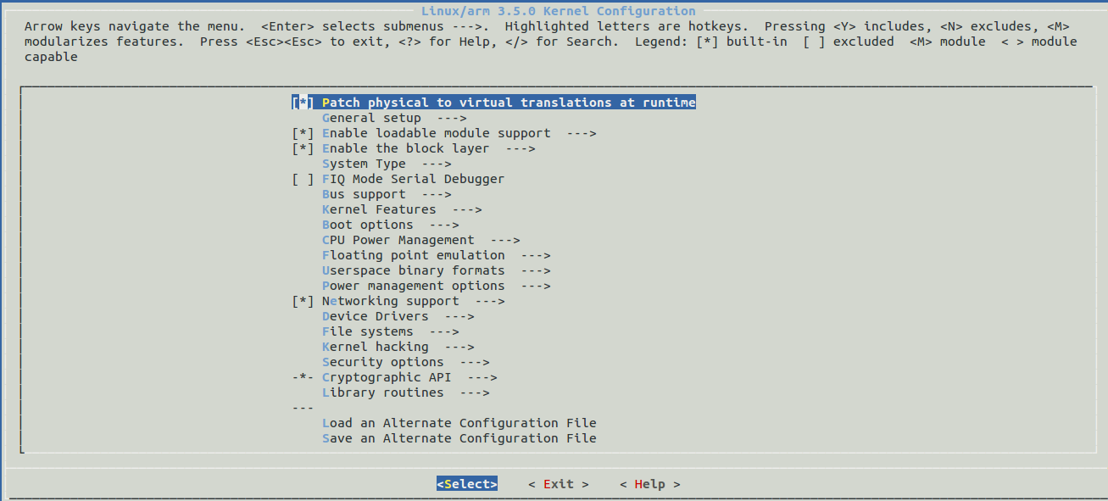
menuconfig

Slide 15
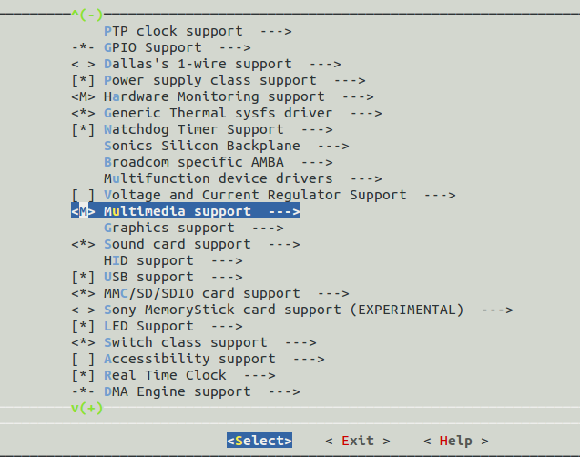
Kernel configuration options

Slide 16
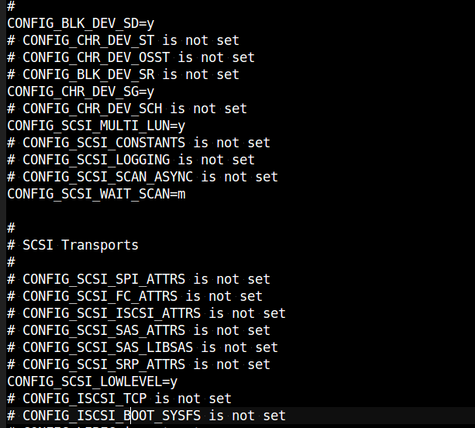
Corresponding .config file excerpt

Slide 17
Kernel compilation
Make
  in the main kernel source directory
  To run multiple jobs in parallel if you have multiple CPU cores
    Make -j4
Generates
  arch/<arch>/boot/*Image
  bzImage for x86, zImage for ARM, vmImage.gz for Blackfin

Slide 18
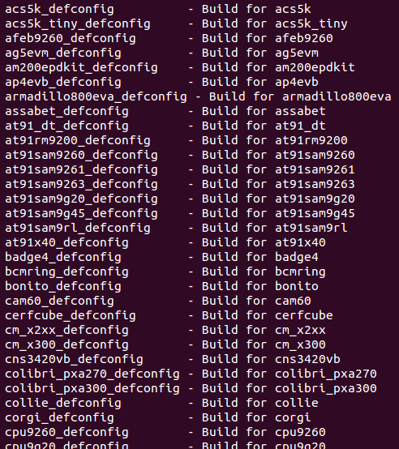
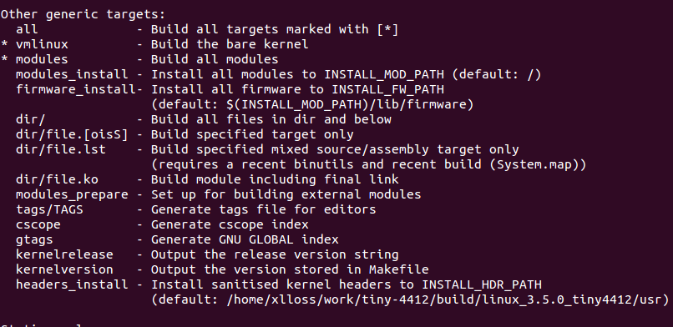
Make help

Slide 19
Module installation
make modules_install
Installs all modules in /lib/modules/<version>
Module .ko (Kernel Object) files, in the same directory
structure as in the sources.
modules.alias
  Module aliases for module loading utilities. Example line:
  alias sound-service-?-0 snd_mixer_oss
modules.dep
  Module dependencies
modules.symbols
  Tells which module a given symbol belongs to

Slide 20
Kernel cleanup targets
make clean
  Kernel cleanup targets
make mrproper
  Remove all generated files (.config)
make distclean
  Remove editor backup and patch reject files

Slide 21
Specifying cross-compilation
The CPU architecture and cross-compiler prefix are defined through the ARCH and CROSS_COMPILE variables in the top-level Makefile
ARCH
  ARCH=arm
CROSS_COMPILE
  arm-linux-

Slide 22
Specifying cross-compilation
make ARCH=arm CROSS_COMPILE=arm-linux- …
export ARCH=arm
export CROSS_COMPILE=arm-linux
Add above setting to script
  source set_arm_toolchain.sh

Slide 23
Predefined configuration files
Default configuration files available, per board or per-CPU family
  They are stored in arch/<arch>/configs/, and are just minimal .config files
make tiny4412_linux_defconfig
To create your own default configuration file
  make savedefconfig, to create a minimal configuration file
  mv defconfig arch/<arch>/configs/myown_defconfig

Slide 24
Building and installing the kernel
Run make
make modules_install is used even in embedded development, as it installs many modules and description files
make INSTALL_MOD_PATH=<dir>
modules_install

Slide 25
Booting with U-Boot
The typical boot process is therefore:
Load zImage at address X in memory
Start the kernel with bootm X in U-boot
X = 0x?0008000
  For example :
    dnw C0008000
    bootm c0008000

Slide 26
Kernel command line
The kernel command line is a string that defines various arguments to the kernel
  root= for the root filesystem
  console= for the destination of kernel messages
  Documentation/kernel-parameters.txt
kernel command line
  In U-Boot, the contents of the bootargs
  Built into the kernel, using the CONFIG_CMDLINE option

Slide 27
Linux Kernel Booting
CPU mode
  All forms of interrupts must be disabled (IRQs and FIQs)
  The CPU must be in SVC mode
Caches, MMUs
  The MMU must be off.
  Instruction cache may be on or off.
  Data cache must be off

Slide 28
Linux Kernel Booting
Bootloader run kernel with parameters
  R0 = 0,
  r1 = machine type number
  r2 = physical address of tagged list

Slide 29
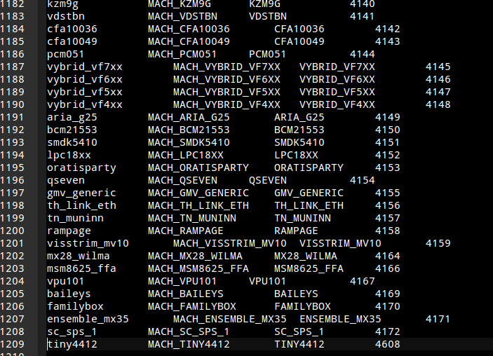
  Machine Type Number
tools/mach-types

Slide 30
Linux Kernel Booting
zImage
decompression
Load device
driver
arch/arm/boot/compressed/head.S
ARM-specific
kernel code
mount rootFS
arch/arm/kernel/head.S
arch/arm/kernel/head-common.S
Processor
independent
kernel code
Environment
initialize
init/main.c: start_kernel

