Slide 1





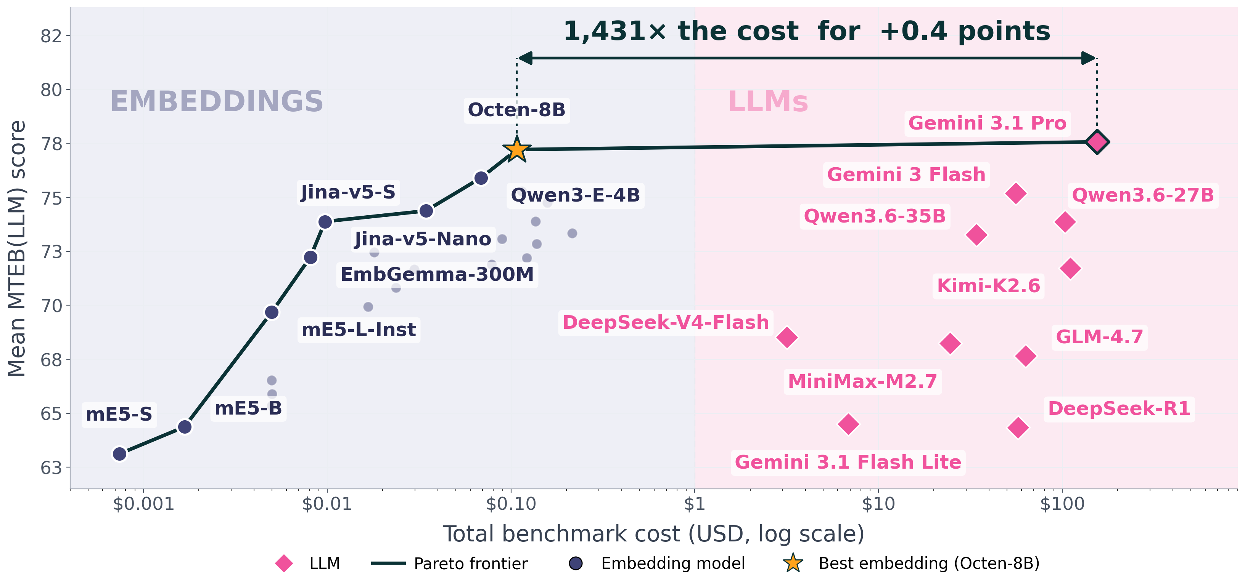
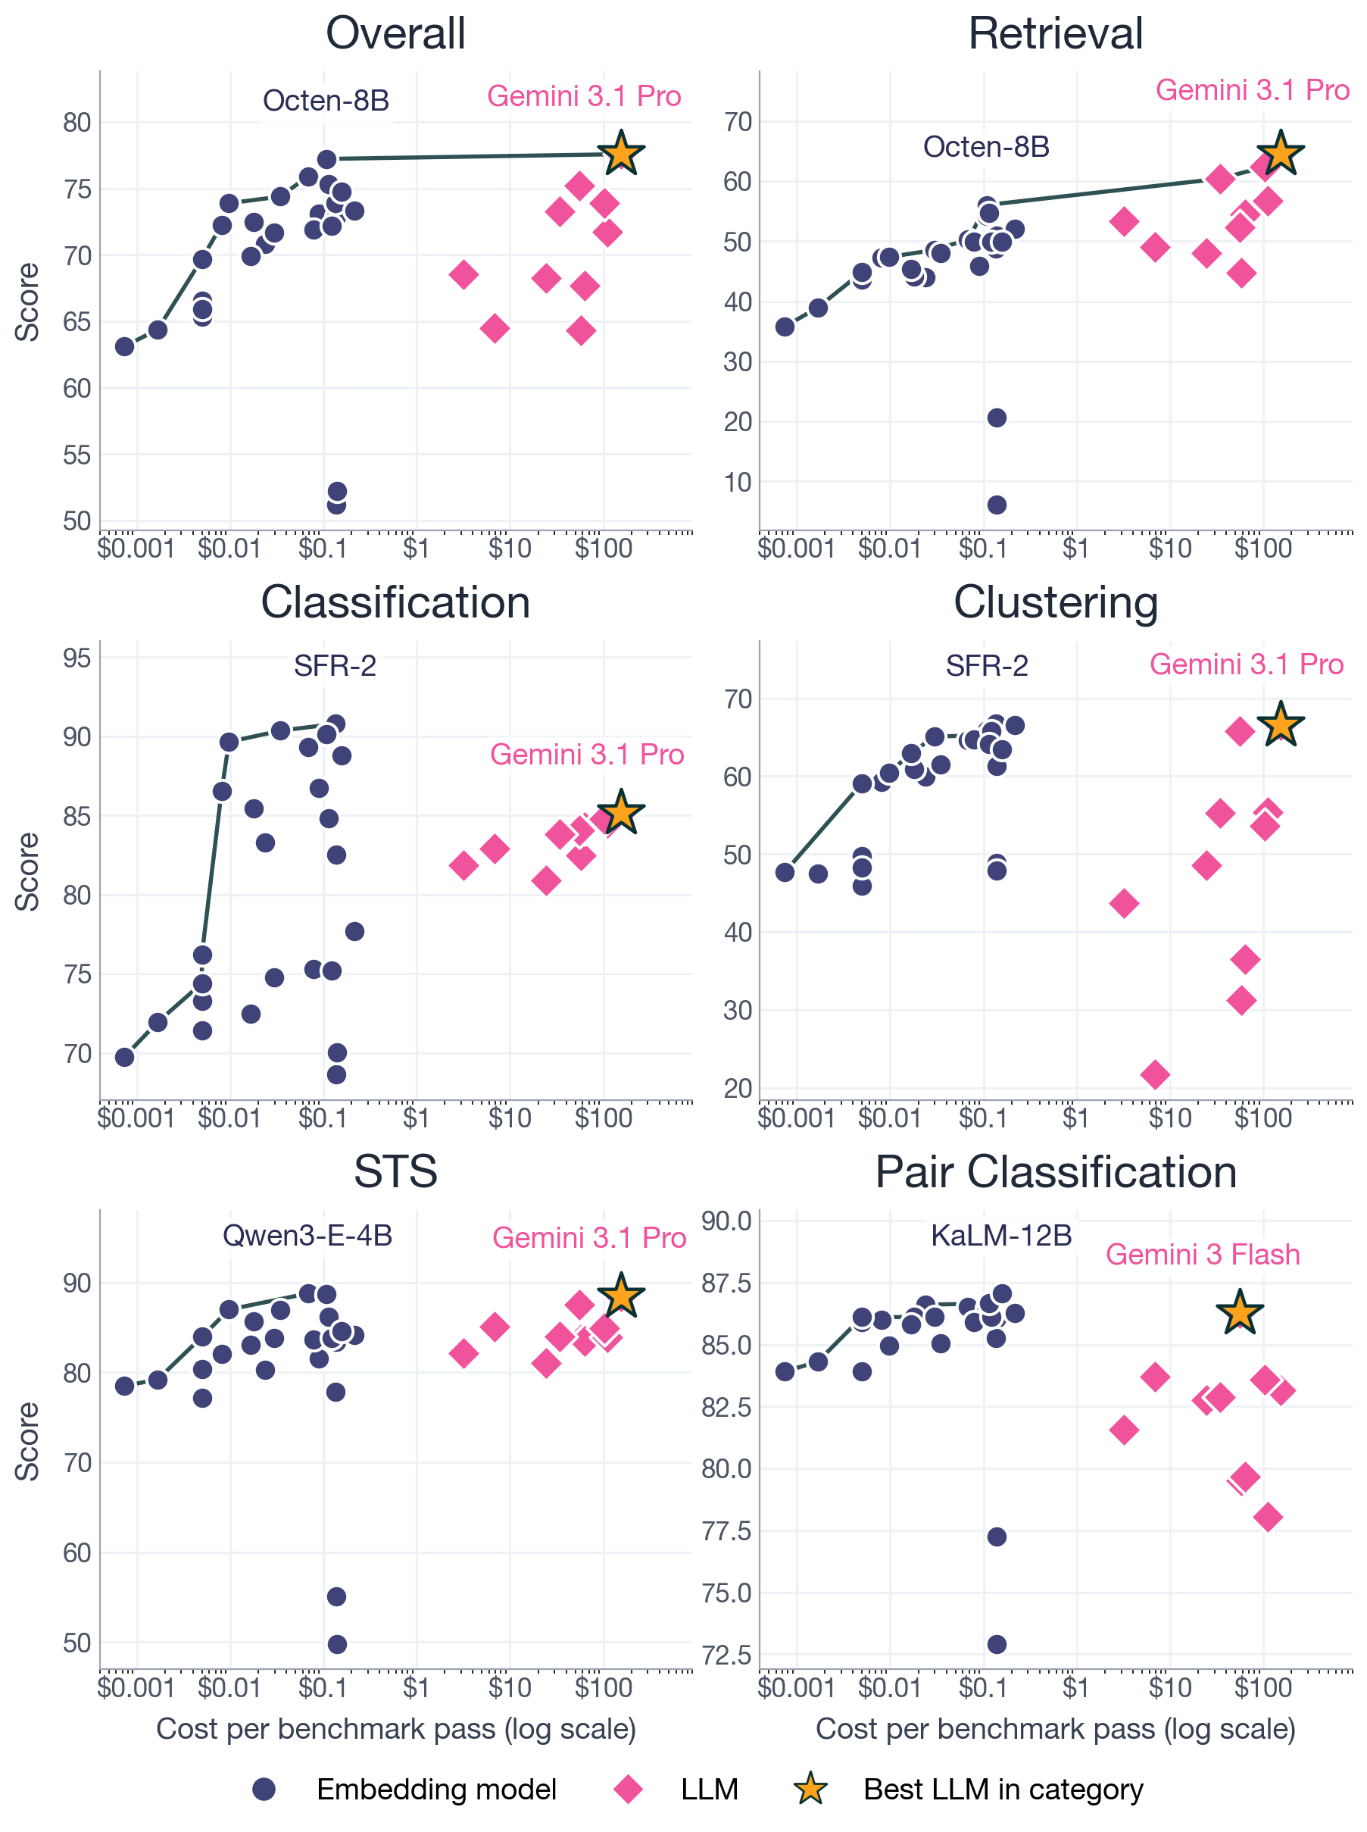
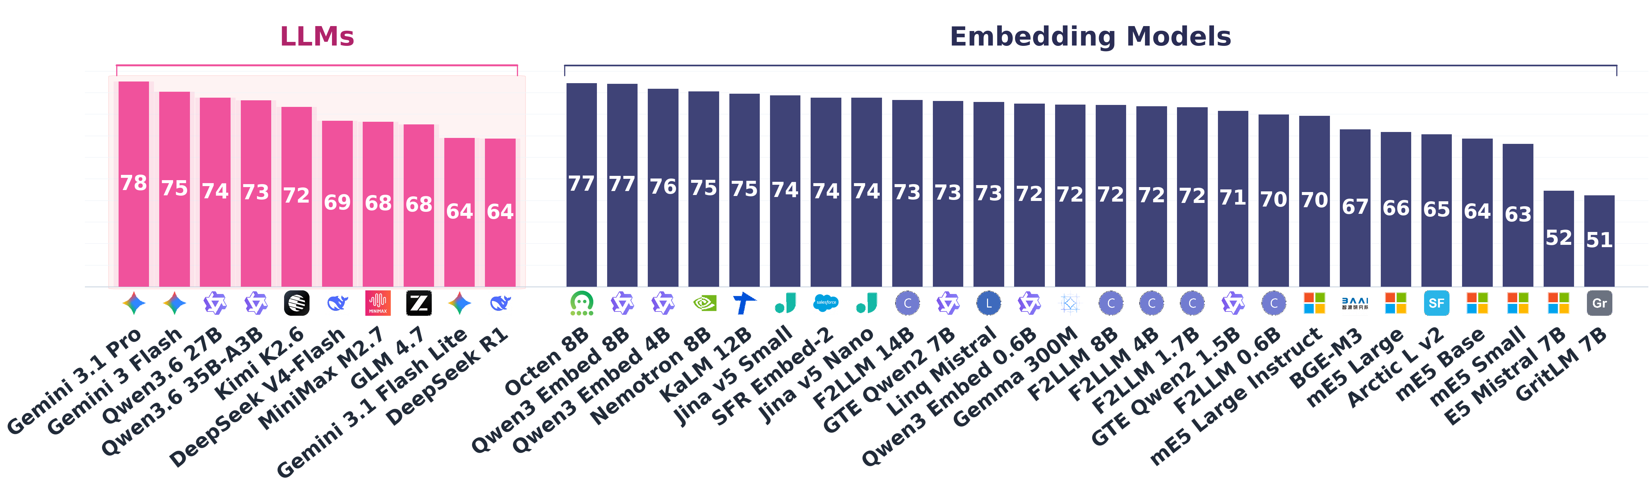
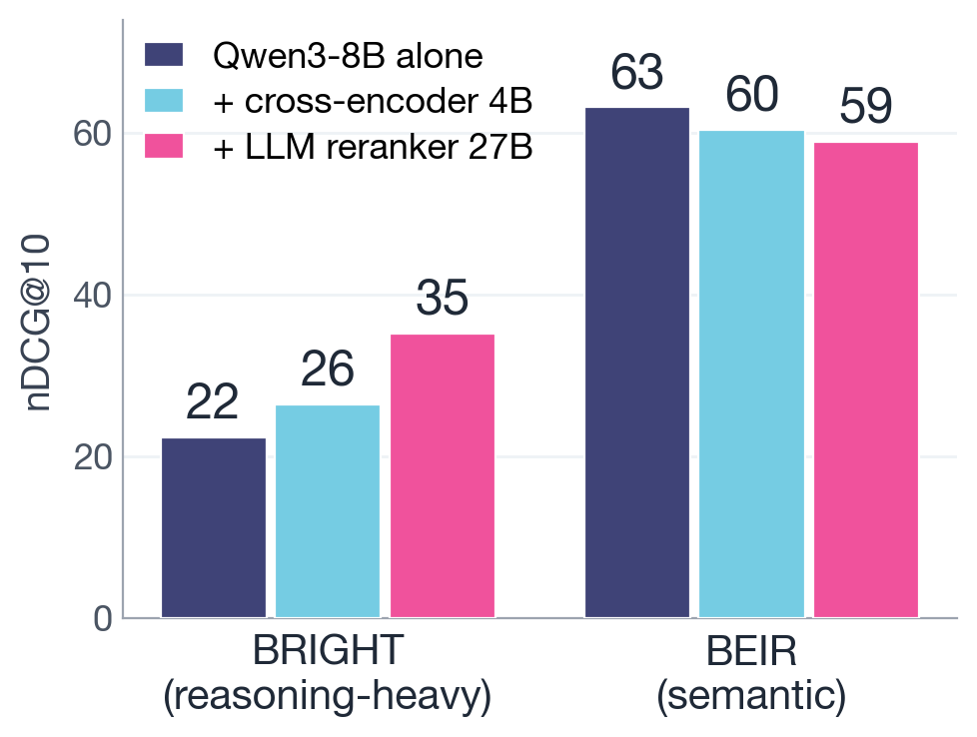
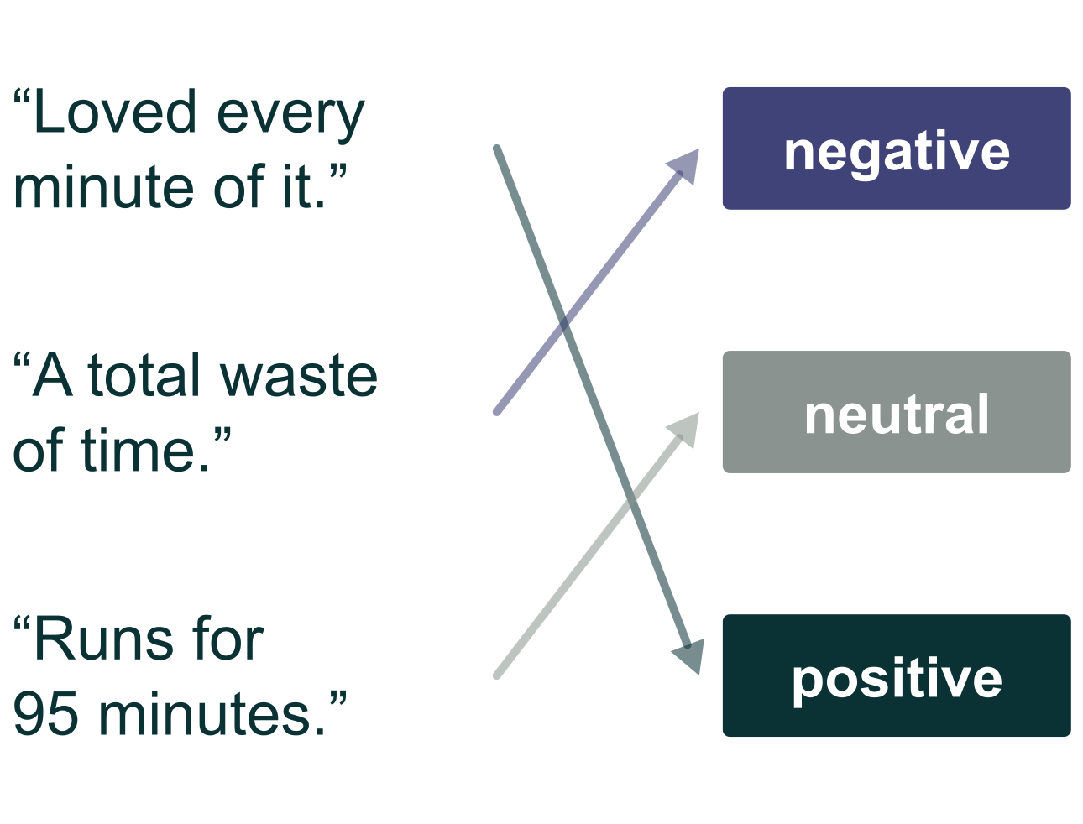
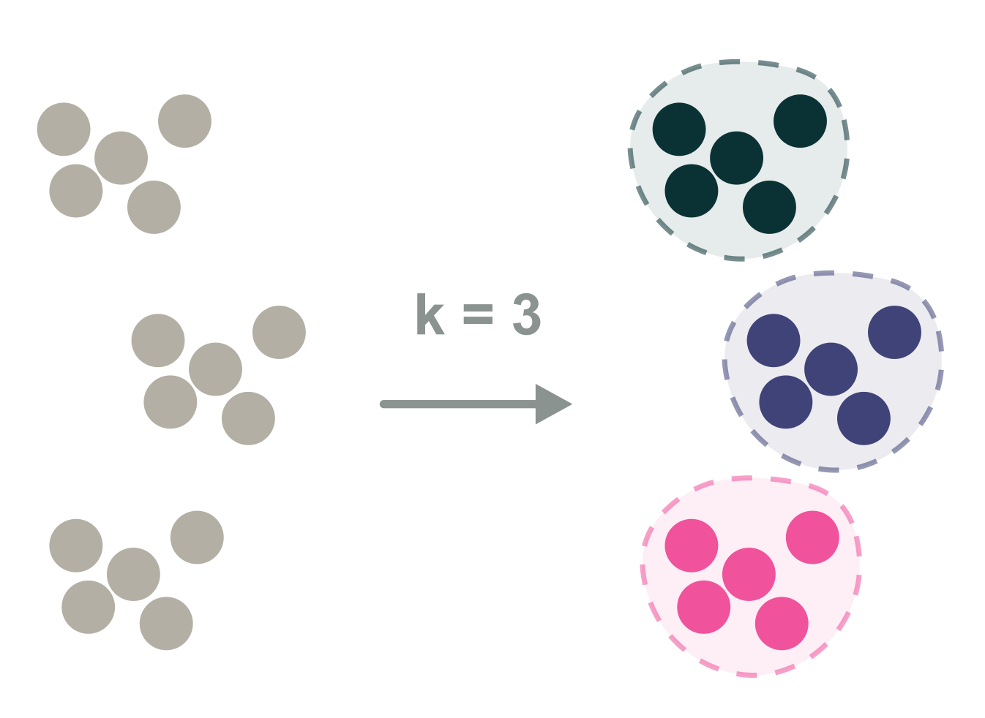
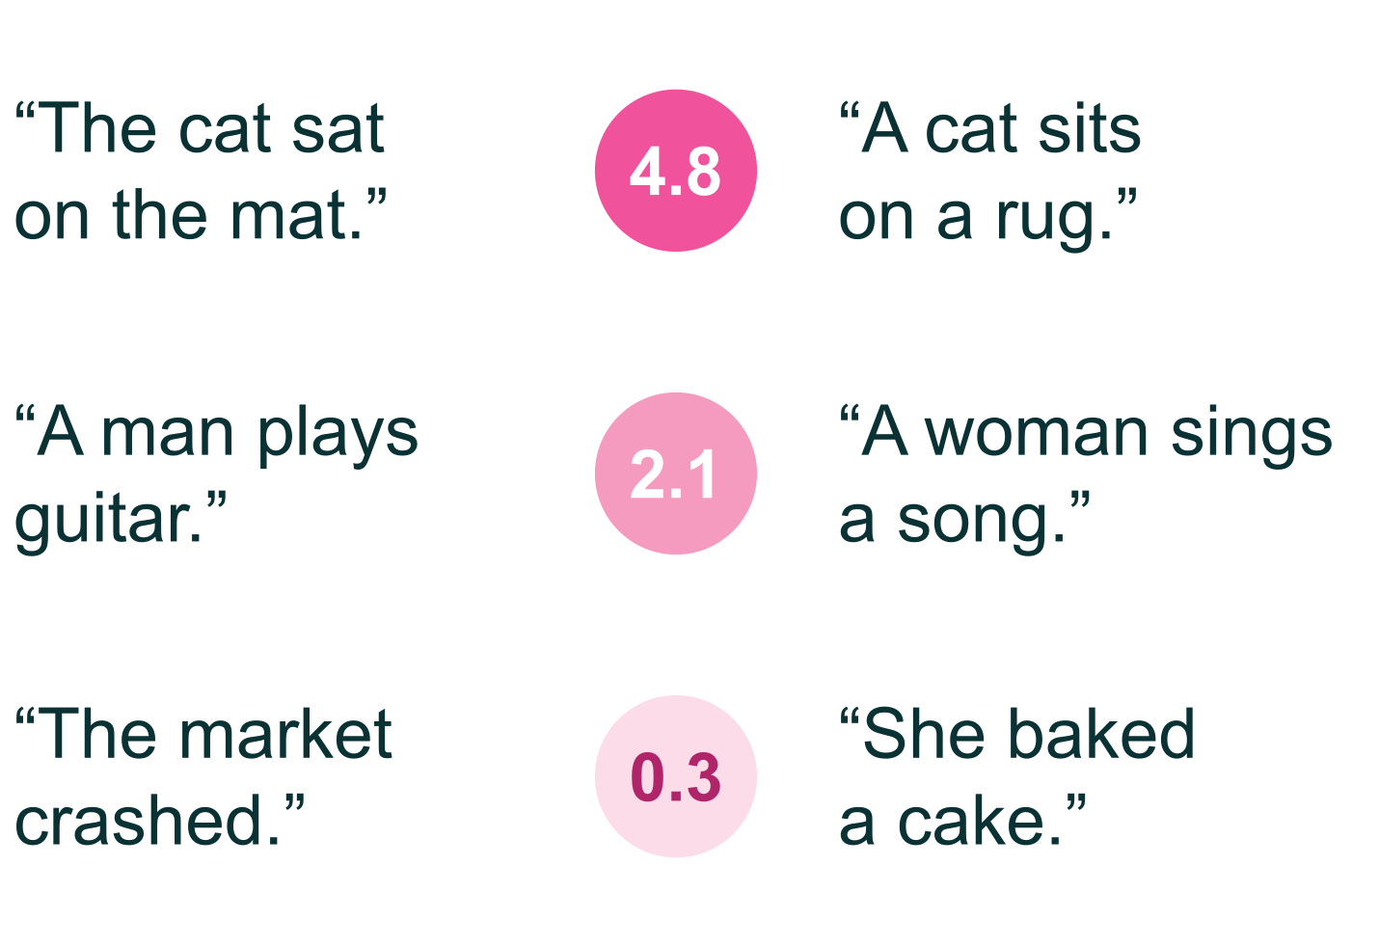
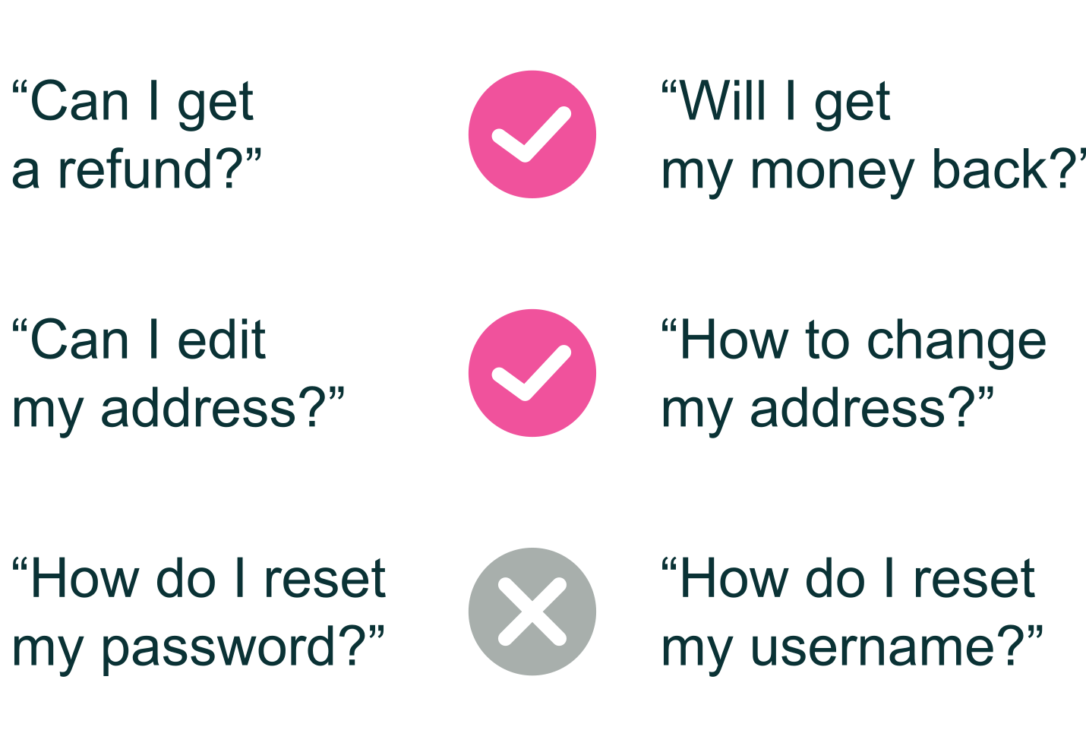
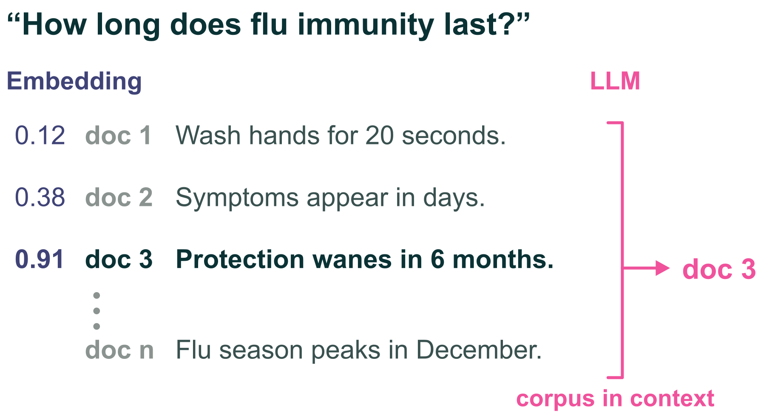
The Embedder's Dilemma: LLMs Are Better, but at What Cost?
Adnan El Assadi · Harvard Niklas Muennighoff · Stanford Jinhyuk Lee · Independent Researcher
Paper
Code
LLMs now match the best embedding models. At 1,431× the cost.
Summary
Cost vs. performance
Cost vs. performance by category
Per task
Should you replace your embedding pipeline with an LLM? We compare 10 LLMs across six families with 26 embedding models on 37 tasks in five categories, with exact cost accounting for every model.
In aggregate they tie: 77.6 vs. 77.2. LLMs lead on reasoning-heavy retrieval; embeddings lead on classification; the other three categories are statistical ties.
An LLM pays 1,431× more for that tie ($154 vs. $0.11 per benchmark pass), reasoning tokens are 28–81% of that bill, and embeddings run 736× faster on the same GPU.
Use embeddings by default, and an LLM only to rerank a shortlist on reasoning-heavy retrieval.
Overall leaderboard
Reranking an embedding shortlist
MTEB(LLM): 37 tasks in five categories
Classification
Clustering
Semantic Similarity
Pair Classification
Retrieval
Which label fits?
Which belong together?
How close in meaning?
Do these ask the same thing?
Which document answers this?

