Slide 1

Semi-Supervised Learning
Author: Trinh Tran
Matriculation: 1105425

Slide 2
Content Layout
Introduction
Generative Model
Generative Paradigm
Diagnostic Paradigm
Implementation: Pre-requisite Theory
Finding a Diamond
Convergence
Robustness and Accuracy
Label Quantity - Accuracy Correlation

Slide 3


What is SSL ?
Linear Regression
K-Means Clustering
Perceptron Learning
Logistic Regression
Backpropagation
Boosting
Support Vector Machine
Principal Component Analysis
…..
Labels
!!!

Slide 4
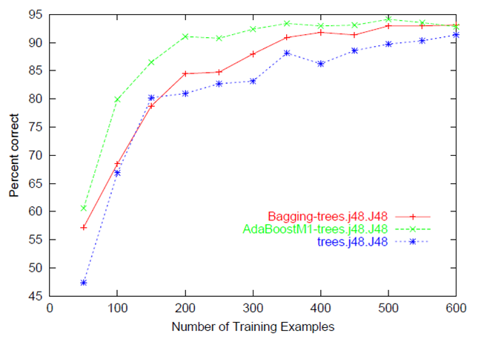
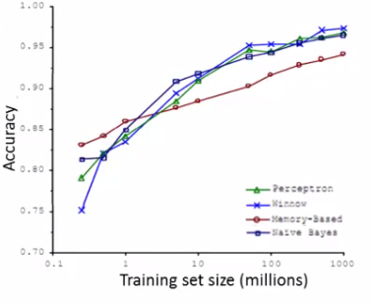
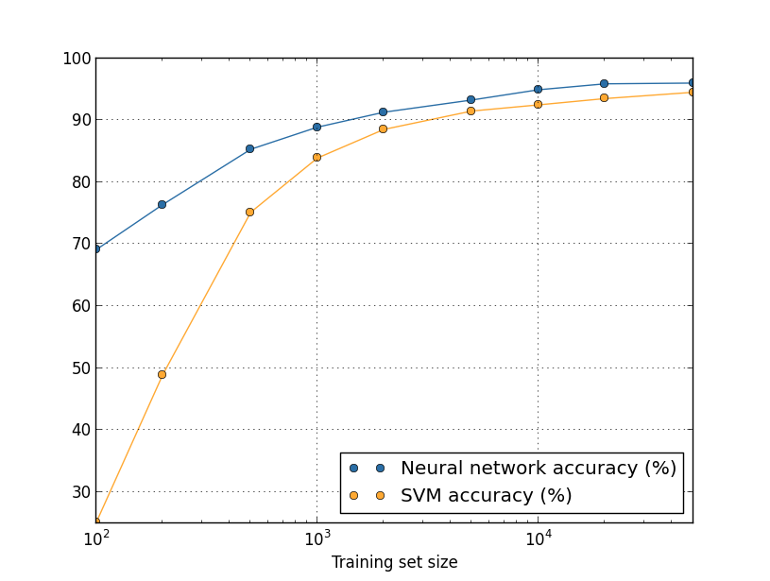
[1]
[2]
[3]
[1] http://germanylandofinnovation.com/questions/12781/was-ist-eine-lernkurve-im-maschinellen-lernen
[2] http://www.holehouse.org/mlclass/11_Machine_Learning_System_Design.html
[3] http://neuralnetworksanddeeplearning.com/chap3.html

Slide 5

What SSL is ?
Linear Regression
K-Means Clustering
Perceptron Learning
Logistic Regression
Backpropagation
Boosting
Support Vector Machine
Principal Component Analysis
…..
Labels
No labels

Slide 6
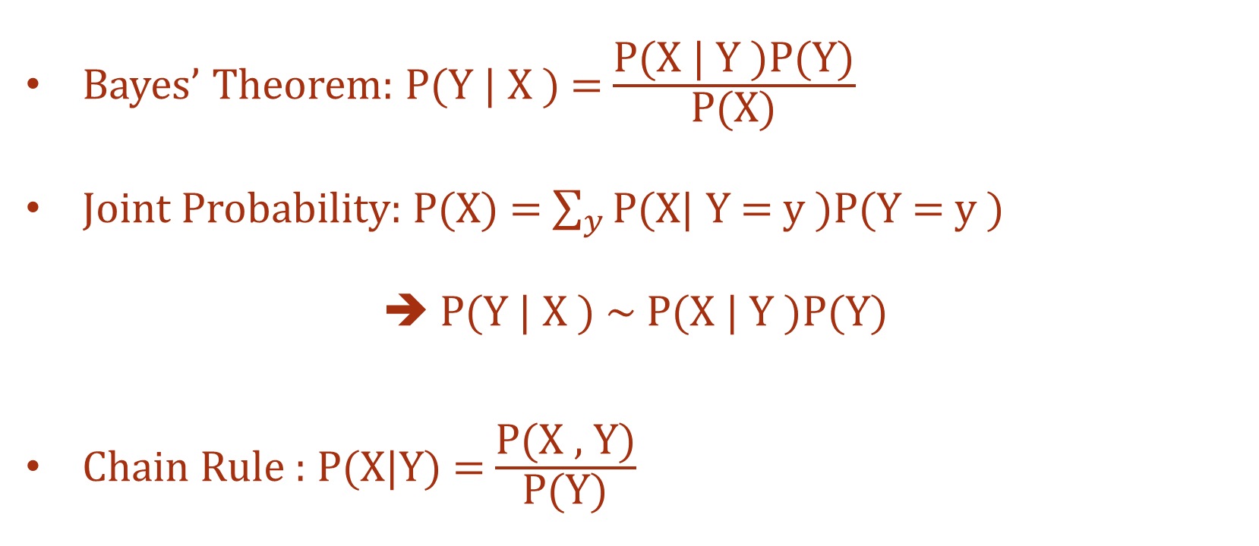
Stated by Math
Bayes’ Theorem: P(Y | X ) = $\frac{\text{P}\text{(}\text{X}\text{ | }\text{Y} \text{)}\text{P}\text{(}\text{Y}\text{)}}{\text{P}\text{(}\text{X}\text{)}}$
Joint Probability: P(X) = $\sum_{y}{\text{P}\text{(}\text{X}\text{| }\text{Y}\text{ = }\text{y}\text{ )}\text{P}\text{(}\text{Y}\text{ = }\text{y}\text{ )}}$
P(Y | X ) ~ $\text{P}\text{(}\text{X}\text{ | }\text{Y} \text{)}\text{P}\text{(}\text{Y}\text{)}$
Chain Rule : P(X|Y) = $\frac{\text{P}\text{(}\text{X} \text{,} \text{Y}\text{)}}{\text{P}\text{(}\text{Y}\text{)}}$

Slide 7
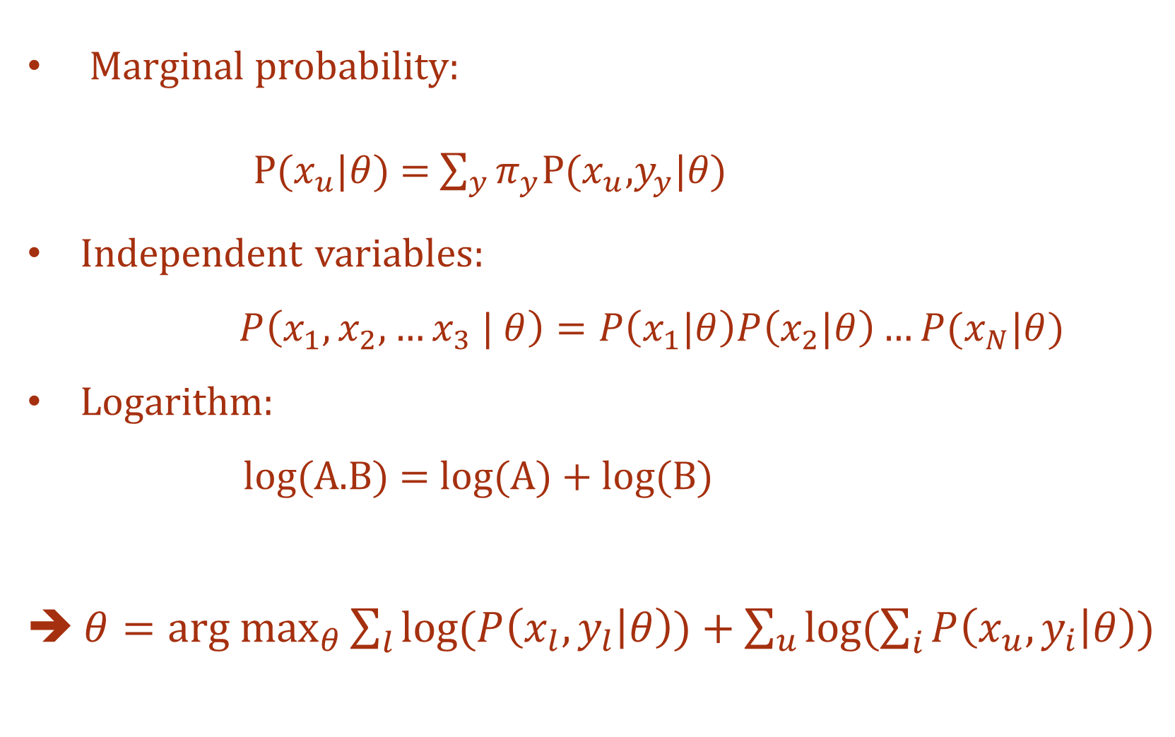
Marginal probability:
$P(x_{u}|θ)$ = $\sum_{y}{π_{y}\text{P}\text{(}x_{u}\text{,}y_{y}\text{|}θ\text{)}}$
Independent variables:
$P\left(x_{1},x_{2},…x_{3} | θ\right)=P\left(x_{1}|θ\right)P\left(x_{2}|θ\right)…P(x_{N}|θ)$
Logarithm:
log(A.B) = log(A) + log(B)
➔ $θ=\underset{θ}{arg max}{\sum_{l}{log⁡(P\left(x_{l}, y_{l} | θ\right))}}+\sum_{u}{log⁡(\sum_{i}{P\left(x_{u}, y_{i} | θ\right)})}$

Slide 8



Diagnostic Result?
Likelihood factor: $P\left(D_{l},D_{u }| θ,μ\right)=P\left(Y_{l} |{ X}_{l}, θ\right)P\left(X_{l}, X_{u} | μ\right)$
Conditional probability: P(Y | X)P(X) = $\text{P}\text{(}\text{X} \text{|} \text{Y}\text{)}\text{P}\text{(}\text{Y}\text{)}$
$$μ$$
$$θ$$
X
Y

Slide 9

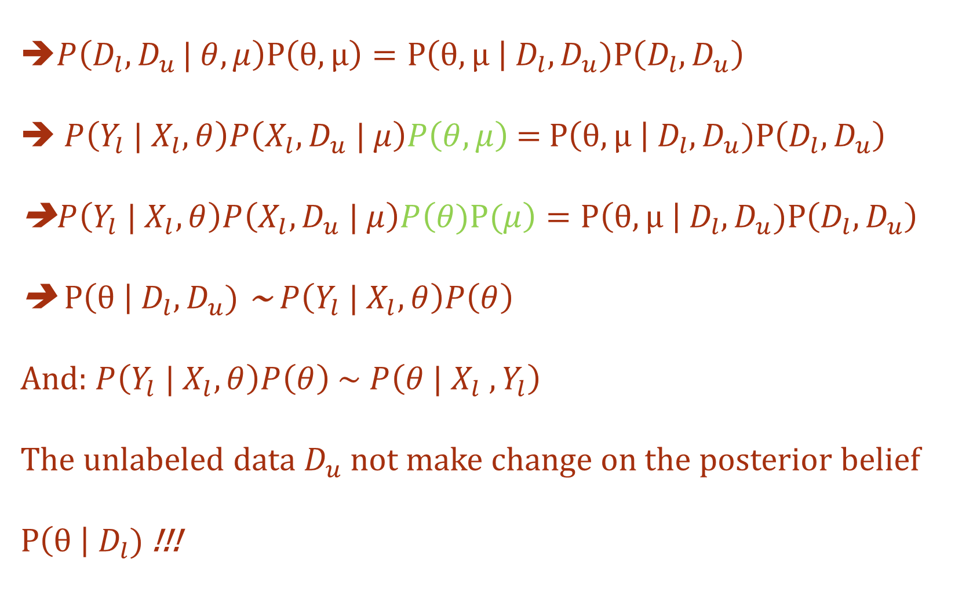
➔$P\left(D_{l},D_{u }| θ,μ\right)P\left(θ,μ\right)=P\left(θ,μ \right| D_{l},D_{u})P\left(D_{l},D_{u}\right)$ ➔ $P\left(Y_{l} |{ X}_{l}, θ\right)P\left(X_{l}, D_{u} | μ\right)P\left(θ,μ\right)$ = $P\left(θ,μ \right| D_{l},D_{u})P\left(D_{l},D_{u}\right)$ ➔$P\left(Y_{l} |{ X}_{l}, θ\right)P\left(X_{l}, D_{u} | μ\right)P\left(θ)P(μ\right)=P\left(θ,μ \right| D_{l},D_{u})P\left(D_{l},D_{u}\right)$ ➔ $P\left(θ \right| D_{l},D_{u})$ ~$P\left(Y_{l} |{ X}_{l}, θ\right)P\left(θ\right)$ And: $P\left(Y_{l} |{ X}_{l}, θ\right)P\left(θ\right)$ ~ $P\left(θ |{ X}_{l} ,Y_{l}\right)$ The unlabeled data $D_{u}$not make change on the posterior belief $P\left(θ \right| D_{l})$ !!!
$$P\left(θ \right| D_{l},D_{u})=P\left(θ |{ D}_{l} \right)$$

Slide 10
Regularization Depending on the Input Distribution: ➔ P(θ, µ) = P(θ|µ)P(µ)
$$μ$$
$$θ$$
X
Y

Slide 11
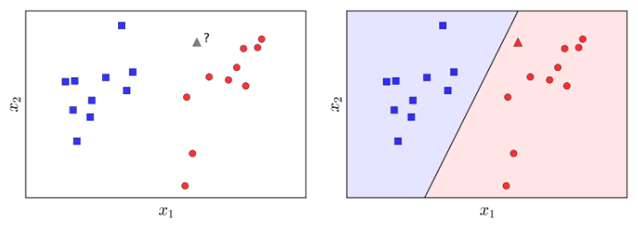
Self – Training Algorithm
Perceptron Learning Algorithm (PLA): Find a flat line so that all the points of class 1 are on one side, all the points of class 2 are on the other side. This line is called as boundary
https://machinelearningcoban.com/2017/01/21/perceptron/

Slide 12
Self-training algorithm:
Train labeled data L to find model H
Use H to predict unlabeled data set U
Choose the most confident samples in U after predict U’
Use L + U’ to train H again to find a H’
In this case of using with PLA, the most confident samples are the samples which are far away the boundary (They are high bias) ➔ Regularization Depending on the Input Distribution

Slide 13
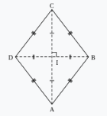
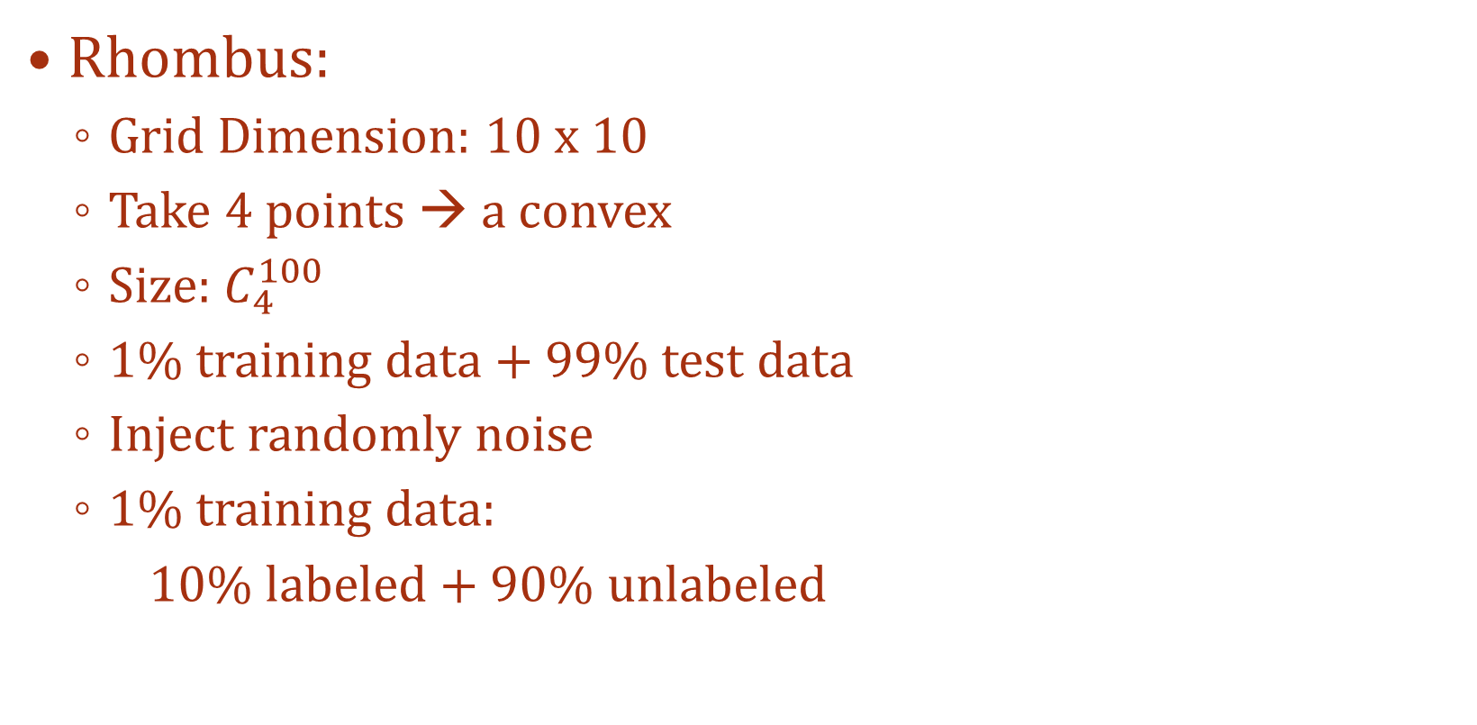
Finding a Diamond
Rhombus:
Grid Dimension: 10 x 10
Take 4 points → a convex
Size: $C_{4}^{100}$
1% training data + 99% test data
Inject randomly noise
1% training data:
10% labeled + 90% unlabeled
https://en.wikipedia.org/wiki/Rhombus

Slide 14
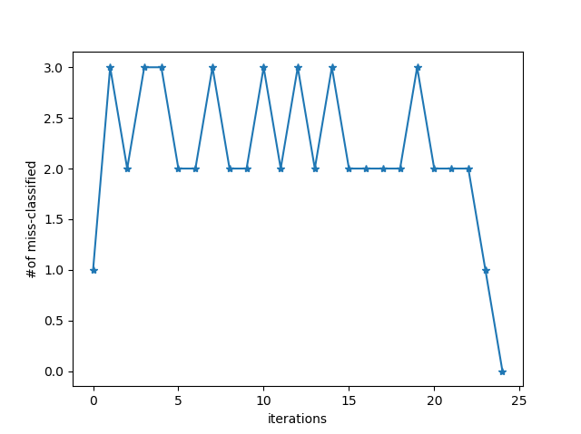
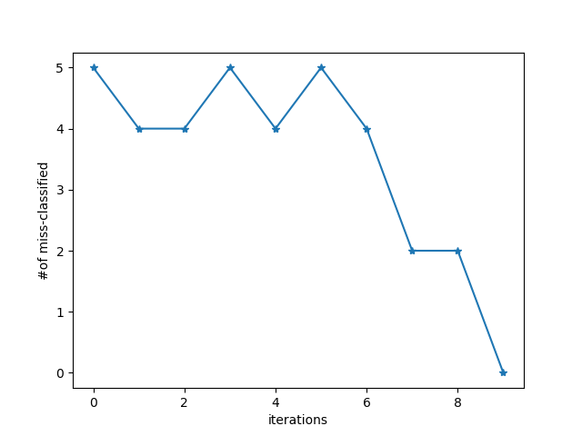
Convergence
PLA
PLA + Self-Learning

Slide 15
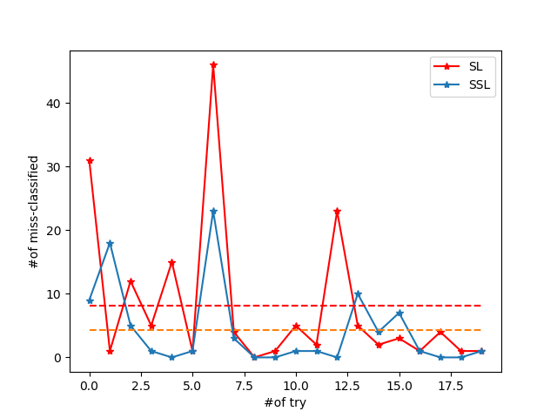
Robustness and Accuracy

Slide 16
Quantity - Quality Correlation
% Labeled Data | % Unlabeled Data | PLA | Self-Learning
10% | 90% | 5.90 | 1.20
20% | 80% | 4.85 | 0.85
30% | 70% | 2.65 | 0.80
40% | 60% | 0.95 | 0.55
50% | 50%
Labeled Data Quantity increases → The mean value of error with PLA sharply decreases, while SL slowly decrease

Slide 17
Contact me!
Email: phrong@stud.fra-uas.de
LinkedIn: https://www.linkedin.com/in/trinh-nguyen-phuong-tran-2a0553142/
Finding a Diamond: https://gitlab.com/trinhTran/semi-learning

Slide 18
Reference
[1] Scudder, H.J. Probability of Error of Some Adaptive Pattern-Recognition Machines.
IEEE Transactionson Information Theory, 11:363–371 (1965). Cited in Chapelle et al.
2006, page 3.
[2] https://en.wikipedia.org/wiki/Vladimir_Vapnik
[3] https://www.jstor.org/stable/2333854?seq=1page_scan_tab_contents
[4] https://en.wikipedia.org/wiki/Linear_discriminant_ analysis
[5] https://en.wikipedia.org/wiki/Expectation%E2%80%93maximization_algorithm
[6] https://dl.acm.org/citation.cfm?id=225348
[7] http://www-isl.stanford.edu/ cover/papers/castelli_cover_96.pdf
[8] https://en.wikipedia.org/wiki/Transduction_(machine_learning)
[9] https://en.wikipedia.org/wiki/Bayes%27_theorem
[10] https://en.wikipedia.org/wiki/Chain_rule_(probability)
[11] O. Chapelle, A. Zien, and B. Sch ̈olkopf, editors. Semi-supervised learning. MIT
Press, 2006, p. 19-20
[12] Blum, A., Mitchell, T. Combining labeled and unlabeled data with co-training. COLT:
Proceedings ofthe Workshop on Computational Learning Theory, Morgan Kaufmann,
1998, p. 92-100
[13] Isaac T., Salvador G. and Francisco H. Self-labeled techniques for semi-supervised
learning: taxon-omy, software and empirical study. Springer-Verlag London, 5 Novem-
ber 2013
[14] Tommi Jaakkola and David Haussler (1998), Exploiting Generative Models in Dis-
criminative Classi-fiers. In Advances in Neural Information Processing Systems 11, p.
487–493. MIT Press
[15] Zhu, Xiaojin and Ghahramani, Zoubin. Learning From Labeled and Unlabeled Data
With Label Prop-agation, 2002
[16] Zal ́an Bodo ́and Lehel Csato’. A note on label propagation for semi-supervised
learning, 2015
[17] Vapnik, V. Statistical Learning Theory. Wiley, 1998, New York, p.434-437
[18] Mitra Basu. Gaussian Based Edge Detection Methods-A Survey. IEEE Transactions
on Systems, Man,and Cybernetics—Part C: Applications and Reviews, vol. 32, no. 3,
Agust 2002
[19] Kozak K, M. Kozak, K. Stapor. Weighted k-Nearest-Neighbor Techniques for High
Throughput Screen-ing Data. International Journal of Chemical, Molecular, Nuclear,
Materials and Metallurgical Engineeringvol.1, no.12, 2007
[20] Xiaojin Zhu, Zoubin Ghahramani, John Laffert. Semi-Supervised Learning Using
Gaussian Fields andHarmonic Functions. 2002,2003
[21] Olivier C., Bernhard S., and Alexander Z. Semi-Supervised Learning. The MIT Press,
2006, p. 191-273.

