Slide 1
Midterm project
Linda Nguyen
Intro to Web Development
NYU School of Engineering
Spring 2016

Slide 2
Motivation
I love birds
My friends loves birds
As hikers, we spend a long time flipping through field guides trying to identify a bird
Websites tend to be even less helpful
Anyone should be able to pull up a webpage and quickly identify a bird with the information ornithology has collected.

Slide 3
Project Statement
Bird searches are ordered:
Alphabetically
Via field guide questions
Birds can’t always be identified by reverse image searching
Lots of page navigation is involved with online bird identification
Goal: Show birds by location by just hovering the mouse.
If the user shares their locations
automatically show what birds are nearby.
Like Pokemon Go’s nearby Pokemon system, but real.

Slide 4
Target Audience
Americans
Curious outdoor people
Hikers
Birdwatchers
For any ages

Slide 5
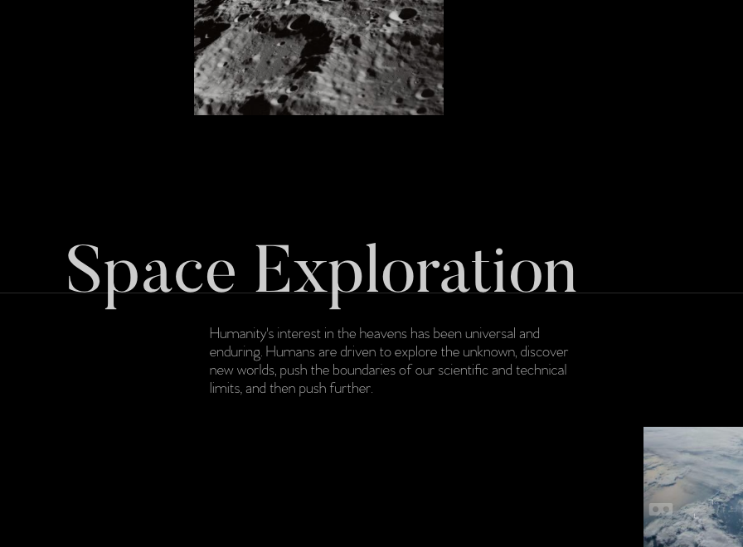
Creative Brief
Minimalistic
Earthy color scheme
Sleek like http://space.vanderlanth.io/

Slide 6
Functionality
Use locations to list birds in the areas
Search bar to search through birds
Display information on the chosen bird

Slide 7
Concepts/Skills
Will need CSS animations/transformations for the selecting a state/hovering
Will need Javascript for the hovering/selecting a state
Will need PHP/database knowledge to display bird information

Slide 8
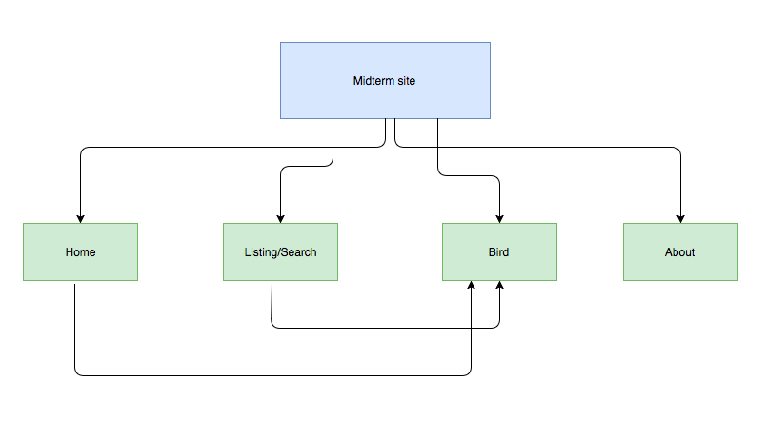
Site Map

Slide 9
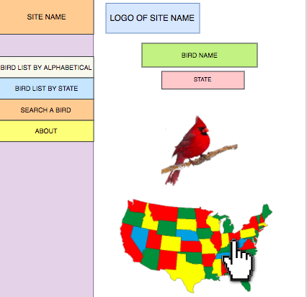
Wireframes: Home page

Slide 10
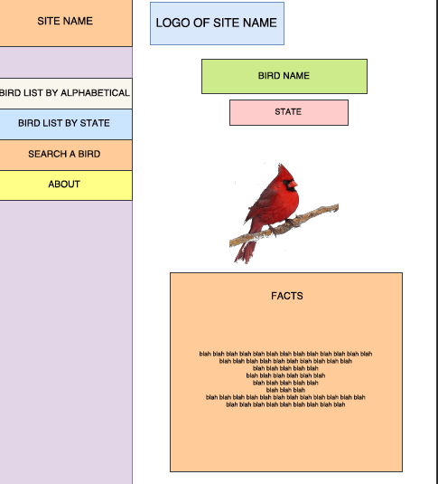
Wireframes: Bird Page

Slide 11
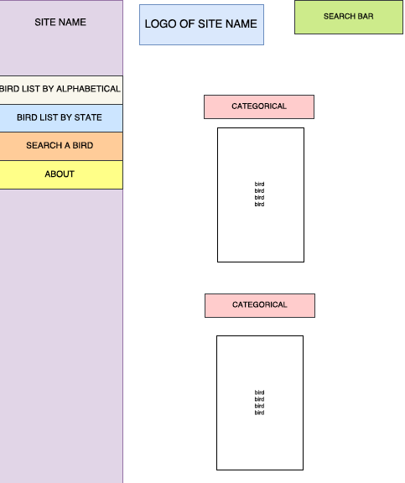
Wireframes: Search/List

Slide 12
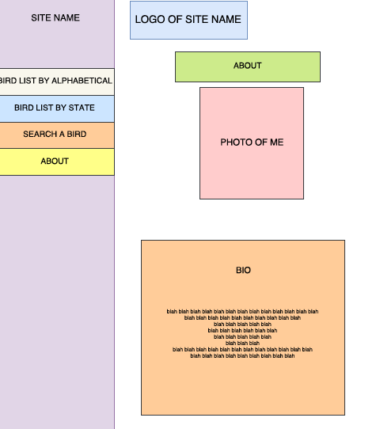
Wireframes: About

Slide 13
Questions/Feedback?
???

